Slide 1
How can the library help me?
Andrew Regan
Emma Shaw

Slide 2
Some library preconceptions, misconceptions, and nostalgia…

Slide 3
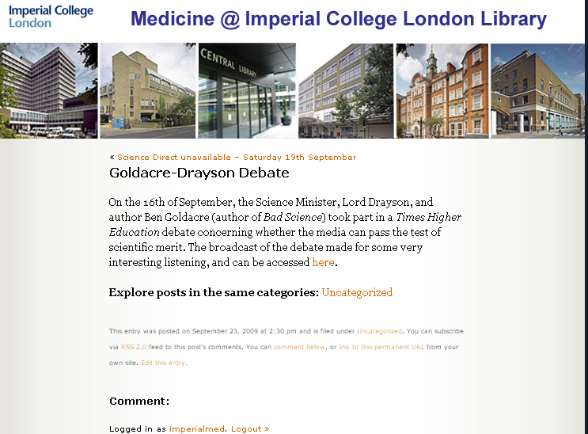
Not Just Books!, Pt. 1
Books! (obviously), journals, and databases
Interactive learning tools (including OLIVIA and Anatomy.TV)
The Medicine @ Imperial blog; plus podcasts, RSS feeds, and Twitter
The Haldane Collection
…AND…

Slide 4
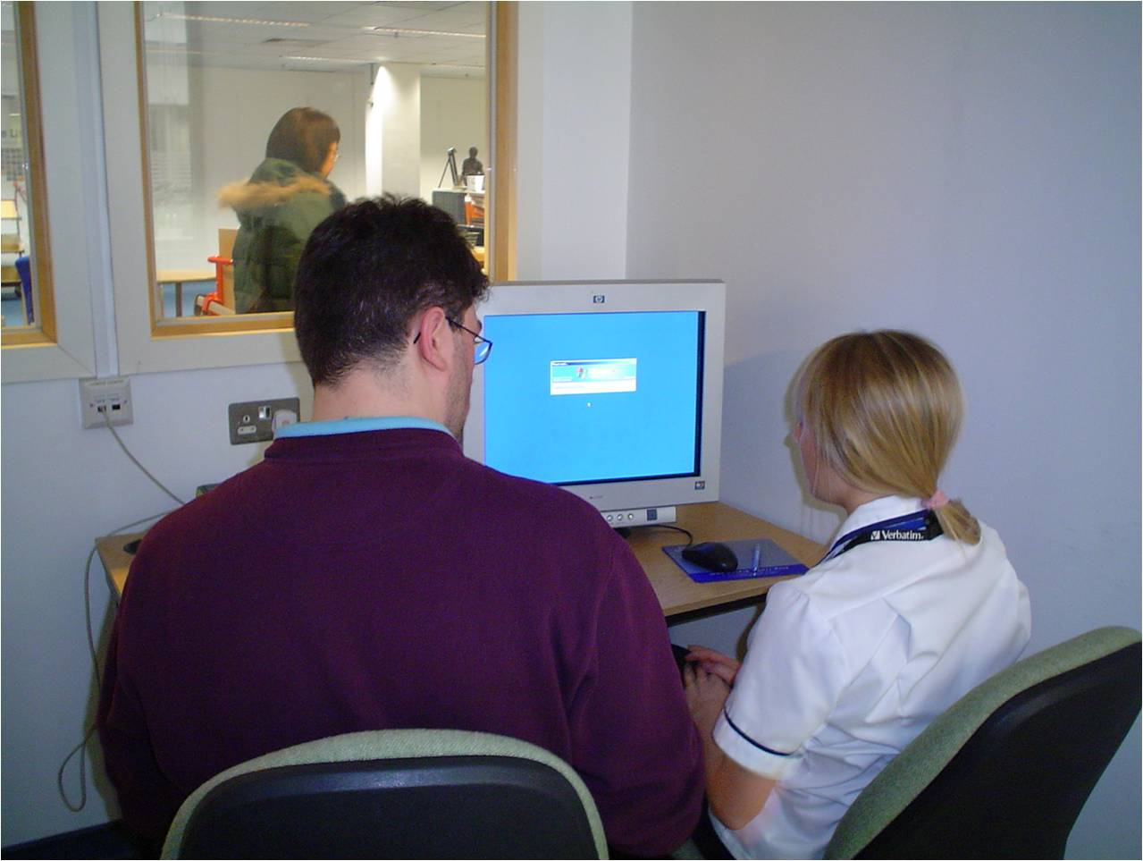
Not Just Books!, Pt. 2
Training and advice on all aspects of info retrieval
Guidance on plagiarism and academic best practice
Critical appraisal skills
Bespoke training as and when required!
Reference management expertise
Notes:
4

Slide 5
…And all in a friendly manner!

Slide 6
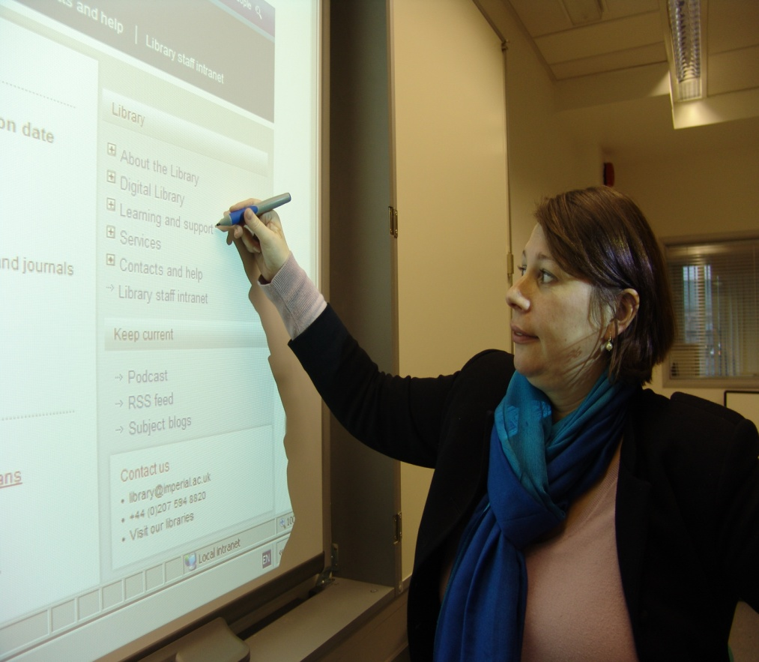
The next 3 weeks…….
Year 1 Workshop 1: Database Searching and Critical Appraisal
Year 1 Workshop 2: Plagiarism and Referencing
Throughout your course; Visit, email or telephone the library for help: medlib@imperial.ac.uk
Notes:
6

Slide 7
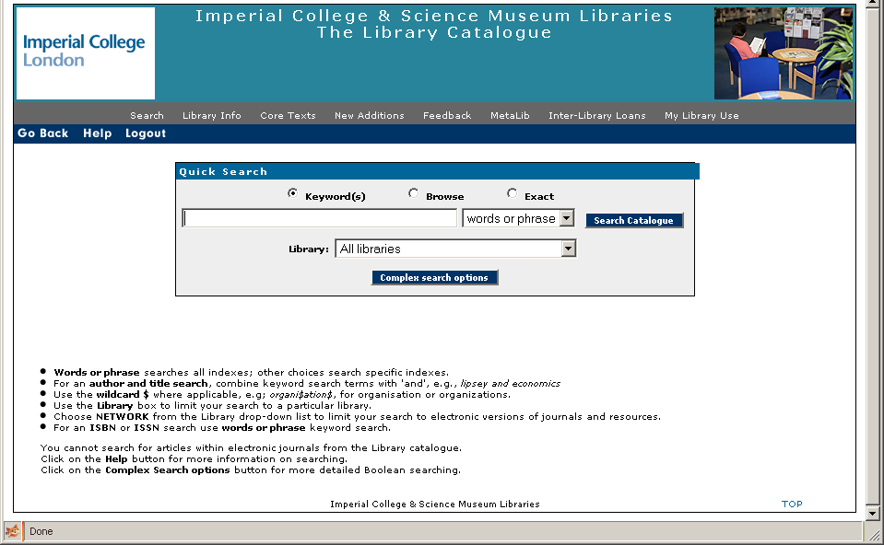
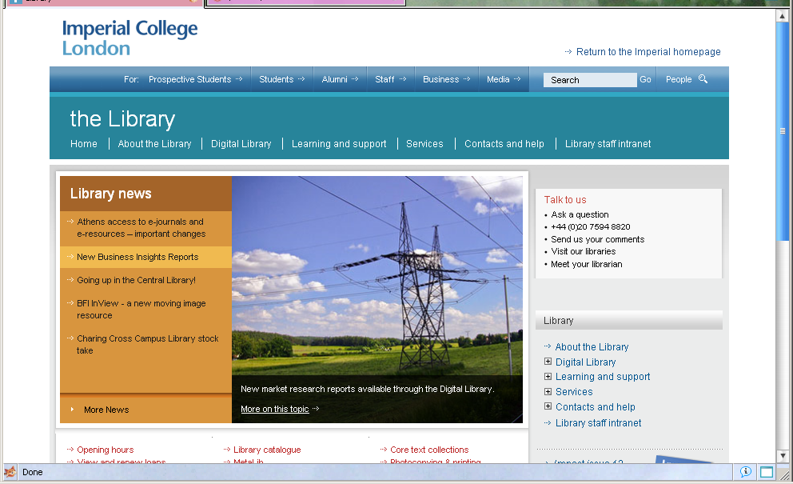
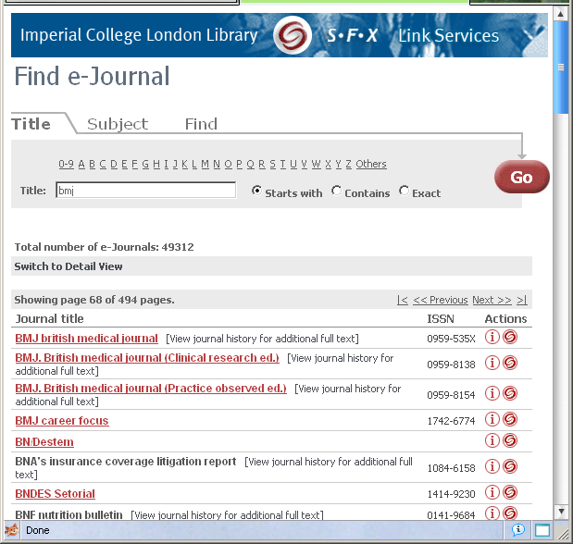
How do I find the resources?
http://www3.imperial.ac.uk/library

Slide 8
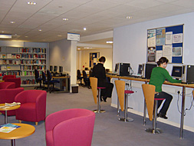
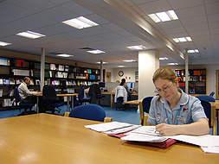
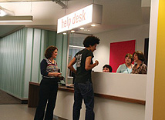
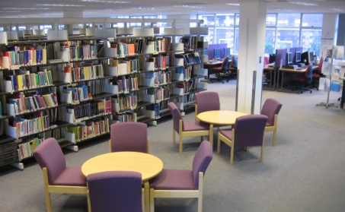
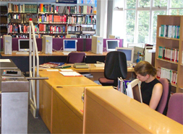
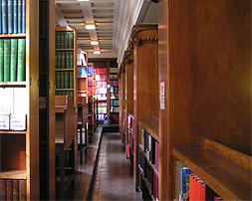
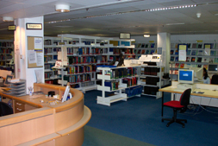
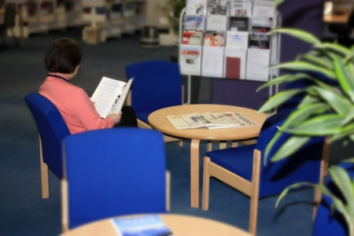
Where is the library?
Royal Brompton Library (NHLI)
Hammersmith Library
Imperial College Libraries
Central library
St. Mary’s
Hammersmith
Charing Cross
Chelsea & Westminster
Royal Brompton (NHLI)
See the library website for details of locations, facilities
and opening hours
http://www3.imperial.ac.uk/library/aboutthelibrary
Central Library, South Kensington
Charing Cross Library
St Mary’s Library
Chelsea and Westminster Library
Notes:
A few practical questions to start with…
As students at IC
Central library at SK
Maps and directions available on Library homepage & leaflets in library
Opening hours do vary so do check the website, but here it’s 9-9 weekdays

Slide 9
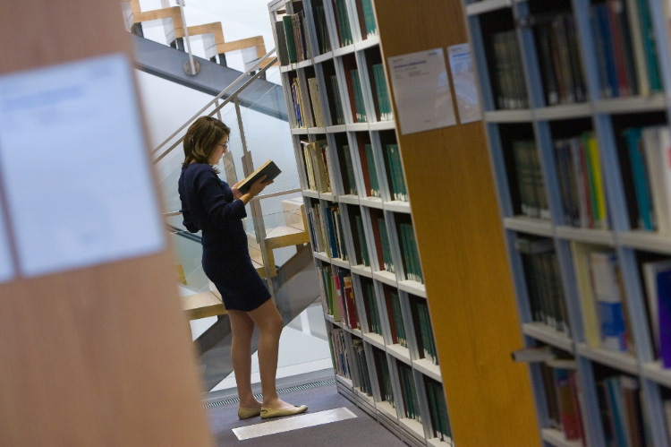
Where do I find the book I need?
Notes:
In the Central Library most of the medicine books are found on the 5th floor. However there are also a small selection found in the business collection on the 5th floor so check the catalogue for the floor you need. On the 5th floor you can also find CDs, DVDs and fiction books so if you can’t afford to buy these and are looking for something to do you can borrow them from the library for free. You can take books etc out at the issue desk on the ground floor and there are also self issue machines.

Slide 10
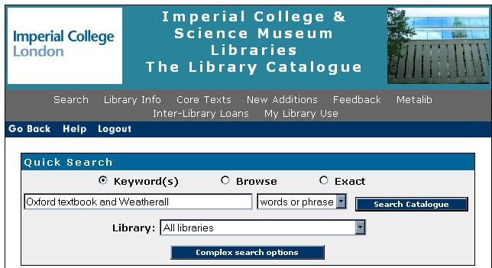
How do I find the book I need?
Notes:
You’re in the library and you’re ready to get the book you need and go read it at home. You already have a library card because you can borrow books with your College ID so you can take it out. To find it on the shelf you need to look it up on the catalogue which is available on the internet (if you want to use it at home) or on terminals on each floor of the library.
There are a lot of ways to search for what you are looking for on the catalogue but the easiest way to search for a book is to type in 2 or 3 words from the title and the author’s surname. You need to put the word AND between the title and the author in order for the search to work. So in this case you could put in Oxford textbook and Weatherall to find the textbook.

Slide 11
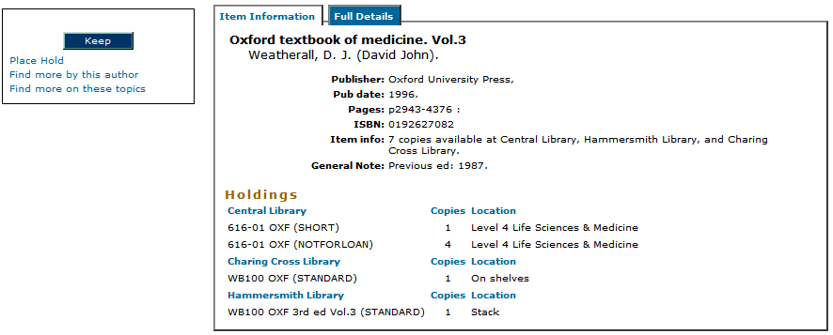
What if there’s no copy on the shelf?
Notes:
Because this particular book is so heavy, it will probably not have been taken out and you should be able to find it in the library. However, if all copies at your location were on loan you could place a hold to reserve a copy when it comes back. When the book becomes available, the library will email you.
We also have a core text copy of all the books on your reading lists so if all the normal lending copies are on loan the core text copy is available from the issue desk for overnight loan.

Slide 12
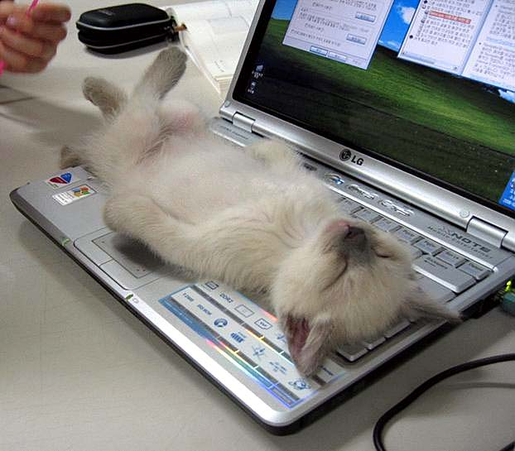
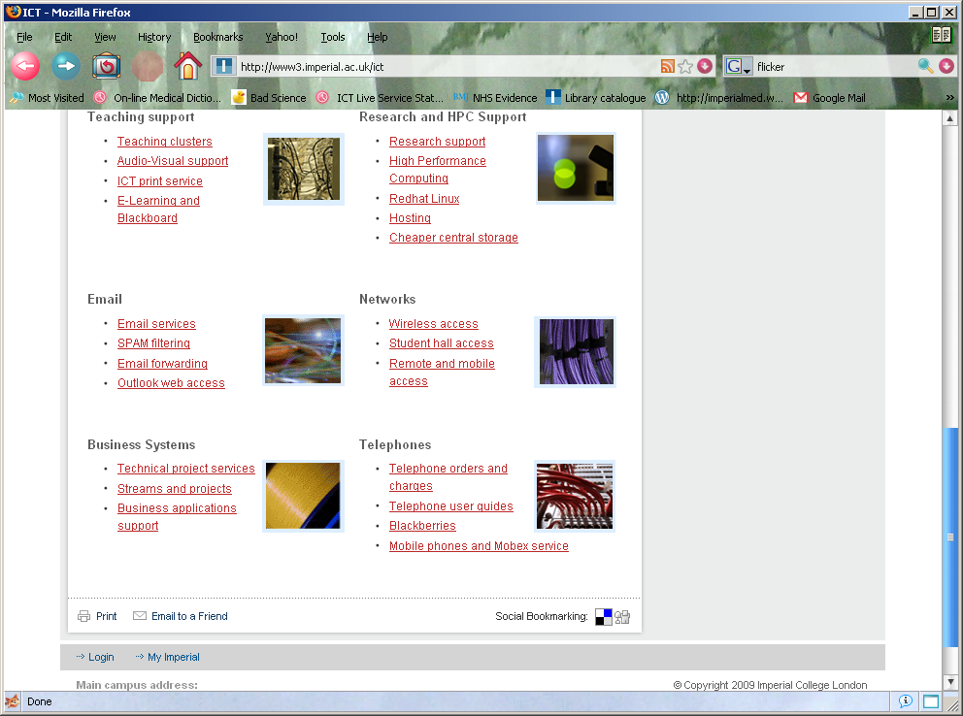
Accessing Library Resources at home
Virtual Private Network (VPN)
http://www3.imperial.ac.uk/ict
Notes:
Library resources can also be accessed from home by either logging into the website, or by connecting to the virtual private network which allows you to connect to you Imperial account from home and thus means you don’t have to keep logging in each time. You can find details on how to set this up by going to the ICT website. - However, not working in a nice quiet Library environment does make one more open to distraction!

Slide 13
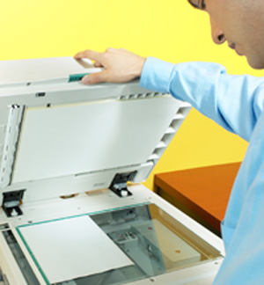
Photocopying and Printing
Notes:
Once you’ve found your journal article you’ll need to print it (or photocopy it if it’s on paper). The library provides a photocopying, printing and scanning service, which you can access at any of our libraries. To use this service you’ll need your College ID card, we charge 3p per B&W A4 page for photocopying and printing and scanning is free. The ICT department will automatically provide you with a printing account which you can top-up by adding credit to your ID card at any of our libraries or online.

Slide 14
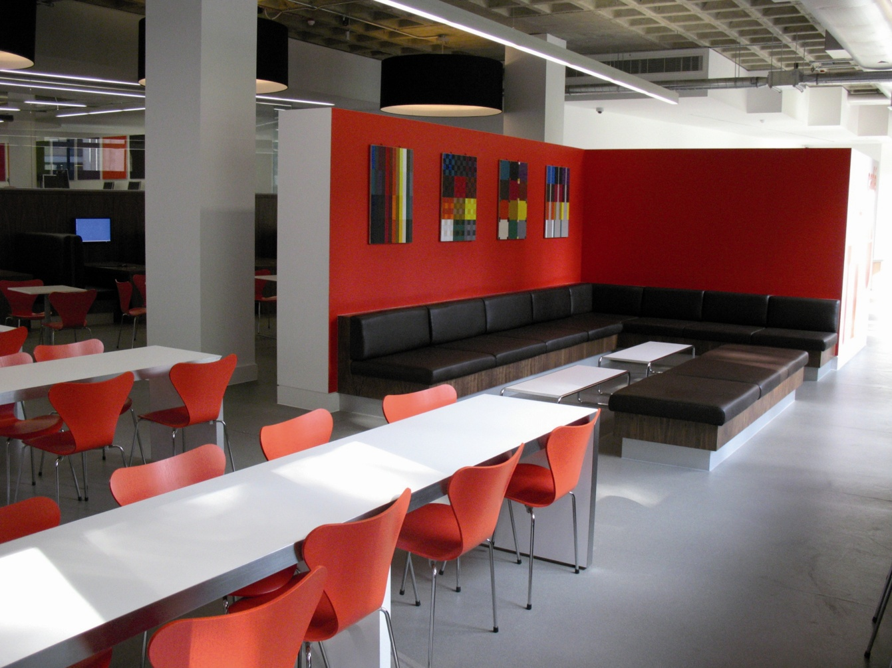
Where can I study?
Notes:
Last year’s students put up with months of building works so that you, this year’s students, could benefit from a new and improved ground floor. There’s now a learning café (seen in this picture) where you can talk and use your laptop and think tanks for group work with big screens. There are group study rooms which can be used to practice presentations. The fourth floor where the medical books are located is a quiet study area.

Slide 15
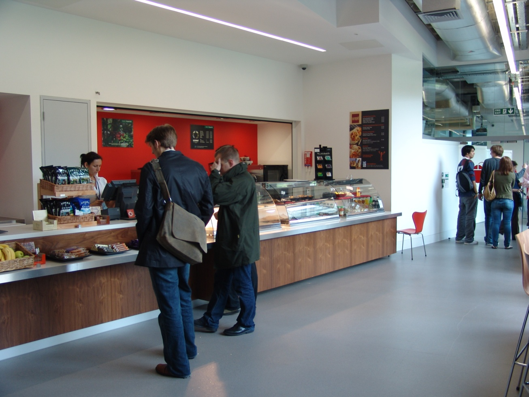
…Even cookies!
Notes:
15

Slide 16
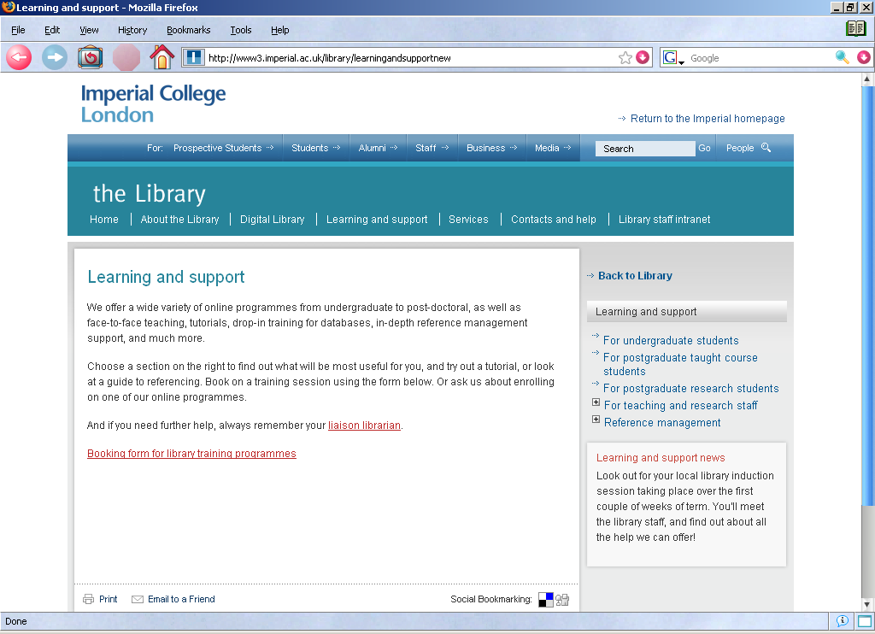
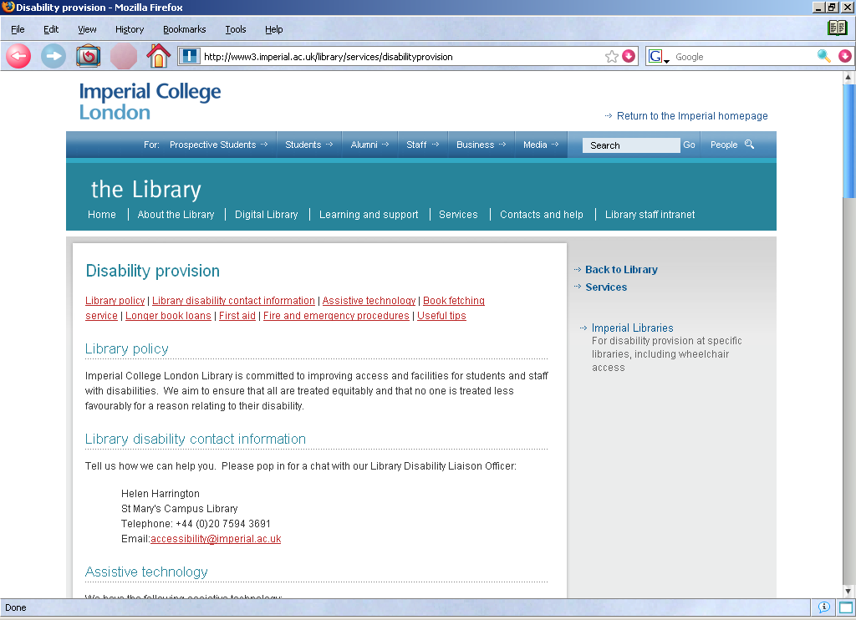
Where to find more information, Pt. 1

Slide 17
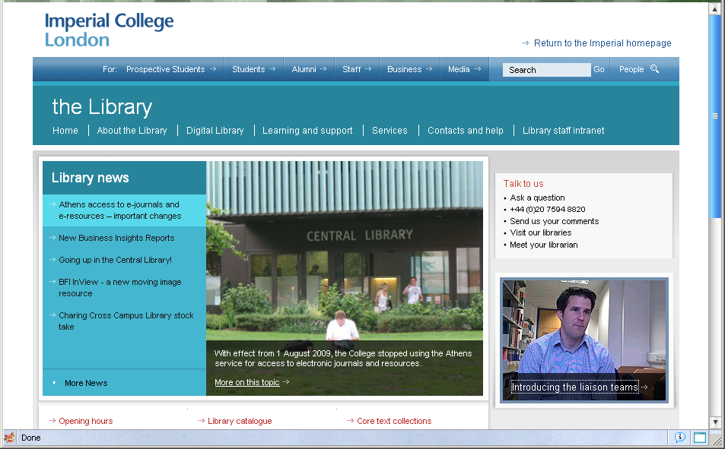
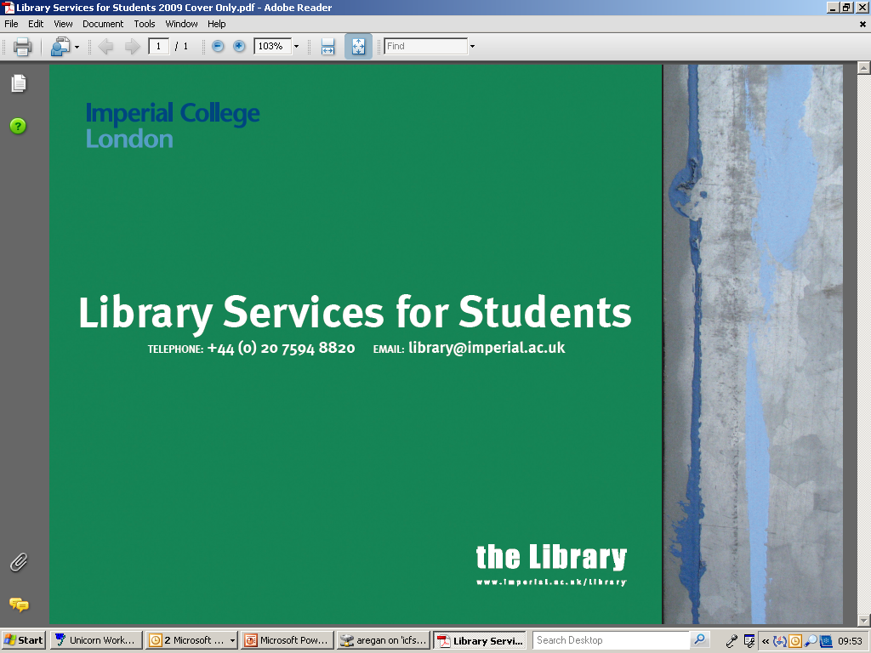
Where to find more information, Pt. 2
Notes:
17

Slide 18
Any Questions?

Slide 19
Credits
Children’s Television Workshop, Sesame Street : Cookie Monster in the Library, accessed via http://www.youtube.com/watch?v=W3ZHPJT2Kp4
Couple in bed with laptop, by essentialgearguide, 2009 http://www.flickr.com/photos/24968934@N08/3481177678/
Imperial College website and images © Imperial College
Cookie Monster, the Metro online, June 25, 2008, http://www.metro.co.uk/news/article.html?in_article_id=191093&in_page_id=34
All other images © clipart.com

