Slide 1
Managing your information: databases and critical appraisal
Emma Shaw
e.shaw@imperial.ac.uk
Rebecca White
Notes:
Introduce yourself
In the presentation we gave you on Thursday, we briefly talked you through the topics you will be covering on your first PBL case. We also introduced you to the idea of searching databases for journal articles and mentioned some of the information skills you will need to develop throughout your course. This morning/afternoon we’d like to go into these subjects in more detail.
Please turn off mobiles and computer monitors.

Slide 2
Aims of the session
Conduct a basic search on PubMed
Obtaining e-journal articles
Introduction to eBooks
Critical appraisal
Notes:
2

Slide 3
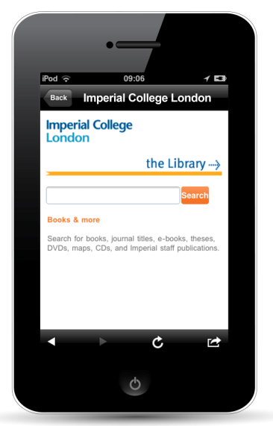
Imperial Mobile app
www.imperial.ac.uk/imperialmobile
Can use to check PC availability in the Central Library

Slide 4
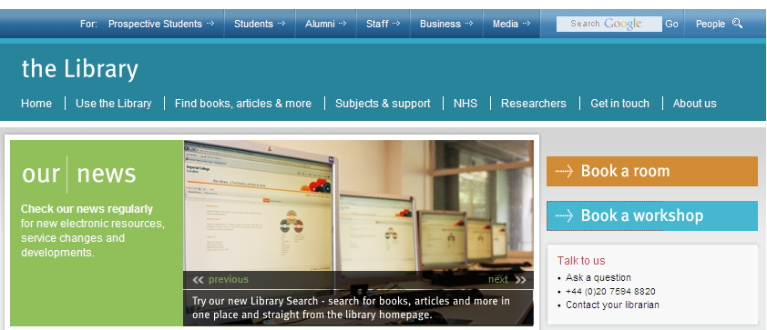
Book study space or workshops
Notes:
You can book a study space for ½ - 2 hours, or book free workshops via the library homepage. Workshops cover reading and note taking, academic writing, Google Scholar and more.

Slide 5

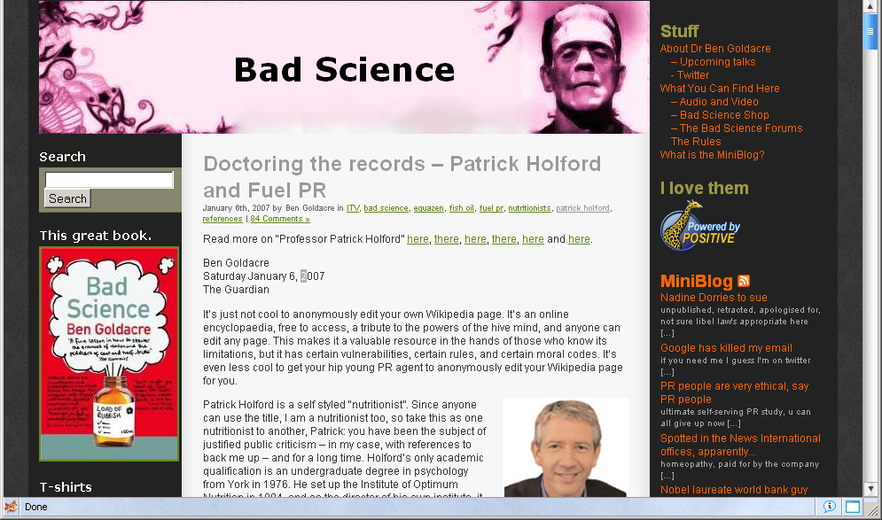

Using Appropriate Information
http://www.badscience.net/2007/01/doctoring-the-records/

Slide 6

New library search
Notes:
This year the library has a new one stop search for resources which makes it easier to find what you are looking for.

Slide 7
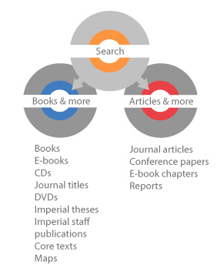
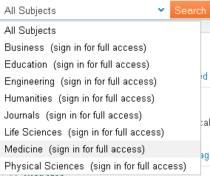
Books & more/Articles & more
Notes:
You may have noticed that there are two tabs, Books and more and Articles and more. Books and more covers books, ebooks and journal titles e.g. BMJ. Articles and more searches journals at the article level (not just the title of the journal), conference papers, ebook chapters. So you will get a lot more results with articles and more if you are looking for more depth in your search. You can search just medicine resources, and sign in to get access to even more full text.

Slide 8
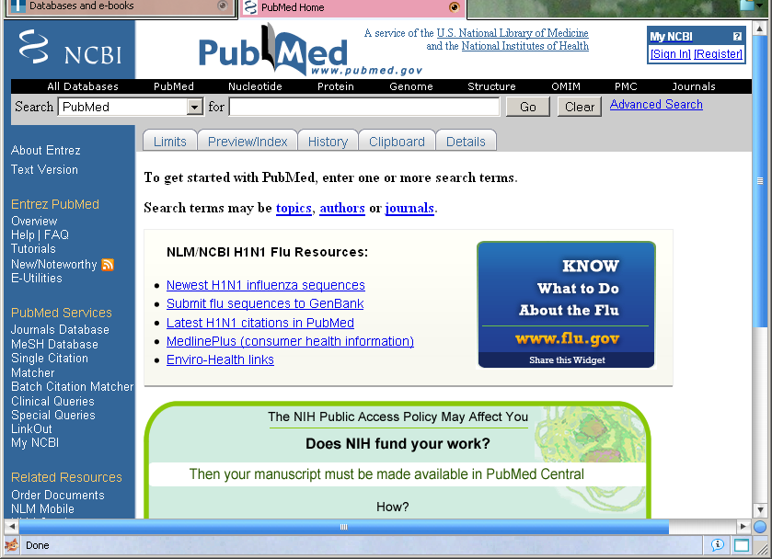
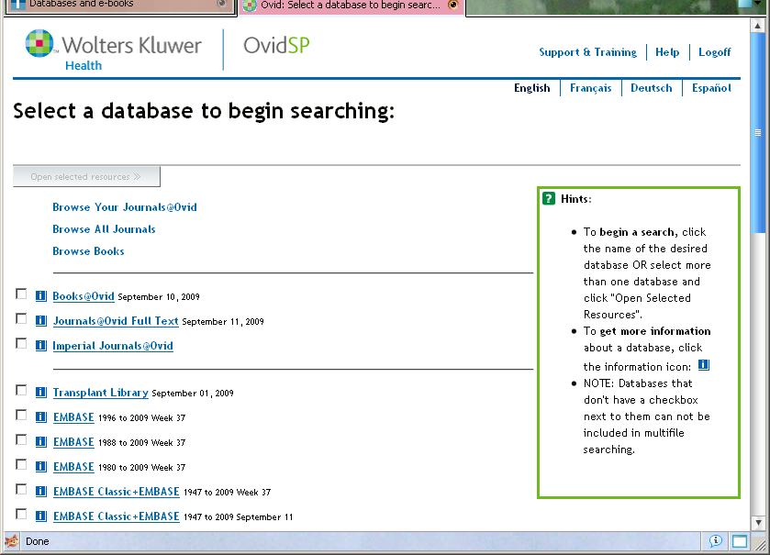
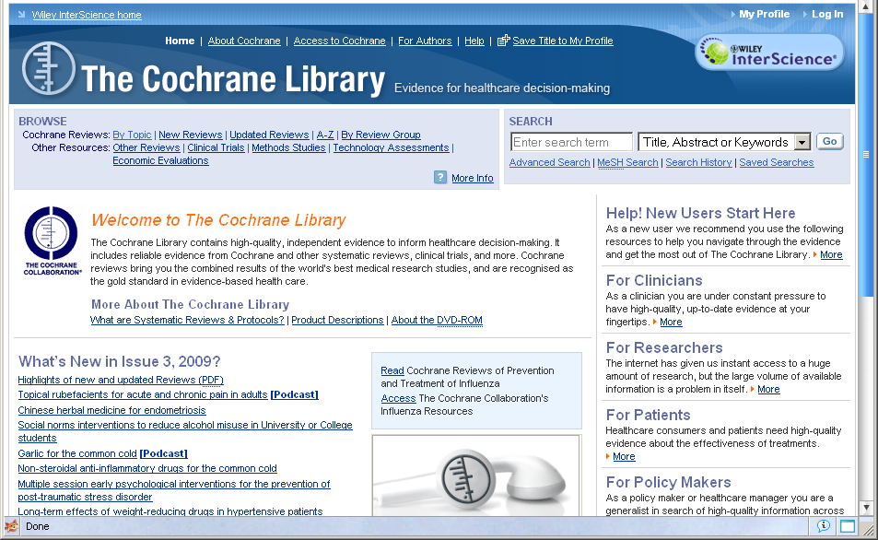
Medical Databases
Provides a way of searching across a large number of journals to find relevant articles.
Contains a collection of Indexed references to journal articles.
Contains bibliographic information and abstracts of journal articles.
Core Medical databases are:
  Medline (available via PubMed & Ovid)
  Embase
  Web of Science
  The Cochrane Library
Not all are freely available to use
Notes:
One of the main resources you will be using is academic medical journals to find research on a given subject. You will be using these shortly for you epidemiology module, so I will show you how to find these via our journal list which I will talk about later.
To find relevant articles from these journals for your given subject, you will need to use a medical database, which is an index of references to articles from medical journals which you can search to find relevant articles to your chosen topic.

Slide 9
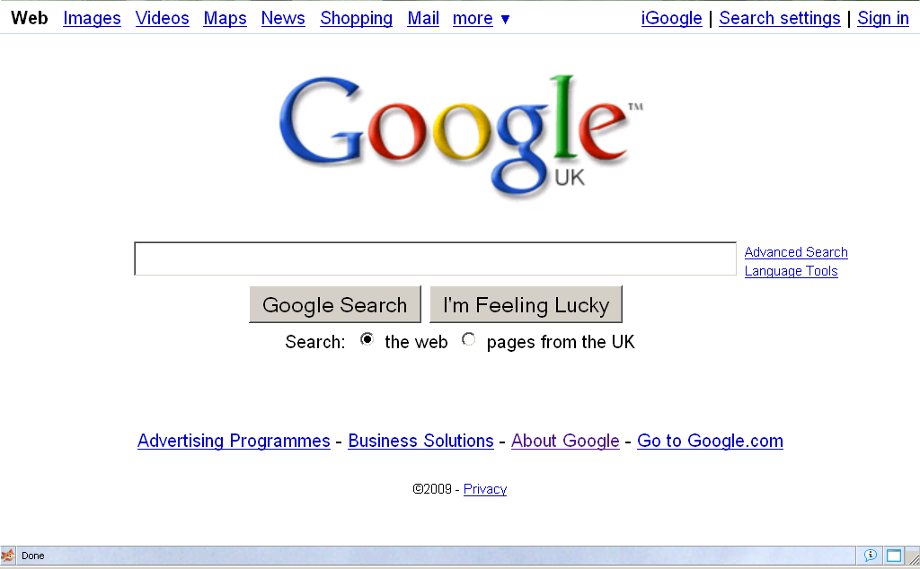
Google and the library aren’t separate entities - articles you find via Google may be paid for by the library
However using high quality resources will:
  Get you better marks.
  Save you time by providing you with good quality and precise results.
  If using via the Library there will often be a quick link to full text documents.
Can we not just use Google?

Slide 10
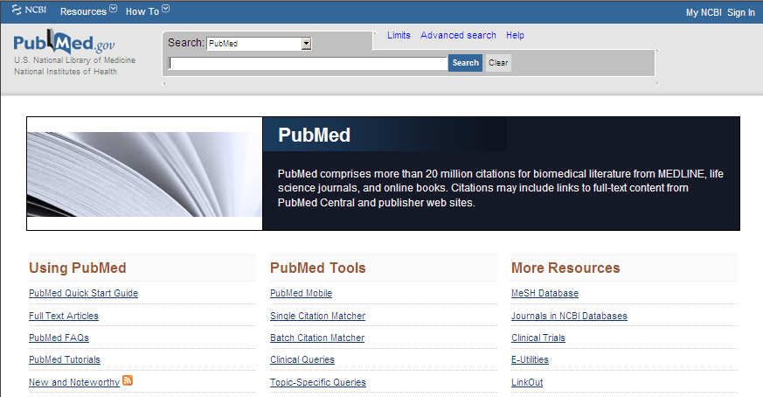
What is Pubmed?
A free service provided by the US National Library of Medicine
Allows you to search across journals included in the Medline database, as well as other life science journals
Includes over 20 million references to journal articles

Slide 11

To access Pubmed, go to the Imperial Library website homepage, type ‘Pubmed’ into the Library Search bar and click Search:
Notes:
You should have a copy of the Pubmed tutorial. In case you have any problems I will leave up the instructions for accessing Pubmed. If you access Pubmed this way rather than just typing in the URL you will find it easier to get the full text of article as it will recognise you as an Imperial user.

Slide 12

Pubmed will be at the top of the results list in Library Search. Click on Online access:

Slide 13
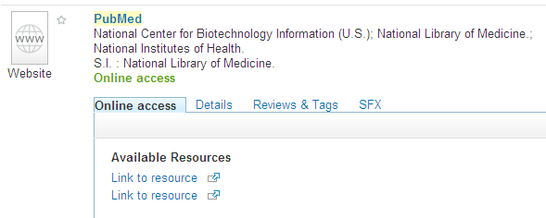
Click on Link to resource (1st link)
This will take you to the Pubmed homepage

Slide 14
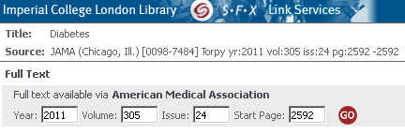
Accessing full text journal articles
Link to full text electronic resources using the SFX button
Notes:
Once you have a final list of results, you will need to find the full text for each journal article. As you saw on the online tutorial, if you want to view the whole article you will need to use the SFX button to see if the library has subscribed to the journal. If there is no SFX button then your second port of call should be the library catalogue where you can check whether the journal (remember it is the journal title you look for not the article title) you require is available in hardcopy at any of the Imperial libraries or if it is available in electronic format.

Slide 15

What if it’s not available online?
Check the Library catalogue (available from library homepage)
We still have many journals in print format
Document delivery service
Notes:
Demo show pubmed and Library e-journal list and catalogue.

Slide 16
Finding e-journal articles
Remember:
Not everything is available online
Different years are available from different publishers – check SFX
If you only have an abbreviated title, you can use a database such as Pubmed to look up the full title

Slide 17
Finding e-journal articles
CMAJ. 2000 Dec 12;163(12):1562-3.
The efficacy of stethoscope placement when not in use: traditional versus "cool".
Hanley WB, Hanley AJ.

Slide 18
Find these 3 journal articles
(1) Romero GL, Kumar S. Case 1: The case of the cookie, the rash and the flu vaccine. Paediatrics and child health 2006;11(10): pp. 675-7.
(2) Turner SA, Luszczynska A, Warner L, Schwarzer R. Emotional and uncontrolled eating styles and chocolate chip cookie consumption. A controlled trial of the effects of positive mood enhancement. Appetite 2010 2;54(1): p. 143-149.
(3) Hong S-W, Yan Z-Y, Otterburn MS, McCarthy MJ. Magnetic resonance imaging of a cookie in comparison with time-lapse photographic analysis (TLPA) during baking process. Magnetic resonance imaging 1996;14(7-8): pp. 923-927.

Slide 19

Did you find all the articles?
Notes:
Demonstrate how to find the first 2 articles online, and the third article on the library catalogue.

Slide 20
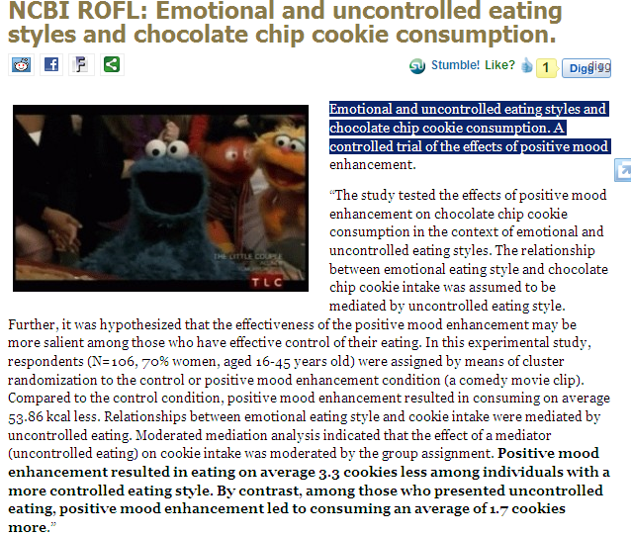
Discoblog
http://blogs.discovermagazine.com/discoblog/category/ncbi-rofl/

Slide 21
eBooks
Can be found on library search
Many popular series such as ABC of..., ...at a Glance and Oxford Textbooks and Handbooks available through the library

Slide 22
eBooks
Different publishers have different interfaces
Some titles have interactive features
Can normally print off up to a chapter

Slide 23
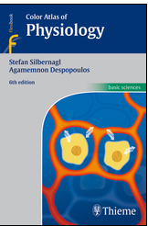
Notes:
Demonstrate finding the Color Atlas of Physiology on the catalogue and show some of the features

Slide 24
Once you’ve found the information,
you’ll need to decide if it is worth
spending time reading it

Slide 25

Critical appraisal
Notes:
There will be occasions throughout your course, including the epidemiology module which you will be doing shortly, where you will be are
not going to go into great detail about it now as you will be learning about this during your. So we will briefly introduce you to it and provide you with information on resources that are available that can support you with this
So we were talking earlier about the importance of critically appraising research, this will be a vital skill in your professional life and one that you will need to develop while at university, using good quality resources will greatly improve both your marks and the standard of your work.

Slide 26
What is Critical appraisal?
“Critical appraisal is the process of systematically examining research evidence to assess its validity, results and relevance before using it to inform a decision”
Hill & Spittlehouse (2007)

Slide 27
Critical appraisal saves you time
Allows you to cut out poorly designed studies
Frees time for reading quality research
Using good quality resources will improve your marks and the standard of your work.
Notes:
The benefits of appraising your work are that… when you are qualified and treating patients it will be imperative that you only use good quality information.

Slide 28
Why is critical appraisal important?
Key to being a good clinician
Putting into practice best treatments
Communication with patients
Notes:
Patients will obviously come to you with treatments they have found on the internet – you need to be able to assess these.
You will want to look at new treatments yourself and whether they are suitable for your patients

Slide 29
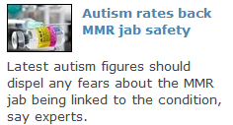
MMR scare
Goldacre B. Bad science. London: Harper Perennial; 2008.
see chapter 15:
The Media's
MMR Hoax

Slide 30
Useful Resources
Greenhalgh T. How to read a paper: the basics of evidence-based medicine. 4th ed. Chichester: Wiley-Blackwell; 2010.
Goldacre B. Bad science. London: Harper Perennial; 2008.

Slide 31
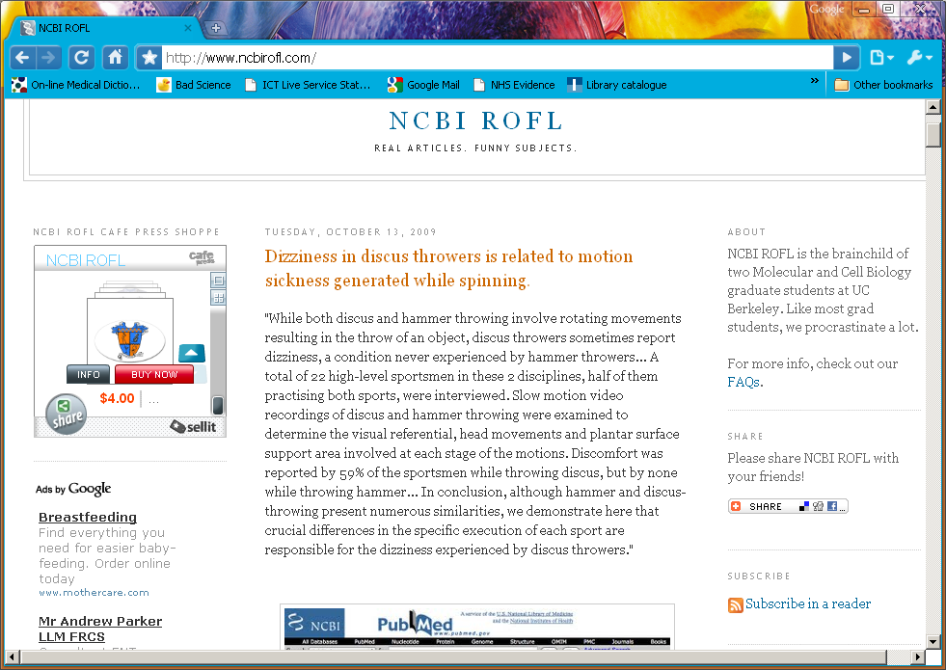
A bit of fun!
http://blogs.discovermagazine.com/discoblog/category/ncbi-rofl/

Slide 32
Summary
Library search
PubMed and search strategies
Critical appraisal
Notes:
Today we have looked at the different types of information the library provides and how to access it.
We have also looked at using search techniques.
I have talked about using passwords to access some information resources.
I have spoken about techniques you can use to manage any information you find, and what to do if you are not finding the information you need.
I have also demonstrated Pubmed to you and you have worked through the online tutorial yourselves.
We have discussed Critical Appraisal – this is something you will be getting into later with your tutors but it’s never too early to think about whether what you are reading is meeting your needs – otherwise you’re wasting your time at best.

Slide 33
Any questions?
Don’t forget if you have any problems you can contact us via:
http://www3.imperial.ac.uk/library/getintouch/yourlibrarian
Notes:
Don’t forget you can contact the team with any further questions – our contact details can be found in Olivia under ‘Help and contacts’ or you can look on the library webpage or at Olivia.

Slide 34
Credits
Cat food and toilet photos, reader image © Wikimedia Commons, Facebook logo © 2009 Facebook.
Hill A, Spittlehouse C. What is critical appraisal? [Online] Available from: http://www.evidence-based-medicine.co.uk/ebmfiles/WhatisCriticalAppraisal.pdf [Accessed 6 June 2011].

Slide 35

Please complete the evaluation form
Notes:
Please take a few minutes to fill in the evaluation form

