Slide 1
Respiratory failure I Dr Richard Stümpfle November 2012

Slide 2
Learning Objectives
1) Understand how the pathological processes of respiratory failure interfere with normal respiratory physiology
2) Explain how alterations in different aspects of respiratory physiology result in the different types of respiratory failure
3) Following lectures 1 and 2, have a basic understanding of treatment principles of respiratory failure

Slide 3
Introduction
The reported incidence of ARF varies between around 78–149 per 100 000 people >15 years of age per year
Ninety-day mortality is close to 40% for ARF and 31–60% for ALI / ARDS
The majority of patients have ARF of pulmonary origin with pneumonia as the predominant diagnosis

Slide 4
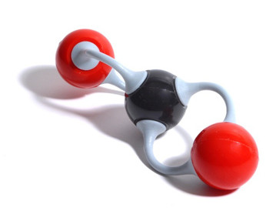
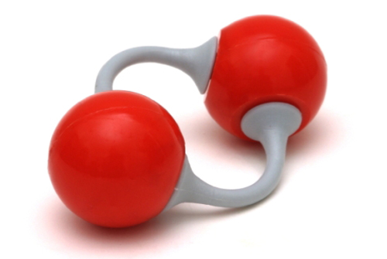
Definition
Respiratory system unable to maintain adequate gas exchange to satisfy metabolic demands, i.e.
Oxygenation
Elimination of carbon dioxide

Slide 5
Consequences
Hypoxaemia is inadequate oxygenation of blood
Anaerobic metabolism starts ~ when P_{a}O₂<4.5kPa
Leads to reduced cellular function, lactic acidosis & cell death
Different tissues have different tolerances
Reversible loss of function starts at:
Skeletal muscle 2hrs
Myocardial tissue 4mins
Cerebral tissue 1min

Slide 6
Classification
Hypoxaemic (Type 1)
PaO₂ <8.0 kPa
Normal or low CO₂
Ventilatory (Type 2)
PCO₂ >6.0 kPa

Slide 7
Non-respiratory Function
Reservoir of blood available for circulatory compensation
Filter for circulation:
Thrombi, microaggregates etc.
Metabolic activity:
Activation:
Angiotensin I→II
Inactivation:
Noradrenaline
Bradykinin
5 H-T
Some prostaglandins
Immunological:
IgA secretion into bronchial mucus

Slide 8
Some Basic Physiology

Slide 9
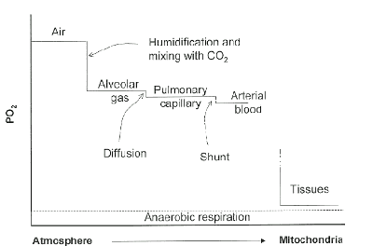
Oxygen Cascade

Slide 10
Oxygenation
P_{A}O₂ dependent on total alveolar pressure & partial pressures of other gases in alveolus
Alveolar Pressure=P_{A}O₂+P_{A}CO₂+P_{A}H₂O+P_{A}N₂

Slide 11
Oxygenation
Factors that can result in changes to P_{A}O₂ include:
P_{A}CO₂
Alveolar pressure
FiO₂
Ventilation
Alveolar gas equation
P_{A}O₂=P_{I}O₂-(P_{A}CO₂/R)

Slide 12
Carbon Dioxide Elimination
CO₂ has high diffusion coefficient cf. O₂ & is very water soluble
CO₂ elimination dependent on alveolar ventilation
Alveolar Ventilation=Respiratory Rate x (Tidal Volume-Dead Space)
Factors that can result in changes to P_{A}CO₂ include:
Respiratory Rate
Tidal Volume
V/Q matching

Slide 13
Dead Space
Fraction of tidal volume that does not take part in gas exchange
Anatomical dead space relates to volume of conducting passages
Mouth, trachea etc.
2.2ml/Kg body weight, or
⅓ tidal volume
Measured by Fowler’s method (N₂ washout)
Alveolar dead space relates to V/Q mismatch
Physiological dead space = Alveolar + Anatomical dead space

Slide 14
Ventilation
Ventilation results in renewal of the A-a gradient
Hypoventilation results in a rise in PaO₂ & PaCO₂

Slide 15
Pathophysiology

Slide 16
Causes of Respiratory Failure
Hypoventilation
Diffusion impairment
Shunting
V/Q mismatch

Slide 17
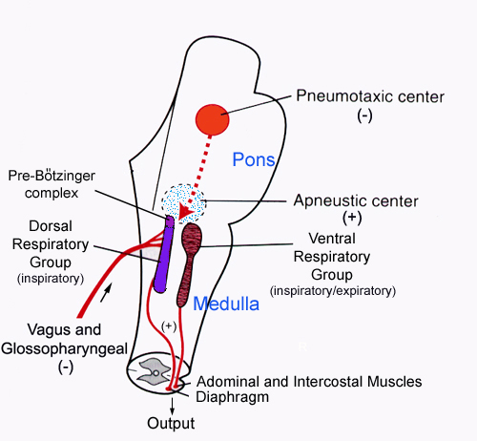
Hypoventilation

Slide 18
Hypoventilation
Brainstem
Injury due to trauma, haemorrhage, infarction, hypoxia,
infection
Metabolic encephalopathy
Drugs
Spinal cord
Trauma, tumour, transverse myelitis
Nerve root injury
Nerve
Trauma
Neuropathy
Motor neuron disease

Slide 19
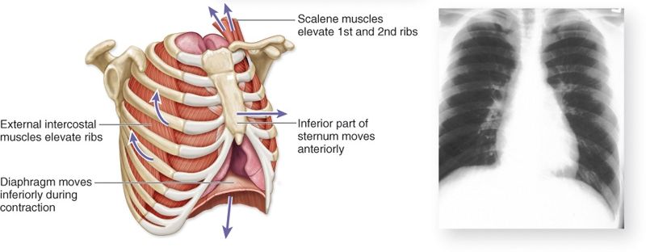
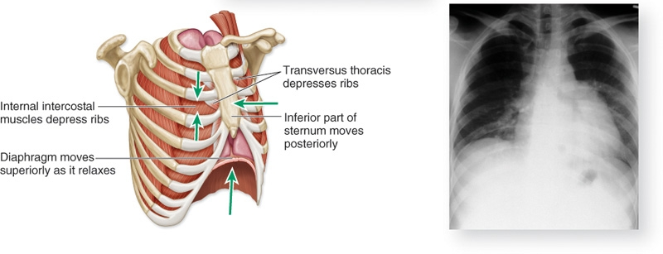
Hypoventilation
Inhalation
Exhalation

Slide 20
Hypoventilation
Neuromuscular junction
Myasthenia gravis
Drugs
Respiratory muscles
Myopathy
Atrophy
Muscular dystrophy
Fatigue

Slide 21
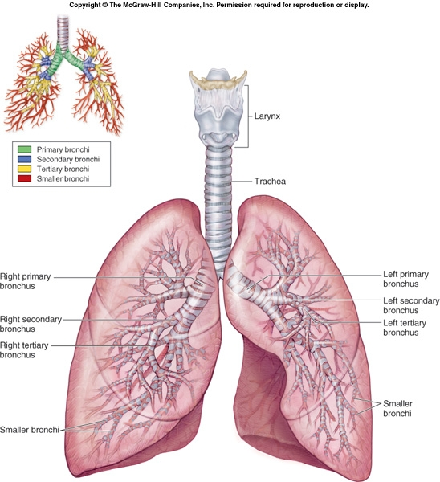
Hypoventilation

Slide 22
Hypoventilation
Respiratory system
Airway obstruction
Reduced compliance (lung, pleural, chest wall)

Slide 23
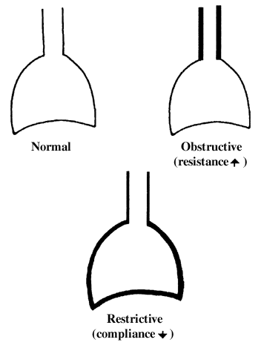
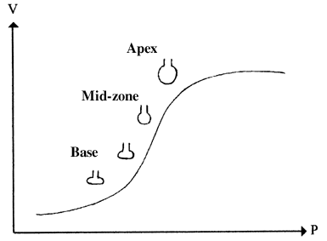
Resistance & Compliance
Resistance is obstruction to air flow by conducting airways
Compliance relates to distensibility or ‘stretchiness’
Lung compliance
Chest wall compliance

Slide 24
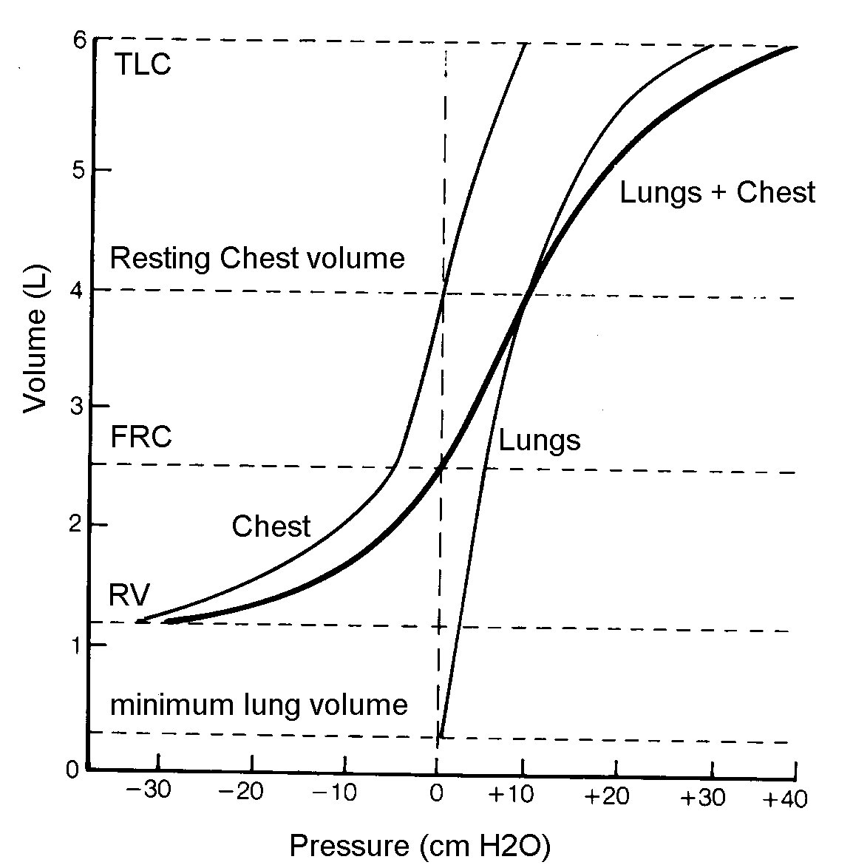
Resistance & Compliance
Compliance relates to distensibility or ‘stretchiness’
Lung compliance
Chest wall compliance

Slide 25
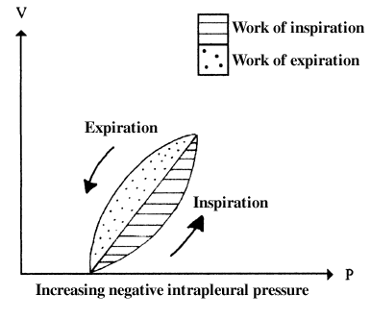
Work of Breathing
Resistance is main contributor to respiratory work

Slide 26
Diffusion Impairment
Lungs provide 50-100m² surface area for diffusion
O₂ diffuses from alveolus to capillary until partial pressures equal
Equilibrium completed in ⅓ time of capillary blood flow (0.75s)
Allows for compensation in higher cardiac output states
Does not affect CO₂ as more soluble
Causes include:
Pulmonary fibrosis
Emphysema
Pulmonary oedema

Slide 27
Perfusion
Determined largely by gravity
Perfusion pressure highest at bases
At apices perfusion pressure may fall below alveolar pressure

Slide 28
Ventilation
Varies according to position of alveoli on compliance curve

Slide 29
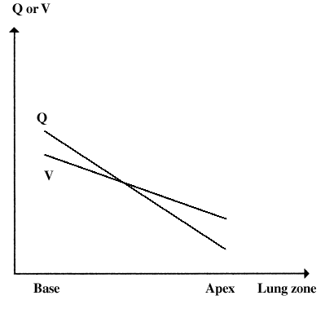
Ventilation Perfusion Matching

Slide 30
Ventilation Perfusion Mismatching
Well ventilated alveoli but no perfusion
Causes include:
Pulmonary embolus
Low cardiac output states
High intra-alveolar pressure

Slide 31
Shunting
Alveoli not ventilated but perfused
Therefore blood not oxygenated
Resulting hypoxia resistant to increases in FiO₂
Hypoxic pulmonary vasoconstriction limits perfusion to poorly ventilated alveoli
Commonest cause of hypoxia in critically ill
Causes include:
Any cause of left to right intra-cardiac shunt
Pneumonia
Pulmonary oedema/haemorrhage
Atelectasis/collapse

Slide 32
Initial Approach

Slide 33
Assessment
History
Examination
Investigations
Management

Slide 34
History
Presenting complaint
Past medical history
Medications
Social history

Slide 35
Assessment
Signs of respiratory compensation
Tachypnoea
Use of accessory muscles
Nasal flaring
Intercostal, suprasternal or supraclavicular recession
Increased sympathetic tone
Tachycardia
Hypertension
Sweating

Slide 36
Assessment
Haemoglobin desaturation
Cyanosis
Hypercapnoea
Respiratory flap
Hypertension
Coma
End-organ hypoxia
Altered mental status
Bradycardia/hypotension

Slide 37
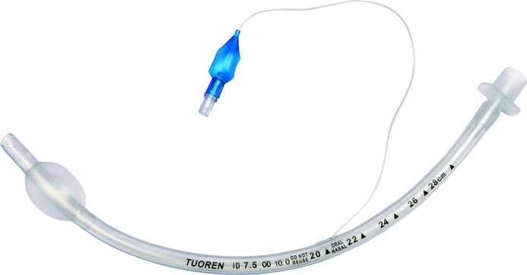
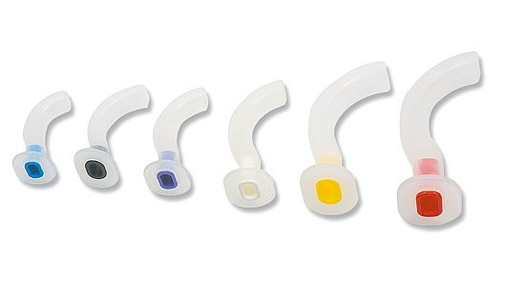
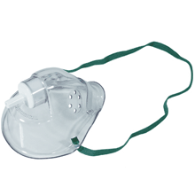
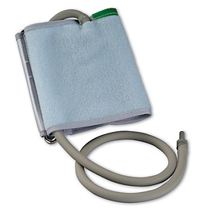
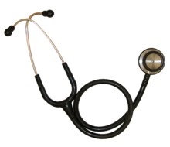
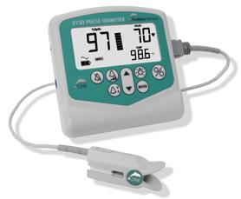
Alternatively
‘A’ is for airway
‘B’ is for breathing
‘C’ is for circulation
‘D’ is for disability

Slide 38
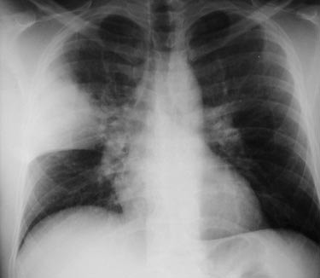
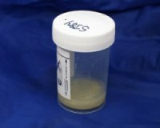
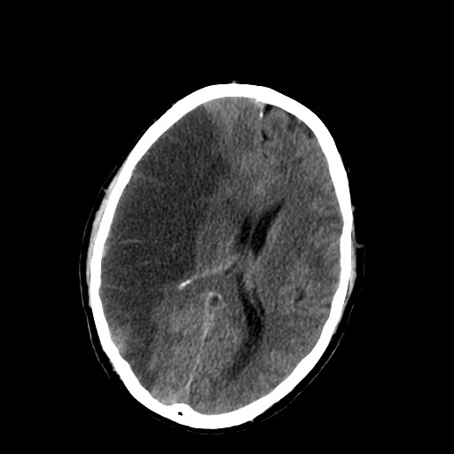
Investigations
Arterial blood gases
Lung function tests
Chest X-ray
Computed tomography scan (CT scan)
Microbiological tests

Slide 39
Management
Oxygen
Non-invasive ventilation
Invasive ventilation
Treat underlying cause

Slide 40
Summary
Respiratory failure results in hypoxia & hypercapnoea
Acute respiratory failure associated with high mortality
Causes related to disruption in physiology
Simple approach to assessment & management

