Slide 19
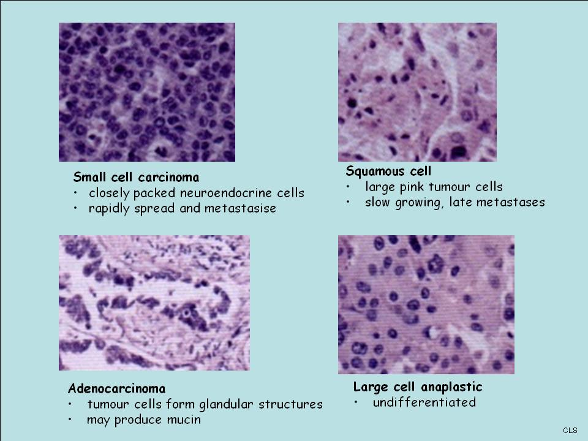

Slide 49
DNA repair
DNA damage
SMOKING
polycyclic aromatic hydrocarbons:
- increased activation
CYP1A1 (aryl hydrocarbon hydroxylase)
CYP2D6 (NNK)
microsomal epoxide hydrolase
- decreased detoxification
Glutathione S-transferase
Early recognition of
Others……….
Xeroderma pigmentosum
- nucleotide excision repair
- photodermatoses
- skin malignancies (2000x)
- visceral malignancies (20x)

Slide 54
