Slide 1
Arterial blood gases and acid-base balance
Professor Stephen Semple
s.semple@imperial.ac.uk

Slide 2
Dalton’s Law of Partial Gas Pressures.
In a gas mixture the pressure exerted by each gas is independent of the pressures of the other gases. The Partial pressure of a gas is the concentration of the gas times the Barometric Pressure e.g. Po₂=21% x 100 kPa = 21kPa.
When the gas is humidified the partial pressure of water vapour must be subtracted from the barometric pressure e.g. Po₂=21% x (100 – 6.3)=19.7 kPa

Slide 3
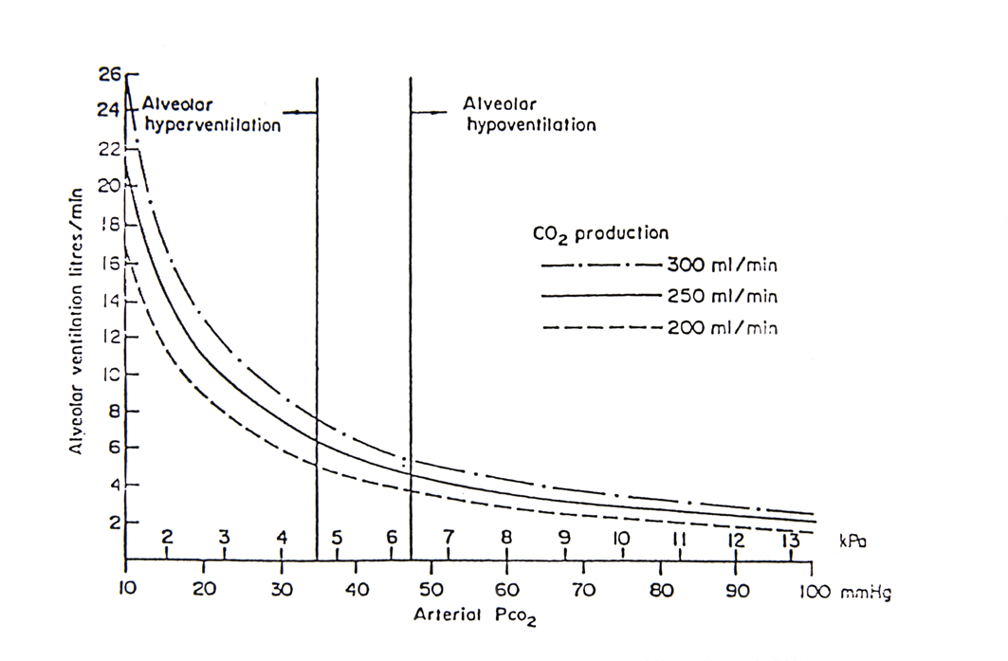
Curved relationship between arterial PCO2(kPa or mm Hg) and alveolar ventilation( litres/min) at three different levels of CO2 production (dashed, continuous and dash dot curves) in ml/min. Changers in CO2 production produce changes in alveolar ventilation such that PCO2 remains within the normal range, between the continuous vertical lines at PCO2 4.7 and 6.4 kPa or between 35 and 48 mmHg. Thus a normal PCO2 implies a normal alveolar ventilation and chemical control of CO2 whatever the CO2 production. Thus a rise in CO2 production from 200 to 300 ml/min leads to an increase of alveolar ventilation from approximately 4 to 6 litres/min
Notes:
Curved relationship between arterial PCO2(kPa or mm Hg) and alveolar ventilation( litres/min) at three different levels of CO2 production (dashed, continous and dash dot curves) in ml/min. Changers in CO2 production produce changes in alveolar ventilation such that PCO2 remains within the normal range, between the continous vertical lines at PCO2 4.7 and 6.4 kPa or between 35 and 48 mmHg. Thus a normal PCO2 implies a normal alveolar ventilation and chemical control of CO2 whatever the CO2 production. Thus a rise in CO2 production from 200 to 300 ml/min leads to an increase of alveolar ventilation from approximately 4 to 6 litres/min

Slide 4
RESPIRATORY FAILURE
The respiratory apparatus in its function as a gas exchange system maintains the gas tensions of carbon dioxide (Pa, CO₂) and Oxygen (Pa, O₂) within quite narrow limits. This control of gas tensions is dependent on alveolar ventilation and gas exchange within the lung. If either or both fail respiratory failure is the result. The limits defining failure are an arterial oxygen tension, less than 60 mmHg (8 kPa) and a carbon dioxide tension above 50 mmHg (6.7 kPa), the patient being at rest and breathing air.
Classification of Respiratory Failure
Respiratory failure can be classified into 3 groups:
Type 1 Hypoxaemic failure in which a low Pa, O₂ is associated with a normal (or low) Pa, CO₂. The disorder of function in this condition is a disturbance of ventilation to perfusion relationships within the lung, whilst overall alveolar ventilation remains normal (point B)
Type 2 Ventilatory failure This condition results from alveolar hypoventilation and produces a raised PaCO₂ and low Pa, O₂ (point A)
Type 3 Combined hypoxaemic and ventilatory failure in which features of type 1 and 2 are mixed, the defect including both alveolar hypoventilation and a disturbance of ventilation – perfusion relationships within the lung. This produces a raised Pa, CO₂ and low Pa, O₂ (point C).

Slide 5
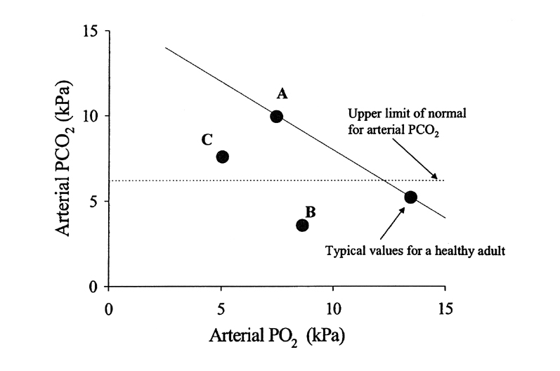
Figure 3
The reciprocal relationship between PO2 and PCO2 within the lung, the oblique continuous line defines this
relationship in a normal ventilated lung. Thus if PCO2 goes up due to alveolar hypoventilation then PO2 goes down
see Point A (and visa versa for alveolar hyperventilation). Because the oblique line is linear, addition of the PCO2 and
PO2 will give the same value at any point on the line (approximately 16 KPa). This relationship is very useful in
characterising type 1 from type 2 respiratory failure.
Example: A: Type 2 (ventilatory failure). (PCO2 10KPa, PO2 7.5KPa)
Example: B: Type 1 (hypoxaemic failure) (PCO2 3.5 KPa, PO2 8.0 KPa)
Example: C: Combined type 1 and 2 failure (PCO2 7.5KPa, PO2 5.0KPa)

Slide 6
Figure 4
CO2 Dissociation Curve.
N is the PC02 and CO2 content of blood leaving a normal lung with normal VA/Q ratios averaged at 0.8 (see N in fig). In disease of the lung there are low VA/Q areas (H) and normal and high VA/Q areas (L). When blood from these areas mix in the left side of the heart the areas of high VA/Q compensate for the low VA/Q areas and resulting arterial PC02 is slightly raised by within the normal range. This normality is achieved because the CO2 dissociation curve is nearly linear and also because any rise in PC02 stimulates the chemoreceptors leading to an increase of ventilation of the high VA/Q areas.

Slide 7
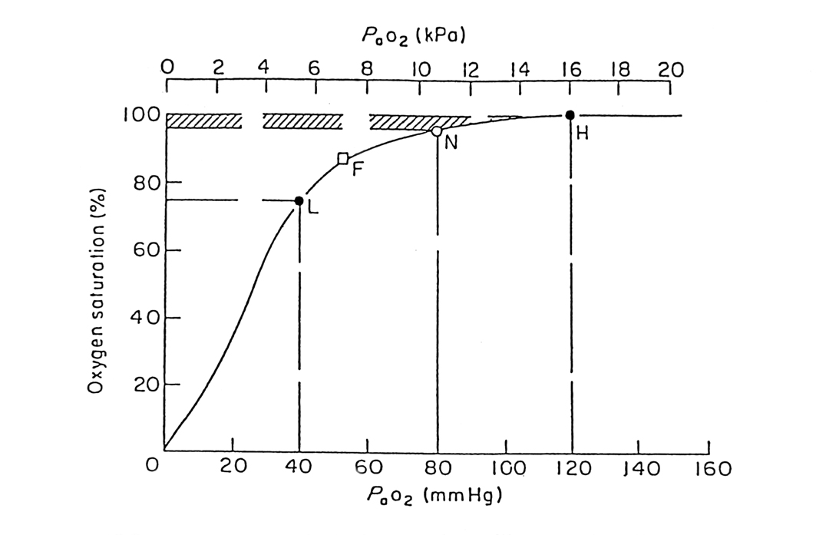
Figure 5.
This is a hypothetical example to illustrate the effect of ventilation to perfusion inequalities in the lung on arterial O₂ tension and saturation as in hypoxaemic (type 1) respiratory failure.
The normal VA/Q areas(N) contribute blood to the pulmonary venous system with a normal PO₂ (11KPa) and saturation(96%)
The low VA/Q(L) areas contribute blood with a PO₂ of 5KPA and saturation 75%(20% drop from normal).
The high VA/Q(H) areas contribute blood with a PO₂ of 16KPa and saturation of 100%(rise from normal of only 4% see hatched area)

Slide 8
Fig 5 (contd)
The blood from the three regions of the lung with different VA/Qs mix in the pulmonary venous system and the left side of the heart. The resulting PaO₂(F) is 7.5KPa with an O₂ saturation of 75%
Thus the areas of high VA/Q do not compensate for the low VA/Q areas due to the sigmoid shape of the oxygen dissociation curve

Slide 9
Figure 5.
This is a hypothetical example to illustrate the effect of ventilation to perfusion inequalities in the lung on arterial O2 tension and saturation.
If two aliquots of blood of equal volume are equilibrated with the same gas with Po2 of 80 mmHg (10.7 kPa) then each aliquot will have an oxygen saturation of 95%. If the two aliquots are mixed anaerobically then the tension and saturation of the mixture will, of course, be 80 mmHg (10.7 kPa) and 95% (point N). Now take the two equal volumes of blood again and equilibrate one with a gas of Po2of 40 mmHg (5.3 kPa) and the other with a Po2 of 120 mmHg (16 kPa); the mean tension is still 80 mmHg (10.7 kPa) and one would expect, if the O2 dissociation curve was linear, that when the two bloods were mixed the resulting tension and saturation would be 80 mmHg (10.7 kPa) and 95%. But an increase of Po2 of 40 mmHG (5.3kPa) only raises the saturation by 4% from 95% to 99% (point H), whilst the decrease of 40 mmHg (5.3 kPa) lowers the saturation by 20% to 75% (point L). When the two equal volumes of blood are mixed anaerobically then the O2 tension and saturation of the mixture are 53 mmHg (7.1 kPa) and 86.5% respectively (point F). This is because the increase in oxygen saturation, and, therefore, oxygen content (ml of O2 per 100ml of blood) of sample H is less than the fall in O2 content of sample L.

