Slide 1
Lecture 3-20
Exercise physiology
Dr Luke Howard
Consultant Physician, Hammersmith Hospital, ICHNT
Honorary Senior Lecturer, National Heart & Lung Institute
l.howard@imperial.ac.uk

Slide 2
O₂ flow
Lungs
Muscle
Expired CO₂ – VCO₂
Circulation
O₂ consumption
CO₂ production
CO₂ flow
Inspired O₂ – VO₂

Slide 3
Basic exercise metabolism
Muscle contraction requires energy for contraction in the form of phosphate, “delivered by ATP”
Three sources of phosphate:
Anaerobic metabolism, incl. Creatine phosphate
Aerobic metabolism
Largest source is aerobic
Cardiac output needs to increase by 5-6 l/min per l/min oxygen consumption
If it fails, anaerobic metabolism required

Slide 4
Basic exercise metabolism
CO₂ + H₂0 ↔ H₂CO₃ ↔ H⁺ + HCO₃⁻
Total body H⁺ is 3.4 micromoles
H⁺ generated at walking speed is 40,000 micromoles per minute from CO₂ production
Cardiovascular system must remove CO2 to lungs where it is eliminated in proportion to rate of delivery
Small errors lead to large changes in pH

Slide 5
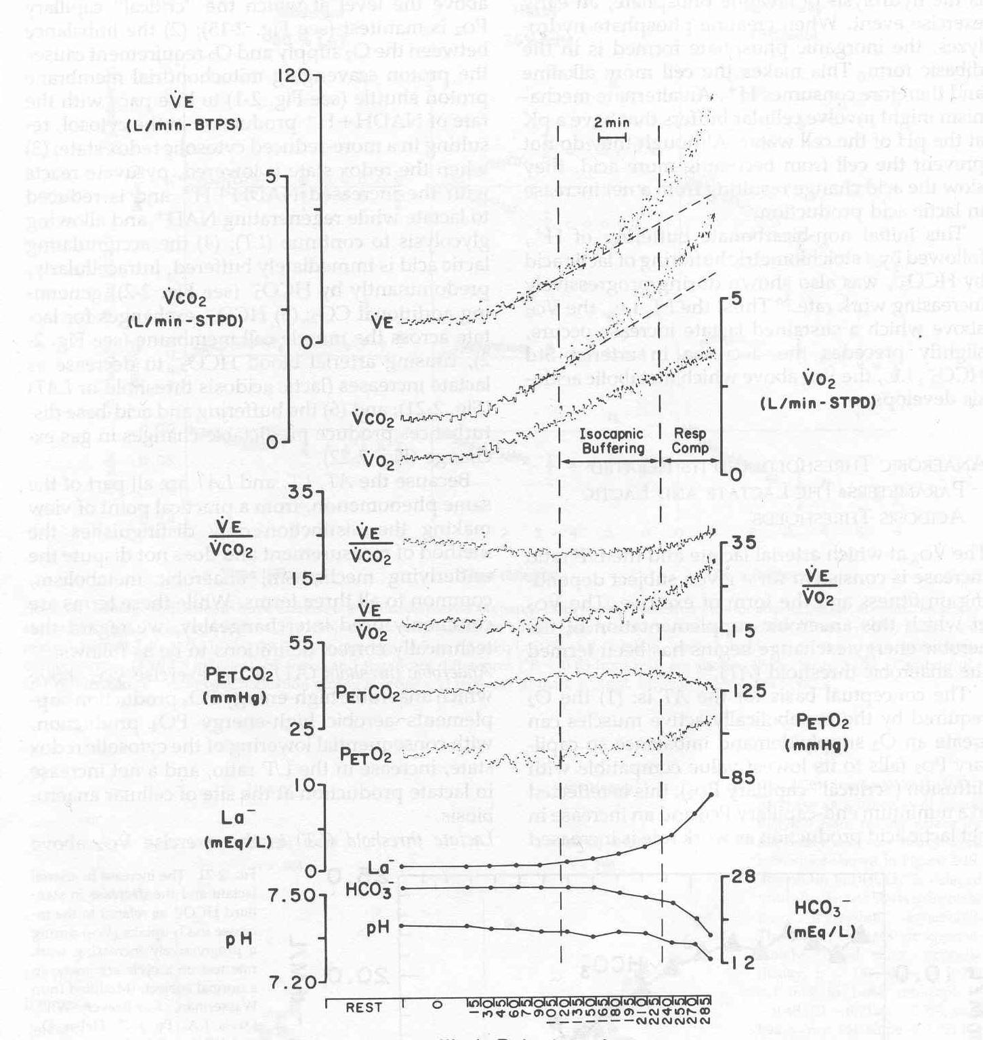

Slide 6
CO₂ flow
Lungs
Muscle
Expired CO₂ – VCO₂
Circulation
CO₂ production

Slide 7
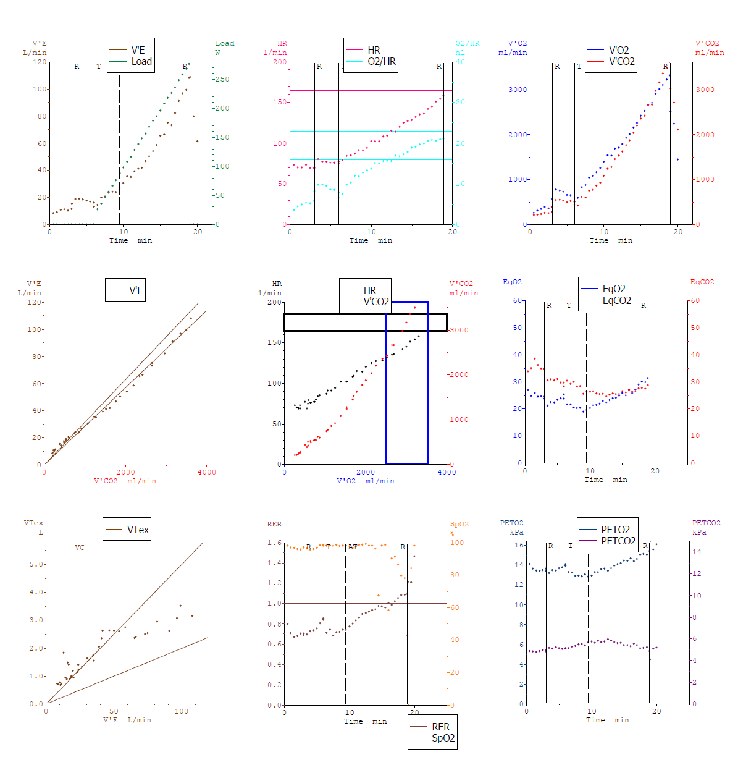

Slide 8
Carbon dioxide production drives exercise response to maintain normal pH
The relationship of ventilation to carbon dioxide production relates to the efficiency of the lungs

Slide 9
Sources of CO2 Output during Exercise
1) Aerobic substrate catabolism
2) Bicarbonate buffering from H+ produced alongside lactate:
3) Pulmonary hyperventilation due to acidosis
Whipp - unpublished

Slide 10
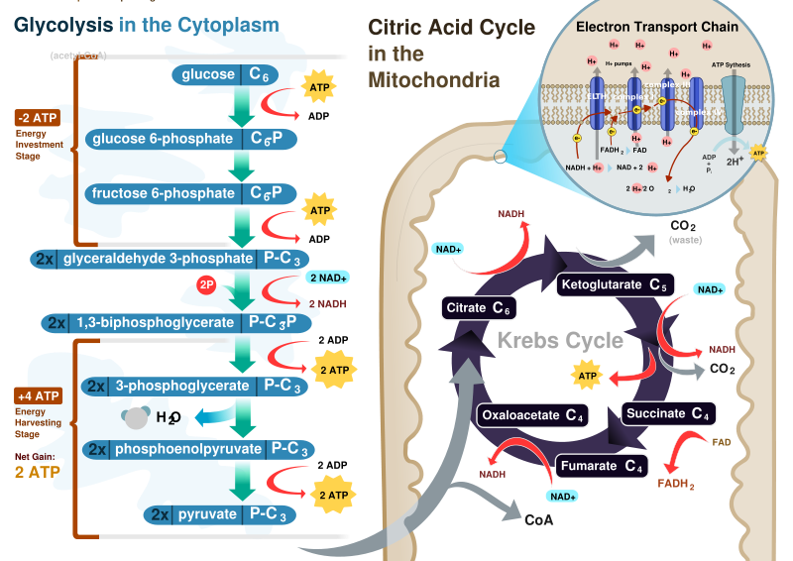
1 glycogen → 3 ATP + 2 H⁺ + 2 Lactate⁻
2 H⁺ + HCO₃⁻ → 2 CO₂
1 glycogen + 6 O₂ → 6 CO₂ +37 ATP
1 palmitate + 23 O₂ → 16 CO₂ +129 ATP

Slide 11
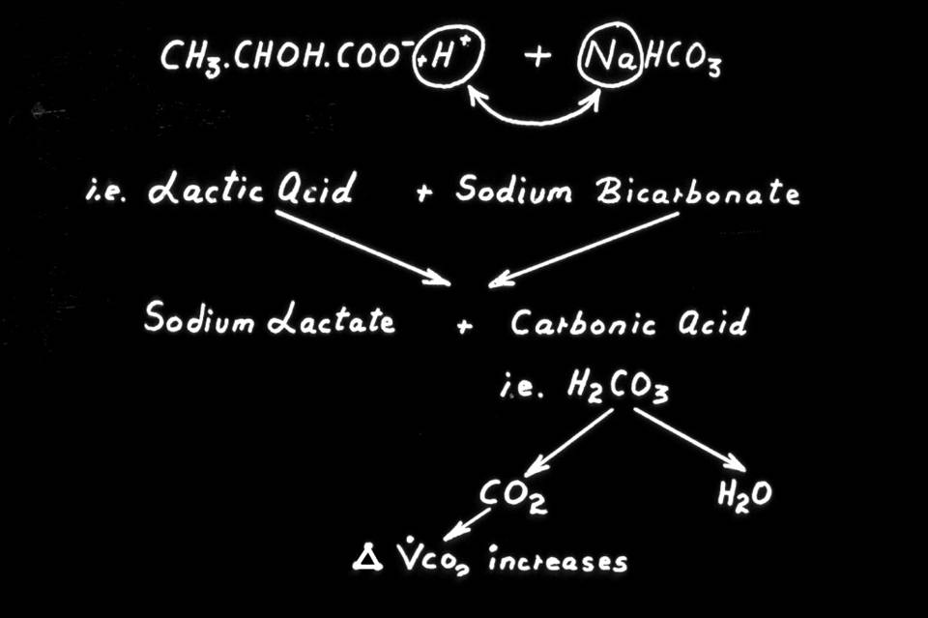
Whipp - unpublished

Slide 12
1 glycogen → 3 ATP + 2 H⁺ + 2 Lactate⁻
2 H⁺ + HCO₃⁻ → 2 CO₂
1 glycogen + 6 O₂ → 6 CO₂ +37 ATP
1 palmitate + 23 O₂ → 16 CO₂ +129 ATP
For incremental work:
Aerobic metabolism more efficient and produces less CO2 per ATP generated

Slide 13
1 glycogen → 3 ATP + 2 H⁺ + 2 Lactate⁻
2 H⁺ + HCO₃⁻ → 2 CO₂
1 glycogen + 6 O₂ → 6 CO₂ +37 ATP
1 palmitate + 23 O₂ → 16 CO₂ +129 ATP
When starved and metabolising fatty acids: RQ ≈ RER = VCO₂/VO₂ ≈ 0.7
When metabolising glycogen alone: RQ ≈ RER = VCO₂/VO₂ ≈ 1.0
When RQ or RER > 1 then anaerobic threshold has been surpassed

Slide 14
1 glycogen → 3 ATP + 2 H⁺ + 2 Lactate⁻
2 H⁺ + HCO₃⁻ → 2 CO₂
1 glycogen + 6 O₂ → 6 CO₂ +37 ATP
1 palmitate + 23 O₂ → 16 CO₂ +129 ATP
For incremental work:
Above anaerobic threshold, CO2 production exceeds O2 consumption. As ventilation is coupled to CO2 production, ventilation rises disproportionately to O2 consumption

Slide 15
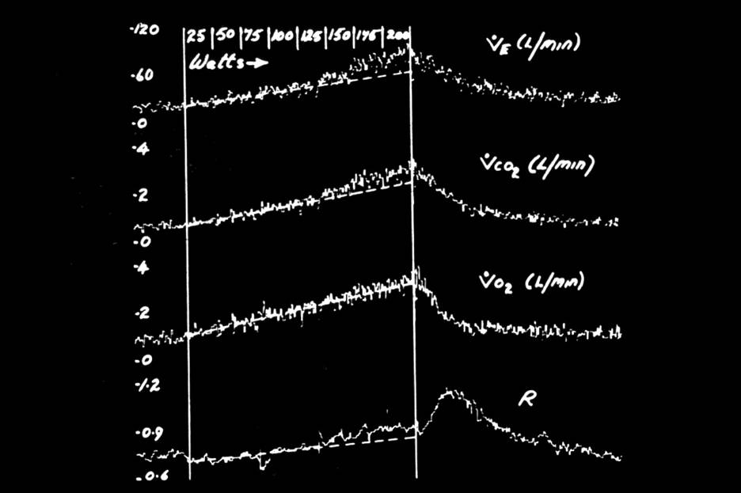
=VCO₂/VO₂
Whipp - unpublished

Slide 16
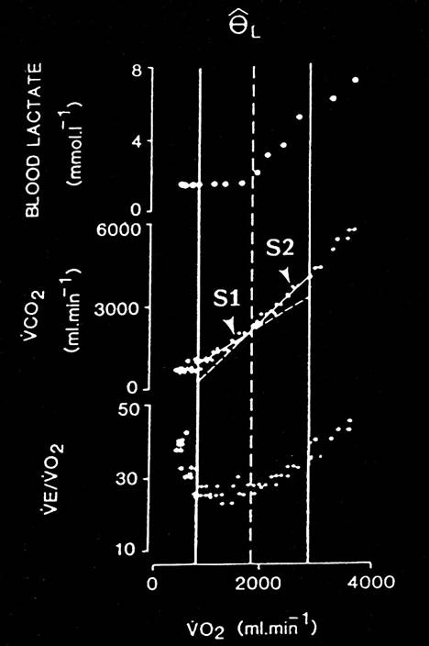
Henson et al 1989

Slide 17
Sources of CO2 Output during Exercise
1) Aerobic substrate catabolism
2) Bicarbonate buffering from H+ produced alongside lactate:
3) Pulmonary hyperventilation due to acidosis
Whipp - unpublished

Slide 19
Changing metabolic substrates in exercise
Practical

Slide 20
CarDiopulmonary response to exercise
Theory

Slide 21
O₂ flow
Lungs
Muscle activity
Expired CO₂ – VCO₂
Circulation
O₂ consumption
CO₂ production
CO₂ flow
Inspired O₂ – VO₂

Slide 22
Muscle bulk
Effort & neuromuscular coupling
Capillary & mitochondrial density
O₂ flow
Lungs
Muscle activity
Expired CO₂ – VCO₂
Circulation
O₂ consumption
CO₂ production
CO₂ flow
Inspired O₂ – VO₂
Cardiac output = Stroke vol. x HR
Haemoglobin
Oxygen saturation
V/Q matching
FEV₁
Respiratory muscle function

Slide 24
Components of the cardiovascular response
Speed of delivery bike
Number of oranges arriving in bike
Number of oranges leaving in bike
Rate of delivery of oranges
VO₂ = CO x (CaO₂ – CvO₂)
VO₂ = SV x HR x (CaO₂ – CvO₂)
VO₂ = SV x HR x 13.4 x Hb x (SaO₂ – SvO₂)
Distance generated by each revolution of pedals
Cycling cadence
Capacity of the basket
% occupancy of the basket

Slide 25
Components of the cardiovascular response
VO₂ = CO x (CaO₂ – CvO₂)
VO₂ = SV x HR x (CaO₂ – CvO₂)
VO₂ = SV x HR x 13.4 x Hb x (SaO₂ – SvO₂)
✓
✓
✓
✓

Slide 26
Components of the cardiovascular response
VO₂ = SV x HR x 13.4 x Hb x (SaO₂ – SvO₂)
VO₂ / HR = SV x 13.4 x Hb x (SaO₂ – SvO₂)
VO₂ / HR α SV x (SaO₂ – SvO₂)

Slide 27
VO₂ / HR = SV x (CaO₂ – CvO₂)
At peak exercise:
CaO₂ 21 ml/100ml
CvO₂ 5 ml/100ml
SV = O2 pulse /16 x 100

Slide 29
Part 1: The normal response to exercise
Dr Luke Howard
O₂ flow
Lungs
Muscle activity
Expired CO₂ – VCO₂
Circulation
O₂ consumption
CO₂ production
CO₂ flow
Inspired O₂ – VO₂
CLS

Slide 30
How is CO₂ cleared from the lung?
VCO₂
Ventilation increases in proportion to CO2 production
Deadspace fraction (VD/VT)
The more deadspace in your lung, the more you have to breathe to clear CO₂
CO₂ set-point
The lower the CO₂ in the blood and lung, the higher the ventilation to clear CO₂

Slide 31
How does flow and ventilation change?
Theory

Slide 32
Cardiac response to exercise
Heart rate
Autonomic nervous system
Drop in vagal tone
Rise in sympathetic stimulation
Activated by cortical and muscle ergoreceptor mechanisms
Stroke volume
Increased venous return from contracting muscles
Decreased intrathoracic pressure with deep inspiration “sucking blood in to the lungs”
Sympathetic response (increasing inotropy)
Reaches peak at 50% of peak VO₂

Slide 33
Vascular response to exercise
Preferential dilatation of active vascular beds
Autonomic nervous system
Local factors
H+
CO₂
K+
Omsolarity
Nitric oxide
Adenosine
Temperature
PO₂

Slide 34
Ventilatory response to steady-state exercise
CO2 and pH are the most important regulators of ventilation in the physiological range. So if they stay constant during exercise, what causes the change in ventilation???
In response to changes in CO2 production
III
II
Cortical
Ergoreceptor
Cardiodynamic
I
Time

