Slide 1


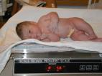
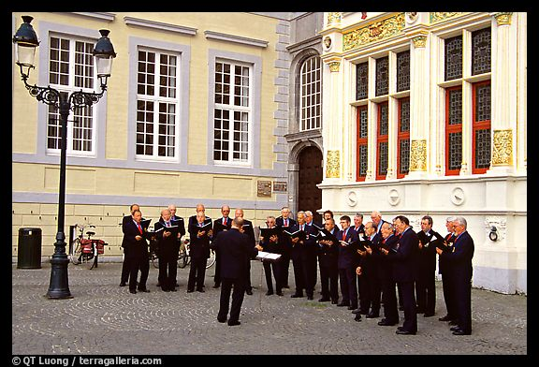
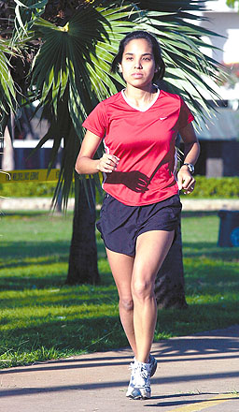
Regulation of breathing
Last gasp
A breath of fresh air
Inspiration
Professor Mary J Morrell
National Heart and Lung Institute
Royal Brompton Hospital
(m.morrell@imperial.ac.uk)

Slide 2
learning objectives (2012)
Part 1 (3)
Distinguish the primary purpose of the automatic reflex and the behavioural controller
Identify neuronal groups in the brainstem that make up the automatic reflex controller for breathing, and structures in higher brain areas (suprapontine) that drive behavioural (non-automatic) control of breathing. Describe how they can act independently or interact for control of the respiratory pump.

Slide 3
Control of Breathing
To regulate gas exchange
To execute behavioural acts
To maintain airways and lung function

Slide 4
Gas Exchange
To regulate gas exchange (O₂/CO₂)
  for homeostasis
    Acid base balance
  for metabolism
    At rest O₂ consumption ~ 250 ml.min⁻¹;
    alveolar ventilation ~ 5 l.min⁻¹
    Exercising O₂ consumption can increase by 20 fold; alveolar ventilation must increase to match this demand

Slide 5
Behavioural Acts
To execute behavioural acts
  communication
    speech, singing, playing wind instruments
  emotion
    laughter, crying, anxiety
  non respiratory functions
    swallowing
    defecation, micturation, parturition, vomiting

Slide 6
To achieve these functions the brain must:
Maintain Airways
To maintain airways and lung function
  Coughing, sneezing, yawning, sighing
Control the pharynx and larynx
  to maintain upper airways patency
Control the pump muscles
  for inspiration
  for expiration

Slide 7
Regulation of Breathing
Voluntary/behavioural
Motor cortex
Emotional
Reflex/automatic
Limbic system
Brainstem
Respiratory muscles

Slide 8
Brainstem Respiratory Centres

Slide 9
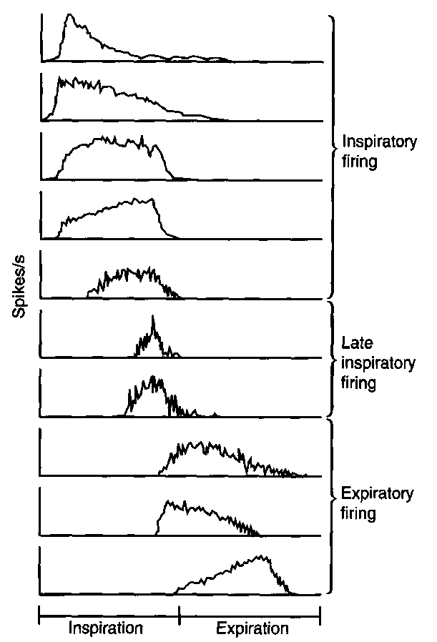
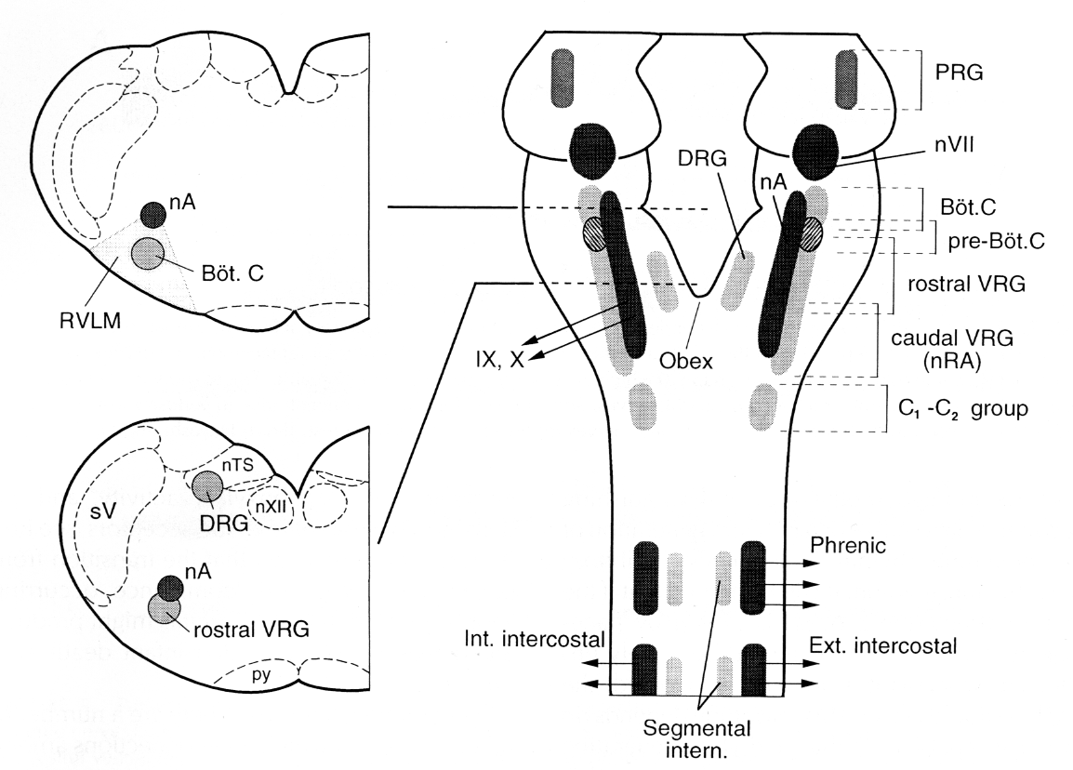
Reflex / Automatic Control of Breathing:
Brainstem Respiratory Neurones
Regulation of Breathing
McKay et al. 2005
(Smith, et al. Science 1991)

Slide 10
Automatic respiratory
rhythm generation (a model)
Respiratory neurones inter-connected to form a pacemaker
Respiratory pacemaker will generate a respiratory rhythm in isolation ⇒ output to pump muscles and upper airways
Inspiratory
Neurones
Late -inspiratory
neurones
Expiratory
neurones

Slide 11
Regulation of Breathing
Voluntary/behavioural
Motor cortex
Emotional
Reflex/automatic
Limbic system
Brainstem
Respiratory muscles

Slide 12
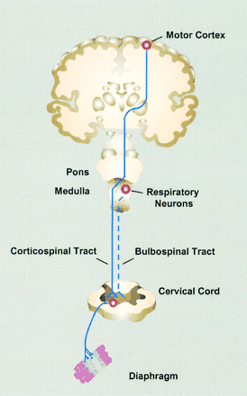

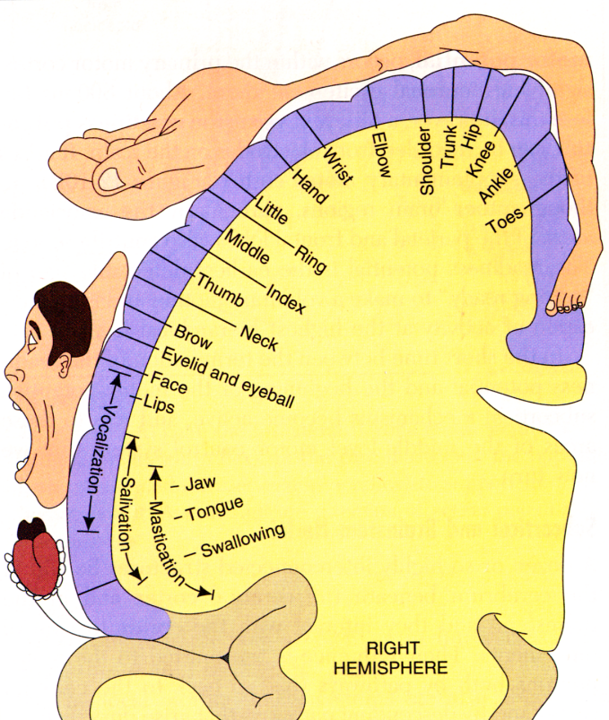
  Supra-brainstem structures
Supplementary motor cortex, primary sensorimotor cortex
(McKay et al. J Appl Phyiol. 2003)
Voluntary: corticospinal pathway
Automatic: bulbospinal pathway
(Laghi and Tobin AJRCCM 2003)

Slide 13
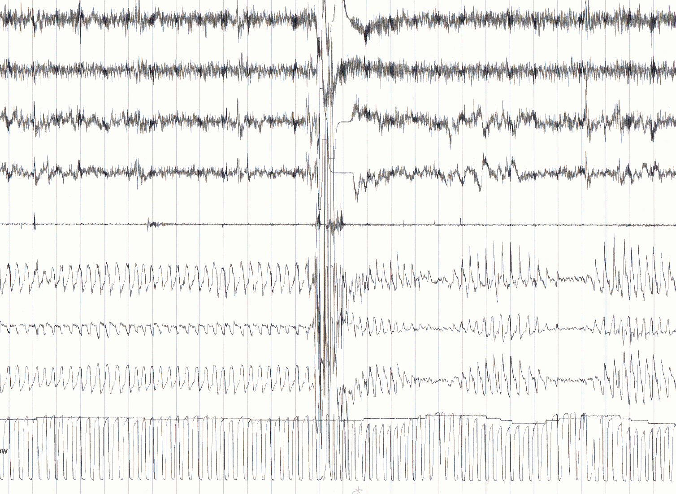
Breathing during Sleep
Asleep
Arousal
Wake / Sleep transition
EEG
EEG
Right eye
Left eye
Chin EMG
Breathing effort
Ribcage effort
Abdominal effort
Oxygen
Saturation
PetCO₂
30 sec
(EEG electroencephalogram, EMG electromyogram)
Notes:
13

Slide 14
Regulation of Breathing
Voluntary/behavioural
Motor cortex
Emotional
Reflex/automatic
Limbic system
Brainstem
Respiratory muscles

Slide 15


Emotional Control of Breathing:
Locked in Syndrome
Regulation of Breathing
Voluntary: corticospinal pathway
Automatic: bulbospinal pathway
(Laghi and Tobin AJRCCM 2003)

Slide 16
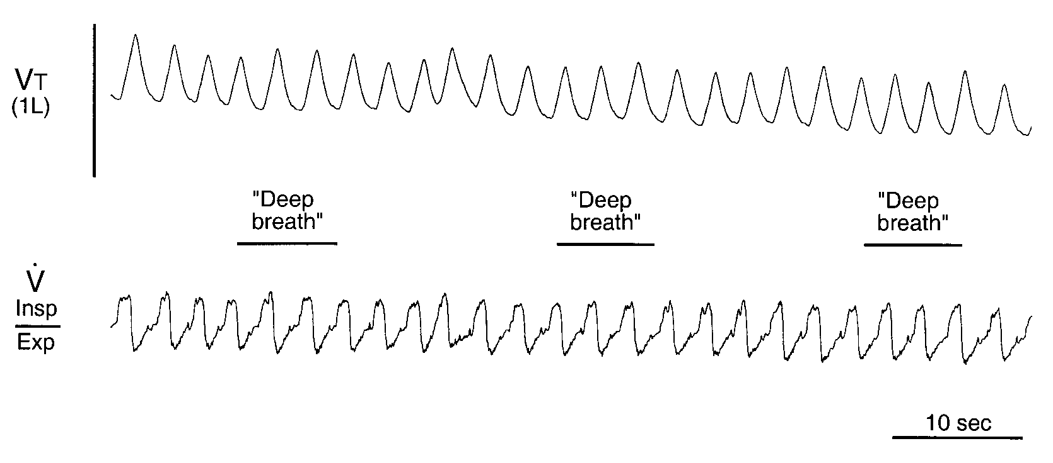
Locked-in Syndrome
(Heywood et al. 1996)

Slide 17
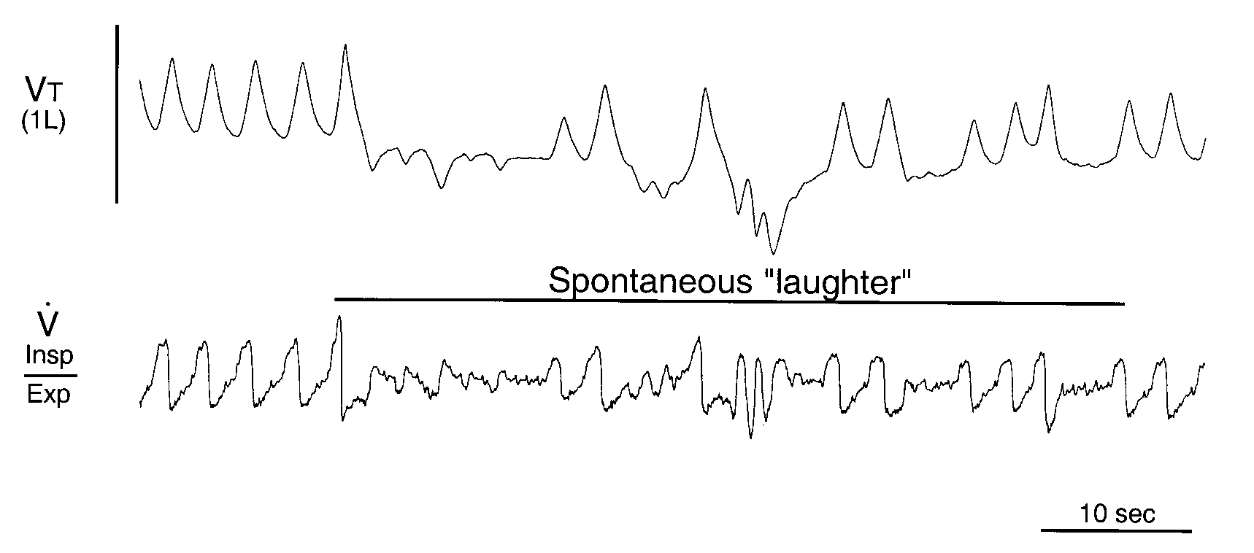
Locked-in Syndrome
(Heywood et al. 1996)

Slide 18
learning objectives (2012)
Part 2 of 3
Locate sources of sensory input to the respiratory control system and describe the common motor outputs.
Describe the ventilatory response to increased arterial PCO2, decreased arterial PO2
To define breathlessness (“dyspnoea”), consider its role in breathing control (lecture 11).
Distinguish the effects on respiratory control of the neurological conditions; ‘locked in’ syndrome and ‘congenital central hypoventilation syndrome’

Slide 19
Control of Breathing (another model)
Respiratory centres
Change in PCO₂/PO₂
Respiratory muscles
Ventilation
Lung inflation

Slide 20
Motor innervation of respiratory muscles
Upper airway muscles
  predominantly via cranial nerves
Pump muscles
  predominantly via the bulbo-spinal tract and spinal nerves

Slide 21
Motor innervation of pharynx and larynx
Cranial nerves
  glossopharyngeal (IX)
  vagus (X)
  spinal accessory (XI)
  hypoglossal (XII)

Slide 22
Motor innervation of pump muscles
Diaphragm
  phrenic nerve
  cervical plexus (C3 - C5)
Intercostal Muscles
  T1 - T12
Abdominal muscles
  T12, L1

Slide 23
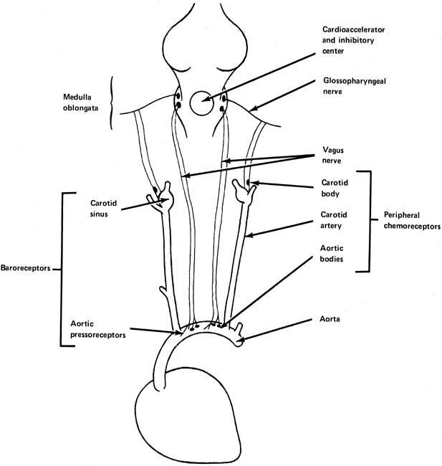
Sensory inputs to the respiratory centre
Peripheral chemoreceptors
  carotid bodies, aortic arch
  pH, PCO₂, hypoxia.
Central chemoreceptors
  located on the surface of the medulla and detect changes in CSF
  PCO₂
  pH

Slide 24
Ventilatory response to inhaled CO₂
Ventilation
(l.min⁻¹)
PACO₂ (kPa)

Slide 25
Ventilatory response to hypoxia
Ventilation
(l.min⁻¹)
PAO₂ (kPa)

Slide 26
Sensory input from:
lungs, airways and chest wall
Nose
  Trigeminal (V)
Pharynx
  Glossopharyngeal (IX) Vagus (X)
Larynx
  Vagus (X)
Lungs
  Vagus (X)
Chest wall
  spinal nerves

Slide 27
The model so far……….
Respiratory centres
Change in PCO₂/PO₂
Respiratory muscles
Ventilation
Lung inflation

Slide 28
learning objectives (2012)
Part 3 or 3
Describe the effect sleep on breathing and blood gases in healthy people
Describe the changes in chemosensitvity that occur during sleep and understand the apnoeic threshold
Explain how the changes in chemosensitivity and the apnoeic threshold led to central sleep apnoea
Describe the influences of sleep on the upper airway which lead to obstructive sleep apnoea
Know one major cardiac, one major respiratory disease that is exacerbated by the sleep-related changes in the control of breathing

Slide 29
Regulation of Breathing
Voluntary/behavioural
Motor cortex
X
Emotional
Reflex/automatic
Limbic system
X
Brainstem
Respiratory muscles

Slide 30
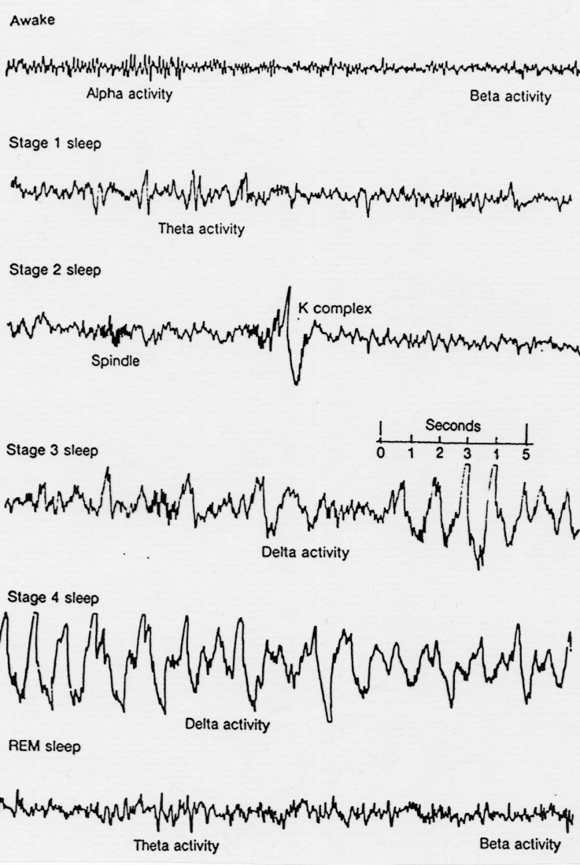
What is Sleep?
Electroencephalogram (EEG)

Slide 31
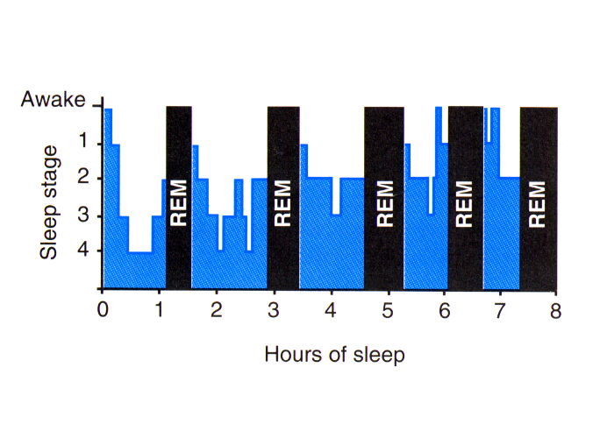
Hypogram in a healthy adult

Slide 32
The model so far……….
Sleep
Respiratory centres
Change in PCO₂/PO₂
Respiratory muscles
Lung inflation
Ventilation
Notes:
The process of sleep affects many aspects of respiratory control
Resp muscles – upper airway and pump muscles
Direct influence on respiratory control centres
Also influences blood gases and chemosensitivity

Slide 33
Breathing during sleep
Measurement Awake Sleep REM
(% Change)
Minute ventilation (l/min) 6.28 5.67 (¯10) 5.44 (¯13)
Alveolar ventilation (l/min) 4.02 3.38 (¯16) 3.21 (¯20)
Frequency (breaths/min) 15.1 15.2 (¯1) 14.9 (¯1)
Tidal volume (V_{T}) 420 373 (¯11) 367 (¯13)
Oxygen saturation (%) 97.3 96.5 (¯1) 96.2 (¯1)
(Stradling et al. 1985)

Slide 34
Oxygen levels when breathing during sleep:
What happens in Lung disease (COPD)?
Changes in SaO₂ with sleep
Lung disease (COPD)

Slide 35
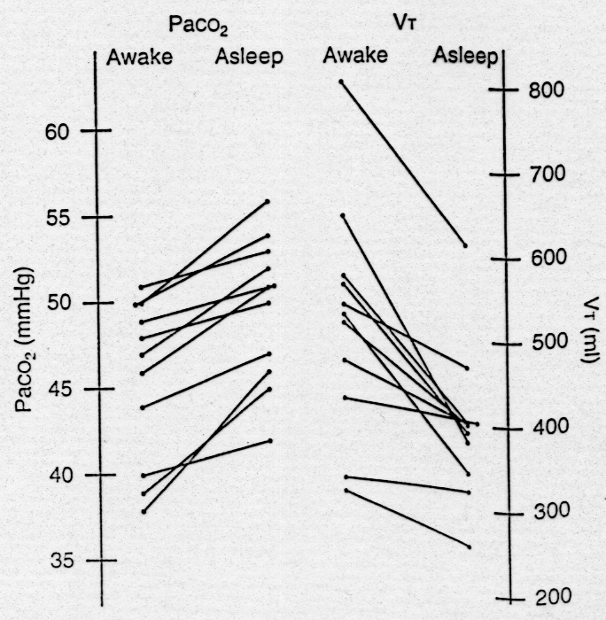
Changes in PaCO₂ During Sleep
(Stradling et al. 1985)

Slide 36
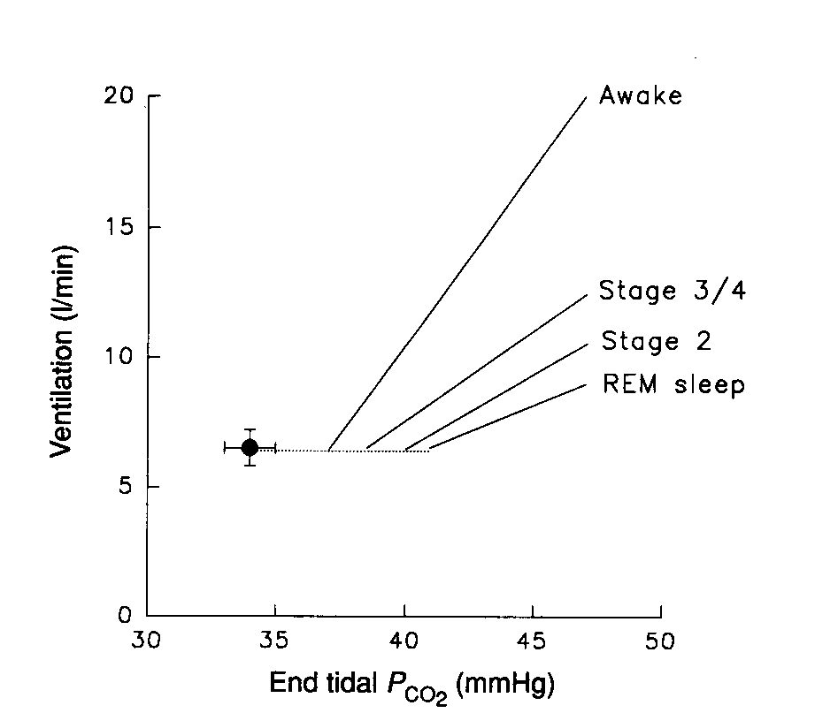
Ventilatory sensitivity to CO₂
Changes in ventilatory Sensitivity to PaCO₂ During Sleep
(Douglas et al. 1983)

Slide 37
Crossing the apnoeic threshold
Asleep
Arousal
Wake / Sleep transition
EEG
EEG
Right eye
Left eye
Chin EMG
Breathing effort
Ribcage effort
Central Sleep Apnoea: HF
Abdominal effort
Oxygen
Saturation
PetCO₂
30 sec
(EEG electroencephalogram, EMG electromyogram)
Notes:
37

Slide 38
The model so far……….
Sleep
Respiratory centres
Change in PCO₂/PO₂
Respiratory muscles
Lung inflation
Ventilation
Notes:
The process of sleep affects many aspects of respiratory control
Resp muscles – upper airway and pump muscles
Direct influence on respiratory control centres
Also influences blood gases and chemosensitivity

Slide 39
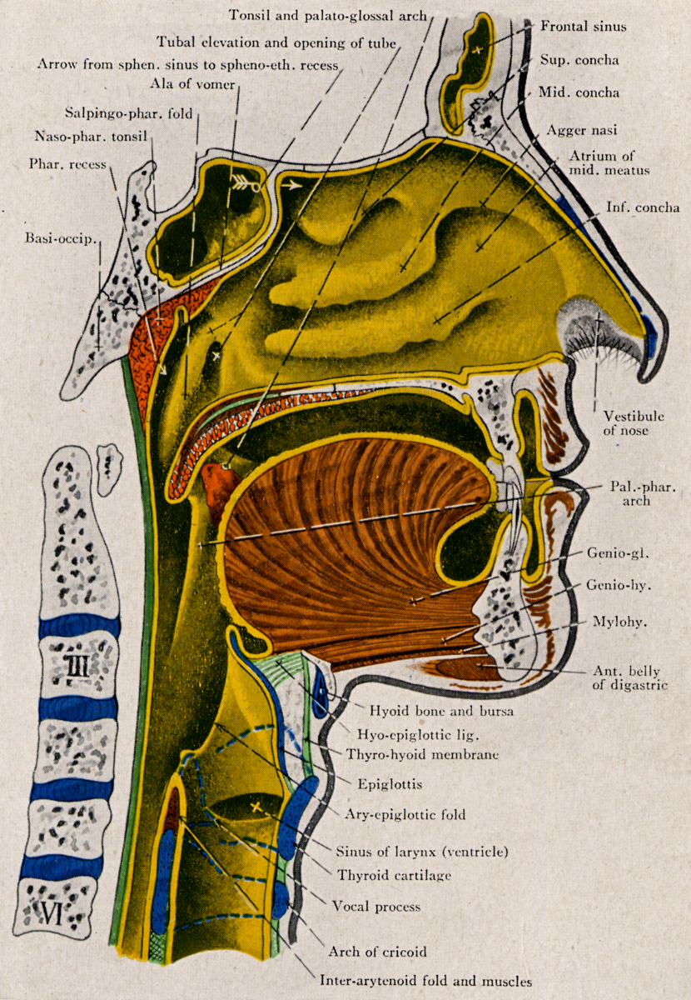
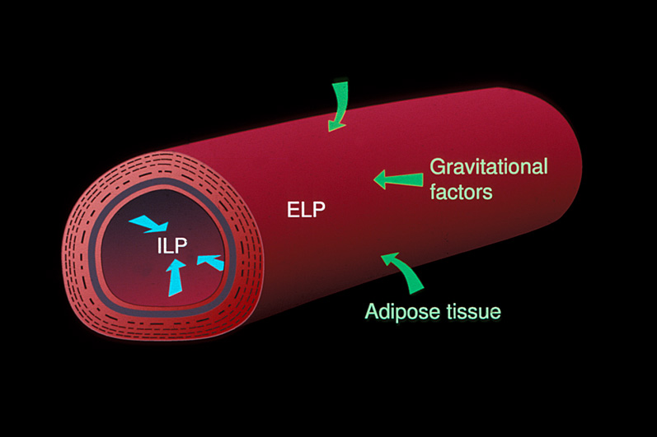
The pharyngeal airway

Slide 40
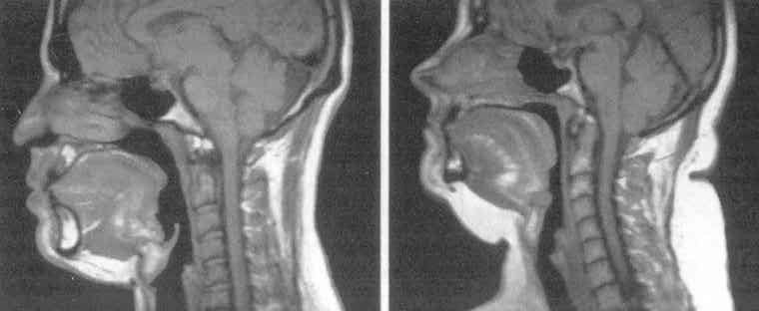
MRI of the pharyngeal airway
The pharyngeal airway
During sleep pharyngeal muscle activity decreases and pharyngeal resistance increases
(Schwab et al. 1995)

Slide 41
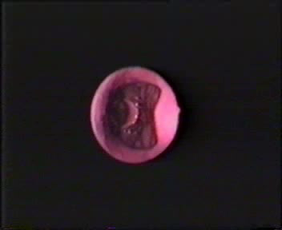
(Morrell et al. 1998)

Slide 42
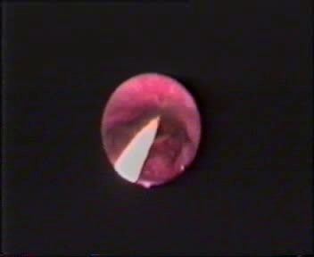
(Morrell et al. 1998)

Slide 43
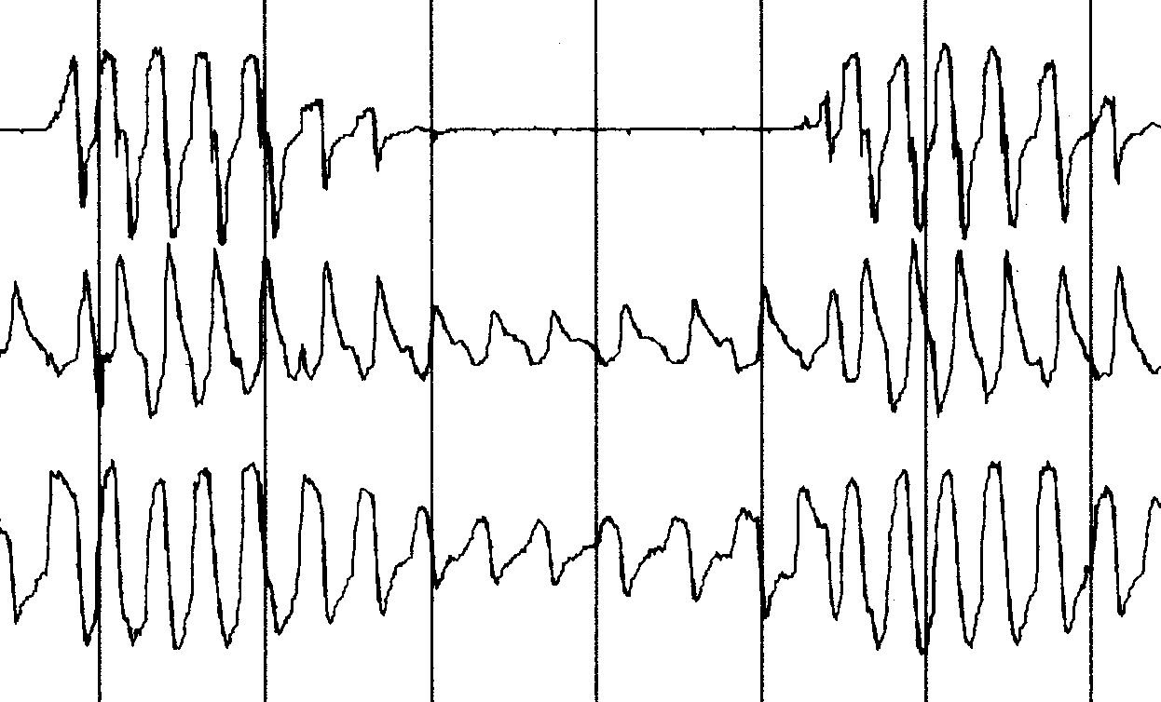
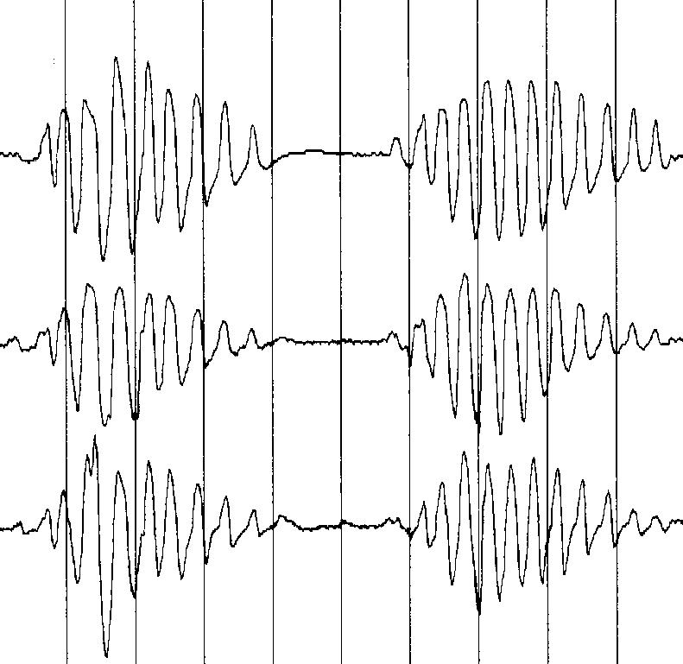
Classification of Sleep Apnoea
Obstructive Apnoea
Central Apnoea
Airflow
Thoracic
Effort
Abdominal
Effort

Slide 44
learning objectives (2012)
Part 1 (3)
Distinguish the primary purpose of the automatic reflex and the behavioural controller
Identify neuronal groups in the brainstem that make up the automatic reflex controller for breathing, and structures in higher brain areas (suprapontine) that drive behavioural (non-automatic) control of breathing. Describe how they can act independently or interact for control of the respiratory pump.

Slide 45
learning objectives (2012)
Part 2 of 3
Locate sources of sensory input to the respiratory control system and describe the common motor outputs.
Describe the ventilatory response to increased arterial PCO2, decreased arterial PO2
To define breathlessness (“dyspnoea”), consider its role in breathing control (lecture 11).
Distinguish the effects on respiratory control of the neurological conditions; ‘locked in’ syndrome and ‘congenital central hypoventilation syndrome’

Slide 46
learning objectives (2012)
Part 3 or 3
Describe the effect sleep on breathing and blood gases in healthy people
Describe the changes in chemosensitvity that occur during sleep and understand the apnoeic threshold
Explain how the changes in chemosensitivity and the apnoeic threshold led to central sleep apnoea
Describe the influences of sleep on the upper airway which lead to obstructive sleep apnoea
Know one major cardiac, one major respiratory disease that is exacerbated by the sleep-related changes in the control of breathing

Slide 47
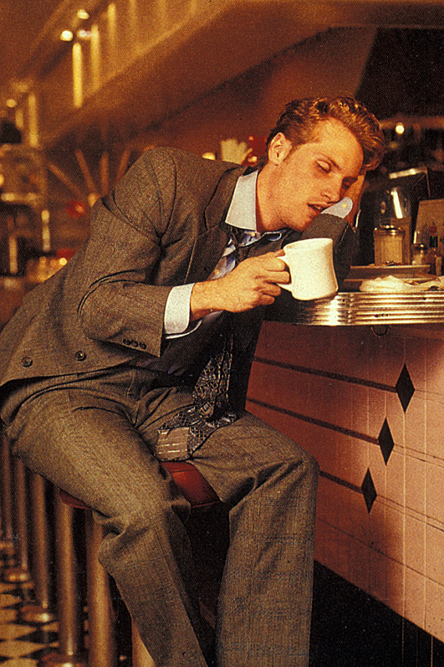
Questions
Questions!

