Slide 1
Airways 2: 2012
Clinical aspects of asthma and COPD
Philip W Ind
Respiratory Medicine
Hammersmith Hospital
NHLI, Faculty of Medicine
Imperial College London, UK

Slide 2
Asthma, COPD and airflow obstruction
Asthma vs COPD clinically
Importance of these conditions
Diagnosis
Asthma ‘triggers’
Bronchodilator response
Airway hyper-responsivenesss
Sputum eosinophilia and neutrophilia
Asthma-COPD overlap
Practical management
Introduction to Guidelines for asthma and COPD

Slide 3
ASTHMA in Britain
5.2 million in Britain ↑prevalence 8-fold in 30 y
1.1 m children (1:5) 1 admission every 18 min
4.1 m adults (1:12)
1381 deaths in 2004 including 40 children <14 y
2.6 m severe asthma symptoms 1:6
430,000 weekly attacks ‘too breathless to speak’
0.5 m severe asthma despite Rx
Costs £889 m per year
12.7 million working days lost /year

Slide 4
Asthma epidemiology
>300 million people world-wide
>£15 billion/y in Europe
10-fold difference in prevalence in different countries eg UK vs Indonesia/Albania ‘Western life-style’
low prevalence in rural areas (farm animals, unpasteurized milk)
large family size, house-hold pets in urban areas -protective
‘hygiene hypothesis’
boys > girls, women >men
severe asthma ~5% costs, morbidity, mortality
‘difficult to treat’

Slide 5
ASTHMA
typically young atopic individuals (‘extrinsic’)
but also older non-atopic patients (‘intrinsic’)
in both family history
rhinitis
variable symptoms (effect of ‘triggers’)
airflow obstruction (β2 reversibility)
hyper-responsive to various stimuli
characteristic airway inflammation
corticosteroid responsive

Slide 6
Asthma Genetics
complex >100 genes implicated IgE, BHR, eos (non-repeatable)
twin studies heritability 0.36-0.77 ~50% environmental
positional cloning ADAM33, PHF11, DPP10, GRPA, SPINK5
candidate genes TLRs, epithelium, beta2 receptor, Th1, Th2, cytokines eg IL4, IL5, IL13, T factors, GATA 3, STAT6, FCERIB
>20 GWAS studies childhood- severe asthma 2007-2012
early onset ORMDL3, GSDML chr 17q21 signal
PDEAD chr 5q12, DENNDIB chr 1q31
late onset MHC genes

Slide 7
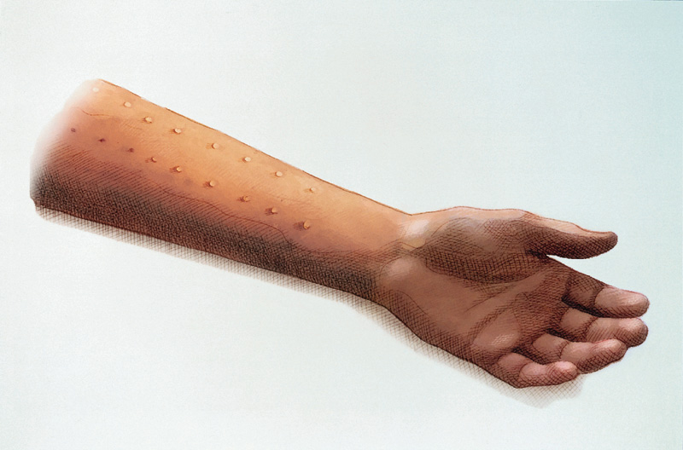
Atopy: eczema, hay fever, asthma
increased IgE
Skin prick test
serum total IgE
specific IgE RAST
Notes:
Skin prick tests are relatively painless and the puncture sites do not usually bleed
The larger the size of weal induced in a positive response, the greater the significance that particular inhaled allergen is likely to be to that individual patient
Allergens are selected for testing based on the patient’s history of sensitivities
Many asthmatic patients give a positive skin prick test to a number of allergens, all of which may contribute to their condition
Skin prick tests should be performed only where adrenaline and resuscitation facilities are readily available, even though the risk of anaphylaxis is very low

Slide 8
Asthma Syndrome
Airflow obstruction
Bronchial
Responsiveness
Symptoms
inhaled
steroids
β₂ agonists
Airway
Inflammation
Long acting
β₂ agonists
LTRAs
PDE4 etc
risk factors or triggers

Slide 9
ASTHMA PATHOPHYSIOLOGY
Allergen
Macrophage/
Dendritic cell
Mast cell
Th2 cell
Neutrophil
Eosinophil
Mucus plug
Epithelial shedding
Nerve activation
Subepithelial
fibrosis
Plasma leak
Oedema
Sensory nerve
activation
Mucus
hypersecretion
Vasodilatation
Cholinergic
reflex
hyperplasia
New vessels
Bronchoconstriction
Hypertrophy/hyperplasia

Slide 10
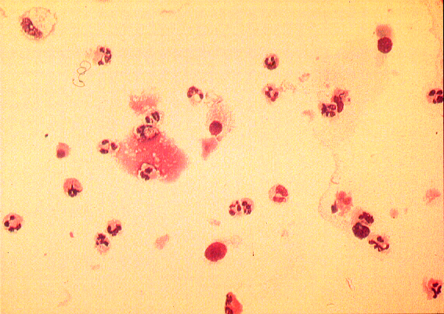
Eosinophils sputum, induced sputum
BAL, bronchial biopsy

Slide 11
Heterogeneity of asthma
gender females >males at steps 3 & 4
age (duration of disease)
obesity
atopy
smoking
aspirin-induced asthma
occupational asthma
eosinophilic vs non-eosinophilic
β₂ polymorphisms ¹⁶gly ↑ downregulation
mixed disease: asthma/COPD overlap
+ severity
Notes:
11

Slide 12
Asthma symptoms
wheeze
breathlessness
chest tightness
cough (phlegm)
nocturnal and early morning symptoms
VARIABILITY

Slide 13
Asthma triggers
URTI
house dust
pollen
animal fur
non-steroidals
food/fizzy drinks
occupational exposure
periods
exercise
cold air
change in weather
pollution -car fumes
-cig smoke
perfume, deoderant etc
laughing
stress

Slide 14
Diagnosis of asthma
typical symptoms
atopic ‘background’
reversible airway narrowing
bronchodilator response ↑PEF >20% after salbutamol
or ↑FEV₁ >12% (>400 mL)
bronchial challenge ↑response to metacholine, histamine, exercise
↓ provocative concentration (PC₂₀)
airway inflammation ↑eosinophils in sputum (induced), BAL etc

Slide 16
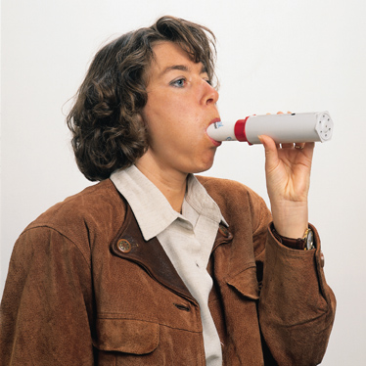
Peak flow measurement
measure best of 3
on waking in AM
in the evening
at time of symptoms
before and after ‘reliever’
compare AM and PM
‘diurnal variation’
Notes:
The most simple test of respiratory function is a measurement of Peak Expiratory Flow (PEF), which is the maximum airflow achieved when an individual exhales as hard and fast as possible, after first taking a full deep breath
The ‘best of three’ PEF measurements is compared with the normal predicted for that individual based on age, height and sex
PEF measurements are particularly valuable in long-term follow up
Home PEF recordings can be taken using one of a variety of inexpensive, portable devices
To make a reliable assessment of long-term control of asthma, it is important for the patient to consistently use the same device

Slide 17
BTS Guidelines for asthma therapy
STEP UP
but also
STEP
DOWN
‘anti-inflammatory’
‘reliever’

Slide 18
Inhaled corticosteroids: cornerstone of asthma Rx
#lung function
$symptoms, #QoL, $β₂ rescue
$bronchial responsiveness
$FEV₁ decline
$Ag-induced bronchoconstriction
$asthma exacerbations
$emergency and A&E visits (? $deaths)
$airway inflammation
? prevent lung damage
delayed introduction may reduce overall benefit

Slide 19
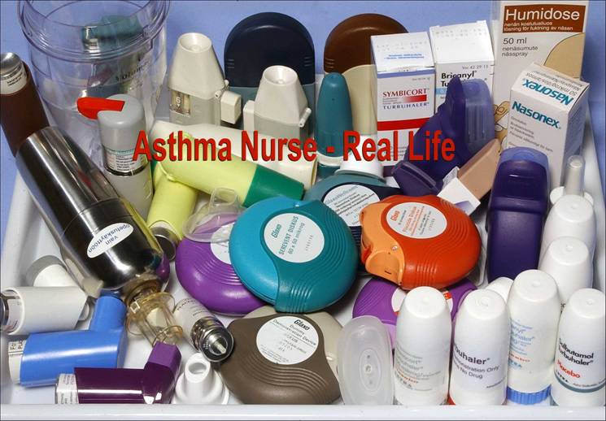
NO ideal inhaler device for every patient

Slide 20
ICS/LABA + Combination therapy
ICS beclometasone, budesonide, fluticasone,
ciclesonide, mometasone
improve symptoms, lung function, quality of life
reduce exacerbations
LABA salmeterol, formoterol, indacaterol
improve FEV₁, symptoms, QoL
reduce exacerbations
Combinations logical, convenient, cheaper
may enhance compliance
prevent differential non-compliance

Slide 21
also MDI Evohaler
2 puffs bd 50/25, 125/25, 250/25
Seretide^{R} Accuhaler (Diskus)

Slide 22
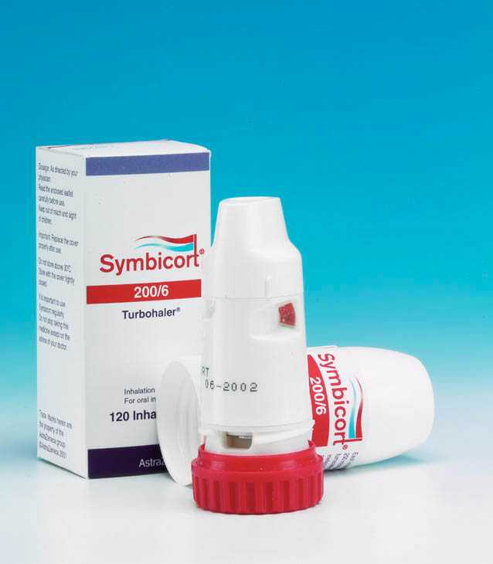
Symbicort® Turbohaler®
100/6, 200/6, 400/12
1-2 puffs BD
also SMART
1-2 puff BD + PRN

Slide 23
Leukotriene antagonists in asthma
effective in mild asthma
particularly NSAID-induced asthma
modest effects in more severe asthma
useful for nasal allergy (with asthma)
oral, well tolerated
few adverse effects
differential use in different countries

Slide 24
THEOPHYLLINE
oral bronchodilator (large and small airways)
anti-inflammatory plasma exudation
non-specific neutrophils, T cells
phosphodiesterase macrophages
inhibitors # mucociliary clearance
beneficial effects on respiratory muscles
heart failure
BUT poorly tolerated, variable pharmacokinetics
drug and other interactions

Slide 25
ASTHMA: delivery of care
specialist respiratory nurses to increase concordance
understand diagnosis and need for treatment
understand drugs
able to use inhalers
able to monitor condition
able to manage condition ‘management plan’
able to access emergency care

Slide 26
Systematic approach to severe asthma
establish diagnosis
?co-morbidities
?adherence
discrepant symptoms exaggerated
BD response, PEF variation
BHR histamine/MCh
inflammation -sputum/BAL
HRCT bronchiectasis
GORD
sinus disease (~100%)
vocal cord dysfunction
scrip ‘filling’
blood assay theophylline
(prednisolone)
breathing pattern
physiotherapy
PSYCHOLOGICALINTERVENTION

Slide 27
Acute severe asthma
immediate R_{x} ongoing assessment
reassurance history, prev episodes
oxygen -high flow ITU, adm, A&E, steroids
high dose inh/neb salbutamol 2.5 mg + repeat heart rate, resp rate
oral prednisolone or IV hydrocortisone PEF (prev best/usual)
high dose inh/neb ipratropium SpO₂
IV Mg⁺⁺ hydration, replace K⁺ PaCO₂
consider IV aminophylline (IV salbutamol) serial observations
ITU mechanical ventilation LIFE SAVING (rare)

Slide 28
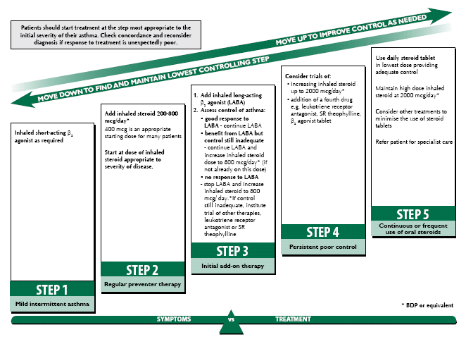
Adults
Conventional management
symptoms esp at night, PEF, inh reliever use, daily activities
Advanced management
Conventional + inflammometry
sputum eos or exh NO
Notes:
28
Reference
British Thoracic Society, Scottish Intercollegiate Guidelines Network. British Guideline on the Management of Asthma: A National Clinical Guideline. Revised Edition, 2008.

Slide 29
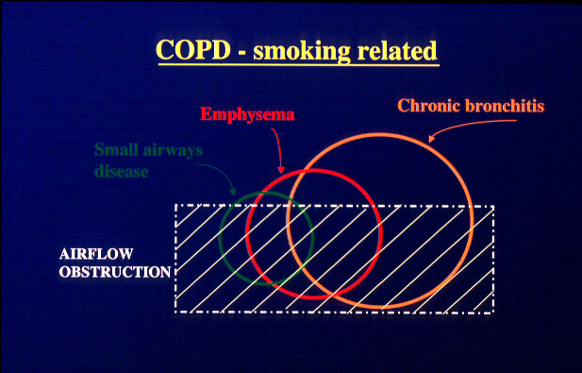
COPD + other causes of Airflow Obstruction
COPD
Misc: bronchiectasis, bronchiolitis

Slide 30
COPD: DEFINITIONS
Chronic obstructive pulmonary disease (COPD) is a disease state characterized by airflow limitation that is not fully reversible. The airflow limitation is is usually both progressive and associated with an abnormal inflammatory response of the lungs to noxious particles and/or gases.
chronic bronchitis chronic productive cough
emphysema destruction of alveolae
airflow obstruction ↓ FEV₁/VC
hyperinflation
reduced diffusing capacity ↓ kCO low attenuation areas on CT
small airways disease bronchiolitis
mixed spectrum of disease cigarette smoking-related
asthma/bronchitis chronic (incompletely reversible) asthma

Slide 31
COPD –importance in the UK
most common respiratory disease in UK [200 patients / GP]
4th leading cause of death (↑to 3rd by 2030)
30,000+ deaths/y (↑women die from COPD >CA breast)
prevalence ~1 million [but under-diagnosed ‘missing millions]
~10% hospital admissions (2nd largest cause, 40% total costs)
10-15% die within 3/12 of hospital admission
costs ~£1billion/y in UK [twice asthma]
often undiagnosed [~50% ‘missing millions’]
largely preventable [90% due to smoking]

Slide 32
COPD: world-wide impact
>500,000/y COPD hospitalizations in US
causes 22.6% male deaths aged 30-69 y in China
9.3% female deaths
emerging importance in India
currently ~1.1 billion smokers world-wide
increasing to 1.6 billion by 2025 (WHO)
by 2020 3rd most common cause of death (6th currently)
      6th most common disease (12th)

Slide 33
Pathogenesis of COPD
NOXIOUS AGENTs
(tobacco smoke, pollutants, occupational exposure)
COPD
Genetic factors
Respiratory infection
Other FH, BW, diet
protease/anti-protease
imbalance
oxidative stress

Slide 34
Risk factors for COPD
unknown
SMOKING
age
males > females
pollution - particulates
occupation - coal, Au, Cd mining
low socioeconomic status
low birthweight (Barker)
“allergy”
diet
recurrent infections
homozygous α₁ anti-trypsin deficiency

Slide 35
COPD: pathogenesis
approx 1:5 smokers (~5% Asians)
accelerated decline in lung function ? cause
α₁anti-trypsin deficiency recesssive inheritance
1% of all COPD
PiZZ phenotype <10% normal levels (342Glu → Val)
early emphysema in smokers
PiSZ 60% normal levels -?some increased risk
PiMZ 65% normal -? some increased risk
genetics CHRNA3/5, HIPP

Slide 36
Symptoms in COPD
shortness of breath -progressive
exercise/lifestyle limitation
cough+/- phlegm
difficulty producing phlegm
wheeze
chest tightness
nocturnal or early morning symptoms

Slide 37
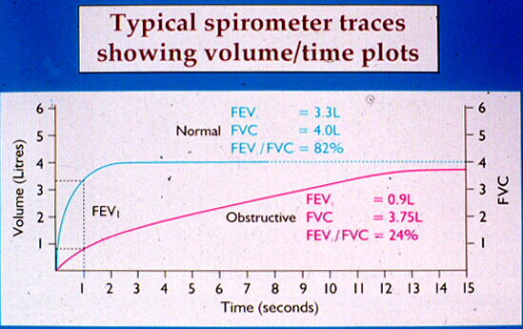
Spirometry in diagnosis of COPD
smoker, older >40 y, men >women
recurrent productive cough, ‘winter bronchitis’

Slide 38
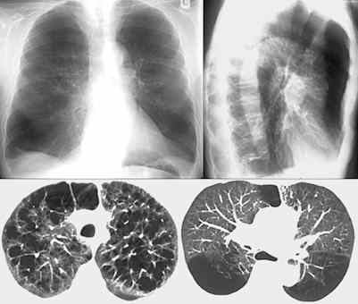
Emphysema

Slide 39
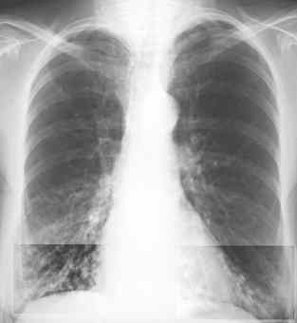
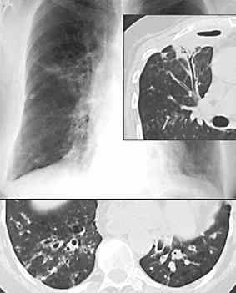
Bronchiectasis

Slide 40
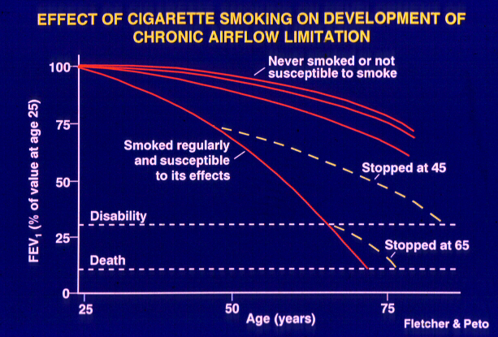

Slide 41
COPD co-morbidities
related to smoking ischaemic heart disease
lung cancer
peripheral vascular disease
osteoporosis
other DM
metabolic syndrome (obesity+
hypertension + hyperlipidaemia)
psychiatric anxiety + depression
cognitive dysfunction
systemic features weight loss, cachexia
arterial stiffness

Slide 42
BTS/NICE Guidelines:Treatment of COPD
Level I bronchodilators (anticholinergic or β₂-
agonist)
trial of inhaled steroid if asthma features
Level II inhaled steroids (for FEV₁ <50%)
+ long-acting bronchodilators
+ theophylline
Level III Pulmonary rehab
trial of nebulised bronchodilators
consider LTOT
Surgery???
Levels I-III STOP SMOKING

Slide 43
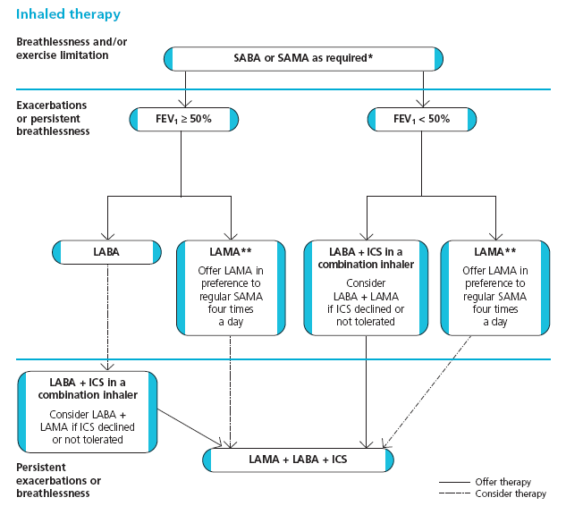
Updated NICE COPD Guideline – June 2010

Slide 44
Treatment of COPD
nicotine replacement
bupropion
varenicline

Slide 45
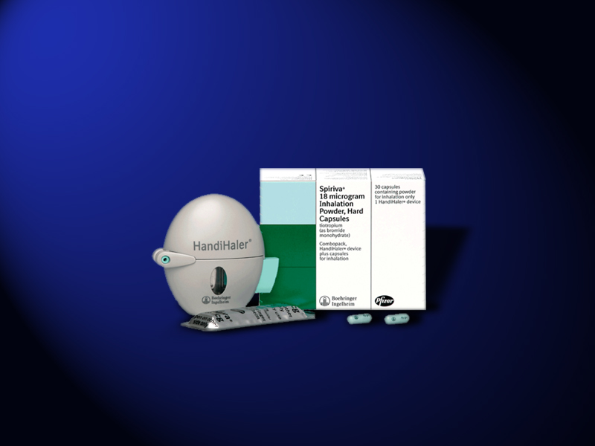
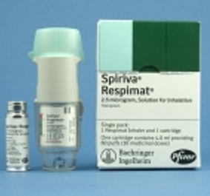
Tiotropium bromide
once daily inhaled cholinergic M3 receptor antagonist
vs placebo ↑ lung function ↑quality of life ↑exercise endurance
ipra 40 μg qds ↓breathlessness ↓hyperinflation
↓ exacerbations (↓hospitalisations over 12 months

Slide 46
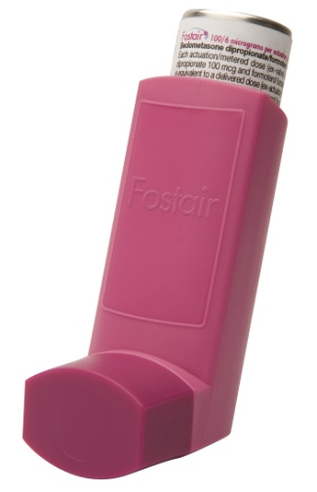
Combination ICS/LABA therapy in COPD
LABA improve FEV₁, symptoms, HRQL
reduce exacerbations
ICS improve symptoms, decline in HQRL
reduce exacerbations
Combinations logical, convenient, cheaper
may enhance compliance
prevent differential
non-compliance
Accuhaler + MDI

Slide 47
Acute exacerbations of COPD
immediate R_{x} ongoing assessment
reassurance history, prev episodes
oxygen –CONTROLLED usual exercise tolerance
high dose inh/neb salbutamol 2.5 mg ITU, adm, A&E, steroids
+ inh/neb ipratropium 0.5 mg heart rate, resp rate
+ repeat SpO_{2,} PaO₂ PaCO₂
antibiotics PEF (prev best/usual)
oral prednisolone or IV hydrocortisone ECG, CXR
IV hydration, replace K⁺ serial observations
consider diuretics, IV aminophylline
Non-invasive ventilation life-saving (not unusual on specialist wards)

Slide 48
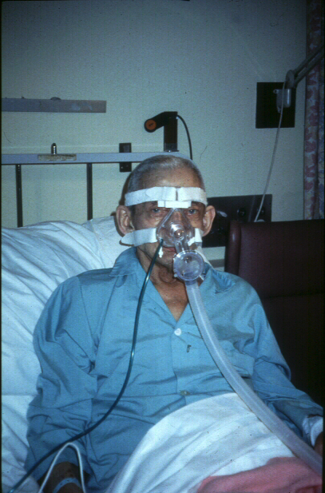
NIV
non-invasive
ventilation
↑ gas exchange
normalises
breathing
↓ diaphragm
activity
↑ pH in 1 h
↓ dyspnoea
↓ mortality
↓ intubation
↓ duration of V
↓ ITU

Slide 49
Other treatments in COPD
oxygen
pulmonary rehabilitation in severe COPD
nasal ventilation in exacerbations
end of life (palliative care)
mucolytics carbocystine, bromhexol, erdosteine
anti-oxidants N-acetyl cysteine
antibiotics prophylactically
(opiates eg morphine, DFII8)
(anxiolytics)
(GH, testosterone)

Slide 50
Comparisons of asthma & COPD
Asthma
CD 4⁺ lymphocytes
eosinophils
mast cells
airflow obstruction
varies over time
& with treatment
hyperinflation acutely
normal gas transfer
COPD
CD 8⁺ lymphocytes
macrophages
neutrophils
airfow obstruction
persistent and progressive over time
hyperinflation in emphysema
reduced gas transfer
may be hypoxic drive
  Patho-physiology: chronic inflammation
physiology
SEVERE asthma resembles COPD
Notes:
COPD differs from asthma in both the type of inflammation involved and in the pattern of respiratory symptoms caused

Slide 51
COPD and Asthma
chronic bronchitis
emphysema
small AW disease
Asthma population
COPD population
~10-20% of patients have both conditions
OVERLAP
Notes:
Out of every 10 people with a diagnosis of either asthma or COPD, one will actually have features of both diseases

Slide 52
Treatments common to Asthma + COPD
beta₂ agonist relievers (anticholinergics in COPD)
inh steroids (in more severe COPD)
long-acting beta2 agonists (tiotropium in COPD)
inhaled combinations (ICS/LABA)
theophylline in severe disease (roflumilast in COPD)
tiotropium in uncontrolled asthma
prednisolone for exacerbations
miscellaneous
omalizumab (anti-IgE in allergic asthma)
[thermoplasty]

Slide 53
Summary 1
Airway obstructive diseases are common
Asthma is common in young, atopic people but occurs at any age
COPD in smokers almost exclusively
Asthma & COPD can co-exist
inhaled therapy preferred as far as possible
-a multitude of inhaler devices
Asthma Nurse specialists important in management esp in 1⁰ care
Self Management Plans in asthma (also in COPD)
short acting beta2 agonists as ‘reliever’ bronchodilators
inhaled steroids in asthma and more severe COPD

Slide 54
Summary 2
long-acting beta2 agonists (LABAs) in asthma and COPD
combination ICS/LABA inhalers in widespread use in asthma + COPD
long-acting antimuscarinic (LAMA) tiotropium (Spiriva) in COPD
tiotropium also in uncontrolled asthma
anti-leukotrienes effective in mild asthma
theophylline effective in severe asthma and COPD
anti-IgE (omalizumab) in very selected, severe allergic asthma
Respiratory Nurse specialists and integrated care evolving
exacerbations of asthma + COPD common
severe exacerbations of asthma + COPD common, life-threatening
require hospital management

