Slide 1
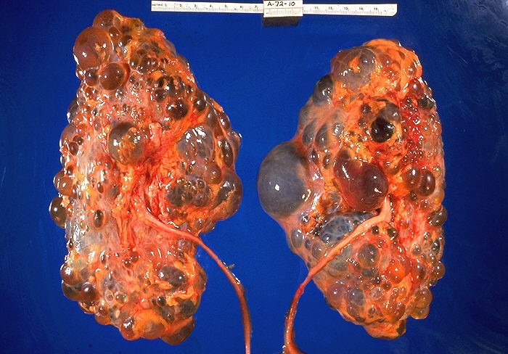
When the kidneys are lost
Damien Ashby

Slide 2
kidney functions
oedema
fluid compartment volumes
ECF Na
ICF H₂O
electrolyte balance
K
pH
excretion of metabolic wastes
urea
loads of others
hormones
erythropoietin
vitamin D
high K
nausea
pericarditis
encephalopathy

Slide 3
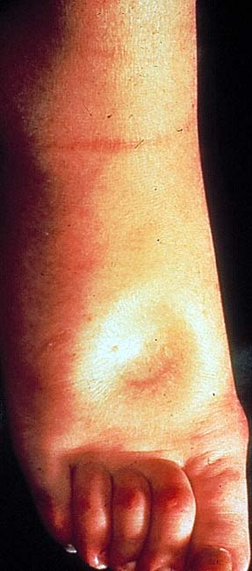
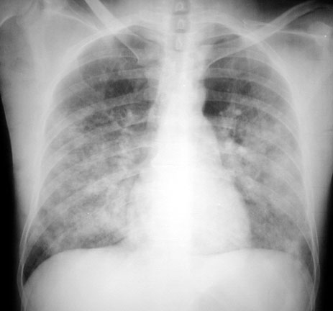
fluid overload
peripheral oedema
pulmonary oedema

Slide 4
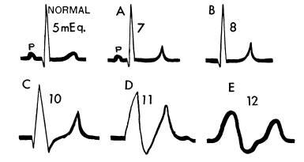
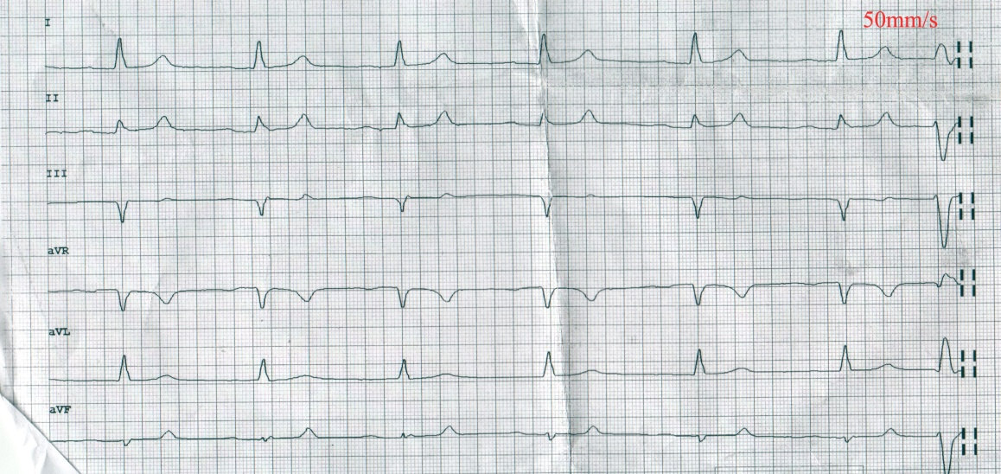
hyperkalaemia
tall T waves
loss of P waves
broad QRS
bradycardia

Slide 5
renal replacement therapy
filtration
dialysis
transplant

Slide 6
home HD
1.1
hospital HD
25.2
transplant
46.6
satellite HD
16.9
automated PD
4.2
manual PD
6.0

Slide 7
UK Renal Registry 11th Annual Report

Slide 8
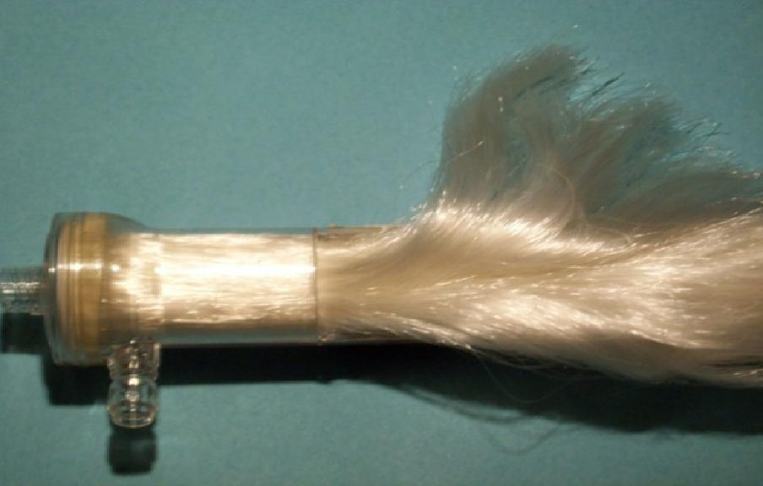
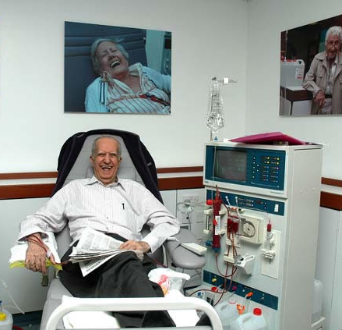
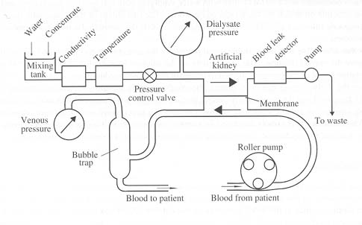
haemodialysis

Slide 9
question 1
which of the following does your dialysis nurse need to know to decide how much fluid to remove?
A
B
C
D
E
how swollen the patient’s ankles are
the patient’s blood pressure
how much fluid the patient has drunk
the patient’s weight
the patient’s plasma sodium

Slide 10
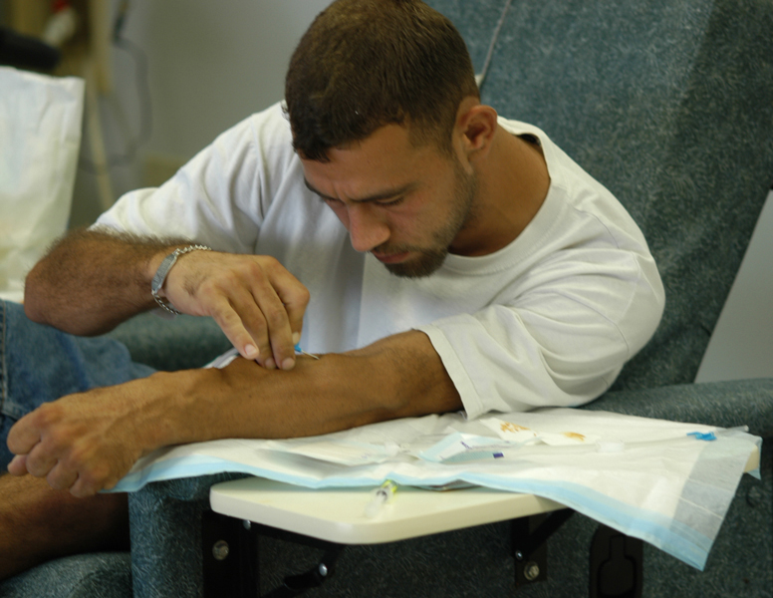
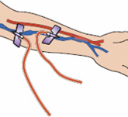
haemodialysis access
fistula
line

Slide 11
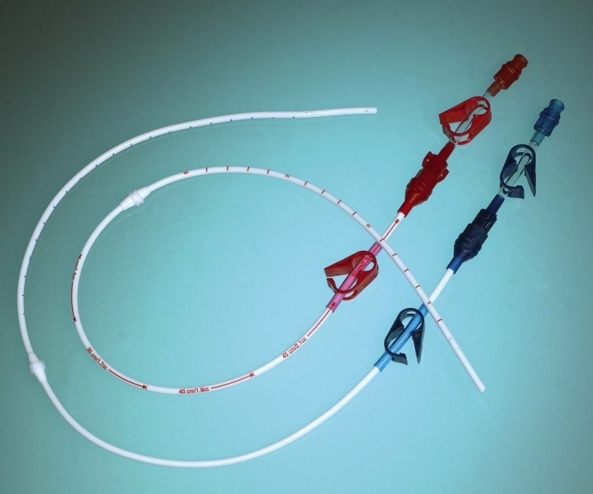
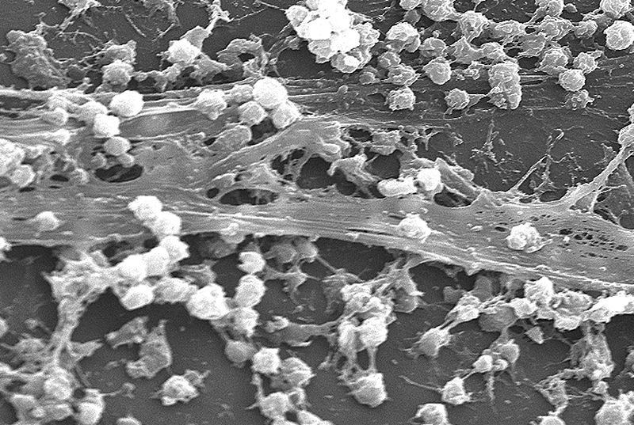
dialysis “line”

Slide 12
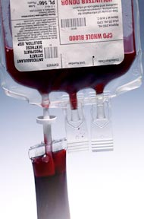
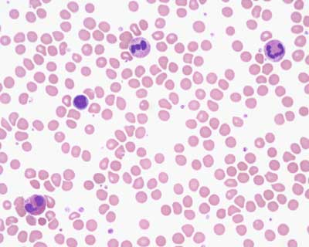
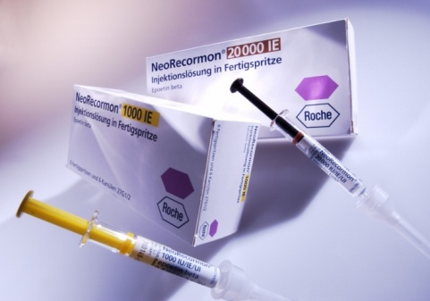
anaemia

Slide 13
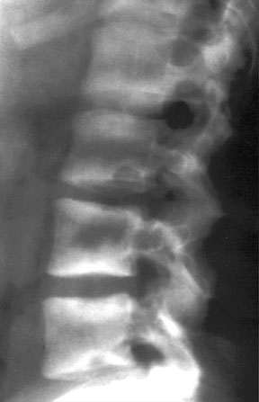
bone disease

Slide 14
UK Renal Registry 11th Annual Report

Slide 15
UK Renal Registry 11th Annual Report

Slide 16
UK Renal Registry 11th Annual Report

Slide 17
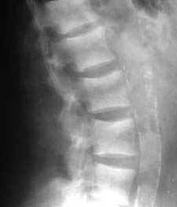
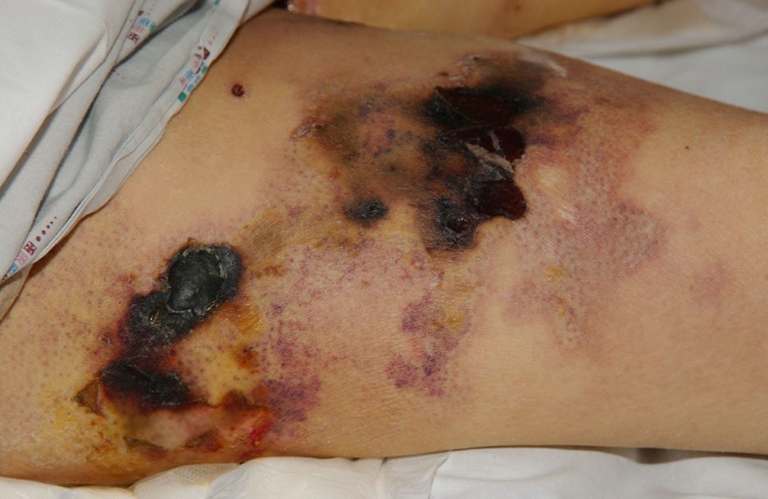
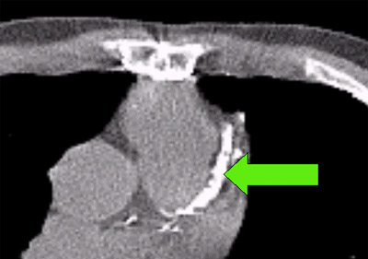
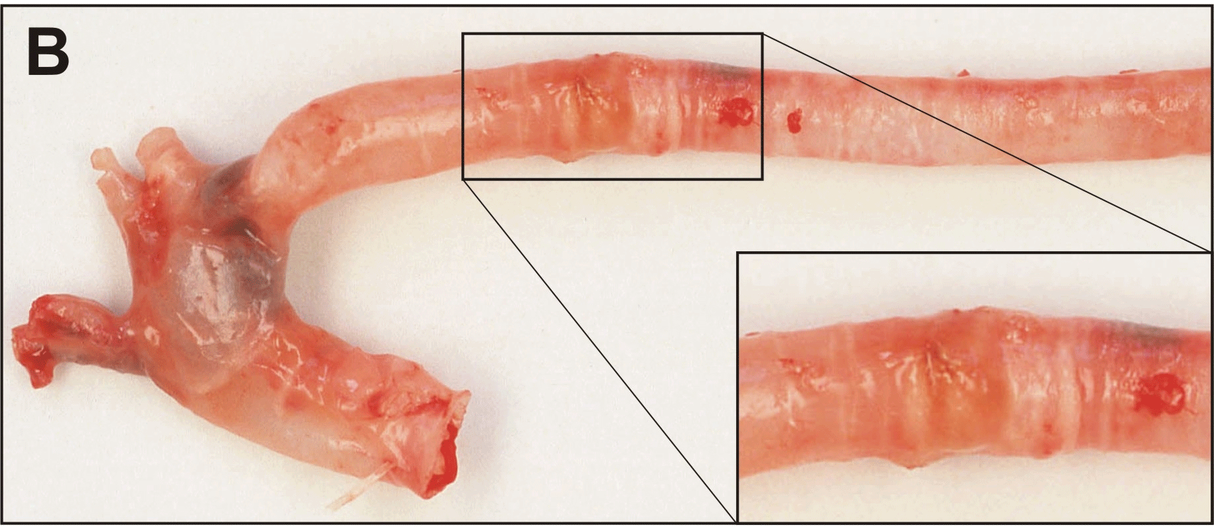
cardiovascular disease
Notes:
So why is it better for dialysis patients to be fat and have high cholesterol?
Quite a likely explanation, is that the cardiovascular disease found in dialysis patients is a different disease process from that found in most people
And it does have strikingly different characteristics, with prominent arterial calcification and often low grade inflammation
These CT scans show extensive coronary and aortic calcification.

Slide 18
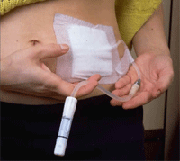
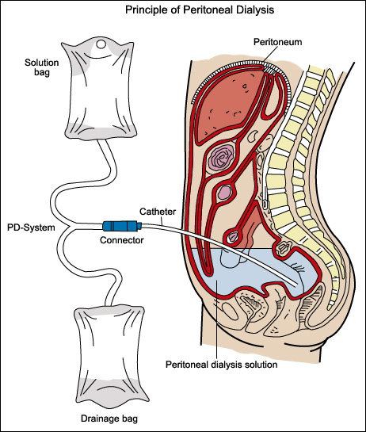
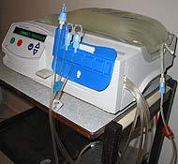
peritoneal dialysis

Slide 19
mortality

Slide 20
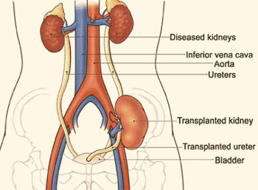
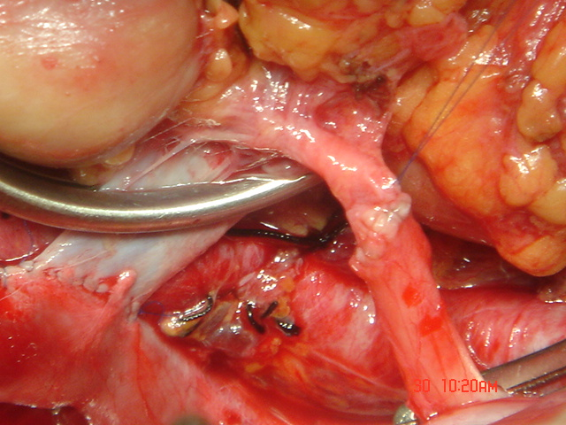
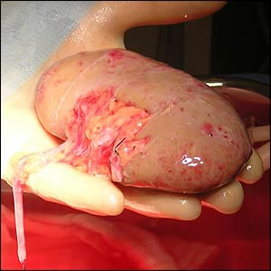
transplantation

Slide 21
UK Renal Registry 11th Annual Report

Slide 22
immune suppression
corticosteroids
calcineurin inhibitors cyclosporine
tacrolimus
antiproliferative agents azathioprine
mycophenolate
monoclonal antobodies IL-2R daclizumab
CD52 alemtuzumab

Slide 23
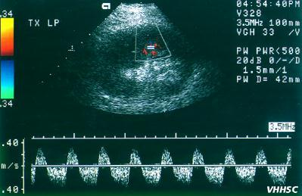
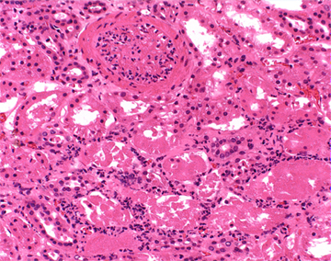
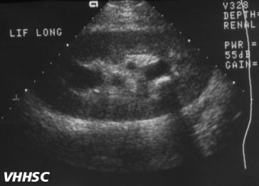
complications - early
vein thrombosis
ureteric obstruction
rejection

Slide 24
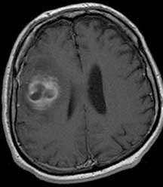
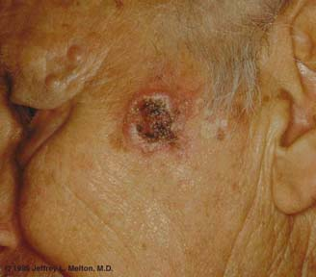
complications - late
infections
CMV
fungal
cancers
skin
lymphoma
chronic graft failure

Slide 25
UK Renal Registry 11th Annual Report

Slide 26
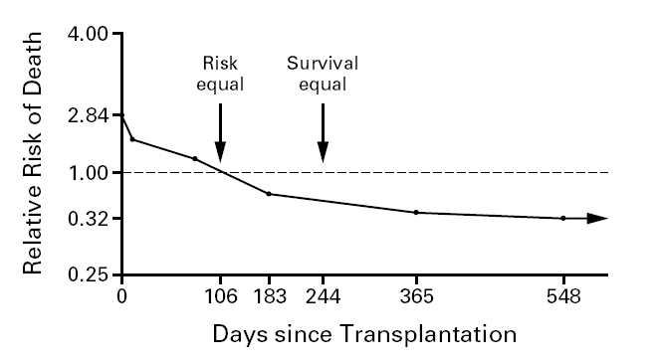
outcome

Slide 27
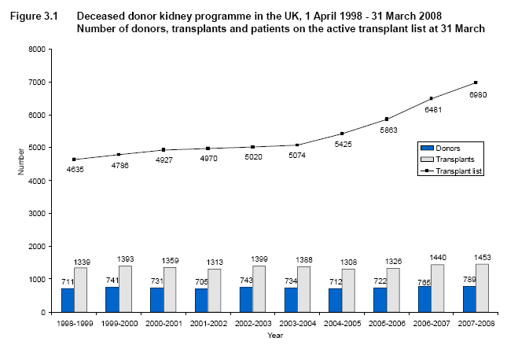
deceased donors

Slide 28
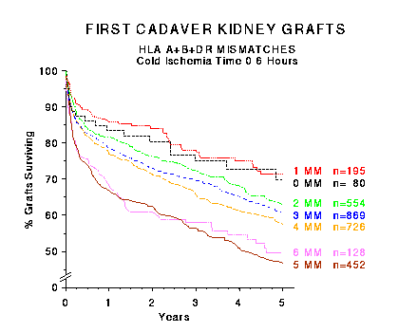
tissue typing

Slide 29
waiting time

Slide 30
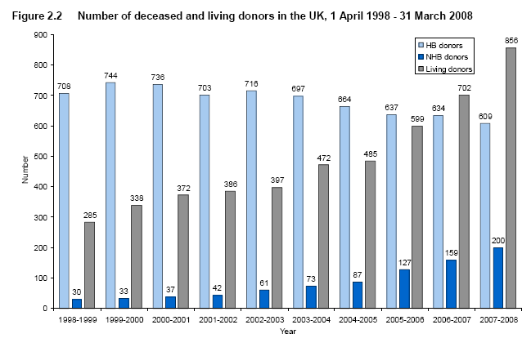
living donors

Slide 31
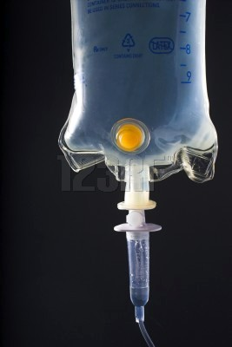
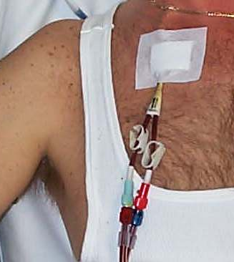
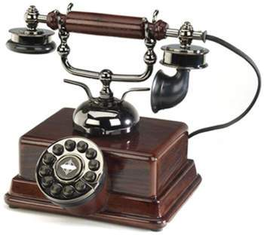
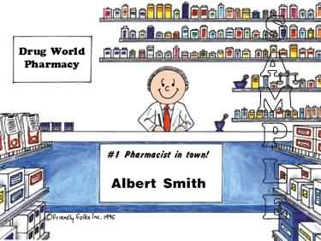
do’s and don’ts
don’t prescribe IV fluids to dialysis patients
don’t use dialysis access devices for anything
do discuss patients with their renal unit
do check drug doses with your pharmacist

Slide 32
summary
life without kidneys is possible, but…
must be planned
changes lifestyle
affects other organs
affects family members
shortens life expectancy
…is best avoided!

