Slide 1
Renal blood flow and regulation
Dr Anisha Tanna
Clinical Research Fellow in Nephrology
Imperial College London
GEP – Renal, Jan 13th 2011

Slide 2
Intoduction
Kidney is central to the circulatory system
It has complex autoregulatory mechanisms to protect its blood supply
If these fail, the glomerular filtration rate declines and you know the patient is in trouble

Slide 3
The kidney and the pumped circulation
Animals too big to supply their cells by diffusion have evolved a pumped circulation
This allows oxygen and nutrients to reach the whole body and allows removal of waste
The primary function of the kidney is to regulate the composition and quantity of the blood
This requires SENSING and EFFECTOR mechanisms

Slide 4
The kidney controls whole blood volume and composition
Controls red blood cell production
Secretion of the hormone erythropoietin
Maintains volume of isotonic fluid in the circulation (ie plasma volume)
Excretion of sodium and water
Maintains composition of plasma
Excretion of acid and other electrolytes/substances
Achieved without loss of protein
Plasma
Red blood cells

Slide 5
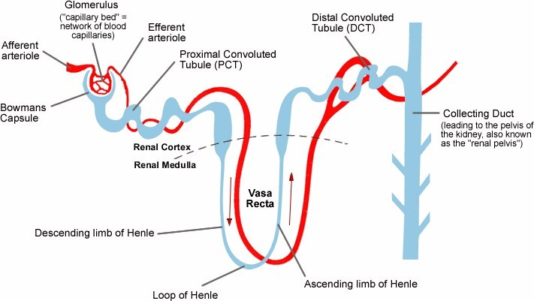
Nephron structure
High pressure vessels
Low pressure vessels
Renal cortex
Renal medulla
Renal blood flow is mainly regulated through the effects
on the proximal capillary system (High pressure)

Slide 6
Total renal blood flow is huge
0.5% body mass receiving >20% of cardiac output
~ 1.2 L/min
Cortex – 90%
Medulla – 10%
Renal Perfusion – one of the highest values/organ in the body
0.4 – 0.7 mL/min per g tissue
To ensure:
Adequate blood filtration
Effective active processes involved in fluid manipulation (absorption, secretion, excretion)

Slide 7
Blood flow regulation: Poiseuille’s Equation
P₁
P₂
R
Blood flow regulation is achieved mainly by alterations in vessel diameter

Slide 8
Modifiable parameters
Arterial blood pressure
Renal vascular resistance

Slide 9
Regulation of arterial blood pressure
Systemic vascular resistance
Cardiac output
Blood volume

Slide 10
Regulation of systemic vascular resistance
Neurohormonal mechanisms
Sympathetic and parasympathetic tone (in acute setting)
Other vasoactive hormones
Nitric Oxide
Bradykinin/Prostaglandins
Angiotensin II
Disease states
Arterio-venous shunting
Vasodilation (eg bacterial endotoxin release)
Reduced blood pressure provokes systemic vasoconstriction

Slide 11
Endothelial derived Nitric Oxide
Produced by endothelium
Causes vasodilation: decreases vascular resistance
Systemically: reduces blood pressure
Locally: Maintains renal blood flow
Maintains basal state of vasodilatation in health
Lost in presence of vascular inflammatory diseases
Smoking
Hypertension
Hypercholesterolemia
Diabetes
Systemic inflammatory conditions
Reactive oxygen species production

Slide 12
Other vasoactive substances
Prostaglandins
Vasoactive autocoids synthesized from fatty acids by Cyclooxygenase
Inhibited by NSAIDs
Most are vasodilators
Bradykinin
Peptide which stimulates NO and prostaglandin production
Broken down by angiotensin converting enzyme (ACE)
Noradrenaline, adrenaline
parallel sympathetic activation – less important
Endothelin
Vasoconstrictor – important in acute BP changes

Slide 13
Regulation of cardiac output
Filling pressure (Starling’s law of the heart)
CRITICAL FACTOR
Depends on blood volume
Sympathetic and parasympathetic tone
Heart rate, stroke volume/contractility
Acetyl choline and adrenergic signals
In disease:
Heart failure or ischaemia
Rhythm disruption (atrial fibrillation, bradycardia etc)

Slide 14
Blood volume and blood pressure
Boyle’s law states that the volume of a liquid in a container of fixed size is proportional to the pressure
Circulation is more complex than this
Major effect of changes in blood volume is on cardiac filling pressure which is prime determinant of cardiac output
Changes in blood volume have a major effect on blood pressure
Blood volume is controlled by the kidney

Slide 15
Key component of renal autoregulation is control of systemic blood volume
Quantity of salt and water excreted by the kidney determines blood volume
Affected by extra-renal horomonal factors: ADH, BNP and ANP
Diuretics are important class of drugs which allow manipulation of blood volume

Slide 16
Renal control of salt and water
Total glomerular filtrate is 180 l/day
Of this ~178l is resorbed in the tubule
Urine output ~2l/day
Plasma volume is only ~3l
Small changes in amount of salt and water reabsorbed can have major effect on plasma volume
Renal molecular mechanisms will be detailed next week
Antidiuretic Hormone and Atrial/Brain Natriuretic Peptides released in response to changes in blood volume

Slide 17
Total renal vascular resistance
Renal blood flow
(nephron)
Most resides in 3 major segments:
Interlobular arteries
Afferent arterioles
Efferent arterioles
Afferent arteriole
Efferent arteriole
Interlobular artery
Resistance (diameter) is controlled by:
Sympathetic nervous system
Local intrarenal control
Hormones
Peritubular capillaries
In general:
Increased R ( D) – reduces RBF
Decreased R ( D) – increases RBF
If renal artery and vein pressures remain constant
Urine
Renal vein
Changes in systemic arterial BP have little influence on RBF and GFR :
they remain constant over BP range of 80-170mmHg due to intrinsic mechanism – autoregulation

Slide 18
Local vascular responses to altered renal blood flow
Muscular renal arterioles respond to reduced pressure by relaxing
Myogenic reflex
Local nitric oxide and prostaglandin E2 release
Increase diameter, reducing resistance and increasing blood flow
Respond to increased pressure by contracting
Increases resistance
Constant renal blood flow maintained across a range of blood pressures

Slide 19
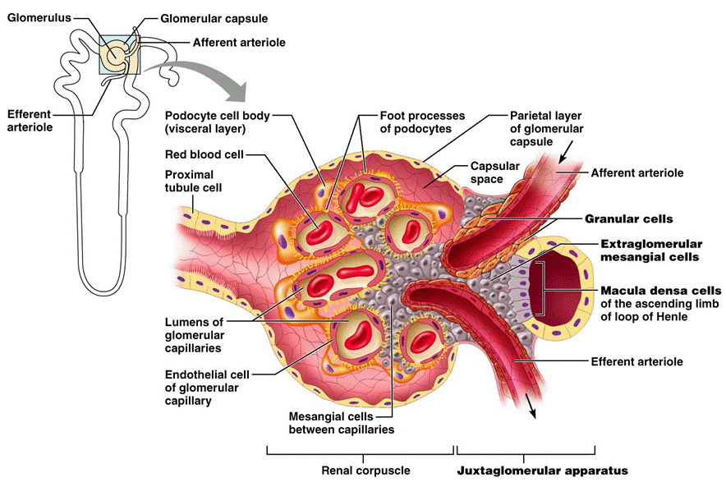

Slide 20
Renal response to blood flow
Changes in blood flow are sensed by juxtaglomerular apparatus
Modulates release of renin and vasoactive substances which act locally and systemically
Has local and systemic effects on blood pressure
Vascular tone (especially afferent and efferent arterioles)
Renal salt and water retention
Renin-angiotensin system
Will be discussed in a separate lecture

Slide 21
How does the kidney adapt to reduced blood flow?
Systemic vasoconstriction, renal vasodilatation, salt and water retention
Maximises perfusion pressure
Protects the Glomerular Filtration Rate (GFR)
When GFR declines renal function is impaired
Oxygen consumption by kidneys is reduced
Eventually damage to the kidneys occurs
Histological appearance is acute tubular necrosis
Usually the damage is recoverable if blood flow is restored
May result in scarring and chronic renal failure

Slide 22
Maintenance of GFR – normal renal blood flow (perfusion pressure)
Afferent arteriole
Efferent arteriole
Oncotic pressure
Hydrostatic pressure
Glomerular filtration pressure = oncotic-hydrostatic pressure

Slide 23
Maintenance of GFR – reduced perfusion pressure
Angiotensin II
PGE₂
PGE₂
Glomerular filtration pressure maintained

Slide 24
Drugs and autoregulation
Some drugs interfere with these mechanisms of autoregulation
Completely safe when renal blood flow is not compromised
DANGEROUS when renal blood flow compromised
Dehydration
Heart failure
Sepsis
Postoperative recovery

Slide 25
Drugs and autoregulation
ACEIs
Angiotensin II
PGE₂
PGE₂
NSAIDs
Glomerular filtration pressure

Slide 26
Autoregulation and hypertension
GFR 180 l/day, tubular resorption 178.5 l/day
1.5 l urine/day
Increase in BP 25% with no autoregulation
Increase in GFR 25% - 225 l/day, tubular resorption constant capacity - 178.5 l/day
Implies 46.5 l urine/day!
Autoregulation protects glomeruli from changes in BP
Increased salt and water loss: pressure diuresis

Slide 27
Summary: Effect of autoregulation
Feedback mechanism intrinsic to kidneys
Aims to preserve the RBF and GFR
Irrespective of changes in systemic blood pressure
Maintains renal excretion of water and solutes (obligatory volume)
RBF
(L/min)
GFR
(L/min)
Changes in systemic arterial BP have little influence on RBF and GFR :
they remain constant over BP range of 80-170 mmHg consequence of autoregulation
1.5
0.15
1.0
0.1
0.5
0.05
0
0
50
100
150
200
Arterial blood pressure (mmHg)

Slide 28
Summary: Renal mechanisms of autoregulation
Modulation of systemic blood pressure
Altered excretion of salt and water
Systemic vascular tone
Renin-angiotensin system, bradykinins, prostaglandins
Modulation of renal blood flow
Local vasodilation
Myogenic stretch
Renin-angiotensin/Prostaglandins/NO
Local vasoconstriction
Efferent>afferent arteriole to maintain glomerular filtration pressure
Renal blood flow constant across physiological range of hydration and blood pressure

Slide 29
Clinical message
Reduced urine output and/or acute renal impairment is a GRAVE PROGNOSTIC SIGN and requires urgent action to correct haemodynamic compromise

