Slide 1
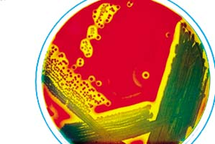
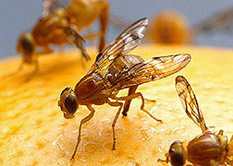
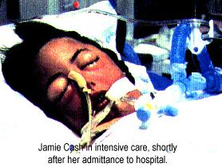
Sepsis and the physiology of infection
PHYSIOLOGY OF INFECTION
PROF S SRISKANDAN
PROF KATHY BAMFORD
PROF JON FRIEDLAND
PROF DANNY ALTMANN
DR STEVEN BRETT

Slide 2

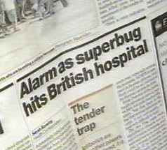
Why Infectious Diseases?
Multi-system
Interacts with every clinical speciality
Multidisciplinary
Major killer (and headline maker)

Slide 3
ACQUISITION OF PATHOGEN- from where? What is/are the likely pathogens?
Learning outcomes
PATHOGEN COLONISES AND PENETRATES EPITHELIUM-
what mechanisms permit this and what prevents it?
PATHOGEN ENCOUNTERS INNATE IMMUNE SYSTEM
What are the components of the innate system?
What parts of the pathogen are important?
INNATE RESPONDER CELLS → CYTOKINES & CHEMOKINES
What are the key responder cells and soluble factors?
How do neutrophils get from vessel lumen to infected tissues?
TRIGGERS TO COAGULATION
PATHOGEN IS KILLED BY NEUTROPHILS OR BY COMPLEMENT
What factors assist this process?
ENDOTHELIAL ACTIVATION AND VASORELAXATION
What triggers activation and relaxation?
CLEARANCE OF PATHOGEN or…..

Slide 4
INVASIVE LOCAL INFECTION
SYSTEMIC SPREAD
Understand fundamental mechanisms leading to…
Low Blood Pressure
Lactic Acidosis (due to anaerobic respiration)
Lung failure
Mitochondrial dysfunction in cells (Cannot extract oxygen correctly)
Poor blood supply
More hypoxia..
Poor organ perfusion
Cells die from hypoxia- Multi-organ failure ensues
Renal failure
Liver failure
Cerebral failure
Myocardial dysfunction/ myocardial infarction in the elderly
Gastrointestinal failure
DEATH

Slide 5
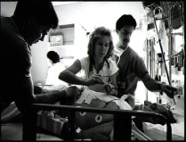


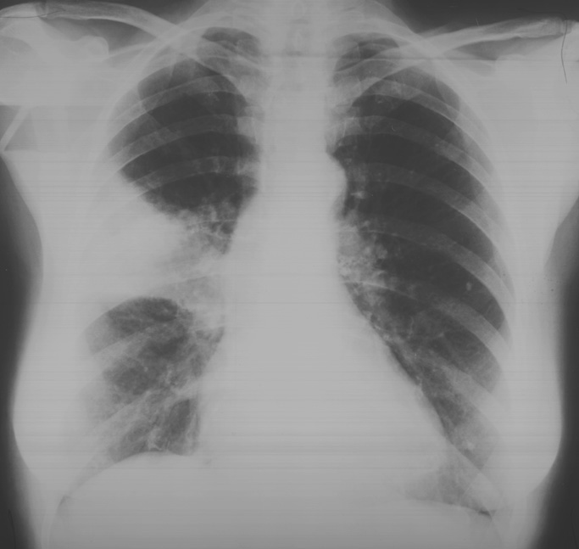
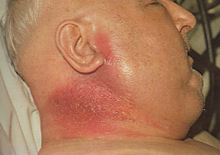
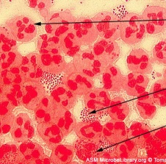
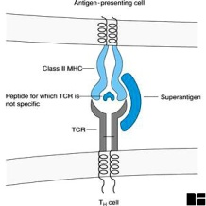
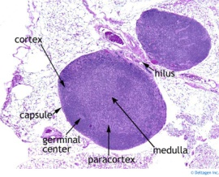
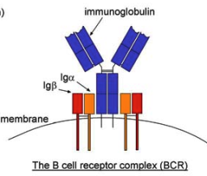
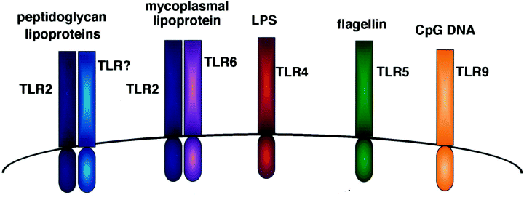
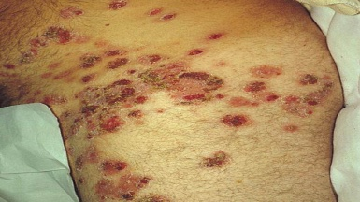
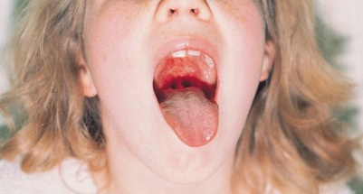
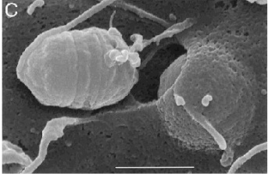
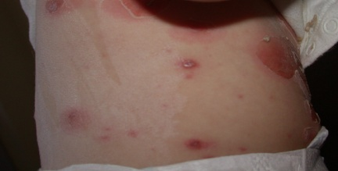

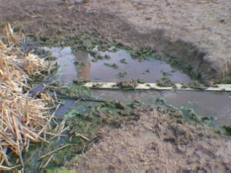
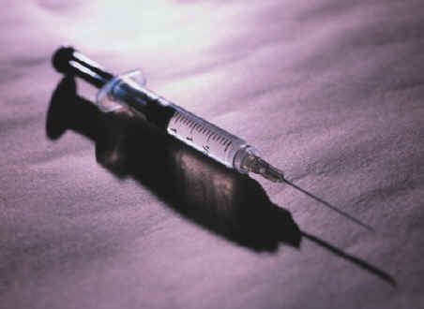
Sepsis and Septic Shock
Recovery and immunity
Invasive infection
Failure of immunity
Overwhelming immune response
Excessive pathogen virulence
Eliciting immune response
Symptomatic disease
Triggering an immediate immune response
Colonisation and penetration of epithelial barriers
Acquisition of Extrinsic and Intrinsic Pathogens

Slide 6
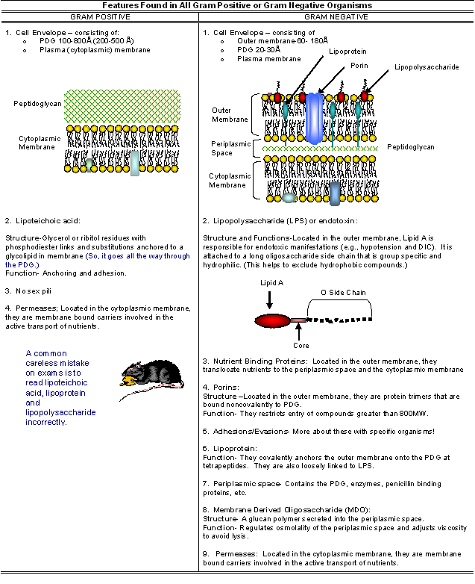
Gram positive vs gram negative cell envelope
POS
NEG
Dr Kathy Bamford

Slide 7
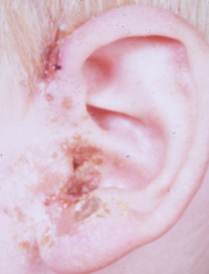
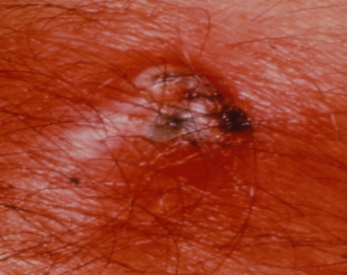
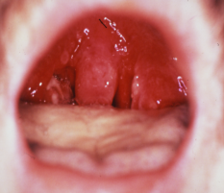
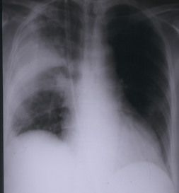
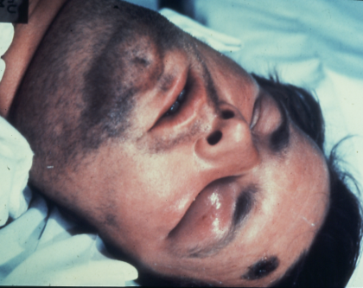
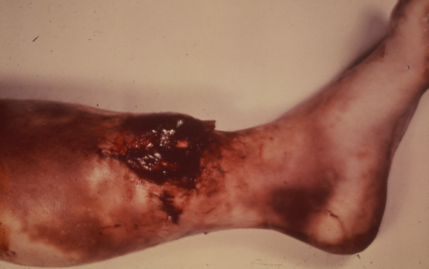
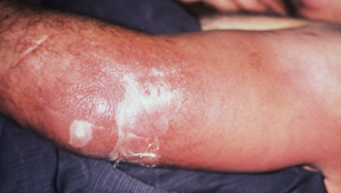
eg Listeria
Bacillus
eg Clostridia
Dr Kathy Bamford

Slide 8
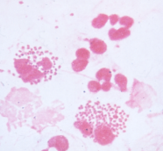
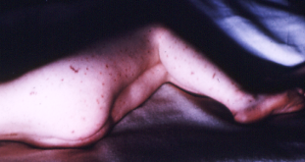
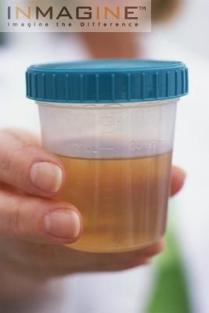
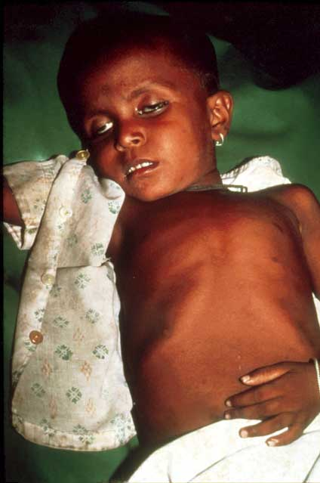
Gram negative bacteria
Gram negative
cocci
rods
Diplococci
Neisseria spp
Aerobic
Anaerobic
Bacteroides
Microaerophilic
Helicobacter
Campylobacter
Lactose fermenting
Escherichia coli
Klebsiella
Non-lactose fermenting
Salmonella
Shigella
Oxidase +ve
Pseudomonas

Slide 9
Where do bacteria come from?
Extrinsic
Intrinsic

Slide 10
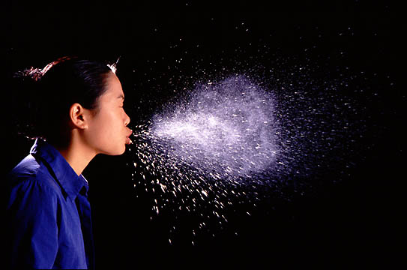

Extrinsic Sources: Respiratory/nasal secretions from others to our respiratory tract
Viruses
Influenza
Parainfluenza
RSV
Rhinoviruses
Bacteria
Streptococcus pneumoniae
Streptococcus pyogenes
Corynaebacterium diphtheriae
Neisseria meningitidis
Staphylococcus aureus
Hand transmission can act as intermediate

Slide 11
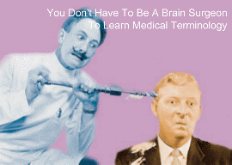
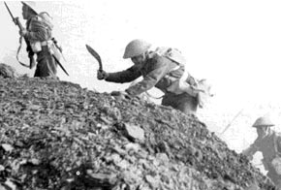
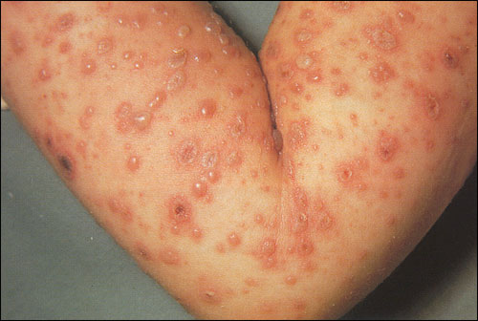
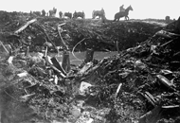
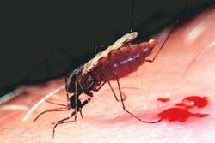
Extrinsic sources: introduction through skin
Surgery
Trauma/ battlefield
Pre-existing skin breaches incl. burns etc
IVDA
Gram positive!
Skin bacteria: Staphylococcus aureus, Streptococcus pyogenes,
altered by antibiotics or hosp exposure eg MRSA, Pseudomonas
Battlefield: Anaerobes e.g. Clostridium perfringens
Insects

Slide 12
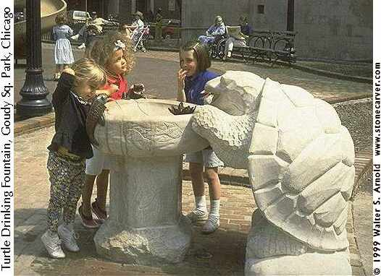


Viruses
Hepatitis A
Norovirus
Hepatitis E
Bacteria
Escherichia coli(travellers diarrhoea/HUS)
Campylobacter jejuni
Salmonella spp.
Shigella spp(dysentery)
Salmonella paratyphi (paratyphoid)
Salmonella typhae (typhoid)
Vibrio cholerae (cholera)
Protozoa
Giardia
Nematodes
Tapeworms, flukes
Spirochaetes
Leptospirosis
Toxins
Staphylococcal enterotoxins
Botulinum toxin
Extrinsic sources: Contaminated food and water (GI secretions from others - our GI tract)
Gram negative!
Tend to cause diarrhoeal illness

Slide 13

Extrinsic sources: sexual transmission
(genital tract to genital tract)
Viruses
HIV, Herpes simplex
Bacteria
Neisseria gonorrhoeae
Chlamydiae
Chlamydia trachomatis
Spirochaetes
Syphilis

Slide 14
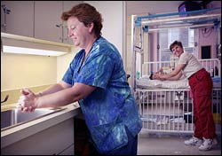
Extrinsic sources: nosocomial transmission
Either between patients OR from healthcare worker to patient

Slide 15

Intrinsic Sources
Mucous membranes
Nose & throat
Commensal oral flora
Streptococcus pyogenes
Staphylococcus aureus
Neisseria meningitidis
Viruses
Skin
Gram positive bacteria
Staph aureus
Staph epidermidis
Gastrointestinal
Tract
Gram negative bacteria
Anaerobes
Candida albicans
Upper Resp. tract
Gram positive bacteria
Gram negative bacteria
Viruses
Urogenital tract
Gram negative bacteria
Candida albicans
Prosthetic surfaces
I.v cannulae, urinary catheters, prosthetic joints, valves etc

Slide 16

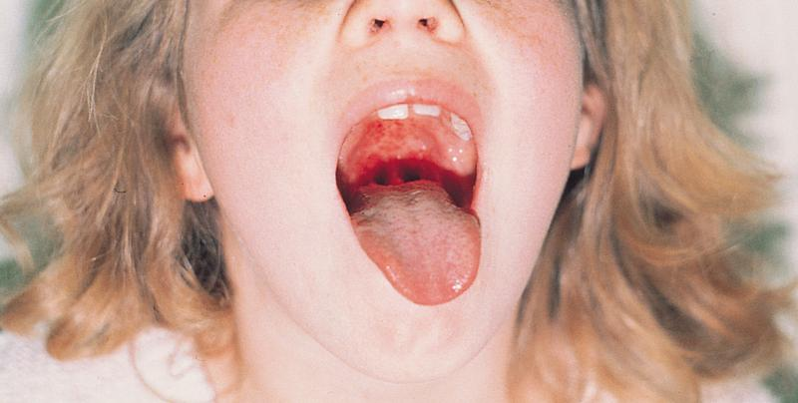
Colonisation of epithelia
How do bacteria hang on?
1. Non-specific electrostatic interactions
e.g. staphylococci and epithelia/devices
2. Tethering via projections “fimbriae”
e.g E.coli and gonococcal “pili”
Also streptococci
3. Attachment via special receptors on human cell surfaces
e.g fibronectin binding proteins (staphs and streps)
4. Internalisation into the epithelial cell
e.g staphs and streps

Slide 17
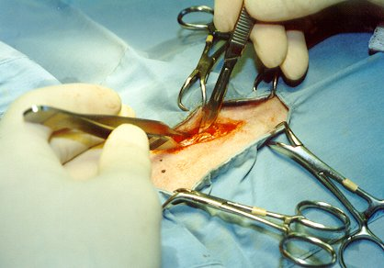
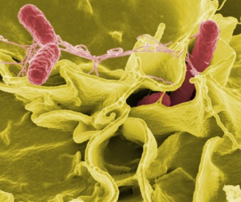
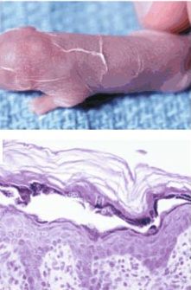
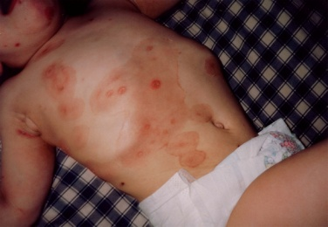
Penetration of epithelial/endothelial barriers
Artificial penetration
breach of epithelium: trauma, injection, surgery etc
Entry into and through the cell
e.g Salmonella spp
Transit inbetween cell layers
e.g. S. aureus exfoliative toxin cleaves desmosomes leading to ‘scalded skin syndrome’ in infants

Slide 18
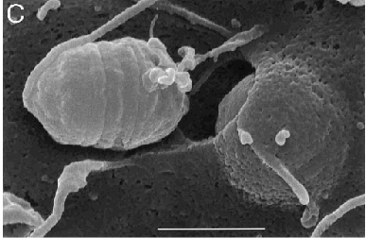
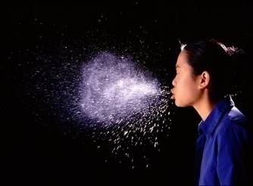
Recovery and immunity
Eliciting immune response
Triggering an immediate immune response
Colonisation and penetration of epithelial barriers
Acquisition of Extrinsic and Intrinsic Pathogens

Slide 19

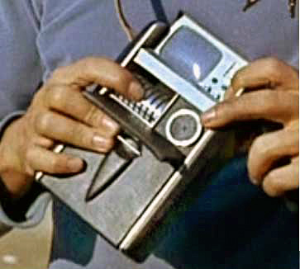
The innate immune response
Pathogen components
Host recognition of enemy
Danger signals

Slide 20
The innate immune response
Pathogen components
Host recognition of enemy
Danger signals
Release of chemokines
e.g. IL-8
Release of cytokines
Complement kills Gram negatives
Neutrophil recruitment
Endothelial activation
Vasorelaxation
Neutrophil transmigration
Phagocytosis of bacteria coated in complement or antibody
Release of granules
Anti-bacterial peptides
Enzymes/MMPs
Recovery

Slide 21
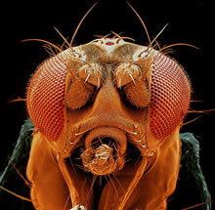
Discovery of Toll-like receptors
Gene (“Toll”) -: sensing and eliminating fungal infection in adult
Several homologues found in human genome (TLRs)

Slide 22
Toll-like receptors
At least 10 members in TLR family (TLR 1-10), still growing
recognition and discrimination of specific microbial components
Lipoproteins from various bacteria
1
CD14, MD2
NOD
TLR9
TLR3
TLR4
TLR78
Nucleotide oligomerisation domain
Release of inflammatory mediators by human cells e.g. TNF, IL8
Recruitment of innate immune response (neutrophils, complement, endothelial activation) and clearance of bacteria

Slide 23
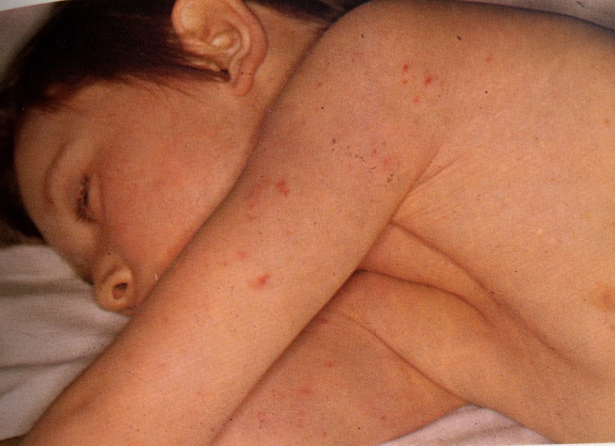
Triggering the innate immune response
Pathogen components
Host recognition of enemy (Toll receptors)
Danger signals
Gram negative infection: what is the disease?
Endotoxin (lipopolysaccharide)-part of cell membrane

Slide 24
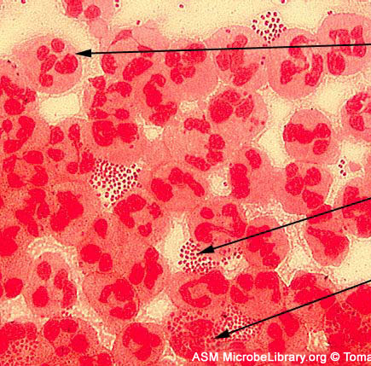
Response to meningococcal infection
?Lipoproteins
1
CD14, MD2
?peptidoglycan
NOD
TLR9
Bacterial DNA
Release of inflammatory mediators by human cells e.g. TNF, IL8
Recruitment of innate immune response (neutrophils, complement, endothelial activation) and clearance of bacteria

Slide 25
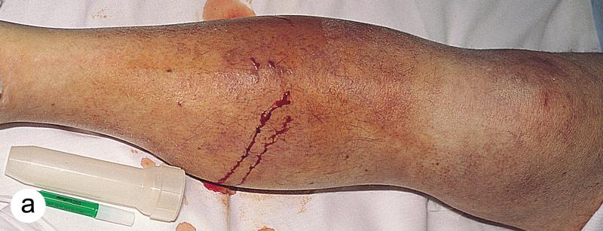

The innate immune response
Pathogen components
Host recognition of enemy (Toll receptors)
Danger signals
Gram positive infection:
Activation of the immune response without endotoxin:
Patient MM
48 year old male
HR 140/minute; BP 80/60
Temp 40.6⁰C
Kick on shin 7 days;
What’s the disease?

Slide 26

Gram positive bacteria
Capsule
Cell wall
Peptidoglycan and lipoteichoic acid
Cell membrane
Lipoproteins

Slide 27

Recognition of streptococcal infection by toll-like receptors
1
peptidoglycan
NOD
TLR9
Bacterial DNA
Release of inflammatory mediators by human cells e.g. TNF, IL8
Recruitment of innate immune response (neutrophils, complement, endothelial activation) and clearance of bacteria

Slide 28


Pathogens can trigger multiple PRRs because of multiple PAMPs
S. TLR2 Lipoproteins
pneumoniae TLR4 Pneumolysin
Legionella TLR4 Lipopolysaccharide
TLR5 Flagellin

Slide 29

Mycobacteria
Gram positives
Flagellin
Gram negatives
peptidoglycan
Viruses
Bacterial DNA

Slide 30
Components of Innate Immunity (1)
Physical barriers
      skin
      mucociliary escalator
Cellular barriers – immune active
Circulating effector leucocytes
      Monocytes/macrophages
      Neutrophils
      NK cells
Jon Friedland

Slide 31
Components of Innate Immunity (2)
Circulating proteins
      Complement
      Collectins and pentraxins (eg CRP)
      Antimicrobial peptides (eg defensins)
Cytokines
Local Enzymes
Jon Friedland

Slide 32
Microbial killing:
Defensins & cathelicidins
Defensins
  in phagocytic cells & epithelial cells
  microbiocidal at micromolar conc; stored in granules
  target bacteria, fungi and viruses
  form pores in cell membranes
Cathelicidins
  in phagocytic cells & epithelial cells
  Often undergo proteolytic cleavage; stored as proforms
Prof Jon Friedland

Slide 33
Cytokines relevant to immunity
Pro-inflammatory
  Tumor Necrosis Factor
  Interleukin-1
Regulatory (activates adaptive immunity)
  Interferon γ
  Interleukin-12
Down-regulatory
  Interleukin-10
  Transforming Growth Factor β
Chemoattractant
  Chemokines eg IL8 (CXCL8)

Slide 34
The role of the endothelium in infection
Responds to cytokines -increased adhesion molecules
Interaction with leucocytes
Release of more cytokines and inflammatory mediators
Release of mediators of vasodilatation
Functional effects on the coagulation system
Tissue injury
Formation of fibrin clot
Dr Stephen Brett
Notes:
The endothelium plays a key role in maintaining homeostasis.^{41,42}
Damaged endothelium exacerbates the inflammatory response.^{41,42}
The endothelium is a dynamic participant in cellular and organ function. Through the expression of surface proteins and soluble mediators, the endothelium plays an important role in maintaining the physiological equilibrium between coagulation and fibrinolysis. Derangements in these normal functions contribute to systemic inflammation.^{41,42}
During the inflammatory response, endothelial cell activation causes overall vasodilation, allowing leucocytes to access infection sites.⁴¹ Normally, the endothelium would downregulate this initial pro-inflammatory response by expressing anti-inflammatory and anticoagulant mediators.⁴²
In sepsis, this regulatory function of the endothelium fails, leading to excessive vasodilation, hypoperfusion, generalised tissue damage and inappropriate cytokine response. The damaged endothelium loses its homeostatic balance and becomes procoagulant, precipitating coagulopathy and microthrombus formation.⁴¹

Slide 35
White blood cell adhesion
Rolling
TNF, IL-1
Receptors
Activation
of integrins
Selectins
Direct signalling
ICAM-1
Chemokines
ICAM: intercellular adhesion molecule, TNF: tumour necrosis factor, IL: interleukin
Dr Stephen Brett
Notes:
There are three main types of adhesion molecules: the immunoglobulin supergene family, integrins and selectins.⁵⁶
Leucocytes are initially slowed on contact with the endothelium by the interaction of selectins with receptors expressed by leucocytes.⁵⁶
Leucocytes respond to chemokines (cytokines and other chemotactic agents) and surface molecules on the endothelium and extracellular matrix. These agents may activate the cell and induce cell migration.⁵⁶
Activation of the cell upregulates the affinity of integrins, which are involved in adhesion to the endothelium and extracellular matrix.⁵⁶
In sepsis, activation of adhesion molecules appears to be increased, with systemic inflammation and widespread thrombin generation.^{57,58,59}
Three main groups of adhesion molecules are associated with leucocyte–endothelium interactions.⁵⁶
• Immunoglobulin supergenes – include cellular adhesion molecules such as intercellular adhesion molecule-1 (ICAM-1), ICAM-2 and vascular cell adhesion molecule-1 (VCAM-1); all of which are expressed on vascular endothelium.^{41,56}
• Integrins – are found on many cells, including leucocytes. They are involved in a wide
range of processes, such as leucocyte adhesion to endothelium and platelet–neutrophil interactions at inflammatory sites.⁵⁶
• Selectins – comprise E-selectin, P-selectin and L-selectin. They are expressed on endothelium, platelets and leucocytes, respectively.^{41,56,58} E-selectin promotes leucocyte adhesion to endothelium and P-selectin expression facilitates leucocyte-platelet interactions that aid leucocyte aggregation.^{41,56,58}
Pro-inflammatory cytokines (including tumour necrosis factor, interleukin-1 and interferon-gamma) and thrombin are important in the up-regulation of adhesion molecules.^{41,57,58} Therefore, in sepsis where there is excessive inflammation and thrombin production, there can also be increased expression of adhesion molecules, which leads to further inflammation, vascular endothelial injury and selectin expression.⁵⁹

Slide 36
Phagocytosis
Macrophages, monocytes and neutrophils
Opsonisation
  Complement especially C3
  Antibody
Ingestion into vesicles usual
Jon Friedland

Slide 37
Phagocytes and microbial killing
Reactive oxygen intermediates
  Free radicals (eg superoxide)
  Chronic Granulomatous Disease
Reactive nitrogen intermediates
Lysosomal enzymes
  Phagolysosomes
Proteolytic enzymes
  Elastase
Jon Friedland

Slide 38


Neutrophil
characteristic cell of the acute inflammatory infiltrate; phagocytoses bacteria; make toxic products - defensins and peroxide, bactericidal enzymes

Slide 39


Monocyte (or in tissues, macrophage)
Phagocytose and kill pathogens - activated by toll-like receptor recognition
Release cytokines IL-1, IL-6, IL-8, IL-12, TNFα

Slide 40
Avoiding Innate Immunity
Inhibition of complement activation – M. tuberculosis
Resistance to phagocytosis – Pneumoccus, Yersinia
Scavenging of Reactive Oxygen Intermediates (ROIs) – Catalase-positive Staphyloccus
Inhibit phagolysosome formation – M. tuberculosis
Escape from phagosome into cytoplasm – Listeria monocytogenes

Slide 41
Innate and adaptive immunity
INNATE
  Very rapid
  Many components
  Evolutionarily ancient (conserved)
  Lack of specificity
  Lack of memory
ADAPTIVE
  Slower
  Specific antibody and cellular effector mechanisms
  Targeted to a specific antigen
  Memory

Slide 42




Adaptive immune response: ANTIGEN PRESENTING CELLS -T lymphocyte INTERACTION
Antigen presentation
DENDRITIC CELL
The bridge between innate immunity and T cell activation in the immune response. Professional antigen presenting cells for priming naïve T cells.
Respond to TLR activation, interferonγ
T CELL
Key cell-type mediating the adaptive immune response. Recognise peptidic fragmens of foreign antigen presented by HLA molecules on antigen presenting cells. Leads to activation, cytokine release, killing, B cell help etc
CD8, CD4 (Th1, Th2, Th17, Treg)
Antigen presentation
Danny Altmann

Slide 43

Priming of B cells by T cells
Blood vessel
Lymph node

Slide 44
Innate and adaptive immunity working together
Cytokines and chemokines
epithelium
defensins
Y
Y
Complement AND
Antibody
Streptococcus pyogenes

Slide 45
Innate immunity - the balance
CONTROL OF
INFECTION
PROINFLAMMATORY
DAMAGE
Low TNF
IL-10
TGF
High TNF
IL-1++++
MMPs
DESTRUCTIVE
PROTECTIVE
Slide from Prof Jon Friedland

Slide 46


Gram positive shock: secreted toxins act as additional triggers
Positive blood cultures: Streptococcus pyogenes
BP< 90 mmHg; Respiratory, renal, cardiac impairment
Isolate: M1 T1
Toxin genotyping: spea+; smez+; speg+

Slide 47
Gram positive shock: the toxin trigger
Conventional Antigen
Superantigen
Monocyte
MHC II
Antigenic peptide
Vβ
TCR
T-cell
TNFα
Shock
Organ failure

Slide 48
Pathogens have additional virulence factors in addition to the basic structural triggers to our innate immune response
Superantigen Toxic shock
  Streptococcus pyogenes . Strep pyrogenic exotoxin A (SPEA), Strep mitogenic exotoxin Z (SMEZ)
  Staphylococcus aureus. Toxic shock syndrome toxin-1 (TSST-1), staph enterotoxin A, B, C etc (SEA, B, C)
Bacterial meningitis
  Neisseria meningitidis. Gram neg. Releases LPS++ by blebbing
  Streptococcus pneumoniae. Gram pos. Produces pneumolysin
Treatment may be influenced by these
Eg additional antibiotics to inhibit toxin synthesis: clindamycin,
Polyclonal immunoglobulins to neutralise toxins eg toxic shock

Slide 49
“Sepsis”
Sepsis
Systemic inflammatory response syndrome
Severe sepsis
Septic shock

Slide 50
The disease continuum: SIRS
Severe
sepsis
Infection
SIRS
Sepsis
Death
A non-specific clinical response including
>2 of the following:
As well as infection, SIRS can also be caused by trauma, burns, pancreatitis and other insults
Temperature >38ºC or <36ºC
Heart rate >90 beats/min
Respiratory rate >20/min
White blood cell count >12,000/mm³ or <4,000/mm³ or >10% immature neutrophils
SIRS: systemic inflammatory response syndrome
Dr Stephen Brett
Notes:
The American College of Chest Physicians and the Society of Critical Care Medicine (ACCP/SCCM), at a Consensus Conference, developed clear clinical definitions for the disease continuum.
SIRS (systemic inflammatory response syndrome) is defined as the presence of two or more objective signs of systemic inflammation.¹¹
To standardise definitions, a Consensus Conference was held in the early 1990s by the ACCP/SCCM.
These groups developed three terms for the progression of clinical symptoms: sepsis, severe sepsis and septic shock.^{2,11}
The conference also defined an initial SIRS, which requires evaluation of abnormalities of temperature, heart rate, respiratory rate and white blood cell count.^{2,11}

Slide 51
The disease continuum: sepsis
Severe
sepsis
Infection
SIRS
Sepsis
Death
SIRS with a presumed or confirmed infectious process
SIRS: systemic inflammatory response syndrome
Dr Stephen Brett
Notes:
The American College of Chest Physicians and the Society of Critical Care Medicine (ACCP/SCCM) defines sepsis as the presence of systemic inflammatory response syndrome (SIRS) with the addition of a confirmed or presumed (i.e. presence of commonly recognised signs of infection without an identifiable pathogen being isolated) microbiological infection.¹¹
Approximately 60% of sepsis cases are associated with a microbiologically confirmed infection.¹⁵
When the underlying site of infection can be identified, the most common infection sites are the lung, abdomen or urinary tract.^{5,16,17} For example, one study found that in 46% of patients the infection site was the lung, 15% the abdomino-pelvic region and 10% the urinary tract.¹⁶

Slide 52
The disease continuum: severe sepsis
Severe
sepsis
Infection
SIRS
Sepsis
Death
Sepsis with signs of at least one acute organ dysfunction
Renal
Respiratory
Hepatic
Haematological
Central nervous system
Unexplained metabolic acidosis
Cardiovascular
Septic shock Severe sepsis with hypotension refractory to adequate volume resuscitation
SIRS: systemic inflammatory response syndrome
Dr Stephen Brett
Notes:
Severe sepsis is defined as sepsis with signs of at least one acute organ dysfunction.¹¹
Septic shock is sepsis-induced refractory hypotension that persists despite adequate fluid resuscitation, along with the presence of hypoperfusion abnormalities or organ dysfunction.¹¹
In septic shock, hypotension is defined as a systolic blood pressure of <90mmHg or a reduction of >40mmHg from baseline in the absence of other causes of hypotension.¹¹
It is important to realise that these stages do not necessarily imply an increasing severity of infection, but rather an increasingly severe systemic response to infection.³

Slide 53
Pathogens involved in sepsis
An overview
Gram negative
Gram positive
Fungal infection
20%
Mixed bacterial
45%
19%
Other mixed
3%
10%
3%
Unconfirmed
Only 60% of severe sepsis/septic shock cases are associated with confirmed infection
Disease progression is similar regardless of causative organism
Dr Stephen Brett
Notes:
The most common microbial causes of sepsis are pure Gram-negative or Gram- positive pathogens (36% and 35% of cases, respectively).¹⁵
Mixed bacterial infections account for 19% of cases, pure fungal 5%, with mixed bacterial/ fungal/viral infections comprising the remaining 5%.¹⁵
Almost every type of micro-organism has the potential to initiate an episode of sepsis. However, only 60% of cases may be associated with a microbiologically confirmed infectious pathogen.¹⁵
The clinical progression of sepsis is similar, regardless of the infectious agent.^{6,15,23}
Although Gram-negative bacteria have traditionally been the most common bacteria associated with septic shock,^{25,26} the relative proportion of cases associated with
Gram-positive infection has escalated.^{6,23,24}

Slide 54
Bacterial pathogens in sepsis
A final common pathway?
Gram-negative
Gram-positive
e.g. Neisseria meningitidis
Escherichia coli
e.g. Staphylococcus aureus
Streptococcus pneumoniae
Enterococcus faecalis
Endotoxin and other toxins
Cell wall components
Extracellular products
Host immune response
Host immune response
INFLAMMATION
SEPSIS
Dr Stephen Brett
Notes:
Gram-negative and Gram-positive bacteria initiate the disease process by different mechanisms.⁶ However, there is an overlap in some inflammatory pathways.
The CD14 receptor, present on many human cell types, plays a key role in initiating cellular activation by bacterial envelope components from both Gram-negative and Gram-positive bacteria.⁶
Despite subtle differences in the host response to Gram-positive and Gram-negative pathogens, disease severity and mortality in sepsis is similar.^{6,23,24}
Despite the apparent differences between Gram-negative and Gram-positive bacteria, the systemic inflammatory responses for both types of pathogen are, in a qualitative sense, similar.^{6,23}
This is important because the identity of the causative organism is often unknown at the onset of sepsis and treatment targeting the host inflammatory response needs to be rapid and beneficial, regardless of the causative organism.^{6,27}

Slide 55
Host response to infection
Progression to sepsis and severe sepsis
Pathogen
Infection
Host response
Endothelial dysfunction
Inflammation
Other
factors
Coagulation/
fibrinolysis
Loss of homeostasis
Organ dysfunction
Death
Dr Stephen Brett
Notes:
Bacterial infection evokes a host response by triggering the immune system.
Normally, the endothelium plays a key role in maintaining homeostasis.^{41,42}
Systemic microvascular endothelial damage compromises the active, moderating role of the endothelium.⁴¹
In the sepsis patient, endothelial dysfunction is central to the imbalance between inflammation, coagulation and fibrinolysis.⁴¹
Other pathophysiological mechanisms, including nitric oxide and mitochondrial dysfunction, may also be involved in disease progression.⁴³
Loss of homeostasis in sepsis patients may result in organ dysfunction.^{41,44}

Slide 56
Pathogenesis of sepsis
An overview
Anti-inflammatory
mediators
e.g. IL-10, IL-1ra receptor antagonists
Pathogen
Infection
Host
responses
Pro-inflammatory
mediators
e.g. Tumour necrosis factor, IL-1, IL-6, IL-8,
nitric oxide
Leucocyte activation
Mitochondrial dysfunction
Inflammation
Microvascular flow redistribution
Endothelial dysfunction
Tissue factor expression
Organ dysfunction
Tissue injury
Microvascular coagulation/
thrombosis
Inhibition of fibrinolysis
Activation of coagulation
Death
Dr Stephen Brett
Notes:
Sepsis involves a complex host response in an attempt to maintain homeostasis.^{41,46}
This illustration provides a simplification of some of the mechanisms involved in sepsis. In reality, a complex series of physiological events occur simultaneously.^{41,46}
Clinical manifestations of sepsis may involve a single organ or may progress to multiple organ dysfunction syndrome (MODS).¹¹
MODS is considered to be the final result of severe, persistent and generalised inflammation.⁴⁵

Slide 57
Genetic factors in severe sepsis
Inflammatory response
Inflammatory tendency
Differing outcomes
Death
Severe
sepsis
Mediator over-
expression
Sepsis
Systemic inflammation
Elevated
Mediator
normal
expression
Localised inflammation
Normal
Recovery of homeostasis
Dr Stephen Brett
Notes:
Individuals respond differently to inflammatory stimuli.
Inflammatory cytokine production may be genetically determined. For example, the tendency for overproduction of tumour necrosis factor (TNF) is a hereditary trait.¹⁰²
Increased TNF production has been linked to an increased risk of organ dysfunction and poor prognosis in severe sepsis.¹⁰²
Responses such as the production of cytokines, that play a key role in the development of sepsis and other inflammatory diseases, may be genetically determined through gene polymorphisms.^{102,104}

Slide 58
Variability in the host response to an infection
General health (diabetes, alcohol) and nutrition status
Previous exposure to pathogen (memory)
Immune-deficiencies - genetic or acquired
Polymorphisms in innate immunity genes
Polymorphisms in adaptive immunity genes, particularly HLA (=‘human leucocyte antigens’)

Slide 59
Summary: host polymorphisms in sepsis (so far)
Innate
TLR4
CD14
MBL
IL-1/IL1 receptor
Adaptive
HLA class II
TNFα, IFNγ, IFNγ-receptor
TNFβ (lymphotoxin)

Slide 60
Treatment: general approach
Immediate resuscitation
Oxygen therapy/ ventilatory support
Haemodynamic support
Identify/treat infection
Metabolic assessment
Supportive care
Take microbiology specimens
Immediate broad- spectrum antibiotics
Assess for surgery/drainage
Identify pathogen
Change treatment as necessary
Prevention of pressure sores
DVT prophylaxis
Nutrition
Stress ulcer prophylaxis
Renal replacement therapy
Good practice basics
Consider infection control throughout
DVT: deep vein thrombosis
Dr Stephen Brett
Notes:
Treatment may be either medical or surgical, or a combination of both.¹²⁹
The initial treatment priority is control of life-threatening abnormalities through assessment of airways, breathing and circulation.
Thereafter, management of sepsis includes treatment of the underlying infection, restoration of tissue perfusion, and patient support.
The purpose of oxygen support is to restore and help maintain adequate tissue oxygenation.
The goals of haemodynamic support are to restore an effective blood pressure to ensure tissue perfusion and to normalise cellular metabolism.
Treating underlying infection through antibiotic therapy and possible surgical debridement is an essential part of sepsis management.^{5,130} The advice of a microbiologist is strongly recommended.
Good practice basics include adherence to aseptic techniques and measures for infection control.

Slide 61
Septic Shock
Recovery and immunity
Invasive infection
Failure of immunity
Overwhelming immune response
Excessive pathogen virulence
Eliciting immune response
Symptomatic disease
Triggering an immediate immune response
Colonisation and penetration of epithelial barriers
Acquisition of Extrinsic and Intrinsic Pathogens

