Slide 1
An introduction to virology
1. What are viruses and how do they replicate?
2. How do viruses cause disease?
3. How may virus diseases be prevented or treated?
Professor Peter O’Hare
Section of Virology
Faculty of Medicine
p.ohare@imperial.ac.uk

Slide 2
Prophylaxis and Therapy
Viruses treatment and prevention
Prophylaxis: preventing disease before the aetiologic agent is acquired, by vaccination or giving a drug before infection.
Therapy: is treating the disease after the host has been infected.
Vaccines
Drugs

Slide 3
Some virus vaccines for humans
Virus | Disease | Vaccine type
Measles | Measles | Live attenuated
Mumps | Mumps | Live attenuated
Rubella | German measles | Live attenuated
Yellow fever virus | Yellow fever | Live attenuated
Polio (Sabin) | Poliomyelitis | Live attenuated
Hepatitis A virus | Hepatitis A | Live attenuated
Varicella-Zoster virus | Chickenpox / shingles | Live attenuated
Polio (Salk) | Poliomyelitis | Inactivated virus
Rabies | Rabies | Inactivated virus
Influenza virus | Influenza | Subunit
Hepatitis B virus | Hepatitis B | Subunit
HPV 16 & 18 | Cervical cancer | Subunit
Variola virus | Smallpox | Vaccinia (live virus)

Slide 4
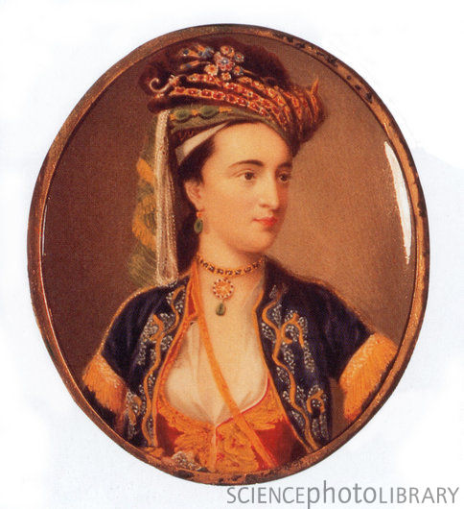
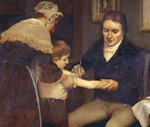
Variolation and smallpox vaccination
Smallpox: Variola; (Latin, Varius, spotted)
Edward Jenner
and James Phipps
Milkmaids spared facial disfigurations of small pox
Injected pus from a cowpox lesion under the skin of Phipps
Lesion developed
Two weeks later; deliberately infected him with smallpox!
Royal society rejects paper
William Woodville: large scale clinical trial of procedure
One hundred years to next vaccine, Pasteur introduces term
Vaccination (Latin, Vacca, cow) in honour of Jenner
Lady Mary Wortley Montague 1723

Slide 5
The eradication of smallpox
1723. Variolation
1796. Vaccination
1801. Eradication predicted
19th century.
  Vaccination spread throughout the world
  Arm to arm transmission banned because of spread of other diseases (measles and syphilis)
1939. Britain became free of smallpox for first time, cowpox and vaccinia viruses shown to be distinct
1950. Freeze dried vaccine developed

Slide 6
The eradication of smallpox
1959. WHO adopted Soviet proposal to achieve global eradication of smallpox
1967. Intensified eradication campaign began
1975. Last case in India
1977. Last case in Somalia
1980. Eradication certified by WHO
1993. Genome of variola virus sequenced
???? Last stocks of variola virus to be destroyed
Smallpox is the first and only disease to have been eradicated

Slide 7
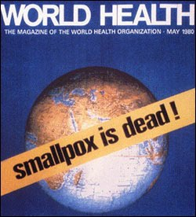
Eradication of a virus from the planet
1977

Slide 8
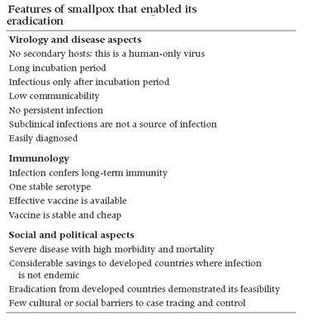
Vaccination induces life long immunity
No animal reservoir
Obvious symptoms in infected people
WHO EFFORT

Slide 9
Milestones in viral vaccines
1796: Vaccination
1885: Pasteur developed rabies vaccine. Dried the spinal chord of rabbits that had died from rabies, used this to immunise Joseph Meister (9-yr old boy bitten 14 times by rabid dog). Present day vaccine grown in cell culture and inactivated by β-propriolactone.
1937: Theiler developed the live attenuated vaccine for yellow fever; still used today
1943: influenza vaccine: present day vaccine constitutes virus glycoproteins purified from virus grown in eggs
1954: polio vaccine (Salk), killed vaccine
1956: polio vaccine (Sabin), live attenuated
1960: measles
1966: rubella
1967: mumps
1986: genetically engineered recombinant vaccine for hepatitis B virus

Slide 10
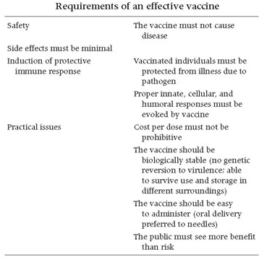
Requirements and types of viral vaccines
Vaccines
Killed vaccine: chemical inactivation
Live attenuated: attenuated pathogenicity
Subunit vaccine: individual proteins (free of nucleic acid)
Recombinant vaccine: DNA vaccine

Slide 11
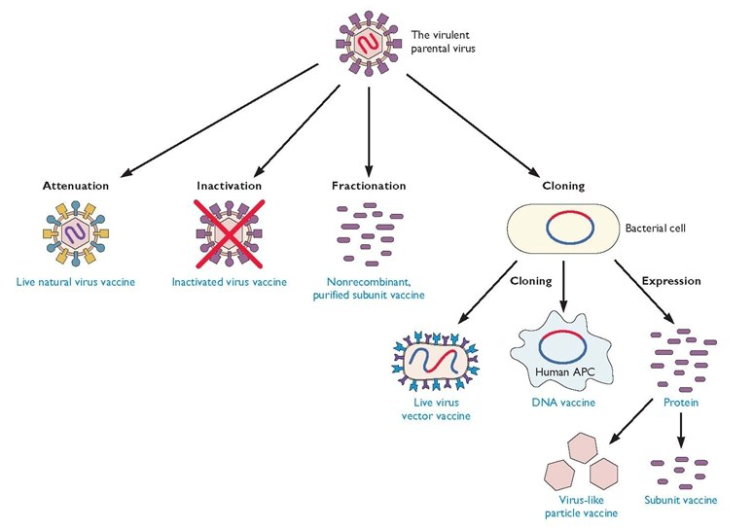
Vaccines

Slide 12
Live:: Attenuated form of virulent organism (yellow fever virus). Immunologically related organism (vaccinia for smallpox). Virulent organism (variolation)
  Advantages: induce both T cell and antibody responses. Long lasting. Low cost and ease of manufacture and administration
  Disadvantages: Safety (may revert to virulence, or cause serious infection in immunosuppressed). Heat lability. Virus may be shed into the environment.
Killed: antigen preparation chemically treated to inactivate infectivity and toxicity
  E.g. whole virus (rabies), specific proteins from virus (surface antigen for HBV, HA for influenza), peptides to important epitopes
  Advantage: safety (as long as the inactivation complete – disasters with polio and FMDV)
  Disadvantage: require multiple administration to achieve solid immunity, may require adjuvants, protection for shorter duration, high cost, reduced cell-mediated immunity

Slide 13
Passive: immune globulin (e.g. for rabies and infants born to HBV +ve mothers), maternal antibodies
  Problems: short lived, serum sickness, immune responses to foreign proteins
  Advantage: immediate protection

Slide 14
Considerations for vaccine development
Which antigens should be used?
What type of immunity is needed?
  Antibody or cell mediated
  secretory (IgA) or systemic (IgG) antibody
When is the immunity needed?
  When does the pathogen induce disease? (rubella)
  Exposure in endemic areas (vaccination before travelling)
How should the vaccine be administered?

Slide 15
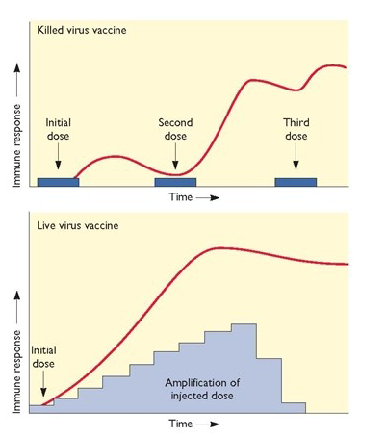
Vaccines
Live attenuated: may provoke an
immune response different from virulent virus
Killed/subunit vaccine: no new viral proteins made.
Immune system must recognise only input material
Killed/subunit vaccine: stimulate antibody responses
but rarely stimulate an effective CTL response

Slide 16
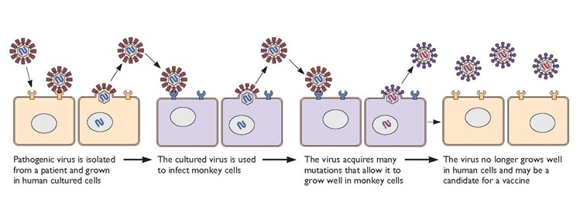
Attenuation of virus to make a live virus vaccine

Slide 17
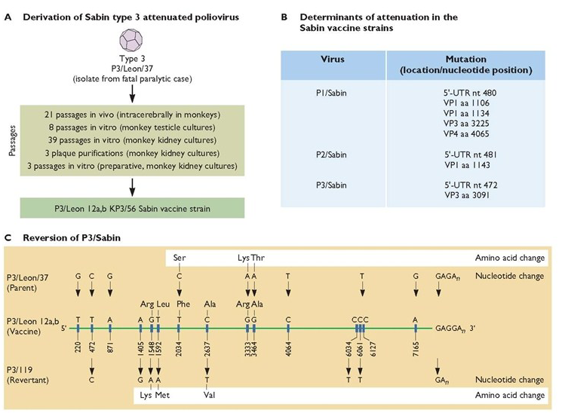
Attenuation of Poliovirus to make a live virus vaccine

Slide 18
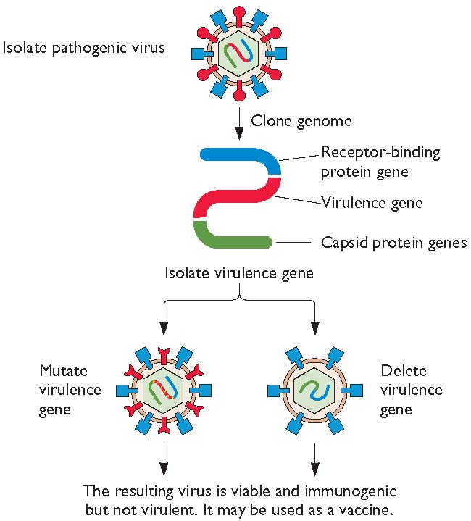
Genetically engineered attenuated virus
Identify the gene encoding the virulence determinant
Delete or mutate the virulence gene
In the parental virus
Viable. Immunogenic, avirulent
Vaccine candidate

Slide 19
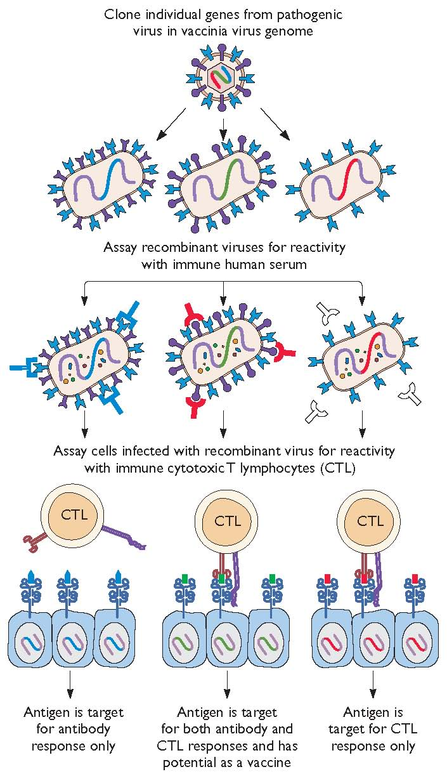
Genetically engineered recombinant virus vaccine

Slide 20
Genetically engineered subunit vaccines
Identify the gene encoding the desired antigen, express the gene and purify the protein
Safe, specific, cheap, abundant supply

Slide 21
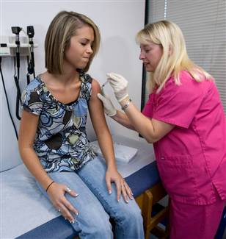
Genetically engineered subunit vaccines
Hepatitis B virus
sAg cloned and expressed in yeast
Used since 1986. Replaced the previous vaccine made from human plasma (expensive, limited supply, danger of other infectious agents)
Papillomavirus
Virus Like Particles from recombinant coat proteins
Gardasil and Cervarix

Slide 22
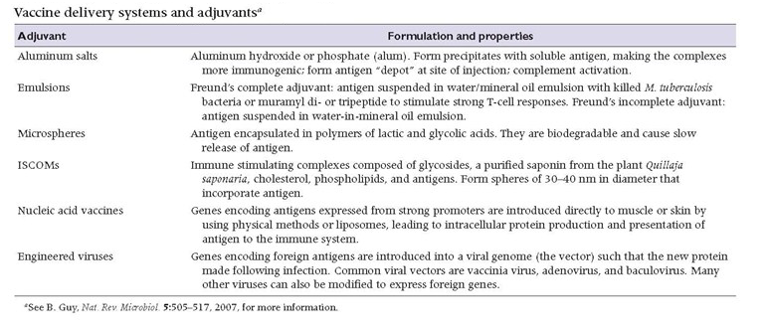
Adjuvants and other delivery systems

Slide 23
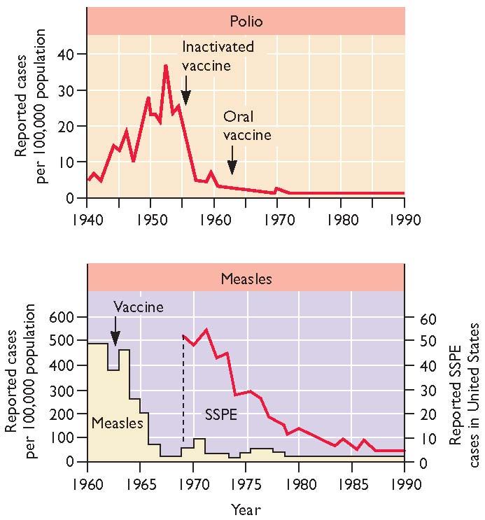
Successful vaccination campaigns

Slide 24
Antiviral drugs
Paradox? So much knowledge, so few antivirals
Principles of Virology 3rd Edition ASM Press

Slide 25
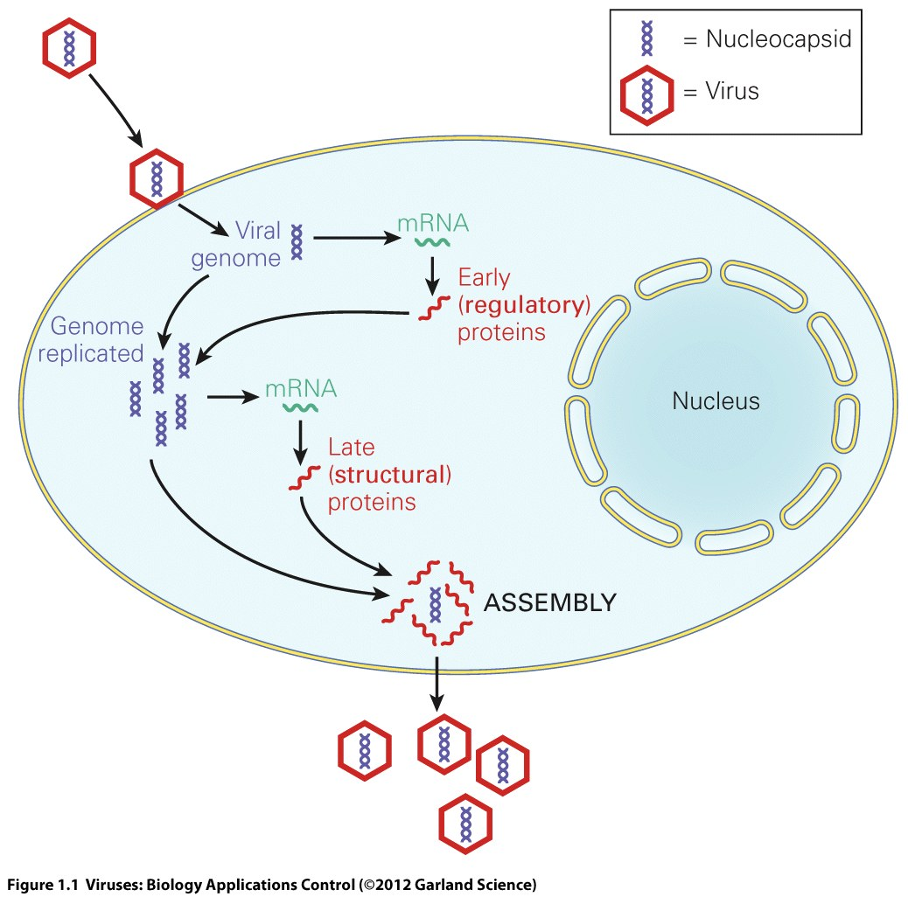
Antiviral drugs
Must inhibit the virus without toxicity for host
Fewer targets than for bacteria
Targets
  virus binding to host cell
  virus replication (n.b. enzymes)
  virus assembly or dissemination

Slide 26
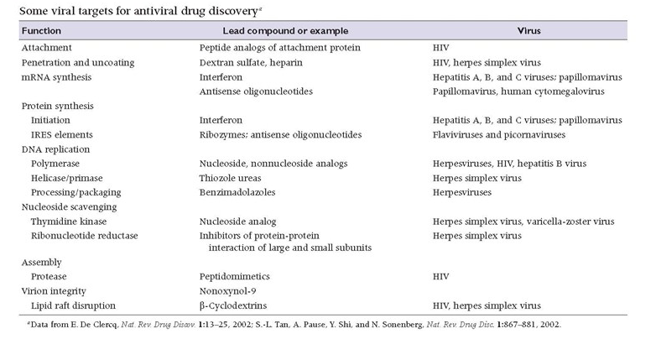

Slide 27
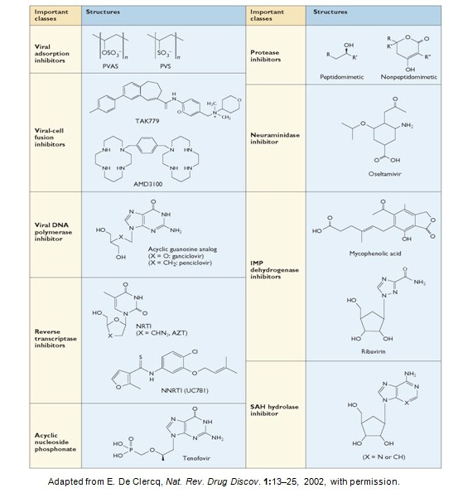
Many inhibitors are nucleoside analogues

Slide 28
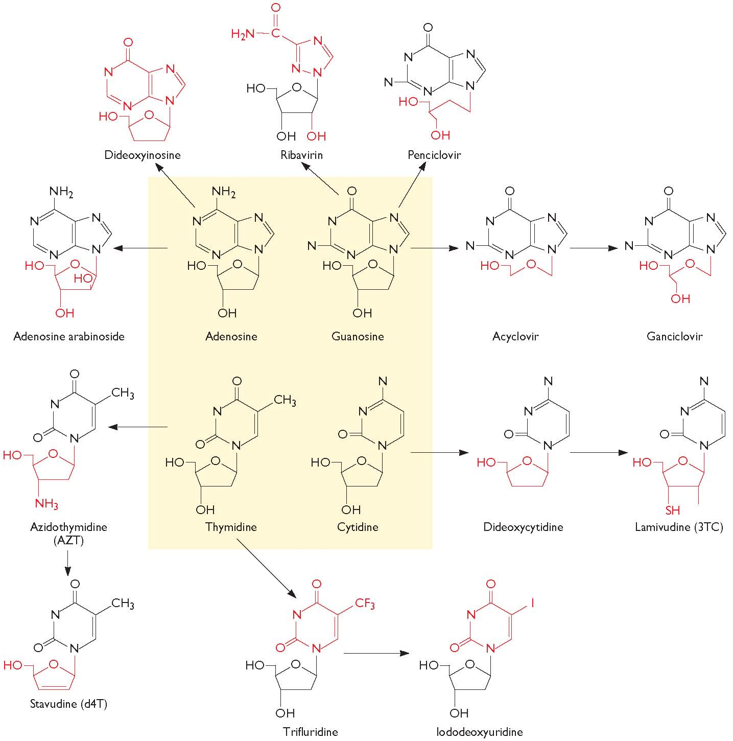
Nucleoside and nucleotide analogues

Slide 29
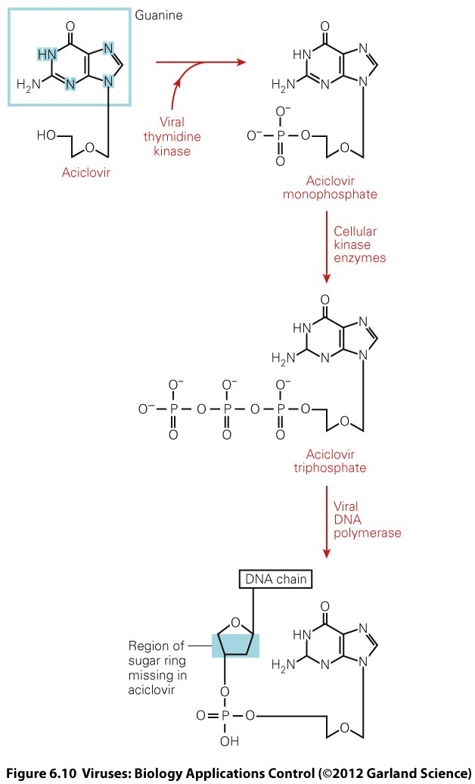
Acyclovir specificity
Only activated inside a virus infected cells
Higher affinity for viral DNA polymerase than for host cell polymerase
Resistance is rare but maps to thymidine kinase.

Slide 30
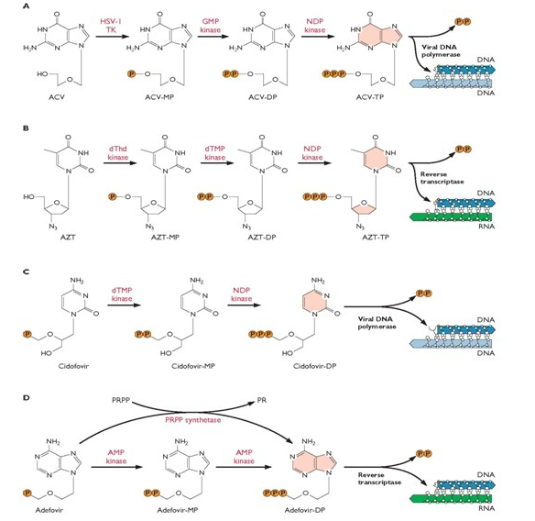

Slide 31
Antivirals against influenza
Target a unique and essential gene of the virus
Be effective against a range of influenza types and strains
Be easy to administer even to very sick patients
Few side effects for compliancy

Slide 32
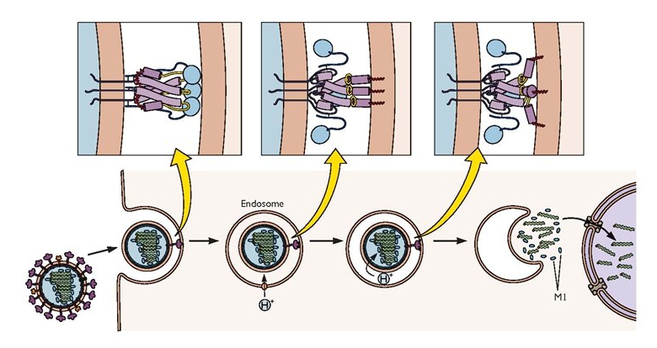
Low pH: Activates virus M2 channel protein Ions enter virions | M1/RNP contacts altered HA/M1 contacts altered | HA conformational change triggered Fusion peptide translocated | Ha<>membrane fusion

Slide 33
M2 the influenza virus ion channel

Slide 34
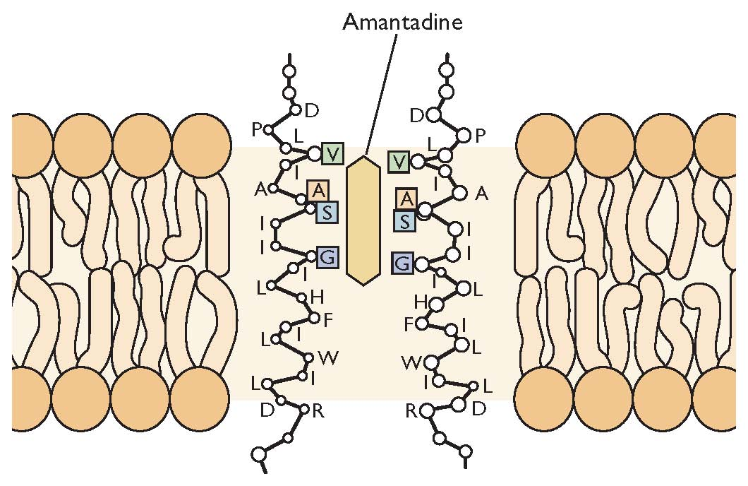
Adamantanes
Amantidine/Rimantadine
Cyclic amines with bulky, cagelike structures
By-products of petroleum refinement
Active against influenza A virus only (Influenza B no M2)
Notes:
6

Slide 35
Resistance to amantadine
Single point mutations e.g. S31N
Little cost to fitness, resistant virus virulent and transmissible
Most H3N2 circulating viruses are amantadine resistant.
Many H5N1 strains are resistant due to overuse in poultry industry.

Slide 36
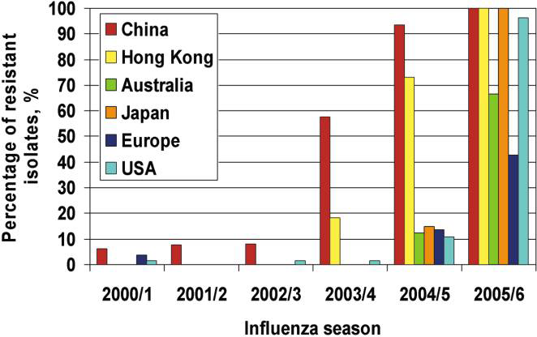
Amantadine resistance in H3N2 community isolates

Slide 37
The role of neuraminidase

Slide 38
Neuraminidase enzyme destroys cell surface receptor

Slide 39
Inhibiting NA inhibits virus spread

Slide 40
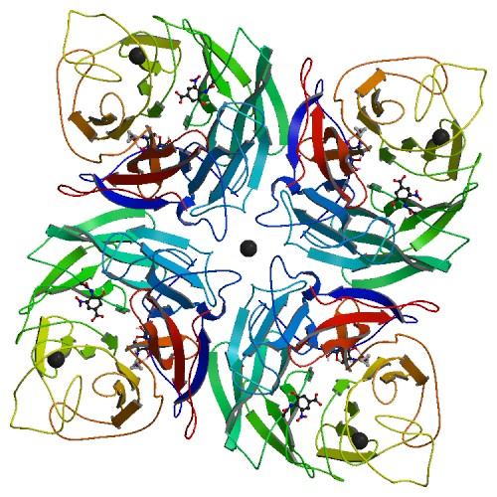
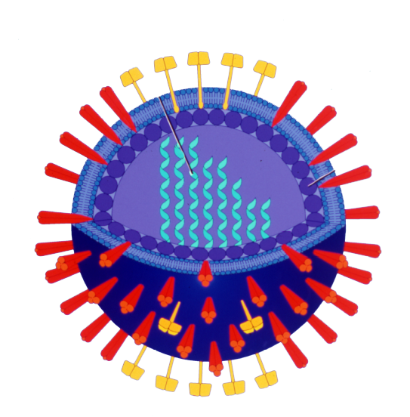
Neuraminidase crystal structure: facilitates drug design
Sialic Acid
RNA segments
NA
HA

Slide 41
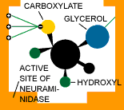
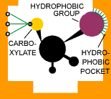
Neuraminidase inhibitors
Sialic Acid
Relenza
Tamiflu
zanamivir
oseltamivir

Slide 42
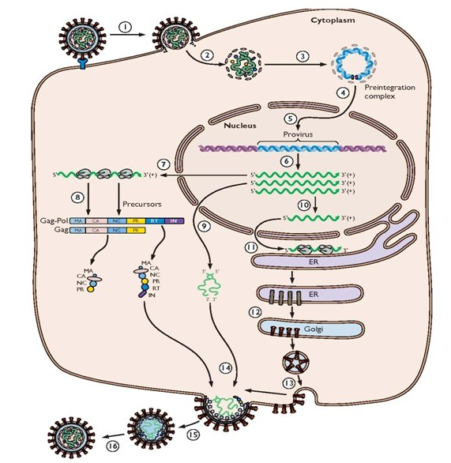
The replication cycle of HIV-1
1.2. Receptor binding, fusion (and endocytosis)
Entry Inhibitors
e.g. Enfuvirtide
Maraviroc
3. Genome Reverse transcribed >dsDNA
NRTI
e.g. Zidovudine(AZT)
Stavudine
4. Nuclear Transport and
5. Integration (Integrase, IN)
6. Transcription by host RNA PolII
Protease Inhibitors
e.g. Atazanavir (with Ritonavir)
Integrase
Inhibitors
e.g. Raltegravir
7. Full length mRNA, several purposes
- mRNAs for Gag and Gag-Pol precursors
- Full length RNA encapsidated
- Spliced to mRNA for Env polyprotein
11.12. Env proteins translated and
transported to Golgi, glycosylated,
cleaved to form SU-TM complex.
13.14 Gag, Gag-Pol precursors,SU-TM, viral
RNA, assemble at budding sites
15.16. Maturation and infectivity. action of virus protease (PR) cleaves Gag and Gag-Pol, core condensation

Slide 43
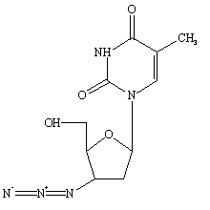
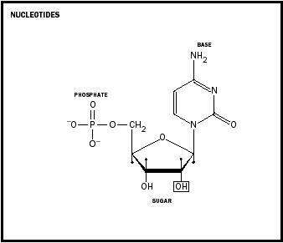
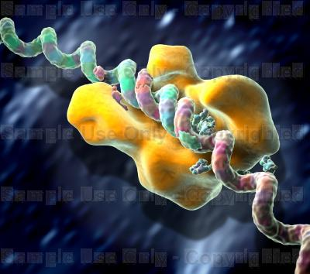
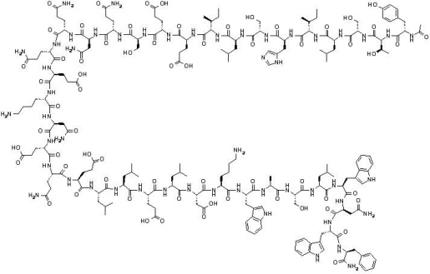
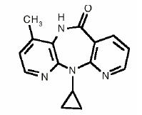
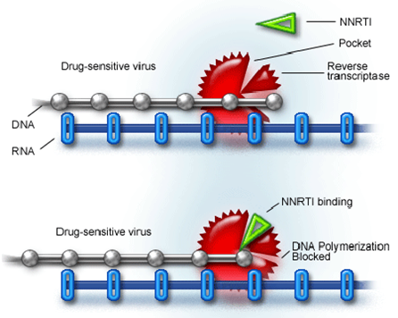
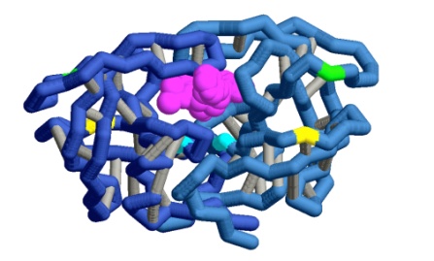
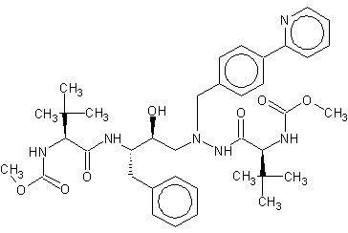
NRTI
Zidovudine
Stavudine
CCR5,CXCR4 inhibitors
e.g. Maraviroc
Blocks gp120/CXCR4
interaction
Entry Inhibitors
Normal nucleotide
T Helper cell
Looks like an Nucleotide
but doesn’t polymerise –
stops chain
CCR5
CXCR4
Reverse Transcriptase
generating DNA from RNA
CD4
Enfuvirtide
gp120
Binds HIV gp41 preventing
Membrane fusion
pore formation and entry
NNRTI
Efavirenz
Viramune
HIV
gp41
‘Allosteric
Inhibitor’
(binds enzyme but
not at the active site)
HIV Protease
Integrase Inhibitors
Raltegravir –
Blocks virus/host
DNA transfer
Viral DNA
Binds enzyme active site
and inhibits activity
Integrase
Protease Inhibitors
Atazanavir (generally taken with Ritonavir)
Integration
Host DNA

Slide 44
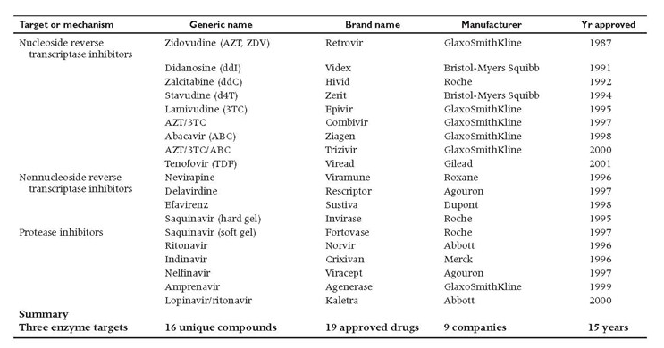

Slide 45
HIV drug resistance
Mutations arise due to error prone nature of reverse transcriptase and RNA pol II
With time the virus becomes resistant to single drug
Change drug
Mutations arise again
Solution: use several drugs simultaneously
  HAART (highly-active anti-retrovirus therapy)
  In widespread use in developed countries
  Harder for virus to develop multidrug resistance simultaneously
  Expensive

Slide 46
HAART: Highly Active Antiretroviral Therapy
Combinations cocktail: 2 nucleoside-analogue RTIs
1 non-nucleoside-analogue RTI or protease inhibitor.
20 pills/day
1 pill/day
Brand Name | Drug Names (INN) | Date of FDA Approval | Company
Combivir | zidovudine + lamivudine | September 26, 1997 | GlaxoSmithKline
Trizivir | abacavir + zidovudine + lamivudine | November 15, 2000 | GlaxoSmithKline
Kaletra | lopinavir + ritonavir | September 15, 2000 | Abbott Laboratories
Epzicom (in USA) Kivexa (in Europe) | abacavir + lamivudine | August 2, 2004 | GlaxoSmithKline
Truvada | tenofovir/emtricitabine | August 2, 2004 | Gilead Sciences
Atripla | efavirenz + tenofovir/emtricitabine | July 12, 2006 | Gilead Sciences and Bristol-Myers Squibb

Slide 47
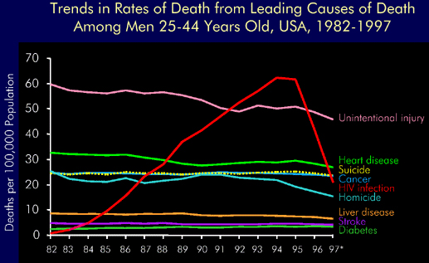
The effect of anti-HIV drugs

Slide 48
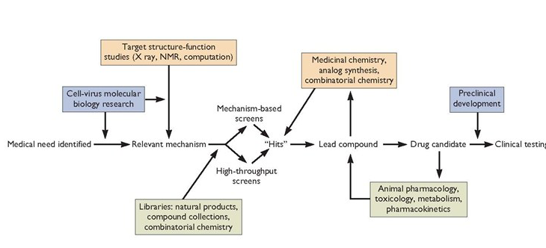
Pathways in Drug Development

Slide 49
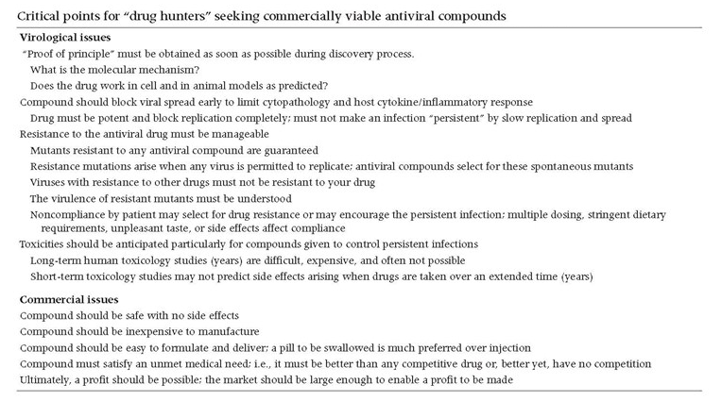

Slide 50
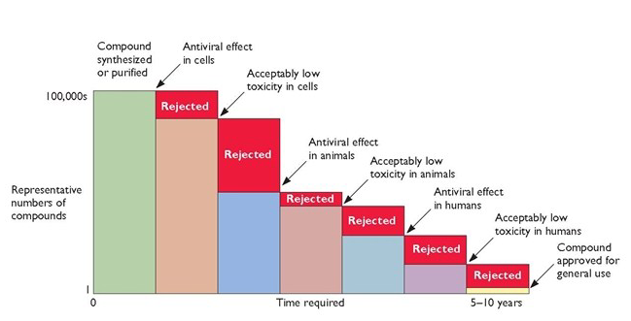

Slide 51
Viruses, friend or foe?
Viruses are valuable research tools:
  For study of cell biology and immunology
  For gene therapy
  As new vaccines
Some Nobel prizes in virology
  Max Theiler for the development of the Yellow fever vaccine
  Howard Temin and David Baltimore for the discovery of reverse transcriptase (in retroviruses)
  Harold Varmus and Michael Bishop for the discovery of oncogenes (in retroviruses)
  Phil Sharp and Rich Roberts for the discovery of splicing (in adenovirus)
  Luc Montagnier & Francoise Barre-Sinoussi (HIV) and Harald zur Hausen (HPV)

Slide 52
An Introduction to Virology
1. What are viruses and how do they replicate?
2. How do viruses cause disease?
3. How may virus diseases be prevented or treated?
Professor Peter O’Hare
Section of Virology
Faculty of Medicine
p.ohare@imperial.ac.uk

Slide 53
An Introduction to Virology
Principles of Virology. AMS Press. 3rd Edition
Flint et al, Molecular Biology, Pathogenesis and Control
Fundamental Virology. Raven Press
Fields & Knipe
Virology. Biology, Applications and Control Garland Science
Harper.
Virology: Molecular Biology and Pathogenesis. AMS Press.
Notkin

Slide 54
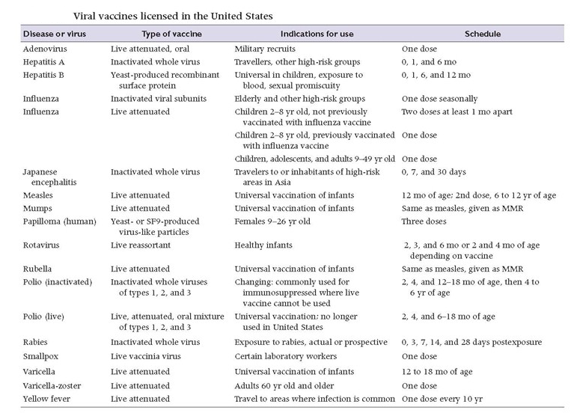

Slide 55
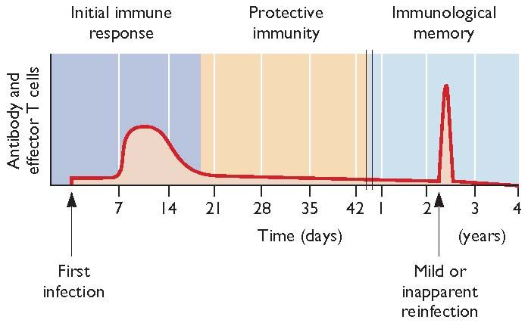
The immunological basis of protection after vaccination

Slide 56
Examples of viruses for which both live and inactivated vaccines are available
Influenza
Poliovirus
Inactivated virus or HA subunit
Updated regularly
DOES NOT give the recipient the flu!!!
LAIV is cold adapted
FluMist delivered intranasally
Updated regularly
Salk inactivated vaccine
Sabin live attenuated vaccine
1 in 7 million vaccinations associated with poliomyelitis
Persisting in immunosupressed individuals
Salk will be required for the ‘end game’.

Slide 57
The Thai trial RV-144 to test HIV vaccine
Combination of canary pox vector that delivers HIV antigens
Boosted with subunit gp120 of clade E
38% efficacy
But no one understands why!

