Slide 1
Antibiotic mechanisms of action and resistance
Dr Hema Sharma
Clinical Research Fellow
ST6 ID/MMV

Slide 2
Learning objectives
Understand the basic principles of mode of action of commonly used antimicrobials
Understand the basic principles of the different key resistance mechanisms used by bacteria

Slide 3
Selective toxicity
Harm the parasite, not the host
Utilisation of fundamental differences between bug and man

Slide 4
Prokaryotic cell structure
Notes:
Prokaryotes-unicellular organisms
Lack a cell nucleus and other membrane bound organelles

Slide 5
Selective toxicity

Slide 6
Selective toxicity
 | Prokaryote | Eukaryote
Peptidoglycan (PG) cell wall | Present | Absent
Ribosome | 70S | 80S
DNA replication | Differing enzymes
Folate synthesis | Differing mechanisms/enzymes

Slide 7
Selective toxicity
Notes:
Therefore current antibacterial targets include
Bacterial cell wall
Bacterial protein synthesis (ribosomes)
Bacterial enzymes
Bacterial cell membrane

Slide 8
Inhibitors of cell wall synthesis
Beta-lactams
Glycopeptides
Fosfomycin
Bacitracin
Cycloserine
These agents selectively inhibit bacterial cell wall synthesis at different stages of production

Slide 9
Inhibitors of cell wall synthesis

Slide 10
Inhibitors of cell wall synthesis

Slide 11
Inhibitors of cell wall synthesis

Slide 12
Beta-lactam antibiotics
Βeta-lactams include
Penicillins, cephalosporins, β-lactamase inhibitors and carbapenems
They are bactericidal antibiotics
Kill bacteria, cf static agents which inhibit bacterial growth

Slide 13
Beta-lactams: Mechanism of Action
Inhibit the final stage of PG synthesis by preventing cross linking of PG wall
They resemble D-ala-D-ala unit that is required for transpeptidation.
Selectively binds to and inhibit PBPs (enzymes responsible for crosslinking protein and sugars into PG)
Causes cell death by lysis

Slide 14
Penicillin Family
Penicillin V/ Penicillin G
Amino-Penicillins
Ampicillin/Amoxicillin/Co-amoxiclav
Anti-Staphylococcal
Methicillin/Oxacillin/Flucloxacillin
Anti-Pseudomonal
Piperacillin/Tazobactam (Tazocin)

Slide 15
Penicillin: Spectrum of Activity
1. Penicillin V/Penicillin G
Streptococci - α, β, γ
Not used for Enterococcus faecium
Pen G-Neisseria sp (GP’s)
2. Amino-Penicillins
Streptococci as above.
More active against Enterococcus faecalis (Not E faecium
and Listeria monocytogenes
Co-amoxiclav (Augmentin)
Staphylococcus aureus (not MRSA)/anaerobes/gram negative rods (GNRs)

Slide 16
Penicillin: Spectrum of Activity
Anti-Staphylococcal
MSSA
Anti-Pseudomonal
Piperacillin-tazobactam (Tazocin)
Pseudomonas aeruginosa, MSSA, some GNRs (check for resistance), anaerobes, Streptococci, +/- E faecium

Slide 17
Cephalosporins
Different generations, 1 to 4.
Increasing activity against G-ve from 1-4 but decrease against G+ve
Most commonly used:
IV – Cefuroxime - CXM (2G),
Cefotaxime - CTX (3/4G)
Ceftriaxone - CRO (3/4G)
Ceftazadime (3/4G) – (anti-pseudomonal)
PO – Cephalexin (Used for UTI)

Slide 18
Cephalosporins: Spectrum of Activity
Cefuroxime
Streptococci (Not E. faecium),
MSSA
GNRs (Esp gut, unless ESBLs)
N meningitides
Cefotaxime
As above but slightly more activity against GNRs
Ceftriaxone
Tx of choice in typhoid and meningococcal
meningitis

Slide 19
Cephalosporins
Traditionally important antibiotics
Used empirically, covers central nervous system, chest, abdominal and urinary sepsis
Community and hospital-acquired sepsis
Usage decreased drastically due to relationship with C difficile – associated diarrhoea (CDAD) and resistance

Slide 20
Carbapenems
Imipenem (caution in RF,Epilepsy)
Meropenem (safer, good CNS penetration)
Ertapenem not as widely used
Doripenem, watch this space
Spectrum of activity:
Tx of choice (depending on sensitivity) for multi-resistant bacteria especially extended-spectrum beta-lactamase producers (ESBLs) and those with inducible beta-lactamase resistance (AMPc)
Pseudomonas Aeruginosa, Streptococci (+/- E. faecium), MSSA, Listeria, anaerobes

Slide 21
Adverse Reactions: Penicillins, cephalosporins and carbapenems
Common
Penicillin allergy is reported in 10% of people
Rash, anaphylaxis
Cross-reactivity occurs, thus allergy to one type of beta-lactam antibiotic may suggest allergy to the others
Need to elicit a very specific allergy history from the patient

Slide 22
Inhibitors of cell wall synthesis
Glycopeptides
Bacteriocidal agents
Similar action to beta-lactams, bind to D-ala-D-ala to prevent cross-linking of peptodoglycan chain
Spectrum of activity
G +ve bacteria only
Streps, Staph (incl MRSA), some Enteroccoci, Listeria mono, C difficile sepsis
Adverse reactions
“Red man syndrome”
Nephrotoxicity and ototoxicity
Therpeutic drug monitoring required

Slide 23
Inhibitors of cell wall synthesis
Cycloserine
Acts in cell cytoplasm, inhibits enzyme involved in producing cell wall precursor
Fosfomycin
Acts in cytoplasm, inhibits formation of peptide chain
Bacitracin
Acts in cell membrane, inhibits essential lipid carrier required for cell wall structure
Isoniazid
Inhibits mycolic acid synthesis (unique to mycobacteria)

Slide 24
Protein synthesis

Slide 25
Inhibitors of protein synthesis
These act on either 30S or 50S subunits
Such agents include:
Tetracyclines
Aminoglycosides
Macrolides, lincosamides, streptogramins
Chlormaphenicol
Fuscidic acid
Linezolid

Slide 26
Tetracyclines
Inhibit bacterial protein synthesis
Act on 30S subunit of ribosome
Bacteriostatic agents
Doxycycline most commonly used tetracycline
Spectrum of activity
G+ve (inc MRSA/VRE) + G-ve
LRTIs/UTI, Skin infection
Spirochaetal infection (Chlamydia/Lyme), tick typhus (RMSF), Malaria
Adverse reactions
Photosensitivity, tooth discolouration

Slide 27
Tigecycline
Semi-synthetic derivative of minocycline
Bacteriostatic
Mainly used to combat multidrug resistant organisms, inc MRSA, VRE, A baumanii
Importantly, it has NO activity against Pseudomonas

Slide 28
Aminoglycosides
Rapidly bactericidal
Acts on 30S subunit, causes misreading of bacterial mRNA to prevent protein synthesis and prevents formation of initiation complexes
Spectrum of activity
G –ve organisms
Used synergistically with penicillin in endocarditis
Used empirically in the treatment of septic shock
Adverse reactions
Nephrotoxicity and ototoxicity, dose related
Requires accurate dosing and monitoring of levels

Slide 29
Aminoglycosides
Therapeutic dose monitoring (TDM)
Based on renal function (Creatinine clearance)
CrCl | Dose
>40ml/min | 5mg/kg IV OD
20-40ml/min | 3mg/kg IV OD
<20ml/min | Discuss with pharmacy

Slide 30
Inhibitors of protein synthesis
Macrolides, lincosamides, streptogramins
All act on closely related sites on 50S ribosomal subunit
Macrolides bind to free ribosomes to prevent protein synthesis, bacteriostatic
Lincosamides indirectly inhibit synthesis by blocking the P site, bacteriostatic
Commercial streptogramins are dual molecules; part A inhibits synthesis, part B enhances A’s activity, bacteriocidal

Slide 31
Macrolides
Different macrolides based on ring structure
14M: Erythromycin, Clarythromycin
15M: Azithromycin
Spectrum of activity
Skin and soft tissue infections
Pneumonia including atypical pneumonias
GI – campylobacter/helicobacter
STDs – gonorrhoea/chlamydia
Adverse reactions
Gastrointestinal upset

Slide 32
Inhibitors of protein synthesis
Linezolid
Oxazolidinone
Acts at earlier stage of protein synthesis than other inhibitors
Acts on 50S to prevent formation of total ribosome (70S)
Used to treat G +ve organisms
Is effective against MRSA
Oral agent

Slide 33
Inhibitors of nucleic acid synthesis
Fluoroquinolones
Inhibit DNA gyrase, responsible for DNA supercoiling, esp in G-ve organisms
Inhibits topoisomerase IV, particularly important in G+ve organisms
Bacteriocidal agents
Ciprofloxacin
Only oral option for Pseudomonas
May be active against resistant G-ve organisms (ESBL/AMPc)
Excellent bone penetration and good secretion into the urinary tract

Slide 34
Fluoroquinolones
Levofloxacin/moxifloxacin
Have no anti-pseudomonal activity
Mainly used for LRTIs
Adverse reactions
Risk of C. difficile diarrhoea

Slide 35
Inhibitors of nucleic acid synthesis
Rifampicin
Inhibits DNA-dependent RNA polymerase, ie prevents transcription of RNA from DNA
Bacteriocidal
Sulfonamides and trimethoprim inhibit folate synthesis by inhibiting key enzymes
Sulfonamides inhibit dihydropteroate synthase
Trimethoprim inhibits dihydrofolate reductase

Slide 36
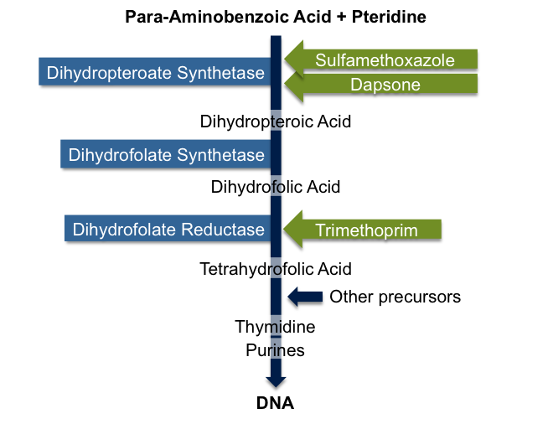

Slide 37
Inhibitors of nucleic acid synthesis
Metronidazole
Binds bacterial DNA resulting in strand breakage
Only active when the nitro group is reduced, therefore only effective against anaerobic bacteria
Nitrofurantoin
Causes DNA strand breakage

Slide 38
Cell membrane active agents
Polmyxins (colistin)
Cationic detergent
Daptomycin
Ca²⁺ dependent, results in membrane depolarisation

Slide 39
Spectra of action
Gram +ve | Gram –ve | Broad
Rifampicin | Polymixins | Penicillins+betalactamase inhibitor
Fuscidic acid | Aminoglycosides³ | Cephalosporins
Clindamycin¹ | Monobactams | Carbapenems
Macrolides^{1,2} | Temocillin | Tetracyclines
Linezolid |  | Chloramphenicol
Glycopeptides | 1. And G-ve anaerobes 2. And Neisseria 3. And staph aureus
Penicillin G²

Slide 40
Antibiotic Resistance
Antimicrobials are amongst the most important medicines ever discovered
Approximately 70% of bacteria are resistant to at least one first line agent
Serious threat to public health
WHO, 2009 named antimicrobial resistance as the 3rd biggest threat to human health
There are few new drugs in the pipeline
Threatens a return to the pre-biotic era
Notes:
-and have been a driving force for the rise in life-expectancy over the last 70 years
underpin modern medicine supporting advances in neonatology, onc, haem, nephrology and transplant.
-This makes infections harder to treat
and resistance is developing faster then there are new abx.
-

Slide 41
WHD 2011 slogan

Slide 42
Mechanisms of antimicrobial resistance
Notes:
Mechanisms of antibiotic resistance in bacteria
1. Antibiotic modification-rendering the antibiotic inactive
2. Impaired entry of the antibiotic into the cell
3. Anitbiotic efflux pumps-prevent antibiotic from entering the cell and reaching its target
4. Alteration in antibiotic target site
5. Metabolic bypass-microbe creates an alternate pathway to circumvent the action of the antimicrobial

Slide 43
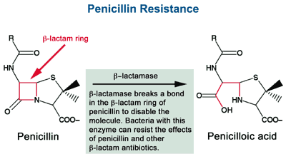
Antimicrobial inactivation or modification
β-lactamases
Hydrolyse the β-lactam ring of penicillin and inactivate antibiotic action
>600 β-lactamases reported to date
http://www.wiley.com/college/pratt/0471393878/student/activities/bacterial_drug_resistance/index.html
Notes:
1st penicillinase recognised in SA
1940s benzpen was introduced
1950s-40-80% of SA resistant due to the production of penicillinase transferred between strains on plasmids
Now only 2% fo all SA are pen S
Aminoglycoside-modifying enzymes
3 main groups
Enterococci
Associated with high level gent resistance (HLGR)
HLGR is associated with decreased synergism in IE
Chloramphenicol acetyltransferases (CAT)

Slide 44
Target site alteration
http://medicalsciences.wordpress.com/category/infectious-disease/
Notes:
Mechanism of resistance to methicillin in MRSA and penicillin resistance in S. pneumos
Penicillin resistance in Strep pneumo (SPn)
Pneumococci have 6 different PBPs
‘foreign’ DNA is taken up by SPn and integrated into its chromosome to form mosaic genes (transformation)

Slide 45
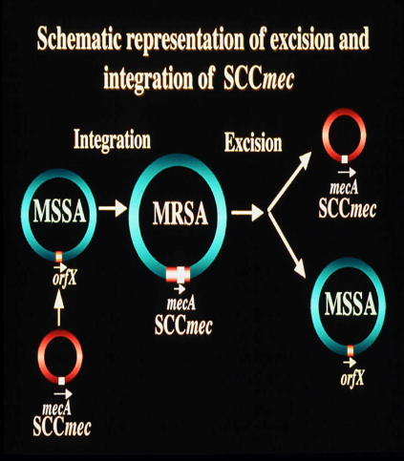
Methicillin- resistant Staphylococcus aureus
1960
Methicillin introduced to combat penicillin resistant S. aureus
1961
Methicillin resistance reported
Expression of novel penicillin binding protein-PBP2a
Low binding affinity for β-lactams
http://www.staphylococcus.net/Pages/SCCmecDescriptionEN.html
Notes:
Semi-synthetic penicillin stable against staphylococcal b-lactamase
Encoded by mecA gene
Integrates into the chromosome of methicllin-sensitive S. aureus and renders it resistant
MecA gene belongs to the SccMec

Slide 46
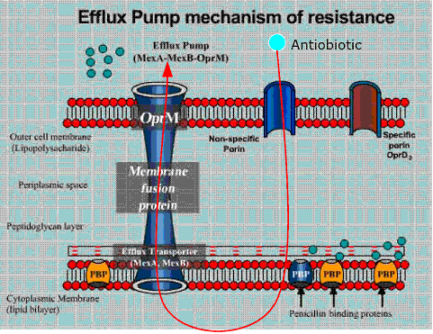
Antibiotic efflux from the cell
Antibiotic is ejected from the cell in an energy dependent process
Mechanism of resistance to tetracyclines, erythromycin resistance in Streptococcus pneumoniae
http://medicalsciences.wordpress.com/category/infectious-disease/

Slide 47
Impaired antibiotic entry
http://medicalsciences.wordpress.com/category/infectious-disease/
Notes:
Mechanism of carbapenem resistance.
Decreased penetration
Cell wall permeability
Outer membrane of GNRs exclude large, hydrophobic molecules (eg glycopeptides, rifampicin)
Cytoplasmic membrane in anaerobes exclude aminoglycosides
Endogenous in many gram negatives
Pseudomonas has several

Slide 48
Metabolic bypass
http://en.wikipedia.org/wiki/File:THFsynthesispathway.png
Notes:
Sulphonamide and trimethoprim resistant bacteria produce additional enzymes that are unaffected by antibiotics and bypass their inhibition

Slide 49
β-lactamases in gram negative bacteria
Class | Active site | Examples – Chromosomal | Examples- Plasmids
A ESBLs (Inhibited by clavulanate) | Serine | Bacteroides, Klebsiella spp | TEM, SHV, ESBLs, CTX-M
B | Zinc | S maltophilia, Aeromonas spp | Carbapenamases, IMP, VIM, NDM
C (not inhibited by clavulanate) | Serine | Enterobacter spp, C freundii, Pseudomonas | AmpC B-lactamases
D | Serine | Aeromonas | OXA-class B-lactamases
SHV
K. pneumoniae
Extended spectrum B-lactamases, ‘ESBLs’
Resistant to 3rd generation cephalosporins
TEM and SHV mutants
CTX-M
CTX-M-15 widely prevalent in resistant E.coli in the community
AmpC
Encoded on the bacterial chromosome
Expression is inducible
TEM
Mechanism of of E. Coli resistance to penicillin
Spread N. gonorrhoea and H. influenzae
Notes:
TEM-1
First described in 1965
Spread to 30% of e.coli and other enterobacteriacae by mid-1970s
Mech of pen and amp res in HI and N. gon
1st hosps, then comm
ESBLs
-mutations in TEM and SHV (chromosomal b-lactamase of cephalosporins)
-Plasmid mediated
Able to hydolyse ‘B-lactamase stable’ 3rd generation cephalosporins created to combat TEM mediated resistance
CTX-M
More active against cefotaxime than ceftazidime
Not derived from TEM or SHV
Genes have escaped from kluyvera sp
>90 enzymes described
Widely prevalent in E Coli in the community -
Enzymes produced by Gram –ve bacteria. (Gram +ve’s have other resistance mechanisms, mostly involving PBP’s)
Confer resistance to Beta-lactam Antibiotics (PNC, Cephalosporins, Monobactams, Carbapnems).
Can be chromosomal or plasmid-mediated

Slide 50
Strategies to prevent and control antimicrobial resistance
Education of patients
Improving antibiotic prescribing
Infection prevention and control
Notes:
Regardless of aetiology
In a one study 85% of patients thought their respiratory symptoms were caused by infection and 87% believed that antimicrobials would help.
One-fifth of these patients specifically asked their physician to prescribe an antimicrobial
Another study showed that patients’ expectations for a prescription were met 75% of the time by prescribers
Professional medical advice impacts patients’ perceptions and attitude towards their illness and perceived need for antibiotics, in particular when they are advised on what to expect in the course of the illness, including the realistic recovery time and self-management strategies

Slide 51
Improving antimicrobial prescribing
Prescribe when there is likely to be a benefit
Use an agent specific for the likely pathogen
Avoid broad spectrum antibiotics when possible
Use an appropriate dose for an appropriate duration
High dose, short duration better than low dose, long duration
Antibiotic policy
Based on local data
Limits choice, limits toxicity, allows familiarity with dose and monitoring
Notes:
Protects against CDAD also, reserves abx for 2nd line rx.
90% 7/7, nnt quinsy >4000

Slide 52
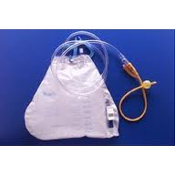
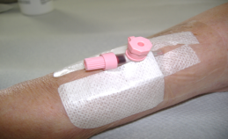
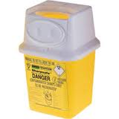
Infection prevention and control
Notes:
Hand hygiene
PPE
VAD
Safe disposal of shaprs
Catheter care

Slide 53
When prescribing antimicrobials….
Consider:
Previous antimicrobial history
Previous history of infection with resistant pathogens
Allergies
Send specimens for investigation when an infection is failing to respond to therapy or if resistance is suspected

Slide 54
Antibiotic resistance

