Slide 1
Tuberculosis management
Dr Moerida Belton
MRC Clinical Research Training Fellow
Specialist Registrar Respiratory Medicine

Slide 2
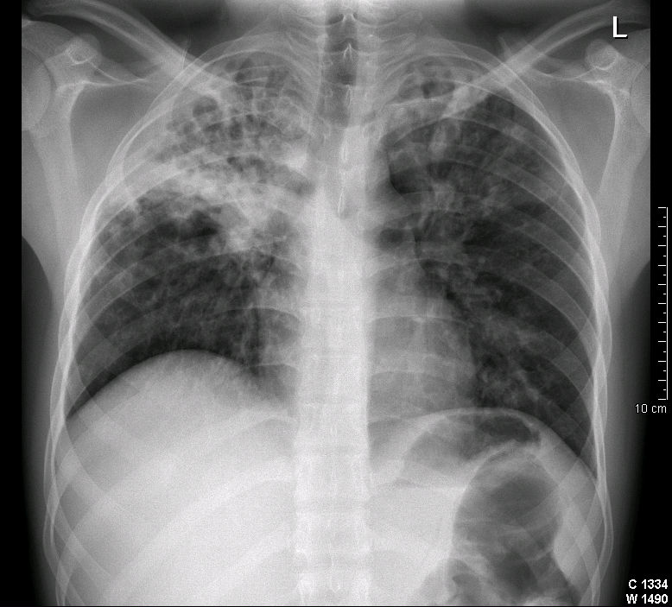
Case 1
21 year old male from Ecuador
Presented with cough, weight loss, diarrhoea
What is the diagnosis?

Slide 3
Sputum 5/5 positive for AFB
How do we diagnose TB?
Should infectious patients should be isolated?
What treatment should he be started on?
What about the people he has been in contact with?
Should be able to answer these questions by the end of the lecture!

Slide 4
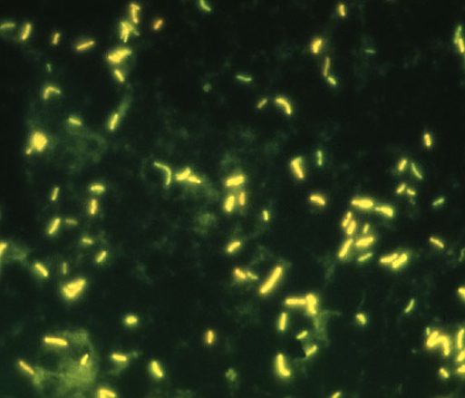
Question 1
How do we diagnose TB?
Clinical diagnosis
Typical scenario
Response to therapy
Identify organism
Microscopy
Culture/sensitivities (4-8 weeks)
New/faster tests in pipeline
Typical pathological changes

Slide 5
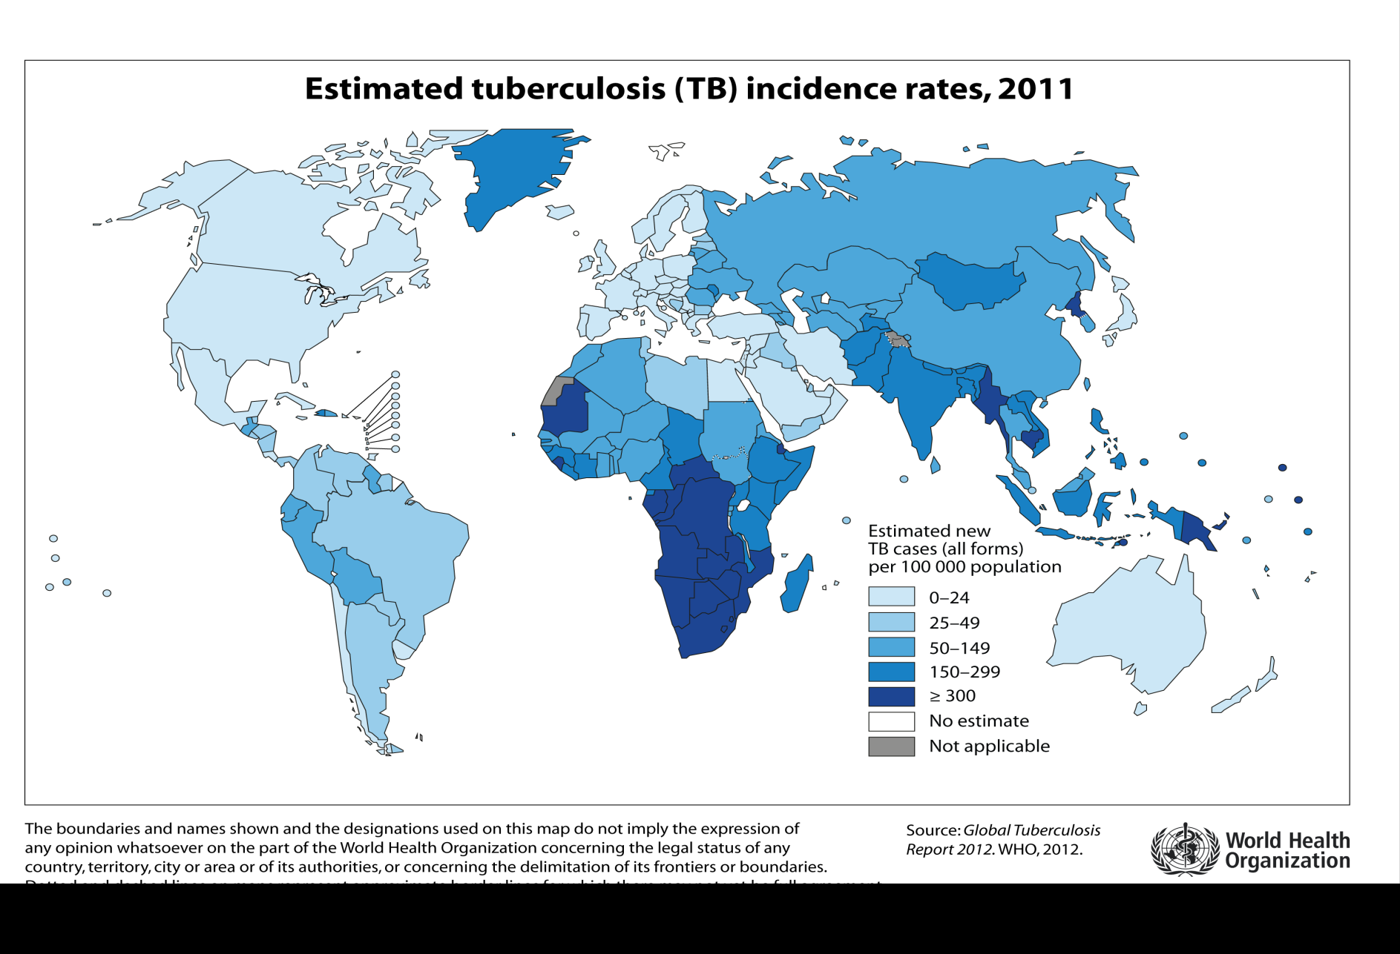
Tb epidemiology worldwide

Slide 6
Figure 1.1. Tuberculosis case reports and rates, UK, 2000-2011
CI - Confidence interval
Sources: Enhanced Tuberculosis Surveillance (ETS). Enhanced Surveillance of Mycobacterial Infections (ESMI). Office for National Statistics (ONS) mid-year population estimates.
Prepared by: TB Section - Health Protection Services, Colindale.

Slide 7
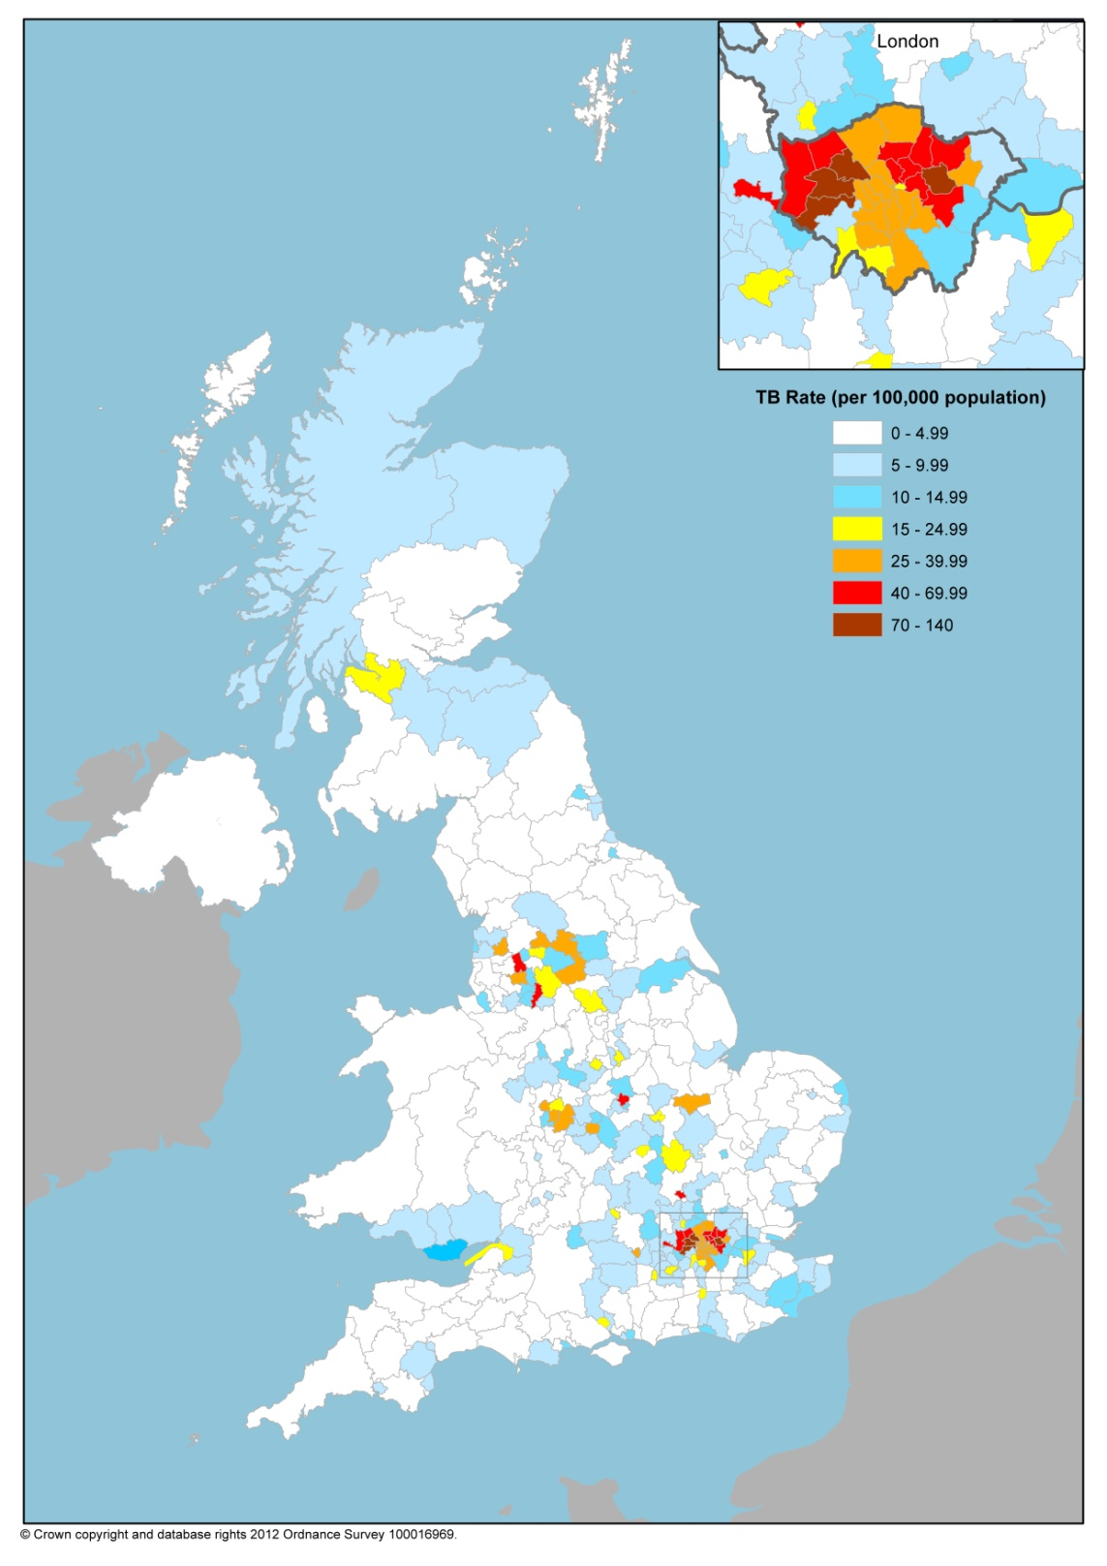
Figure 1.4. Three-year average tuberculosis case rates by local areas*, UK, 2009-2011
*England – Local Authorities, Scotland – NHS Boards, Wales – Local Health Boards, NI – data not available.
Sources: Tuberculosis in the UK: Annual report on tuberculosis surveillance in the UK, 2012. London: Health Protection Agency. July 2012.

Slide 8
Figure 1.3. Tuberculosis case reports and rates by region, England, 2011
CI – Confidence interval
Sources: Enhanced Tuberculosis Surveillance (ETS), Office for National Statistics (ONS) mid-year population estimates.
Data shown in Appendix B; ii, iii.
Prepared by: TB Section - Health Protection Services, Colindale.

Slide 9
Therapy for Mtb
Prolonged
To eradicate the organisms
Very slow growing/intracellular
Multi-drug
Speed killing
Combat resistance

Slide 10
Mycobacterium tuberculosis response to therapy
Rapid growers – 98% dead within 1 week
Slow growers – weeks to months to die
Sporadic growers – months to eradicate

Slide 11
Treatment of tuberculosis
Multiple drugs needed for at least 6 months
Rifampicin
Isoniazid
Pyrazinamide
Ethambutol
Multiple-drug resistant disease: at least 18 months
Extensively-drug resistant disease: even more difficult

Slide 12
Rifampicin (rifampin)
Bactericidal
Kills both active and semi-dormant bacteria
Excellent absorption
Hepatic metabolism, bile excreted
Potent inducer cytochrome P450
High drug interactions eg OCP, warfarin, corticosteroids, methadone
Bi-directional effects with anti-retrovirals
Dose: 10mg/kg (600mg max)
Orange urine, tears, stain contact lens: universal
Skin reactions: itch etc up to 6%
Abnormal liver function: usually transient
‘Flu-like’ reaction
Haemolysis: Rare
Interstitial nephritis

Slide 13
Isoniazid
Only active against Mtb
Kills actively dividing cells
Excellent oral absorption
Therapeutic levels in CSF
Metabolisied by acetylation
Slow acetylators increased neurotoxicty
Excreted in urine
Dose: 5mg/kg (300mg max)
Hepatoxicity: 1%
Small AST rise frequently occurs
Increased with age
Also with underlying liver disease
SLE-like syndrome <1%
Neurotoxicity 0.2%
Neuropathy, optic neuritis, encephalopathy, psychosis
Preventable with vitamin B6 – pyridoxine 10 mg/day
Indicated if malnourished, alcoholic, HIV, extensive TB

Slide 14
Pyrazinamide
Thought to kill dormant / acidic bacteria
Inhibits fatty acid synthesis
Well absorbed
Good CSF penetration
C/I in gout and severe liver disease
Hepatic metabolism : pyrazinoic acid
Inhibits renal excretion of uric acid
Dose: 20-25mg/kg/day
Hepatotoxic
GI disturbances
Arthralgia: minor

Slide 15
Ethambutol
Bacteriostatic
Inhibits arabinosyl transferase
80% oral absorption inhibited by alcohol
Poor CSF penetration unless active meningitis
Dose: 15mg/kg/day
Optic neuritis most serious complication
Rare if less than 25 mg/kg/day
Colour vision and visual field loss
Monitor visual acuity at each visit
Ophthalmology review if therapy >2 months

Slide 16
Combination preparations
Rifater
Rif (120mg) + INH (50mg) + PZA (300mg)
40-49kg 4 tabs, 50-64kg 5 tabs, >65kg 6 tabs
Rifinah
Rif + INH
<50kg 3 Rifinah-150, >50kg 2 Rifinah-300
Improve adherence
Minimise resistance
India: Accurit-4
Rif + INH + Pyrazinamide + Ethambutol
Can dose with food is helps symptoms

Slide 17
Short Course Therapy for Tuberculosis
2 months
Isoniazid
Rifampicin
4 months
Isoniazid
Rifampicin
Pyrazinamide
Ethambutol
Pyridoxine 10mg od throughout
Vitamin D supplementation ??

Slide 18
Special circumstances
Cavitary patients smear +ve at 2 months 9/12
No initial PZA 9/12
TB meningitis 12/12
Steroids
TB pericarditis Steroids
Renal failure Eth → Moxifloxacin

Slide 19
Case 2
Contact of patient with smear positive Tb
Bolivian
No past medical history
Feeling well
Blood Normal CRP <5
Positive mantoux 16mm

Slide 20
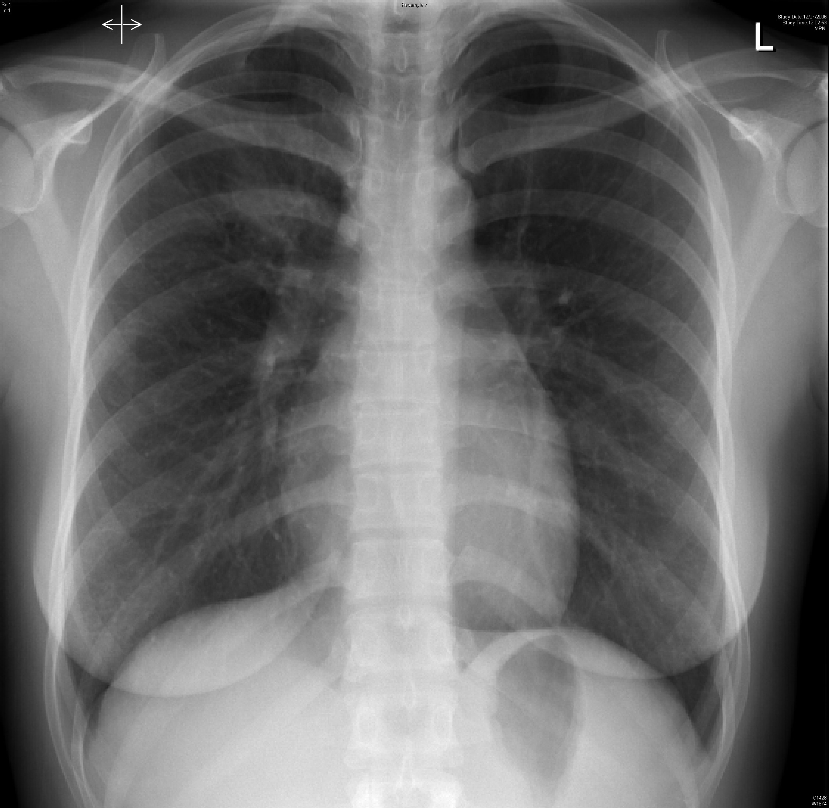
CXR 12th July
Normal or abnormal?

Slide 21
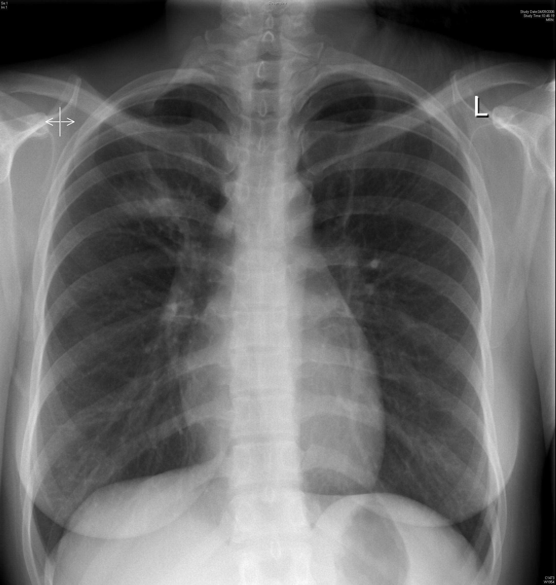
CXR 4th Sept
Normal or abnormal?
X3 sputum samples negative for AFB, next investigation?

Slide 22
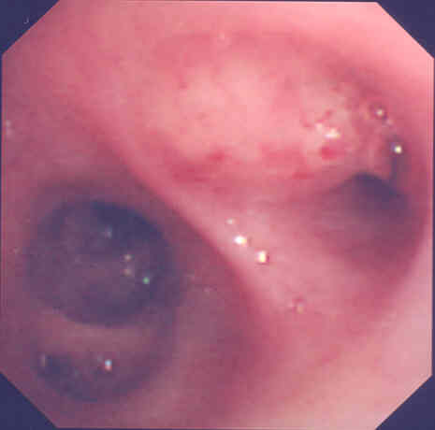

Slide 23
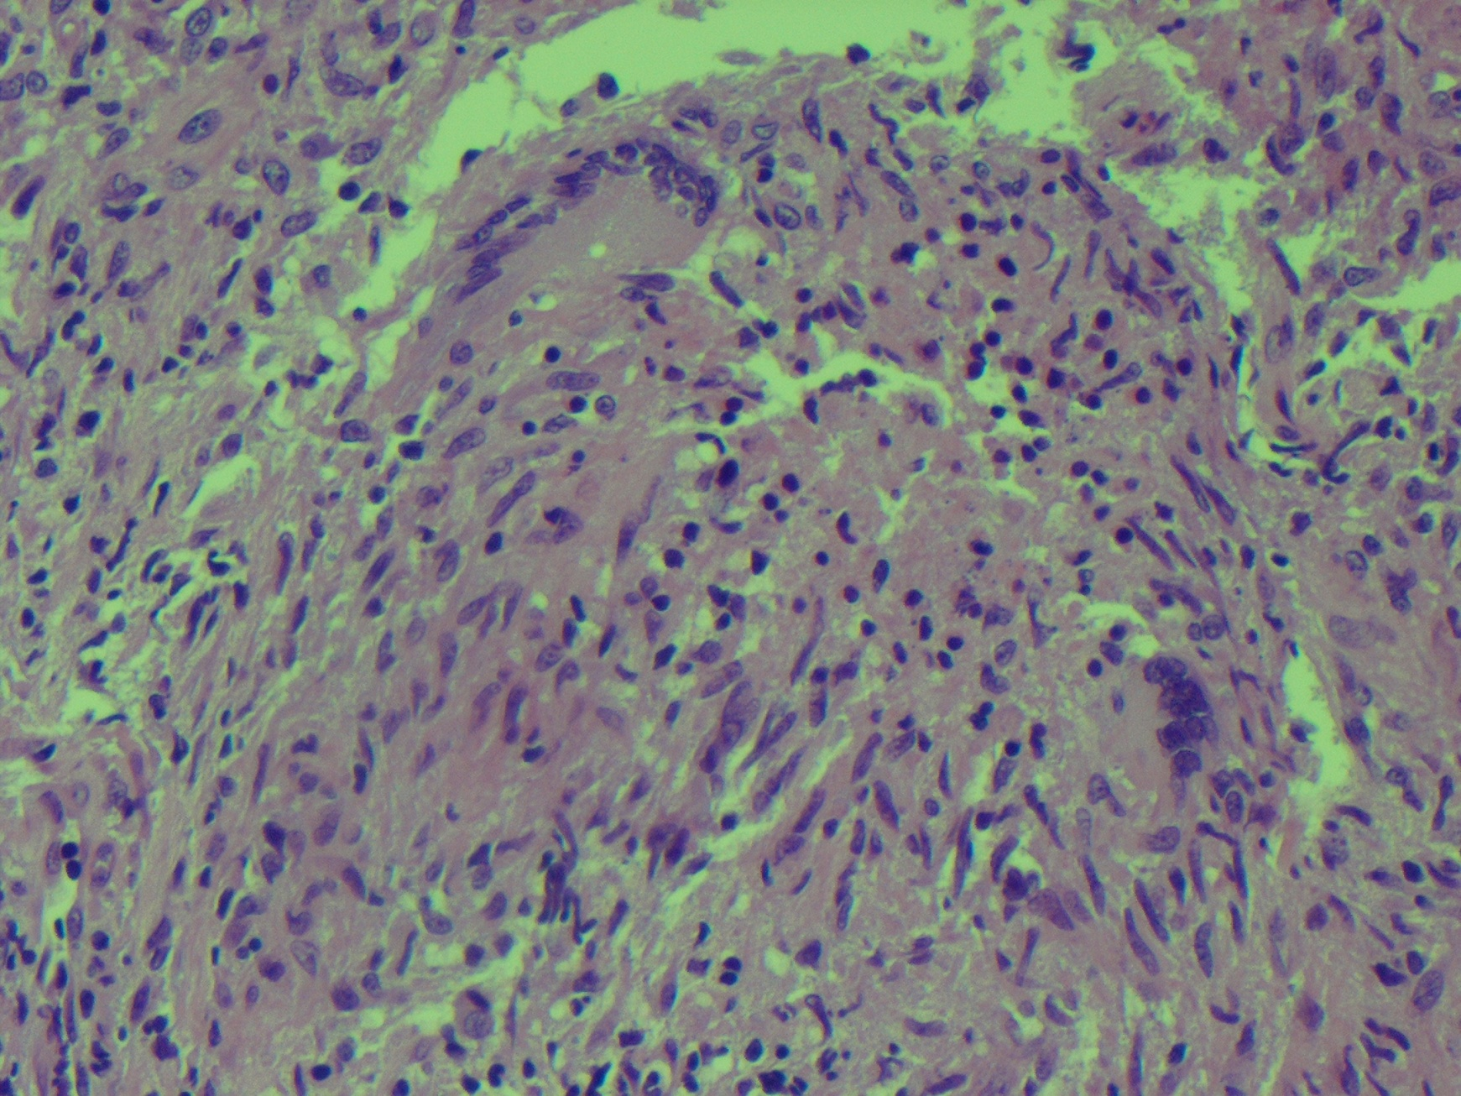

Slide 24
Progress
Cultured fully sensitive Mtb
Did not return to clinic
Tb nurses contacted
Evidence of alcohol problem
? Next appropriate step?

Slide 25
Directly observed therapy - DOT
Mycobacteria are slow growing
Long post-antibiotic effect
Amenable to intermittent treatment
2 or 3 times per week
‘Carrot and stick’ approach
3x per week regime
Isoniazid 15mg/kg (max 900mg)
Rifampicin 600 – 900mg (15mg/kg)
Pyrazinamide <50kg, 2g, >50kg 2.5g
Ethambutol 30mg/kg

Slide 26
Can we shorten the duration of therapy?
AJRCCM 2009 180: 558
Tried to identify patients who could have 4/12 treatment
Non-cavitary TB with negative sputum culture at 2/12. HIV -ve
Standard Rx for 4/12
Then randomized to stop or continue
394 patients enrolled, stopped by safety monitoring committee
Increased relapse in short course treatment
13 relapses vs 3 (p 0.054)

Slide 27
Interruptions in therapy
Evidence is scant
In first 2 months
If >14 days, start from scratch
If <14 days, carry on
After 2 months, most clinicians use 4 weeks as cut-off
Patients should always go on to DOT if interruption occurs

Slide 28
Monitoring on therapy
Warn patient
Stop therapy and seek immediate advice if become jaundiced or suffer visual loss
Other side effects can often be treated through
Eg Omeprazole, cyclizine, anti-histamines, NSAIDs
Check colour vision and acuity prior to commencing ethambutol and at each visit
Role/frequency of liver function testing uncertain
Hammersmith practise is to test at 2/52
Others advocate not treating unless symptomatic

Slide 29
Re-introduction after hepatotoxicity
AST >3x normal with symptoms or >5x asymptomatic
BHIVA guidelines useful
Often do not get recurrence of hepatotoxicity
Can cover with Amikacin and Moxifloxacin if unwell
Guidelines for the reintroduction of anti-tuberculous chemotherapy following elevation of liver function tests or cutaneous reaction grade 1-3
Day Isoniazid Rifampicin Pyrazinamide
__________________________________________________________________
1 50mg _
2 150mg _
3 300mg _
4 300mg 75mg _
5 300mg 150mg _
6 300mg 300mg _
7 300mg 450mg > 50kg / 600mg < 50kg _
8 300mg 450mg/600mg 250mg _
9 300mg 450mg/600mg 500mg _ 10 300mg 450mg/600mg 1g _
11 300mg 450mg/600mg 1.5g > 50kg / 2g < 50kg
12 300mg 450mg/600mg 1.5g/2g
13 300mg 450mg/600mg 1.5g/2g

Slide 30
Case 3
54 year old man
History of alcohol excess
Presented with cough and weight loss

Slide 31
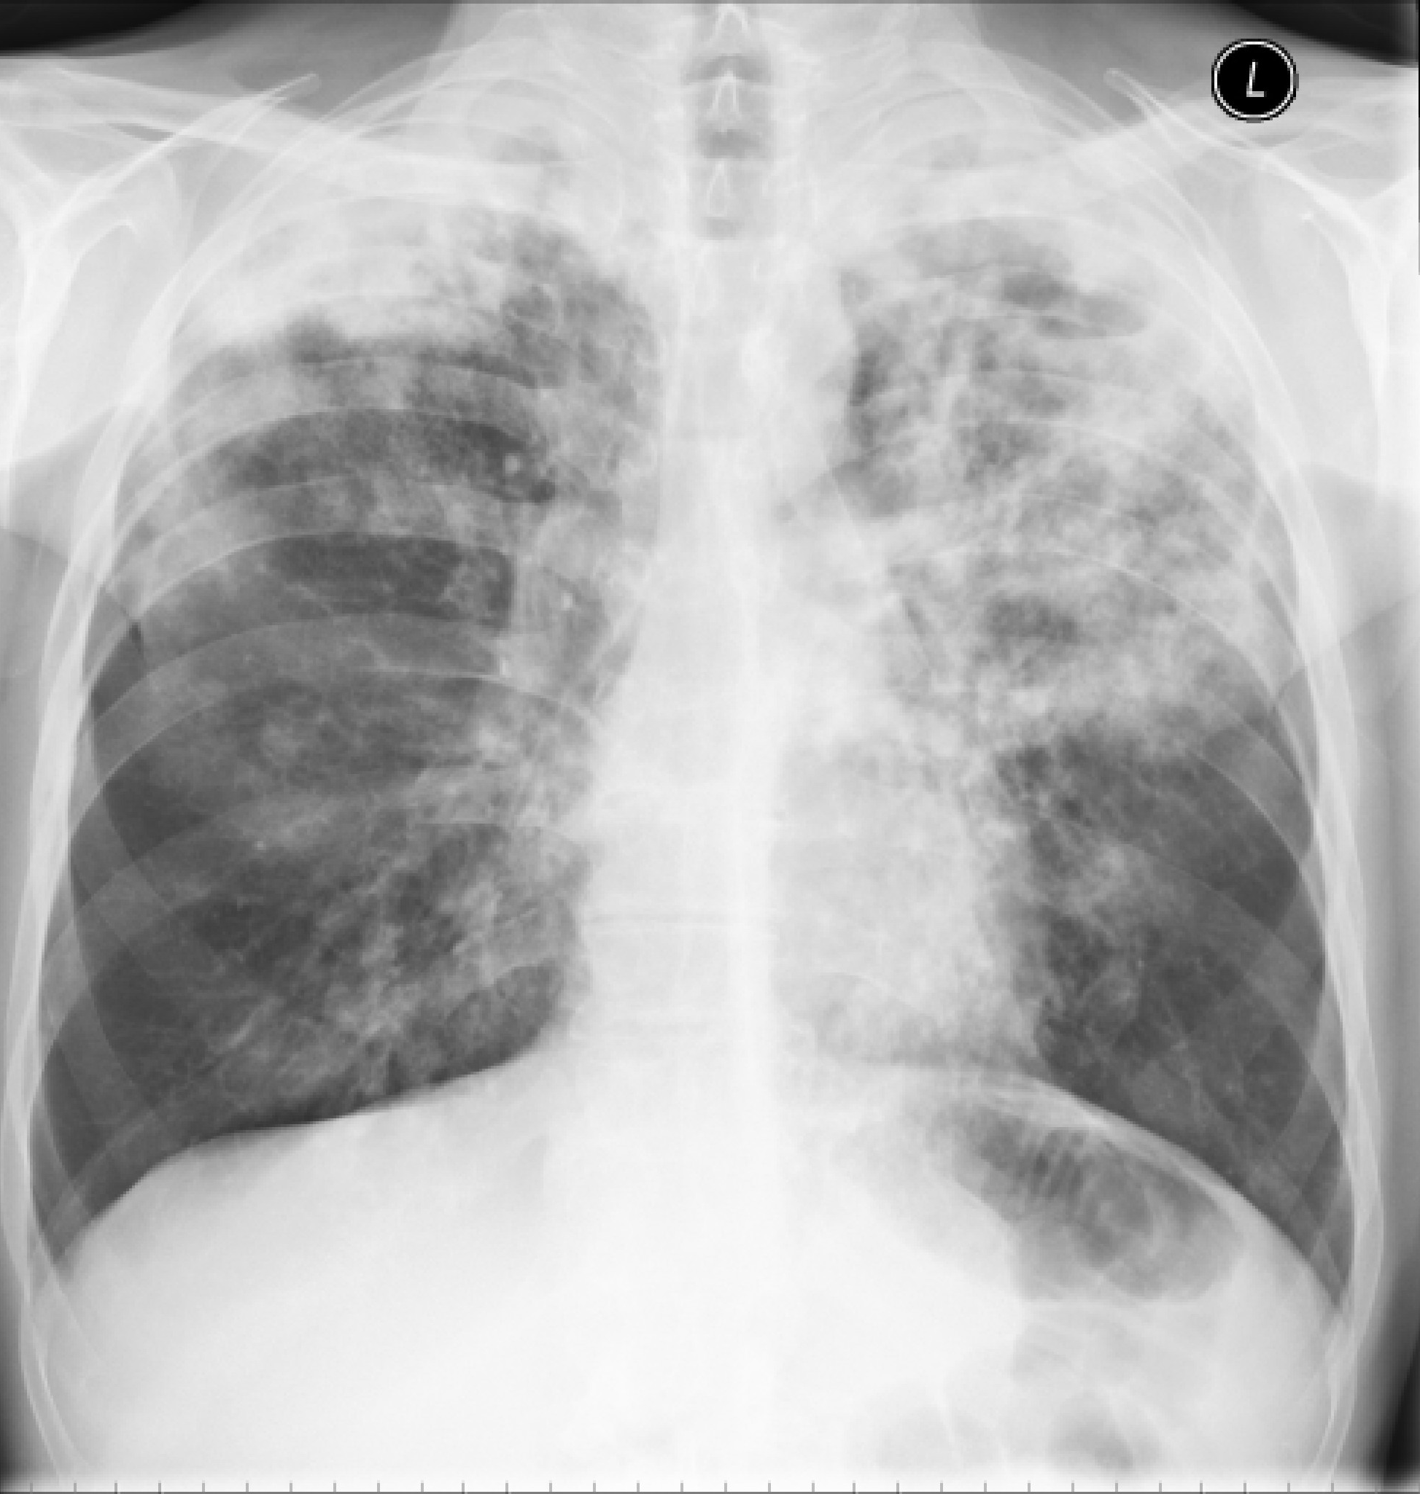
Notes:
In conclusion
We have shown that M. tb is a potent stimulus for de novo synthesis and secretion of MMP-9.
MMP-9/ CSF leukocyte was significantly higher in TBM than BM or VM, was raised in non survivors and was higher in patients with specific signs of cerebral damage.
Moreover, since TBM is a meningo-encephalitis, monocytes in TBM are spread widely throughout the brain parenchyma and are therefore potentially more harmful, compared to BM where the inflammatory cell infiltrate is confined to the brain surface.
TIMP-1 was constitutively expressed in vitro and in vivo but our data suggests that it is not upregulated sufficiently in TBM to limit the harmful effects of MMP-9.
Monocyte-derived MMP-9………may therefore…….

Slide 32
Sputum 4/5 samples positive for AFB
Large number of AFBs seen
Heavy growth of drug resistant MTb

Slide 33
Multi-drug resistant TB (MDR-TB)
Risk factors for MDR-TB
Previous/incomplete anti-TB therapy
Poor compliance
Acquired in high MDR-TB region
IVDU or alcoholic
Homelessness
HIV infection

Slide 34
Management of MDR-TB
Sensitivity data if at all possible
Expert advice
At least three preferably 4 or 5 active drugs
One injectable for first 6 months
Monitor compliance
DOT

Slide 35
Second-line anti-TB therapy
Quinolones
Ciprofloxacin, ofloxacin
Moxifloxacin – most potent ‘in vitro’
Aminoglycosides
Streptomycin, amikacin, kanamycin
Macrolides
Clarithromycin
Azithromycin

Slide 36
Good evidence of anti-mycobacterial activity accumulating
Phase II trial of smear positive TB in Brazil
Moxifloxacin 400mg vs Ethambutol (15-20mg/kg)
85 in each group
80% sputum culture conversion in Moxifloxacin group vs 63% in ethambutol group (p 0.03).
In mouse, replacement of Moxi for Isoniazid improves sterilization. Not confirmed in man.
Precise role relative to isoniazid and ethambutol not yet defined
At HH, replace Ethambutol with Moxifloxacin in patients with renal failure

Slide 37
Second-line anti-TB therapy
Ethionamide or prothionamide
Capreomycin
Cycloserine
Thiacetazone
Para-amino salicylic acid

Slide 38
Group | Description | Drug | Abbreviation
1 | First-line oral antituberculosis drugs | isoniazid | H
 |  | rifampicin | R
 |  | ethambutol | E
 |  | pyrazinamide | Z
 |  | rifabutin | Rfb
2 | Injectable antituberculosis drugs | kanamycin | Km
 |  | amikacin | Amk
 |  | capreomycin | Cm
 |  | streptomycin | S
3 | Fluoroquinolones | levofloxacin | Lfx
 |  | moxifloxacin | Mfx
 |  | ofloxacin | Ofx
4 | Oral bacteriostatic second-line antituberculosis drugs | ethionamide | Eto
 |  | protionamide | Pto
 |  | cycloserine | Cs
 |  | terizidone | Trd
 |  | p-aminosalicylic acid | PAS
5 | Antituberculosis drugs with unclear efficacy or unclear role in MDR-TB treatment (not recommended by WHO for routine use in MDR-TB patients) | clofazimine | Cfz
 |  | linezolid | Lzd
 |  | amoxicillin/clavulanate | Amx/Clv
 |  | thioacetazone | Thz
 |  | clarithromycin | Clr
 |  | imipenem | Ipm

Slide 39
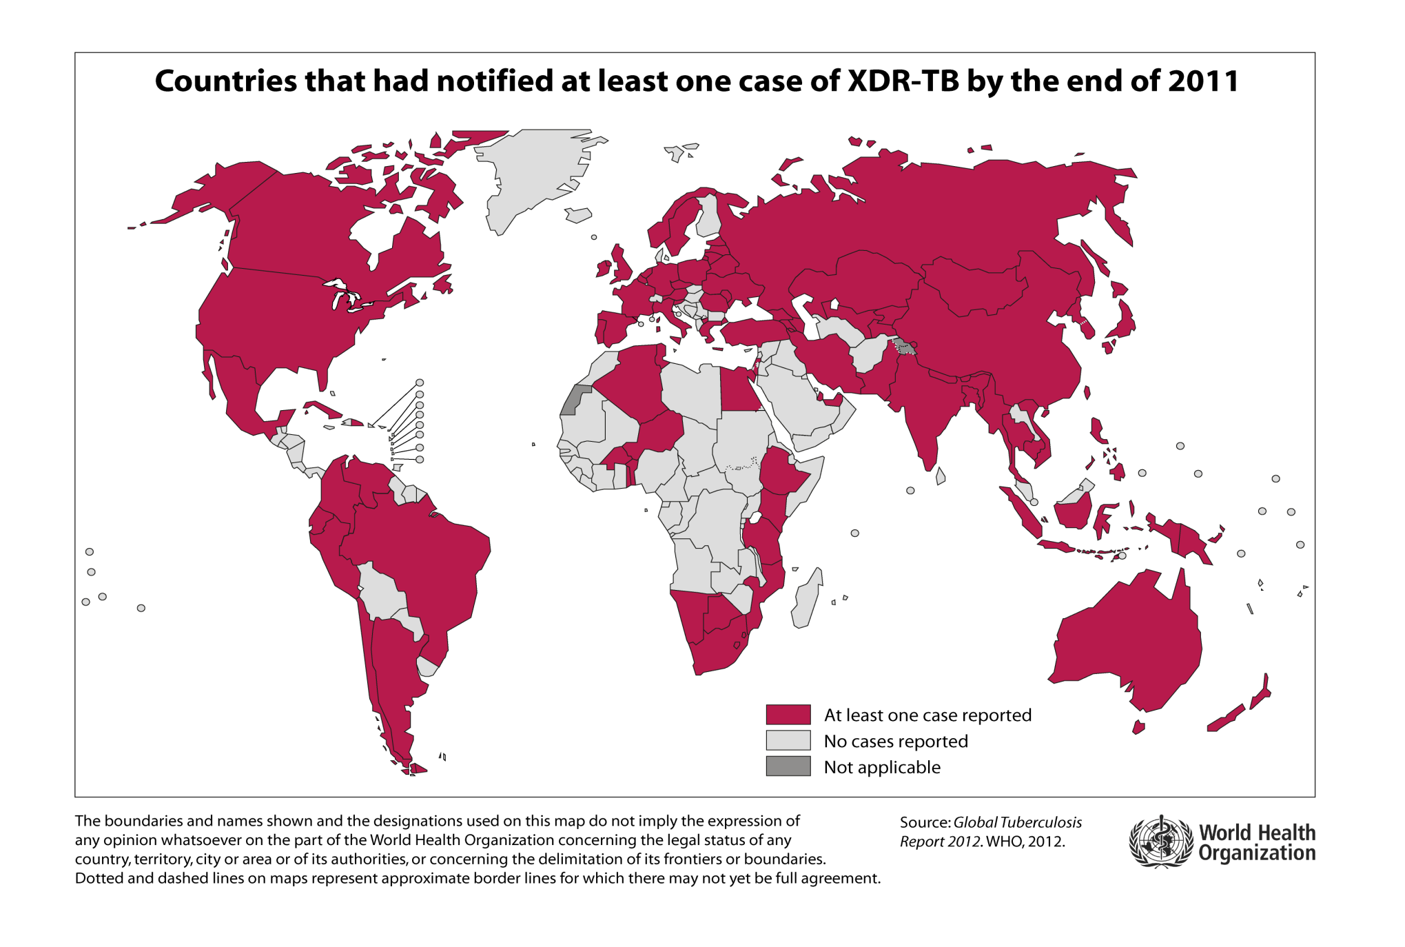

Slide 40
NEJM 2009 260: 2397
Phase II trial in Stellenbosch
Newly diagnosed MDR-TB
TMC207 400mg daily for 2/52, then 200mg 3x wk for 6/52
23 treated vs 24 placebo
Combined with standard 5-drug second line regime
Reduced time to negative sputum culture (p 0.003)
Increased proportion with conversion of culture (48% vs 9%)
Nausea increased in TMC group

Slide 41
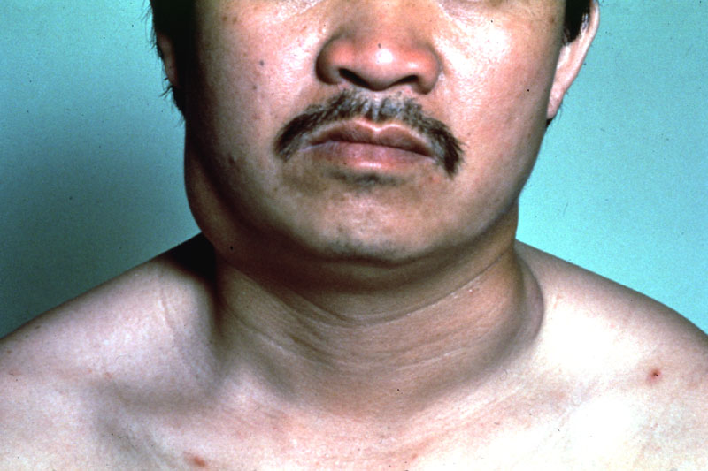
Case 4
44 year old man from Brazil
Presented with swelling under angle of jaw
Previously fit and well
Recently, sweats and weight loss

Slide 42
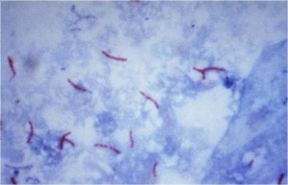
Tissue section Ziehl-Nielsen
What test is needed?

Slide 43
TB in HIV
Globally, HIV co-infection is the single biggest risk factor for developing TB
Increased susceptibility to TB
Increased treatment failure
Significant drug interactions
Protease inhibitor group
Increased drug toxicity

Slide 44
Case 5
28 year old man
Presented with visual disturbance
Fever and weight loss
4th nerve right palsy on examination
Next Ix?
CT head?
Lumbar puncture?
Other investigation?

Slide 45
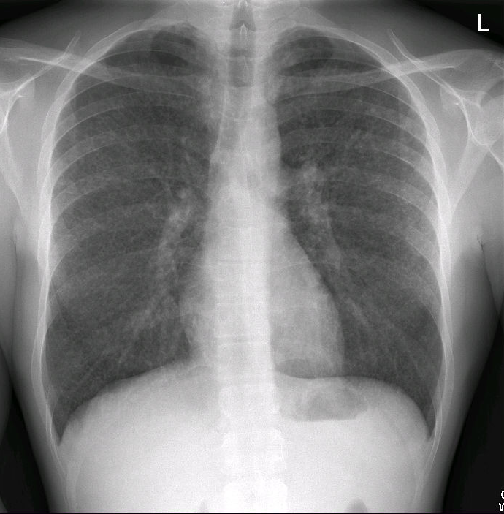

Slide 46
Millet seeds

Slide 47
CSF findings
WCC 127 95% lymphocytes
Protein 1.0 (N < 0.4)
Glucose 2.1 (Serum 6.7)
Treated with quadruple therapy and dexamethasone
CSF AFB –ve and PCR negative
BAL AFB –ve but PCR +ve

Slide 48
CNS disease
May not be able to take by mouth early on
Via N/G tube
IV therapy – Rifampicin, isoniazid, amikacin, ciprofloxacin
Adjunctive corticosteroids indicated
Dexamethasone
60-80 mg prednisiolone/day
TB abscesses (tuberculoma) may paradoxically worsen on therapy

Slide 49
AIDS 2010 24: 2381
Recruited patients with new paradoxical TB-IRIS
Prednisolone 1.5mg/kg for 2 weeks, then 0.75mg/kg for 2 weeks vs placebo
55 in each arm
Pred reduced hospitalisation and therapeutic procedures
More rapid improvement in symptoms and QOL
Isolates of 10 participants were found to be rifampicin resistant
Therefore, need to exclude drug-resistant disease

Slide 50
Case 6
Household contact of patient with pulmonary TB
Asymptomatic
Normal blood tests
Normal CXR
Mantoux 22mm
What should be done ?

Slide 51
TB prophylactic therapy
Immunocompetent
After exposure to TB plus evidence of immunological response
Mantoux or Interferon gamma release assay
Positive tuberculin skin test
Age cut-off 35 but negotiable
Immunocompromised
Consider where significant cell-mediated immunodeficiency + high epidemiological risk or exposure
Eg prednisolone dose >20 mg/day, anti-TNF antibodies, post transplantation etc

Slide 52
Prophylactic regimens
Isoniazid monotherapy for 6 months
Rifampicin plus isoniazid for 3 months
Routine practice at Hammersmith
Rifampicin plus pyrazinamide for 2 months
USA regimen
Recently reported high rate of hepatotoxicity

Slide 53
Guidelines
http://www.brit-thoracic.org.uk/Clinical-Information/Tuberculosis/Tuberculosis-Guidelines.aspx
http://www.nice.org.uk/CG033
http://www.thoracic.org/statements/resources/mtpi/rr5211.pdf
http://www.bhiva.org
National Guideline Clearing House (US – infinite links)
http://www.guideline.gov/

Slide 54
Conclusions
Tuberculosis remains a major threat to global health and is one of the main infectious killers
Prevalence in UK increasing in relation to trends elsewhere in the world
Successful management requires a coordinated multi-disciplinary approach

