Slide 1
Calcium disorders: Calcium, phosphate, vitamin D and PTH
Karim Meeran
Chemical Pathology
1st March 2013

Slide 2
Calcium
99 % in the skeleton
Plasma calcium tightly controlled to remain between 2.2 and 2.6 mM
Calcium is important in the control of nerve and muscle
Changes cause muscle depolarisation

Slide 3
Regulation of calcium
Parathyroid hormone (negative feedback): when calcium low, PTH rises.
PTH causes:
movement of calcium from bone
activation of renal 1 alpha hydroxylase
hence increased calcium

Slide 4
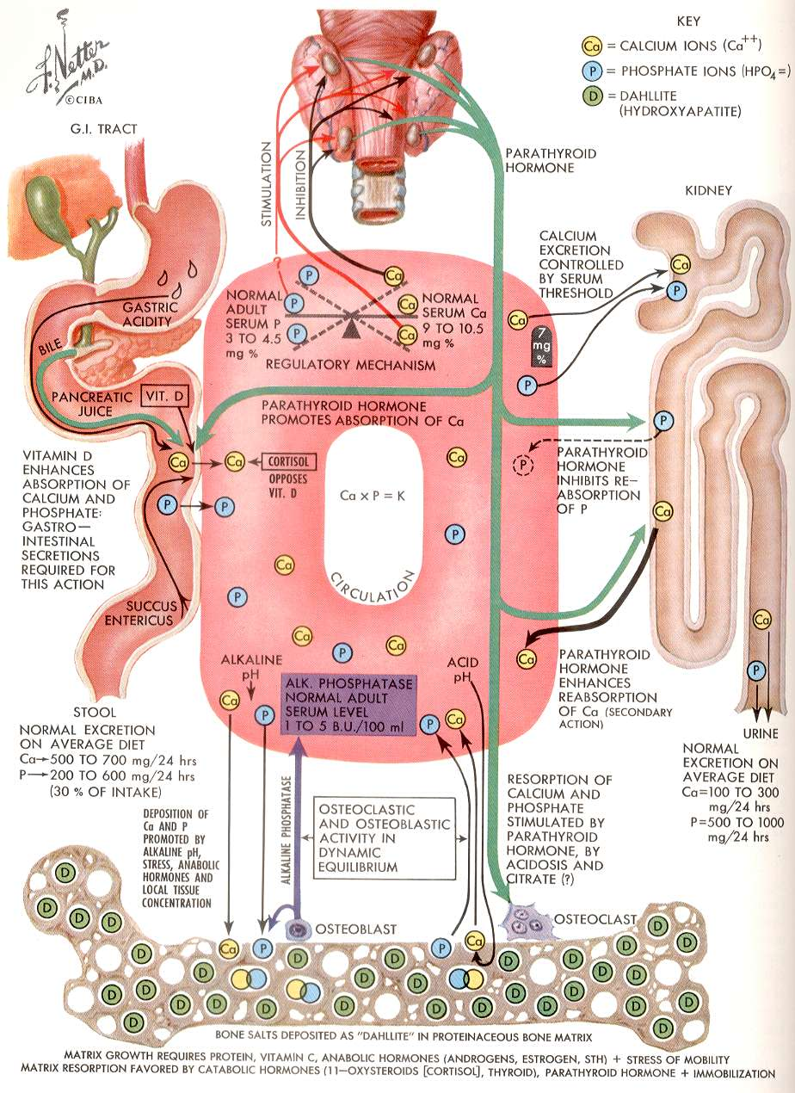
Vitamin D
(100% in liver)
25 hydroxyvitamin D
(rate limiting in
kidney under PTH
control)
1, 25 dihydroxyvitamin D

Slide 5
High Calcium in the plasma
Calcium leaks out of bone (fractures)
Extra calcium gets stuck in kidneys
Causes psychiatric symptoms
Causes abdominal pain and constipation

Slide 6
High Calcium in the plasma
Bones
Kidney stones
Causes psychiatric symptoms (Moans)
Causes abdominal pain (Groans)

Slide 7
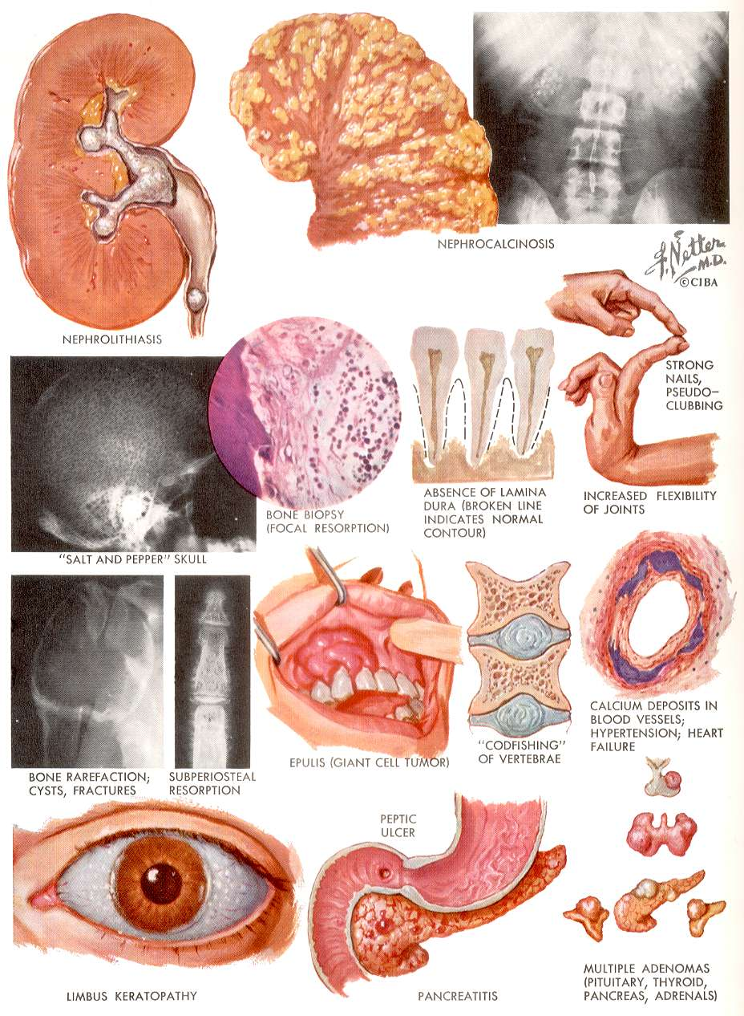

Slide 8
Causes of hypercalcaemia

Slide 9
Causes of hypercalcaemia
Too much PTH
(Primary hyperparathyroidism)

Slide 10
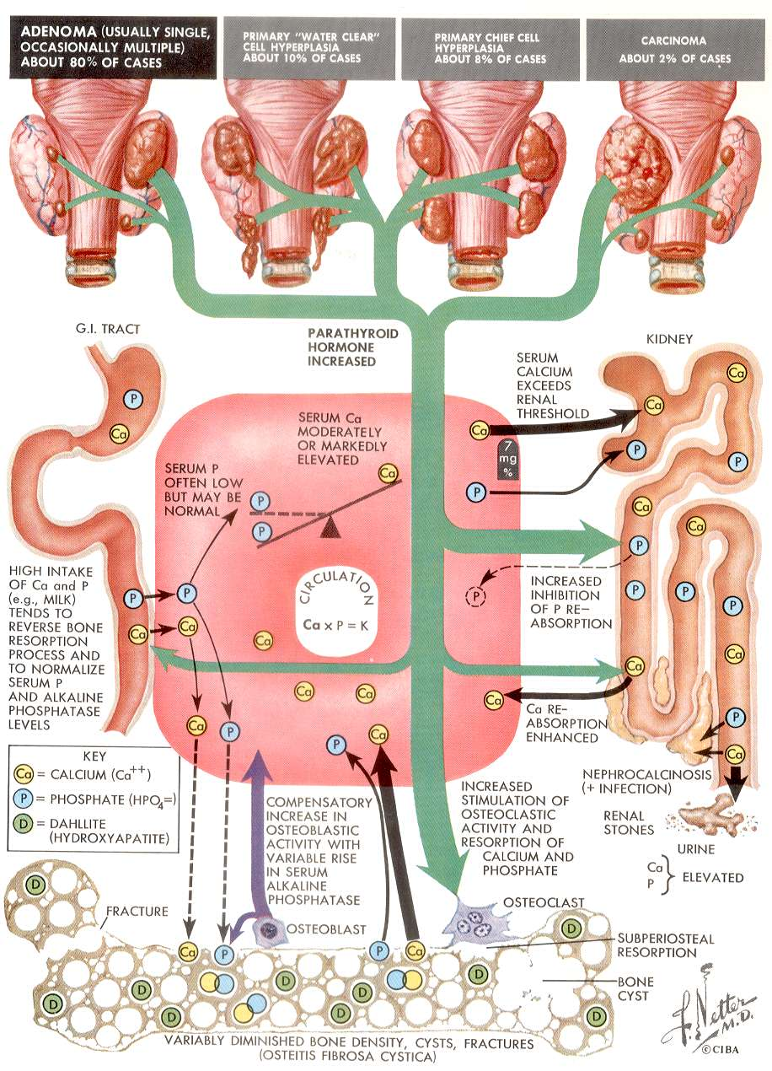

Slide 11
Causes of hypercalcaemia
Too much PTH
(Primary hyperparathyroidism)

Slide 12
Causes of hypercalcaemia
Too much PTH
(Primary hyperparathyroidism)
Cancer with bone metastases

Slide 13
Causes of hypercalcaemia
Too much PTH
(Primary hyperparathyroidism)
Cancer with bone metastases
Overactive vitamin D

Slide 14
Synthesis of vitamin D
Vitamin D3 is synthesised in the skin (cholecalciferol)
Vitamin D2 is a plant vitamin (ergocalciferol)
Both are active

Slide 15
Wikipedia: D3 and D2

Slide 16
Synthesis of vitamin D
Next stage in the liver:
100% of any absorbed vitamin D is hydroxylated at the 25 position
enzyme: 25 hydroxylase
25 hydroxy vitamin D is inactive
This is the stored and measured form of vitamin D

Slide 17
Activation of vitamin D
Normally happens in kidney
enzyme: 1 alpha hydroxylase
Rarely, this enzyme can be expressed in lung cells of sarcoid tissue

Slide 18
25 hydroxylase
1 hydroxylase

Slide 19
Investigations of high calcium
Calcium
Serum PTH (high or normal suggest hyperparathyroidism)
Low PTH suggests cancer
Vitamin D levels
CXR (sarcoidosis)

Slide 20
Role of the skeleton (Orthopaedic view)
Structural framework
Strong
Relatively lightweight
Mobile
Protects vital organs
Capable of orderly growth and remodelling

Slide 21
Role of skeleton
Metabolic role in calcium homeostasis
Main reservoir of calcium, phosphate and magnesium

Slide 22
Metabolic bone disease
Osteoporosis
Osteomalacia
Paget’s disease

Slide 23
Circulating calcium
Important for normal nerve and muscle function
Plasma concentration must thus be maintained despite calcium and vitamin D deficiency
Chronic calcium deficiency thus results in loss of calcium from bone in order to maintain circulating calcium

Slide 24
Osteoporosis
Cause of pathological fracture
Occurring more often as people live longer
Loss of bone mass
Bone slowly lost after age 20
Residual bone normal in structure

Slide 26
Osteomalacia
Bone is demineralised
Caused by vitamin D deficiency
Renal failure
Anticonvulsants induce breakdown of vitamin D
Lack of sunlight
Chappatis (phytic acid)

Slide 27
Paget’s disease of bone
Bone has increased turnover
Increased osteoblast and osteoclast
Bone pain
High alkaline phosphatase
Normal calcium handling

Slide 28
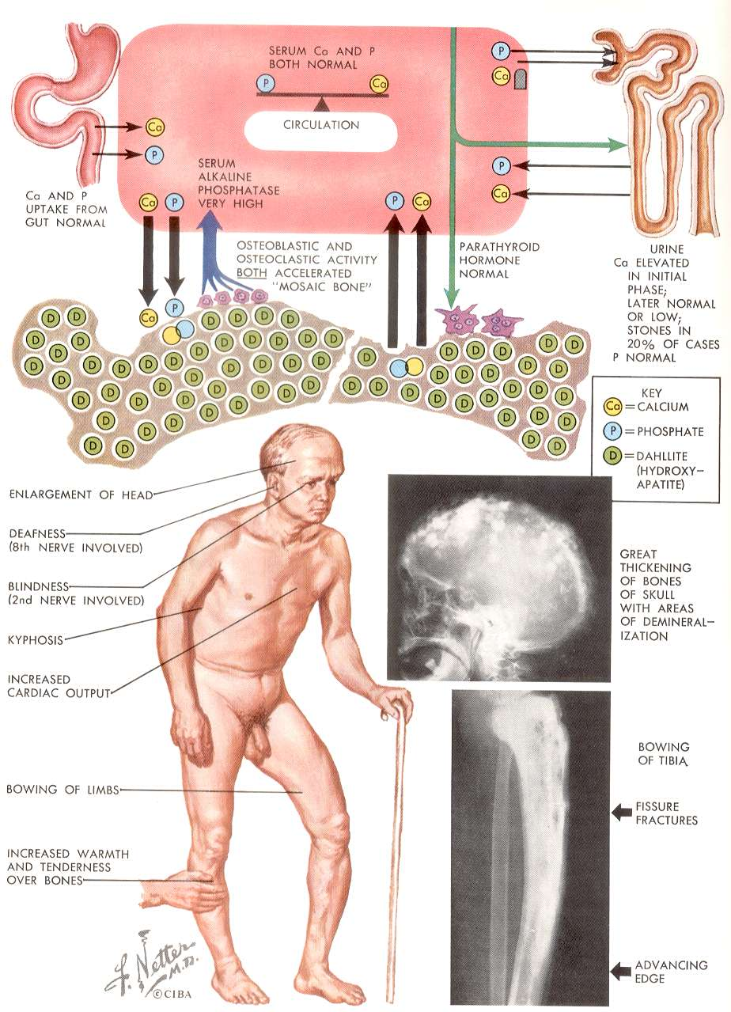

Slide 29
Case history 2

Slide 30
Case history 2
Very high alkaline phosphatase and bone pain

Slide 31
Case history 2
Very high alkaline phosphatase and bone pain
Paget’s disease

Slide 32
Case history 3
What are the CLINICAL SIGNS of a low calcium

Slide 33
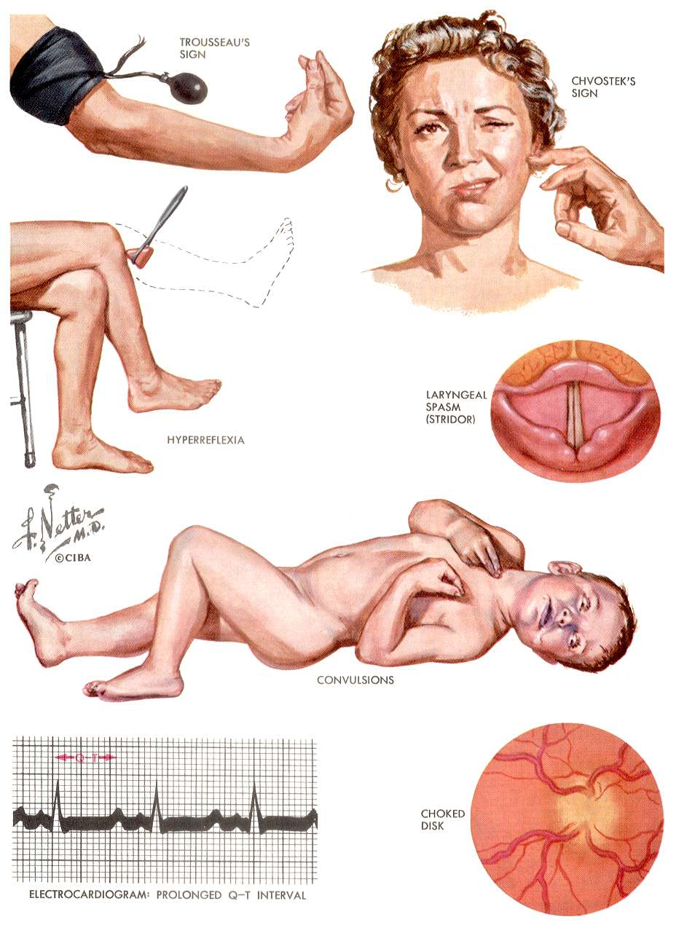

Slide 34
Case history 3

Slide 35
Case history 3
Low calcium, low phosphate
High PTH
High alkaline phosphatase

Slide 36
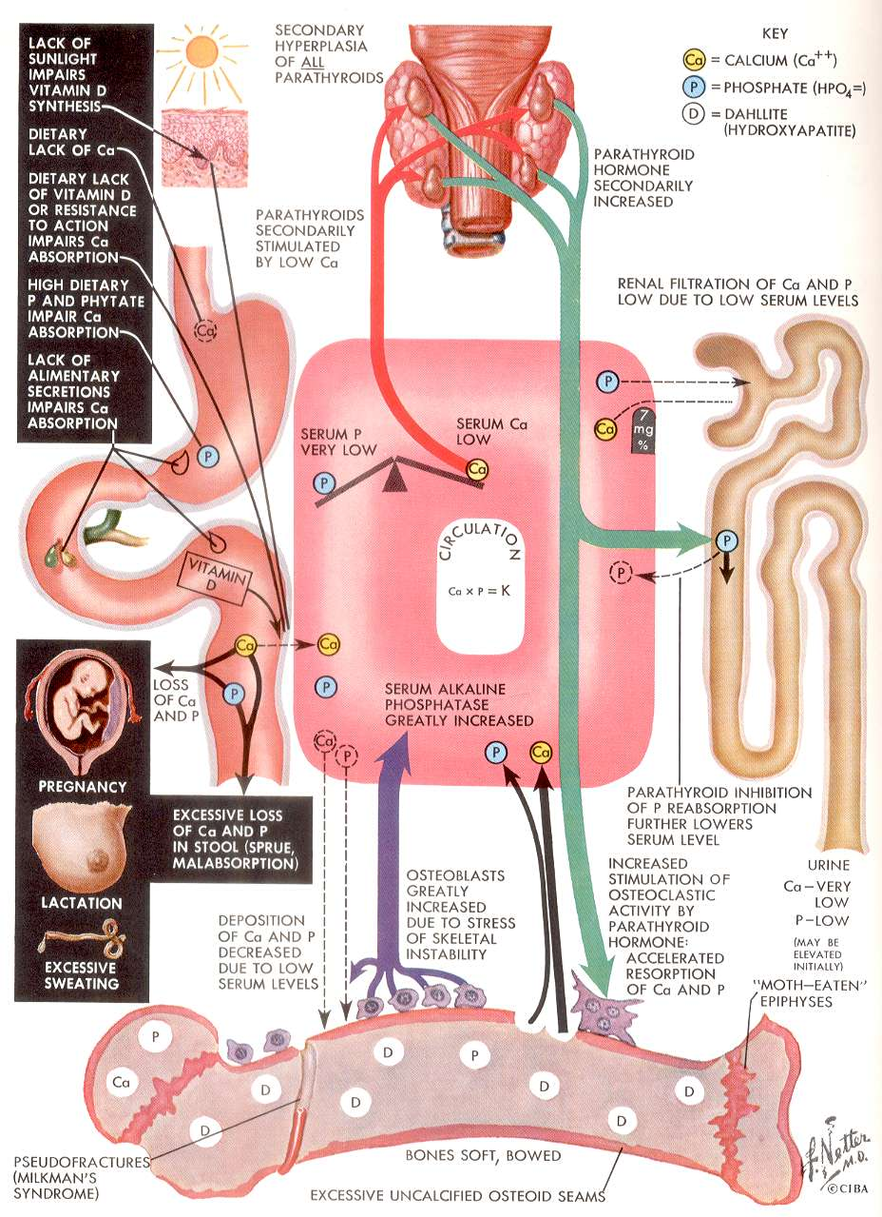

Slide 37
Case history 3
Low calcium, low phosphate
High PTH
High alkaline phosphatase
OSTEOMALACIA

Slide 38
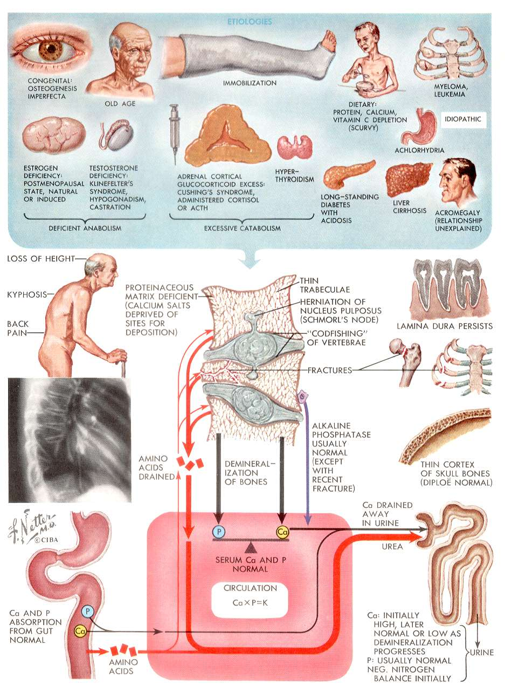
Osteoporosis by comparison has bone loss but with a normal calcium

Slide 39
Predict the consequences of loss of endocrine functions of the kidney
What hormones does the kidney make?

