Slide 1
T cell mediated immunity
Peter Kelleher
Senior Lecturer, Imperial College London, Chelsea & Westminster campus

Slide 2
Glossary of some terms used in lecture
BCR B cell receptor
Β2MG: beta-2 microglobulin
CLIP: Class II-associated invariant chain peptide
CTLA-4: Cytotoxic T-Lymphocyte Antigen 4
Forkhead box protein 3 FoxP3
IBD: Inflammatory bowel disease
IPEX: Immunedysregulation polyendocrinopathy enteropathy X-linked
PD-1: Programme Death-1
PDL-2: Programme Death Ligand-2
RAG: recombinase activating gene
RORyt: Retinoic acid related Orphan Receptor gamma t
SCID: Severe combined immune deficiency
T bet: T-box transcription factor
TCR: T cell receptor
TGF-β: Transforming growth factor β
TEC: Thymic epithelial cortical

Slide 3
Learning objectives
Give a brief overview of characteristics of the adaptive immune system and generation of antigen specific T and B cell receptors
Outline the principles of T cell development and maturation
Describe how T cells recognize antigens
Discuss mechanisms of T cell activation
Briefly describe the different T cell subsets in relation to developmental transcription factors, cytokine signatures and function

Slide 4
Adaptive immune system
Generation of T and B cell receptors

Slide 5
Adaptive immune system
Adaptive immune system consists of billions of T and B cells
Each individual T and B cell has expresses a single unique receptor.
Receptors of the adaptive immune system are generated by somatic gene rearrangements which encode for variable and constant regions of the T and B cell receptor
Receptors of the adaptive immune system can recognize virtually any protein or carbohydrate structure (specific) .
The immune system has regulatory controls to try and prevent T and B cell responding to self proteins/carbohydrates

Slide 6
Adaptive immune system
Recognition of antigen by a T or B cell receptor promotes cell proliferation: all progenitor cells express the same receptor
It take 4-5 cell division on average for the adaptive immune cell to overcome or eliminate antigens/toxins/allergen: hence time-scale for adaptive immune responses is of the order 5-7 days.
Once the adaptive immune system has eliminate an antigen a pools of antigen specific immune cells persists.
Re-encounter of antigen specific adaptive immune cells with foreign protein/carbohydrate results in a faster (1-3 days) and greater immune response (memory)

Slide 7
Generation of T and B cell receptors
Each T and B cell receptor is generated by re-combination of 3-4 gene segments
Several different variants of each gene are encoded in DNA
Variable part of T and B cell receptor is encoded by imprecise combination of V D J genes
Insertion of random number of nucleotides between VDJ and C segments is final step in expression of T and B cell receptor
V
D
J
C
V
D
J
C
V
D
J
C

Slide 8
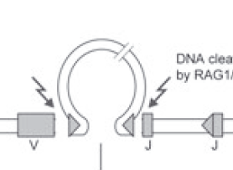
Molecular basis for generation of T and B cell receptors
DNA chain is broken by RAG enzymes
Broken end of DNA helix form a hairpin loop
Hairpin loops are opened
DNA break is sealed by the addition of nucleotide bases and the 2 ends are the joined together
Mutations in proteins involved in this process results in absence of T and B cells: Severe Combined Immune Deficiency (SCID )

Slide 9
Diversity of T and B cell receptors
Large numbers of different gene segment variant are encoded in the human genome
Combination of different gene segments is imprecise
recombination enzymes activity variable
Random addition of addition of nucleotide to plug gaps in DNA breaks
T and B cell receptors consist of 2 (TCR) or 4 (BCR) polypeptide chains

Slide 10
T cell development and maturation
Key concepts
T cell development occurs in the thymus and involves the formation of T cell receptors and differentiation of precursors into distinct T cell subsets
T cell receptors (TCR)
are created recombination of different genes in a step wise manner
consist of two polypeptide chains
each polypeptide contains a variable region which can bind antigen and a constant region
T cell lineage commitment
Several different T cell subsets are generated in the thymus
T cell maturation occurs in distinct regions of the thymus

Slide 11
T cell receptor: structure
T cell receptor (TCR) is a heterodimeric polypeptide chain
αβ TCR expressed by 95% of T cells in blood and γδ found in 5-10% T cells
Each polypeptide chain contains a variable (V) and constant (C) region
The variable region contains a V (variable) D (diverse) and J (joining) domains
Vα and Vβ contains 3 hypervariable area known as Complementary Determining Regions (CDR) to which antigen binds
Antigen

Slide 12
Selection of functional TCR involves positive and negative selection of T cells
Thymic epithelial cortical (TEC) cells select T cell receptors which can bind to self-MHC proteins (positive selection).
At the cortico-medullary junction T cells that recognize self peptides are eliminated by DC (negative selection)
Expression of a tissue specific peptides by thymic medullary epithelial cells and DC is under the control of a gene called the autoimmune regulator (AIRE).
90-95% of developing T cells are eliminated in the thymus.
Thymic epithelial
cortical cells
Dendritic cells

Slide 13
T cell lineage commitment occurs in the thymus
Double negative T cell precursors enter the thymus (CD4-/CD8-).
In the cortex developing T cells express CD4+and CD8+ glycoproteins
Positive selection by MHC Class I expressing TEC cells generates CD4-CD8+ T cells.
Positive selection by MHC Class II expressing TEC cells generates CD4+CD8- T cells
Single positive T cells (CD4+ or CD8+) with high affinity for self -MHC and self peptide under go negative selection at the corticomedullary junction.
Mature T cells which express either CD4 or CD8 are found exclusively in the medulla
CD4 T cells which express the forkhead box protein 3 (FoxP3) transcription factor are also generated in the thymus

Slide 14
Antigen recognition by T cells

Slide 15
Antigen recognition by T cells
A major challenge faced by the immune system is to identify host cells that have been infected by microbes that then use the cell to replicate within the host
The major role of the T cells is to identify and destroy infected cells
The immune system has evolved to recognize both a self component (MHC) and peptide fragments of antigens that are derived from the cytoplasm or have been ingested and processed into peptide segments within endosomes.
T cell recognize peptide-MHC complexes displayed on the cell surface of all nucleated cells (MHC I) or on antigen presenting cells (MHC II). Main antigen presenting cells are DC, B cells and monocytes/macrophages

Slide 16
Overview of DC-T cell interaction

Slide 17
Antigen-uptake and processing by DC
Tissue DC (immature) are very efficient in antigen-capture
macropinocytosis
receptor mediated endocytosis
phagocytosis of microbes and apoptotic/necrotic cells
Antigen uptake leads to activation and maturation of DC
loss of endocytic/phagocytic receptors
up-regulation of co-stimulatory and MHC molecules
loss of inflammatory chemokine receptors and induction of LN homing chemokine receptors
changes in the class II MHC compartment to allow antigen processing
DC maturation is promoted by activation of PPR (LPS, bacterial DNA, and viral double stranded RNA) and pro- and anti-inflammatory signals (TNF, IL-1, IL-6, IL-10, TGF-b and PGE)

Slide 18
Antigen presentation to T cells
Dendritic cells migrate to the T cell zone in lymph node.
Peptide-MHC complexes on surface of DC bind to T cell receptors (antigen presentation).
T cells provides further DC maturation signals via CD40L-CD40 binding to promote secretion of IL-12.
Sustained antigen presentation promotes naïve T cell proliferation and cytokine production.
Outcome of dendritic T cell interaction may results in immune activation (on-switch) or immune tolerance (off-switch)

Slide 19
Properties of Major Histocompatability Complex or Human Leukocyte Antigen
T cells recognition of processed peptides depends on the property of MHC molecules to bind small peptides
Self peptide-MHC complexes select developing T cells in the thymus: MHC restriction
Non self-peptide-MHC complexes are recognized by T cells during an adaptive immune response
MHC Class 1 and MHC Class II are extremely polymorphic
each allele encodes molecules with different peptide properties
immune evasion to all MHC molecules by pathogenic microbes through the population is extremely unlikely

Slide 20
Genetics of MHC/HLA proteins
HLA gene expression is co-dominant: protein from both chromosomes are expressed on surface of the cell: most individuals are heterozygous for each HLA locus.
HLA gene sequences can be inherited in discrete gene segments which encode for several different alleles: the HLA haplotype
Frequency among NW Europeans of HLA-A1 is 20% HLA-B8 is 16.2% and HLADR3 is 16%.
If the each allele was inherited independently the frequency of this haplotype would be 20% x 16.2% x 16.0 = 0.052%: the observed frequency of this haploype is however 9.0%
The linkage disequilibrium Δ value (the difference between frequency observed for a particular combination of alleles and that frequency expected for each individual allele) is 9.0-0.05 = 8.5

Slide 21
MHC Class I molecules
Expressed by all nucleated cells
3 major subtypes HLA-A, HLA-B, and HLA-C
Single polymorphic alpha chain consisting of 3 extracellular domain bound to β2MG
The alpha1 and alpha 2 subunits form a groove in which antigenic peptide bind
MHC Class 1 molecules bind peptide fragments of 9-11 amino acids which fit snugly into antigen binding region

Slide 22
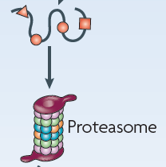
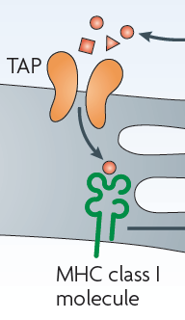
MHC Class I molecules present antigenic peptides derived from the cytosol (endogenous antigens)
Foreign proteins in cytoplasm are tagged with ubiquitin which directs them to the proteasome
The proteasome generate peptide fragments of appropriate length(9-11 amino acids) and charge that can be presented by MHC Class I molecules
Peptide fragments are then transported into the endoplasmic reticulum (ER) by Transporter associated with antigen presentation (TAP) proteins
In the ER peptide are loaded are loaded onto MHC Class I protein complex and then transported to the cell surface
Protein
Cell cytoplasm
PEPTIDES
ER
Peptide MHC Class I
and β2MG

Slide 23
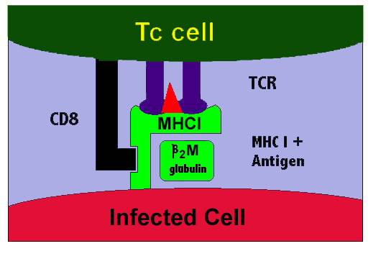
MHC Class I molecules
If a peptide MHC Class I complex is recognized by a T cell receptor CD8 binds to the MHC Class 1 protein
This stabilises the TCR peptide-MHC complex and is the initial step in CD8 T cell activation and proliferation
Class 1 MHC are highly polymorphic: more than 650 alleles at HLA-A locus, more than 1000 at the HLA-B locus and greater than 350 alleles at HLA-C locus
Polymorphism allow MHC to bind multiple different peptide fragments

Slide 24
MHC Class II molecules
MHC Class II proteins expressed by APC and can be induced by IFN-γ on T lymphocytes, endothelial and epithelial cells
2 polypeptide chains with variable regions
α1 and α2 to which antigen binds
constant region β1 and β2 domain which binds to CD4 molecules on T cells
MHC Class II proteins bind amino acids 11-15 length which can protrude from either end of antigen binding groove

Slide 25
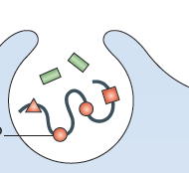
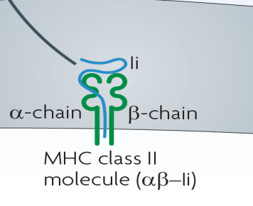
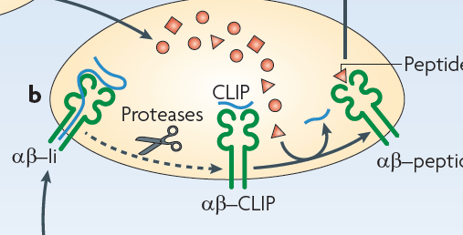
MHC Class II molecules present antigenic peptides derived from endosomes (exogenous antigens)
Exogenous antigens are broken down in the lysosomal compartment
In the ER a region of the invariant chain (Ii) known as CLIP binds to the peptide groove of the newly synthesised Class II proteins
Processed antigen and MHC Class II/Ii complex is transported to an endosome known MHC Class II endosomal loading compartment
Within the MHC Class II loading compartment the Ii chain is degraded and CLIP is removed which allow peptide to bind to the MHC Class II protein.
The assembled Class II protein-peptide complex is then delivered to the plasma membrane for recognition by CD4 T cells

Slide 26
MHC Class II protein
If a peptide MHC Class II complex is recognized by a T cell receptor CD4 binds to the MHC Class II protein
This stabilises the TCR peptide-MHC complex and is the initial step in CD4 T cell activation and proliferation
Class II MHC are highly polymorphic: HLA DRA1 (1 allele) can pair with HLA DRB1 (500 alleles) and HLA DRB3 (60 alleles). HLA DQA (25 alleles) pairs with HLADQB (72 alleles). HLA DPA (16 alleles) pairs with HLA DPB (118 alleles)
Each individual may express 4 different HLA DP and DQ proteins and 4 distinct HLA-DR protein based on pairing between gene products of both maternal and paternal chromosomes
CD4
APC

Slide 27
Non MHC antigen presentation
CD1 proteins (structurally homology to MHC Class 1) present glycolipid antigens to αβ T cells and γδ T cells
CD1 mediated antigen recognition is important in the detection of mycobacterial infection.
Carbohydrate containing lipids can be presented to T-cell subset that also expresses NK markers called NK T-cells which secrete immuno-regulatory cytokines.
Damaged or stressed cells express MHC class 1 related chains A and B (MICA, MICB) that are recognized and eliminated by γδ T cells

Slide 28
Clinical relevance of MHC
More than 40 diseases are found much more frequently in subjects carrying certain MHC Class 1 and II alleles than in the general population
HLA-B27 and ankylosing spondylitis, inflammatory eye disease
HLA-DQ2 and coeliac disease
HLA-A1 HLA-B8 HLADR3 haplotype associated with autoimmune disease.
Assessment of MHC genotype to predict life threatening drug reactions
HLAB57 and abacavir (HIV-1 antiviral drug ) and hypersensitivity syndrome
MHC Class I and II proteins play a major role in governing transplant rejection
HLA-DR HLA-A and HLA-C matching between organ donor and transplant recipient to prevent organ rejection in solid organ transplantation
HLA-A: HLA-B: HLA-C and HLA-DR matching to prevent graft rejection and more importantly graft versus host disease in BMT

Slide 29
Summary slide of T cell self-MHC peptide recognition
CD8⁺ T cell
CD4⁺ T cell
CD8⁺
CD4⁺
TCR
TCR
HLA-A/B/C
Class I
HLA-DR/DP/DQ
Class II
APC
APC

Slide 30
T cell activation and proliferation

Slide 31
T cell activation needs 2 signals
TCR αβ associated with the CD3 receptor complex which transmits signals to cell interior following peptide MHC antigen complex recognition.
The peptide-MHC complex only provides a partial signal for T cell activation.
Full T cell activation (proliferation, IL-2 production and development of an effector cell function) requires additional help form co-stimulatory molecules expressed by APC and T cells
CD3 protein
complex
T cell
Peptide MHC
Complex
Signal 1
Co-
stimulatory
proteins
Signal 2
APC

Slide 32
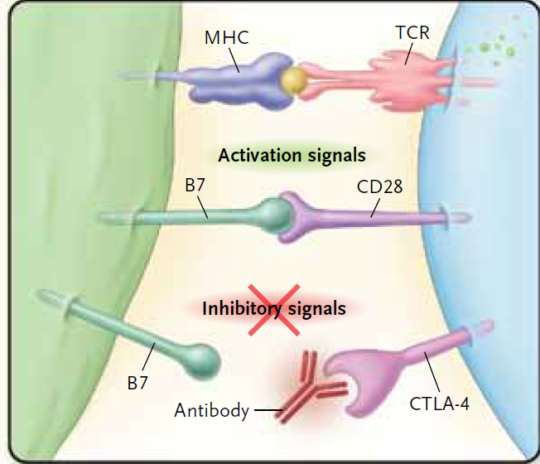
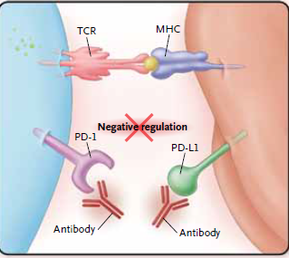
Signal 2: co-stimulatory APC-T cell interactions
Binding of CD80 and CD86 on APC to CD28 on T cell switches promotes T cell proliferation
Expression of IL-2 receptor and secretion of IL-2 by antigen specific T cells
After 48-72 hours activated T cells express the protein CTLA-4 which can bind to CD86 and CD80 on APC to switch of T cell activation
Persistent exposure of antigen to T cells results in the expression of a protein called Programmed Death 1 (PD-1) inhibitory receptor which on binding to PD-1 Ligand 1and PD-1 ligand 2 on antigen presenting cells regulated T cell activity
Monoclonal antibody therapy against CTLA-4 and PD-1 have shown impressive results in the treatment of some cancers which have not responded to standard chemotherapy

Slide 33
T cell activation by peptide-MHC complex leads to clonal selection: hallmark of adaptive immunity

Slide 34
Antigen stimulation results in formation of distinctive T cell subsets
CD4 Th1 Cells
CD4 Th2 Cells
CD4 Th17 cells
CD4 T regulatory cells

Slide 35
CD4 Th1 cells
CD4 Th1 cells have the following characteristics
Secrete IFN-γ IL-2 and LTα
IL-12 and IFN-γ promote the development of CD4 Th1 from naïve T cells
Lineage stabilisation under the influence of transcription factor T-bet and STAT-4 signalling
Key role in induction of cell mediated immune responses
Interferon -γ play a crucial role in cell mediated immunity
Enhances the capacity of monocyte phagocytes to eliminate intracellular pathogens
Induces expression of MHC proteins on T cells, epithelial and endothelial cells
Promotes neutrophil killing
Inhibits viral replication

Slide 36
CD4 Th1 cells drive cell mediated immune responses to eliminate intracellular infection
CD4 Th1 lymphocyte
NK cell
IFN-γ
AP + IL-12
DCe
IL-2 + IFN-γ
IFN-γ +IL-2
IFN-γ
Macrophage
B lymphocyte
Cytotoxic T lymphocyte
Immunoglobulin secretion
Macrophage

Slide 37
CD4 Th2 cells
CD4 Th2 cells have the following characteristics
Secrete IL-4, IL-5, IL-13 and IL-25
IL-4 promotes the development of CD4 Th2 from naïve T cells
Lineage stabilisation under the influence of transcription factor GATA and STAT-6 signalling
Key role in host protection against worm and parasitic infection
IL-4 induces immunoglobulin isotype switch from IgM to IgE
Enhances the APC capacity of B cells
Promotes the expression of VCAM-1 on endothelial cells which promote recruitment of T cells , eosinophils and monocytes to inflammatory sites
Activates mast cells

Slide 38
CD 4 Th2 cells enhances IgE antibody production and protects against worm/parasite infections
CD4 Th2 cell
AP + IL-4
DC/basophil
IL-13
Eosinophil
IL-5
IL4
Basophils
B lymphocyte
Mast cell
IgE Antibodies

Slide 39
CD4 Th17 cells
CD4 Th17 cells have the following characteristics
Secrete IL-17A, IL-17F, IL-21 and IL-22
TGF-β1 and IL-6 promotes the development of CD4 Th17 from naïve T cells
Lineage stabilisation under the influence of transcription factor Retinoic acid related Orphan Receptor gamma t (RORyt) and STAT-3 signalling
IL-23 expands the pools of committed CD4 Th17 cells

Slide 40
CD4 Th17 cells involved in host defence against extracellular bacterial infections
CD4 Th17 involved in activation and recruitment of neutrophils to mucosal surfaces (IL-17)
Maintenance of integrity of epithelial cells (IL-22)
Secretion of mucosal antimicrobial proteins (IL-22)
Secretion of IL-21 important in induction of T cell dependent antibody responses

Slide 41
CD4 regulatory T cells suppress inflammatory responses in blood and tissues
CD4 regulatory T cell which express CD25 (IL-2 R) protein are derived from the thymus and can also be generated from naive CD4 T cells
TGF-β1 and IL-6 promotes the development of CD4 Threg from naïve T cells
CD4 regulatory cells express the transcription factor forkhead box protein 3 which is responsible for the development and maturation of this T cells subset
Anti-inflammatory effects is mediated
Secretion of TGF-β, IL-10, IL-35
Direct cell contact
Metabolism of amino acid tryptophan by IDO enzmye

Slide 42
Cytotoxic CD8 T cells
Kill infected cells by
Releasing perforin which punches holes in the target cell membrane
This allows granzymes to enter target cell and induce apoptosis
OR
Secretes anti-viral cytokines (IFN-γ) and chemokines (MIP-1α) which inhibit viral replication or viral transmission

Slide 43
Clinical implications of defects in T cell function
Loss of function mutations in generation of TCR and T cell signalling protein complex results in a very severe T cell immune deficiency known as SCID
Excess CD4 Th2 lymphocyte activity is associated with allergic disorders (asthma, hay fever, eczema)
Excess CD4 Th17 activity is linked to several autoimmune diseases (psoriasis, IBD, SLE, Multiple Sclerosis )
Mutations in STAT-3 affecting CD4 Th17 development results in an immune deficiency known as the hyper-IgE syndrome
Mutation in FoxP3 leads to very severe autoimmune endocrine, gut and skin disease in young boys (IPEX syndrome).

Slide 44
Learning points
The cardinal features of the adaptive immune system are antigen specificity and immune memory
T cell development and maturation take places in the thymus
Dendritic cells process and present antigen for recognition by T cells
T cells recognize self-MHC restricted peptide complexes
T cell activation requires input from the peptide-MHC complex and co-stimulatory proteins
Distinct T cell subsets can be identified by expression of cytokines and transcription factors and have unique roles in the immune system

Slide 45
SBA
Select the best option
Antigen processing and presentation
A. MHC Class II proteins are expressed by all cells.
B. MHC Class I proteins present endosomal derived antigens to CD4 T cells.
C. MHC Class II protein present glycolipids to CD8 T cells
D. MHC proteins show limited polymorphism
E. Peptide fragments containing 9-11 amino acids bind to MHC Class I proteins

Slide 46
Correct answer: Option E

