Slide 1
Immune response to microbial challenge
19 April 2013
Professor Julian Dyson
Section of Molecular Immunology
Department of Medicine

Slide 2
Immune response to microbial challenge
Commensal microbiota
Links between innate and adaptive immunity
Adaptive immune response to microbes
Role of host genetic polymorphism on disease susceptibility

Slide 3
Immune response to microbiological challenge
Learning outcomes:
-Contrast commensal microbiota (beneficial) and pathogens.
-Understand the links between innate and adaptive immunity which..
-Facilitate tailored adaptive immune response to microbes.
-Understand the role of host genetic polymorphism on
susceptibility to infection

Slide 4
Variability in susceptibility/host response to an infection
General health and nutrition status
Previous infection > immunological memory
Immune-deficiency
Genetic: eg SCID (ADA deficiency affects B/T cells)
Acquired: eg HIV infection
Induced: eg Immune suppression Cyclophosmamide for transplantation
Polymorphism in innate immunity genes
Polymorphisms in adaptive immunity genes, particularly HLA (=‘human leucocyte antigens’)

Slide 5
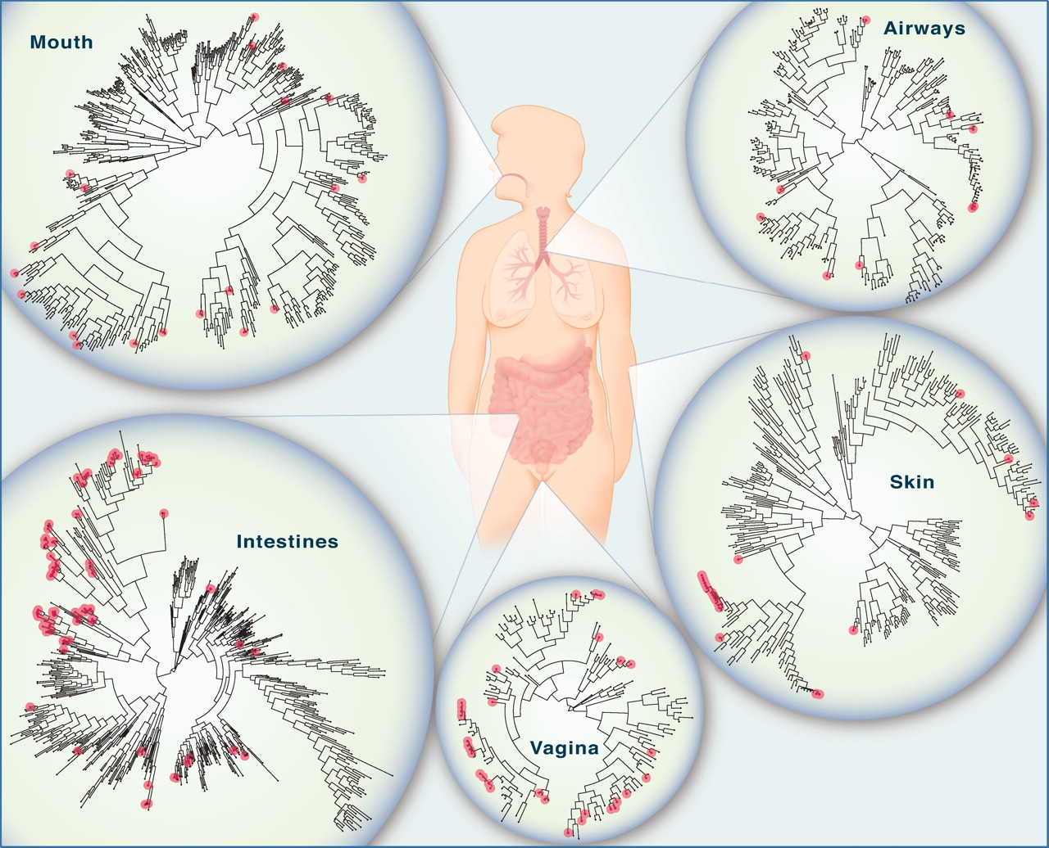
Commensal microbiota are essential for tissue integrity
and immune function
The microbiome of various anatomical locations of the human body
This partnership, forged over many millennia of coevolution, is based on a
molecular exchange involving bacterial signals that are recognized by host
receptors to mediate beneficial outcomes for both microbes and humans.
Published by AAAS
Y K Lee, S K Mazmanian Science 2010;330:1768-1773
Notes:
The microbiome of various anatomical locations of the human body. Numerous bacterial species colonize the mouth, upper airways, skin, vagina, and intestinal tract of humans. The phylogenetic trees show the speciation of bacterial clades from common ancestors at each anatomical site. Although the communities in different regions of the body share similarities, they each have a unique site-specific “fingerprint” made of many distinct microbes. Each site has a very high level of diversity, as shown by the individual lines on the dendrograms. Data are from the NIH-funded Human Microbiome Project; circles represent bacterial species whose sequences are known.

Slide 6
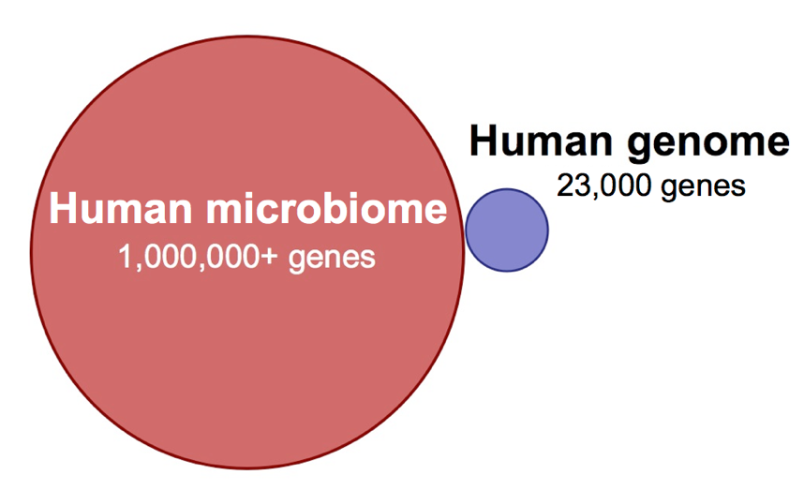
Commensal microbiota are essential for tissue integrity
and immune function
The microbiome of various anatomical locations of the human body
This partnership, forged over many millennia of coevolution, is based on a
molecular exchange involving bacterial signals that are recognized by host
receptors to mediate beneficial outcomes for both microbes and humans.
Published by AAAS
Y K Lee, S K Mazmanian Science 2010;330:1768-1773
Notes:
The microbiome of various anatomical locations of the human body. Numerous bacterial species colonize the mouth, upper airways, skin, vagina, and intestinal tract of humans. The phylogenetic trees show the speciation of bacterial clades from common ancestors at each anatomical site. Although the communities in different regions of the body share similarities, they each have a unique site-specific “fingerprint” made of many distinct microbes. Each site has a very high level of diversity, as shown by the individual lines on the dendrograms. Data are from the NIH-funded Human Microbiome Project; circles represent bacterial species whose sequences are known.

Slide 7
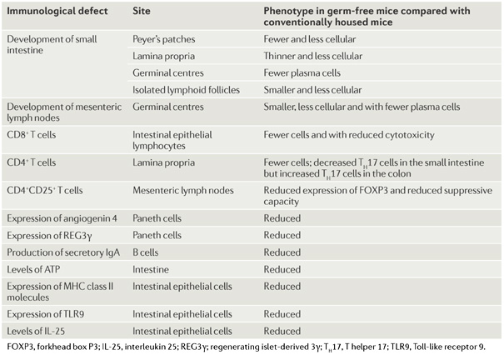
Intestinal immunological defects in germ-free mice

Slide 8
Disordered microbial communities in asthmatic airways
Disordered microbial communities in asthmatic airways. Hilty M et al.PLoS One. 2010 5:e8578

Slide 9
Peaceful mutualism with commensal microbiota
Clostridium forms a thick colonising layer on the epithelium and enhances
release of TGF-β and indoleamine 2,3-dioxygenase (IDO) from epithelial cells.
Kunisawa J, Kiyono H. Cell Host Microbe. 2011 9:83-4

Slide 10
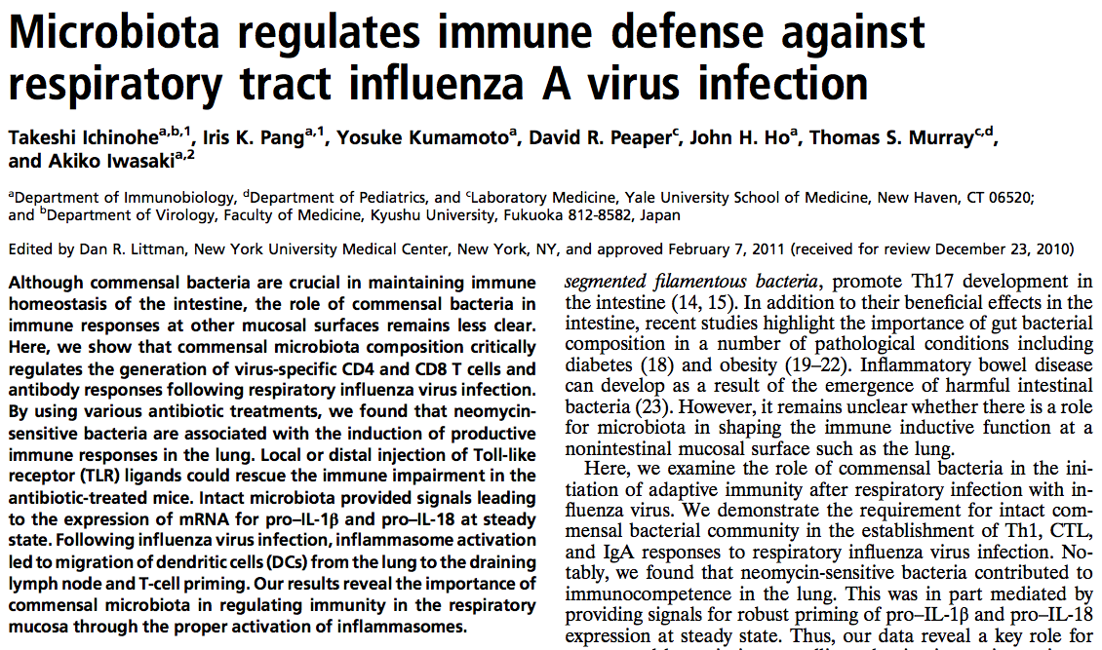

Slide 11
Host barriers to colonisation by pathogenic microbes
Structural barriers: skin, mucous membranes, respiratory cilia
Competition with commensal microbiota for niches
Chemical – eg low pH of stomach
Anti-microbials - lysozyme in mucous sectretions, α-defensins (intestine), β-defensins (respiratory and skin)
Collectins - Lung surfactant proteins A and D, mannose binding lectin (MBL)
α and β interferons
Complement activation
Neutrophils
Monocytes
Natural killer cells
NKT cells

Slide 12
Initiation of the adaptive immune response to
microbiological challenge
Commensal microbiota
Links between innate and adaptive immunity
Adaptive immune response to microbes
Role of host genetic polymorphism on disease susceptibility

Slide 13
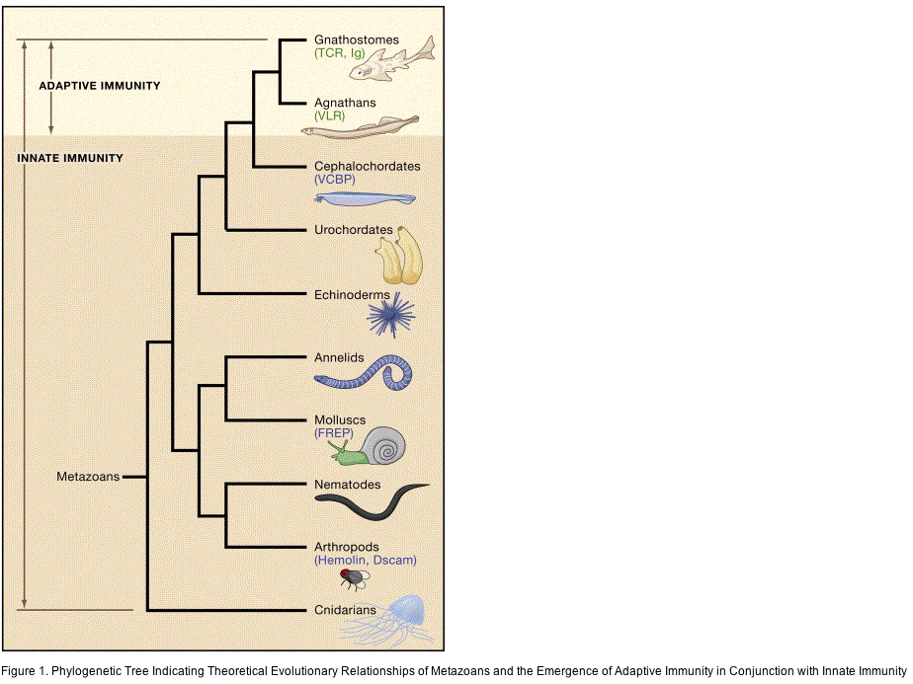
Adaptive immunity is a ‘recent’ evolutionary device for host defense
(500 million years)
Though innate immunity is ‘primitive’, we depend on the interplay between innate and adaptive immunity

Slide 14
Innate and adaptive immunity
INNATE
Very rapid
Many components
Evolutionarily ancient (conserved)
Lack of specificity
Lack of memory
ADAPTIVE
Slower
Specific: antibody (B cell)
: cellular (T cell)
Multiple effector mechanisms
Targeted to a specific antigen
Memory
Immunity highly effective in healthy individuals
Immune deterioration (elderly)/ill health/poor nutrition/
poor sanitation - increases infection risk

Slide 15
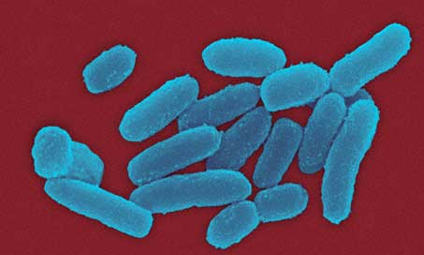
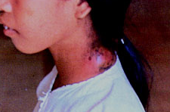
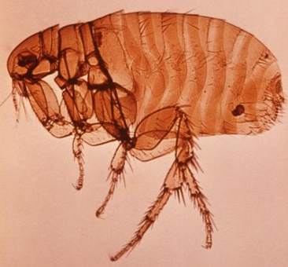
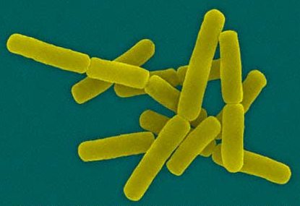
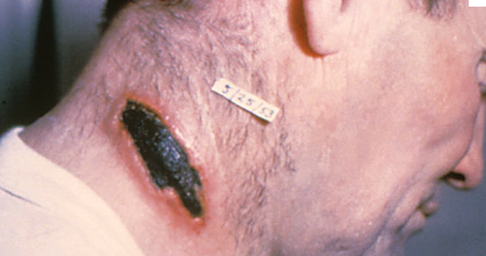
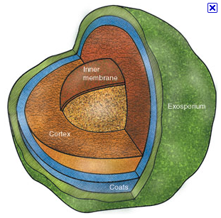
Most pathogenic microbes do not kill (dead-end for host and pathogen) Many serious pathogens are zoonotic: (transmitted from another species
Yersinia pestis Plague (~50% mortality, carried by rodents)
Bacillus anthracis Anthrax (~50% mortality)
also HIV smallpox measles

Slide 16
Most pathogenic microbes do not kill (host resistance/transmission/zoonoses)
Yersinia pestis Plague (~50% mortality, carried by rodents)
Bacillus anthracis Anthrax (~50% mortality)
-inhaled spores phagocytosed by alveolar macrophages
-delivered to regional lymph nodes
-despite macrophage environment, some spores survive
-germinate into vegetative bacteria & kill the macrophage
-further bacterial growth leads to hemorrhage and
systemic spread

Slide 17
Innate and adaptive immunity
CELLS OF INNATE IMMUNITY

Slide 18
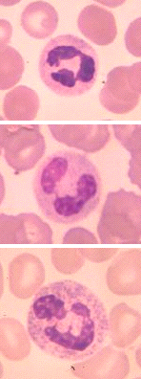
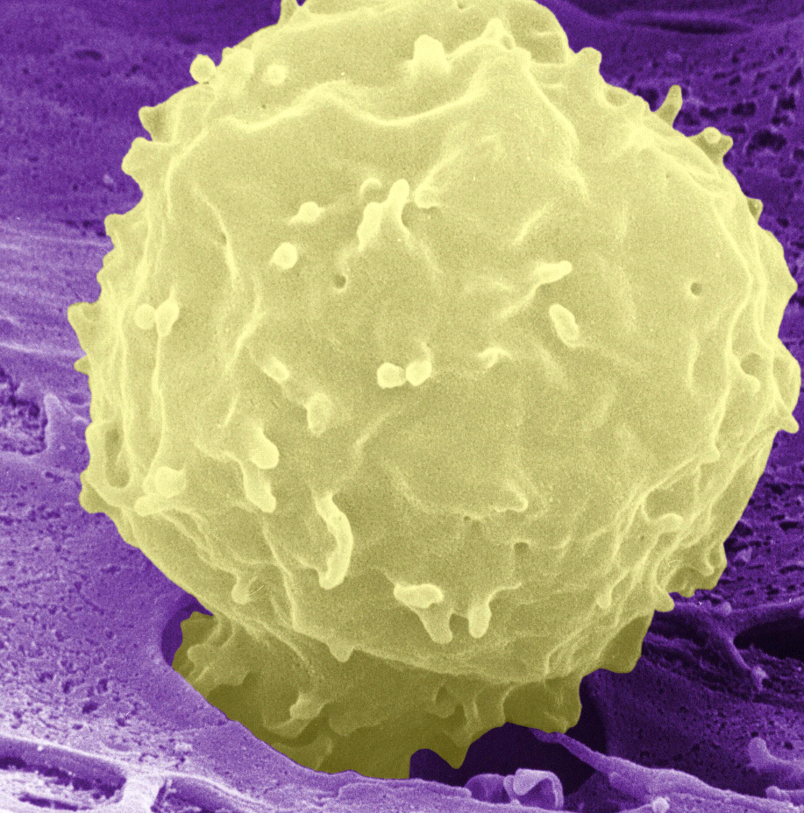
Neutrophil
Most abundant white blood cell
characteristic cell of the acute inflammatory infiltrate; phagocytoses bacteria; makes toxic products - defensins and peroxide, bactericidal enzymes

Slide 19
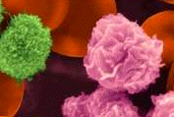
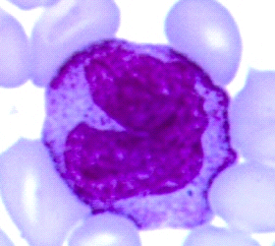
Monocyte (or in tissues, macrophage)
Phagocytose and kill pathogens - activated by toll-like receptor (TLR) recognition of pathogen-associated molecular patterns (PAMPs)
Release cytokines IL-1, IL-6, IL-8, IL-12, TNFα

Slide 20
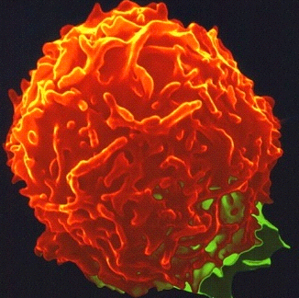
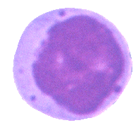
Natural killer (NK) cells
A lymphocyte population (non B, T)
Uses an array of cell surface receptors to scan for pathogen-associated molecular patterns (PAMPs)
Acts by direct killing (release of cytolytic granules) and cytokine release (interferon-γ)

Slide 21
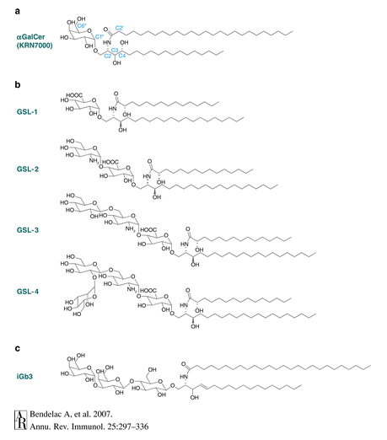
NKT cells use a semi-invariant αβ TCR to recognise microbial lipid antigens
Secrete large amounts of gamma interferon
Although a T cell lineage, NKT have innate properties
(limited TCR repertoire ~ limited ligand set)

Slide 22
Initiation of the adaptive immune response to
microbiological challenge
Commensal microbiota
Links between innate and adaptive immunity
Adaptive immune response to microbes
Role of host genetic polymorphism on disease susceptibility

Slide 23
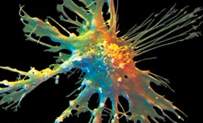
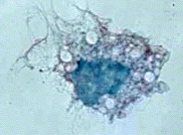
Dendritic cell
The bridge between innate immunity and T cell activation in the immune response. Professional antigen presenting cells for priming naïve T cells.
Respond to environment:
PAMPS by Pattern Recognition Receptors
Cytokines interferonγ

Slide 24
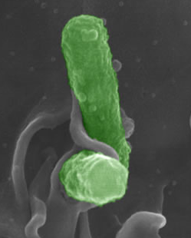
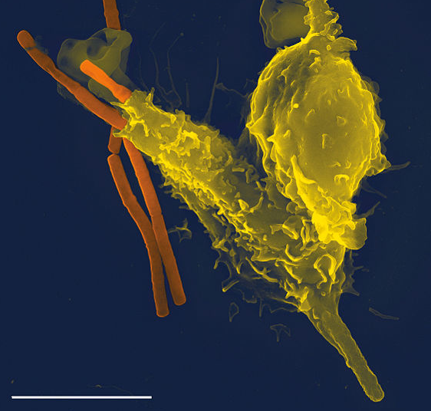
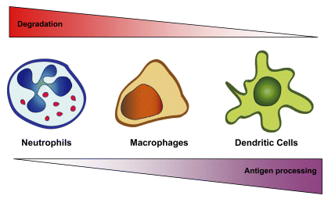
Dendritic cell: phagocytosis antigen processing activation (via PAMP recognition) migration to LN
Neutrophil
DC
Main function of phagocytosis
for pathogen removal
Main function of phagocytosis
for antigen processing

Slide 25
Dendritic cells: phagocytosis, antigen processing activation (via PAMP migration to LN
T cells recognise internal determinants of folded protein antigens
hidden when the protein is in its native conformation
B cells recognise external determinants that are exposed on the
native molecule
Prior to T cell antigen recognition,
antigen “processing” step is required
internalisation (phagocytosis)
This involves: denaturation of the antigen
proteolytic digestion

Slide 26
Antigen presentation by MHC Class II
microbe/fragment
Endo-lysosomal compartment (MIIC)
endogenously
synthesised
protein
DM
DO
Golgi
MHC class II+li
ER

Slide 27
Specificity of T cells
CD8⁺ T cell
CD4⁺ T cell
CD8⁺
CD4⁺
MHC
Class I
MHC
Class II
TCR
TCR
APC
APC

Slide 28
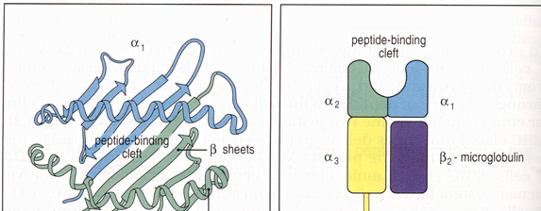
MHC class I

Slide 29
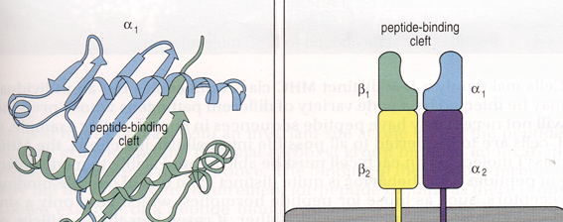
MHC class II

Slide 30
Dendritic cell: phagocytosis antigen processing activation (via PAMP recognition) migration to LN
Neutrophil
DC
Main function of phagocytosis
for pathogen removal
Main function of phagocytosis
for antigen processing

Slide 31
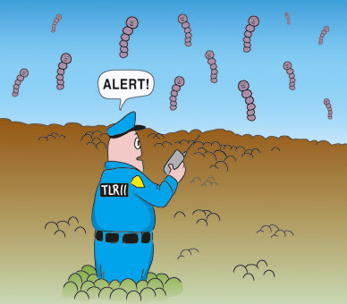
Innate and adaptive arms form an integrated immune system
Naïve T cells can only be activated by activated dendritic T cells

Slide 32
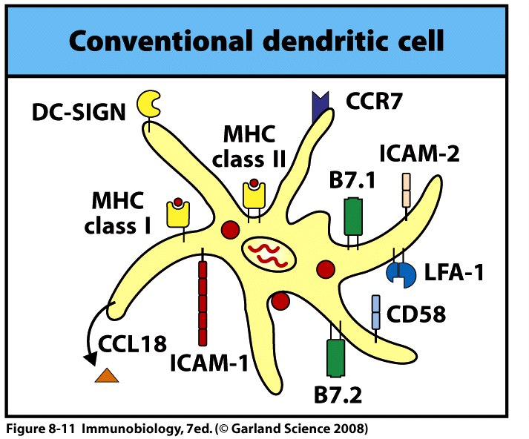
conventional DC (CD11c^{hi})
CCR7
Migration to LN
B7.1 B7.2
T cell co-stimulation

Slide 33
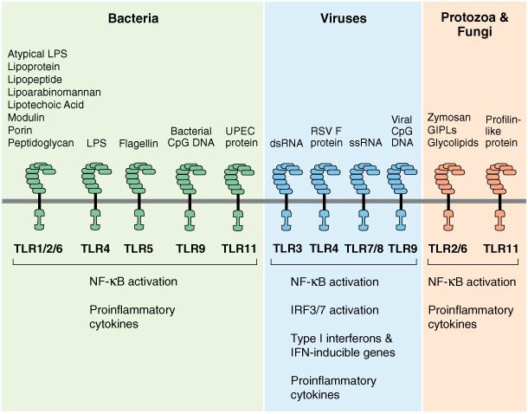
Innate and adaptive arms form an integrated immune system
Pattern associated molecular patterns (PAMPs) are ‘read’ by
Toll like receptors (TLRs) on dendritic cells leading to
DC activation and appropriate T cell differentiation

Slide 34
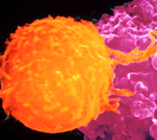
T lymphocyte (T cell)
Key cell-type mediating the adaptive immune response. Recognise peptidic fragments of foreign antigen presented by HLA molecules on antigen presenting cells. Leads to activation, cytokine release, killing, B cell help etc

Slide 35
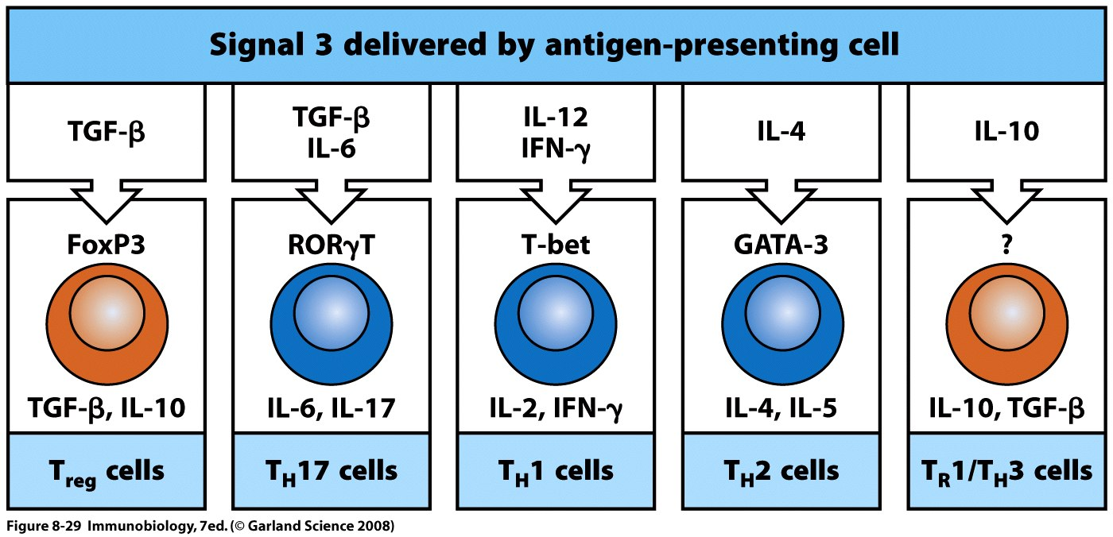
Adaptive Treg

Slide 36
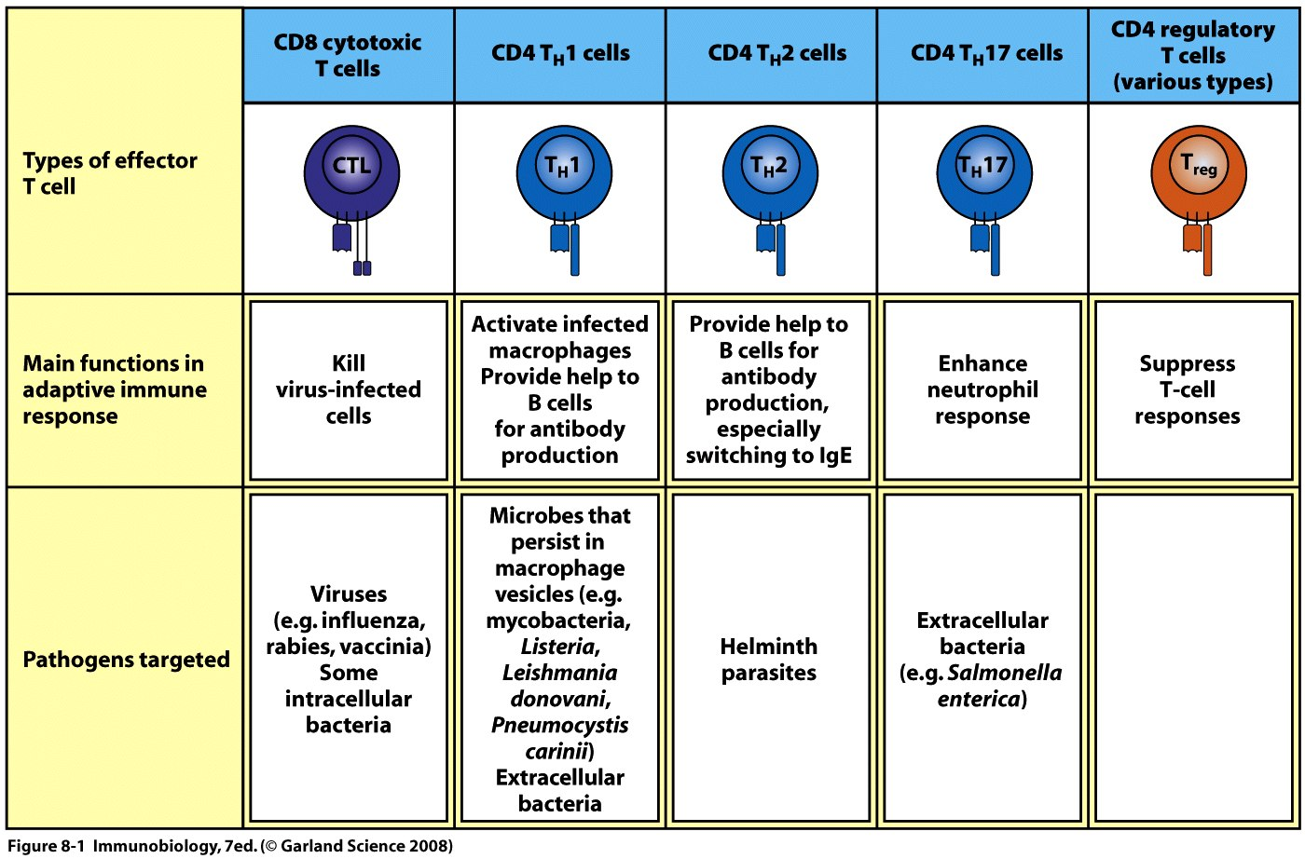
Effector T cells in CMI and humoral immunity

Slide 37
Dendritic cell: phagocytosis antigen processing activation (via PAMP recognition) migration to LN
Neutrophil
DC
Main function of phagocytosis
for pathogen removal
Main function of phagocytosis
for antigen processing

Slide 38
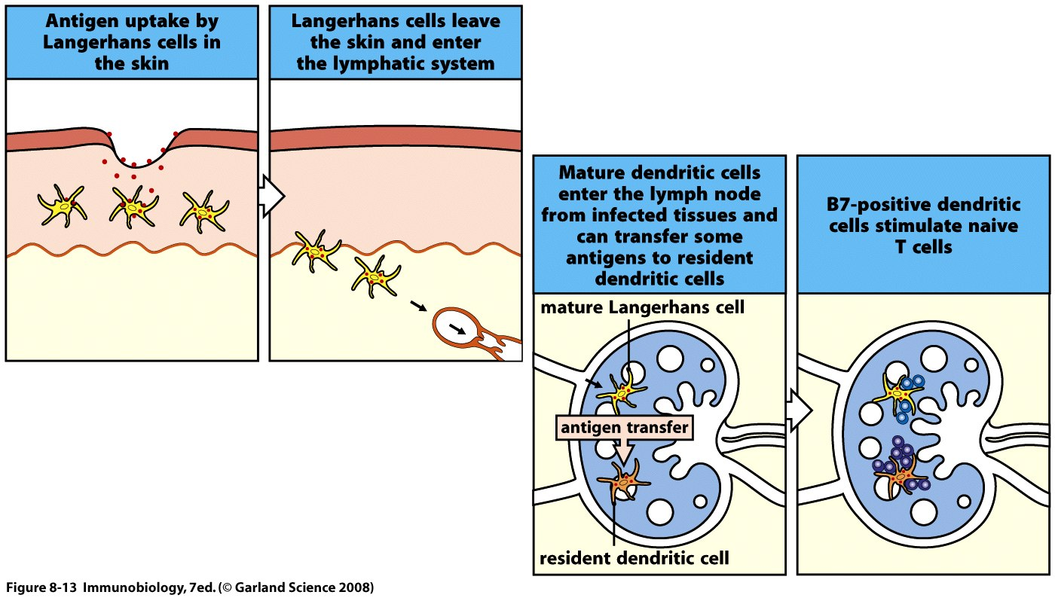

Slide 39
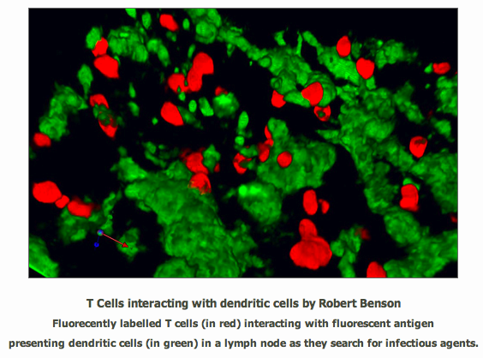
Migrated T cells present antigen to naïve T cells in draining
lymph node

Slide 40
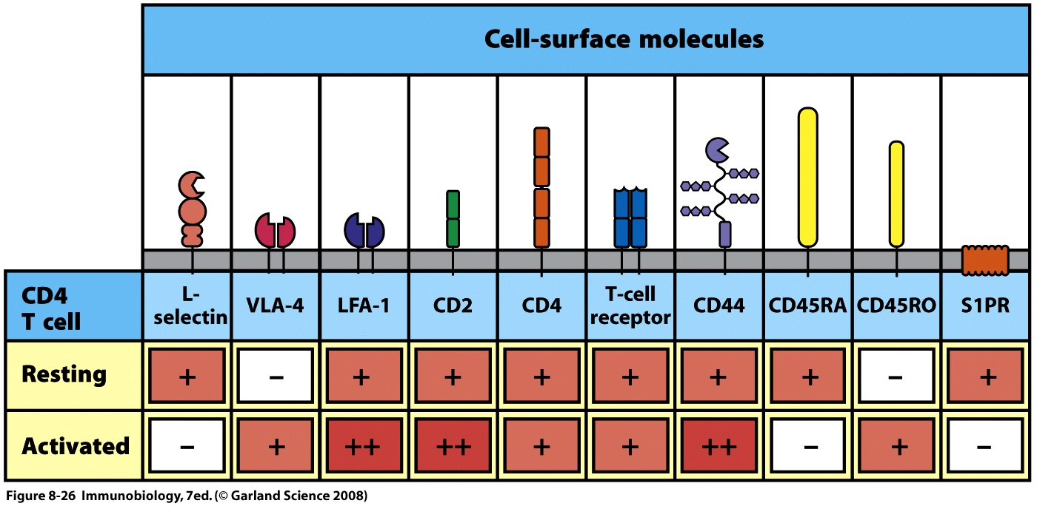
CD4 T activation

Slide 41
Activated T cells migrate to site of infection
OUTSIDE
LYMPH NODE
Pathogen
Immature, antigen capturing DC’s
CHEMOKINES
Afferent Lymphatics
Antigen specific T cells
Chemotaxis under the influence of chemokines, cytokines, pathogenic mediators
migration
Activated, pathogen-specific T cells in blood
tethering
rolling

Slide 42
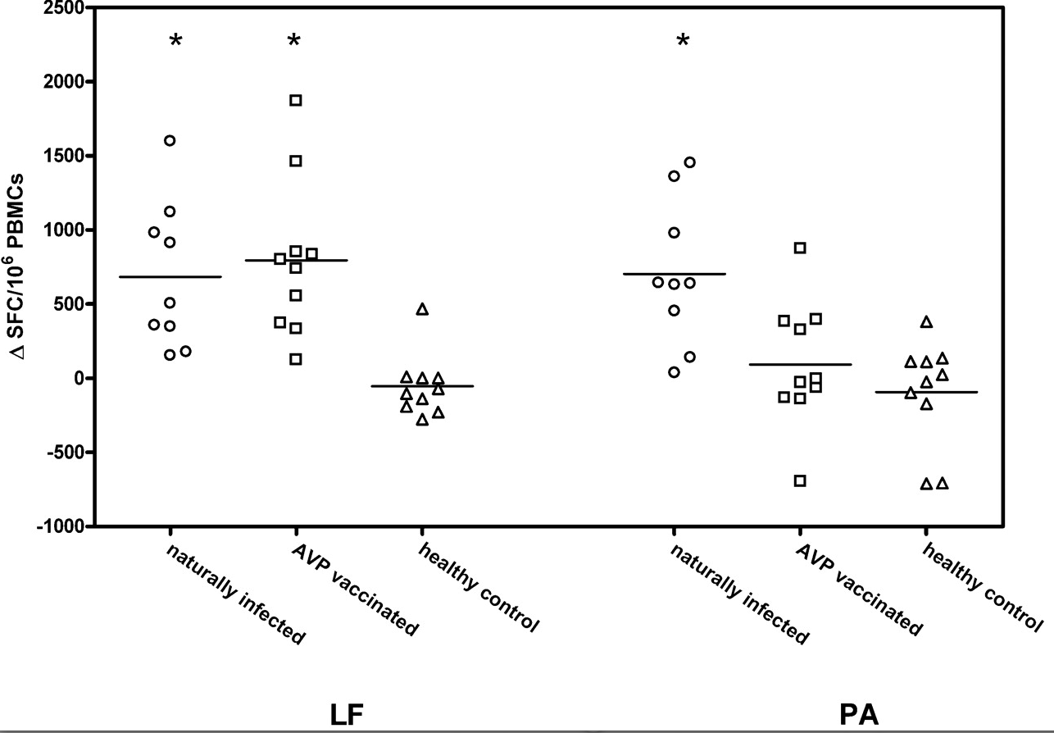
CD4 T cell response to cutaneous Yersinia infection/vaccination
T cell IFN-γ release in response to the toxin components LF and PA were quantified using
ELISpot in naturally infected (○), vaccinated (□), and healthy control (△) cohorts
Ingram et al J Immunol. 2010 184:3814

Slide 43
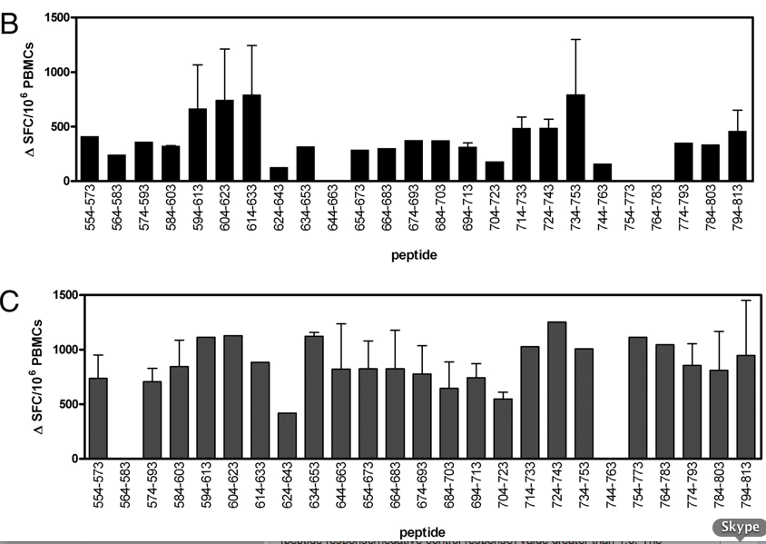
CD4 T cell response to cutaneous Yersinia infection/vaccination
IFN-γ release elispot assay to define peptides recognised by CD4 T cells
Ingram et al J Immunol. 2010 184:3814

Slide 44
Initiation of the adaptive immune response to
microbiological challenge
Commensal microbiota
Links between innate and adaptive immunity
Adaptive immune response to microbes
Role of host genetic polymorphism on disease susceptibility

Slide 45
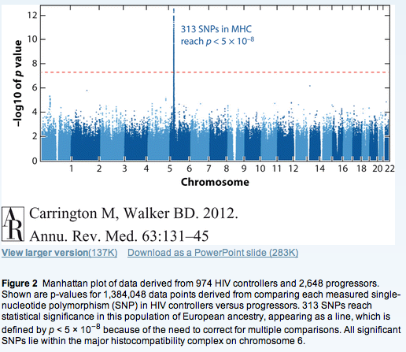
Genome analysis of HIV controllers/non-controllers

Slide 46
Genome analysis of HIV controllers/non-controllers
Limitations of genome analysis
-Racial differences in freq of alleles
-Large sample number required
-Identifies linkage not GENE

Slide 47
Reading: Text Book
eg
Janeway's Immunobiology : The Immune System
Garland

