Slide 1
Introduction to the Immune System
Organs and cells
Peter Kelleher
Senior Lecturer, Imperial College London, Chelsea & Westminster campus

Slide 2
Learning objectives
Give a brief overview using the ‘Immunology Tree of Life’ cartoon as to why study of immunology is important for our understanding of human health and disease.
Outline the anatomy of the immune system with emphasis on primary and secondary lymphoid tissue and the mucosal immune system.
Briefly describe the phenotype and function of cellular components of the immune system.

Slide 3
Immune system
&
Medicine

Slide 4
The purpose of the immune system
Complex cellular and protein network that has evolved to protect the host from pathogenic microbes.
The immune system has evolved to accomplish the following:
  distinguish pathogenic from commensal microbes
  eliminate toxic, allergenic proteins
  avoid risk of collateral damage to self tissues
Failure of the immune system to accomplish some/all of these tasks results in infectious, allergic or autoimmune disease

Slide 5
‘The Immunology Tree of Life’

Slide 6
Immune system and disease
Some diseases are caused by abnormal or loss of function of the immune system
Allergy Asthma and hay fever
Autoimmune disease SLE or ‘Lupus’
Coeliac disease
Infection HIV-1 infection, Tuberculosis
Cancer Chronic lymphatic leukaemia Multiple myeloma

Slide 7
Immune tests may be used to help diagnose or monitor disease
Blood tests helpful in the diagnosis of disease
Antinuclear antibodies (ANA) SLE
Tissue transglutaminase Coeliac disease
Interferon gamma release assay TB infection
Blood tests helpful to monitor extent or activity of disease
CD4 T cell count HIV-1 infection
Complement levels SLE

Slide 8
A greater understanding of the immune system has led to the development of immune based therapies to treat disease
Bone marrow transplantation SCID
Immunoglobulin replacement Primary Antibody deficiency
Specific B cell ablation therapy Lymphoma
Anti-cytokine therapy Rheumatoid arthritis
DC based vaccination Prostate cancer

Slide 9
Anatomy of the Immune System

Slide 10
Primary Lymphoid Organs
Bone marrow
Production of immune cells
B cell maturation and differentiation
Thymus
Site of T cell maturation and development

Slide 11
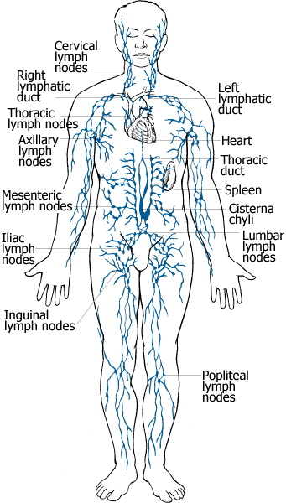
Secondary lymphoid organs and tissues
Site of immune reactions
Lymph nodes
skin
internal organs
Spleen
Mucosa associated lymphoid tissues (MALT): gut, lungs and genito-urinary system

Slide 12
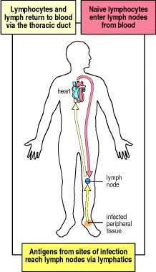
Circulation of lymphocytes
Antigens from sites of infection reach lymph nodes via lymphatics
Antigen naïve T and B cells travel from blood into lymph nodes
Lymph node are sites of immune responses
Lymphocytes which respond to antigen return back to tissues whereas lymphocytes which have not met antigen recirculate back to blood

Slide 13
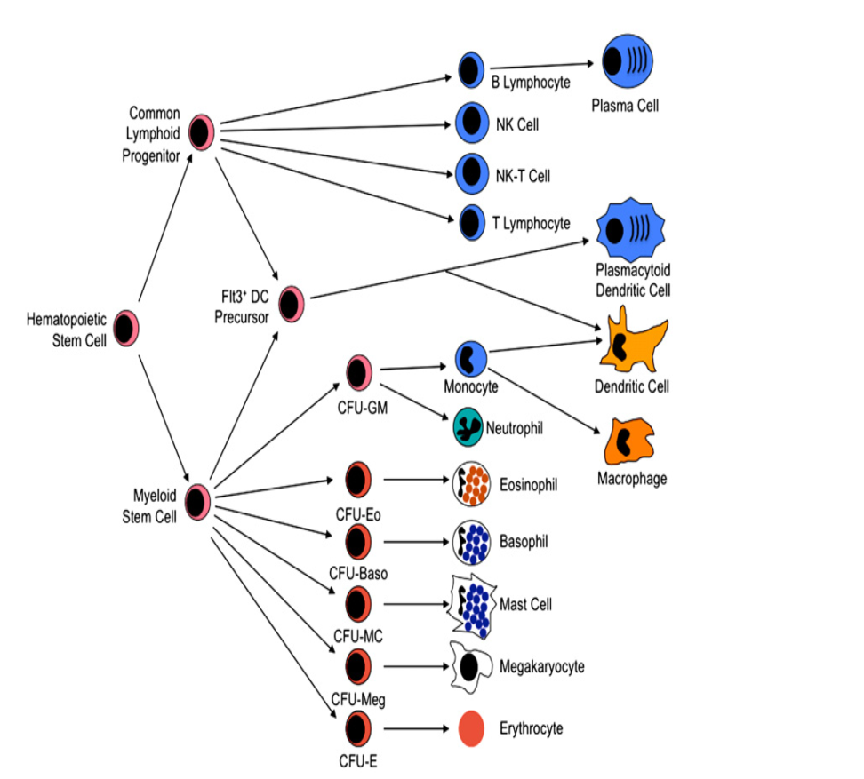
Cells of the immune system originate from the bone marrow
Stem cells in bone marrow give rise to red cells, white cells (immune cells) and platelet
  Lymphoid progenitors cells give rise to T cells, B cells, NK cells
Myeloid progenitor cells give rise to granulocytes and monocytes

Slide 14
Development and maturation of immune cells in bone marrow
Development and regulation of cells of the immune system is associated with programmed appearance of specific cell surface molecules and responsiveness to selective cytokines
Bone marrow is site of antigen independent B cell maturation
Some immune cells (monocytes and dendritic cells) undergo further maturation in peripheral tissues

Slide 15
The thymus is the site of T cell maturation and development
T cell progenitors
Cortex: Positive T cell selection
C-M junction Negative T cell selection
Medulla T cell maturation
Mature T cells

Slide 16
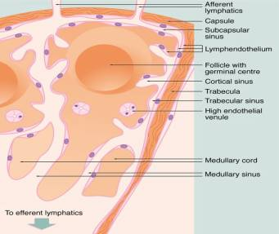
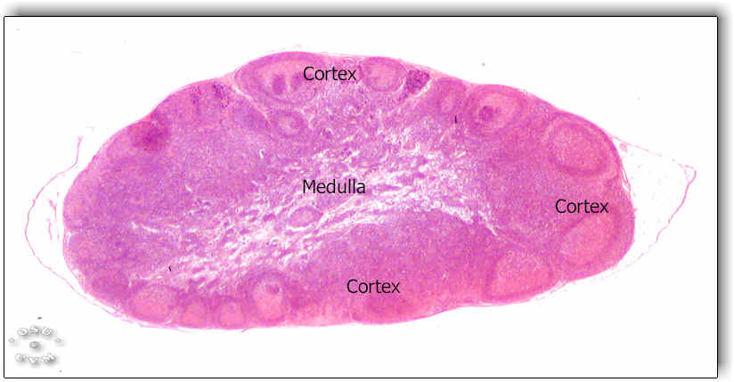
Anatomy of lymph node
The lymph node has 2 distinct compartments: cortex and medulla
Cortex
B cell zone: primary and secondary follicles (latter contain germinal centres)
T cell region: paracortical zone surrounding the lymphoid follicles contains dendritic and T cells
Medulla
Exit point for B and T cells: afferent lymphatic vessels

Slide 17
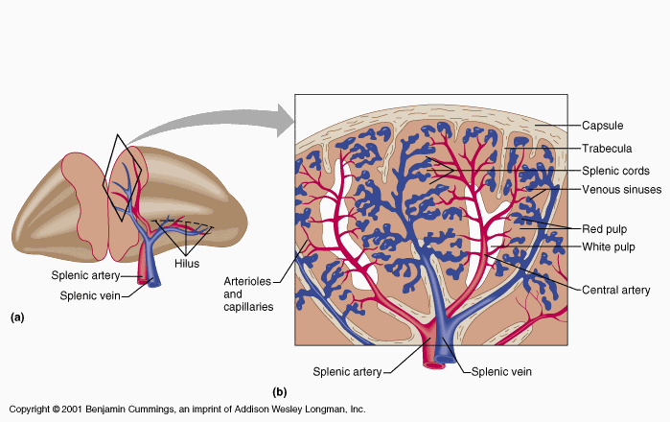
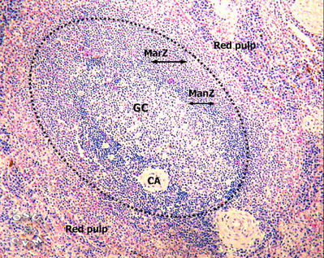
Anatomy of the spleen
2 main compartments: red pulp (arterial
venous filter) and white pulp
White pulp
T cell zone surrounding central arteriole
B cell zone (mantle zone & germinal
centre)
Marginal zone: interface between white
and red pulp contains unique B cell, T cell
neutrophil and macrophage subsets
Marginal zone is site of T cell independent
antibody responses

Slide 18
MALT: key concepts
Consists of discrete inductive and effector compartments
  Inductive: encounter with antigen; activation of immune cells
  Effector: secretion of antibody: release of cytokines
Lymphocytes leave the inductive compartments travel to the mesenteric lymph nodes and then directly go to the blood stream and back to effector compartment
Immune response to any antigen at any one mucosal surface usually leads to dissemination of lymphocytes to other mucosal surfaces as well

Slide 19
MALT key concepts
Composition of mucosal immune cells differs significantly from blood and lymph nodes
  Memory cells far exceed naïve cells
  CD4 T cells express high levels of the CCR5 chemokine receptor
  Distinct set of CD8 T cells and dendritic cells are found in MALT
The dominant immunoglobulin at mucosal sites is IgA
In the gastro-intestinal tract commensal bacteria influence the composition of immune cells and production of IgA antibody

Slide 20
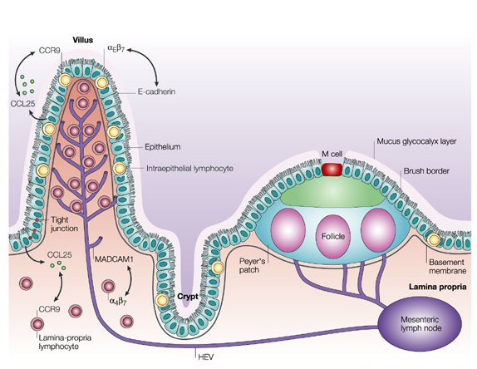
Diagram of mucosal immune system
Effector
Unit
Inductive
Compartment

Slide 21
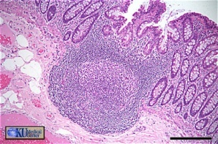
Gastrointestinal lymphoreticular tissue (GALT):
Inductive compartment
Peyer’s patches (PP)
Isolated lymphoid follicles (IEL)
Follicular associated epithelium
  No afferent lymph node drainage
  Antigen uptake occurs via M cells
  DC can also take up antigen from lumen of intestine
Within PP and IEL
  Antigen presentation takes place to B cells
  IgA class switching occurs
  IgA plasma cells exit and head for LP

Slide 22
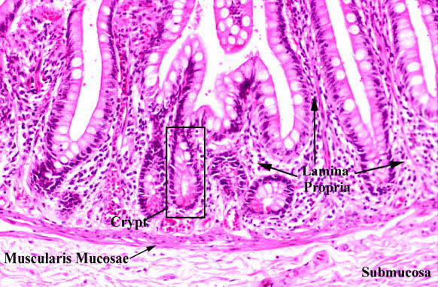
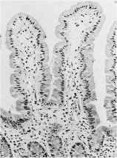
GALT: effector compartment
Diffuse collection of immune cells located beneath epithelial lining
Contains activated T and B cells that have been exposed to foreign proteins
Lamina propria cellular network
  CD4 T cells >> CD8 T cells
  Plasma cells which secrete IgA
Intra-epithelial lymphocytes
  Mainly CD8αα T cells
  Function not fully understood

Slide 23
Identification of immune cells
Leukocyte subsets can be identified using a combination of histological stains or monoclonal antibodies to label glycoproteins that are known as differentiation antigens which are usually expressed on surface of the cells
Each differentiation antigen is assigned a unique number: cluster of differentiation (CD) number: more than 350 exist
Some useful CD markers to remember:
  CD3+ T cell
  CD19+ or CD20 B cell
  CD14 Monocyte/Macrophage
  CD3+CD4+ T helper cells
  CD3+CD8+ Cytotoxic T cell
  CD3-CD16+CD56+ NK cell

Slide 24
Cells of the immune system

Slide 25
Granulocytes
White blood cells characterized by the presence of granules in in their cytoplasm
Granulocytes are distinguished by morphology, pattern of cytoplasmic staining and expression of CD markers
3 main type of granulocytes
  Neutrophils
  Eosinophils
  Basophils

Slide 26
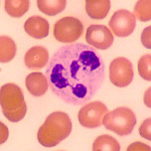
Neutrophils
Comprise majority (90%) of granulocytes
Short lived cells (2-3 days) end stage cells
Accumulate rapidly at sites of bacterial infection and tissue injury
Phagocytic capacity: major means for elimination of pathogens
Secrete enzymes that contribute to tissue remodelling and repair after injury

Slide 27
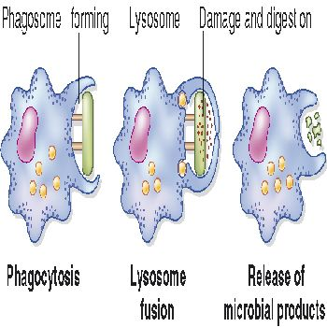
Neutrophil phagocytosis
Phagocytic capacity: engulfment of microbes and particulates into lysosomes
Breakdown of pathogens and particulates following exposure to large quantities of toxic reactive oxygen species and degradative enzymes
Phagocytic capacity enhanced by expression of complement and immunoglobulin Fc receptors

Slide 28
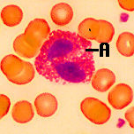
Eosinophils
Prominent cytoplasmic granules containing toxins (MBP) and enzymes that are active against helminths and parasites
Mode of action: degranulation and release and granule contents into extracellular space
Growth and differentiation and maturation of eosiniphils controlled by cytokines GM-CSF, IL-3 and IL-5

Slide 29
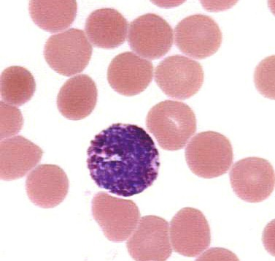
Basophils
Basophil minor fraction of granulocytes : less than 2%
Basophils express high affinity IgE receptor: release inflammatory proteins after when antigen binds to IgE
Basophils are believed to produce a protein called IL-4 which promote allergic immune responses
  Protection against helminths and parasites

Slide 30
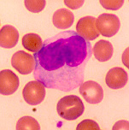
Mononuclear phagocytes I
Monocytes are mobilised after neutrophils to inflammatory sites
Persist for long periods at sites of chronic infection and inflammation
Monocytes may differentiate into tissue macrophages and dendritic cells
Macrophages are involved in the formation of tissue granulomata
Functions: Phagocytosis
Wound healing

Slide 31
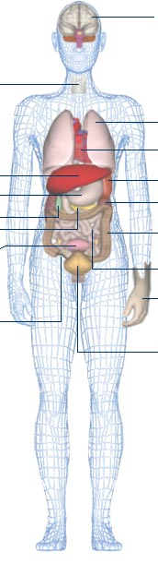
Mononuclear phagocytes
Brain
Microglial cells
Macrophages process and present antigens to T and B cells
Important source of IL-12 and IFN-γ which promote CD4 T helper 1 and CD4 T helper 17 immune responses
Specialized macrophages exist in different tissue as shown in figure
Distinct monocyte and macrophage subsets have recently been characterised
Liver
Kuppfer cells
Kidney
Mesangial cells
Bone
Osteoclast

Slide 32
Mast cells
Tissue based cells which express the high affinity receptor for IgE
Cross linking of IgE receptor leads to degranulation and release of inflammatory proteins (histamine, tryptase and leukotrienes)
Host protection against helminth & parasite infections
Mast cell degranulation implicated in immediate hypersensitivity (allergic) reactions
IgE receptor

Slide 33
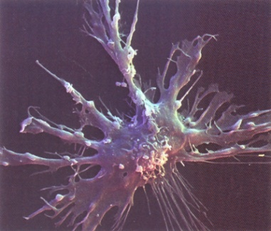
Dendritic cells
Myeloid and lymphoid subsets; strongly express
MHC Class I and II and co-stimulatory molecules
Antigen uptake and processing in periphery, migration to lymph nodes to present antigen to T and B cells
Lymphoid DC: plasmacytoid DC migrate from blood to LN; secrete IFN-α , role in anti-viral immunity
Myeloid DC migrate from tissues to LN, secrete IL-12 promote CD4 Th1 immune responses
In steady state DC promote immune tolerance

Slide 34
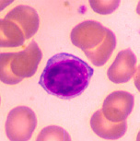
Natural Killer (NK) cells
Large granular lymphocytes
Recognize viral infected or tumour cells using complex array of activating and inhibitory receptors
Host defence against viruses, parasites intracellular infection and parasites
Tumour lysis and antibody dependent
cell cytoxicity
Promote of CD4 Th1 immune response

Slide 35
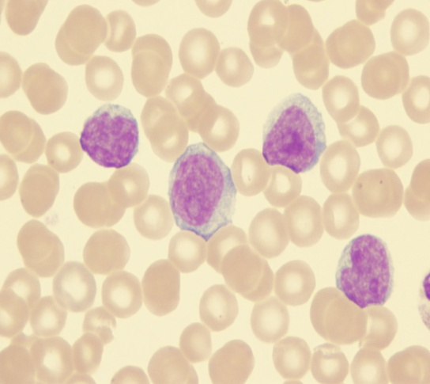
B cells
Express antigen specific receptor (surface immunoglobulin) and co-receptor signal transduction complex (CD19, CD21, CD81).
Activation of B cells leads to secretion of immunoglobulin by plasma cells .
Immunoglobulins recognize 3-D shapes present on surface of foreign proteins or carbohydates (antigens).
Several different types of B cells exist
  Marginal zone B cells
  Class switched memory B cells

Slide 36
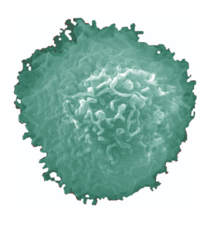
T cells
T cell express antigen specific receptors (TCR) and CD3 protein signal transduction complex
Most TCR consists of α and β polypeptide chains : minority (5%) express γδ chains
T cell recognize linear peptide sequences presented in conjunction with Major Histocompability Class (MHC) proteins
Several different types of T cell exist
  CD4 T helper cell
  CD4 regulatory cells (maintain tolerance)
  CD8 T cytotoxic cell

Slide 37
Learning points
1. Loss or abnormal immune function may result in increased susceptibility to infection, allergic, autoimmune diseases and cancers.
2. Primary lymphoid organs are the site of immune cell production and maturation whereas immune responses occurs in secondary lymphoid tissues.
3. Cells of the immune system protect the host against infection or toxins and maintain tolerance to self proteins.

Slide 38
SBA question
Select the best option:
  Neutrophils are the first immune cells to arrive at the site of infection
  Eosinphils are active against viral infections
  Basophils have high affinity receptors for IgA
  B cell mature in the thymus
  Natural killer promote CD4 T helper 2 immune responses

