Slide 1
Innate immune system
Peter Kelleher
Senior Lecturer, Imperial College London, Chelsea & Westminster campus

Slide 2
Learning objectives
Understand the basic principles of innate immune responses and the timescale in which they occur
Describe the major recognition strategies used by the innate system to detect the presence of infection and tissue damage.
Describe the role of mediators of innate immunity such as complement, inflammatory cytokines and chemokines in host defense against infection.
Be able to give some examples in which disorders of affecting components of the innate immunity are associated with human disease.

Slide 3
Glossary of some terms used in lecture
APC: Antigen presenting cells
CARD: Caspase recruitment domain
CLR: C-type lectin receptors
CR2: Complement receptor 2
CRP: C-reactive protein
DC: Dendritic cells
DC-SIGN: Dendritic Cell -Specific Intercellular adhesion molecule-3-Grabbing Non-integrin)
DAF: Decay accelerating factor
ELC: Glutamine-leucine-arginine
IL: Interleukin
IPS: IFN-β promoter stimulator
IFN: Interferon
Jak: Janus kinase
LPS: Lipopolysaccharide
MCP: Membrane cofactor protein

Slide 4
Glossary of some terms used in lecture
MDA: Melanoma differentiation antigen
MHC: Major histocompability complex
MIP: Macrophage inflammatory protein
NALP3: Nacht domain, leucine rich repeat and PYD-containing protein 3
NF-κB : Nuclear factor kappa B cell
NOD: Nucleotide oligerimerization domain
PYD: Pyrin domain
RIG: Retinoic acid inducible gene
SAP: Serum amyloid protein
SLE : Systemic lupus erythematosus
STAT: Signal transducer and activator of transcription
TARC: Thymus and activation regulated chemokine
TLR: Toll like receptors
Th: T helper
TNF: Tumour necrosis factor

Slide 5
Principles of the innate immune system
Innate immune system is first line of defense against pathogens
Influences the magnitude and type of subsequent adaptive T and B adaptive immune responses
Consists of anatomical and physiological barriers
  Intact epithelial cell layers
  Organ specific pathogen clearance mechanisms
Innate immune system also contains:
  Cellular components (neutrophils, eosinophils, basophils mast cells, monocytes, macrophages DC and NK cells)
  Soluble proteins (anti-microbial peptides , complement, chemokines, cytokines)

Slide 6
The innate immune system can detect the presence of pathogens and tissue damage
  Micro-organisms and damage to host cells and tissues (danger signals) are recognized by invariant germ-line encoded proteins known as ‘pathogen pattern recognition (PPR) receptors
  PPR receptors recognize conserved microbial structures (Pathogen Associated Molecular Patterns PAMP)
      Molecular structures associated with microbial envelopes
      Microbial nucleic acids
  ‘Danger signals’ (Danger Associated Molecular Patterns DAMP detected by innate immune receptors
      Liberated intracellular proteins
      Altered matrix proteins
      Extracellular host nucleic acids

Slide 7
Actions of innate immune receptors
  Expressed by all cells of innate immune system and by epithelial cells of skin and mucosal tissues
  Allows the innate immune system to respond rapidly to external insults/tissue damage (minutes to hours)
      Millions of identical receptors expressed by innate immune cells
      Millions of innate immune and epithelial cells
      Millions of bacteria/viruses/fungi etc express ligands for PPR receptors
  Has little/no memory for previous encounters and response is not enhanced by second exposure

Slide 8
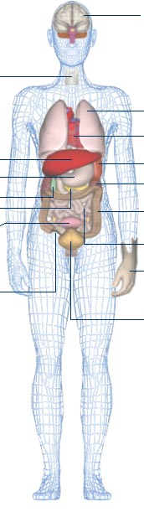
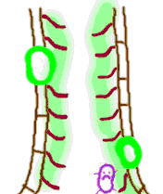
Mechanical and physiological defences against infection
Particulate removal in nasal turbinates
(hairs, mucus)
Lysozyme in tears
Skin;
physical barrier, toxic fatty acids
Gastric acidity
Bronchi – mucocilliary escalator
Urinary tract – flushing, defensins
Gut – mucus, peristalsis, defensins

Slide 9
Common innate immune recognition strategies
Receptor families
Recognition strategy
1. Detect conserved microbial structures (PAMP)
2. Detect metabolic consequences of cell infection or injury (DAMP)
3. Detect ‘missing self’
Toll like receptors (TLR)
NOD like receptors (NLR)
C-type-lectin receptors (CLR)
RIG-1 like receptors (RLR)
NOD-like receptors (NLR)
MHC Class 1 specific activation and inhibitory receptors

Slide 10
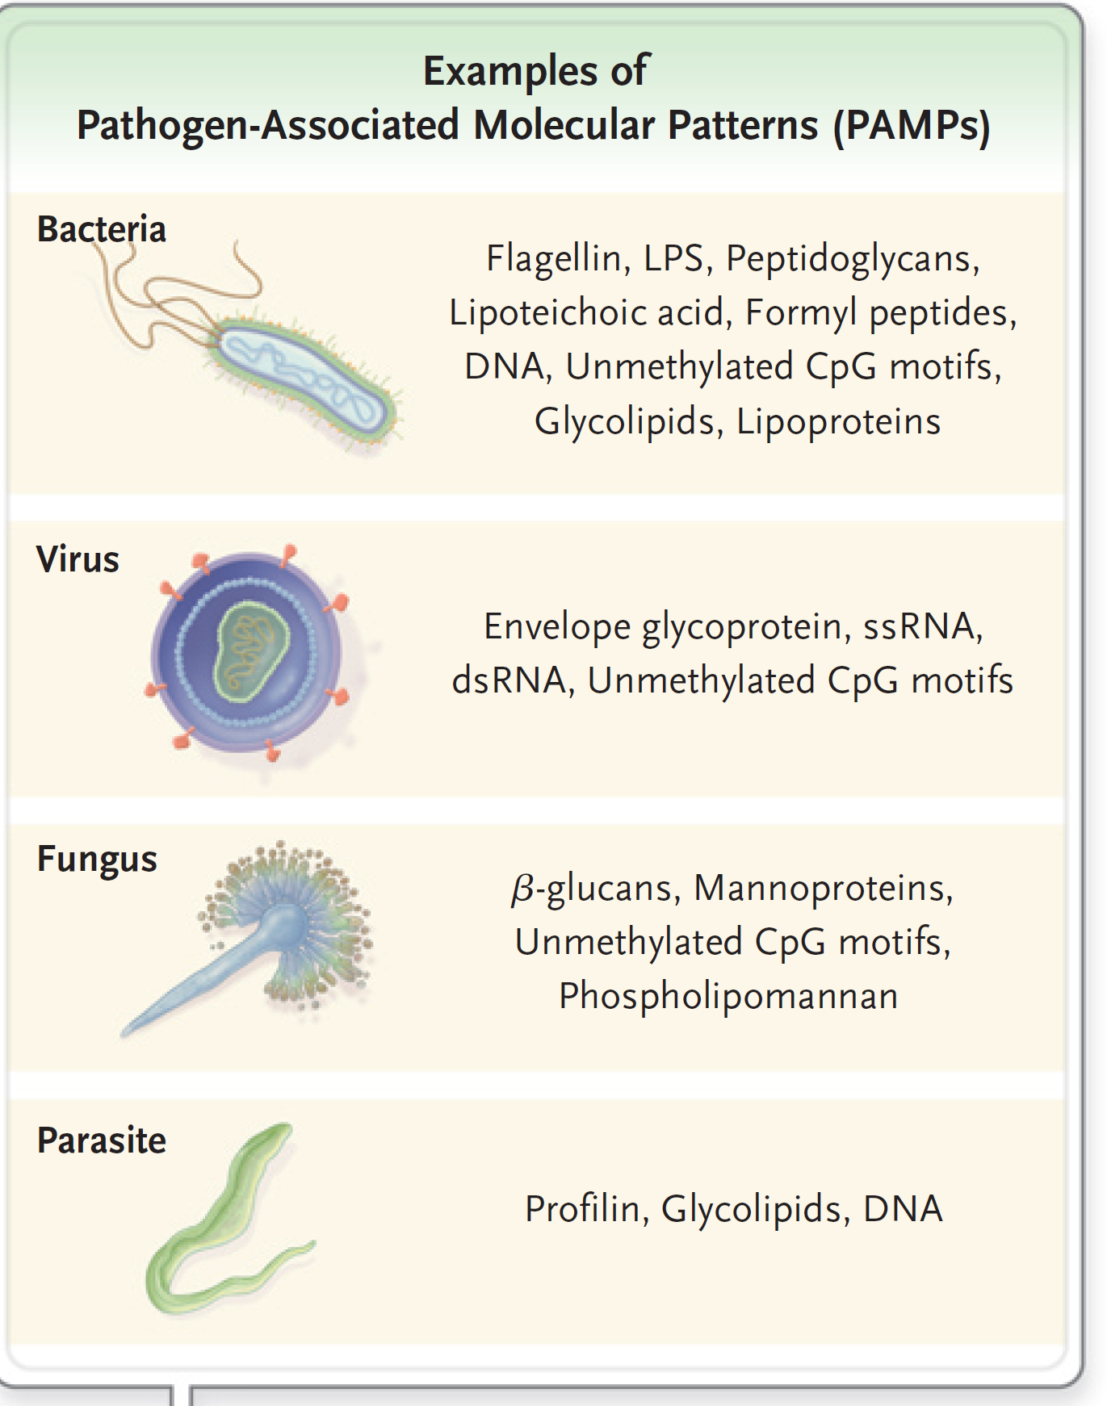

Slide 11
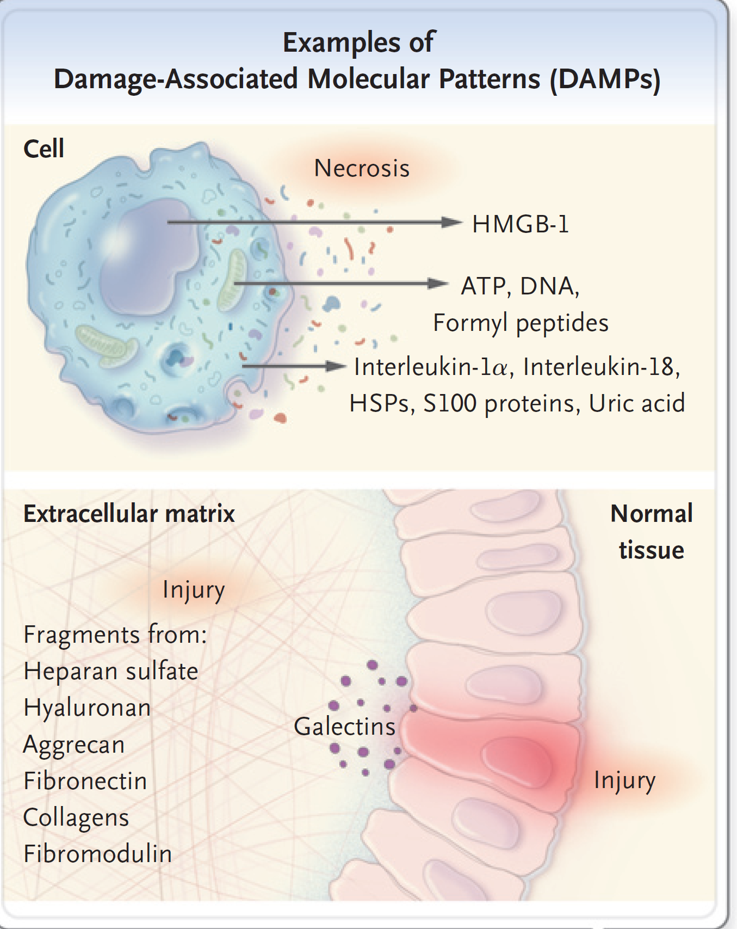

Slide 12
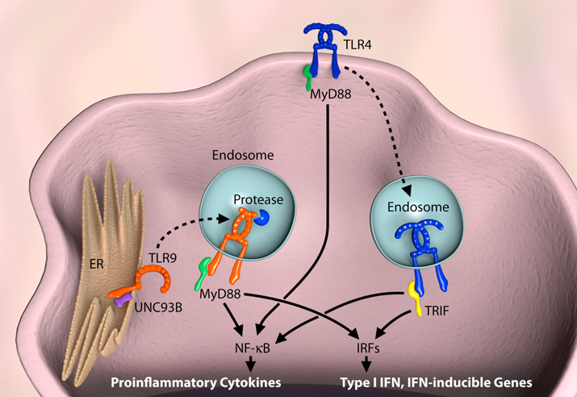
Toll-like receptors (TLR)
Transmembrane receptors with leucine rich extracellular pathogen recognition domain and cytoplasmic signalling region homologous with IL-1 receptor
In humans 10 different TLR now defined
Expressed by phagocytic cells dendritic cells, macrophages and epithelial cells
Found on cell surface (TLR2 TLR4 TLR6) and endoplasmic reticulum, phagosome and endosome membranes (TLR3, TLR7, TLR9)
Cell surface TLR recognize microbial envelope structures whereas phagosome/endosomal TLR detect nucleic acids

Slide 13
TLR: ligands and function
TLR ligands
  TLR1 2/6 Lipopoteins
  TLR3/7 RNA
  TLR4 LPS
  TLR5 Flagellin
  TLR9 DNA
TLR signalling results in
  Up regulation of inflammatory cytokines and chemokines
  Secretion of antiviral interferons
  Maturation of dendritic cells
  Induction of CD4 Th1 immune responses
  Immunoglobulin secretion

Slide 14
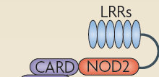
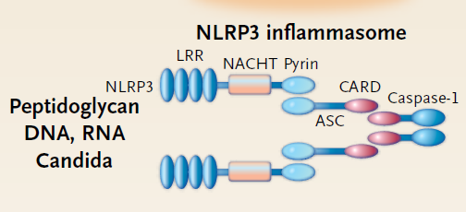
NOD-like receptors (NLR)
Cytoplasm proteins which detect intracellular infection or cell damage : 22 different types in humans most of which are still not fully characterized
Contain ligand sensing leucine rich repeating region, NOD domain and different effector regions (CARD, PYD) to initiate cell signaling.
Some members of NLR family (NLRP3) form part of a multi-protein complex known as the inflammasome .
  NOD1/NOD2 recognize intermediate products of bacterial lipoprotein metabolism (peptidoglycans) and activate NF-κB
NOD-2 protein

Slide 15
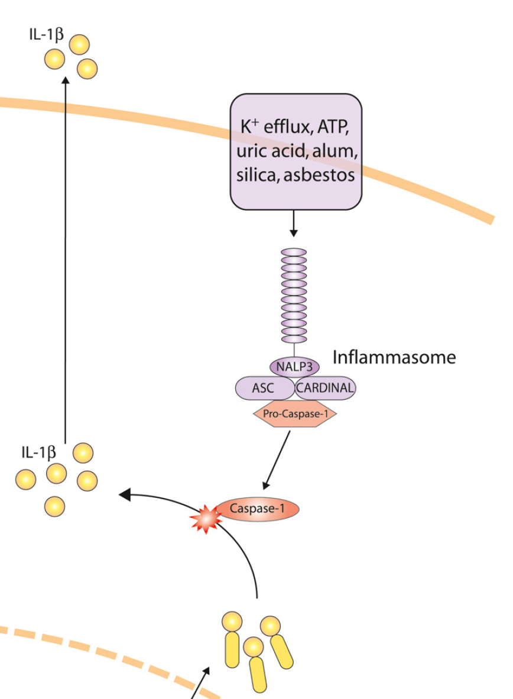
Inflammasome
Ligands include microbes
Markers of cell damage (increased extracellular concentration of K^{+,} ATP and uric acid)
Activates an enzyme called caspase 1
Caspase 1 regulates the secretion of pro-inflammatory cytokines, IL-1β, IL-18 and IL-33

Slide 16
Clinical implications of TLR/NLR innate immune recognition system
TLR/NLR ligands are important components of common vaccine adjuvants
Complexes of self RNA-TLR7 and self DNA-TLR9 are believed to trigger SLE
Loss of function mutations in the TLR signalling pathway can cause invasive bacterial disease
Mutation of NOD-2 found in 30-50% of patients with Crohn’s disease in NW Europe
Gain of function mutations in NLRP3 results in excess secretion of IL-1 and cold induced auto-inflammatory syndromes known as cryopyrinopathies (fever, urticaria and CNS disease)

Slide 17
C-type-lectin like receptors (CLR)
C type lectins recognize carbohydrates expressed by bacteria, viruses, fungi and parasites
C-type lectins include mannose receptor, DC–SIGN, mannan binding lectin (MBL), pentraxins (C-reactive protein) and ficolins
Actions of C-type lectins include
  Sets up inflammatory immune responses
  Activates complement (MBL)
  Opsonisation of microbes (MBL)
  Elimination of any potentially harmful endogenous glycosylated proteins

Slide 18
Dectin-1
Dectin-1 (C-type lectin) is a transmembrane receptor that binds to β-glucan in cells walls of yeast (candida)
Activation of Dectin-1 promotes CD4 Th17 immune responses
Loss of CD4 Th17 immune responses predisposes humans to persistent skin and mucosal candida infections

Slide 19
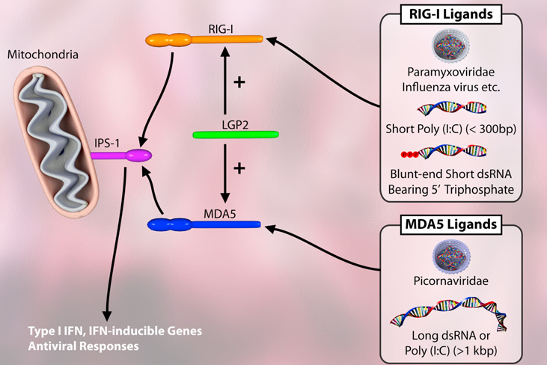
RIG-like receptors (RLR)
Cytosolic receptors to detect RNA viruses (TLR only recognize virus in endosomes)
Contain a C-terminal RNA helicase domain with/without N-terminal CARD signalling domain.
RLR recognize dsRNA which is usually not found in host cells but is generated in the cytoplasm during viral replication
RIG-1 detect short dsRNA intermediates and ss RNA virus (influenza) and MDA5 recognizes longer dsRNA intermediates and ssRNA virus (picornavirus encephalomyocarditis virus)
Promote Type 1 antiviral interferon (IFN-α/β) immune responses by binding to the mitochondrial adaptor protein (IPS-1)

Slide 20
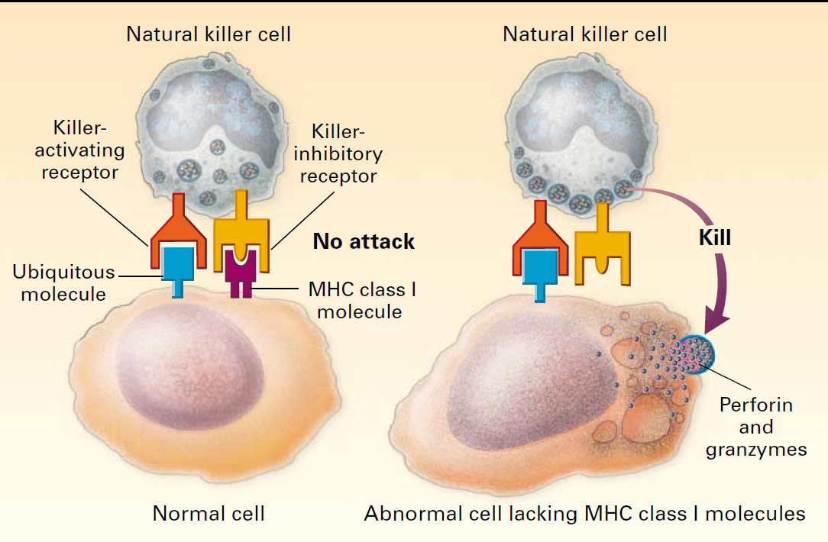
Detection of ‘missing self’
Natural Killer cell express activation and inhibitory receptors: inhibitory receptors over ride activation receptors
Healthy cells express MHC Class I proteins
Recognition of MHC Class I proteins by NK cell inhibitory switches this cell off
Viral infection can lead to reduction in MHC Class I protein expression
Unopposed action of activation receptors results in NK cell induced target lysis.

Slide 21
Complement
Complex protein network which play important roles in
Innate immune defence and inflammation.
Amplification of B cell mediated immune responses.
Recognition and disposal of apoptotic cells and immune complexes.
Increasing recognition of importance of complement in T cell differentiation, CNS development, lipid metabolism and cancer surveillance

Slide 22
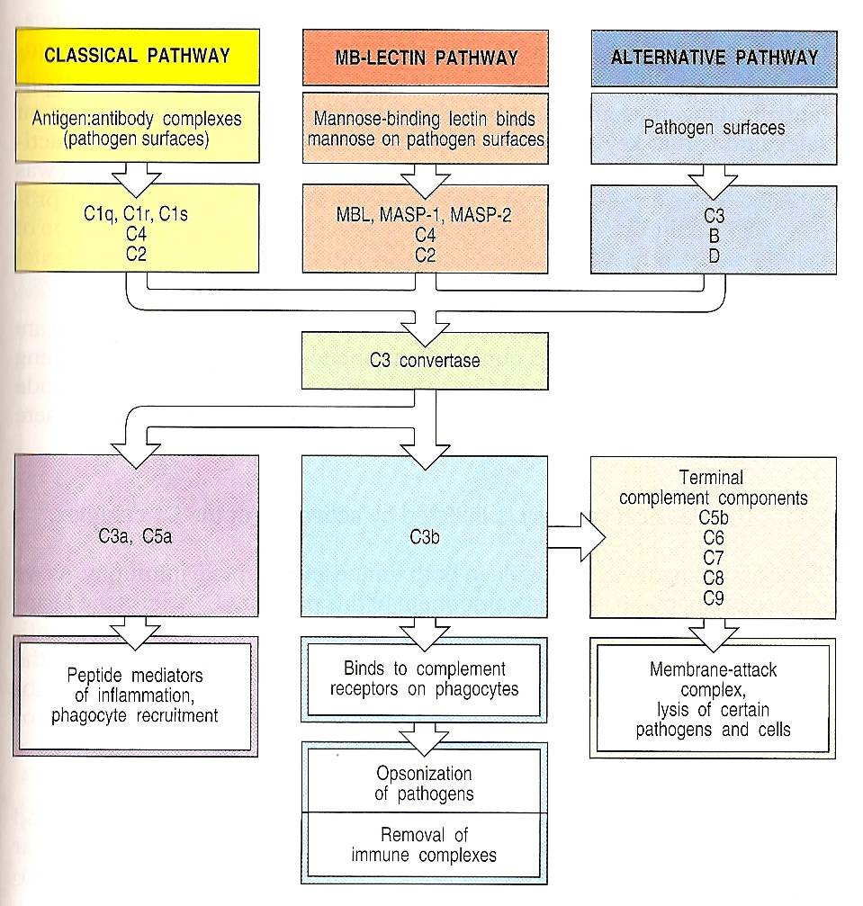
Overview of complement pathway & function

Slide 23
Complement
Complement system composed of 25 plasma and cell surface proteins
Several plasma (C1 inhibitor, Factor H) and membrane(DAF, MCP) inhibit complement activation pathways to prevent unwanted damage to host tissues.
Complement activity is switched on by 3 main mechanisms:
  Classical pathway: antigen-antibody immune complex
  Mannan binding lectin pathway: Mannan containing microbes
  Alternative pathway: microbial components
Key functions of complement activation:
  Deposition of C3b on microbial targets (opsonisation) which facilitates phagocytosis by neutrophils and monocyte/macrophages
  Generation of peptide fragments C5a, C3a which increases vascular permeability, activates mast cells and recruit neutrophils and monocytes to sites of inflammation
  Assembly of membrane attack complex (MAC), a pore forming complex of proteins that kills target cells by osmotic lysis

Slide 24
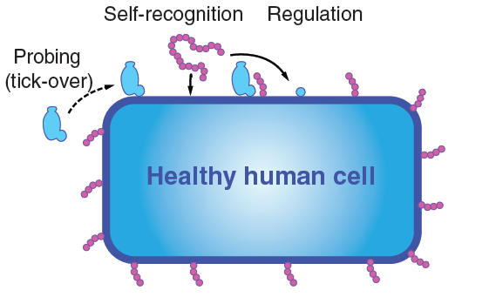
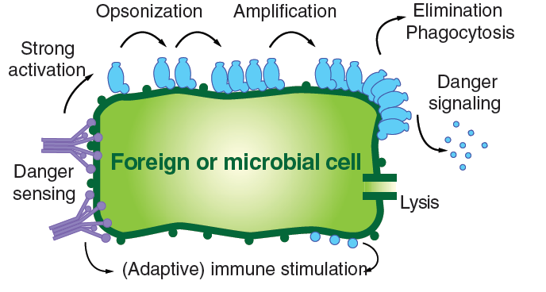
Complement in innate immune defence and inflammation
Complement proteins can also act as pattern recognition proteins to check the integrity of healthy cells (variant of missing self) and to detect foreign or microbial cells
Interact with TLR to enhance phagocytic anti-microbial activity & inflammatory cytokine secretion
Activates coagulation system to limit spread of infection
Mobilise immune cell progenitors from the bone marrow

Slide 25
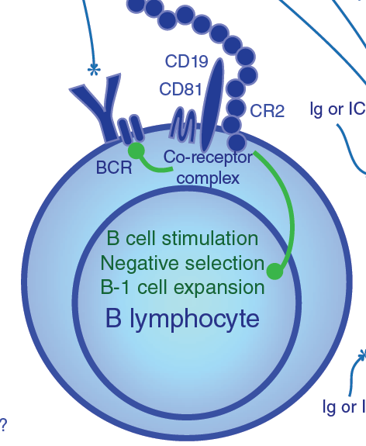
Complement and adaptive immunity
Complement protein iC3b, C3d,C3dg (blue circles) bind to C19-CD81-CD21 B cell co-receptor complex and significantly reduces the threshold of B cell activation resulting in increased antibody production
Ligation of the CR2 (CD21) promotes B cell survival in germinal centres
Complement proteins (C5a) also promote FcR activity and B cell phagocytosis
Interaction between TLR, complement receptors and regulators influence the activation and differentiation of T cells

Slide 26
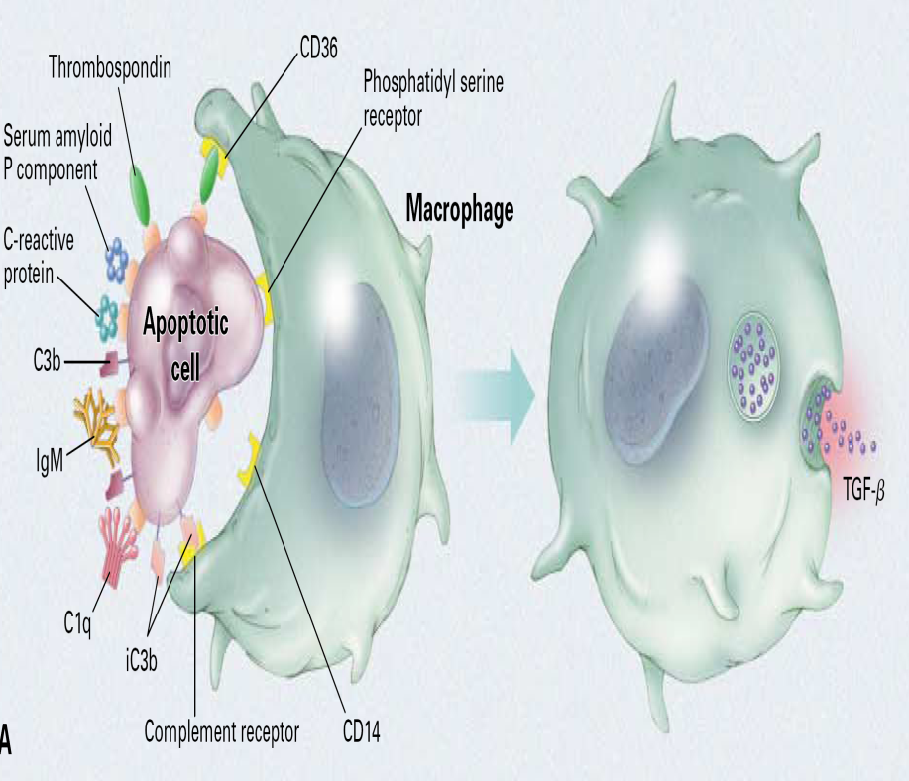
Complement is involved in disposal of apoptotic cells and immune complexes
Complement plays a key role in resolution of inflammation by promoting safe clearance of apoptotic cells and immune complexes using a combination of soluble PPM (C1q CRP and SAP) and opsonins (C3b) and complement receptors (CR3)
Opsonisation and CR3 phagocytosis down-regulates IL-12 (inflammatory cytokine) and reduces respiratory oxidative burst
Failure of complement mediated clearance of apoptotic cells and immune complexes is thought to play an important role in the development of multi-system disease SLE

Slide 27
Regulation of complement activation
Activation of classical complement C1 inhibitor
C3 and C5 convertase enzyme Factor H
Factor I
MCP (CD46)
C3 alternative convertase Properdin
Membrane attack complex (MAC) DAF and CD59

Slide 28
Clinical relevance of complement system
C1q C4 and C2 deficiency SLE
C3 deficiency Pyogenic infection
C5 C6 C7 C8 deficiency Neisserial infection
C1 inhibitor deficiency Hereditary angioneurotic oedema
Factor H, Factor I deficiency Atypical haemolytic uraemic syndrome
(kidney failure and red cell breakdown)
DAF deficiency Paroxysmal nocturnal haemoglobinuria

Slide 29
Cytokines (innate immunity)
Secreted proteins with growth, differentiation and activation functions that regulate and determine the nature of immune responses
Cytokines derived from DC and mononuclear phagocytes promote potent innate immune responses and serve to influence nature and magnitude of adaptive immune responses
Stimuli for cytokine production by DC and MP include
  Ligation of pattern recognition receptors
  Antigen processing and presentation
Predominant cytokines produced by APC include TNF-α, IL-1 family members IL-6, IL-8 , IL-12 family members
Some of these cytokines are also secreted by T cells, NK cells, neutrophils, endothelial cells and numerous other cells

Slide 30
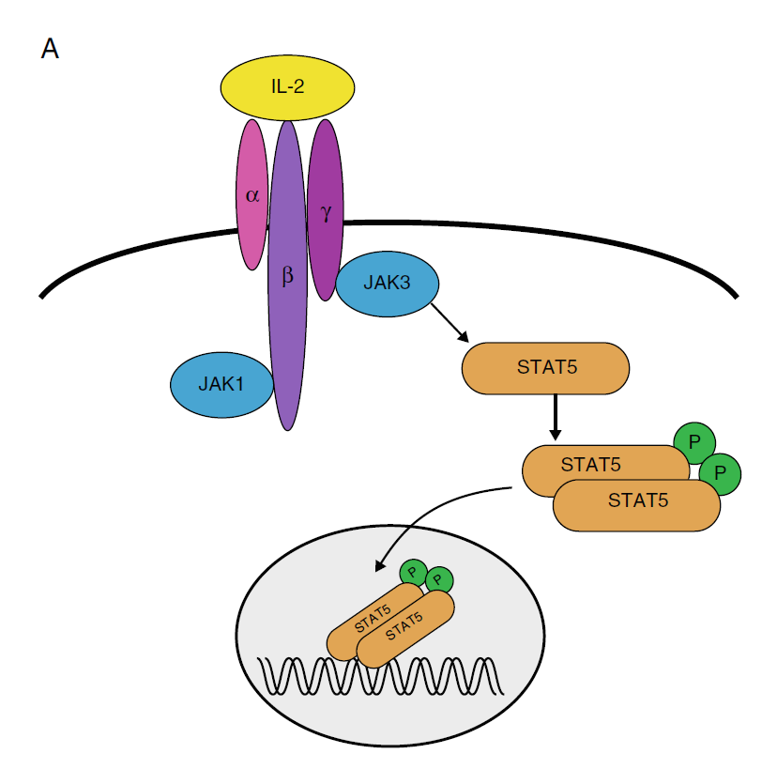
Mechanism of action of cytokines
Cytokines acts on cells through transmembrane surface receptors.
Cytokines often share receptor sub-units
  γc protein (IL-2, IL-4, IL-7, IL-15, IL-21)
  gp130 (IL-6 cytokine family)
  β chain (CD131) IL-3, IL-5, GM-CSF
Most cytokine receptors signal using Janus kinases (Jak) family and STAT proteins
STAT usually form dimers and migrate from cytoplasm to nucleus and bind to transcription factors (NF- κB, AP-1) to switch on immune responses

Slide 31
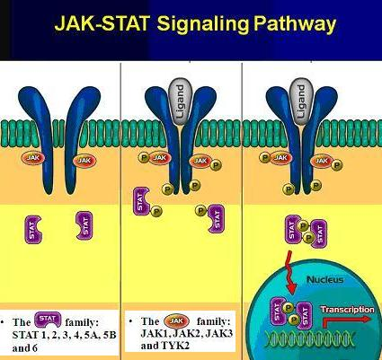
Some cytokines preferentially use STAT proteins
IFN-α/β STAT-1
IFN-α/β STAT-2
IL-6 STAT-3
IL-10 STAT-3
IL-12 STAT-4
IL-2 STAT-5
IL-4 STAT-6

Slide 32
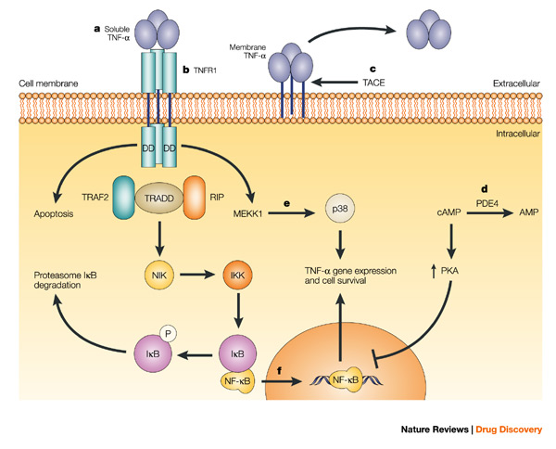
Tumour necrosis factor (TNF)-α
TNF-α homo-trimeric cytokine binds to p75 and p55 receptors
It increases vascular permeability, up-regulates adhesion molecules on endothelial cells which facilitate entry of granulocytes into inflammatory sites
Potent activator of neutrophil function (adherence, chemotaxis, degranulation & respiratory burst)
This cytokine is the main mediator of
septic shock
TNF-α antagonists used in the treatment of Rheumatoid arthritis and Crohn’s disease

Slide 33
IL-1 cytokine family
IL-1 cytokine family consists of IL-1α, IL-β, IL-1Ra, IL-18 and IL-33
IL-1α and IL-β similar biological effects: IL-1Ra antagonizes action of IL-1α, IL-β
IL-1 cytokine family cleaved by caspase 1 contained in the inflammasome into active secreted forms
IL-1 stimulates adherence of leukocytes to endothelial cells through up-regulation of ICAm-1 VCAM-1
IL-1 acts on CNS to produce fever, lethargy sleep and anorexia and on the liver to increase synthesis of acute phase proteins (CRP, C3 C4) and inhibit production of albumin
IL-1 activate T cells by enhancing production of IL-2 and expression of IL-2 receptors
IL-1 antagonists used in the treatment of auto-inflammatory diseases (cryopyrinopathies)

Slide 34
IL-6 cytokine family
IL-6 cytokine consists of IL-6, IL-11, IL-27, ostopontin, oncostatin M:
IL-6 cytokine family receptor is multi-subunit complex which contains specific cytokine binding site and a common gp130 receptor subunit
IL-6 acts on CNS to produce fever, lethargy sleep and anorexia
IL-6 is the most potent inducer of acute phase proteins
IL-6 promotes differentiation of B cells into plasma cells which secrete immunoglobulin
IL-6 has a primary role in CD4 Th17 cell differentiation
IL-6 antagonists used in treatment of RA and multi-centric Castleman’s disease

Slide 35
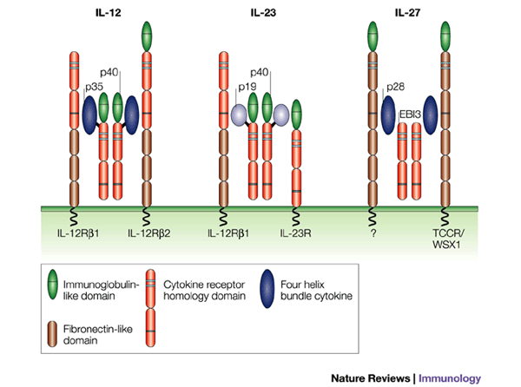
IL-12 cytokine family: IL-12, IL-23 IL-35
IL-12 and IL-23 are heterodimer cytokines sharing a common p40 subunit and use IL-12β1 receptor
DC and mononuclear phagocytes are major source of both cytokines
IL-12/IL-23 (IL-18) stimulates production of IFN-γ
IL-12 stimulates NK activity and is the primary driver in CD4 Th 1 development
IL-23 is involved in CD4 Th17 development:
Mutations in IL-12/23p40 subunit or IL-12β1 receptor results in disseminated NTM & salmonella infections

Slide 36
Type 1 and Type 3 interferons (IFN)
Member of the type 1 interferon family include IFN-α, IFN-β and IFN-ω
Type 1 interferons are derived from plasmacytoid DC, monocytes macrophages and B cells
Type 1 IFN direct inhibit viral replication and prevent transmission of virus to un-infected cells
Type 1 IFN stimulate antiviral immunity by promoting CD8 and NK cytotoxicity and cytokine secretion
IFN-α up-regulates the expression of MHC Class 1 antigens and has anti-tumour activity
IFN-α used in the treatment of Hepatitis C infection and in some haematological malignancies
Type 3 interferons (IFN-λ family, IL-28 and IL-29) similar anti-viral, anti-tumour activities to Type 1 interferons : polymorphism in IL-28 predict spontaneous clearance and response to treatment in Hepatitis C infection

Slide 37
Chemokines
Chemokines are a group of small 8-12 kd protein that can induce cell migration or chemotaxis by various cells of the immune system
Chemokine functions
  Recruitment and activation of leukocytes to mount an immune response and initiate wound healing
  Regulation of immune cell migration (DC trafficking, B-T cell interactions,
  T cell homing to particular tissues under basal and inflammatory conditions)
  Markers for maturation and differentiation status of CD4 T cell subsets
  Angiogenesis and organ development

Slide 38
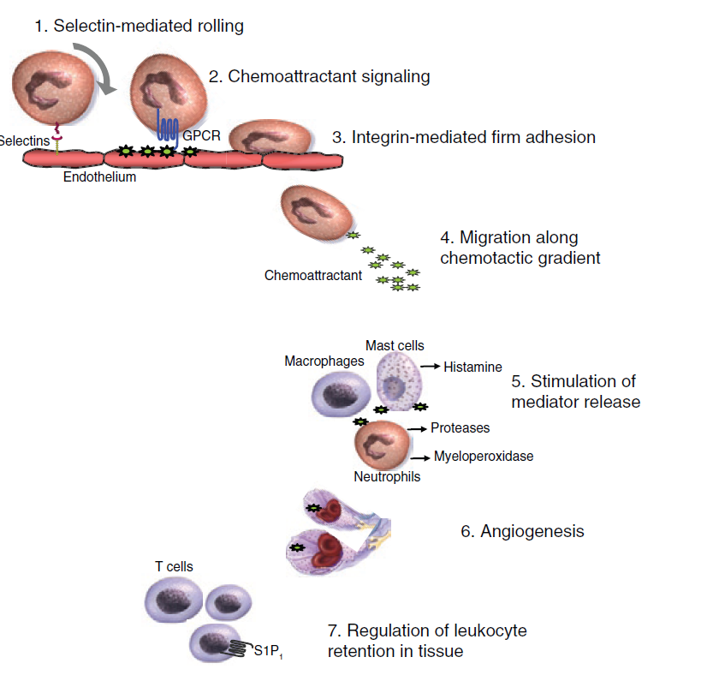
Functions of chemokines
Recruitment of immune cells to inflammatory sites
Chemokines act a several sites in this process including
  Adhesion of leukocyte to endothelium
  Migration along a chemotactic gradient
  Stimulate white cells to release histamine and proteases
  Development of new bloods vessels
  Exit of inflammatory cells from tissues

Slide 39
Classification of chemokines
Chemokines are characterized by presence of 3-4 conserved cysteine residues can be subdivided into 2 major family based upon the positioning of N-terminal cyteine residues
C-X-C subfamily is characterized by the separation of the first 2 cysteine residues by a variable amino acid
C-X-C chemokines
  Attract neutrophils
  Have variable effects on vasculature: some promote while other inhibit formation of blood vessels
C-C family the cysteine residues are adjacent to each other
  Attract T cells, monocytes eosinophils

Slide 40
Learning points
The innate immune system can detect the presence of infection and tissue damage and responds quickly to external insults
Activation of complement plays an important role in protection against infection and unwanted tissue damage.
Cytokines play an important role in promoting inflammatory immune responses and directing subsequent adaptive immune reactions
Excess cytokine activity contributes to several inflammatory diseases and have been successfully targeted to develop new treatments.

Slide 41
SBA
Select the best option
Which of the following is not a recognised function of the complement protein system
A. Clearance of immune complexes
B. Stimulation of antibody production
C. Opsonisation of microbial structures
D. Inhibition of mast cell activation
E. Protection against neisserial infection

Slide 42
Correct answer: Option D

