Slide 1
B cell mediated immunity
Peter Kelleher
Senior Lecturer, Imperial College London, Chelsea & Westminster campus

Slide 2
Learning objectives
Understand how B cell recognize and respond to antigen
Outline the developmental and maturational stages of B cells
List the immunoglobulin classes. Describe their functions and relate these to their individual structure.
Compare and contrast immune responses to T cell dependent and T cell independent immune responses

Slide 3
Antigen recognition by B cells

Slide 4
B cell receptor/surface immunoglobulin
BCR or (surface immunoglobulin) consists of 2 identical heavy (H) and 2 identical light (L) chains
Each polypeptide contains a variable region (V) and a constant region (C)
There are 2 light chain subclasses: Kappa and Lambda
There are 5 heavy chains subclasses which define IgG, IgA, IgM, IgD and IgE isotypes

Slide 5
B cell receptor
The variable regions of both heavy and light chains contain hyper-variable areas which form the antigen binding domain.
Each immunoglobulin molecule has 2 identical antigen binding sites.
Proteolysis of immunoglobulin gives rise to 2 different fragments
Fab: refers to antibody binding region of molecule
Fc region: Crystalline domain: function is antigen independent but does vary with immunogloblin isotype

Slide 6
B cell development occurs in bone marrow
B cell development occurs in bone marrow and is independent of antigen.
Heavy chain gene rearrangement occurs first followed by light chain gene rearrangement.
One functional heavy and light chain rearrangement have occurred on one allele identical gene re-arrangement are silenced on second B cell allele (allelic exclusion).
Immature B cell express surface IgM.
Antigen naïve B cells express IgM and IgD and exit bone marrow into the blood stream.

Slide 7
Human immunoglobulin gene loci
V_{H} V_{K} V_{L}
V segments 51 40 30
D segments 27 -- --
J segments 6 5 4
Chromosome 14q32.3 2p11-12 22q11.2

Slide 8
B cell gene rearrangement follows same principles of T cell gene rearrangement
V region encoded by 2-3 different genes.
C regions encoded by a single gene.
Receptor diversity generated by
Combination of different genes
Random insertion of extra nucleotides at junction between gene segments
baseline somatic mutation
combinatorial association between different light and heavy chains
Potential antibody repertoire is 10¹⁶
different immunoglobulins.

Slide 9
B cells recognize conformational epitopes on external surface of proteins/carbohydrates

Slide 10
B cell receptor complex
CD79a
CD79b
B cell receptor complex includes the signal transduction membrane proteins Igα (CD79) and Igβ (CD79b).
B cell also express co-receptors can alter threshold for activation after binding by antigen.
C19 CD21 CD81 complex enhance B cell activation: ligand C3d.
CD22 and FcRIIB inhibit B cell activation (ligands CD45 an IgG respectively).
Activating co-receptors
CD21 CD19 CD81
BCR
B CELL
Inhibitory receptors
CD22 and FcRIIB

Slide 11
T cell dependent antibody responses
Somatic hypermutation and affinity maturation for T cell dependent antigens takes place in germinal centre of lymph nodes.
Exposure to antigen results in isotype class switching: from IgM to IgG, IgA, IgE.
B cell which successfully exit germinal centre differentiate into either memory B cells or end stage B cells (plasma cells) which secrete secrete immunoglobulin.
Plasma cells home to the bone marrow niches to continue antibody production and secretion.

Slide 12
Somatic hypermutation (SHM) and affinity maturation
SHM: increase in the baseline mutation rate of antibody binding domains of heavy and light chain.
Under the control of a number of enzymes; best recognized protein are an RNA editing enzyme called Activation induced cytidine deaminase (AID) and DNA uracil glycosylase.
Somatic mutation
diversification of B cell receptor repertoire
increases affinity of antibody for antigen (affinity maturation) and B cell survival
reduced or loss of affinity B cell death
Germinal centre is therefore is a site of an intense evolutionary pressure for selection of ‘fittest’ antibody-antigen recognition immune complex.

Slide 13
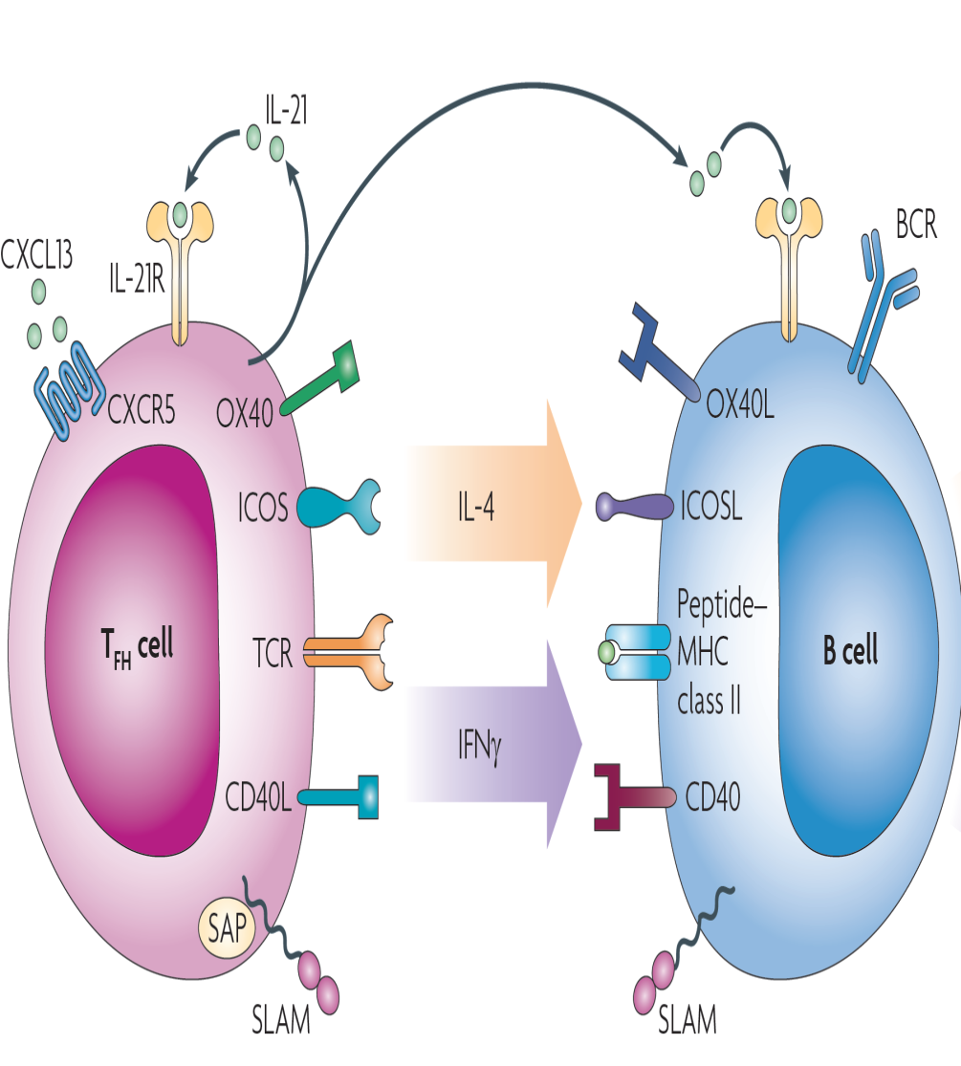
Follicular CD4 T cells promote B cell isotype switching in LN germinal centres
CD4 follicular T cell
Transcription factor Bcl-6
Cytokine profile IL21, IL-4 and IFN-γ
Binding to CXCL13 to CXCR5 on CD4 follicular cell directs T lymphocyte to germinal centre in lymph node.
B cell present peptide MHC complex to CD4 follicular T cells which then promotes isotype switching by cell-cell contact and cytokine secretion.

Slide 14
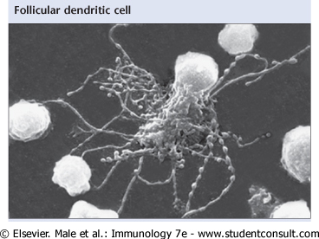
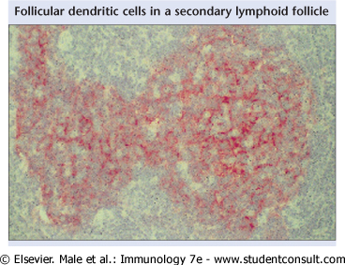
Follicular dendritic cells (FDC): antigen depot in lymph node germinal centre which promote survival of high affinity B cells
Branched morphology: MHC class II negative
Express FcR and complement receptors.
Hold antigen (in the form of immune complexes) for long periods of time (years).
Responsible for maintenance of B cell memory.

Slide 15
Germinal centre reaction
T cell proximal dark zone
Contains centroblasts (red circles)
Site of B cell proliferation
Site of SHM and isotype class switching
Distal T cell light zone
Contains centrocytes (green circles)
Antigen specific follicular CD4 T cells
Antigen laden FDC (yellow stars)
Site of positive/negative B cells
GERMINAL CENTRE
Dark zone
CD4 TFH
Light zone

Slide 16
Overview of GC reaction
After positive selection by FDC and additional help by CD4 FH cells B cells can either re-enter dark zone or exit GC as plasma cells or GC memory B cells
Antigen experienced
B cells enter
the dark zone

Slide 17
Isotype switching
Switching moves the re-arranged heavy chain IgM VDJ exon into a position immediately upstream of and alternative heavy chain exon (IgG, IgA, IgE).
This reaction is promoted by AID and DNA glycoslyase enzymes .
Isotype switching involved T and B cell contact (CD40L on T cell binds to CD40 on B cells) and secretion of cytokines by T cells.
IL-10, IFN-γ IL-21 IgG switch
IL-4 & IL-13 IgE switch
TGF-β, IL-5 IgA switch
VDJ
IgM
VDJ
IgG
VDJ
IgA
VDJ
IgE

Slide 18
T cell independent antibody responses
T cell independent antigen immune responses occurs in marginal zone of spleen and at mucosal surfaces and produce low affinity IgM and class switched IgG and IgA within 24 hours of antigen exposure (innate effector B cells).
B cell activation is triggered by
Cross linking and clustering of BCR by polymeric antigens (repeating structures) such as carbohydrate structures
Antigen recognition by BCR and co-stimulation by TLR ligands or CD40L related TNF family members proteins (APRIL and BAFF) which are secreted by antigen presenting cells
Lack of T cell means that somatic mutation does not occur and immune memory is limited.
Vaccination with carbohydrate antigens does not usually offer live long immunity.

Slide 19
Structure and function of Immunoglobulin

Slide 20
Functions of Antibodies
Fab region function
Recognition of conformational epitopes on proteins, peptides, carbohydrates
Neutralising of pathogens and toxins
Fc region function
Activation of complement
Clearance of Immune complexes, particulates, apoptotic via reticulo-endothelial system
Elimination of antibody coated pathogens
Transport and delivery of immunoglobulin to different body compartments
Regulation of immune responses

Slide 21
Structure and function of IgM
Pentameric structure with J chain
Low affinity for to individual antigen binding sites: capacity to bind multiple antigen binding sites promote increase the strength of the interaction (affinity) to a multivalent antigen.
This increase in functional affinity is known as avidity.
Function
Primary immune response
Complement fixation
Useful index of recent exposure to immunogen or pathogen.

Slide 22
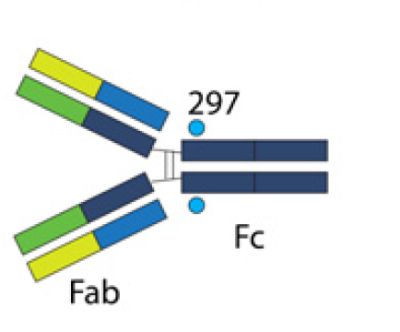
Structure and function of IgG
IgG predominant isotype in body tissues:
4 main subclasses in serum:
IgG1, IgG2, IgG3 IgG4
different functional capacity
Function of IgG include
Opsonisation
Phagocytosis
Complement fixation
ADCC
Neutralisation of toxins and viruses
Placental transport to fetus.

Slide 23
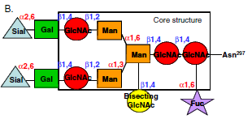
IgG FcR structure
A single N-linked glycosylation site exists at the amino acid 297 in the heavy chain of all IgG subclasses.
This glycan is essential for all inflammatory activities of IgG antibodies as it keep heavy chain in an open conformation need for FcγR binding.
Glycan composition varies considerable in healthy adults .
Addition of specific sugars (fucose, sialic acid) may reduce affinity of IgG Fc for FcR.

Slide 24
Structure of IgA
IgA is the main immunoglobulin at mucosal surfaces.
Mucosal IgA is a dimer: contains
J chain (binds to an antibody transporter expressed by epithelial cells which allows IgA to translocate to the luminal surface.
J chain is essential for formation of IgA dimers.
Secretory component which protects IgA from proteolytic cleavage and anchors this immunoglobulin to mucus lining the epithelium.
There 2 IgA subclasses in humans IgA1 in serum and IgA2 at mucosal surfaces.

Slide 25
Function of IgA
Low affinity IgA excludes commensals from mucosal surfaces by
Anchoring bacteria to mucus
Masking bacterial protein involved in epithelial attachment
This immune response does not generate inflammatory product
High affinity IgA
Neutralizes microbial toxins and invasive pathogens (prevents bacterial replication and toxin mediated damage)
Helps neutrophils at mucosal surfaces to eliminate bacteria/viruses
Promote uptake of antigen by intestinal DC
Absent IgA deficiency is the commonest human immune deficiency.

Slide 26
Structure and function of IgE
Free IgE is present at very low concentration in serum.
Most IgE attached to high affinity receptor on mast cells, basophils, eosinophils and DC.
IgE also binds to low affinity receptor on above cells as well as B cells, NK cells and platelets.
IgE function
Protection against helminth parasite infection.
Cross linking of IgE bound to high affinity by antigen leads to exocytosis of mast cell, basophil, eosinophil content.
Associated with immediate hypersensitivity (allergic reactions).

Slide 27
Structure and function of IgD
IgD found at very low levels in serum.
Role in host immunity to bacterial infection in the upper airways.
Cross linking of IgD on basophils induces
secretion of B cell activating cytokines such as IL-4 and IL-13
Release of antimicrobial peptides

Slide 28
Clinical implications of failure in B cell development or maturation
Loss of IgG and IgA antibodies results in sino-pulmonary infection.
Synthesis of IgE to aero-allergens (grass and trees pollens, cat and dog dander) associated with allergic diseases (asthma, hayfever, eczema).
Production of IgG to self nuclear proteins found in SLE.
B cell cancers
Marginal zone MALT lymphoma
Germinal centre Burkitt’s lymphoma
Plasma cell Multiple myeloma

Slide 29
B cell effector function: Fc receptors

Slide 30
Fc receptors (FcR)
Specific molecules with which cells recognize CH2, CH3 domains of immunoglobulins.
Three main types
Classical FcR bind IgM, IgG, IgA, IgE, and IgD
MHC-I: FcRn binds to IgG (transport across placenta)
C-type lectin bind carbohydrate residues on IgG Fc
Cross linking of Fc receptors essential for biological activity which varies with different Ig isotypes
FcR can switch on the immune system or turn it off

Slide 31
Function of FcR
Antibody Fc region provides the mechanistic link between antigen specific V-domain and the 4 main antigen non specific activity.
Activation of complement
Elimination of antibody coated pathogens
Transport and delivery of immunoglobulin to different body compartments
Regulation of immune responses

Slide 32
Activation of complement
Y
C1q can bind to immune complexes containing the Fc chain of IgM and IgG
Cross linking of C1Q globular heads by antibody-antigen immune complexes activates C1r and C1s
Activated C1r and C1s trigger classical complement cascade which leads
to deposition of C3b on surface of antigen
generation of pro-inflammatory C5a and C3a fragments
Formation of MAC and lysis of target cell
Y
Y
C1s
C1r
Activation of classical
complement cascade

Slide 33
Elimination of antibody coated pathogens

Slide 34
There are 3 main mechanisms to eliminate antibody coated pathogens
Bacteria/Viruses Phagocytosis
Virus/Bacteria /Helminths ADCC
Helminths Mast cell degranulation

Slide 35
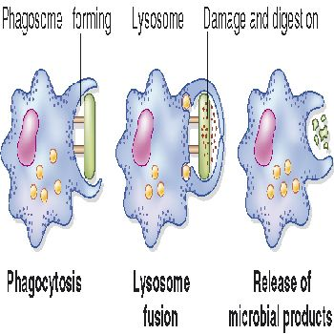
Phagocytosis: Fc IgG and IgA
Pathogen is coated with complement
and IgG/IgA
Binding of IgG to FcR and complement
to CR1 results in phagocytosis
Fusion of phagosome with lysosome
Destruction of microbial products by
reactive oxygen species and proteases
Release of degraded microbial products

Slide 36
Antibody dependent cytotoxicity (ADCC)
Antibody binds antigen on surface of target cell
FcR (IgG/IgA) recognize bound antibody
Cross linking of Fc receptors promotes release of cytotoxic enzymes (perforin, ECP) and pro-inflammatory cytokines (TNF-α)
Target cell dies by apoptosis /necrosis

Slide 37
Mast cell/basophil degranulation
High affinity FcεR1 can bind IgE directly
Cross linking of bound IgE by antigen results in
Release of pre-formed inflammatory mediators from granules (histamine)
Release and synthesis of lipid mediators (leukotrienes, prostaglandins)
Synthesis of pro-inflammatory cytokines
Mast cell degranulation leads to
Recruitment of soluble proteins and inflammatory cells to site of infection
Increase in rate of lymphatic flow back to regional lymph nodes
Smooth muscle contraction in lungs and gut (may help to expel pathogens)

Slide 38
Neonatal Fc receptor (FcRn)
Transport of IgG into different tissues and regulation of IgG levels

Slide 39
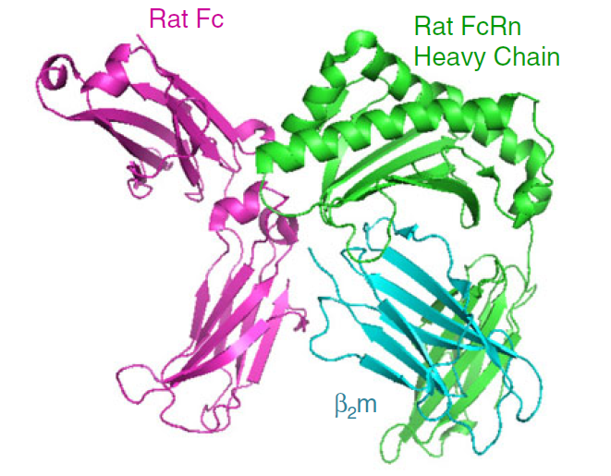
FcRn: trans-placental transport of IgG
FcRn consists of MHC Class like alpha chain bound to β2 microglobulin
The MHC class like heavy chain of FcRn binds to CH2-CH3 to IgG Fc domain
Binding only of neonatal Fc receptor to IgG constant domain only occurs at acidic PH
FcRn allows transport of maternal IgG to the fetus
Albumin is another ligand for FcRn

Slide 40
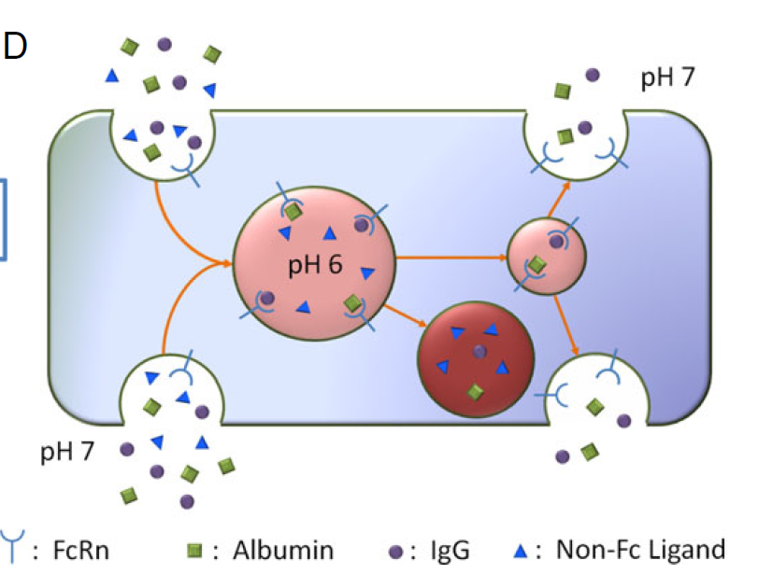
FcRn:regulation of IgG levels
IgG binds to FcRn in acidic environment of endosomes
Protected from destruction in lysosomes
Recycles to cell surface and released at neutral pH
Saturable FcRn: once IgG levels exceed a threshold it is degraded by lysososmes

Slide 41
Regulation of immune responses FcγRIIγB receptor

Slide 42
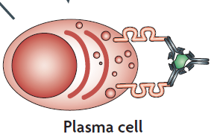
FcγRIIγB and B cells
Late peripheral B cell tolerance checkpoint
Follicular exclusion of low affinity auto-reactive B cells
Inhibition of activation and expansion of high affinity auto-reactive B cells
Promotes competitive dislocation in bone marrow plasma cell niches by triggering apoptosis of plasma cell generated during previous immune responses

Slide 43
FcRγIIB and innate immunity
Switches off ADCC and pro-inflammatory cytokine secretion
Outcome of IR depends on balance between activation and inhibitory receptors
Ratio of affinity for activation v inhibition shows good predictive value for action of IgG subclass
RED = Inhibitory FcγRIIB receptor
GREEN = Activating FcγRIIA receptors

Slide 44
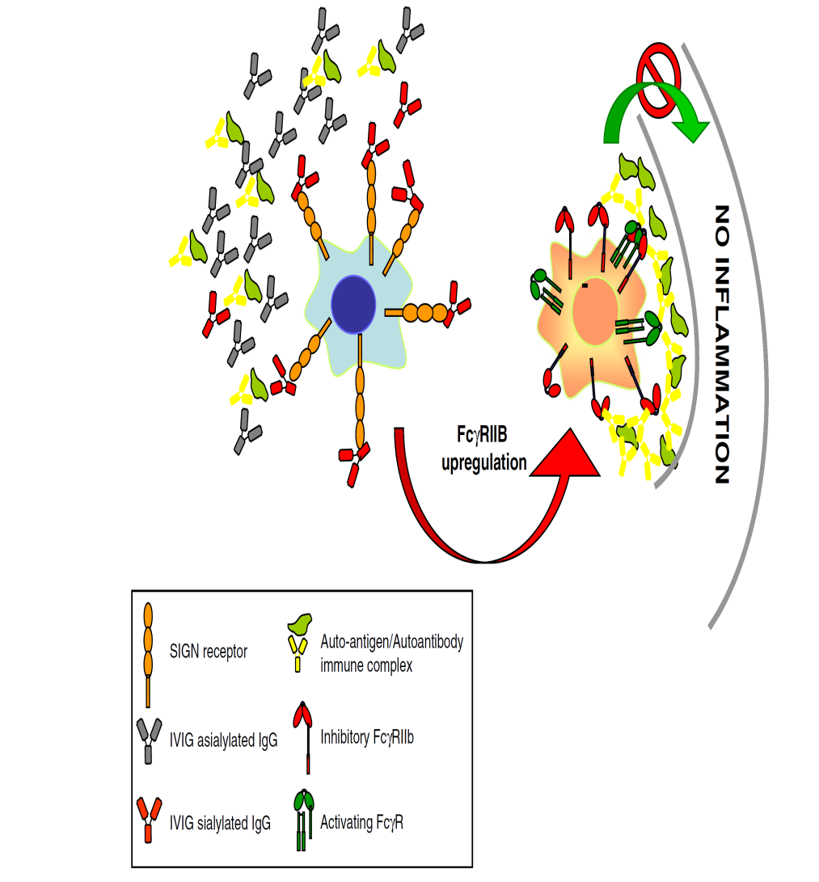
Anti-inflammatory activity of FcR
Anti-inflammatory activity of serum IgG and replacement IgG therapy dependent on sialylated IgG Fc glycans
Sialylated IgG Fc glycans are believed to induce expression of FcγR11B on splenic DC in humans
The receptor for sialylated IgG Fc glycans on DC is the lectin DC-SIGN

Slide 45
FcR and medicine
Promotor polymorphism and allele variants in FcγRIIB are associated with SLE (loss of inhibitory activity)
Cross linking of bound IgE/FcεR1 complexes by allergens crucial contributor to asthma, hayfever, food allergy
Sialylated fraction of IgG (1-3% of total) may underlie anti-inflammatory activity of IgG therapy in different autoimmune diseases (ITP, CIDP, Kawasaki disease)
ADCC important mechanism of action for monoclonal antibody based cancer and autoimmune therapies

Slide 46
Learning points
Antigen independent B cell maturation and development occurs in the bone marrow.
After encounter with antigen B cell undergo further maturation
Fab somatic hypermutation to increase antibody binding affinity
Fc isotype switching for flexiblity in immune function
Antibodies play a key in recognition of extracellular and elimination of pathogens.
T cell dependent antibody responses results in long term immune memory

Slide 47
SBA
Select the best option
Immunoglobulin structure and function
A. B cell receptor consists of 1 heavy chain and 2 identical light chains.
B. IgM is a pentameric structure
C. Ligation of IgE Fc receptor promote phagocytosis
D. IgG is a dimer present at mucosal surfaces
E. IgD is the main circulating immunoglobulin

Slide 48
Correct answer: Option B

