Slide 1
Allergy and transplantation
GE Pathology 2012-2013
Immunology lecture 7
Dr Keith Gould
k.gould@imperial.ac.uk

Slide 2
Learning objectives
Explain the immunological processes underlying the development of allergic diseases
Describe the clinical features of IgE mediated immune responses
Discuss how the immune system responds to alloantigens
Outline the clinical features of transplant rejection

Slide 3
Appropriate Immune Reactions
Appropriate immune responses occur to foreign harmful agents such as viruses, bacteria, fungi, parasites
  Required to eliminate pathogens
  May be concomitant tissue damage as a side effect, but as long as pathogen is eliminated quickly will be minimal and repaired easily
Involves antigen recognition by cells of the immune system and antibody production

Slide 4
Allergic Reactions
Hypersensitivity reactions made in response to inherently harmless environmental antigens e.g. pollen, food, drugs
Most are IgE mediated, type I hypersensitivity reactions, but other reaction types may also be involved

Slide 5
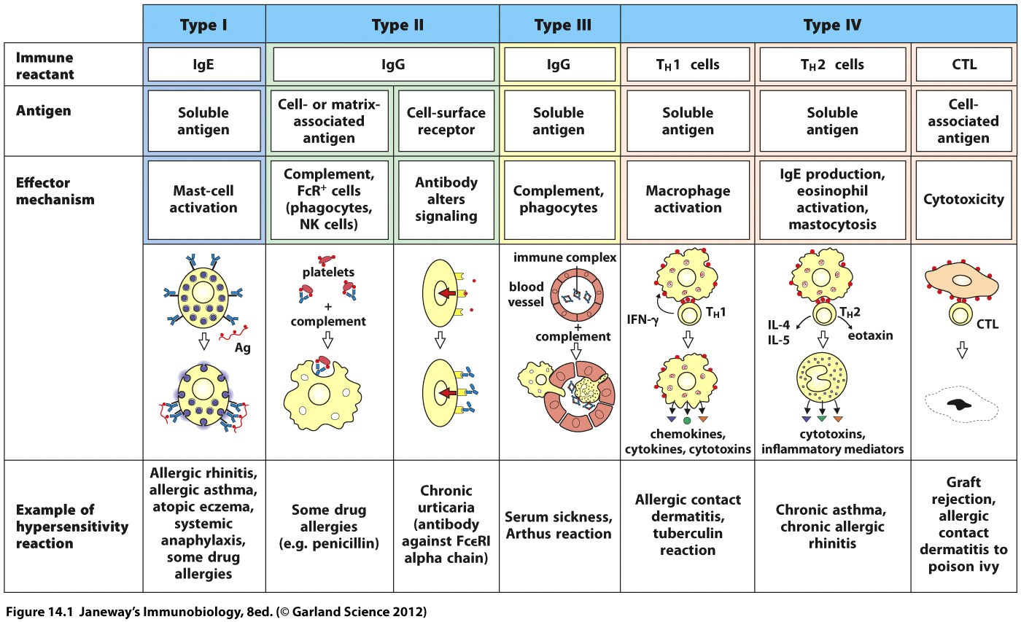
Hypersensitivity reactions

Slide 6
Expression of disease requires:
Sensitisation to allergens to sensitise (primary response - usually in early life)
Exposure to produce disease (memory response - any time after sensitisation)
Predisposition to become IgE-sensitized to environmental allergens is called atopy

Slide 7
Allergy
Common - prevalence of atopy is 50% in young adults in UK
Severity varies -
  mild occasional symptoms
  severe chronic asthma
  life threatening anaphylaxis
Risk factors - genetic and environmental

Slide 8
Genetic risk factors
~80% of atopics have a family history
Polygenic
  50-100 genes linked to asthma/atopy
  genes of IL-4 gene cluster (chromosome 5) linked to raised IgE, asthma, atopy
  genes on chromosome 11q (IgE receptor) linked to atopy and asthma

Slide 9
Environmental risk factors
Age - increases from infancy, peaks in teens, reduces in adulthood
Gender - asthma more common in males in childhood, females in adults
Family size - more common in small families
Infections - early life infections protect
Animals - early exposure protects
Diet – breast feeding, anti-oxidants, fatty acids protect?

Slide 10
Type I Immediate Hypersensitivity
Anaphylaxis
Asthma
Rhinitis
  Seasonal (hay fever)
  Perennial (house dust mite)
Food Allergy

Slide 11
Type I Immediate Hypersensitivity
1⁰ Antigen exposure
IgE antibody production
IgE binds to Mast Cells & Basophils
2⁰ Ag Exposure
More IgE Ab produced
Antigen cross-links IgE on Mast Cells/Basophils
Degranulation
Y
Y
Y
High Affinity
IgE Receptor
Y
Y
u
Y
u
Y
u
Degranulation
Mediators

Slide 12
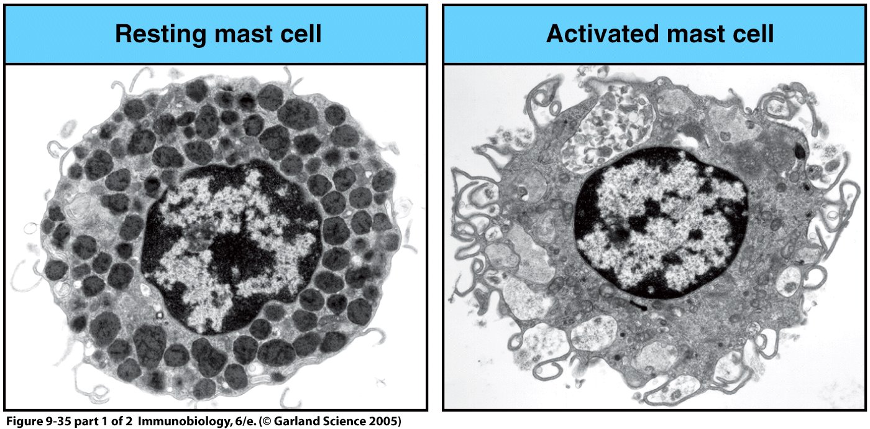

Slide 13
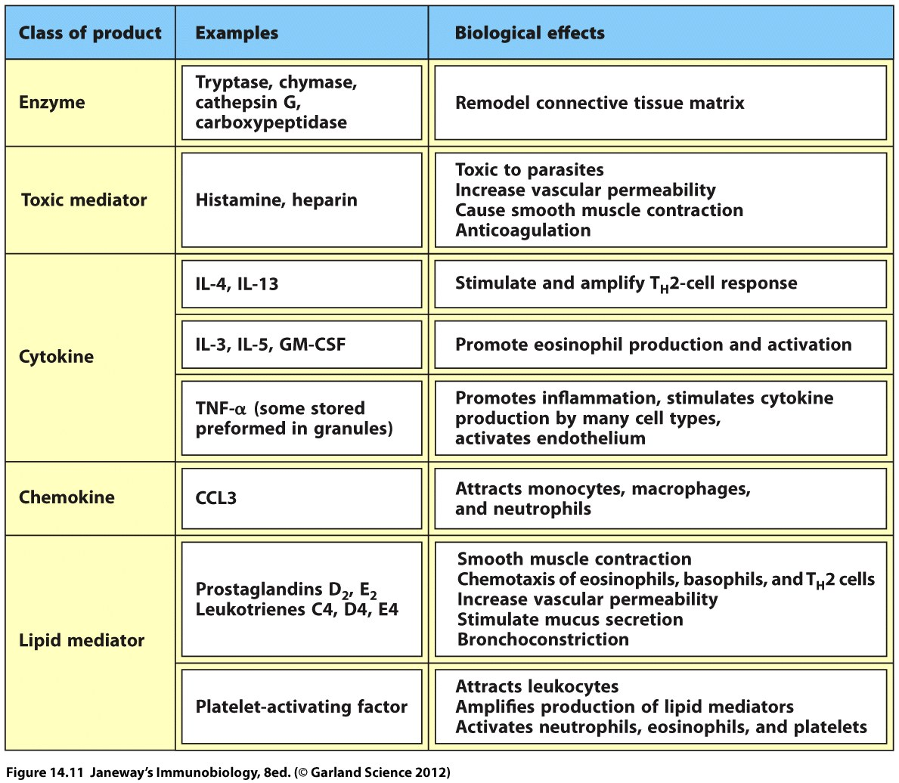
Molecules released by mast cells on activation
Pre-formed
Newly synthesized

Slide 14
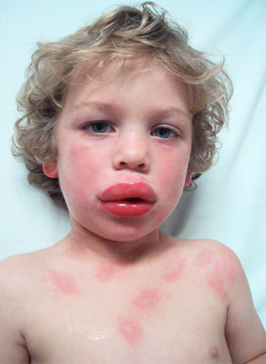
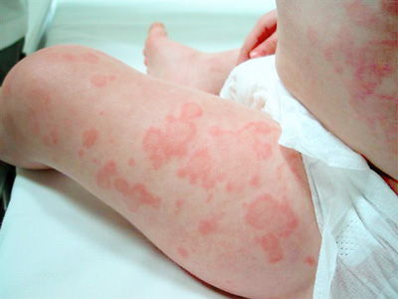
Anaphylaxis
Anaphylaxis: severe generalised allergic reaction
Uncommon, potentially fatal
Generalised degranulation of IgE sensitised mast cells
Symptoms:
  itchiness around mouth, pharynx, lips
  swelling of the lips, throat and other parts of the body
  wheeze, chest tightness, dyspnoea
  faintness, collapse
  diarrhoea & vomiting
  death if severe & untreated
Systems:
  Cardiovascular - vasodilatation, cardiovascular collapse
  Respiratory - bronchospasm, laryngeal oedema
  Skin - vasodilatation, erythema, urticaria, angioedema
  GI - vomiting, diarrhoea

Slide 15
Asthma - immunopathogenesis
Acute inflammation of the airways
  mast cell activation and degranulation
    Pre-stored mediators
      histamine
    Newly synthesised mediators
      prostaglandins, leukotrienes
  acute airway narrowing
Vascular Leakage
Smooth muscle contraction
Airway Wall
Edema
Mucus
Secretion

Slide 16
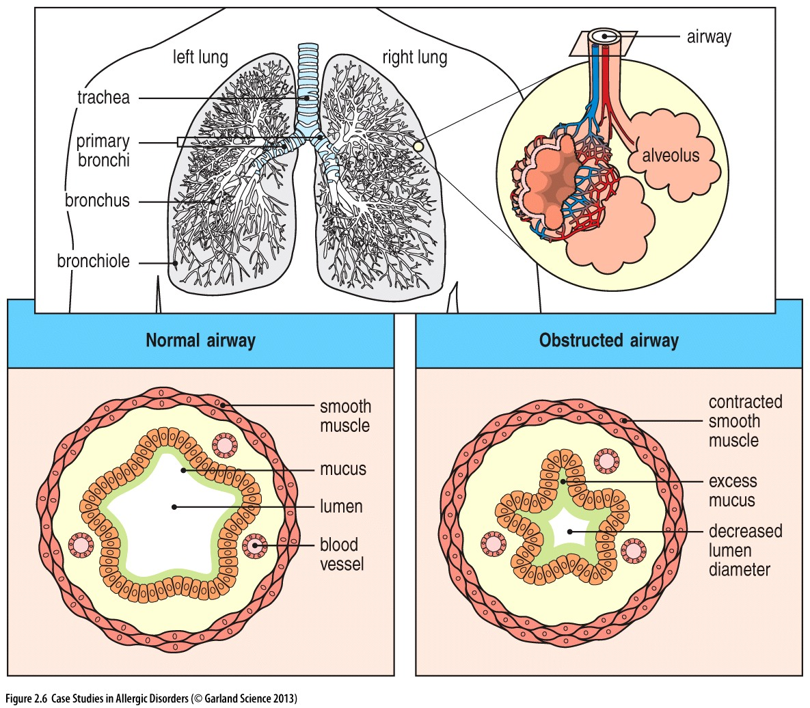
Asthma - immunopathogenesis
Chronic inflammation of the airways
  Cellular infiltrate
    Th2 lymphocytes, eosinophils
  Smooth muscle hypertrophy
  Mucus plugging
  Epithelial shedding
  Sub epithelial fibrosis

Slide 17

Asthma – clinical features
Reversible generalised airway obstruction
  Chronic episodic wheeze
Bronchial hyperresponsiveness
  Bronchial irritability
Cough
Mucus production
Breathlessness
Chest tightness

Slide 18
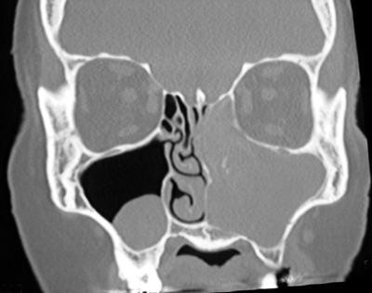
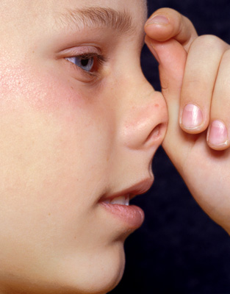
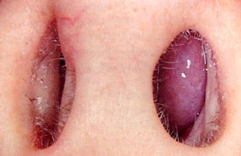
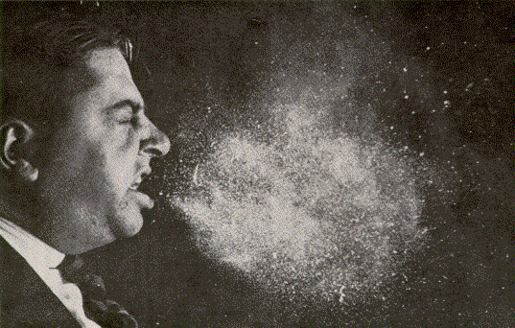
Allergic rhinitis
Seasonal - hay fever - grass, tree pollens
Perennial - perennial allergic rhinitis
  House dust mite, animal
Symptoms
  sneezing
  rhinorrhoea
  itchy nose, eyes
  nasal blockage, sinusitis, loss of smell/taste

Slide 19
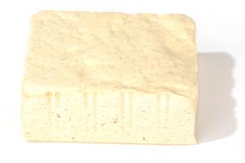
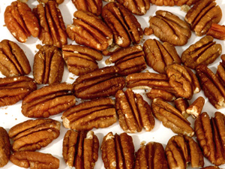

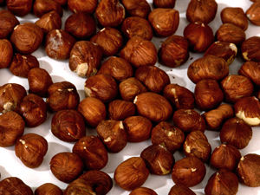
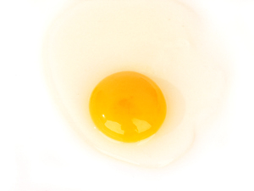
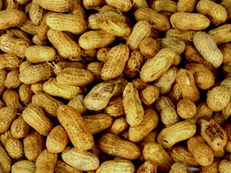
Food allergy
Infancy-3yrs
  egg, cows milk
Children/adults
  peanut, shell fish, nuts, fruits, cereals, soya
Mild
  Itchy lips, mouth, angioedema, urticaria
Severe
  Nausea, abdominal pain, diarrhoea
  Anaphylaxis

Slide 20
Type IV Delayed Hypersensitivity Responses
Chronic graft rejection
Graft versus host disease (GVHD)
Coeliac disease
Contact hypersensitivity
Asthma
Rhinitis
Eczema

Slide 21
Type IV Delayed Hypersensitivity Responses
Three Main Varieties
Th1
Cytotoxic
Th2
Mechanisms
Transient/Persistent Ag
T cell activation of macrophages, CTLs
Much of tissue damage dependent upon TNF-α
Allergen
TNF-α
IFN-γ
APC
Th1
Macrophage
IL-2
FGF
Fibroblast
Cytotoxic
T lymphocyte
(CTL)
Angiogenesis
Fibrosis

Slide 22
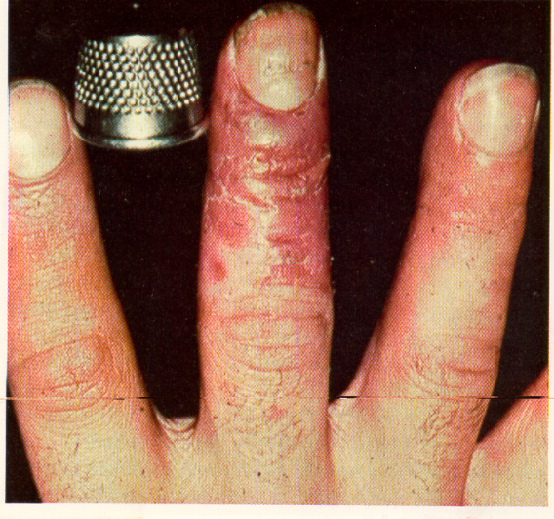
Type IV Delayed Hypersensitivity Responses
Nickel
Contact Hypersensitivity

Slide 23
Take home messages
Hypersensitivity reactions are inappropriate adaptive immune responses against harmless environmental and self antigens: allergies and autoimmune diseases are hypersensitivity reactions.
Hypersensitivity reactions may be classified into 4 main types (I to IV) based on the immunological mechanisms involved. In practice, many conditions involve a mixture of different types, rather than a single type of reaction.
Genetic and environmental factors are involved in the risk of developing hypersensitivity reactions.
Type I reactions are immediate hypersensitivity reactions, and involve specific IgE production: allergies including asthma and hay fever are predominantly type I reactions.
Type II reactions involve autoantibodies (often IgG) binding to insoluble antigen on cell surfaces or extracellular matrix, and include some organ-specific autoimmune diseases.
Type III reactions are immune complex-mediated reactions, in which autoantibodies bind to soluble antigen. Subsequent deposition of immune complexes causes immune activation and inflammation.
Type IV reactions are immune cell-mediated delayed type hypersensitivity reactions.

Slide 24
Learning objectives
Explain the immunological processes underlying the development of allergic diseases
Describe the clinical features of IgE mediated immune responses
Discuss how the immune system responds to alloantigens
Outline the clinical features of transplant rejection

Slide 25
Transplantation
Organs are transplanted when they are failing or have failed, or for reconstruction
Life-saving or life-changing

Slide 26
Definitions
Autografts
  within the same individual (e.g. vein, skin)
Isografts
  between genetically identical individuals of the same species
Allografts
  between different individuals of the same species
Xenografts
  between individuals of different species (e.g. heart valve)
Prosthetic graft (plastic, metal)

Slide 27
Allograft
Solid organs (kidney, liver, heart, lung, pancreas)
Small bowel
Free cells (bone marrow, pancreas islets)
Temporary: blood, skin (burns)
Privileged sites: cornea
Framework: bone, cartilage, tendons, nerves
Composite: hands, face, larynx

Slide 28
Allograft
Deceased donor –
  Solid organs: kidney, heart, pancreas, lungs, liver,
  Others: cornea, heart valves, bone, skin, composite
Living donor – bone marrow, kidney, liver
Urgent requirement for more donors

Slide 29
Immunology of transplantation
The immune system recognises someone else’s organ as foreign
Most relevant protein variations in clinical transplantation
  1. ABO blood group
  2. HLA (human leukocyte antigens) encoded on chromosome 6 by Major Histocompatibility Complex (MHC)

Slide 30
1. ABO blood group
A and B proteins on red blood cells but also endothelial lining of blood vessels in transplanted organ
Naturally occurring anti-B antibodies in A patients and vice versa
O patients have both anti-A and anti-B

Slide 31
Heart transplant from blood group B donor –
i.e. cells express blood group B
Patient: blood group A
Red cells express A
Patient serum contains naturally occurring anti-B antibodies

Slide 32
Circulating, pre-formed, recipient anti-B antibody binds to B blood group antigens on donor endothelium
B
B
Cross section of donor vessel

Slide 33
Activates complement
  Complement mediated lysis
  Increased permeability
Other cells rapidly recruited
  Phagocytes
Disruption of endothelium
  Platelets activated
  Inflammation
  Thrombosis
Hyperacute rejection

Slide 34
ABO-incompatible transplantation
In recent years, it has become possible to remove the antibodies in the organ recipient with good outcomes
Kidney, heart, liver

Slide 35
2. HLA (human leukocyte antigens)
Discovered after first failed attempts at human transplantation
Cell surface proteins
Highly polymorphic
Variability of HLA molecules is important in defence against infections
HLA molecules present processed fragments of antigens for possible recognition by the immune system

Slide 36
Self APC
B7
Self MHC
Co-stimulation
Bacterial peptide
CD28
TCR
T cell

Slide 37
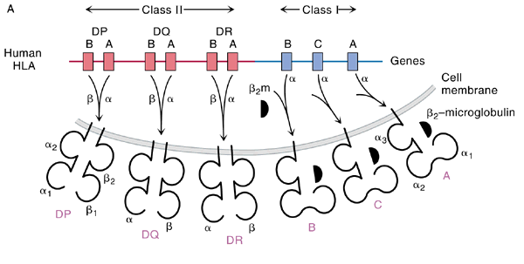
Human Leukocyte Antigens
Class II Class I
DP
A B
DQ
A B
DR
A B
B
C
A
Genes
α
α
α
Cell
membrane
α
α
α
β₂Μ
β
β
β
HLA-A
HLA-DP
HLA-C
HLA-DQ
HLA-DR
HLA-B

Slide 38

Polymorphism in the human MHC
Variation >1% at a single genetic locus in a population of individuals
In the human population, over 4,200 HLA class I/II proteins have been identified
1505
705
Class I
Class II
No of
variants
1024
124
709
89
26
16
2
A
B
C
α
β
α
β
α
β
DR
DP
DQ
Data from http://www.anthonynolan.org.uk Oct 2010

Slide 39
HLA matching in organ allocation
 | HLA-A | HLA-B | HLA-DR
Recipient | HLA-A1 HLA-A2 | HLA-B4 HLA-B27 | HLA-DR3 HLA-DR7
Donor | HLA-A1 HLA-A11 | HLA-B8 HLA-B51 | HLA-DR3 HLA-DR7
Number of mismatches | 1 | 2 | 0
Number of mismatches : 0 to 6

Slide 40
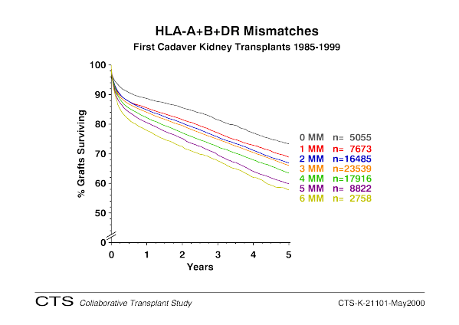
Minimising HLA differences between donor and recipient improves transplant outcome

Slide 41
Rejection
Most common cause of graft failure
Diagnosis = histological examination of a graft biopsy
Treatment = immunosuppressive drugs
- hyperacute rejection - acute rejection - chronic rejection | - T-cell mediated rejection - antibody-mediated rejection

Slide 42
Acute T-cell mediated rejection
Recognition of donor HLA antigens by CD4+ T cells
Activation of CD4+ cells
  Production of cytokines
    Help for CD8+ cells
    Help for B cells
    Recruitment and activation of macrophages and neutrophils
= Type IV hypersensitivity response
4
4
4
4
Production of cytokines

Slide 43
Acute antibody-mediated rejection
Antibody against graft HLA and AB antigen
Antibodies arise
  Pre-transplantation (“sensitised”)
  Post-transplantation (“de novo”)

Slide 44
Rejection
Clinical
  Kidney - creatinine
  Liver - liver function tests
  Pancreas – serum amylase and lipase, glycaemia
Subclinical
  Heart (no good test for dysfunction, regular biopsies)

Slide 45
Prevention of rejection
Maximise HLA compatibility
Life-long immunosuppressive drugs

Slide 46
Treatment of rejection
Increased immunosuppression
Immunosuppressive drugs
Target T cell activation and proliferation
Target B cell activation and proliferation, and antibody production

Slide 47
Standard immunosuppressive regime
Base-line immunosuppression:
  Signal transduction blockade, usually a calcineurin inhibitor: Tacrolimus or Cyclosporin; sometimes mTOR inhibitor (Rapamycin)
  +/- antiproliferative agent: Mycophenolate mofetil (MMF) or Azathioprine
  +/- corticosteroids
Treatment of episodes of acute rejection:
  Cellular: steroids, anti-T cell agents
  Antibody-mediated: give IVIG, plasma exchange, anti-complement C5

Slide 48
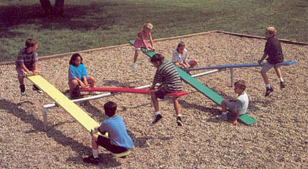
The ups and downs of immunosuppression
Rejection
Infection
Tumours
Drug toxicity

Slide 49
Take home messages
Organs are transplanted when they are failing or have already failed, or for reconstruction, for example after physical injury. Transplantation may be life-saving or life-changing.
Transplants may be within the same individual (autograft), between genetically identical individuals (isograft), between genetically different individuals (allograft), or even between species (xenograft).
For organs, the most common type of transplant is an allograft, from either a deceased or living donor: living donors are often a family member of the patient.
The most important protein variations in clinical transplantation that can lead to immunological rejection are the ABO blood group antigens and the Human Leukocyte Antigens (HLA), the name of the human MHC antigens.
Depending on the organ transplanted, minimising HLA differences between donor and recipient improves transplant outcome: complete matching is rarely possible, and therefore immunosuppressive treatment must be used to prevent transplant rejection.
The major problems in transplantation are a shortage of donor organs, graft rejection, and side effects from immunosuppression: increased susceptibility to infections and malignancy.

