Slide 1

Risk factors and coronary artery disease
Dr Tsung Tan MBBS MRCP(UK)
Cardiology Research Fellow
National Heart and Lung Institute
Imperial College London

Slide 2
CAD: Introduction
Leading cause of death worldwide
7.3 million RIP in ‘08 = 12.8% global deaths (WHO)
UK: 69,917 deaths (14.2% of total 2010), CAD mortality steadily declining over the last 3 decades (Harding et al.)
Higher rates of CAD in Scotland and Northern England
UK: CAD rate decline smallest in those born in Scotland, Northern Ireland, East Africa, India, Pakistan, Bangladesh, Poland, Hungary

Slide 3
UK CAD mortality rates – BHF 2008

Slide 5
“Old-fashioned beliefs”
Up to 1950’s, atherosclerosis and arteriosclerosis was considered a normal part of aging and occurred universally as people became older.
Hypertension and elevated serum cholesterol were also seen as normal consequences of aging in the 1950s, so no treatment was initiated.
Though insurance companies were previously already charging additional premiums for those with high BP or obesity…..

Slide 6
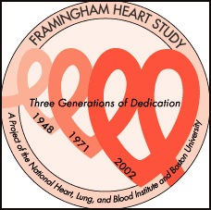
Framingham Heart Study
The term “risk factor” was coined by Dr William Kannel, one of the pioneers of the Framingham Heart Study (FHS), and used in medical literature by 1961
First epidemiological study for CVD, started in 1948
5,209 men & women between 30-62 years recruited from the town of Framingham, Massachusetts
2-yearly detailed medical history, physical examination and lab tests

Slide 7
Framingham Heart Study Research Milestones
1960 | Cigarette smoking found to increase the risk of heart disease
1961 | Cholesterol level, blood pressure, and electrocardiogram abnormalities found to increase the risk of heart disease
1967 | Physical activity found to reduce the risk of heart disease and obesity to increase the risk of heart disease
1976 | Menopause found to increase the risk of heart disease
1978 | Psychosocial factors found to affect heart disease
1988 | High levels of HDL cholesterol found to reduce risk of death
1998 | Development of simple coronary disease prediction algorithm involving risk factor categories to allow physicians to predict multivariate coronary heart disease risk in patients without overt CHD
2009 | Framingham Heart Study researchers contribute to discovering hundreds of new genes underlying major heart disease risk factors—body mass index, blood cholesterol, cigarette smoking, blood pressure and glucose/diabetes

Slide 8
Seven Countries Study
Started 1958: 12,763 men, 40-59 years of age, were enrolled as 16 cohorts, in seven countries (USA, Italy, Greece, Yugoslavia, the Netherlands, Finland, and Japan).
Repeat surveys were made at 5 &10-year intervals and mortality follow-up for >50 years.
First study to systematically examine the relationships between lifestyle, diet (Mediterranean vs. Western), CHD & stroke in different populations from different regions of the world.

Slide 9
Seven Countries Study
Highlighted benefits of the Mediterranean diet
Confirmed dyslipidaemia, hypertension & smoking as important CVD risk factors. Populations with saturated fat intake <10% of daily energy have little CHD
Showed presence of CVD risk factors in mid life increases risk of dementia
Limitations: Males only, small numbers, participant recruitment not completely randomised

Slide 10
CHD Risk Factors
Age
Sex
Heredity/ ethnicity
Diabetes
Elevated blood pressure
Elevated serum cholesterol
Smoking
Also:
Obesity
Physical inactivity
Deprivation
High alcohol intake
Low fruit & vegetable intake
Novel risk factors
Non-modifiable
Modifiable

Slide 11
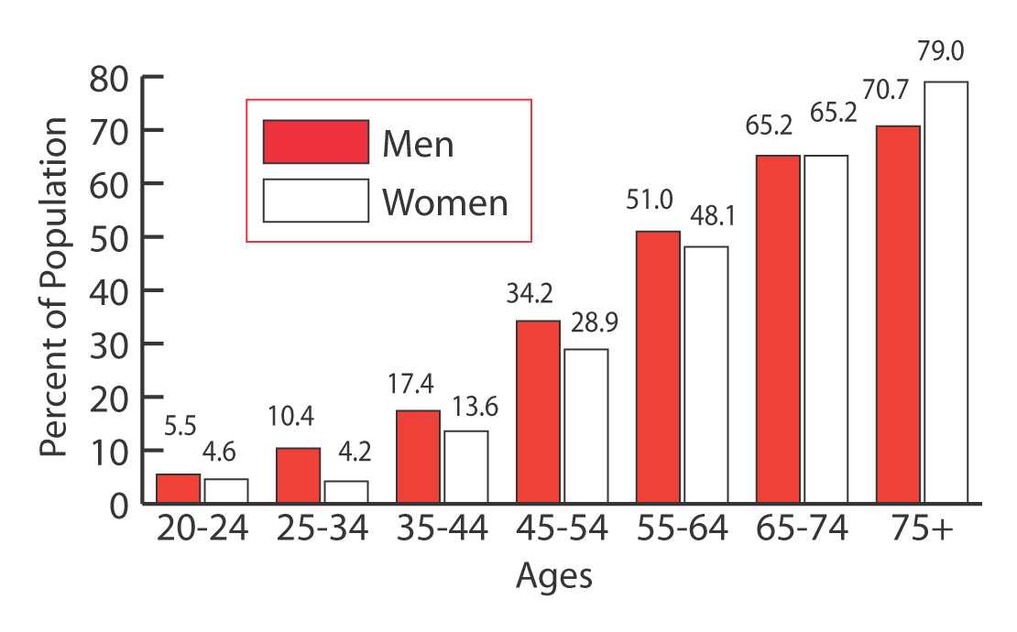
Age
NHANES III (Nurses Health & Nutrition Status) : 1988-94

Slide 12
Heredity
Best illustrated in classic twin studies comparing concordance for disease status for monozygotic (MZ) and dizygotic (DZ) twin pairs
Swedish Twin Registry study (21 004 individuals, 2810 had fatal CHD) showed RR of fatal CHD in the 2nd male twin among pairs where the first twin had died of CHD before 55 years was 8.1 (95% CI: 2.7–24.5) for MZ twins and 3.8 (95% CI: 1.4–10.5) for DZ twins.
The RR of fatal CHD in the second female twin among pairs where the first twin had died of CHD before the age of 65 was 15.0 (95% CI: 7.1–31.9) for MZ twins and 2.6 (95% CI: 1.0–7.1) for DZ twins.
Notes:
Classic twin studies compare concordance for disease status between members of monozygotic and dizygotic twin pairs—a higher relative risk of disease to the monozygotic co-twins of cases compared with the dizygotic co-twins of cases is evidence for a genetic contribution to disease aetiology. These studies generally assume that the degree of similarity in environmental exposures between members of a twin pair is the same for both monozygotic and dizygotic pairs, which is almost certainly an over-simplification; such an assumption tends to inflate the estimate of the effect of genes. Thus, estimates from twin studies should probably be regarded as upper extremes of the true genetic contribution to disease risk.

Slide 13
Heredity
This therefore indicates a significant genetic contribution to the risk of CHD death
Differences between MZ and DZ twins became smaller as the age at which a co-twin died of CHD increased
No significant difference seen between MZ and DZ twins in pairs where the first twin died after the age of 75 i.e. genetic component of CHD more prominent larger at younger ages
Notes:
Genetic epidemiological studies of coronary heart disease. Int J Epidem 2002

Slide 14
Serum Cholesterol
First identified in 1769 in solid form in gallstones
Vital biological component :
  Essential component of cell membranes
  Precursor for biosynthesis of steroid hormones, bile acids and vitamin D
Influenced by dietary consumption of fat rather than cholesterol (saturated, polyunsaturated, trans-fats).

Slide 15
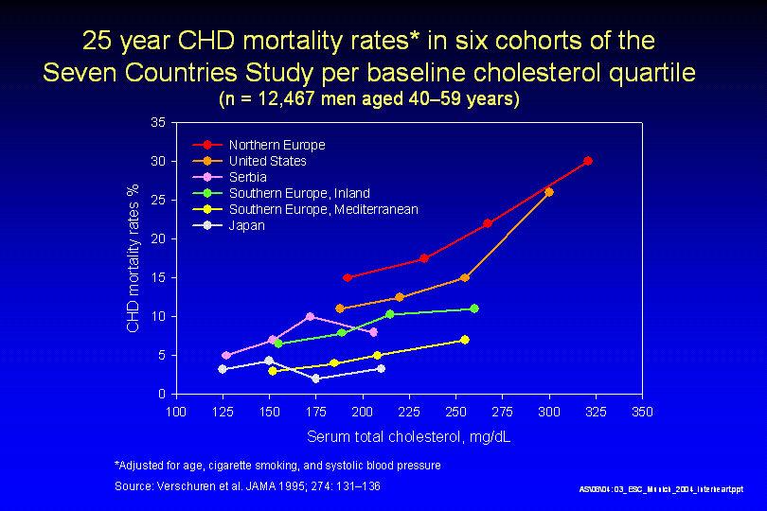

Slide 16
Cholesterol
  TC reduction by 0.6mmol/L reduced risk of CHD by 50% at age 40, falling to 20% at age 70
  5 main classes
    Chylomicrons
    Very low density lipoproteins (VLDL)
    Intermediate density lipoproteins (IDL)
    Low Density Lipoprotein (LDL)
    High Density Lipoprotein (HDL)
  Transported from liver to peripheral tissues by lipoproteins
Notes:
BMJ. 1994 Feb 5;308(6925):367-72.

Slide 17
Scandinavian Simvastatin Survival Study (4S Trial, 1994)
Multicentre RCT
4444 patients (3617 men, 827 women), aged 35–70 years, with angina pectoris or previous MI, and high total cholesterol (5.5–8.0 mmol/L)
Patients with MI in previous 6 months or unstable angina excluded, primary end-point: All cause mortality. Median 5.4 years F/U
Treatment: Placebo or simvastatin 20 mg ON, increased or decreased as necessary to 40 or 10 mg to achieve serum total cholesterol 3.0–5.2 mmol/L
Notes:
Lancet

Slide 18
4S: Results
With simvastatin, total and LDL cholesterol and triglycerides reduced by 25%, 35% and 10%, respectively; HDL cholesterol increased by 8%
In treatment group, significant reduction seen in:
    All-cause mortality
    Fatal coronary events
    Combined endpoint of nonfatal or fatal coronary events
    Myocardial revascularization procedures (11.3 vs. 17.2%, relative risk 0.63, P<0.00001)

Slide 19
4S Primary Endpoint: Overall Survival
% Surviving
30%
risk reduction
p = 0.0003
Years since randomization

Slide 20
4S: Coronary Death and Nonfatal MI
34%
Risk Reduction
% of patients without events
p<0.00001
Years since randomization
The Lancet, Vol 344, November 19, 1994

Slide 21
4S: Need for PTCA/CABG
% of patients without
PTCA/CABG
37%
Risk
Reduction
p<0.00001
Years since randomization
The Lancet, Vol 344, November 19, 1994

Slide 22
Hypertension
Responsible for 7.6 million deaths annually
Age-standardised blood pressure levels and mortality rates falling since 1980 in developed regions
80% burden borne by low-, middle-income countries
Prospective Studies Collaboration:
Meta-analysis of 1 million adults in 61 prospective studies, 2002, demonstrated that lower BP levels were continuously associated with lower risks of fatal CHD & fatal stroke (down to as low as 115/75 mmHg)

Slide 23
Hypertension
Risk of CHD against BP by age group from the Asia Pacific Cohort Studies Collaboration.

Slide 24
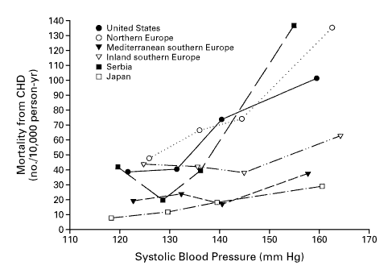

Slide 25
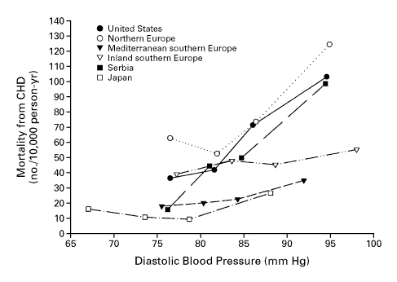

Slide 26
INTERHEART: Smoking & MI
16
8
OR (99% CI)
4
2
1
Never 1-5 6-10 11-15 16-20 21-25 26-30 31-40 41+
The Lancet, Volume 368, Issue 9536, Pages 647-658

Slide 27
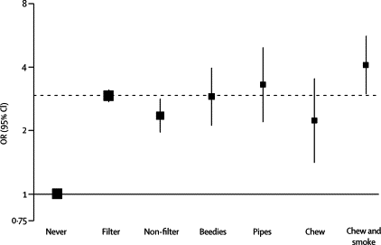
Risk of AMI associated with type of tobacco used
The Lancet, Volume 368, Issue 9536, Pages 647-658

Slide 28
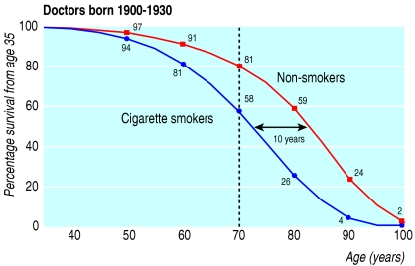
Survival among UK male doctors born 1900-1930 (n=34,439, 1951)
Notes:
averages the findings in figure 2 for all men born in 1900-1930, distinguishing between lifelong non-smokers and continuing cigarette smokers. (Among the latter, the median age when they began smoking was 18, and at the start of the study their median age was 36 and their mean self reported cigarette consumption was 18 a day.) The results suggest a shift of about 10 years between the overall survival patterns of the continuing cigarette smokers and the lifelong non-smokers in this particular generation. That is not to say that all such smokers died about 10 years earlier than they would otherwise have done: some were not killed by their habit, but about half were, thereby losing on average more than 10 years of non-smoker life expectancy. Indeed, some of those killed by tobacco must have lost a few decades of life.
34 439 male British doctors. Information about their smoking habits was obtained in 1951, and periodically thereafter; cause specific mortality was monitored for 50 years
The excess mortality associated with smoking chiefly involved vascular, neoplastic, and respiratory diseases that can be caused by smoking.
The cigarette smoker versus non-smoker probabilities of dying in middle age (35-69) were 42% nu 24% (a twofold death rate ratio) for those born in 1900-1909

Slide 29
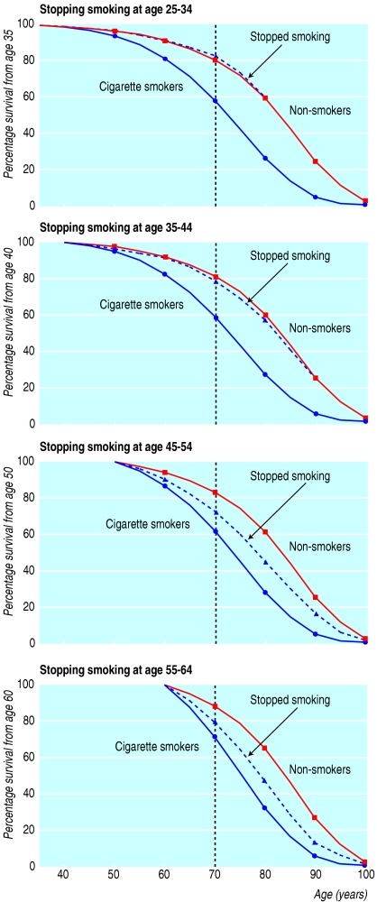
Effects on survival of stopping smoking cigarettes at age 25-44

Slide 30
Effects on survival of stopping smoking cigarettes at age 45-64

Slide 31
Diabetes
National Health and Nutrition Examination Survey II (NHANES II), 1976-1980: Prevalence of angina was higher in people with than in those without diabetes
Age-adjusted incidence of CHD was 4X greater in diabetics than non-diabetics in the Multiple Risk Factor Intervention Trial (MRFIT)
CHD contributes to 60% deaths in diabetics
Diabetics have 2-3 fold increased risk for CHD and 2-4 fold increased risk for CHD morbidity/mortality

Slide 32
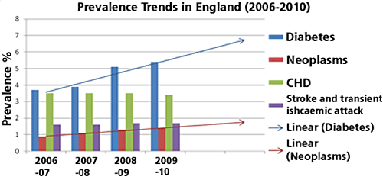

Slide 33
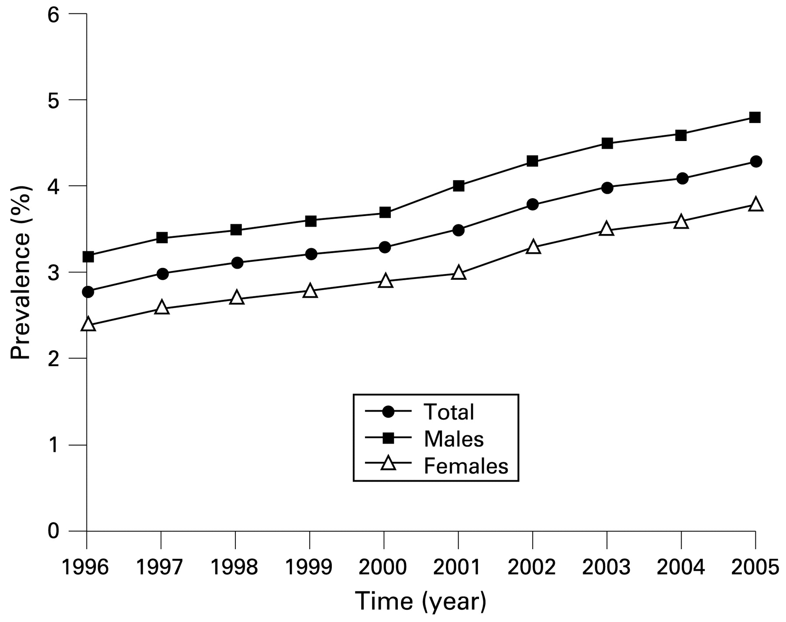
Type-2 Diabetes – UK prevalence

Slide 34
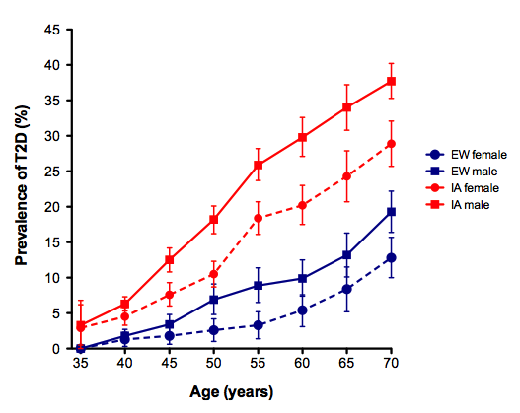

Slide 35
Contribution of risk factors to CHD
Known CHD risk factors contribute to 50% of CHD: True/False
Notes:
Risk factors tend to aggregate.

Slide 36
MRFIT & CHA Trials
Greenland et al 1999: Published results of 2 large prospective studies with 366,559 mainly Caucasian participants, 16 & 22 yr F/U
Individuals were segregated into young and middle-aged groups, and further stratified into ‘low-risk’ and ‘others’ subgroups.
Low-risk criteria
Serum cholesterol (mmol/L) | <5.17
Systolic BP/Diastolic BP (mmHg) | ≤120/80
Current Smoker | No
Diabetes history | No
MI history | No
ECG Abnormalities* | No
Table. Low-risk criteria (*only for CHA cohort).

Slide 37
MRFIT & CHA Trials: Results
Cohort | n | Low-risk | Others | Age-adjusted RR Low-risk vs. Others
MRFIT Men aged 35-39 | 72,144 | 11 (0.2) | 735 (1.5) | 0.14 (0.08-0.25)
CHA Men aged 18-39 | 10,025 | 1 (0.6) | 126 (5.9) | 0.08 (0.01-0.61)
MRFIT Men aged 40-57 | 270,761 | 126 (4.4) | 9,578 (19.9) | 0.22 (0.18-0.26)
CHA Men aged 40-59 | 7,490 | 6 (8.8) | 516 (38.1) | 0.23 (0.10-0.51)
CHA Women aged 40-59 | 6,229 | 2 (3.5) | 181 (14.5) | 0.21 (0.05-0.84)
Low-risk status predicted that CHD and MI mortality rate was 86-92% lower for young men, and 77-79% for middle-aged individuals compared with those ‘at risk’.

Slide 38
INTERHEART
Case-control study (12,461 cases and 14,637 controls) of incident myocardial infarction in 52 countries (10 regions).
Using population attributable risk (PAR), they concluded that nine modifiable risk factors contribute to an average of >90% proportion of the risk of an initial acute MI across all populations.
But PAR unable to explain the CHD risk inequality between different populations
Lancet. 2004 Sep 11-17;364(9438):937-52.

Slide 39
Novel risk factors/biomarkers for CHD
To account for the remaining unexplained ~25% CHD risk
Important questions re. any potential biomarker:
  Are they independently associated with CHD?
  If so, how strong is the association?
  Do they lie on the pathogenetic pathway for the development of atherosclerosis, plaque rupture or plaque-associated thrombosis?
  Would we be better able to estimate the risk of CHD in individuals if we took any of these biomarkers into account?

Slide 40
Alternative risk factors/biomarkers for CHD
Traditional risk factors: Smoking, hypertension, glucose intolerance, diabetes, hyperlipidemia (total cholesterol, LDL, HDL, triglycerides), low exercise levels, male gender, older age
Physical signs: Obesity, body mass index, ankle-brachial index, palmar/tuberoeruptive xanthomas, corneal arcus
Novel plasma-based biomarkers
Non-traditional lipid markers: Lipoprotein(a), apoA, apoB, particle size, particle density
Markers of inflammation: hsCRP, SAA, IL-6, IL-18, TNF, cell adhesion molecules, CD40 ligand, MPO
Markers of hemostasis and thrombosis: Homocysteine, tPA/PAI-1, TAFI, fibrinogen, D-dimer
Markers of oxidation: ox-LDL, glutathione
Imaging-based biomarkers
Noninvasive: Carotid intima-medial thickening, coronary calcification, magnetic resonance imaging angiography
Invasive: Coronary angiography, intravascular ultrasound
Genetic biomarkers
Proteomic biomarkers

Slide 41
Novel risk factors/biomarkers for CHD
Lp(a)
  lipoprotein subclass first discovered in 1963
  Recent evidence for consideration as a CV RF
  Hampered by:
    Modest association (adjusted risk ratio 1.13 in 1 paper)
    African Americans can have high levels w/o increased risk
    May only be significant RF when LDL levels elevated
    Lack of a reliable standardised assay and accurate measurement method
    Lack of evidence to show reduction in LP(a) reduced CVD events
Notes:
Some evidence suggests it is only a CV risk factor when LDL is elevated.
May be high in afro-caribeans without increasing risk

Slide 42
Novel risk factors/biomarkers for CHD
Homocysteine
  Associations with CHD reported since 1969
  Lack of association in several large prospective studies
  Reduction in homocysteine levels w vit B did not reduce CVD risk
CRP, fibrinogen, uric acid, Cystatin C, GGT:
  Weak associations
  Unlikely to add predictive power to CHD risk models

Slide 43
Novel risk factors/biomarkers for CHD
Genomic markers e.g. SNPs:
  31 CHD SNPs currently identified
  (i.e. independently associated with CHD)
  All have small effect individually
  Account for <10% remaining CHD risk in aggregate

Slide 44
Risk prediction tools
Framingham risk score
Performs well in North America and Australasian cohorts, but consistently over-estimates risk in European cohorts by up to 50%
Other major limitations:
Framingham cohort almost entirely Caucasian , with recalibration likely inadequate in more ethnically diverse populations
Framingham risk equations were developed during the peak incidence of cardiovascular disease in America
Social deprivation, BMI, FH of CVD, & current antihypertensive treatment not taken into account
Notes:
the association with smoking varied from 1.33 in a North American cohort to 2.44 in a Norwegian one.

Slide 45
Other risk prediction tools
SCORE
ASSIGN
PROCAM
The Reynolds risk score
updated Diamond-Forrester
Morise
Duke
COronary Risk SCORE (CORSCORE)
Suboptimal performance
Not widely used
Further validation needed

Slide 46
Other risk prediction tools
QRISK1
QRISK2
Most promising as model includes ethnicity and deprivation, and may prove capable of continuous semi-automatic modification.
Developed in the UK!
Not yet validated in other coutries (currently underway)
http://www.qrisk.org/

Slide 47
NICE
Withdrew recommendation of a Framingham-based approach in 2010
Choice of risk prediction methods left to local determination.

Slide 48
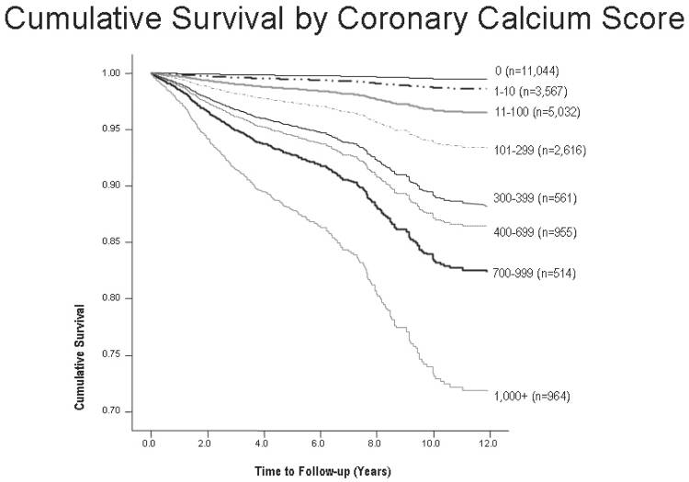
Vasc Health Risk Manag. 2008;4(2):315-24.
Notes:
Pubmed 18561507
Coronary artery calcification compared with carotid intima-media thickness in the prediction of cardiovascular disease incidence: the Multi-Ethnic Study of Atherosclerosis (MESA). Arch Intern Med. 2008 Jun 23;168(12):1333-9. 18574091

Slide 49
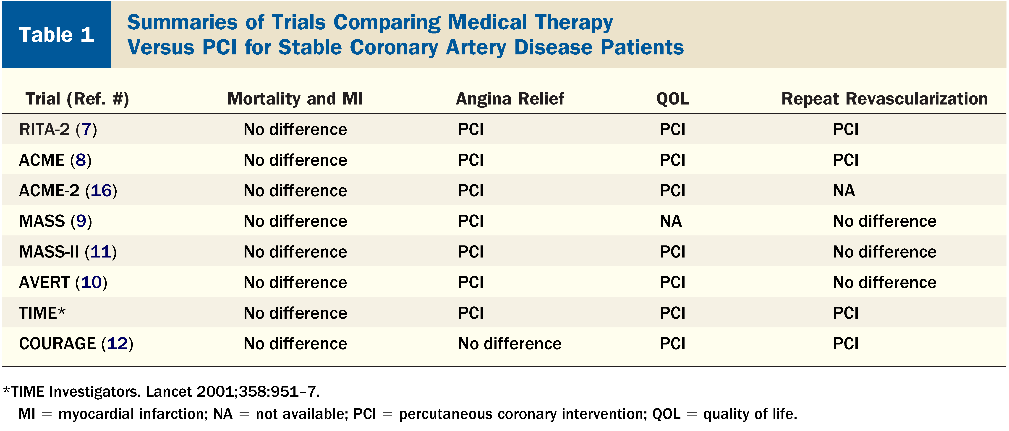
JACC Vol. 50, No. 16, October 16 2007:1598–603

Slide 50
Conclusions
PCI does not improve outcomes in stable IHD patients, rather done mainly for symptomatic relief
Dyslipidaemia, hypertension & smoking account for ~3/4 CHD risk after adjusting for age
Primary strategy for CHD risk reduction remains appropriate risk factor modification
FRS overestimates CHD risk in UK. QRISK2 shows most promise as a modern CHD prediction tool
Remaining 25% CHD risk and CHD risk inequality between different populations yet to be fully explained

Slide 51
Questions?

