Slide 1
Mechanical properties of the heart
Dr Ken MacLeod
Cardiac Medicine, NHLI, Faculty of Medicine, Imperial College London, UK
Graduate Entry
Cardiovascular System
© Imperial College London

Slide 2
Topics covered - learning objectives
Calcium and the heartbeat
Excitation-contraction coupling in the heart
Length – tension relation in the heart
Concepts of preload and afterload
Starling’s Law of the heart
The Cardiac Cycle

Slide 3
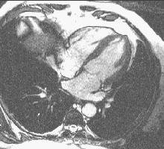
Contraction of the whole heart
Viewed by nuclear magnetic resonance
4 chambered view

Slide 4
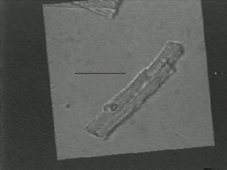
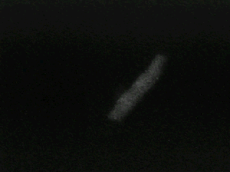
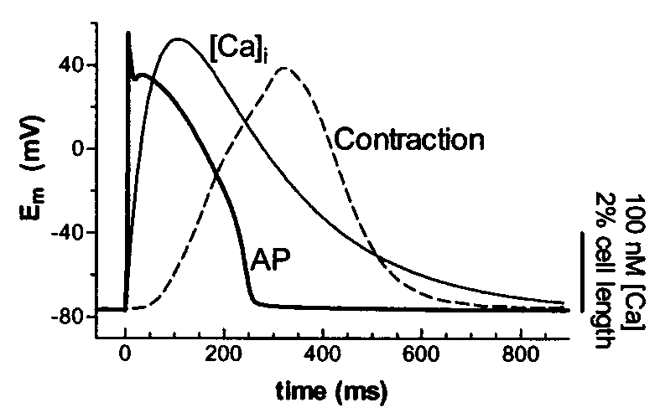
A single ventricular cell
contraction
calcium ion transient
Electrical event
Ca transient
Contractile event

Slide 5
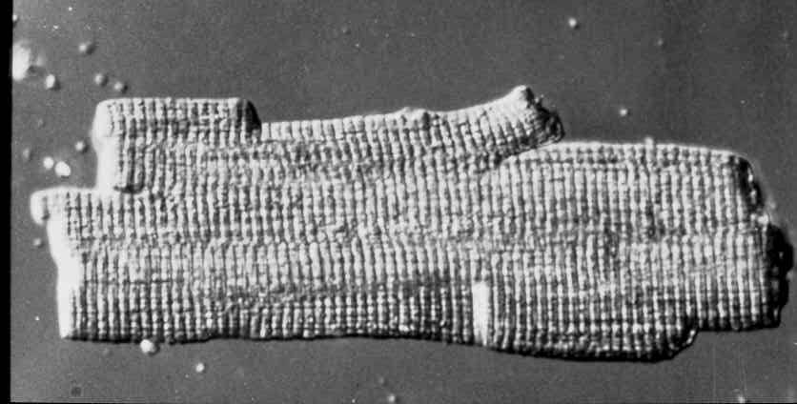
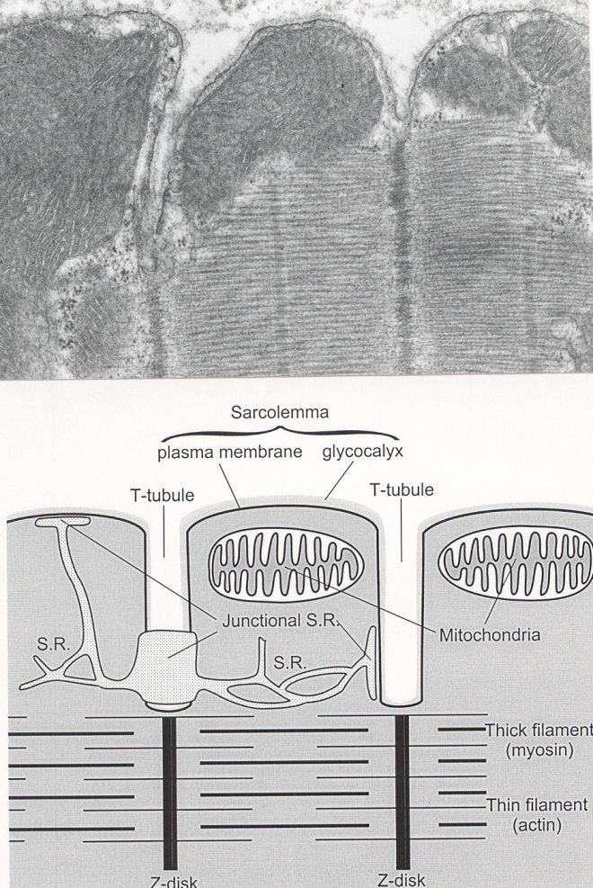
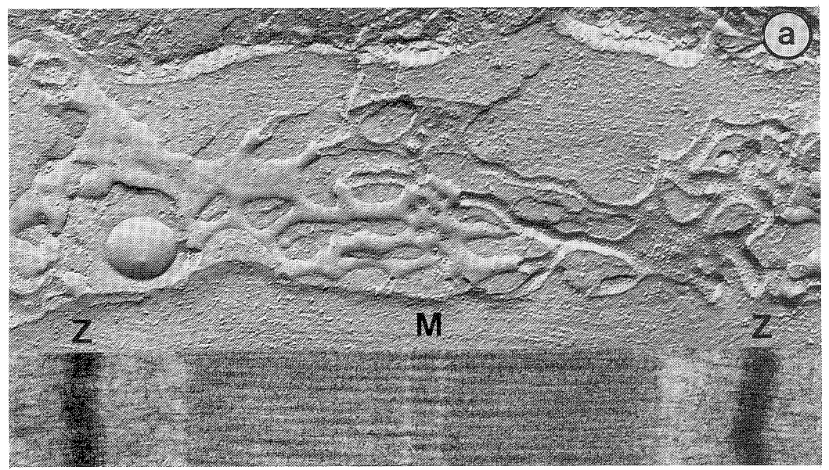
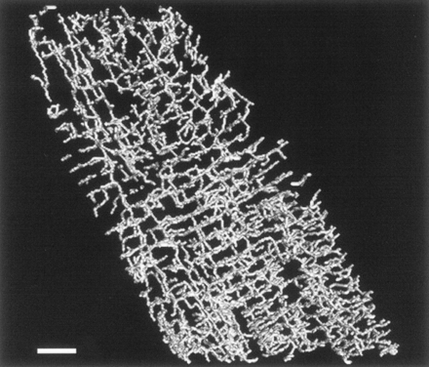
Single cell structure
Ventricular cells 100 μm long and 15 μm wide
T-tubules are finger-like invaginations from the cell surface
T-tubule openings up to 200 nm in diameter
Carry surface depolarisation deep into the cell
Spaced (approx. 2 μm apart) so that a T-tubule lies alongside each Z line of every myofibril.

Slide 6
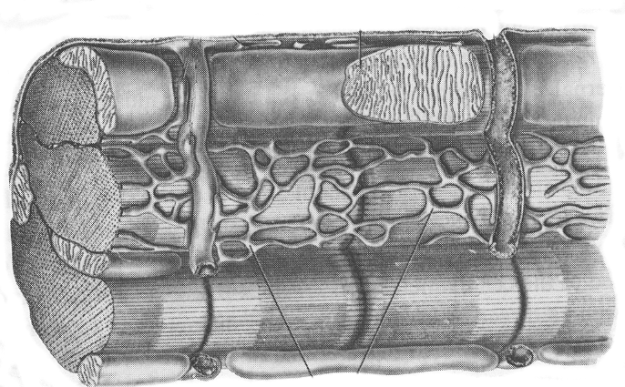
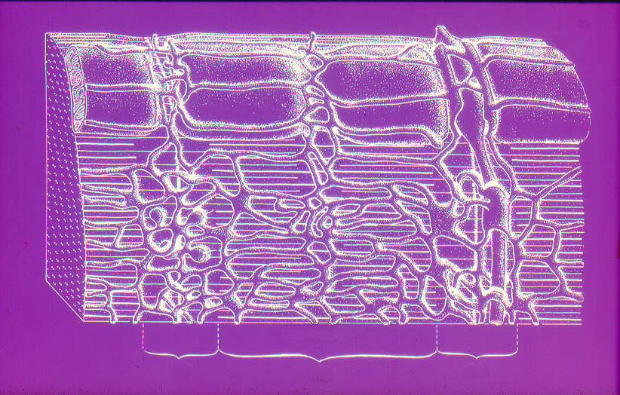
3D single cell structure
T
jsr
mito
sarcoplasmic reticulum
myofibril
Major components of the cell
Z
I
A
I

Slide 7
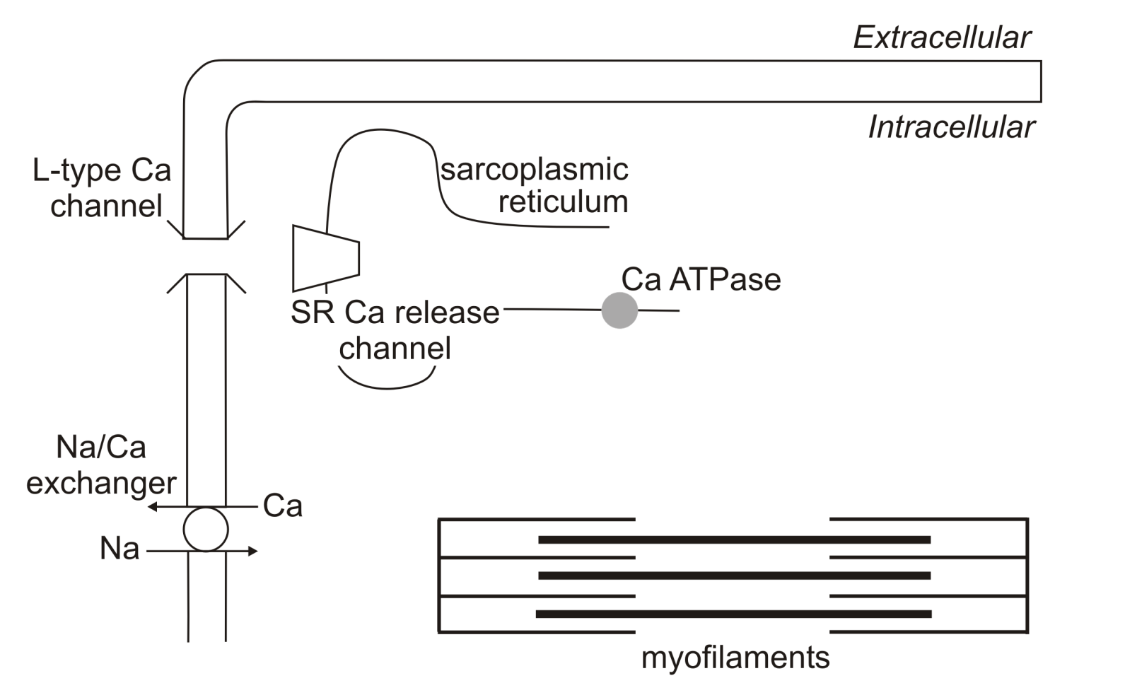
Excitation-Contraction (EC) coupling in the heart
Ca
Ca
Ca

Slide 8
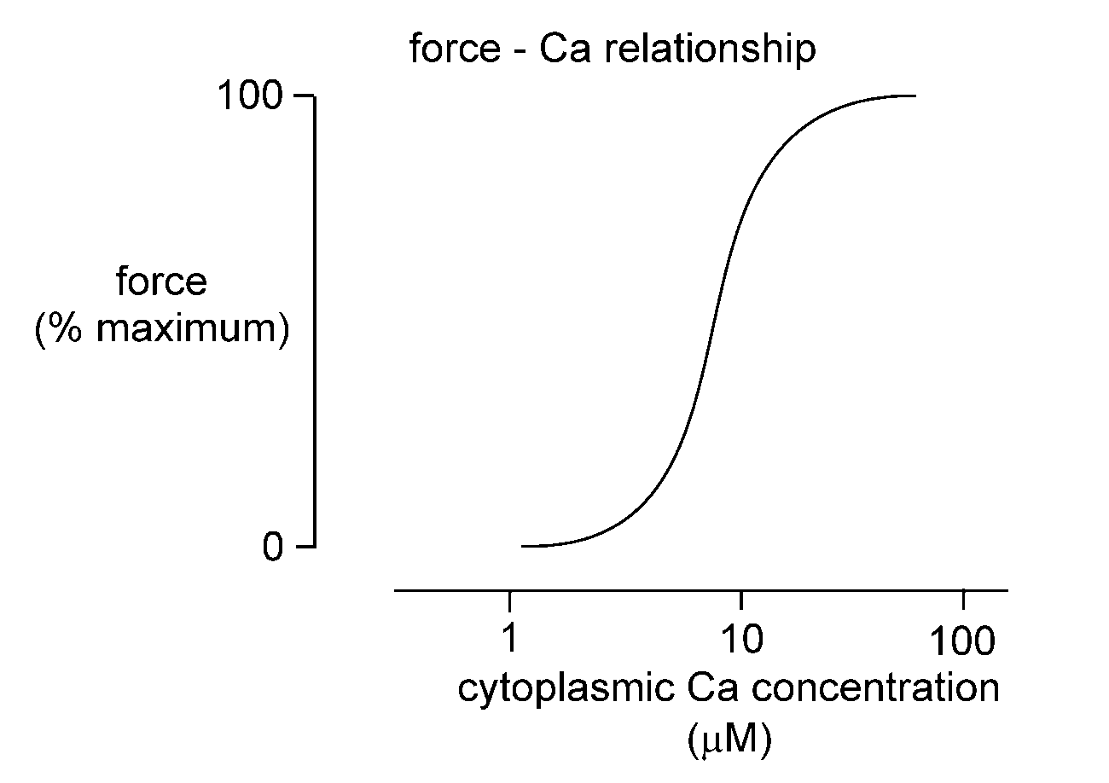
The relationship between force production and intracellular [Ca]

Slide 9
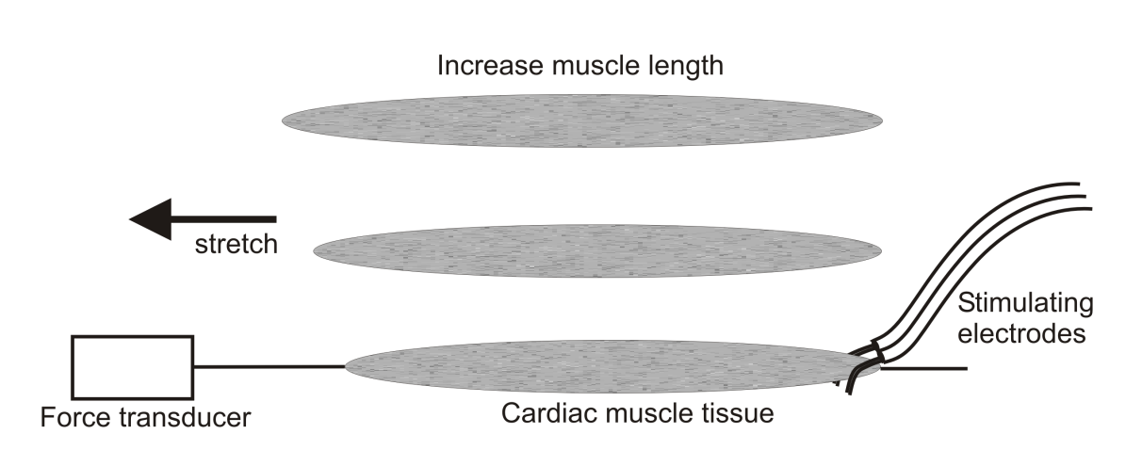
Length – tension relation in cardiac muscle
Active force production
Isometric (no shortening)
contraction
Force
Passive force
A
B
C
Muscle length
C
B
A

Slide 10
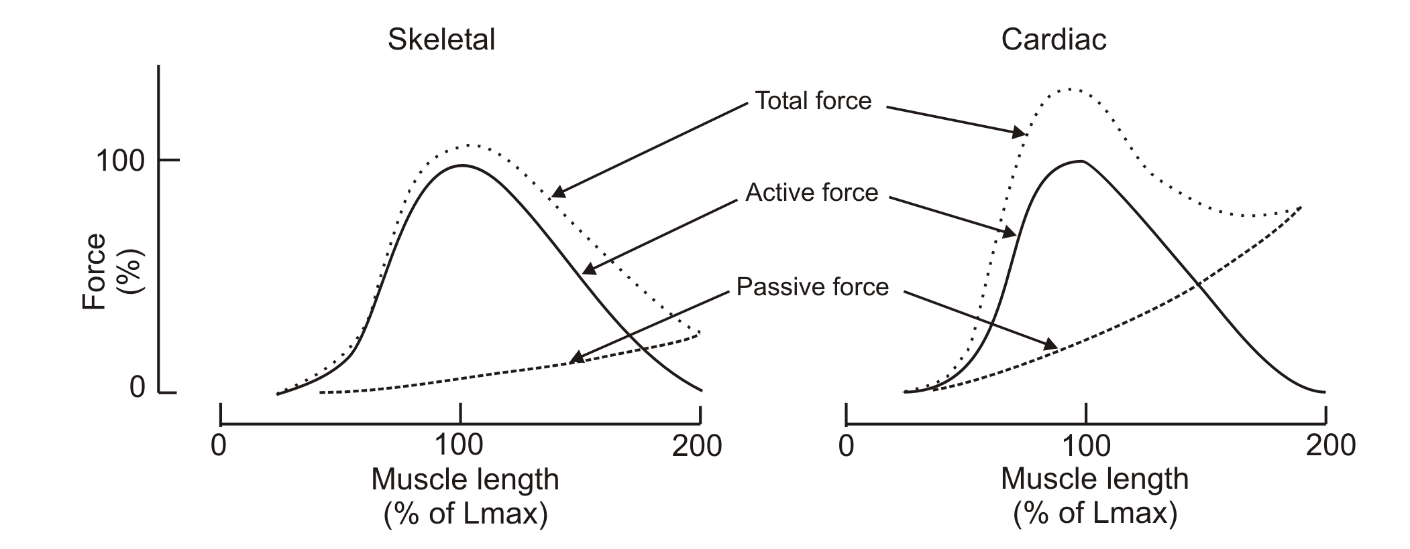
Length – tension relation
Cardiac and skeletal muscle compared
Cardiac muscle more resistant to stretch
Less compliant than skeletal muscle
Due to properties of the extracellular matrix and cytoskeleton
Only ascending limb important for cardiac muscle

Slide 11
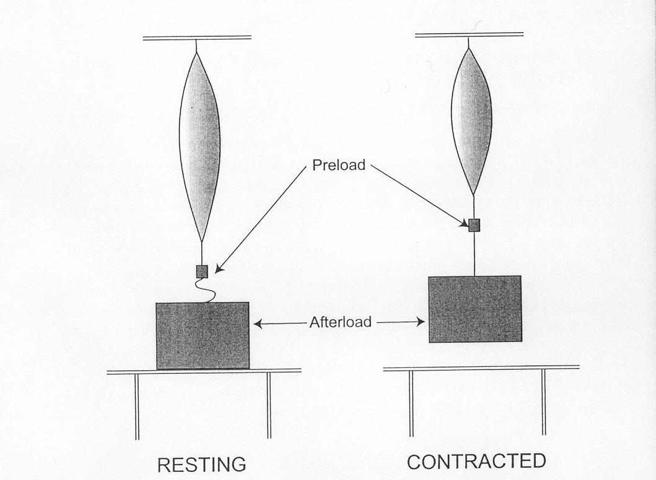
Concepts of preload and afterload
Preload - weight that stretches muscle before it is stimulated to contract
Afterload - weight not apparent to muscle in resting state; only encountered when muscle has started to contract
Isometric (no shortening) contraction
Isotonic (shortening) contraction
Larger preload
Small preload
Force
Shortening
Velocity of
shortening
Preload (stretch)
Afterload
Afterload

Slide 12
in vivo correlates of preload
As blood fills the ventricles during the relaxation phase (or diastole) of the cardiac cycle it stretches the resting ventricular walls
The stretch or filling determines the preload on the ventricles before ejection
Preload is dependent upon venous return to the heart
Measures of preload: end-diastolic volume, end diastolic pressure, right atrial pressure

Slide 13
in vivo correlates of afterload
Definition: The load against which the left ventricle ejects blood after opening of the aortic valve
A simple measure of afterload is the diastolic arterial blood pressure
Any increase in afterload decreases the amount of isotonic shortening that occurs and decreases the velocity of shortening

Slide 14
How the contraction of the heart responds to ventricular filling and aortic pressure
Larger ventricular filling
Small amount
of ventricular filling
Force
Shortening
Velocity of
shortening
Preload (stretch)
Afterload
Afterload
Ventricular filling
Pressure in the aorta
Pressure in the aorta

Slide 15
Frank-Starling relationship
From observations by Otto Frank (1895) and EH Starling (1914) that as the filling of the heart increased there was a more forceful contraction
Definition: Increased diastolic fibre length increases ventricular contraction
Consequence: Ventricles pump greater stroke volume so that, at equilibrium, cardiac output exactly balances the augmented venous return

Slide 16
Frank-Starling relationship
Due to two factors:
  Changes in the number of myofilament cross bridges that interact
  Changes in the Ca sensitivity of the myofilaments

Slide 17
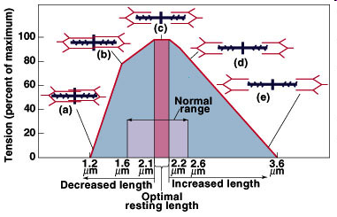
Changes in the number of cross bridges
At shorter lengths than optimal the actin filaments overlap on themselves so reducing the number of myosin cross bridges that can be made.

Slide 18
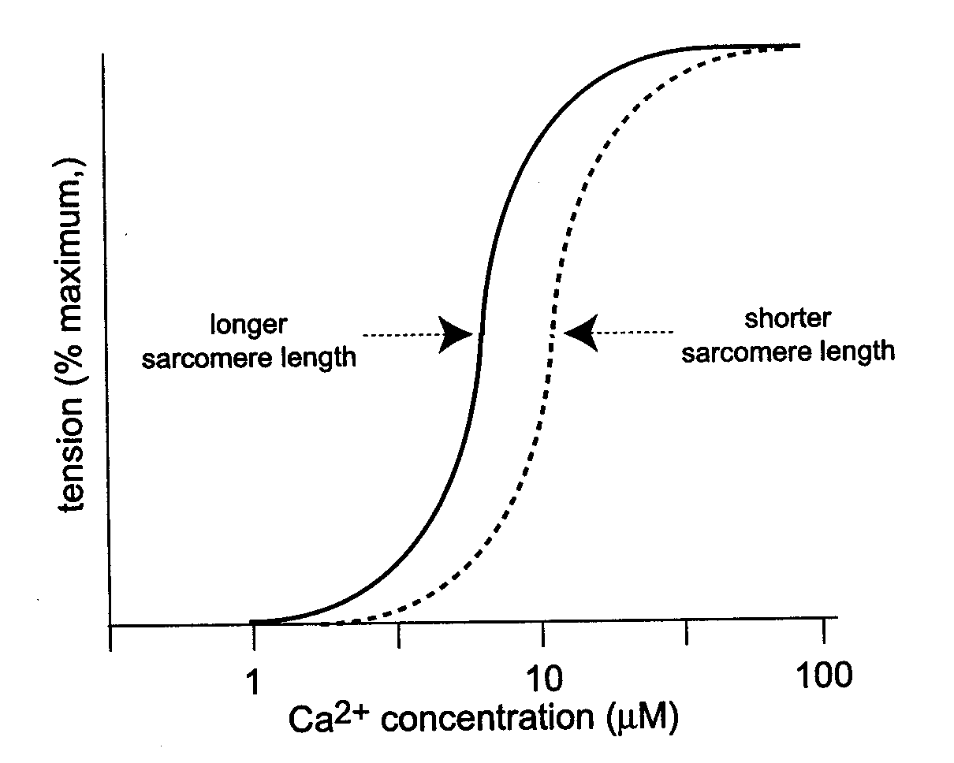
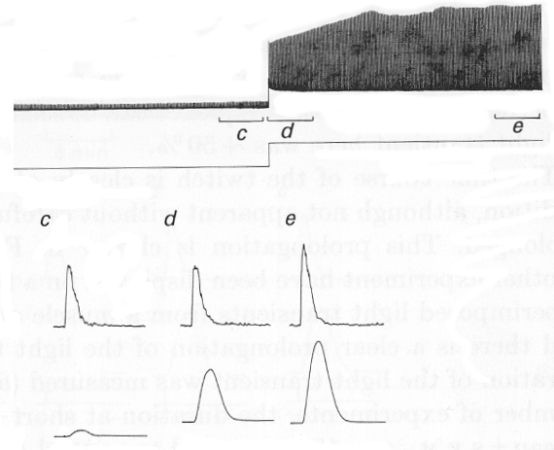
Length and myofilament sensitivity
Calcium required for myofilament activation
Troponin C is thin filament protein that binds Ca
TnC regulates formation of cross-bridges between actin and myosin
At longer sarcomere lengths the affinity of troponin C for Ca is increased
Less Ca required for same amount of force
Force
Length
[Ca]_{i}
Signal averaged traces over period shown
Force
Allen et al. (1988) J. Physiol. 406, 359

Slide 19
The Cardiac Cycle
- a description of mechanical and electrical events, volume changes and sounds associated with the heart beat
Heart beat is divided into two main phases
Diastole
Systole
ventricular relaxation during which the ventricles fill with blood
ventricular contraction when blood is pumped into the arteries
Split into four sub-phases
Split into two sub-phases

Slide 20
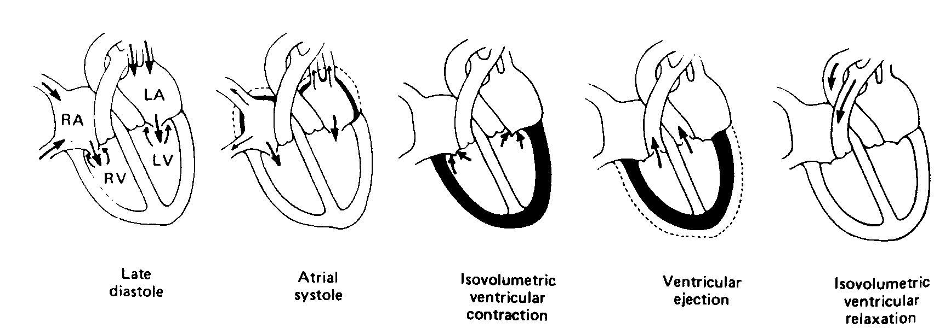
Phases of the Cardiac Cycle
Filling the ventricles
Contraction of the ventricles
Relaxation of the ventricles
Relaxation – filling periods 3 sub-phases
Contraction – 2 sub-phases
Relaxation – 1 sub-phase
Rapid filling
Reduced filling
DIASTOLE
SYSTOLE
DIASTOLE
End-diastolic volume
-
End-systolic volume
= Stroke volume
Ejection fraction (EF) = SV / EDV

Slide 21
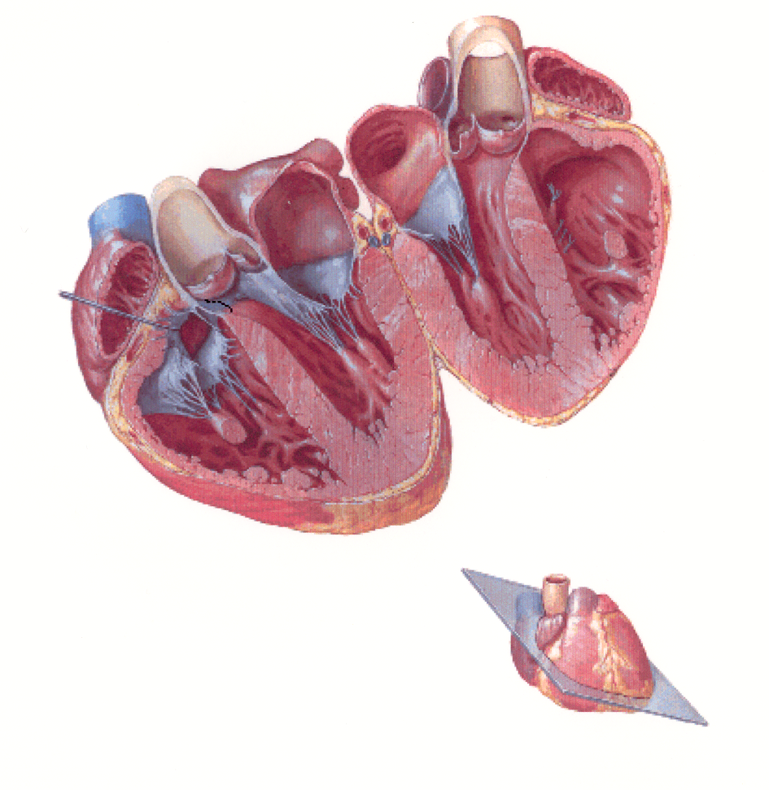
Quick review of anatomy - heart valves
Ascending aorta
Left atrium
Aortic valve
(a semilunar valve)
Mitral valve
Tricuspid valve
Left ventricle
Right ventricle

Slide 22
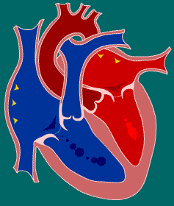
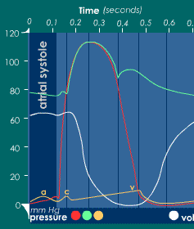
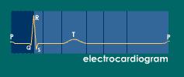
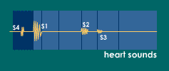
Atrial systole
Mechanical: just prior to atrial systole blood flowing passively through open AV valves
Atria contract “topping off” volume of blood in ventricle
Atrial contraction complete before ventricle starts
aortic, ventricle, atrial
ventricular vol
As atria contract “a” wave (orange) occurs
Blood also pushed back up jugular vein causing first discernable wave in jugular venous pulse
SA node activation depolarizes atria
P wave is atrial depolarization
4th heart sound – abnormal & occurs with congestive HF, pulmonary embolism or tricuspid incompetence

Slide 23
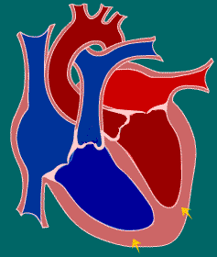
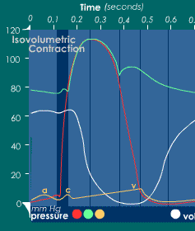
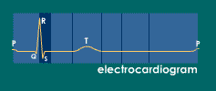
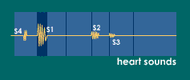

Isovolumic contraction
aortic, ventricle, atrial
The interval between AV valves (tricuspid & mitral) closing and semi-lunar valves (pulmonary & aortic) opening
Contraction of ventricles with no change in volume
AV valves close as ventricular pressure (red) exceeds atrial pressure (orange)
Pressure in ventricles increases without a volume change and approaches aortic pressure (green)
QRS complex marks ventricular depolarization
1st heart sound (“lub”) due to closure of AV valves and associated vibrations

Slide 24
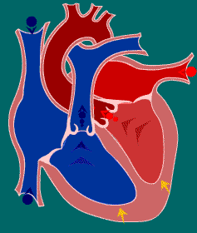
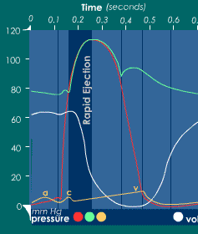
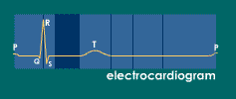
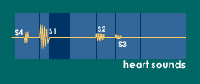
Rapid ejection
aortic, ventricle, atrial
Aortic & pulmonary valves open and mark the start of this phase
As ventricles contract pressure within them exceeds pressure in aorta and pulmonary arteries
SL valves open, blood pumped out and volumes of ventricles decreases
“c” wave caused by RV contraction pushing tricuspid valve into atrium so creating small wave into jugular vein

Slide 25
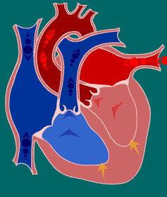
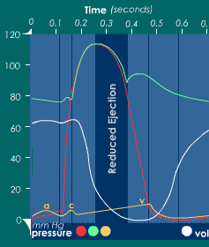
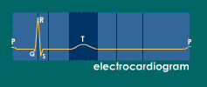
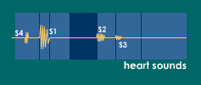
Reduced ejection
aortic, ventricle, atrial
This phase marks the end of systole
Aortic & pulmonary valves begin to close
Blood flow from ventricles decreases and ventricular volume decreases more slowly
As pressures in ventricles fall below that in aorta, blood begins to flow back causing SL valves to close
The T wave is due to ventricular repolarization marking the end of ventricular systole

Slide 26
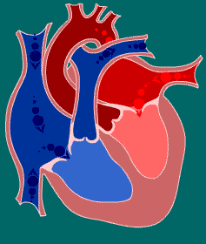
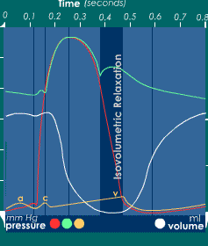
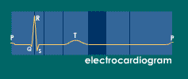
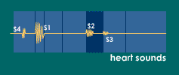
Isovolumic relaxation
aortic, ventricle, atrial
The beginning of diastole
The aortic & pulmonary valves have now just shut
AV valves remain closed until the end of this phase
Atria have now filled with blood but AV valves shut hence atrial pressure rises (orange). Blood pushing tricuspid valve gives second jugular pulse (“v” wave).
Dichrotic notch due to rebound pressure wave against aortic valve as distended aortic wall relaxes.
2nd heart sound (dub) occurs when aortic & pulmonary valves close
Split S2
normal

Slide 27
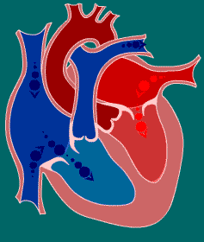
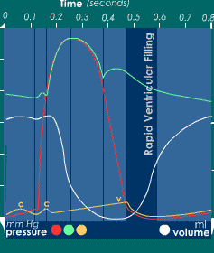
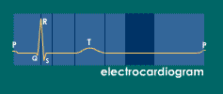
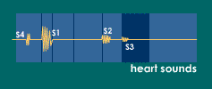
Rapid ventricular filling
aortic, ventricle, atrial
Presence of 3rd heart sound usually abnormal and can signify turbulent ventricular filling
Can be due to severe hypertension or mitral incompetence
Once AV valves open blood in the atria flows rapidly into the ventricles
Ventricular volume increases (white) and atrial pressures fall (orange)
S4
http://www.blaufuss.org/

Slide 28
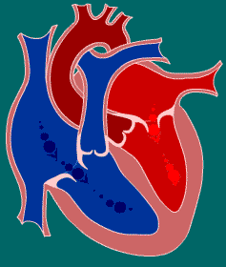
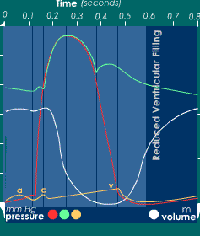
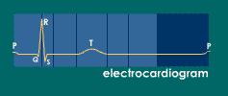
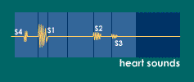
Reduced ventricular filling
aortic, ventricle, atrial
This phase can be called diastasis
Ventricular volume increases more slowly

Slide 29
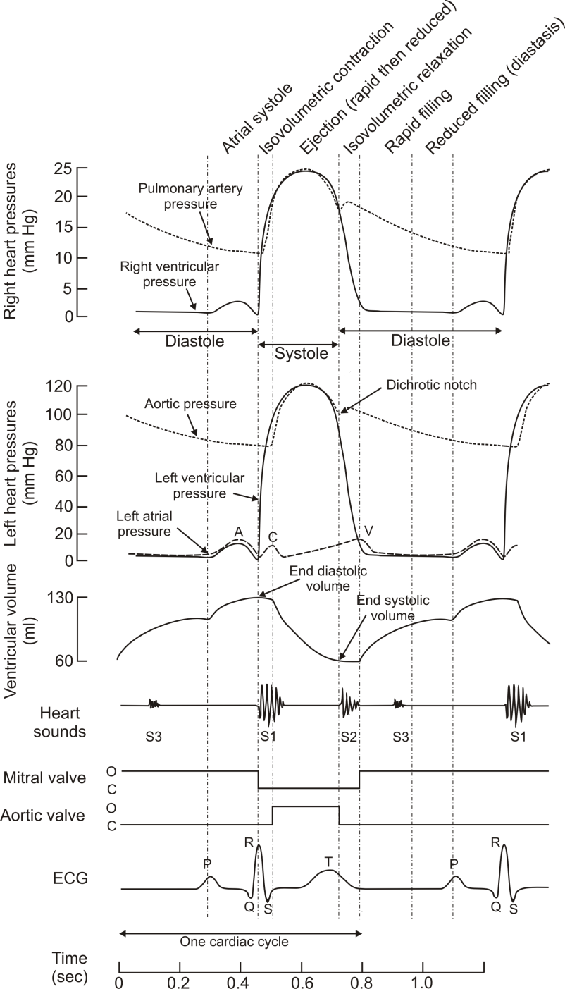
The Wiggers diagram

Slide 30
Pulmonary circulation pressures – a reminder
The patterns of pressure changes in the right heart are essentially identical to those of the left
Quantitatively, the pressures in the right heart and pulmonary circulation are much lower (peak of systole – 25mmHg in pulmonary artery)
Despite lower pressures right ventricle ejects same amount of blood as left!

Slide 31
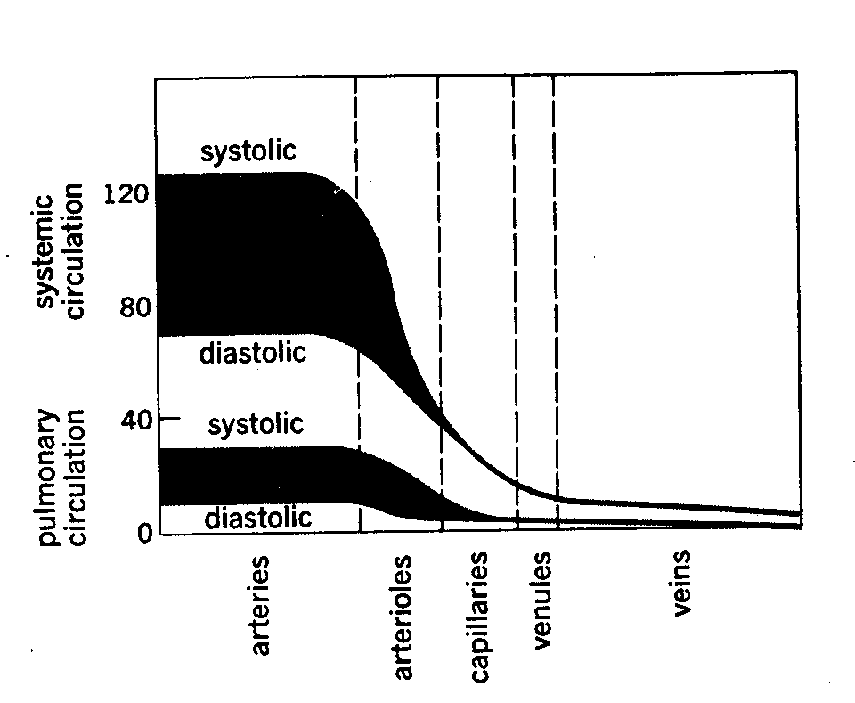
Pressures
Systemic and pulmonary circulations
  High and low pressures
120/80 vs 25/5 mmHg

Slide 32

Pressure – volume loop in heart
Aortic pressure
ESV
Aortic pressure encountered
x
Left ventricular pressure
x
3
2
LV pressure
x
x
1
EDV
4
LV volume
1
2
3
4

Slide 33

Preload and afterload on the pressure – volume loop
Blood filling the ventricle during diastole determines the preload that stretches the resting ventricle
The blood pressures in great vessels (aorta and pulmonary artery) represent the afterload

Slide 34
Frank-Starling relationship
Active force
Force
Pressure
Passive force
Muscle fibre length
Volume

Slide 35


Increasing preload increases stroke volume

Slide 36

Increasing afterload decreases stroke volume
Less shortening as working against afterload
Greater pressure required to open aortic valve
End-systolic PV line
Remember from previous lecture that as afterload increases, the amount of shortening that occurs decreases

Slide 37
Cardiac contractility
Definition: Contractile capability (or strength of contraction) of the heart
Simple measure of cardiac contractility is ejection fraction
Contractility is increased by sympathetic stimulation
Family of different Frank-Starling relations as cardiac contractility changes

Slide 38


Different Frank-Starling relations as cardiac contractility changes
Family of ESV PV lines

Slide 39

Changes occurring during exercise
During exercise contractility is increased due to increased sympathetic activity
During exercise end diastolic volume is increased due to changes in the peripheral circulation (venoconstriction and muscle pump)

Slide 40
Review – essential elements
Ca and the heartbeart
Excitation-contraction coupling in the heart
Length – tension relation in the heart
Concepts of preload and afterload
Starling’s Law of the heart
  Relation of force to length of muscle fibre
  Mechanisms underlying Starling’s Law
The cardiac cycle
  Systole
  Diastole
  Atrial, aortic & ventricular pressures
  Heart sounds
PV loops

