Slide 1
Regulation of the cardiovascular system
Dr Ken MacLeod
NHLI, Faculty of Medicine, Imperial College London, UK
Graduate Entry Course
Cardiovascular System
© Imperial College London

Slide 2
Topics covered - learning objectives
Flow control
  Supplying oxygen and nutrients to tissues
Local mechanisms regulating blood flow
  Autoregulation, the endothelium
Systemic regulation by hormones
  circulating vasoconstrictors, Kinins, ANP,
Neural regulatory mechanisms
  Nervous control of blood vessel diameter
  Cardiac innervation, changing cardiac contraction
  Baroreceptors
  Reciprocal innervation
Integration of control systems

Slide 3
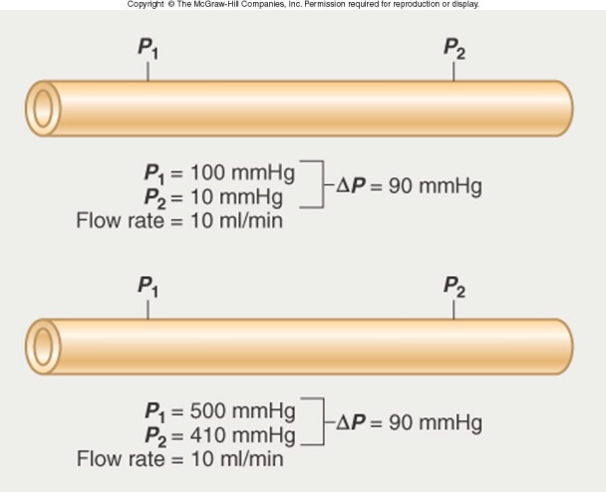
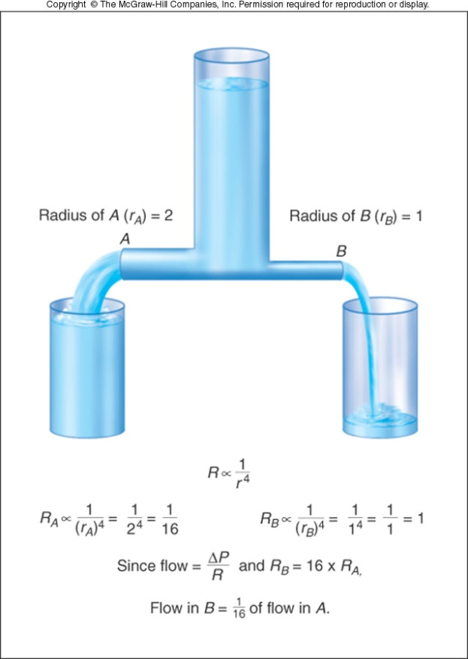
Physics of flow
Flow (l/min) depends on two variables:
Flow is proportional to the difference in pressure between two points (not absolute pressure)
Flow is inversely proportional to the resistance
Resistance of a tube depends on three variables:
Fluid viscosity (η)
The length of the tube (L)
Inner radius of the tube (r)
Not fixed but in most physiological conditions is constant
Fixed – lengths of blood vessels remain constant
Variable – main determinant of resistance
Halving the radius decreases flow 16 times

Slide 4
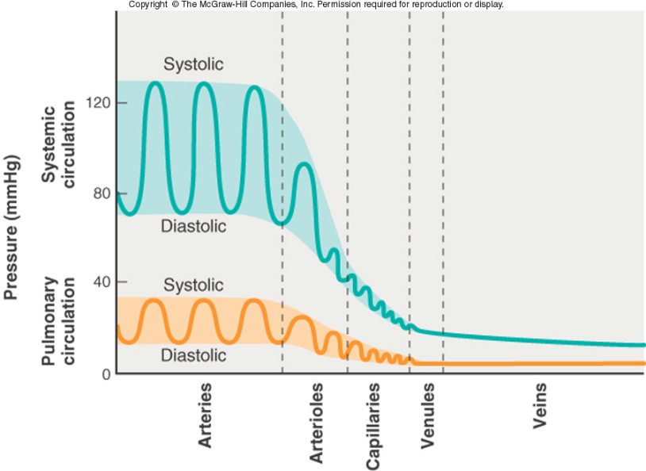
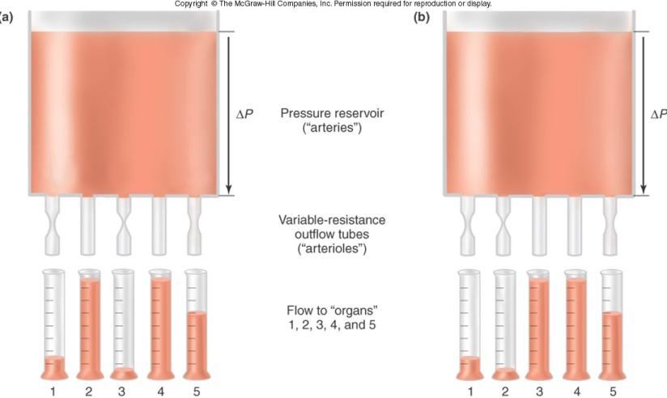
Flow control
Arterioles:
Determine blood flow to organs they serve
Determine mean arterial blood pressure
By changing arteriolar radius
the pattern of distribution of
blood to organs can be changed

Slide 5
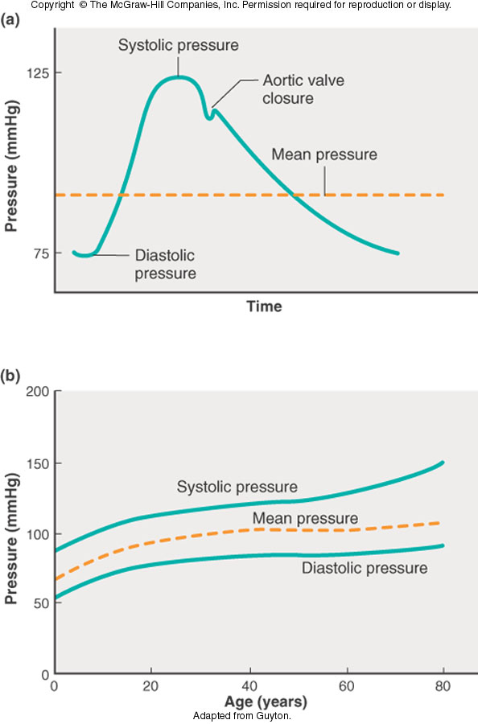
Key equations
Stroke volume = end-diastolic volume - end systolic volume
  SV = EDV - ESV
Cardiac output = heart rate x stroke volume
  CO = HR x SV
Mean systemic arterial pressure = cardiac output x total peripheral resistance
  Mean BP = CO x TPR

Slide 6
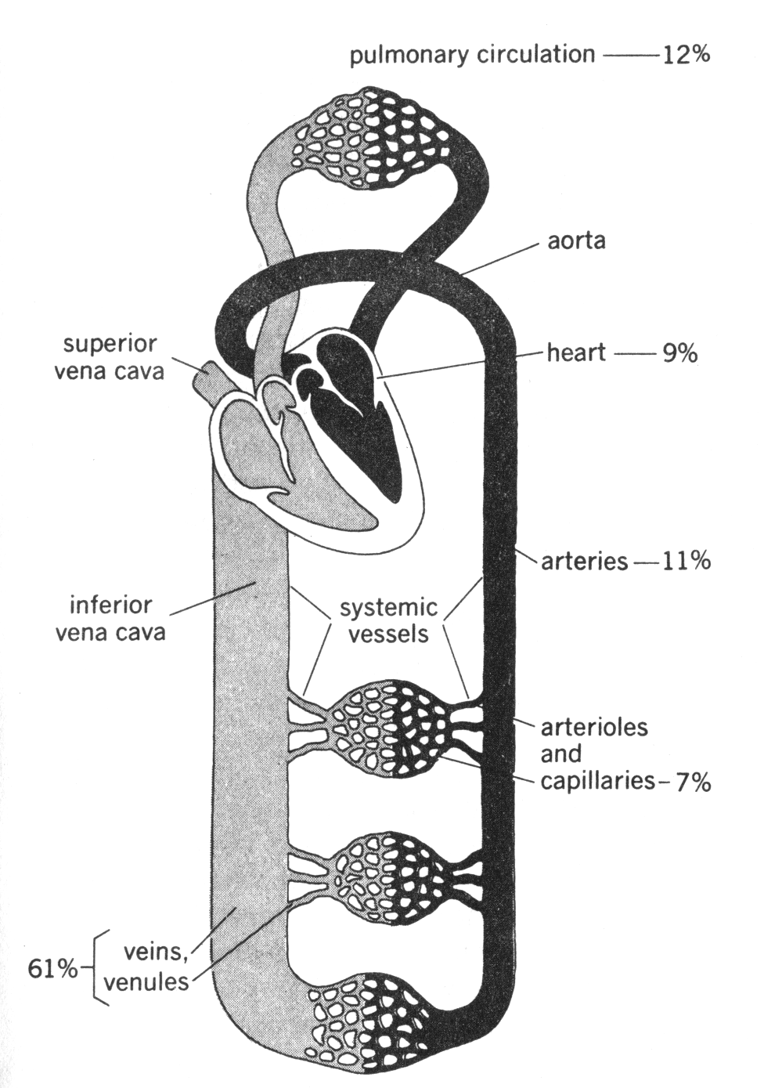
Design of the cardiovascular system
Systemic & pulmonary circulations
Right heart → lungs → left heart
Veins have capacitance
Venous volume distribution affected by
  peripheral venous “tone”
  gravity
  skeletal muscle pump
  breathing
Central venous pressure (mean pressure in the superior vena cava) determines the amount of blood flowing back to the heart.
The amount of blood flowing back to the heart determines stroke volume

Slide 7
Ways of regulating blood flow
Local mechanisms
  intrinsic to the smooth muscle itself or closely associated
Systemic regulation
  circulating hormones
Autonomic nervous system

Slide 8
Local mechanisms regulating blood flow (1)
Autoregulation
( the intrinsic capacity to compensate for changes in perfusion pressure by changing vascular resistance)
No autoregulation
  Myogenic theory (smooth muscle fibres respond to tension in the vessel wall; as pressure rises muscle fibres contract; stretch-sensitive channels involved)
  Metabolic theory (as blood flow decreases “metabolites” accumulate and vessels dilate; when flow increases “metabolites” are washed away)
  Injury (serotonin release from platelets causes constriction)
Resistance
autoregulation
500
Flow (ml/min)
300
No autoregulation
Pressure
100
(mm Hg)
70
e.g. CO₂, H⁺, adenosine, K⁺
0
2
4
6
Time (min)

Slide 9
Local mechanisms regulating blood flow (2)
Substances released from the endothelium
  Nitric oxide (endothelium-derived relaxing factor synthesised from arginine; plays key role in vasodilation)
  Prostacyclin & thromboxane A2 (vasodilator & vasoconstrictor – relative amounts important for clotting)
  Endothelins (potent vasoconstrictors)

Slide 10
Design of autonomic NS
CNS
Peripheral nervous system
Parasympathetic
cranial
ganglion
thoracic
Sympathetic
lumbar
Pre-gangionic fibre
Post-ganglionic fibre
Parasympathetic
sacral
ACh
Transmitter at synapse
NA

Slide 11
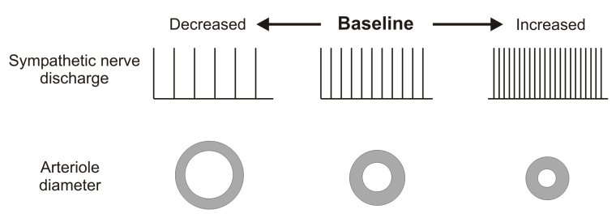
Nervous control of blood vessel diameter
Vasomotor centre in medulla
All blood vessels receive symp. post-ganglionic innervation
Transmitter = noradrenaline
Always some level of tonic activity
Control of nerve activity can accomplish dilation or constriction
Generally no parasympathetic innervation to vascular system
Some non-cholinergic, non-adrenergic autonomic neurons with NO as transmitter
Pressor
Depressor
*
-
+

Slide 12
Summary – control of blood vessel radius
Remember
Vessel radius
Sympathetic
vasoconstrictor
nerves
Circulating hormones eg
plasma noradrenaline
Local controls
O₂
K⁺
CO₂
H⁺
osmolarity,
metabolites

Slide 13
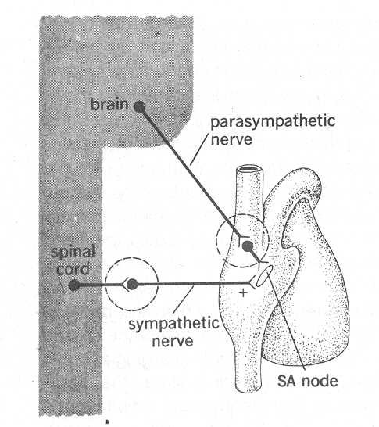
Cardiac innervation
HR
beats/min
Sympathetic
nerves stimulated
Parasympathetic
nerves cut
120
90
normal
60
Sympathetic
nerves cut
30
Parasympathetic
nerves stimulated
time
Heart rate
Activity of
sympathetic
nerves to heart
Activity of
parasympathetic
nerves to heart
Plasma
adrenaline

Slide 14
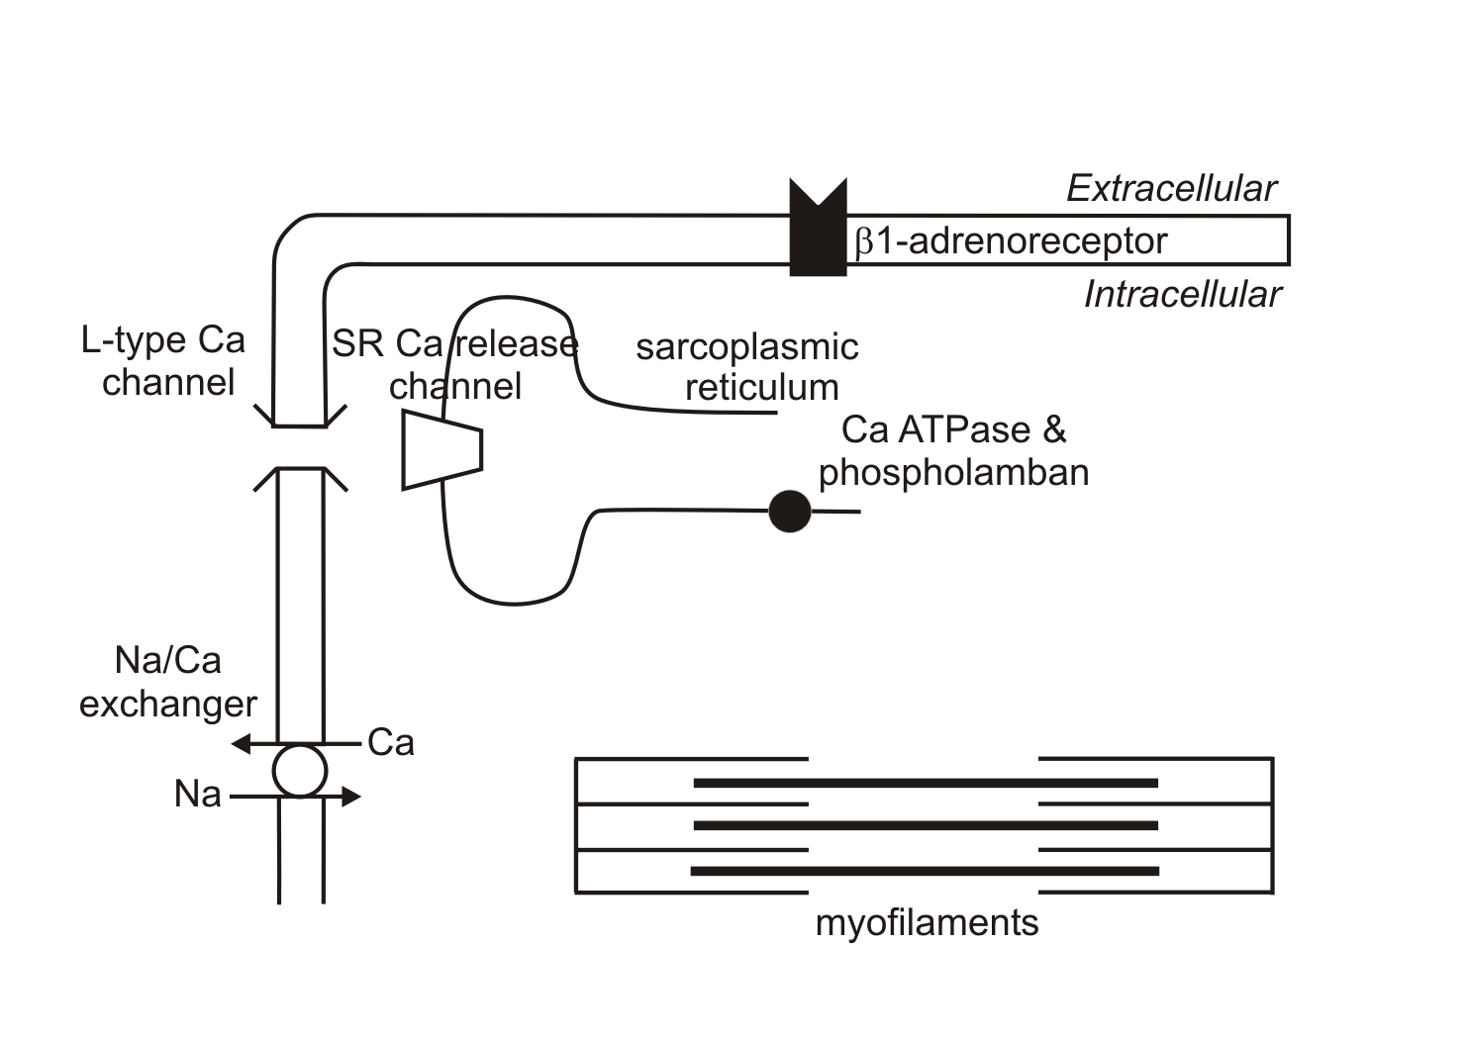
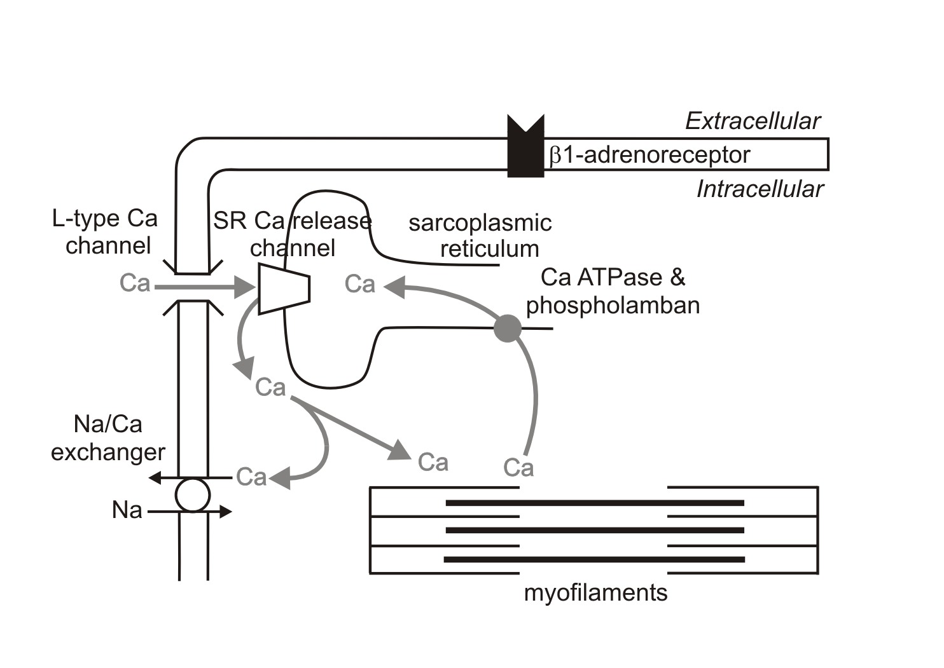
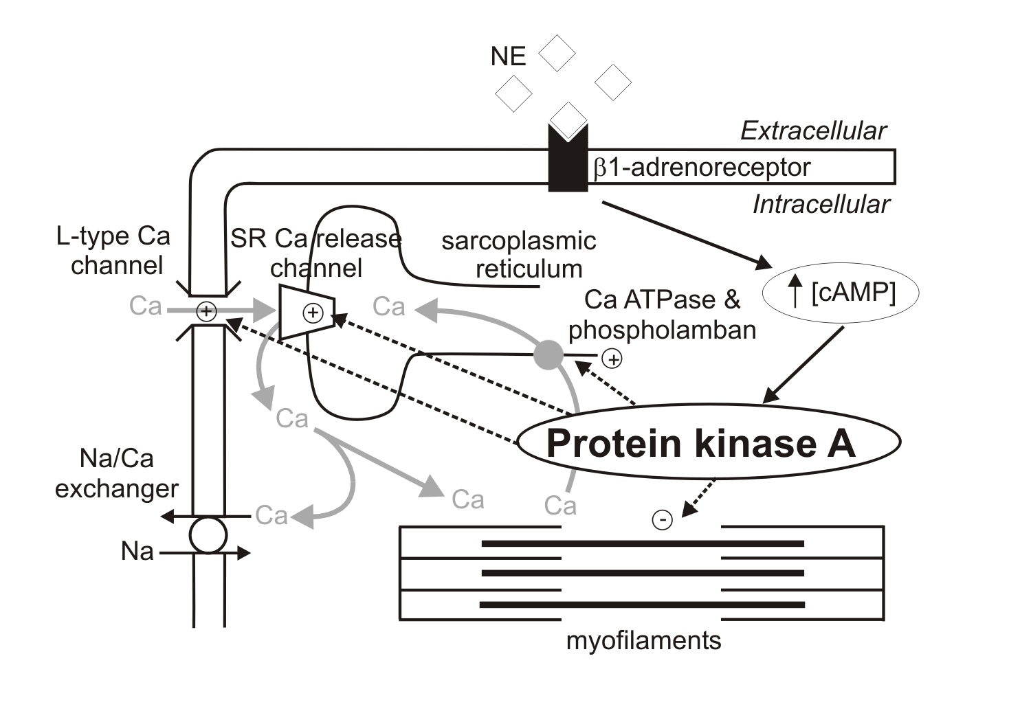
Controlling force of contraction
Ca influx increased
Ca uptake into intracellular stores increased

Slide 15
Controlling stroke volume
Stroke volume
Activity of
sympathetic
nerves to heart
Plasma
adrenaline
Starling’s
Law
End-diastolic
ventricular
volume
Extrinsic control
assists
Intrathoracic
pressure
Intrinsic control
Atrial
pressure
Venous return
Respiratory movements

Slide 16
Integration so far
Cardiac output = stroke volume x heart rate
Cardiac output
Stroke volume
Heart rate
End-diastolic
ventricular
volume
Plasma
adrenaline
Activity of
sympathetic
nerves to heart
Intrathoracic
pressure
Atrial
pressure
Respiratory movements
Activity of
parasympathetic
nerves to heart
Venous return

Slide 17
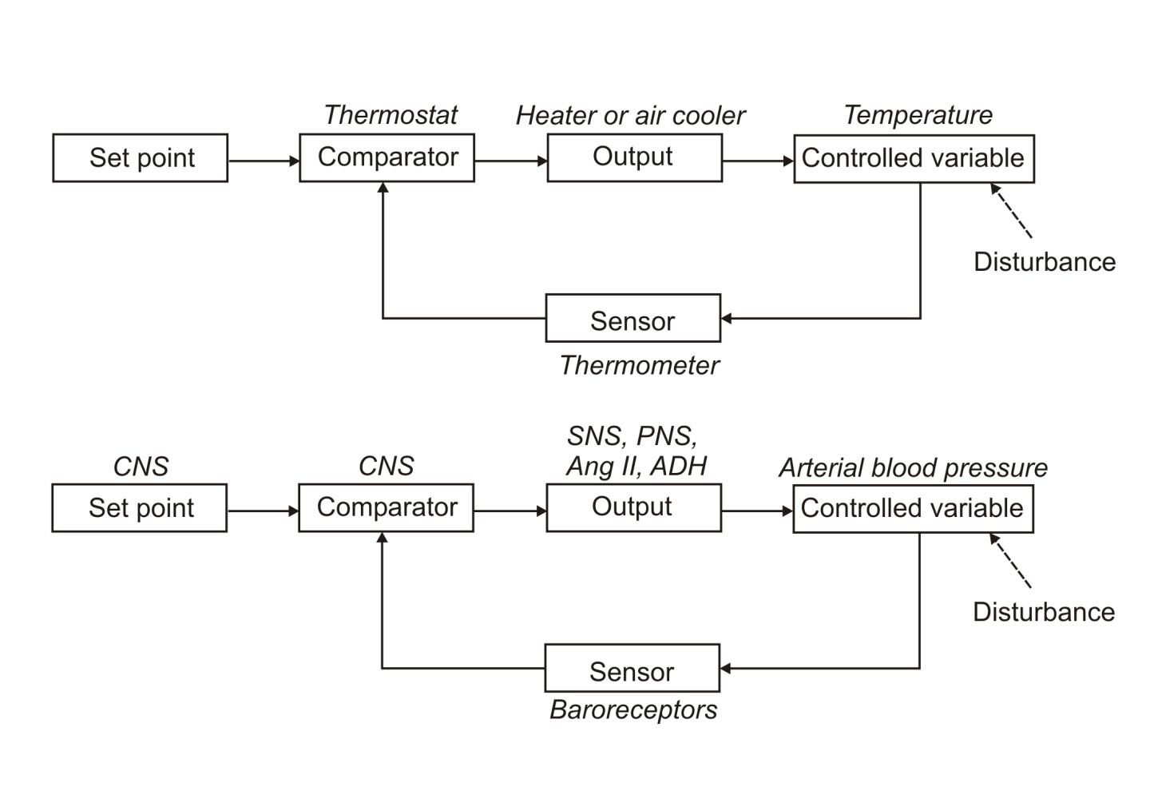
Providing feedback

Slide 18
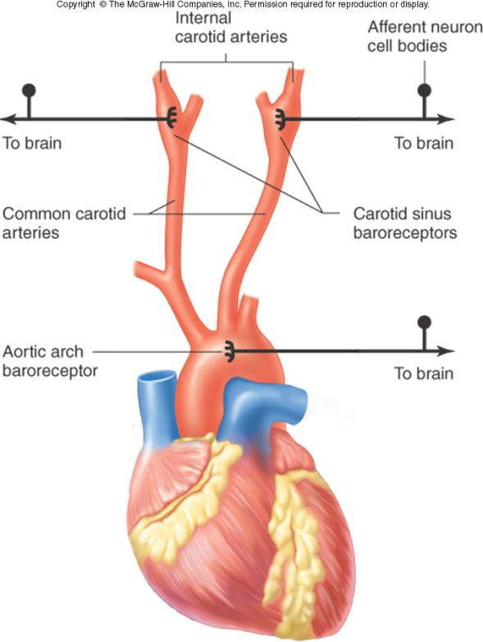
Providing feedback - baroreceptors
Glossopharyngeal nerve
Vagus nerve
Cardioregulatory
and vasomotor
centers in the
medulla oblongata
Baroreceptors in the carotid sinus and aortic arch

Slide 19
Baroreceptor activity
Baroreceptor action potential frequency
Normal resting value
40
80
120
160
Mean arterial pressure (mmHg)

Slide 20
Reciprocal innervation
Afferent input
  Stimulates parasympathetic nerves to heart
  Simultaneously inhibits sympathetic innervation to heart, arterioles and veins
RECEPTOR
Afferent nerve
Parasymp.
nerve
Inhibitory
interneurone
HEART
-
Tonic activity
ARTERIOLES
AND VEINS
Symp. nerve

Slide 21
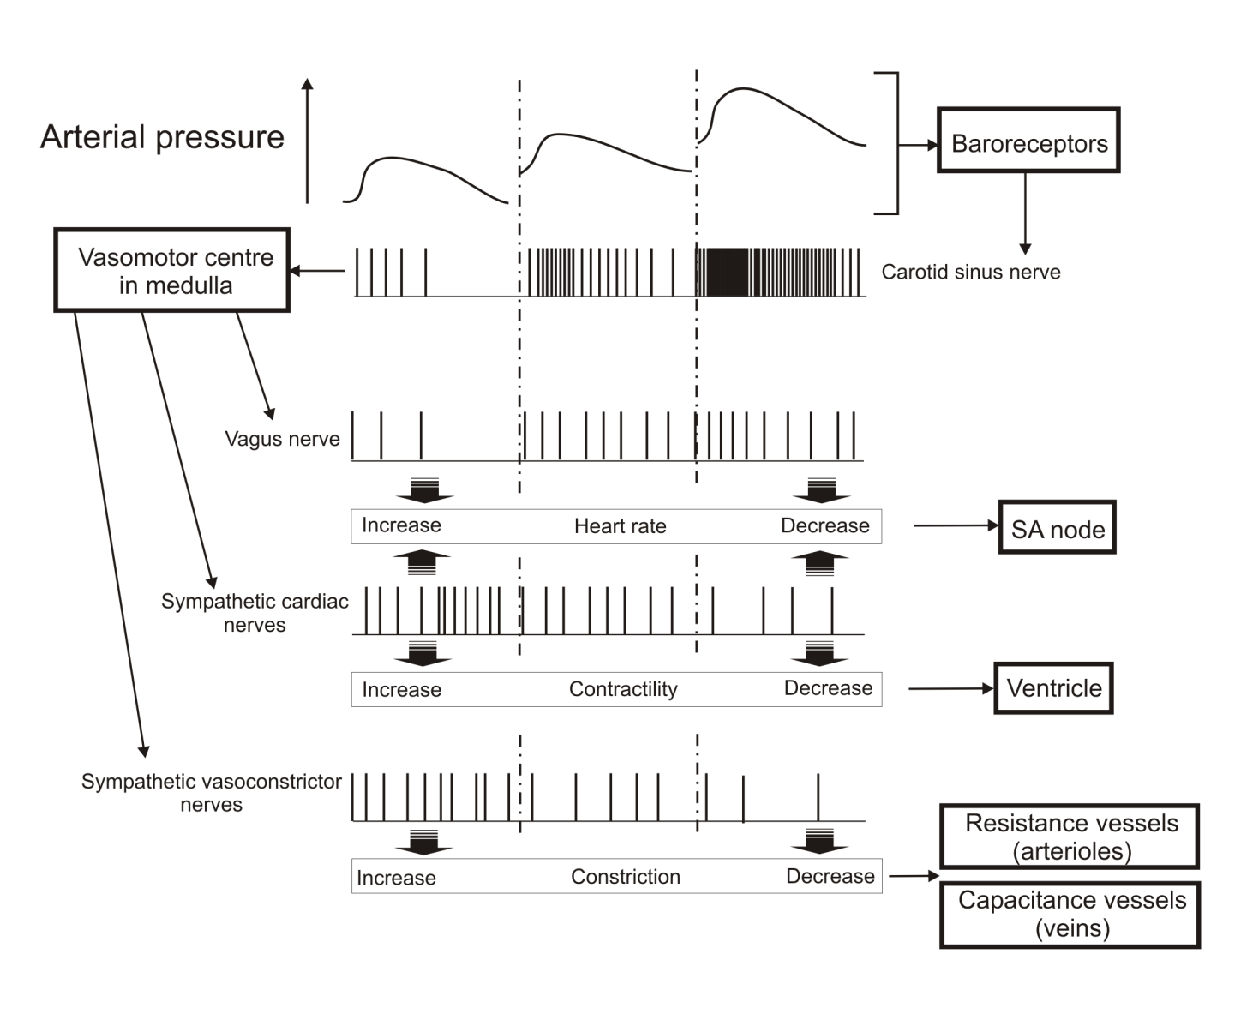
Reflexes controlled by carotid sinus nerve activity
control of venous return

Slide 22
Control of venous return
Atrial pressure
Venous return
Venous pressure
Blood volume
Respiratory
movements
Activity of
sympathetic
nerves to veins
Skeletal
muscle “pump”

Slide 23
Feedback for blood pressure control
haemorrhage
Blood volume
Venous pressure
Venous pressure
decrease
Venous return to heart
Atrial pressure
Venous constriction
increase
Ventricular end diastolic volume
Stroke volume
Sympathetic discharge
to veins
Arterial blood pressure
Baroreceptor feedback & reciprocal innervation
Cardiac output
reflexes

Slide 24
Maintaining arterial pressure
Mean systemic arterial pressure = cardiac output x total peripheral resistance
Arterial pressure
haemorrhage
Cardiac output
CO = HR x SV
Peripheral
resistance
Heart rate
Stroke volume
Ventricular end diastolic volume
Arterial pressure
Venous return
Arteriolar
constriction
Venous pressure
Firing of
baroreceptors
Cardiac
contractility
Venous tone
Parasymp
discharge
to heart
Symp discharge
to heart
Symp discharge
to veins
Symp discharge
to arterioles
Reflexes

Slide 25
Regulation of the cardiovascular system - summary
Flow control
Local mechanisms regulating blood flow
  Autoregulation, the endothelium and paracrine effects
Systemic regulation by hormones
  circulating vasoconstrictors, kinins, ANP
Neural regulatory mechanisms
  Nervous control of blood vessel diameter
  Cardiac innervation, changing cardiac contraction
  Baroreceptors
  Reciprocal innervation
Integration of control systems
The system is designed to maintain appropriate supplies of oxygen and nutrients to the tissues

