Slide 1
Graduate Entry Programme Alimentary System
12 December 2012
Malabsorption
Professor Julian Walters Consultant Gastroenterologist Hammersmith Hospital

Slide 2
Objectives:
To recognise the clinical presentation of malabsorption
To understand the disease mechanisms leading to malabsorption
To learn about the clinical importance, presentation, complications and treatment of coeliac disease

Slide 3
Malabsorption: Presentation
Key presenting features:
Diarrhoea / Steatorrhoea
Growth failure / Weight loss

Slide 4
What is diarrhoea?
Patient:
Change in consistency of stools
“watery / explosive / floating”
Urgency to defecate /
uncontrollable defecation
(incontinence / “accidents”)
Increased frequency
Clinical:
Increased volume (weight) of stool
(Increased frequency)
(watery texture)
Normal frequency of bowels: 3x / day to 3x / week
Normal volume / weight of stools: < 200 ml /day

Slide 5
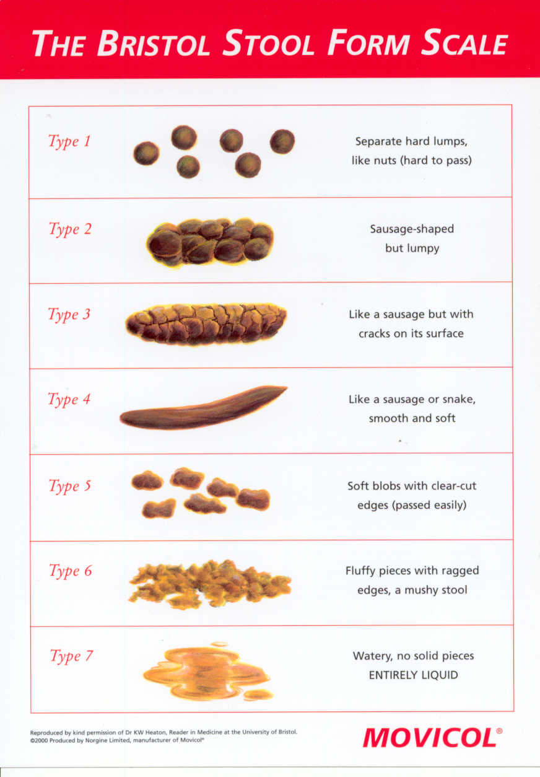
Constipation
Diarrhoea

Slide 6
When to investigate diarrhoea?
Infectious diarrhoea is common
rarely lasts longer than 2 weeks
Chronic diarrhoea has many causes :
Osmotic
Secretory
Inflammatory
Often a combination of these is responsible.

Slide 7
Steatorrhoea
Description
Pale poorly formed stools
Offensive smell
Difficult to flush away
Float
Oil rings
Faecal leakage
Faecal weight
normal range < 200 g / day
Faecal fat content
normal range < 6 g / day
Faecal Sudan Stain

Slide 8
Nutritional assessment – examination
Muscle wasting
Loss of fat
Oedema / ascites
low albumin
(anaemia, skin lesions, hair loss, poor wound healing, purpura etc.)
Anthropometry

Slide 9
Nutrition: Assessments and Requirements
Remember the full range of nutrients !

Slide 10
Nutrition
F ats
A mino acids and protein
C arbohydrates
E lectrolytes and water
M inerals
T race elements
V itamins

Slide 11
Malnutrition
?
Increased needs
Insufficient supply
Food intake
?
Malabsorption
Maldigestion

Slide 12
Maldigestion & Malabsorption
Abnormal digestion
Reduced gastric tissue/secretion
Loss of pancreatic tissue
Impaired bile secretion
Reduction in intestinal brush-border enzymes
Abnormal absorption
Loss of functional enterocytes
Pre- and post-mucosal effects
Single gene disorders

Slide 13
Tests for malabsorbed nutrients
Fats
Steatorrhoea: clinical +/- faecal fat
Protein & nitrogen
Urinary excretion, albumin
Minerals
Iron, calcium, magnesium, zinc etc.
Vitamins
B₁₂ (cobalamin), D (calciferol), folate, vitamin K, carotene

Slide 14
Investigation of Malabsorption – some tests
Tubeless tests
(Xylose absorption)
(Pancreolauryl test)
(Schilling test)
Faecal Pancreatic Elastase 1
Stable during passage through GI tract
Small sample of stool collected
Monoclonal antibody to human protein - ELISA
High sensitivity and specificity for diagnosing pancreatic insufficiency
Values below 200 µg elastase/g stool indicate exocrine pancreatic insufficiency

Slide 15
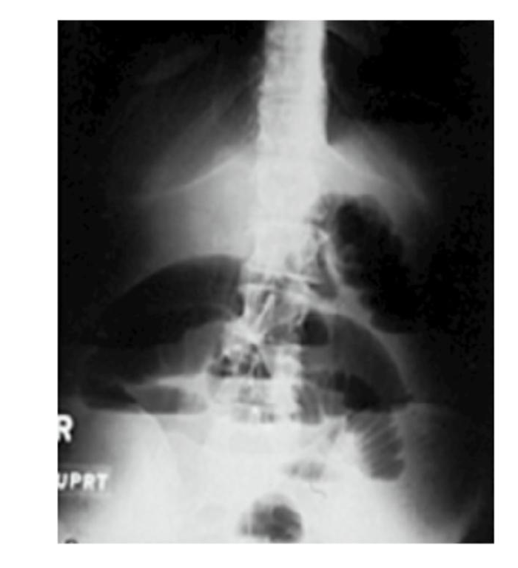
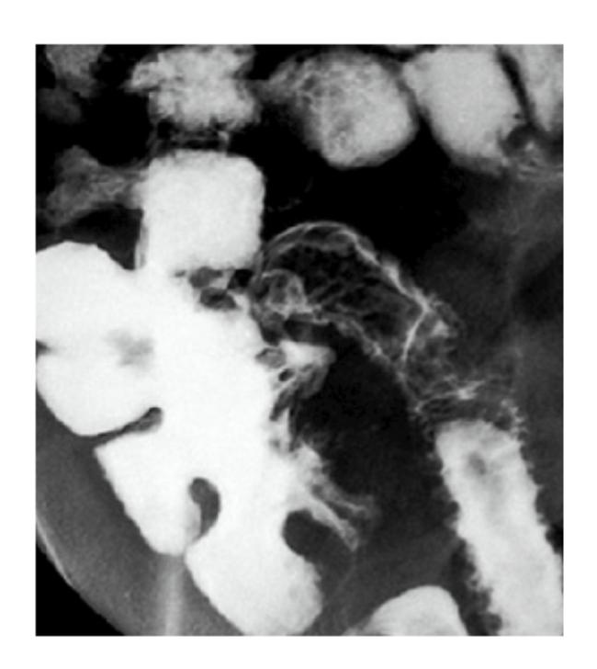
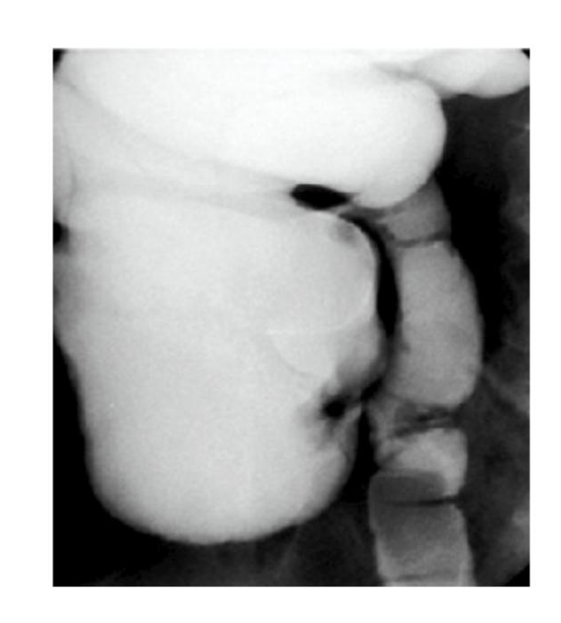
Plain abdominal X-ray
Small bowel enemas

Slide 16
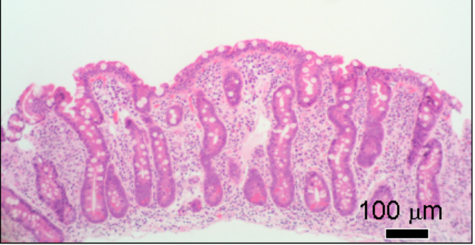
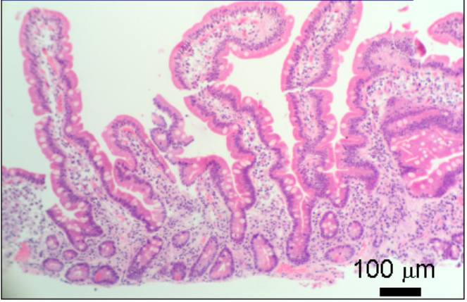
DUODENAL HISTOLOGY
Subtotal villous atrophy with crypt hyperplasia
Normal mucosa

Slide 17
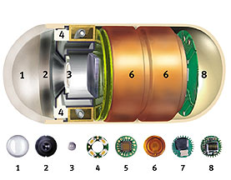
Wireless Capsule Enteroscopy
Normal jejunum Coeliac

Slide 18
Causes of Malabsorption
Common | Coeliac disease | Gluten sensitive enteropathy
 | Small bowel bacterial overgrowth | Gastric surgery and achlorhydria Intestinal blind loops post-surgery Jejunal diverticula Intestinal strictures Fistulae (as in Crohn's disease) Impaired peristalsis (fibrosis)
 | Pancreatic insufficiency | Chronic pancreatitis Cystic fibrosis

Slide 19
Causes of Malabsorption
Less common | Short bowel syndrome | Intestinal resection for Crohn's disease, mesenteric vascular disease or injury
 | Chronic infections | Tropical sprue Giardiasis, Other parasites (e.g. Strongyloides) Tuberculosis, AIDS, Whipple’s
 | Lymphoma | IPSID, EATL, refractory sprue & ulcerative jejuno-ileitis
 | Radiation enteritis | Fibrosis, Atrophy, Strictures, Lymphangiectasia
 | Intestinal lymphangiectasia | Congenital, Infective, Fibrotic, Malignant, Cardiac
 | Drugs | Orlistat, Laxatives, Neomycin Cholestyramine (and certain others with specific interactions)
 | Allergic | Eosinophilic enteritis, Milk and soya enteropathy Autoimmune enteropathy
 | Immunodeficiency | Congenital, acquired

Slide 20
Rare inherited disorders of intestinal absorption
Disorders associated with non-functional transporters can present in childhood:
Glucose-galactose malabsorption
Sucrase deficiency
Fructose malabsorption
Cystinuria (Cys, Lys, Arg)
Hartnup disease (Trp, Phe, his)
Lysinuric protein intolerance (Lys, Arg)
Blue diaper syndrome (Trp)
Oasthouse urine disease
(Met, Leu, Ile, Val)
Iminoglycinuria (Pro, Gly)
Congenital chloride diarrhoea
Acrodermatitis enteropathica (Zn)
Menkes’s kinky-hair disease (Cu)
Abetalipoproteinaemia and hypolipoproteinaemia

Slide 21
Common Forms of Malabsorption of Specific Nutrients
Nutrient
Condition
Lactose
Lactase non-persistence
Vitamin B12
Pernicious anaemia
(loss of intrinsic factor)
Bile salts
Bile salt diarrhoea

Slide 22
Short bowel syndrome
Usually after surgery for Crohn's disease, infarction or trauma
Less than 200cm of small intestine
Malabsorption
Malnutrition
Electrolyte imbalance
Progressive weight loss
Requires nutritional support for intestinal failure
Enteral or parenteral feeding

Slide 23
Mrs C.M. 47 year old – History (1)
Urgently referred by GP
Anaemia “? Cancer”
Haemoglobin 4.7 g/l (normal >11.5g/l)
c/o Tiredness
No rectal bleeding or change in bowel habit
No dyspepsia or weight loss
Long-term “heavy periods”

Slide 24
History (2)
PMH Anaemia treated 25 years ago
Infertility – endometriosis
DH Ferrous sulphate
Inhalers for asthma
FH Mother - Type I Diabetes mellitus
SH Non smoker; little alcohol
Examination:
Well nourished, clinically anaemic

Slide 25
Investigations
↓ ↓ ↓ Hb 4.9, ↓ MCV 70.4
↓ ↓ Iron 6.0, Transferrin 4.9 , ↓ ↓ transferrin saturation index 5%
Serum B12 & folate normal
Liver function tests & albumin normal
Thyroid function, calcium / phosphate normal,
Coeliac screening antibodies positive
Upper & lower GI endoscopies
Duodenal biopsy histology

Slide 26
DUODENAL HISTOLOGY
Subtotal villous atrophy with crypt hyperplasia
Normal mucosa

Slide 27
COELIAC DISEASE
Inflammatory disease of upper small intestine resulting from gluten ingestion in genetically susceptible individuals
It can present in many ways:
- Typical disease
- Atypical disease
- Silent or asymptomatic disease

Slide 28
What are the clinical features of Coeliac disease?
Frequent (~50%)
Malaise
Fatigue
Steatorrhoea
Diarrhoea
Weight loss
Anaemia
Folate
Fe
Common (>25%)
Anorexia
Abdominal pain
Oral ulcers
Distension
Bloating
Flatulence
Osteopenia
Childhood history
Family history
B12
Albumin
25-OH vit. D
↑ PTH
Occasional (<25%)
Nausea
Muscle Pains
Tetany
Bone pains
Bruising
Oedema
Constipation
Rashes
Fractures
Lymphoma
Alk. Phos.
Ca²⁺
Mg²⁺
↓ Zn²⁺
Transaminases
PT
Completely asymptomatic

Slide 29
COELIAC DISEASE IN CHILDREN
Classical symptoms such as those described by Gee in 1888
Diarrhoea & Steatorrhoea
Abdominal distension
Failure to gain weight
Weight loss
Lassitude
Abdominal pain
Anorexia
Vomiting
Irritability
Respiratory infections

Slide 30
CHANGING EPIDEMIOLOGY OF COELIAC DISEASE
Coeliac disease was once thought to be only a childhood disease
Now well recognised to present at any age:
In 1998 over 85% of newly diagnosed members were adults
Coeliac UK society
Between 1975 and 1999, mean age at diagnosis increased from 40 to 51
West et al BSG 2001

Slide 31
CHANGING PRESENTATION OF COELIAC DISEASE
Under-diagnosis in the community may be related to changes in presentation of Coeliac Disease
possible decline in the severity of the illness
less reliance on wheat-based diets
We now recognise there are many non-specific symptoms
Good serological tests now enable the diagnosis to be made easily and reliably

Slide 32
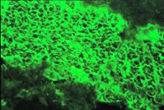
ANTIBODIES IN COELIAC DISEASE
IgA class
Endomysial antibodies
Detected by indirect immunofluorescence
Tissue transglutaminase (tTG)
Autoantigen recognized by endomysial antibodies
tTG cross-links glutamine residues
Produces neo-antigens from gliadin
Measured by ELISA
High specificity (>95%) & sensitivity in diagnosis
Useful in monitoring response to treatment

Slide 33
Burgin-Wolf et al – Sc J Gastro 2002

Slide 35
The Coeliac Iceberg
Lymphoma
Nutritional deficiencies
DH
Villous atrophy
Subtle histology
Antibodies
Complicated
Clinically active
Subclinical
Latent / potential

Slide 36
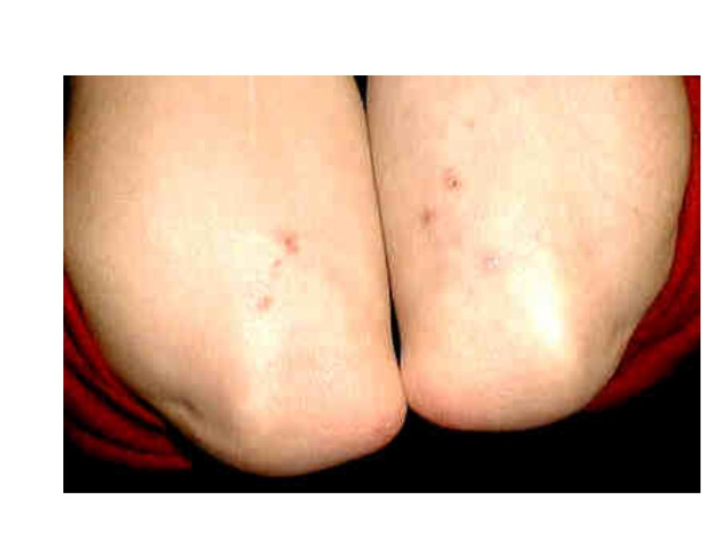
DERMATITIS HERPETIFORMIS
Vesicular rash
intense pruritus
blisters rarely present
esp. arms & shoulders
Skin biopsy
granular IgA deposits
Associated villous atrophy and gluten-sensitivity

Slide 37
COELIAC DISEASE: SCREENING POPULATIONS
Groups with prevalence between 1 and 5%:
Diabetes (Type I)
Thyroid disease
Anaemic blood donors
Irritable Bowel Syndrome
Osteoporosis
In general population, prevalence may be ~1%.

Slide 38
COELIAC DISEASE = GLUTEN SENSITIVE ENTEROPATHY
GLUTEN
Fraction of cereals that binds (glues)
Proteins found in wheat, barley, rye
A-gliadin (wheat), hordein (barley), secalin (rye)
Specific polypeptides rich in Q and P
Shan et al Science 2002
LQLQPFPQPQLPYPQPQLPYPQPQLPYPQPQPF
33-mer, residues 57 – 89 of α2-gliadin
stable in gastric, pancreatic & intestinal proteases
reacts with tTG
stimulates HLA- restricted intestinal T cell clones from coeliacs

Slide 39
COELIAC DISEASE = GLUTEN SENSITIVE ENTEROPATHY
SENSITIVE
Immunological reaction
tissue transglutaminases and neo-antigen formation
activated HLA-restricted T-lymphocytes
Genetic predisposition to immune response ...

Slide 40
COELIAC DISEASE: FAMILY STUDIES
Risk in first degree relatives approximately 10 - 12%.
Monozygotic twins: concordance 70%
Note the need to confirm monozygosity
& to look for asymptomatic disease

Slide 41
COELIAC DISEASE: GENETICS & HLA
HLA associations:
Class I: HLA-A1, HLA-B8
Class II:
HLA-DR3
HLA-DQ2 (DQA1* 0501, DQB1*0201 alleles)
95% of Northern European coeliac patients
20% non-coeliac controls
In HLA-matched sibs concordance for coeliac disease ~ 30%.
Everyone eats gluten!
Other gene(s) must contribute to the inheritability ...

Slide 42
COELIAC DISEASE = GLUTEN SENSITIVE ENTEROPATHY
ENTEROPATHY
Inflammatory damage
Cell death (apoptosis)
Histological changes
Enterocyte apoptosis (villous atrophy)
Stimulated regeneration (hyperplastic crypts)
Functional changes leading to malabsorption of nutrients

Slide 43
In coeliac disease these are environmental toxins!

Slide 44
COELIAC DISEASE: PRINCIPLES OF TREATMENT
!!!! NO WHEAT, BARLEY, RYE !!!!
Gluten-free diet
(some pts may also be symptomatic with oats)
Maintain adequate nutrition
Gluten-free products on prescription
Nutritional supplements
(energy sources, Fe, Ca, vitamin D, folate, etc.)
Prevent complications
The Coeliac UK society provides patient support
List of gluten-free products – updated regularly

Slide 45
COELIAC DISEASE: COMPLICATIONS
Nutrient malabsorption & impaired nutritional status
(Slow growth, anaemia, neurological disorders, infertility)
Small bowel malignancy
Lymphoma
Enteropathy-associated T-cell lymphoma (EATL)
Adenocarcinoma
(and ? other cancers)
Osteoporosis / osteopenia

Slide 46
Mrs. C.M. – a Diagnosis of Coeliac Disease
Management of Mrs. C.M.
Gluten-free diet – helped by Dietitians
Iron and multivitamin supplementation
DXA scan showed osteopenia
Treated with calcium & vitamin D
Clinical response
Weight increase: 8 kg in 9 months
Hb increase: 11.4g/l in 9 months
Less tired “100 times better”

Slide 47
Objectives:
To recognise the clinical presentation of malabsorption
To understand the disease mechanisms leading to malabsorption
To learn about the clinical importance, presentation, complications and treatment of coeliac disease

