Slide 1
GE Alimentary System
Review of intestinal cells and development
Friday 7 December 2012
Professor Julian Walters
Hammersmith Campus

Slide 2
Intestinal cells
To review the structure of the small and large intestine
To review the types of cells found in the intestinal mucosa
To appreciate mechanisms of cell turnover and differentiation

Slide 3
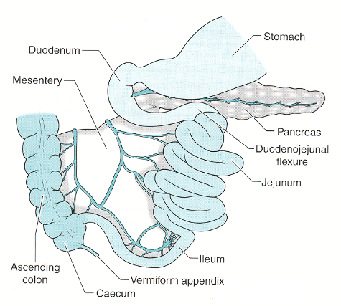
Duodenum, Jejunum and Ileum
Main Functions:
Digestion, absorption, motility
Duodenum 25cm
Jejunum ~2.5m
Ileum ~3.75m
Fan-shaped mesentery throws intestine into folds and supports the blood supply.

Slide 4
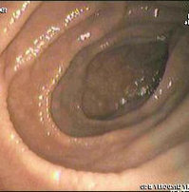
Endoscopic appearances of duodenum
Folds of Kerckring

Slide 5
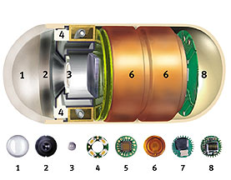
Wireless Capsule Enteroscopy
Since 2001
Disposable capsule
2 frames per second
8 hour battery life
Recording system worn externally
Images analysed at a later time

Slide 7
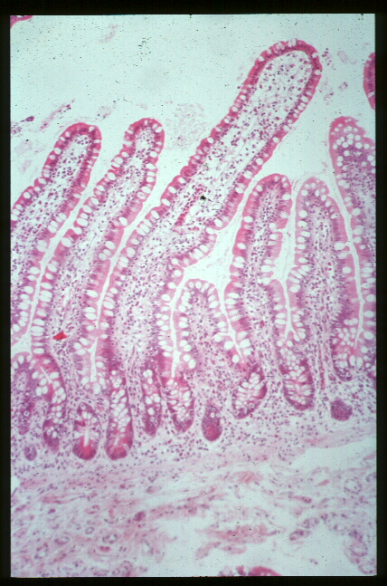
THE INTESTINAL MUCOSA
Villus
Crypt
Muscularis mucosa
Submucosa

Slide 8
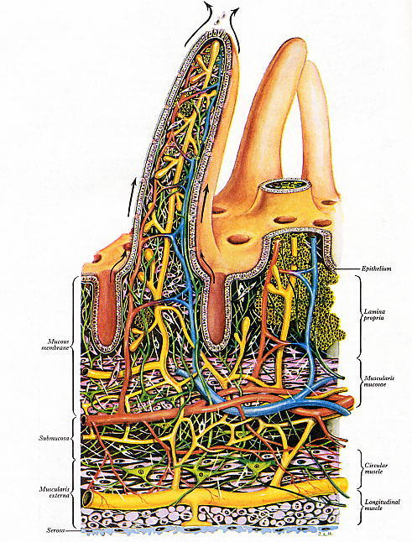
Tissue Organisation of Small Intestine

Slide 9
THE INTESTINAL MUCOSA
Amplification of surface area by villi

Slide 10
THE INTESTINAL MUCOSA
Further increase in surface area for absorption by microvilli (brush-border membrane) of enterocytes

Slide 11
INTESTINAL SURFACE AREA
Type of Surface | Amplification Factor | Surface Area (cm²)
Mucosal cylinder | 1 | 3,300
Folds of Kerckring | 3 | 10,000
Villi | 10 | 100,000
Microvilli | 20 | 2,000,000
Total surface area = 200 m²
Double tennis court = 175 m²
Notes:
(AGA 25-9)

Slide 12
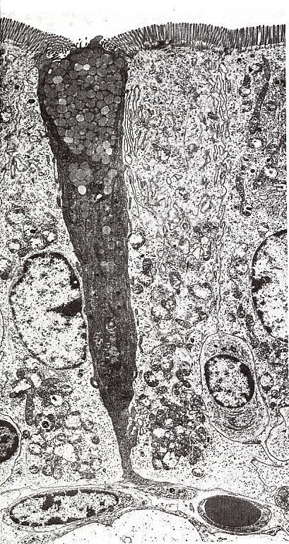
EM of Intestine
Note:
Microvilli
ER in absorptive cells
Goblet cell with mucus vesicles
Nucleus
Capillary with erythrocyte

Slide 13
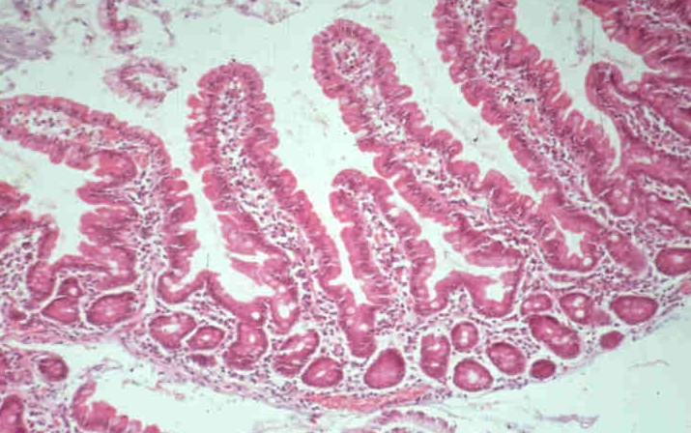
INTESTINAL STRUCTURE
Villus tip enterocytes express the genes that are necessary for active transport

Slide 14
Digestive and transport properties of villus and crypt regions differ
 | Brush border hydrolases | Nutrient transport | Net water & ion transport | Permeability
Villus | Abundant | High | Absorption | Low
Crypt | Sparse | Low | Secretion | High
Notes:
(AGA 25-11)

Slide 15
Cells of the Intestinal Mucosa
Enterocytes
Goblet cells
M-cells
Enteroendocrine cells
Paneth cells
Intra-epithelial lymphocytes (T)
Lamina propria lymphocytes (B)
Dendritic cells
Monocytes
Myofibroblasts
Vascular & lymphatic cells
Neuronal cells etc.
Stem cells

Slide 16
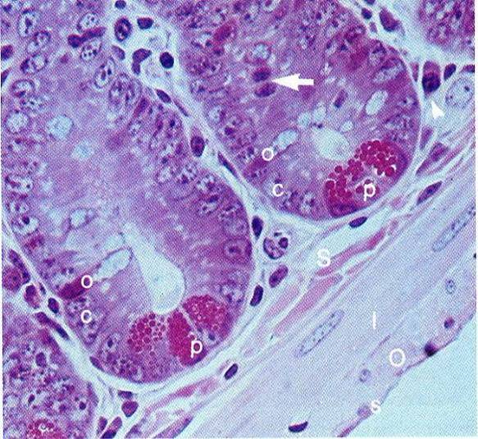
Base of Small Intestinal Crypt
Stem cell in mitosis
Paneth cell

Slide 17
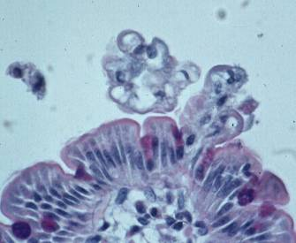
Epithelial Cells Are Continually Renewed
Cell death (apoptosis) and extrusion
Turnover time = 48 – 72 h
Dividing cells
Stem cells
Number of cells lost =
number of cells formed
Notes:
(AGA 25-10)

Slide 18
The Brush-border & Basolateral domains of enterocytes are structurally & functionally distinct
Glycocalyx
Complex cytoskeleton
Specific exchangers & channels
Apical brush-border membrane
Basolateral membrane
Simple cytoskeleton
Different exchangers & ion-pumps
Notes:
(AGA 25-12)

Slide 19
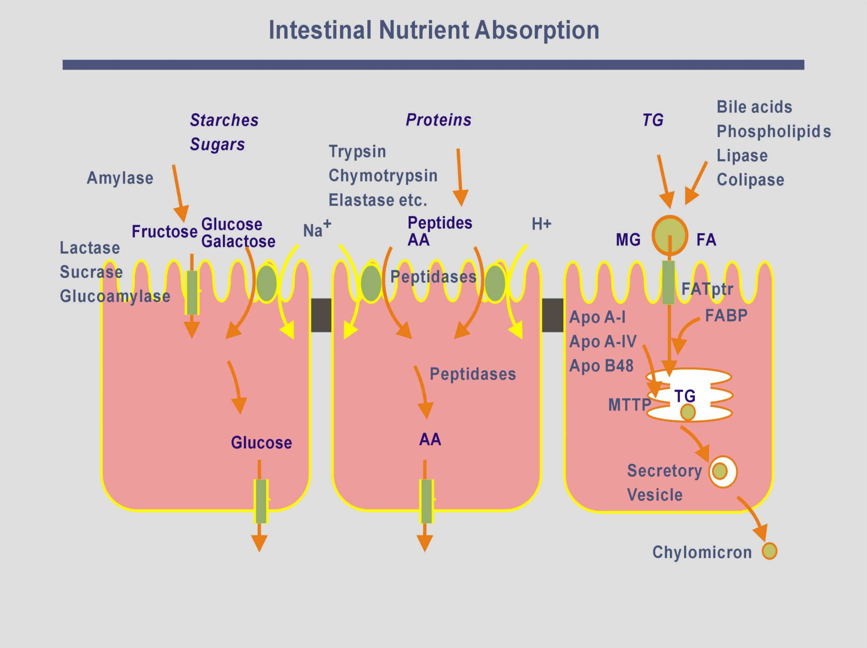
Notes:
Transport pathways in small intestinal enterocytes (CHO, proteins, lipids)

Slide 20
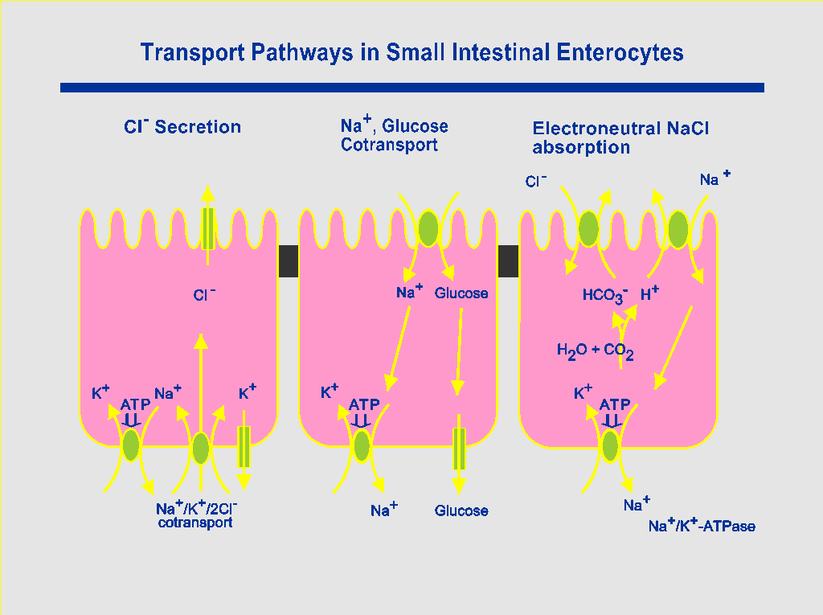
Notes:
Transport pathways in small intestinal enterocytes (NaCl)

Slide 21
Types of Transport in the Intestine

Slide 22
Secondary Active Transport – Cotransport
Ca²⁺Na⁺
Na⁺
Glucose
Na⁺
AA
Out
H⁺
AA
In
K⁺
Na⁺ / glucose cotransporter (SGLT1)
Na⁺ / amino-acid cotransporter
(+ many others)
H⁺ / amino-acid cotransporter
Co-transport = Na⁺ (or H⁺) -linked, (coupled) transport
Uses existing gradients

Slide 23
Gene Expression in the Intestine
Differences in
Crypt and villus
Regions of intestine
Duodenum / jejunum / ileum

Slide 24
Rates of Absorption of Different Nutrients Along the Small Intestine
Duodenum
Jejunum
Ileum
Carbohydrates
Protein & Lipids
Iron & calcium
Bile salts
Cobalamin (B12)
Notes:
(AGA 12-45)

Slide 25
Expression Profiling using cDNA Microarrays
David J Duggan et al. Nature Genetics 21, 10 – 14 (1999)

Slide 26
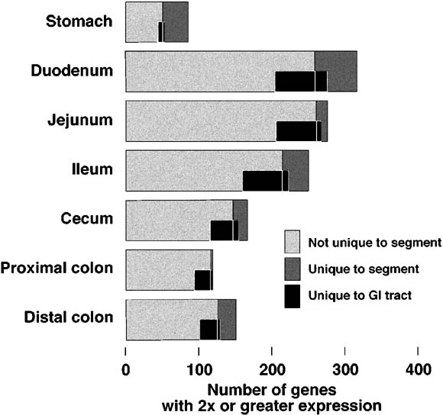
Microarray Study of Mice Gastrointestinal Genes
Numbers of genes highly expressed in specific segments of the adult mouse GI tract.
Bates et al. Gastroenterology 2002

Slide 27
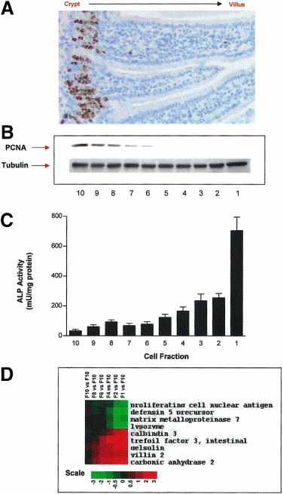
Microarray Study of Mice Intestinal Genes Expressed in Crypt and Villous Cells
Gene expression profiling of intestinal epithelial cell maturation along the crypt-villus axis
Mariadason et al. Gastroenterology 2005
14,685 unique genes
1113 differentially expressed genes
Changes demonstrated in genes for:
cell-cycle
RNA processing
cytoskeleton
Transport
Wnt pathway
(Myc ↓, MAD ↑, MAX↑ etc.)

Slide 28
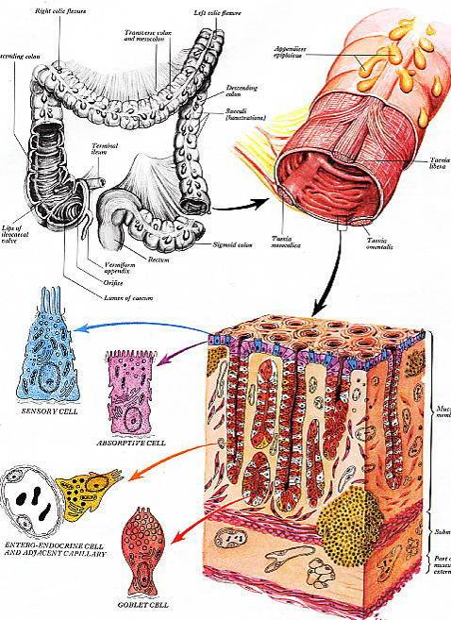
Colonic structure

Slide 29
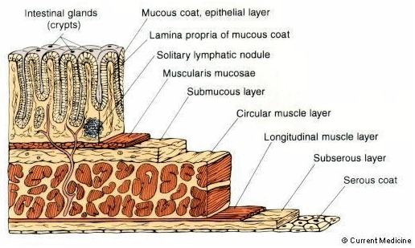
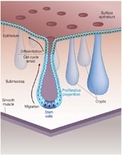
Large intestine epithelium

Slide 30
Colonic cells

Slide 31
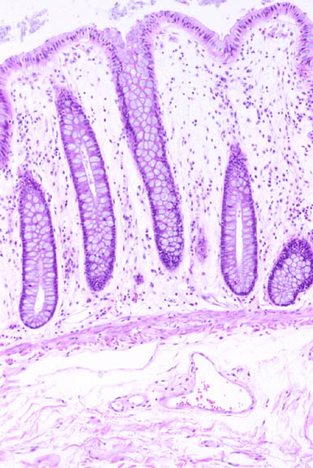
Colon histology
No villi
Deep Crypts
Many goblet cells

Slide 32
Regulation of Intestinal Cell Growth
Changes with diet
Development
Weaning
Repair after injury
Ischaemia
Inflammation
Radiation
Chemotherapy
Adaptation following surgery

Slide 33
Regulation of Intestinal Cell Growth
Endocrine factors
Epidermal Growth Factor (EGF)
Glucagon-like peptide 2 (GLP2)
etc.
Paracrine factors
Wnt pathway
Hedgehog pathway
BMP pathway
etc.

Slide 34
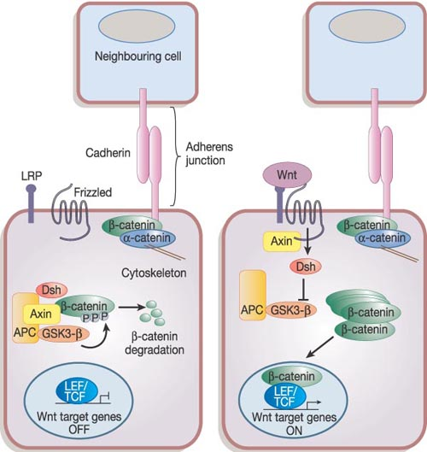
Wnt
Reya & Clevers. Wnt signalling in stem cells and cancer. Nature 2005; 434, 843-850
Canonical Wnt signalling pathway

Slide 35
APC, β-Catenin, Wnt, SOX9, CDX1, CDX2
APC targets β-Catenin for degradation
β-Catenin/TCF functions as transcription factor
Loss of APC increases Wnt pathway activity
Increased Wnt pathway activity in colorectal and other GI cancer
SOX9
important intestinal crypt transcription factor
CDX1 & CDX2
Regulate many genes expressed in intestine

Slide 36
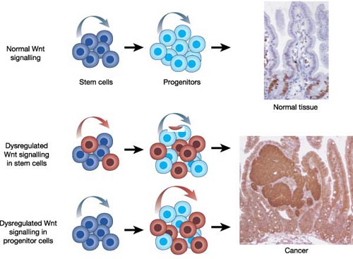
Wnt & Colorectal Cancer
Reya & Clevers. Wnt signalling in stem cells and cancer. Nature 2005; 434, 843-850
Activation of Wnt cascade in CRC
(mutations in APC or other genes in pathway)
Excess unregulated proliferation

Slide 37
Hedgehog targets
Hedgehog
(Shh, Ihh)
Patched receptor
Cyclopamine
Smo Gli
Many genes

Slide 38
Hedgehog pathway
Activation of Hedgehog pathway in many tumours
Digestive tract (increased SHH / IHH expression)
oesophageal
stomach
pancreatic
biliary
(not colonic)
Berman et al. Nature 2003
Thayer et al. Nature 2003
Interaction of the Hedgehog, Wnt and BMP4 systems
IHH in differentiated colonocytes
downregulation of Tcf4 & β-catenin
Van der Brink et al. Nat Genet 2004

Slide 39
Bone morphogenetic proteins
Bone morphogenetic proteins
(BMP2, BMP4)
Noggin
BMPRIa / BMPRIb + BMPRII
PTEN
Smad
(1,4,5,8)
PI3K
Akt
β-catenin
Many genes

Slide 40
Bone Morphogenetic Proteins
Part of TGF-β family
BMP2 in colonocytes
BMP receptors act via Smad4 and PTEN
Mutations in BMPR1A, Smad4 and PTEN found in juvenile intestinal polyposis syndromes (not FAP or Peutz-Jegher's syndrome)
BMPs control duplication of stem cells (prevent crypt fission)
Wnt required for stem cell activation and self-renewal
He et al. Nat Genet 2004

Slide 41
Summary
The structure of the small and large intestine
The types of cells found in the intestinal mucosa
Structure and functional correlation
Regional and crypt differences
An appreciation of the mechanisms of cell turnover and differentiation

