Slide 1
Graduate Entry
Tuesday 4 December 2012
Introduction to the alimentary system
The burden of GI diseases
Professor Julian Walters
Gastroenterology

Slide 2
Overview
The organs of the alimentary tract
Symptoms and signs
What are the main diseases of the GI tract and liver
The economic burden of GI and liver diseases

Slide 3
Organs of the Alimentary System
Mouth and Oesophagus
Stomach
Duodenum
Liver
Biliary system
Pancreas
Small intestine
  duodenum, jejunum & ileum
Large intestine
  colon, rectum & anus

Slide 4
Functions of the Alimentary System
Digestion of food
Absorption of nutrients
Motility from mouth to anus
Barrier
Immunological
Endocrine
Metabolic

Slide 5
GI tract
History
Examination

Slide 6
Symptoms of Digestive Diseases
General
Upper GI Tract
Liver & Biliary
Mid GI Tract & Pancreas
Lower GI Tract

Slide 7
Symptoms of Digestive Diseases
General
  Anorexia
  Weight loss
  Anaemia
Upper GI Tract
Liver & Biliary
Mid GI Tract & Pancreas
Lower GI Tract

Slide 8
Symptoms of Digestive Diseases
General
Upper GI Tract
  Haematemesis and Melaena
  Nausea & vomiting
  Dysphagia, odynophagia
  Heartburn, acid regurgitation & belching
  Chest pain
  Epigastric pain
Liver & Biliary
Mid GI Tract & Pancreas
Lower GI Tract

Slide 9
Symptoms of Digestive Diseases
General
Upper GI Tract
Liver & Biliary
  RUQ pain
  Biliary Colic
  Jaundice
  Dark Urine / pale stool
  Abdominal distension (Ascites)
Mid GI Tract & Pancreas
Lower GI Tract

Slide 10
Symptoms of Digestive Diseases
General
Upper GI Tract
Liver & Biliary
Mid GI Tract & Pancreas
  Abdominal pain
  Diarrhoea / steatorrhoea
  Distension
Lower GI Tract

Slide 11
Symptoms of Digestive Diseases
General
Upper GI Tract
Liver & Biliary
Mid GI Tract & Pancreas
Lower GI Tract
  Abdominal pain
  Bleeding
  Constipation
  Diarrhoea
  Incontinence

Slide 12
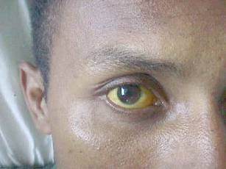
Signs of Digestive Diseases
General
  Cachexia
  Obesity
  Lymphadenopathy
  Anaemia
  Jaundice
  Stigmata of chronic liver disease
Hands
Abdomen
Anus & Rectum

Slide 13

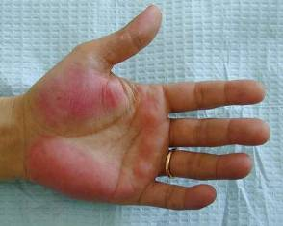
Signs of Digestive Diseases
General
Hands
  Koilonychia
  Leuconychia
  Clubbing
  Palmar erythema
  Dupytrens contracture
  Tremor
  Tachycardia
Abdomen
Anus & Rectum

Slide 14
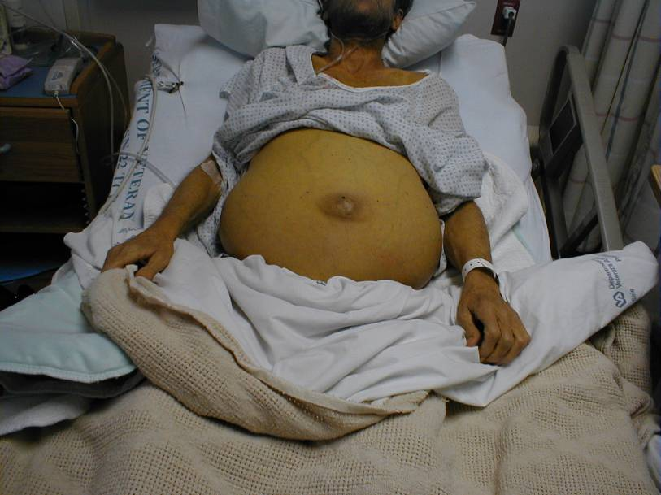
Signs of Digestive Diseases
General
Hands
Abdomen
  Organ enlargement
  Mass
  Tenderness
  Distension
Anus & Rectum

Slide 15
Signs of Digestive Diseases
General
Hands
Abdomen
Anus & Rectum
  Haemorrhoids
  Fistula
  Fissure
  Rectal masses
  Proctitis

Slide 16
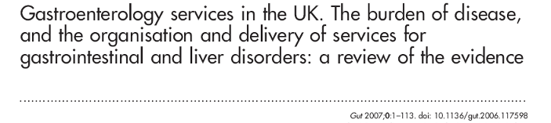
Williams, Roberts, Ali, et al. for the BSG.
Gut 2007

Slide 17
General statistics
5% of British adults suffer from long-standing illness of the digestive tract

Slide 18
General statistics
Digestive Diseases in UK are responsible for:
  12% of all deaths - totalling 64,061 in 2002
  1 in 8 of all admissions to general hospitals
  1 in 4 main operations within general hospitals

Slide 19
Contrasting Patterns of Major Diseases
Worldwide
  Malnutrition
  Enteric infections
  Viral hepatitis and consequences
  Gastric cancer
UK
  Dyspepsia / indigestion / abnormal bowels
  Liver disease due to alcohol and obesity
  Colon cancer

Slide 20
Burden of Disease
Prevalence / Incidence
Morbidity
  Reduced quality of life
  Inability to work
Mortality
Health cost
  Individual
  Taxpayer

Slide 21
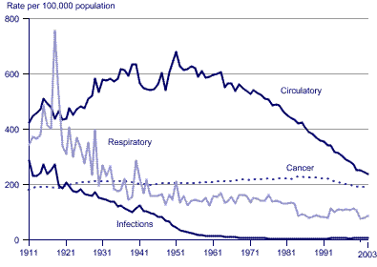
Mortality Rates: England & Wales

Slide 22
Liver Deaths:
England & Wales

Slide 23
Age-standardised MR from CLD in Different Countries
Age Standardised Mortality from Chronic Liver Disease. Selected countries. Latest available year
70
60
50
40
Rate per 100,000 population
30
20
10
0
Norway
Australia
Israel
Sweden
Canada
Japan
UK: E&W
USA
Spain
Poland
Finland
France
Latvia
Denmark
Portugal
Germany
Austria
Lithuania
Georgia
Estonia
Slovakia
Croatia
Russia
Slovenia
Azerbaijan
Romania
Hungary
New Zealand
Netherlands
Switzerland
Czech Republic
Rep. Korea
Kyrgyzstan
Source: WHO, EuroStat
Figures standardised to European Standard Population

Slide 24
Main Causes of Chronic Liver Disease in UK
4 - 6% of UK population have abnormal LFTs:
- Chronic hepatitis B (0.5 – 2.0%)
- Chronic hepatitis C (0.4 – 1.0%)
Increasing percentages with
- Alcohol related steatohepatitis
- Obesity related steatohepatitis (NAFLD)
Complications of cirrhosis are the major cause of death in alcoholics

Slide 25
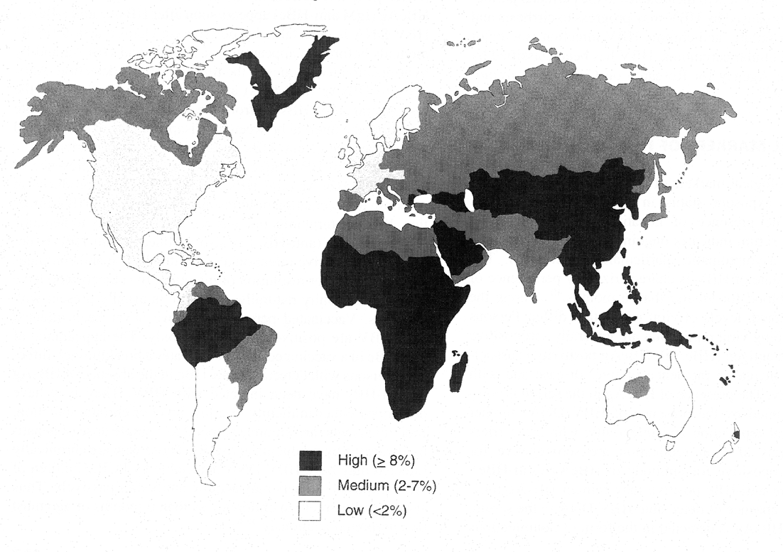
HBV Epidemiology
350 Million chronically infected
1 Million deaths per year

Slide 26
Outcome of HBV Infection
Infection
<1%
10%
90%
10%
Fulminant
Infection
Self limiting Infection
Persistent Infection
30%
70%
Cirrhosis +/- HCC
Asymptomatic Carriage

Slide 27
HCV Epidemiology
Prevalence
Western Europe – 1.4 %
US – 2 %
Japan - 2 %
Romania – 4.7%
Egypt – 20%
Reprinted from Cohen J. Science. 1999;285:26.

Slide 28
Outcome of HCV Infection
Infection
20%
80%
Self limiting infection
Persistent infection
20%
80%
Progressive
Non-Progressive

Slide 29
Dyspepsia
Common reason for 1º / 2º care consultations
High NHS costs
Effects on Quality of Life
Risk of complications
40% of adults suffer with dyspepsia
2% consult their GP
£600,000,000 for endoscopies and drugs
£100,000,000 for OTC medications

Slide 30
Demographics of peptic ulcer, GORD & dyspepsia
70
Data from four separate studies
60
50
40
30
% adult population
20
10
0
Lifetime
Lifetime
Month
Week
Day
Lifetime
Week
Peptic ulcer
GORD
GORD
Dyspepsia
Jones RH, et al. Gut 1990; Jones R. Scand J Gastroenterol 1995;
Nebel OT, et al. Dig Dis 1976; Penston JG, et al. Aliment Pharmacol Ther 1996

Slide 31
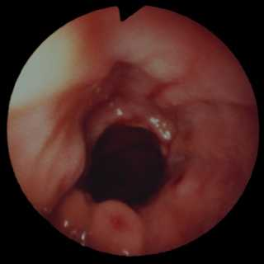
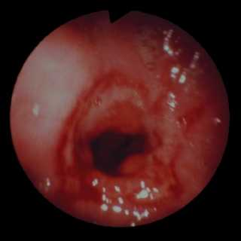
Gastro-oesophageal reflux disease (GORD)

Slide 32
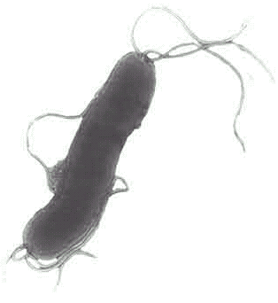
What is Helicobacter pylori?
Gram-negative, spiral bacterium
Colonises the gastric mucosa
Infection persists for life unless treated

Slide 33
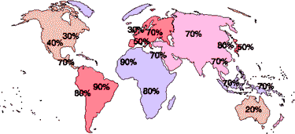
Epidemiology
H. pylori is found in 50% of the world’s population.
Geographic distribution is closely linked to socio-economic development.
http://www.helico.com/

Slide 34
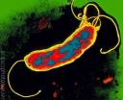
Helicobacter Related Disease
Chronic gastritis
85% - no long term effects
14% - peptic ulceration
1% gastric adenocarcinoma or lymphoma

Slide 35
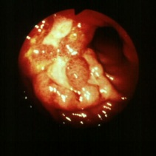
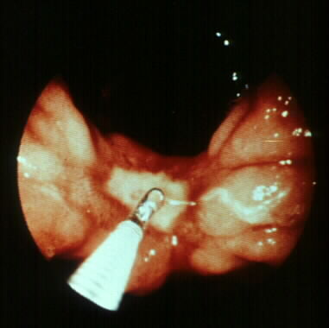
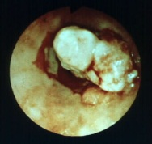
Gastric ulcer & cancers
Notes:
1

Slide 36
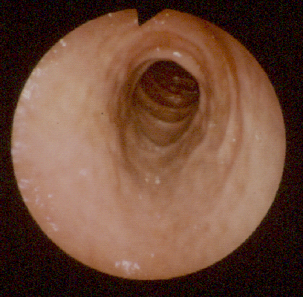
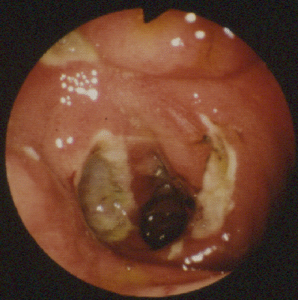
Duodenal ulcer
Notes:
1

Slide 37
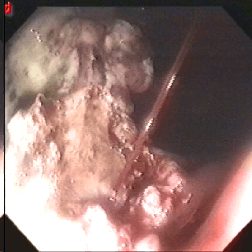
Bleeding ulcer
Peptic ulceration affects up to 10% population
Estimated to cause up to
  16,500 deaths each year in USA
  2,000 deaths each year in UK
NSAIDS & H. pylori factors

Slide 38
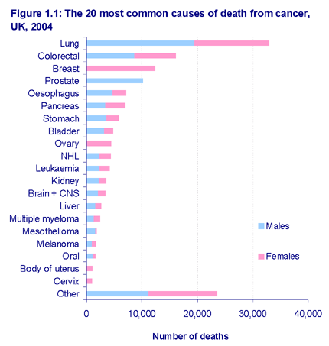
UK Mortality from Cancer in the GI Tract

Slide 39
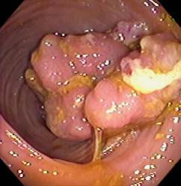
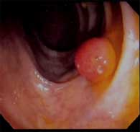
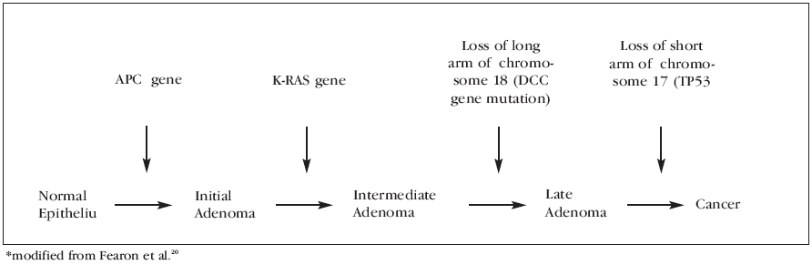
Colorectal Neoplasia

Slide 40
Colorectal Neoplasia
Lifetime incidence
  Polyps 25%
  Carcinoma ~6%
Genetic & dietary factors
Prevention by colonoscopic screening
Surgery for cancer
Prognosis excellent at early stages (5 year survival)
  Duke’s A 95%
  Duke’s B 85%
  Duke’s C 50%
  Duke’s D 15%

Slide 41
Gastrointestinal Cancers
Liver cancer
  most is metastatic
  primary liver cancer (hepatocellular and cholangio carcinomas) 2000 cases pa
  primary liver cell cancer (HCC) higher in cirrhosis
  can be detected at an early stage by ultrasound scanning
  50% 5 year survival
  cholangiocarcinoma increased 20 fold in last 20yrs; no treatment.

Slide 42
Cholangiocarcinoma: An increasing problem?
ASMR of Intrahepatic Cholangiocarcinoma in males,
England and Wales, 1968-1998

Slide 43
Gastrointestinal Cancers
Pancreatic cancer
  95% adenocarcinoma of pancreatic duct
  difficult to diagnose early
  one of the poorest survival rates (2% at 5y)

Slide 44
Inflammatory Conditions of the Intestine
Ulcerative colitis & Crohn's disease (IBD)
  1 in 400 people in the UK
  8,500 new cases are diagnosed every year
  Genetic effects on intestinal immune response
  Morbidity & increased mortality
    Sepsis, drugs and surgery
Coeliac Disease
  1% of UK population
  Genetic sensitivity
  Gluten-free diet

Slide 45
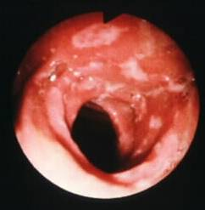
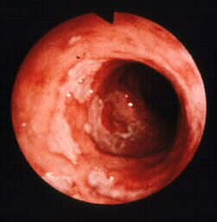
Crohn’s disease
Terminal Ileum
Colon
Notes:
1

Slide 46
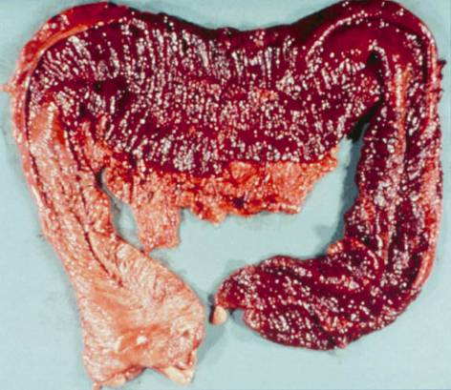
Ulcerative colitis; toxic megacolon

Slide 47
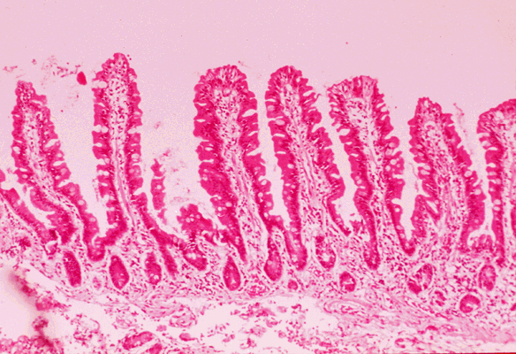
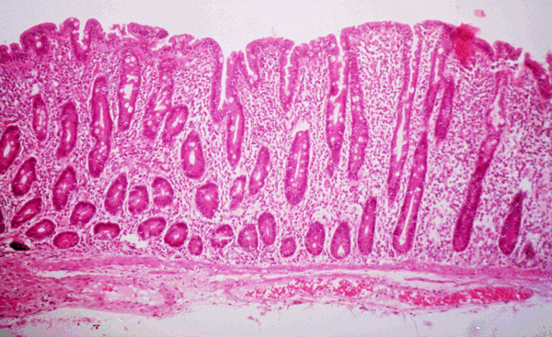
Duodenal Histology in Coeliac disease
Normal
Coeliac disease
Notes:
1

Slide 48
Biliary Diseases and Conditions
Gallstones
  About one in ten people in Britain
  especially women, overweight, middle aged or over
  Biliary colic
  Cholecystitis
  Obstructive jaundice
  Gallbladder carcinoma
  Acute pancreatitis

Slide 49
Pancreatic Diseases
Acute pancreatitis
  Mild to life-threatening
  Blockage of pancreatic duct
  Back-up of pancreatic enzymes causing severe inflammation
  Ethanol & gallstones in 80%
Chronic pancreatitis
  Permanent damage to pancreas
  Alcohol excess main cause
  Can greatly impair Quality of Life

Slide 50
Intestinal Diseases and Conditions
An estimated 200 million people around the world, on any given day, suffer from diarrhoea
Water and Food-borne infections
    Viruses
    Bacteria
    Parasites
    Clean water supply essential
    Enormous global indirect costs

Slide 51
Large Bowel Diseases & Conditions
Irritable bowel syndrome (IBS)
  IBS is very common
  1 in 3 of population at one time or another
  1 in 10 people suffer symptoms bad enough to go to a doctor
  Constipation-predominant
  Diarrhoea-predominant
  Bloating / pain / mixed

Slide 52
Anal Diseases & Conditions
Faecal incontinence (soiling) may affect 1 in 20 people
About half the population has haemorrhoids by age 50
Over half the over 70's population of the UK have diverticula of the large intestine

Slide 53
Economic Burden of GI Disease
Wellcome Trust PRISM Project 1995/6
Summary of costs
  Mortality & lost years
  Absence from work
  Morbidity
  NHS prescription costs

Slide 54
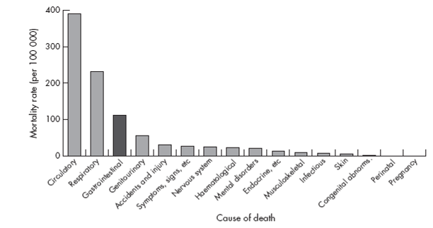
Population based mortality rates for major disease groupings, in
England and Wales, 2000: people of all ages.
Source: ONS, 2001.

Slide 55
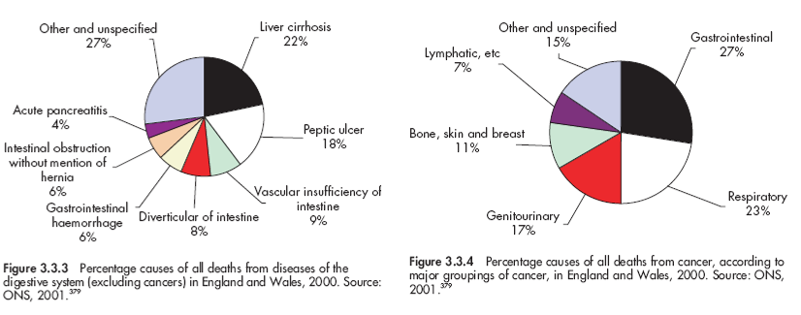
Mortality from Digestive Diseases

Slide 56
Economic Burden of GI Disease in UK
(BSG PRISM study – Wellcome Trust 1995/6; updated to 2004)
Loss of productive work
  dying early £3.23 billion
  long-term absence £1.05 billion
  short-term absence £2.90 billion
  Total = £7.18 billion
NHS costs
  in-patients £1.40 billion
  primary care £0.14 billion
  Drugs £0.80 billion
  Total = £2.34 billion
  + out-patients + community services
  Total > £10 billion

Slide 57
Cost of NHS Prescriptions
Classes of drug (BNF)
  Antacids
  Antispasmodics
  Ulcer-healing
  Chronic diarrhoeal agents
  Laxatives
  Haemorrhoid treatment
  Stoma care
  Intestinal secretion drugs
In 2002, 60 million prescriptions for GI drugs
Total cost to NHS for drug alone was £802 million
  £596 million for ulcer-healing drugs
  £51 million for laxatives

Slide 58
Diseases of the Digestive Tract
Diverse group of conditions
Major impact on health
Significant economic burden
Significant impact on Quality of Life

