Slide 1
Graduate Entry
Intestinal absorption
7 December 2012
Julian RF Walters
Gastroenterology
Hammersmith Hospital
Imperial College London

Slide 2
Intestinal Absorption: Summary
To consolidate knowledge of the mechanisms of protein and lipid absorption
To review absorption of electrolytes and water
To appreciate mechanisms of absorption of certain other nutrients

Slide 3
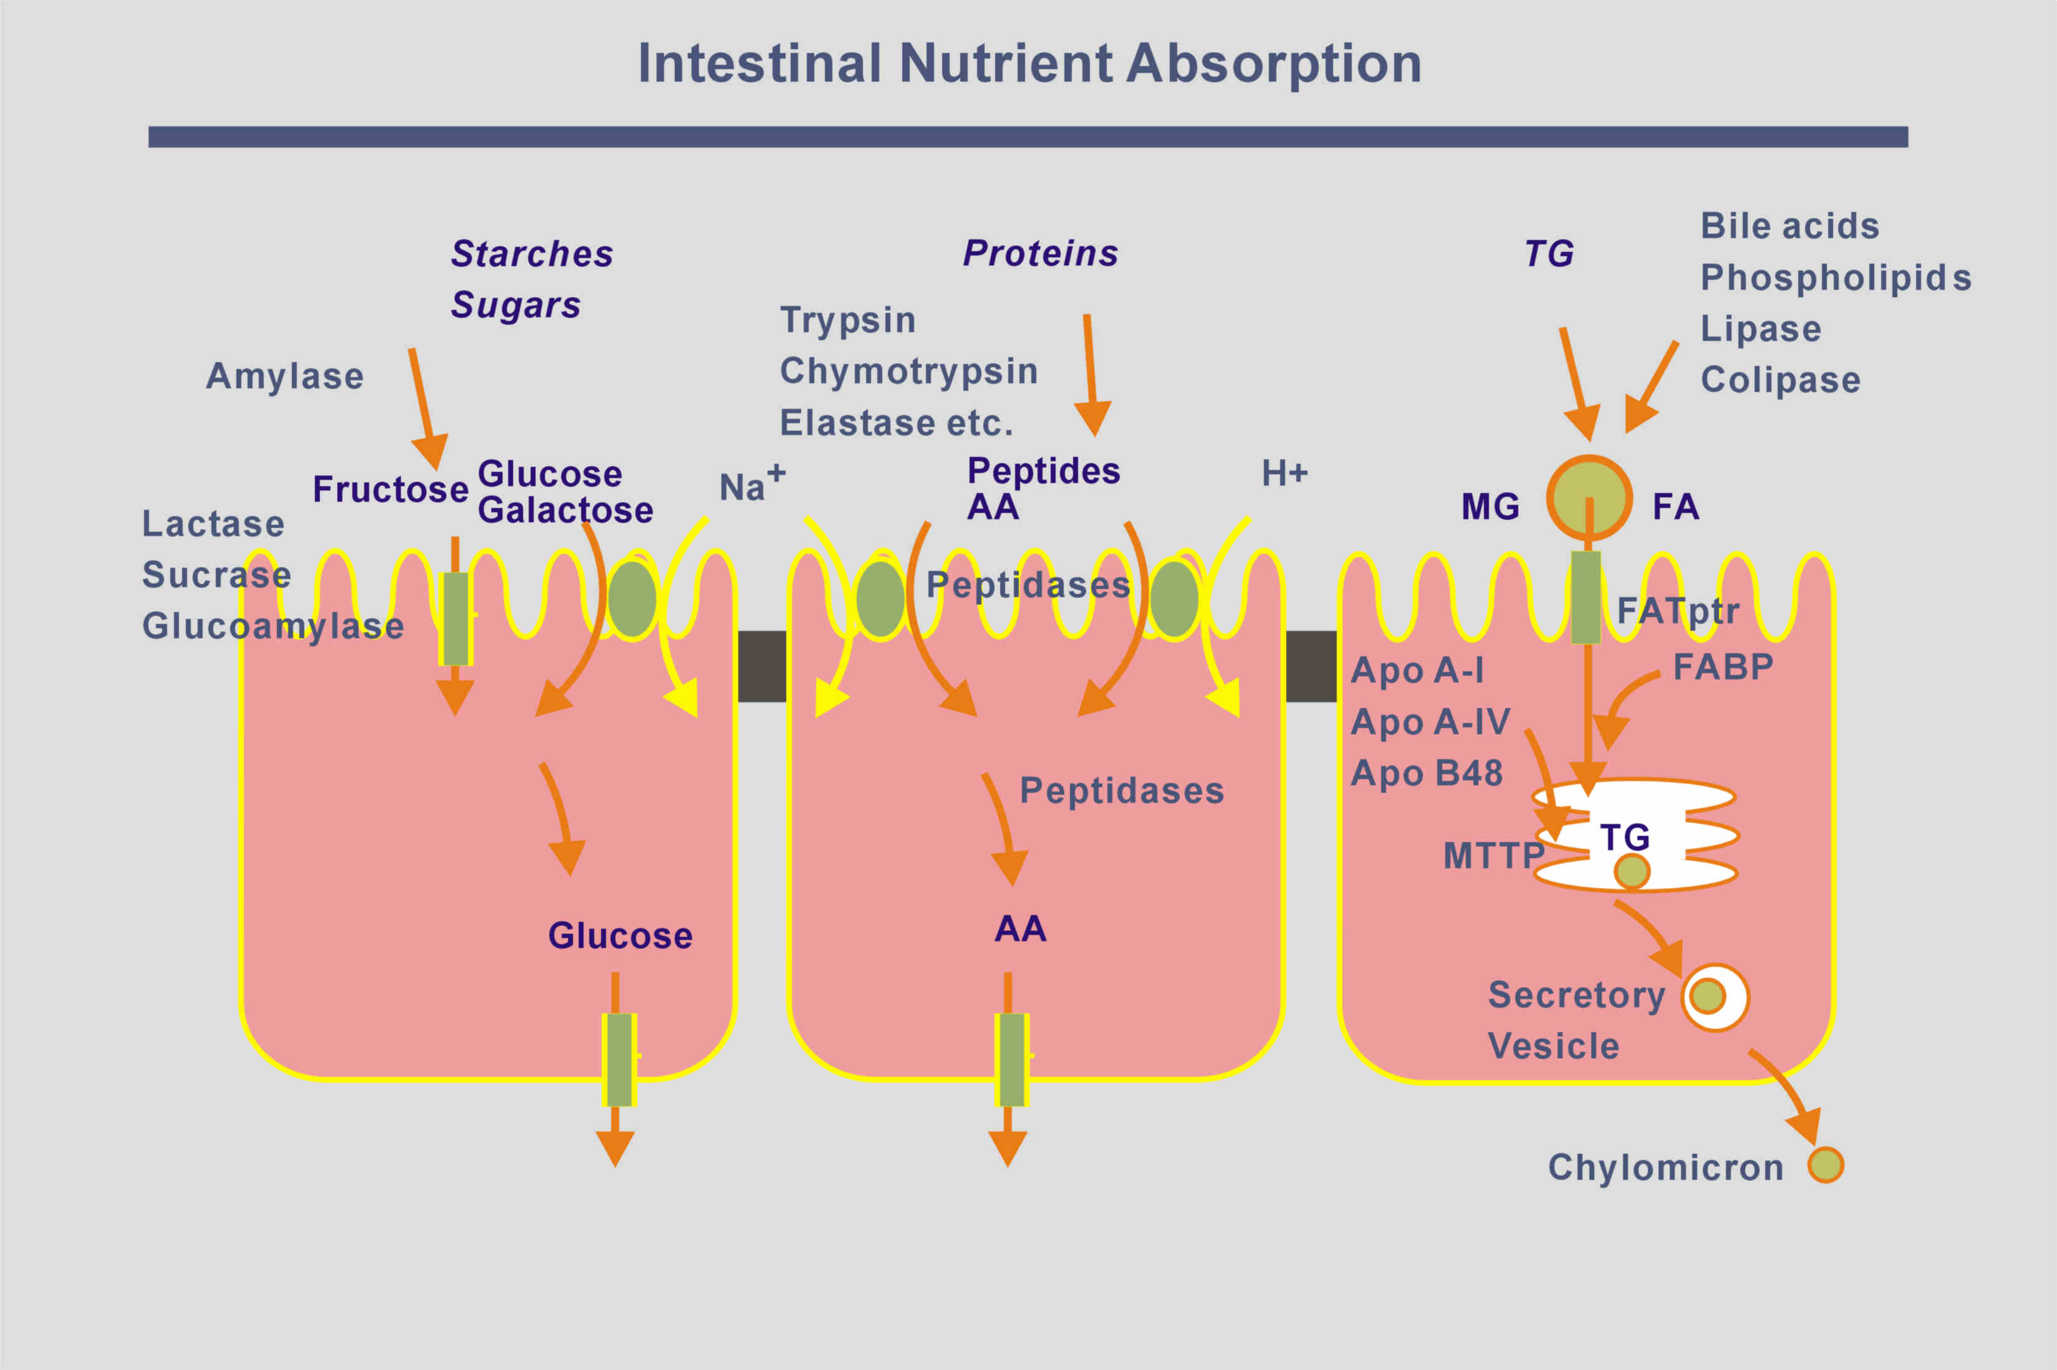
Notes:
Transport pathways in small intestinal enterocytes (CHO, proteins, lipids)

Slide 4
Electrolytes & Water in GI Tract
Secretion:
Saliva
Stomach
Bile
Pancreas
Proximal small intestinal crypts
Absorption:
Distal small intestinal villi
Large intestine
Intake + Secretion = Absorption + Faecal Output

Slide 5
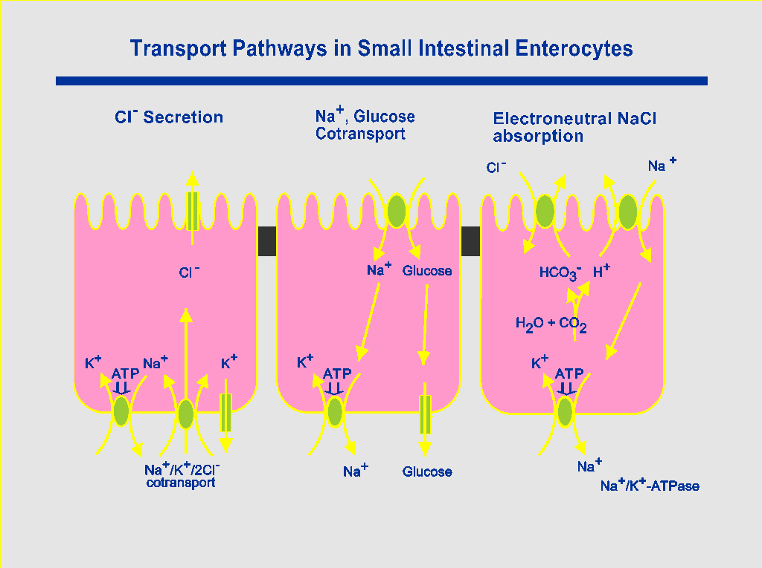
Notes:
Transport pathways in small intestinal enterocytes (NaCl)

Slide 6
Calcium Absorption by the Intestine
Absorption of calcium from dietary sources
Differing amounts of calcium in foods
Differing availability of calcium
Solubility in gastric acid
Greatest rates of absorption in duodenum & proximal jejunum
Specific genes expressed in this region
Regulation by the vitamin D hormonal system
1,25-dihydroxyvitamin D₃

Slide 7
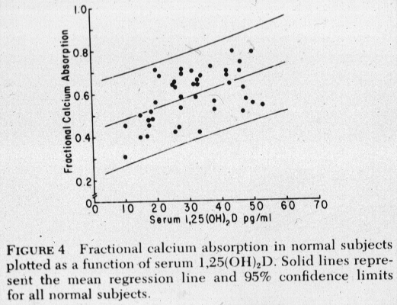
Human Calcium Absorption and 1,25-(OH)₂D₃
Gallagher et al JCI 1979

Slide 8
CALCIUM ABSORPTION BY THE INTESTINE
10⁻³ M
TRPV6
10⁻⁷ M
Calbindin
ADP
PMCA1
ATP
10⁻³ M

Slide 9
Rates of Absorption of Different Nutrients along the Small Intestine
Duodenum
Jejunum
Ileum
Carbohydrates
Protein & Lipids
Iron & calcium
Bile salts
Cobalamin (B12)
Notes:
(AGA 12-45)

Slide 10
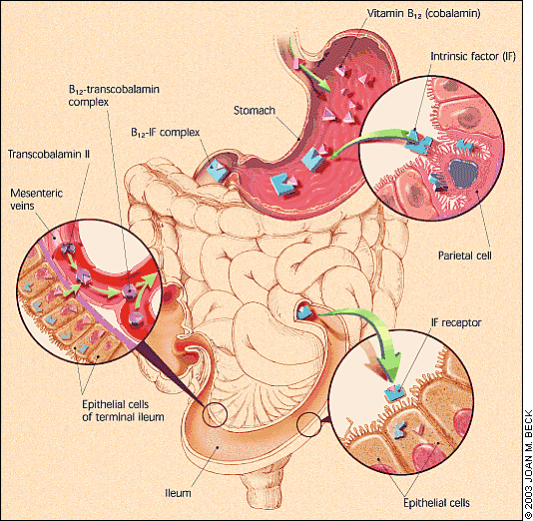
Vitamin B12 Absorption
B12 (cobalamins) only in animal products
Intrinsic factor from stomach
Absorption in terminal ileum

Slide 11
Malabsorption of Sugars – Lactose
Low lactase activity in the small intestinal brush-border membrane (hypolactasia) results in failure to digest lactose
Neonates all have high lactase
Lactase non-persistence is usual adult human phenotype
Lactase persistence occurs in most (but not all) Northern Europeans

Slide 12
Malabsorption of Sugars – Lactose
Lactose malabsorption in small intestine delivers lactose to the colon
Lactose breaks down in colon producing H₂, CO₂, lactate and other short chain fatty acids
Basis of lactose-H₂ breath test
Lactose intolerance is a clinical diagnosis made from history of symptoms after lactose (in malabsorbers)

Slide 13
Sugar Breath Tests
Lactose
Fructose / Sorbitol
Glucose
Lactulose
Principles:
Fasting breath H₂ < 20 ppm
Only produced by bacterial action on sugars
Sugar taken by mouth
Breath samples every 30 mins for 2-3 hours
Increase of 20 ppm significant

Slide 14
Lactose-hydrogen Breath Test for Lactase Deficiency
Lactase persistent Deficient
Breath H₂:
Low High
Small intestine:
Lactase
Present Not present
Glucose/galactose
Absorbed Not formed
Large intestine:
No lactose Lactose substrate for bacterial action
H₂ production
Oral lactose

Slide 15
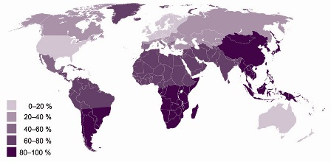
Prevalence of Lactase Non-Persistence in Adults

Slide 16
Mechanisms of Lactase Persistence / Non-persistence
Genetic basis
Protein active in childhood but not in adults
Polymorphisms in lactase gene
Heterozygote studies showed cis acting elements
Transcription factors regulating expression of lactase
Developmental switches
Polymorphism 14kb upstream associated with persistence/non-persistence in Finnish population
Enattah Nature 2002

Slide 17
Malabsorption of Sugars
Fructose and Sorbitol:
Abdominal pain and diarrhoea following fruit juices (especially in children) or diet/diabetic drinks
Small intestinal malabsorption of these monosaccharides results in metabolism in colon
Diagnosis from history and from breath H₂ excretion after ingestion of sugar

Slide 18
Sugar Maldigestion / Malabsorption
520 patients with functional dyspepsia
Lactose (25g), fructose (25g), sorbitol (5g)
Breath hydrogen and small bowel transit time measurements
Malabsorption of Lactose
25% N. Europeans
65-70% Greeks, Italians, Jews, Arabs
85% Asians, Africans
Malabsorption of Fructose and Sorbitol
40-65% overall
(Mishkin et al. Dig Dis Sci 1997)

Slide 19
Glucose-Hydrogen Breath Test for Small Intestinal Bacterial Overgrowth.
Normal SI bacterial overgrowth
Breath H₂
Low High
Small intestine
Bacterial counts
Low High
Glucose
Absorbed Some metabolised to H₂
Oral glucose

Slide 20
Causes of Small Intestinal Bacterial Overgrowth
Gastric surgery & achlorhydria
Jejunal diverticula
Intestinal blind loops after surgery (as in Crohn's)
Intestinal strictures (as in Crohn's)
Fistulae (as in Crohn's disease)
Impaired peristalsis (fibrosis, amyloid, myopathy, neuropathy)

Slide 21
Lactulose Hydrogen Breath Test
Lactulose not digested or absorbed by small intestine
Basis of use as laxative
Broken down by bacteria to give H₂
Normal colonic flora
Small intestinal flora in SIBO
Rise in breath hydrogen measures
SI transit time
SI bacterial overgrowth

Slide 22
Intestinal Absorption: Summary
To consolidate knowledge of the mechanisms of protein and lipid absorption
To review absorption of electrolytes and water
To appreciate mechanisms of absorption of certain other nutrients (Calcium and vitamin B12)
To review mechanisms of carbohydrate digestion
To appreciate genetic variation in nutrient absorption
To understand the basis for breath hydrogen tests

