Slide 1
Acute liver failure (ALF)
Dr Harry Antoniades
Lecturer & Honorary Consultant Hepatologist
Imperial College London

Slide 2
Definitions
Encephalopathy in a patient with NO previous liver disease

Slide 3
Aetiology
Cause
Viral hepatitis
Hepatitis A, B, D E, CMV, HSV, Seronegative hepatitis
Drug related
Paracetamol
Anti tuberculous drugs,
lipid therapies
Recreational drugs Idiosyncratic reactions Anticonvulsants, NSAID,

Slide 4
Aetiology
Toxins
Carbon tetrachloride, Amanita phalloides
Vascular events
Ischaemia VOD, Budd-Chiari
Other
Acute fatty liver of pregnancy, liver rupture, Heatstroke,
Wilson’s disease, lymphoma, carcinoma
Trauma

Slide 5
Aetiology: geographical variations

Slide 6
Causes of drug-induced liver injury

Slide 7
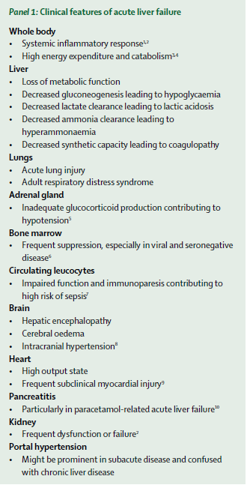
Clinical syndrome
Multisystem disorder
Typical stigmata of liver disease are very unusual (more common in subacute ALF)

Slide 8
Acute liver injury
-toxic
- viral
EXTRA
HEPATIC
HEPATIC
HEPATIC
COMPARTMENT
HEPATOCYTE DEATH
& REGENERATION
INNATE IMMUNE
RESPONSES
METABOLIC
SYSTEMIC
COMPARTMENT
MICROCIRUCLATORY
DYSFUNCTION
SIRS RESPONSES
HYPERAMMONAEMIA
HYPERLACTATAEMIA
END ORGAN FAILURE
IMMUNOSUPPRESSION/
INFECTION
MUTLIPLE ORGAN DYSFUNCTION
SYNDROME
ENCEPHALOPATHY/
INTRACRANIAL HYPERTENSION
Notes:
A simplistic appraoch to biomarkers in liver inflammatory disorders is to consider it in 3 components: the hepatic, systemic (ciruclatory) and end organ compartmentds and an understanding of the relationship between events in the liver, it’s effects on the systemic “circulatory” compartment and the sequelae of end organ dysfunction.
An inherent problem with using circulating biomarkers here is that we are making assumptions that what we quantify in the circulation trully reflect intrahepatic events
So, when looking at the available biomarkers in ALF:
We have biomarkers of hepatocyte death, activation of immune responses and metabolic dysfunction. At the systemic level, this translates to.... And the effects of these processes are reflected in terms of deleterious effects due to immnosuppression/infection, refractory organ failure, and encephalopathy

Slide 9
Clinical syndrome
Multisystem involvement
Typical stigmata of liver disease are very unusual (more common in subacute LF)
Systemic inflammatory responses
Jaundice
Encephalopathy/intracranial hypertension
Renal failure
Haemodynamic failure
Respiratory failure
Haematological failure
Infection

Slide 10
SIRS in acute liver failure
ALF has striking phenotypic similarities with septic shock:
hyperdynamic circulation
Increased CO state
Profound peripheral vasodilatation
Effective intravascular depletion
Occurrence of SIRS in acute liver failure (ALF) is well recognised (Rolando et al Hepatology 2000, Vaquero et al Gastroenterology 2003)
SIRS was present in 40% patients with ALF in absence of infection
Massive elevations in both pro-(TNF-a, IL-1β, IL-6) & anti-(IL-10) inflammatory cytokines
Both studies demonstrated SIRS, independent of infection, is associated:
severity of organ failure (SOFA, APACHE II)*
↑ encephalopathy score
poorer outcome
* Schmidt et al, Crit Care Med ‘06

Slide 11
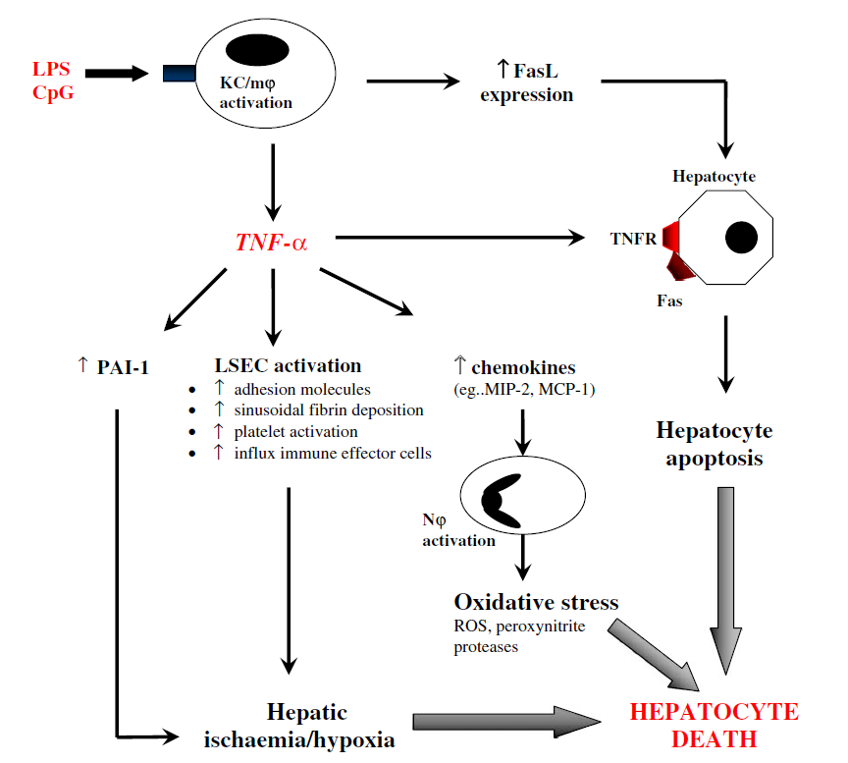
Macrophages : orchestrators of systemic inflammation

Slide 12
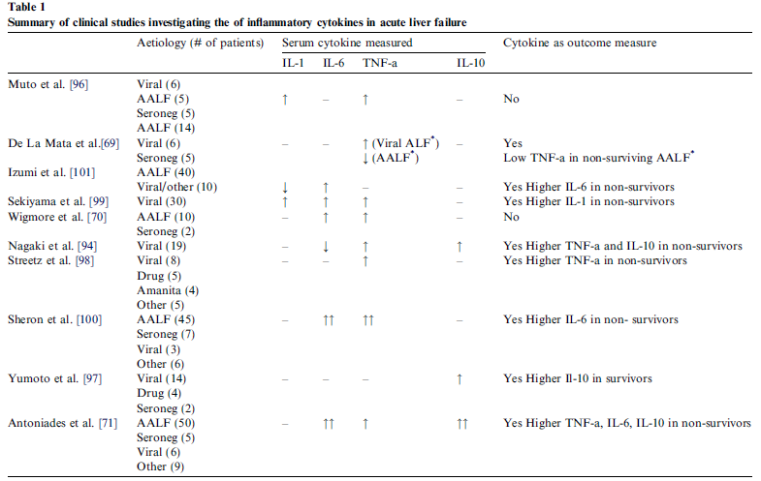
Circulating cytokines in ALF
Antoniades et al, J Hepatol ‘08
Notes:
As you can see from this summary of the studies examining the expression of circulating inflammatory cytokines- the majority examined the pro-inflammatory componnet documenting higher ciruculating lvels of IL-6, TNFa-a in non-surivvors. Only recently, have we and others examined the expression of anti-inflammatory cytokines (predominately IL-10) documenting increased expression in predominately AALF patients..

Slide 13
Encephalopathy & Intracranial hypertension
Encephalopathy:
I/II: mild disorientation, drowsiness, respond appropriately
III: agitation and disorientation, unable to follow commands
IV: deep coma
Intracranial hypertension:
Occurs in grade IV encephalopathy:
70% hyperacute liver failure
55% acute liver failure
Up to 15% subacute liver failure
Major cause of early mortality due to cerebral oedema and brainstem herniation

Slide 14
Ammonia & clinical studies
High circulating ammonia correlates:
encephalopathy
cerebral oedema/raised ICP
high mortality
Variable threshold concentrations for prediction of cerebral oedema/complications:
severe/progression HE: > 100-150μmol/L*
Risk of intracranial hypertension: >200μmol/L
(sensitivity 25%; 92% sensitivity)
Risk factors for progression & development HE:
ammonia
MELD>32
?other factors contribute to the development of HE/ICH
* Clemmesen et al, Hepatology ‘99; Bhatia et al, Gut ‘06; Bernal et al, Hepatology ‘07
Notes:
Raised ammonia conc is present in >90% patients with ALF.
Ammonia not able to detect threshold value for risk of ICP sensitivity 92%; specficity 92%. Failure to identify 75% of patients who develop ICH.

Slide 15
Ammonia & encephalopathy
Pathogenesis & mechanisms incompletely understood
Traditional theory: role of glutamine
hyperammonaemia → ↑ astrocyte glutamine → astrocyte swelling →cerebral oedema/ICH
Experimental models of ALF:
Changes in neurotransmitter synthesis/release
neuronal oxidative stress/impaired mitochondrial function
Astrocyte osmotic changes and swelling
Notes:
Changes in neurotransmitter: imparied glutaminergic neurotransmission (excitatory) leading to excessive neurointhibition (characterisitc of encephalopathy in ALF)

Slide 16
Neuroinflammation & HE
Inflammation & metabolic
mediators (ammonia/lactate) play “synergisitc” role in pathogenesis of HE
Activated microglial cells:
tissue macrophages
activated by inflammatory stimulus
implicated in other neuroinflammatory disorders
↑ pro-inflammatory cytokines (TNF-α, IL-1, IL-6)
Butterworth et al, Neurochemistry Int ‘12
Astrocyte
Microglial cell

Slide 17
Neuroinflammation & HE
Acute liver injury
-toxic
- viral
Neurotoxins
(ammonia, lactate)
glutamate
Astrocyte swelling
glutamine
TNF-a, IL-1, Il-6
ROS, RNI
Liver –brain inflammatory axis
Activated microglial cells
Systemic inflammation
(TNF-a, IL-1, IL-6)
CEREBRAL OEDEMA
RAISED ICP
Notes:
Evidence of neuroinflammation was first documented by a report of Jiang et al. (2006) followed by the results of a study suggestive of increased production of proinflammatory cytokines in brain in ALF patients (Wright et al., 2007) who measured TNF-a, IL-1b and IL-6 in blood sampled from an artery and a reverse jugular catheter in 16 patients with ALF due primarily to acetaminophen overdose. Crrelations of cytokines efflux and degree of ICH
Unequivocal evidence of neuroinflammation was subsequently provided by studies reported by Jiang et al. (2009a) who demonstrated microglial activation and concomitant increases in expression of genes coding for proinflammatory cytokines in experimental ALF in the rat resulting from hepatic devascularization
systemic proinflammatory mechanisms may initiate the signaling process, via one of several mechanisms that include
direct transfer of cytokines,
(2) interaction with receptors on circumventricular organs lacking a BBB or
(3) activation of afferent neurons of the vagus nerve. In addition, it has been proposed that systemic inflammatory signals
have the potential to result in increased permeability of the BBB to cytokines in ALF
A number of neurtoxic substancres are implcated in the pathogenesis of neuroinflammation in ALF. A wide range of molecules with the potential to threaten the functional integrity of the brain have the capacity to trigger the transformation of microglia from the resting to the active state. Such molecules include not only ammonia but also lactate, glutamate, and neurosteroids

Slide 18
Renal failure
Common 45% of all cases overall
75% paracetamol ALF with grade IV encepaholopathy
Multifactorial - frequently ATN rather than HRS
Intolerant of haemodialysis
Haemodynamics and cerebral oedema
Buffer
sodium bicarbonate
Anticoagulation
epoprostenol, regional anticoagulation,
Does NOT respond to terlipressin/any other forms of “renal” inotropes!

Slide 19
Metabolic disorders
Hypoglycaemia- reduced gluconeogenesis
Hyperlactataemia- reduced hepatic lactate clearance to bicarbonate
Hypophosphataemia
Hyponatraemia
Metabolic acidosis (independent of renal function):
lactic acidosis, peripheral AV shunting (tissue hypoxia)

Slide 20
Hepatocellular death
Hepatic necrosis markers:
High Mobility Group Box-1 protein
(total & acetylated HMGB1)
keratin-18 (K18)
M65 (CK-18)
Actin-free Gc Globulin (AF-Gc)
Hepatic apoptosis markers:
cK-18
Caspase-3 cleaved CK-18 fragment (M30)
Notes:
There have been a large number of recent publications and interest in the utility of biomarkers of hepatic necrosis and apoptosis in ALF.. These include
HMGB1 and K19- HMGB1 is passively released by cells undergoing necrosis and acts as a Damage Associated Molecular Pattern
(DAMP) molecule by targeting Toll-like Receptors (TLR) and the Receptor for Advanced Glycation End products (RAGE) . HMGB1 is also actively secreted as an inflammatory mediator by monocytes and macrophages in a hyper-acetylated form
Caspase 3-mediated cleavage CK-18 during apoptotic cell death results in a soluble cytokeratin fragment, M30. Total, intact CK-18 that is release from cells undergoing either necrotic or apoptotic cell death, can in turn be quantified by the M65.
Circulating M65 & M30 concentrations reflect degree of necrotic vs apoptotic cell death

Slide 21
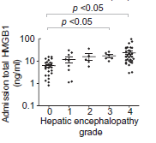
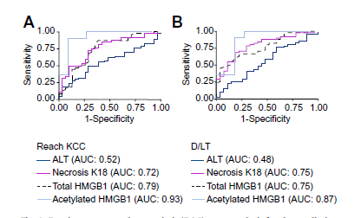
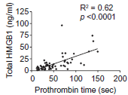
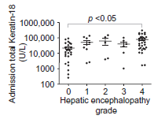
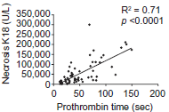
Hepatocyte necrosis
Necrosis (total K-18) is dominant form of cell death in early APAP
Apoptosis related marker (cK-18) not elevated at early stages of APAP
Acetylated form of HMGB-1 – released from activated immune cells
elevated in patients with adverse outcome (died/OLT)
Antoine et al; J Hepatol ‘12
Notes:
w
On the basis of analysis of 78 patients, the results from this investigation show that elevated total and acetylated HMGB1, FL-K18,and a lower percentage of K18 derived from apoptosis are all associated with patients that had a worse prognosis or died/required liver transplant.
To date a number of studies have utilised these markers of apoptosis and necrosis in acute liver failure, however results have been conflicting and many studies limited by heterogenous cohorts containing patients with varied aetiologies. Volkmann et al in a mixed cohort of 70 patients found elevated serum M30 levels to be predictive of spontaneous survival. However in the most recent and comprehensive examination of these markers published by Antoine et al, a correlation between elevated M65 levels and poor outcome from AALF was demonstrated. Craig et al and Bechmann et al have also recently published finding that suggest that M30 has no prognostic significance in patient groups with varied ALF aetiology[.

Slide 22
Hepatocyte regeneration
Alpha fetoprotein (AFP)
Serum phosphate
Regenerating livers:
↑ Protein phosphorylation/↑ ATP
↑ hepatic uptake of phosphorus
Hypophosphataemia correlates with acute liver injury
>1.2mmol/L indicator of non-survival
Detectable AFP at peak ALT (72-96hrs) post APAP
= favourable prognosis
↑ AFP often precedes ↓ INR
Schmidt et al, Hepatology ’04; Hepatology ‘02
Notes:
Following acute liver injury with extensive necrosis, an increase in AFP is interpreted as a sign of dedifferentiated hepatic regeneration. A peak ALT value was identifiable in all patients and appeared at a mean of 2.9 days (range, 1-6 days) after the overdose. In survivors, an increase in AFP was generally detectable 72 to 96 hours after the acetaminophen overdose.
When AFP values were related to the day of peak ALT, AFP values were significantly higher in survivors than in nonsurvivors starting on the day of peak ALT
In conclusion, an elevation of AFP above 3.9 g/L on the day after peak ALT was a highly discriminative indicator of survival from severe acetaminophen-induced liver injury. In many cases, the increase in AFP preceded the decrease in INR and thereby provided additional prognostic information
PHOSPHATE PAPER:
Hypophosphatemia is frequently observed in acetaminophen- induced hepatotoxicity and is correlated to the severity of liver damage.
Alternative
mechanisms leading to hypophosphatemia in acute liver failure include intracellular phosphate redistribution
because of hyperventilation, dextrose infusion, or phosphate consumption
Protein phosphorylation is a major regulatory
mechanism of cell proliferation, and, in regenerating rat
liver, hyperphosphorylation of nuclear proteins can be
demonstrated already 3 hours after partial hepatectomy.
The hepatic uptake of phosphorus and the mitotic activity of the hepatocytes increase more than 100-fold within 24 hours of major liver resection in rats.24 The peak increase in DNA synthesis at 24 hours and maximum mitotic activity at 48 hours after partial hepatectomy are preceded by a rapid turnover of intracellular high-energy phosphate, including adenosine triphosphate and creatine phosphate. A similar turnover of adenosine triphosphate
after major resection is seen in rabbits. Hepatic regeneration also involves plasma membrane proliferation, which requires phosphate for the synthesis of phospholipids.

Slide 23
Pulmonary complications
Non cardiogenic pulmonary oedema/ALI- occurs in 40% cases
Most common in POD ALF
Other causes:
Aspiration of gastric contents
Neurogenic 2º raised ICP
Primary pneumonia

Slide 24
Infection
Increased risk of bacterial and fungal sepsis
Conventional markers of sepsis (ie. Temp, WCC) are absent in ALF
Diagnosis difficult in context of progressive MOF
Common organisms: Staph, streps, coliforms, candida
Rolando et al

Slide 25
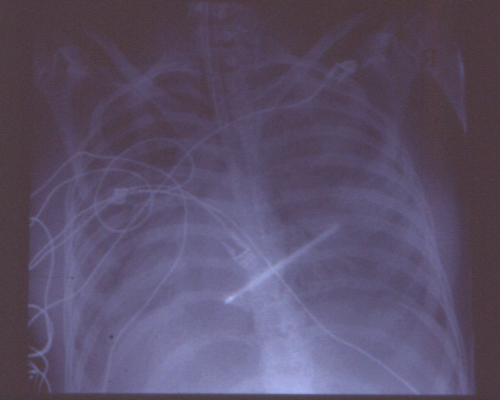
Infection and ALF Rolando et al 2000 Hepatology 32:734 and 31(4):872
15 - 35% nosocomial infection rate vs 5 - 7 % in general hospital population (CLD)
Proven bacterial infection 335 of 887 patients (550 episodes)
Gram positives : 50%
Severe sepsis 58% mortality
Septic shock 98% mortality
Fungal infection 99 of 887 : 11%
64% mortality
prophylaxis (high risk)
viral infection :CMV,HSV

Slide 26
Haematological complications
Decreased circulating levels:
Fibrinogen
II, FV, VII, IX, X
Platelet dysfunction
Quantitative (70% <100)
Qualitative
Increased incidence of pancytopenia (haemopahogocytosis)

Slide 27
Investigations
Further Ix
Hepatitis serology
Autoantibodies
Serum copper, caeroplasmin, urinary copper
urinary myoglobin
Imaging
Liver biopsy???
Baseline Ix
FBC
U&E, LFT
CK
Amylase
Coagulation
Mg²⁺, PO²⁻
Haemolysis screen

Slide 28
Prognostic criteria
King’s College Criteria most widely adopted criteria for selection
Meta-analyses indicate good sensitivity but low sensitivity (unable to identify pts who need OLT)
rare condition (1-6 cases/million/year)
Low patients number; heterogeneous aetiology
Worldwide variation in definition of ALF
Changes in medical care and spectrum of disease
Exceptions:
Amanita phalloides poisoning
Wilson’s Disease
Pregnancy related liver failure syndromes
Acute Budd-Chiari syndrome

Slide 29
Indications for liver transplantation
Paracetamol Non-Paracetamol
pH < 7.30 pH<7.3
all 3 of the following INR > 6.5
within 24 hrs
PT > 100 INR > 6.5 Any 3 of :
Creatinine > 300 µmol/l seronegative hepatitis or
grade 3 - 4 encephalopathy drug reaction
Bilirubin > 300 µmol/l
INR > 3.5
Age < 10 yrs or > 40 yrs
J - E > 7 days
Lactate : 4 hrs > 3.5
Lactate : 12 hrs > 3.5
Clichy criteria (French)
Encephalopathy +
Factor V < 20%
or < 30% if > 30 yrs of age

Slide 30
Basis of Management
Recognition of
problems
Evolution of disease
- cerebral
- cardiovascular
- renal
- infection
- pulmonary
- metabolic
- nutrition
- coagulation
Monitoring
Measurement and
manipulation of
physiological
parameters
Multisystem Involvement

Slide 31
Management of liver failure
Coagulopathy
Give FFP only when decision for OLT listing established or significant bleeding
Platelet/cryo support
Metabolic
Correct all electrolyte deficiencies
HCO⁻³ as temporary measure (8.4% used)
Nutrition
Frequent poor recent oral intake ± vomiting
No evidence for protein restriction in either acute or CLD
Gastric prophylaxis : role unproven
PPI routinely administered

Slide 32
Management of ALF
Renal failure
Almost always occurs in hyperacute ALF
Haemodialysis not tolerated
Continous veno-veno haemofiltration
Corrects acidosis and hyperlactataemia
Use of high volume CVVHF in ALF- achieve metabolic stability and bridge to OLT.
Anticoagulation: epoprostanol

Slide 33
Management
Infection
Those who fulfill transplant criteria
This group get systemic antifungals in addition
Most patients will be given oral candida prophylaxis (fluconazole)
Signs of sepsis / SIRS
Typically: Tazocin 4.5g bolus
(infusion 13.5g/24/hrs)
Fluconazole/amphotericin

Slide 34
Management
Haemodynamics/tissue perfusion
Invasive monitoring (PICCO,PA catheter)
Achieve adequate/optimal fluid resuscitation
1st choice- noradrenaline
2nd line –vasopressin
Consider hydrocortisone infusion-
Functional adrenal insufficiency in ALF* (give supplemental steriods)
Synacthen test
abnormal synacthen response
hypotension associated with lower baseline and increment (p<0.05)

Slide 35
Management
N-acetylcysteine (150mg/kg/24hrs)
Within 24 hours of POD- reduces/prevents liver damage
Role in improving outcome in late presentation POD (36-80hrs)
Improved oxygen delivery to tissues-inprovments in cerbral/systemic haemodynamics
“Antioxidant” use in ischaemic & toxic insults
Recent US ALF study demonstrating utility in non-paracetamol ALF- when initiated early in disease course*
* Lee et al, Gastroenterology ‘09
Notes:
When given within 24 h of paracetamol ingestion,
N-acetylcysteine can prevent or reduce liver damage evenN-acetylcysteine, and intervention studies showed
improvements in systemic and cerebral haemodynamics
and oxygen uptake.106,107 A multicentre double-blind
randomised trial108 of N-acetylcysteine in non-paracetamol
acute liver failure was completed after 8 years of
recruitment. N-acetylcysteine was well tolerated and
associated with improved non-transplanted survival, but
only in patients treated early in the course of disease and
with low-grade encephalopathy
after large overdoses.105 Early randomised trials suggested
reductions in mortality from late administration of

Slide 36
Management
Neurological
Intubate/ventilate (grade III)
Head up 20⁰C
Sedation +++(decreases cerebral metabolism)
Temperature (34-35⁰C)
pCO2- 4.5-5
Insert RJV (measures cerebral oxygen extraction)-55-80%
Monitor pupillary abnormalities
Strong Na+ infusion (Na+~150mmol/L)

Slide 37
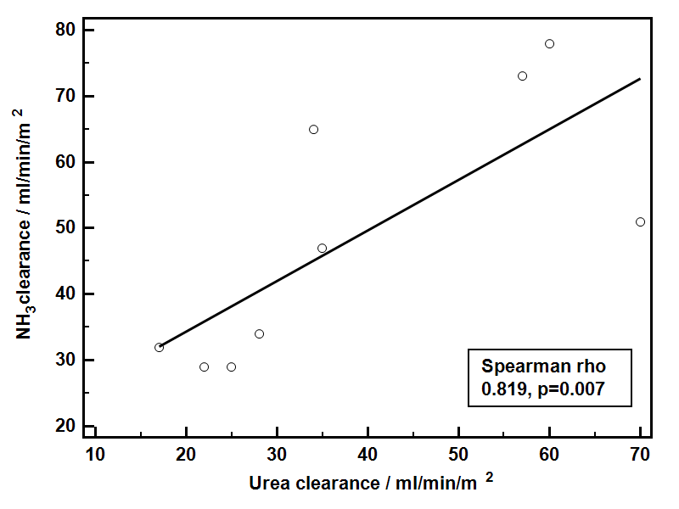
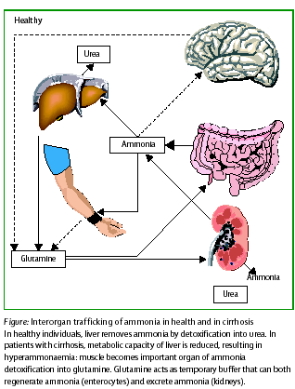
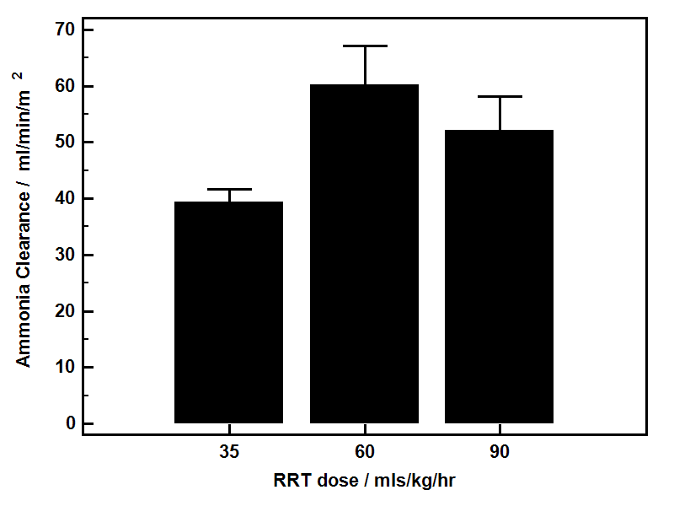
Haemofiltration- clearance of ammonia

Slide 38
Cerebral Monitoring
ICP
If JV saturations outside normal range
Pupillary abnormalities
Hypertonia and clonus
Prior to ICP bolt : coagulation support : FFP / platelets
Camino system : 5mm burr hole, make hole in dura, catheter inserted
CT scans - only if there is concern regarding bleed
Can do EEG and cerebral dopplers if concerned

Slide 39
Management
ICP: aim <25mmHg
Cerbral perfusion pressure (CPP)
>55 (MAP-ICP)
Rx options: raised ICP
Bolus sedation
Bolus strong Na+ (hypertonic saline)
Mannitol bolus
Indomethacin
Hepatectomy (anhepatic)

Slide 40
Liver-brain proinflammatory axis
Necrotic liver source of “pro-inflammatory”cytokines
Associated:
ICH
Changes in cerebral blood flow (CBF)
Removal of inflamed liver improved ICH/CBF
Jalan et al, J Hepatology ‘02
Notes:
Evidence of a relationship between systemic inflammatory responses derived from the inflamed liver and the encpehalopathy go back a decade from this very elegant case report from Jalan and colleagyes from Edinburgh....

Slide 41
Outcome- transplantation

Slide 42
Novel therapies?
Liver assist devices
MARS/Prometheus- no benefit
Plasmapheresis

Slide 43
Plasmapheresis in ALF
Unpublished data; multicentre, multinational study

Slide 44
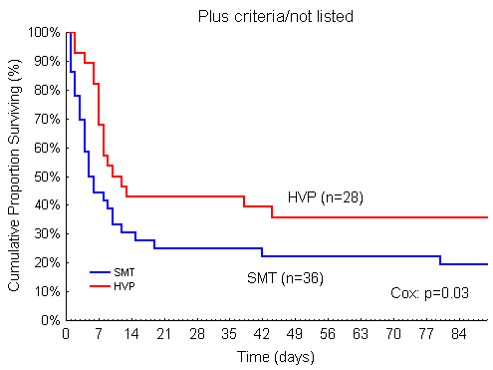
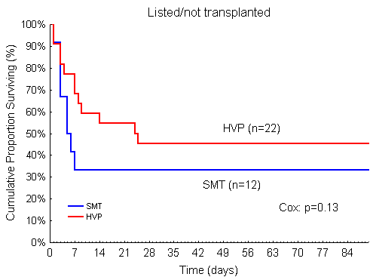
Stratified survival analysis
Plasmapheresis in ALF

Slide 45
Case scenario
27yr accountant
30g paracetamol 2/7
alcohol with overdose
nausea/vomting
epigastric pain
PMH
DHx
PSHx

Slide 46
Case scenario
Examination

Slide 47
Case Scenario
Bloods
Hb 12 Albumin 31
WCC normal Ur 8.5
Plts 120 Cr 90
INR 2.1
ALT 750 ABG pH 7.4
Bili 40 pCO2 3.9
pO2 11.5
HCO3 19
BE -9
Lactate 2.5

Slide 48
Case scenario
Advice & management plan?
24 later:
coffee ground vomiting
not wanting to continue with NAC/pulling out lines- wanting to self discharge

Slide 49
Case scenario
Advice/management plan?
-
Hb 9 ALT 4980
Plts 50 Bili 90
INR 7.5 ABG pH 7.3
Cr 140 pCO2 2.9
HCO3 12
BE -12
Lactate 8

