Slide 1
Human pregnancy overview
Mark Sullivan

Slide 2
References
Langmans Medical Embryology. TW Sadler (Lippincott).
The Developing Human. Moore and Persaud (Elsevier).
Essential Reproduction. Johnson & Everitt (Blackwell Scientific Pubs).
Use the most recent editions!

Slide 3
Human pregnancy
Mother
Baby (conceptus, infant, embryo*, fetus)
Placenta
*: can equal conceptus early in development

Slide 4
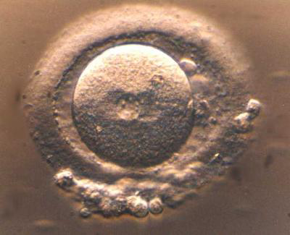
Turning a fertilised human egg ……….
http://www.eurekalert.org/multimedia/pub/web/19315_web.jpg

Slide 5
……. into one of these!
http://www.graphicshunt.com/search/11/baby.htm

Slide 6
Human pregnancy
0
13
26
39
Maternal changes - throughout
L1
Embryo Fetus Viability Term
L3
Placental changes – complex, mostly first half
L2
There are 3 trimesters of pregnancy
They were not defined by science, but were based on experience

Slide 7
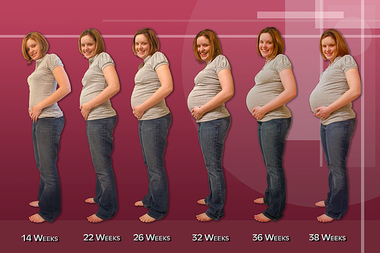
The look of human pregnancy
http://miracleinthewomb.com/wp-content/uploads/2011/09/First-Trimester-Of-Pregnancy-mom
http://www.sharedpregnancy.com/pregnancy-symptoms/staying-fit-during-pregnancy-tips-for-each-trimester/

Slide 8
Human pregnancy
Maternal changes
Increased weight
Increased blood clotting tendency
Decreased blood pressure
Decreased brain size (very slight!!)
Altered hormones
Altered appetite
Altered fluid balance
Altered emotional state
Altered joints
Altered immune system

Slide 9
Essential pregnancy
To focus on the main events in each trimester of human pregnancy

Slide 10
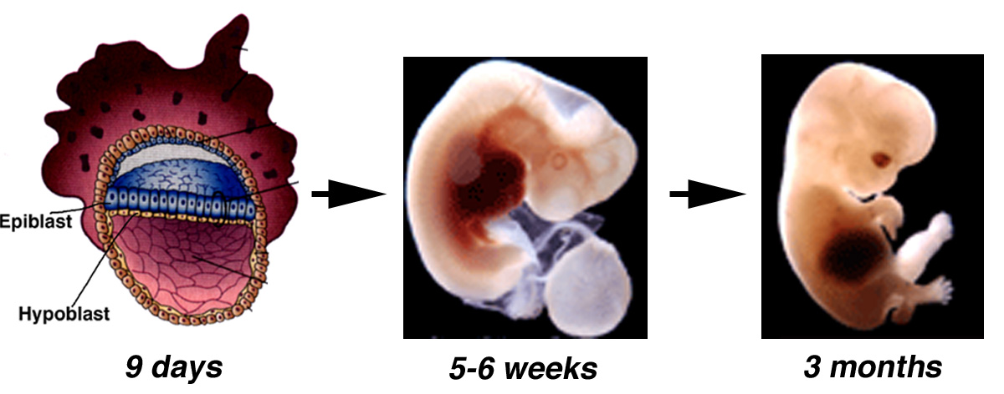
First trimester - baby
Blastocyst
Embryo
Fetus
(0.1 cm)
(1 cm)
(7 cm)

Slide 11
Essential pregnancy
0-13 weeks: The first trimester
Precondition 1: fertilisation
How do we count pregnancy?

Slide 12
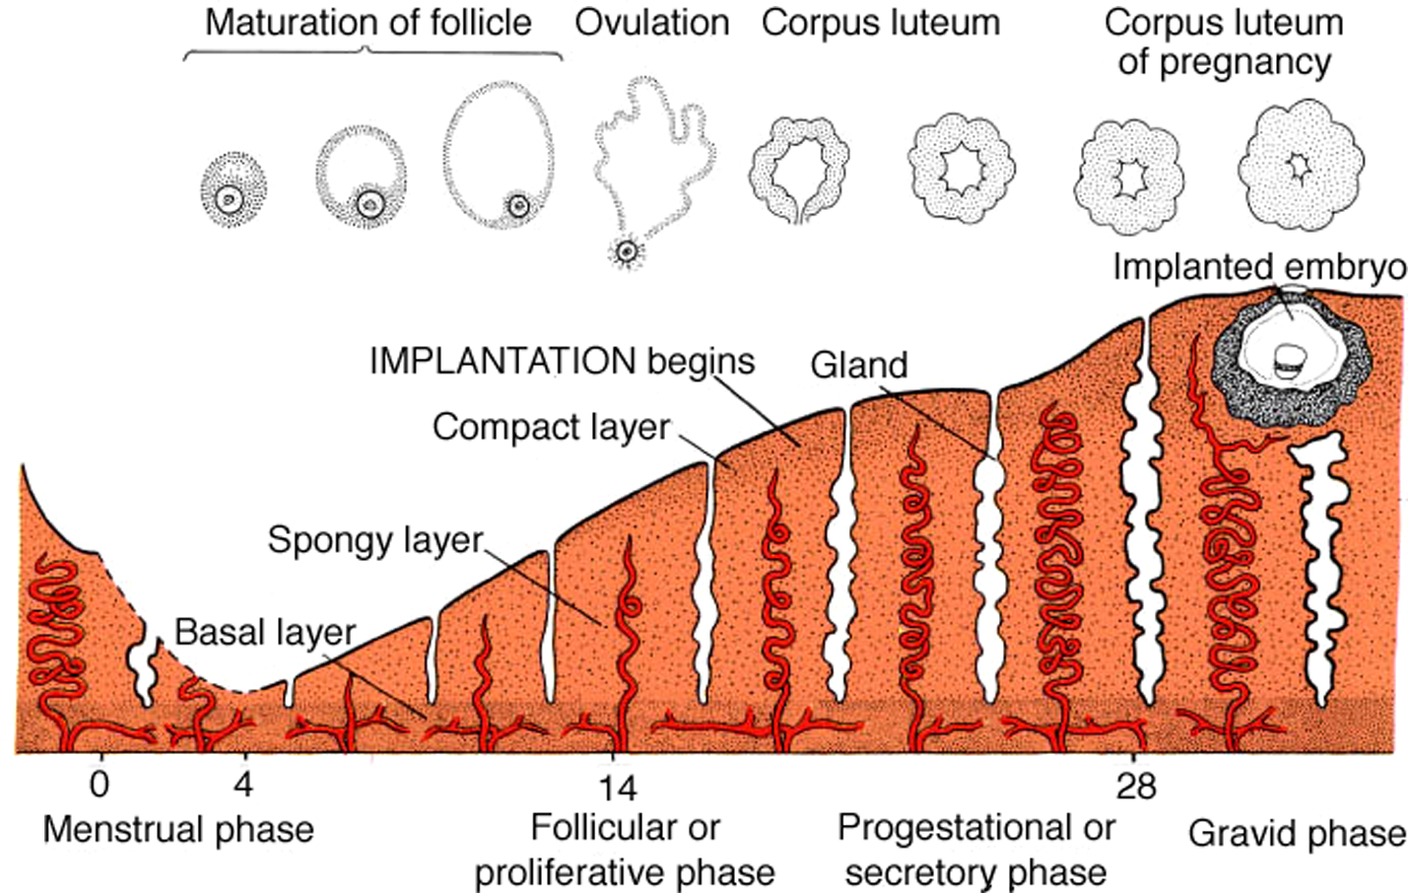
Uterine changes following fertilisation
LMP

Slide 13
First trimester
‘Week 1 (pregnancy)’
Normal menstrual cycle days 0-7
‘Week 2 (pregnancy)’
Normal menstrual cycle days 8-14
Ends with ovulation & fertilisation

Slide 14
First trimester
‘Week 3 (pregnancy)’
Week 1 of embryonic development
Normal menstrual cycle days 15-21
Implantation of conceptus in decidualising endometrium begins (~day 20)
Pre-implantation development of conceptus

Slide 15
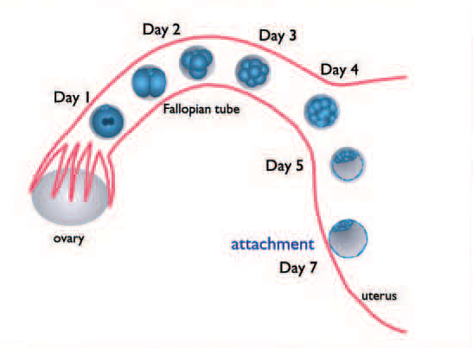
Preimplantation development

Slide 16
First trimester
‘Week 4 (pregnancy)’
Week 2 of embryonic development
Abnormal menstrual cycle, no endometrial shedding (day 28) – ‘missed period’
Implantation of conceptus in decidualising endometrium MOSTLY complete by day 28
Conceptus = blastocyst
Embryo – consists of 2 layers of cells
Placenta – trophoblast differentiation by end of week 2, primary structure developing

Slide 17
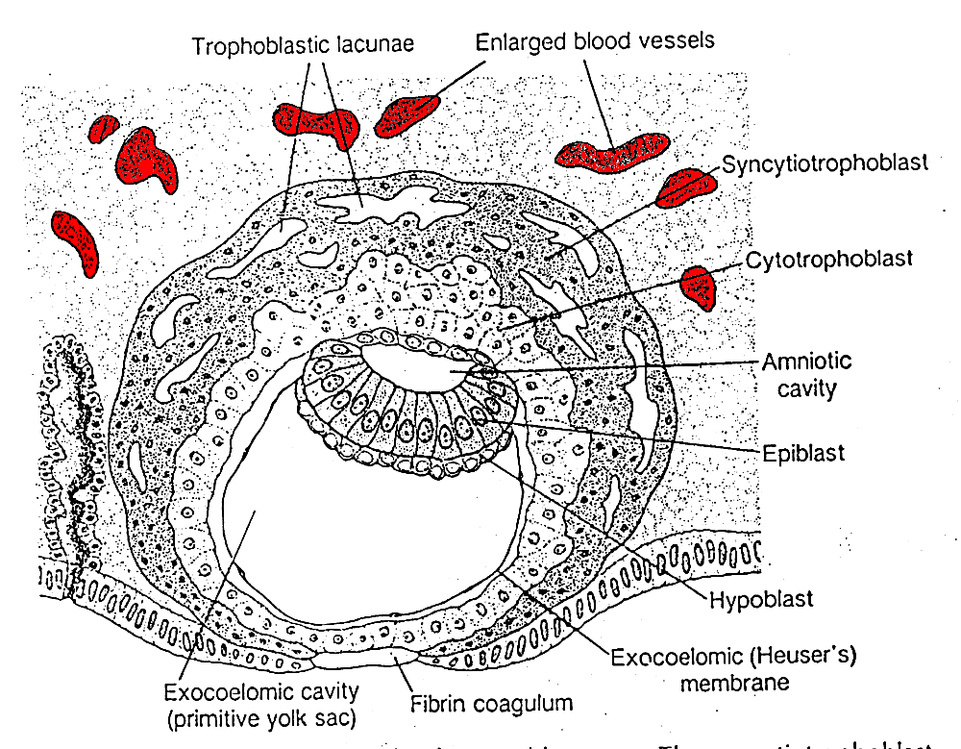
~Day 9 (PF) - embryonic

Slide 18
First trimester
‘Week 5 (pregnancy)’
Week 3 of embryonic development
Maternal – increasing levels of progesterone from corpus luteum, increasing hCG from conceptus. Pregnancy test may be positive.
Definite ‘missed period’
Embryo – gastrulation: formation of 3 layer disc, initiation of CNS & blood vessels – 3mm
Placenta – structure of villi present, contain fetal blood vessels; contact with maternal capillaries

Slide 19
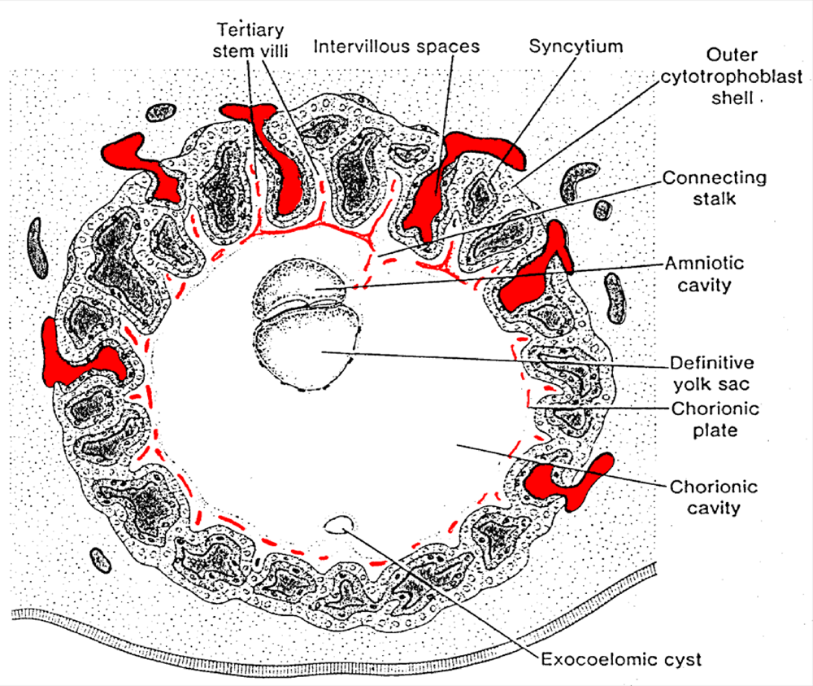
~Day 21 (PF)
Sadler, 2006

Slide 20
First trimester
‘Week 6 (pregnancy)’
Week 4 of embryonic development
Maternal – hormone levels increasing
Embryo – Closure of neural tube. Heart, face, arm initiated. 4mm
Placenta – villi become more elaborate. Cytotrophoblast shell isolates conceptus from maternal blood supply. Umbilical cord forming.

Slide 21
Early in development embryos of different species look very similar.

Slide 22
‘Pregnancy’ lengths
Mouse: 21 days
Zebrafish: 4 days hatching, maturity 3 months
Chicken: 21 days
Human: 9 months
Dog: 9 weeks
Hedgehog: 5-8 weeks
Alligator: 9 weeks

Slide 23
First trimester
‘Week 7 (pregnancy)’
Week 5 of embryonic development
Maternal – hCG levels increasing rapidly
Embryo - Face & limbs continue. (5-8mm). Isolated from maternal blood supply.
Placenta – Histiotrophic nutrition established. Progesterone production increasing

Slide 24
First trimester
‘Week 8 (pregnancy)’
Week 6 of embryonic development
Maternal – hCG levels reaching their peak. Corpus luteum beginning to degenerate.
Embryo - Face, ears, hands, feet, liver, bladder, gut, pancreas. (10-14mm)
Placenta – no major changes in structure, but progesterone production increases further.
Spiral arteries of decidualised endometrium: start of remodelling by placental cells.

Slide 25
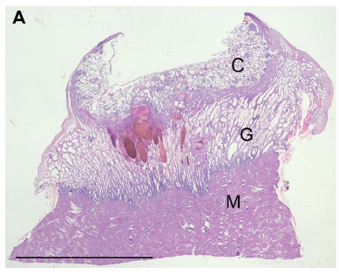
~week 8 GA
From: Hempstock et al, 2004. Rep.Biol.Endo. Doi:10.1186/1477-7827-2-58

Slide 26
First trimester
‘Week 9 (pregnancy)’
Week 7 of embryonic development
Maternal – Second period missed. Corpus luteum regresses; ‘luteo-placental shift’.
Embryo - Face, ears, fingers, toes. (17-22mm)
Placenta – becomes the main source of progesterone to sustain the pregnancy
Spiral artery remodelling continues

Slide 27
First trimester
‘Week 10 (pregnancy)’
Week 8 of embryonic development
Maternal – no major changes
Embryo - Lungs, liver, kidneys, (28-30mm)
Placenta – no major changes

Slide 28
First trimester
‘Week 11 (pregnancy)’
Week 9 of embryonic development
Maternal – no major changes
Embryonic stage now completed, referred to as fetus.
Placenta – interface with decidual spiral arteries changes, placenta begins to receive full maternal blood supply.

Slide 29
First trimester
‘Week 12 (pregnancy)’
Week 10 of embryonic development
Maternal – no major changes
Fetus – gradual growth
Placenta – completion of exposure to maternal blood supply

Slide 30
First trimester
‘Week 13 (pregnancy)’
Week 11 of embryonic development
Maternal – end of first trimester. 3rd missed period.
Fetus – 8cm / 45g
Placenta – Little change. ~5cm in diameter.

Slide 31
Blastocyst
Embryo
Fetus

Slide 32
The first trimester
Summary
Greatest changes and risks for the fetus
If the fetus survives to week 13 (P), then live birth is ~95%
Limited effect on maternal system, though NB hormones

Slide 33
The second trimester
Weeks 14-27
Maternal changes become obvious
Fetus changes from development to growth
The limit of fetal life (end of trimester)

Slide 34
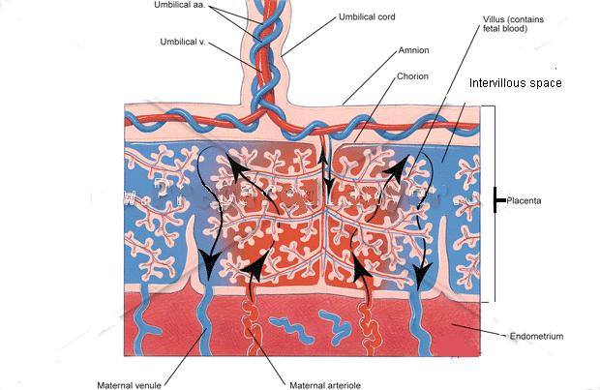
After 12 weeks of pregnancy

Slide 35
www.arnenixoncenter.org/. ../Willow%20Tree.JPG

Slide 36
www.arnenixoncenter.org/. ../Willow%20Tree.JPG

Slide 37
Maternal changes
Increased weight
Increased blood volume
Increased blood clotting tendency
Decreased blood pressure
Altered hormones
Altered appetite (quantity and quality)
Altered fluid balance
Altered emotional state
Altered joints
Altered immune system

Slide 38
Second trimester
Overview
Safest time for the baby and the mother
Fetal weight increases from 50g – 1000g
Placental size increases from 5cm-20cm
Uterine stretch!!
Progesterone levels continue to increase
Estrogens increase
Not a good time to be born!
Detailed knowledge is limited……..

Slide 39
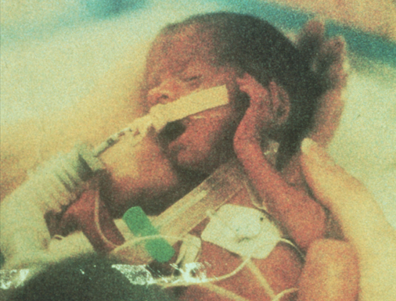

Slide 40
Third trimester
Weeks 27-39 (term)
Everything grows
Fetus (infant) ~3.5kg at term
2 kg increase during last trimester
>30cm in length
Placenta ~0.5 kg, 25cm in diameter
Effectiveness of placenta: 50g – 1000g – 2000g per trimester

Slide 41
Third trimester
Maturing of key systems for life:
Brain
Lungs
Digestion
Immune system

Slide 42
Labour stages
Not in labour (~39 weeks)
Latent stage (~8 weeks)
Labour (12-48 hours)
13w 26w 39w
First trimester Second trimester Third trimester
Phase 1 (many hours)
Contractions, cervical changes
Phase 2 (hours)
Baby delivered
Phase 3 (30 min)
Placenta delivered

Slide 43
Risks at delivery
Placenta
Disposable, has done its job
Can be lost without a problem
Placenta & umbilical cord have NO nervous system

Slide 44
Risks at delivery
Infant
Must breathe within a very short time of delivery
Must become independent of placenta
Placenta must be separated (limit blood loss)
Heart circulation must change to lungs
Lungs must work

Slide 45
Risks at delivery
Mother
Blood loss
All placenta MUST leave uterus
Link between these factors
Other factors

Slide 46
Third trimester
Summary
Infant size increases
Organ systems reach in utero maturity
Uterine system prepares for delivery
Risks connected with delivery process, not with pregnancy per se

Slide 47
Learning objectives
Trimester 1 – slide 32
Trimester 2 – slide 38
Trimester 3 – slide 46

