Slide 1
Anatomy of the reproductive tract in the adult male
Layi O. Oduwole, PhD
3 January 2013

Slide 2
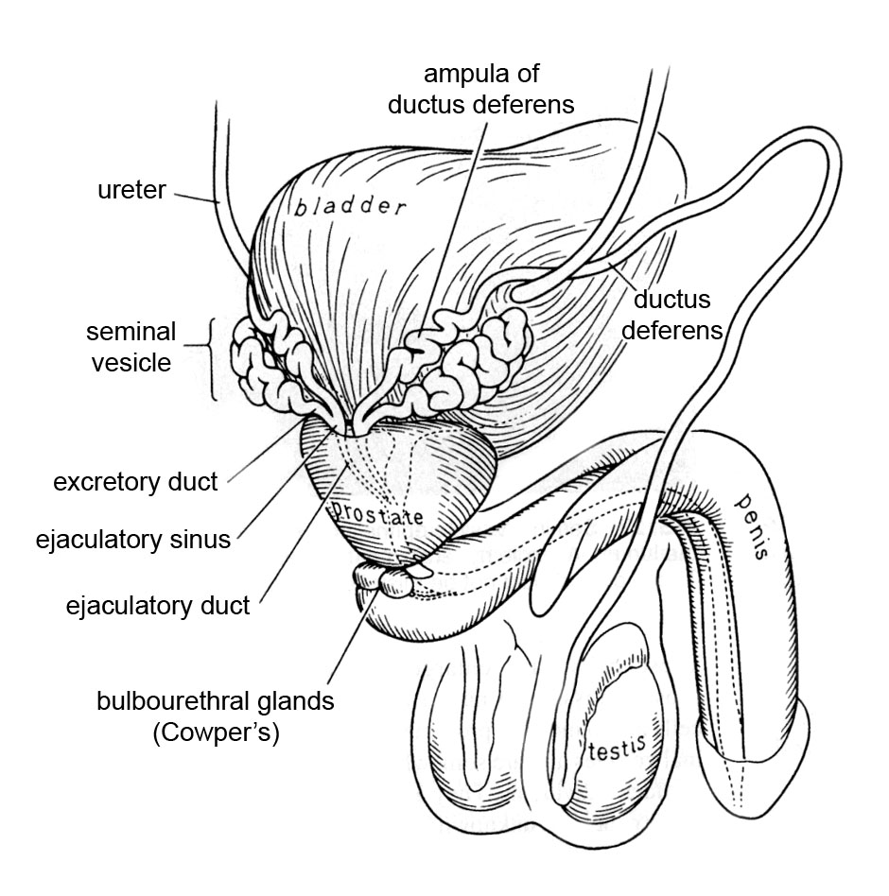
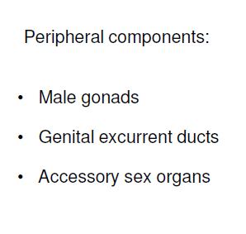
Male reproductive system

Slide 3
Functions
To produce and secrete male sex hormones responsible for maintaining the male reproductive system
To produce, maintain and transport sperm and protective fluids
To discharge sperm within the female reproductive tract during intercourse

Slide 4
How does the system function?
The entire system is dependent on hormones. The three main hormones involved are:
The gonadotropins, LH and FSH and Testosterone (T). LH and FSH are the main regulators of postnatal testicular action.
LH: Stimulates the Leydig cells production of testosterone, which is required for spermatogenesis.
FSH: Regulates the Sertoli cell function.
Testosterone: Responsible for the development of male characteristics, including muscle mass and strength, fat distribution, bone mass, facial hair growth, voice change, and sex drive.
In rodents, T production starts independently from endogenous circulating gonadotropins and Leydig cells become dependent on gonadotropins shortly after birth. Unlike in rodents, human fetal testis binds hCG and physiologic levels of hCG stimulate T production already at early pregnancy, at least from 14 weeks of gestation.

Slide 5
Testicular descent and migration
Testes descent is the male-specific developmental process by which the gonads descend from their original position in the urogenital ridge to the final position in the scrotum. In humans, it occurs during fetal development and should be completed before birth.
Major actors of the descent are T and insulin-like peptide 3 (INSL3).
Incomplete descent of the testes (cryptorchidism) is one of the most common male congenital disorders.
MAMMALIAN SEX DIFFERENTIATION
The embryonic gonad begins differentiation into either testis or ovary at around gestational week 6. The determination of sex in mammals is strictly chromosomal, with the male being the heterogametic sex (XY) and the female the homogametic sex (XX). In the presence of the male-determining Y chromosome, a cascade of events is initiated leading to the development of the testes. These includes germ cell migration into the gonad, differentiation and migration of Sertoli cells, formation of the seminiferous cords around the Sertoli cells and the development of hormone producing Leydig cells.

Slide 6
Phases of testicular descent
Two stage model proposed by Hutson et al, 1997:
Intra-abdominal phase
- Androgen-dependent regression of cranial suspensory ligament (CSL)
- Insl3-mediated gubernaculum outgrowth
- Some evidence from animal models and human inter-sex conditions supports a role for Müllerian inhibiting substance (MIS), believed to cause regression indirectly through its effects on the mesenchymal cells surrounding the Müllerian ducts. However, these
observations have not been translated into direct evidence for a role for MIS experimentally.
Inguinoscrotal phase
- Dilation/masculinisation of inguinal canal
- Androgen-mediated gubernaculum regression

Slide 7
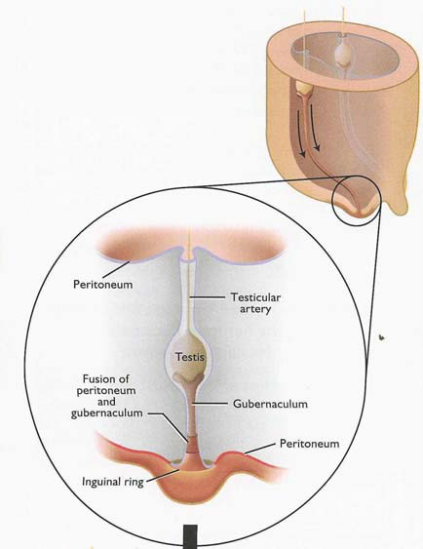
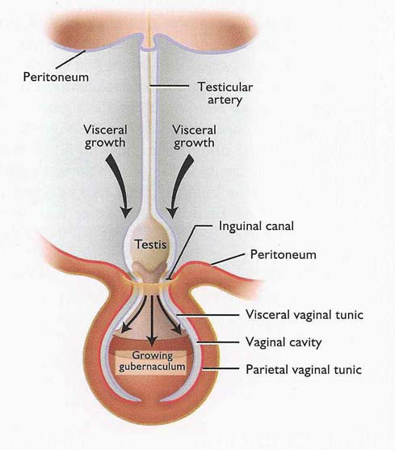
Role of gubernaculum in testicular descent (1)
1. Gubernaculum penetrates the inguinal ring and grows rapidly from the distal end

Slide 8
Role of gubernaculum in testicular descent (2)
2. Once the testes are in the inguinal region the first phase of testicular descent in complete.

Slide 9
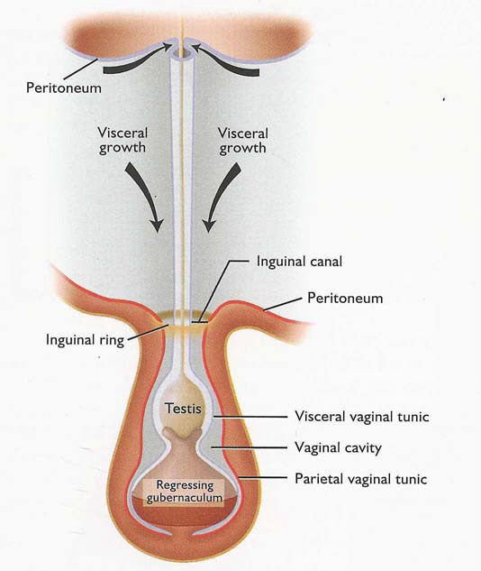
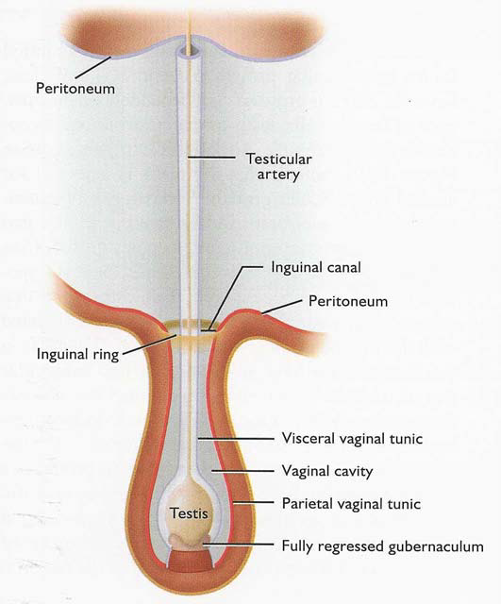
Role of gubernaculum in testicular descent (3)
3. The gubernaculum begins to regress. The regression is the driving force that pulls the testes into the scrotum.

Slide 10
Role of INSL3
INSL3 (or relaxin-like factor; RLF) is produced and secreted by Leydig cells prior to mesenchymal proliferation and gubernacular growth. It is the testicular hormone responsible for the gubernacular outgrowth and swelling, enabling the testis to be positioned at the inner ring of the inguinal canal and then transferred through the widened inguinal canal.
Acts directly on the gubernaculum via its G-protein-coupled receptor RXFP2 (relaxin-family peptide receptor 2, LGR8 or GREAT), stimulating the proliferation of the mesenchymal gubernacular cells.
INSL3 also induces cAMP production in gubernacular tissues.
Transgenic INSL3 ^{-/-} mice are cryptorchid with undeveloped gubernaculum.

Slide 11
Role of androgens in testes descent
They are important in gubernaculum bulb development
Individuals with complete or partial androgen insensitivity syndrome (AIS) - testes located either at the internal opening of the inguinal canal, within the inguinal canal or emerging from the inguinal canal - Evidence of the involvement of testosterone in the rapid process of transinguinal testis passage.
When given anti-androgens, gubernaculum growth and testis descent is inhibited.
Timing of the action of androgens is critical and the effect on transinguinal and scrotal descent could occur directly via ARs which are expressed in the human gubernaculum.

Slide 12
Interaction between INSL3 and Testosterone
Evidence from animal experiments indicate a high degree of interconnctivity between INSL3, T and their respective receptors (relaxin-family peptide receptor 2;RXFP2/LGR8 and AR).
Together the interplay between INSL3, T and their respective receptors is interwoven and this complicates the distinction between events driven by either T or INSL3 alone, and those of the two hormones in concert. Mutations of these genes in the mouse results in male infertility secondary to cryptochidism.

Slide 13
Problems with testicular descent
Cryptorchidism
A mild malformation that has the potential of affecting the health of a male. Aetiology is multifactorial, involving ∼3% of males at birth. It represent the best characterised risk factor for testicular cancer and reduced fertility in adult life.
Risk factors include low birth weight when adjusted for gestational age and maternal exposure to estrogen in the 1st trimester
Surgical correction prevent loss of germ cells in humans
Considerable evidence exists in animal models to support a genetic cause, and environmental factors might also contribute to the aetiology. Mutations in the gene for INSL3 and its receptor and those of the androgen receptor gene may also explain a minority of cases.

Slide 14
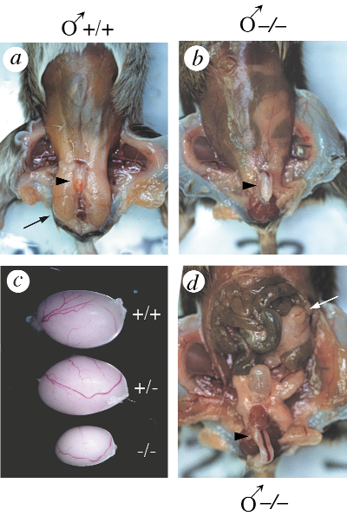
Cryptorchidism in Insl3^{−/−} male mice
(a) External localization of the testes
(arrow) in an adult wild-type mouse.
(b) Absence of external testes in an Insl3^{−/−} adult male.
(c) Dissected testis from adult wild-type, heterozygous and mutant
male mice.
(d) Intrabdominal localization of testes in Insl3^{−/−} males.
Nef & Parada; Nature Genetics, Vol. 22, 1999

Slide 15
Additional factors
Rodent model Causes of cryptorchidism Reference
DAX1^{-/-} mouse DAX1 deficiency Caron P et al, 1999
Desrt^{-/-} mouse A-T rich interaction domain (ARID) Lahoud MH et al, 2001
Class transcription deficiency
GREAT ^{-/-} mouse INSL3/relaxin receptor deficiency Overbeek PA et al, 2001
hpg (hypogonadal mouse) GnRH deficiency Charlton HM et al, 1983
Hoxa 10^{-/-} mouse Homeobox gene product A 10 deficiency Satokata I et al, 1995
Hoxa 11^{-/-} mouse Homeobox gene product A 11 deficiency Hsieh-Li HM et al, 1995
Hoxa10/Hoxa11 Abdominal related homeobox gene Branford WW et al, 2000
transheterozygous deficiency
Insl3^{-/-} mouse INSL3 deficiency Nef and Parada, 1999
LuRKO mouse Zhang P et al, 2001
Tfm (testicular feminization) mouse Charest NJ et al, 1991

Slide 16
Thermoregulation
Thermoregulatory control mechanisms involve the modulation of radiant heat loss through thin scrotal skin, which is devoid of fat, and via a countercurrent heat exchange in the system in the blood vessels of the spermatic cord.
Maintenance of testicular temperature 2-7°C below body temperature is essential for spermatogenesis.
Testicular descent allows testicles to be kept at lower than core body temperature. Core body temperature is lethal for germ cells.
Studies have indicated that scrotal temperature is increased in men with varicoeles. Varicoele and venous dilatation of the spermatic cord are associated with male infertility.
Main anatomical features for thermoregulation:
- Thin scrotal skin, often hairless, lots of sweat glands
- Tunica dartos and cremaster muscle
- Pampiniform plexus (countercurrent heat exchange)
- Absence of fat

Slide 17
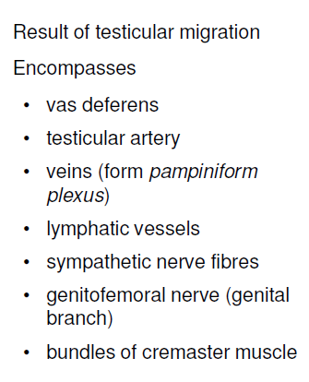
Spermatic Cord

Slide 18
Blood supply and arrangement of the efferent ducts and the subdivisions of the epididymis and vas deferens
The arterial supply to the testes arises at the level of the second lumbar vertebra from the aorta on the right and the renal artery on the left and these vessels descend retroperitoneally to descend through the inguinal canal forming part of the spermatic cord.
The testicular artery enters the testes on its posterior surface sending a network of branches that run deep to the tunica albuginea before entering the substance of the testis.
The venous drainage passes posteriorly and emerges at the upper pole of the testis as a plexus of veins termed the pampiniform plexus. As these veins ascend they surround the testicular artery, forming the basis of a countercurrent heat exchange system which assists in the maintenance of a temperature differential between the scrotally placed testes and the intra-abdominal temperature

Slide 19
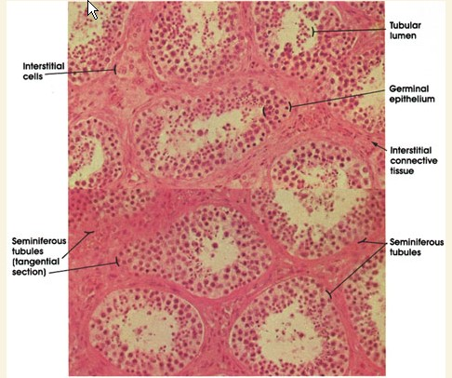
Testes and Seminiferous Epithelium
The testes are both "exocrine" and endocrine in nature. They produce both a cellular "secretory product" in the form of sperm, and the hormone testosterone as a true endocrine secretion.
The testes of most mammals are located extra-abdominally in the scrotum. This is actually a temperature controlling device.
When the ambient temperature drops, the testes are pulled up by muscular action towards the warmth of the body cavity, and when it rises, the muscle relax, allowing the testes to descend and remain cool.
The bulk of the testicular tissue is the seminiferous tubules which are present in astonishing quantity. A human testis may have 800-1600 tubules, with an aggregated length of about 600 meters.
The process of spermatogenesis as observed by the various stages represented in a seminiferous tubule from the primary and secondary spermatocytes. These, in turn, complete the second meiotic division, giving rise to haploid daughter cells, the round spermatids. Over time, the round spermatids complete cyto-differentiation and become mature, elongated spermatids. Mature spermatids shed into the tubular lumen are termed spermatozoa.

Slide 20
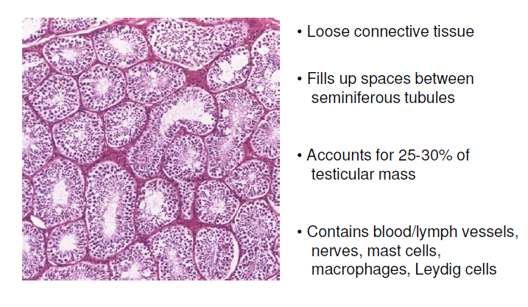
Interstitial Tissue

Slide 21
Leydig Cells

Slide 22
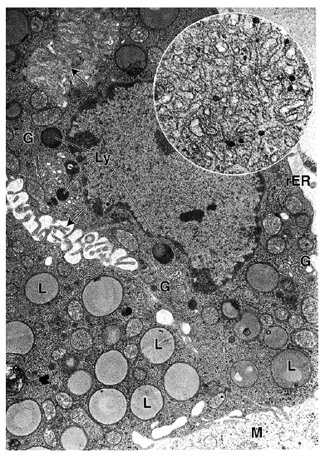
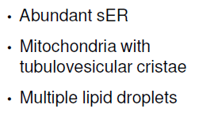
Leydig Cells: Ultrastructural Signs of Steroid Synthesis

Slide 23
Sertoli Cells

Slide 24
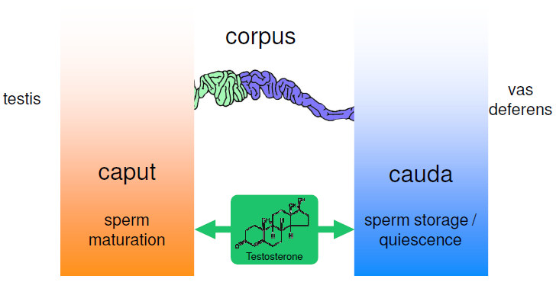
Epididymis

Slide 25
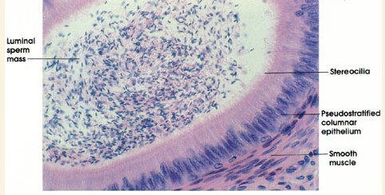
Epididymis contd.
Columnar pseudostratified – tallness decreases caudally, while lumen dilates
Principal cells (65-80%) – bear stereocilia; also narrow, apical, clear, basal and halo
Tight junctions sequester maturing sperm - blood-epididymis barrier
Peristaltic contractions move thespermatozoa towards the corpus/cauda
Caudal smooth muscle fibres contract only during sexual stimulation concurrently with the contraction of the vas deferens

Slide 26
Vas deferens
Fibromuscular tube that is continuous with the epidiymis.
Enters the abdominopelvic cavity through the inguinal canal and passes along the lateral pelvic wall.
Crosses over the ureter and the urinary bladder, down towards the prostate gland.
Lined with pseudostratified columnar epithelium and similar to epididymis, the cells have long stereocilia.
The lamina propria is rich in elastic fibres and the muscularis is well developed

Slide 27
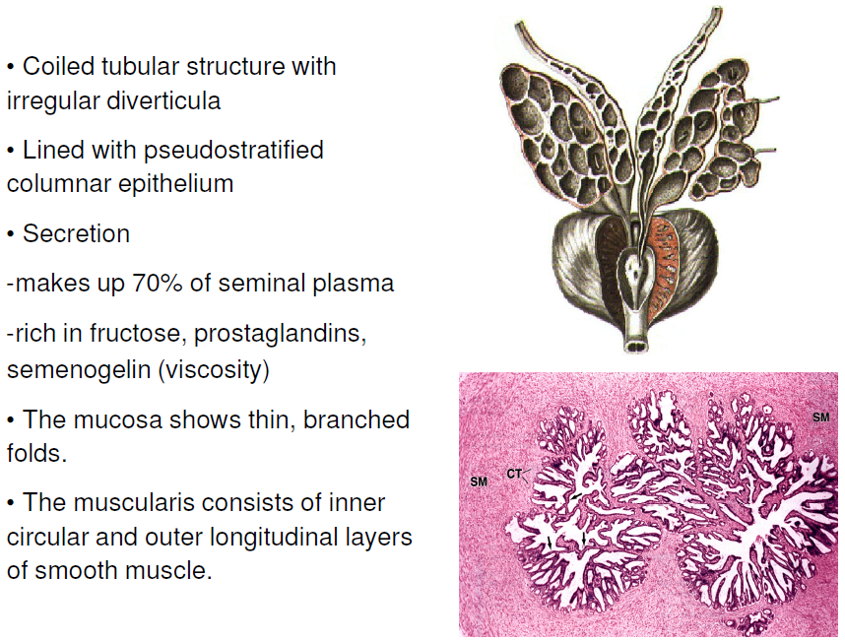
Seminal Vesicles

Slide 28
Prostate
The prostate gland is a chestnut-shaped reproductive organ located directly beneath the bladder of the male. It adds secretions to the sperm during the ejaculation of semen. The gland surrounds the urethra, with the diameter in the broadest area being about 4 cm.
Consists of four zones: transition zone, central zone, peripheral zone (carcinoma) and anterior fibromuscular stroma.
It is a conglomerate of 30 to 50 tubular or saclike glands that secrete fluids into the urethra and ejaculatory ducts. The secretory ducts and glands are lined with a moist, folded mucous membrane. The folds permit the tissue to expand while storing fluids. Beneath this layer are connective tissues composed of a thick network of elastic fibres and blood vessels.
In humans, the prostate contributes 15–30 percent of the seminal plasma (or semen). The fluid from the prostate is clear and slightly acidic. It is composed of several protein-splitting enzymes; fibrolysin, citric acid and acid phosphatase, which help to increase the acidity; and other constituents, including ions and compounds of sodium, zinc, calcium, and potassium.
Normally the prostate reaches its mature size at puberty. Around the age of 50, the size of the prostate and the amount of its secretions commonly decrease. Increase in size after midlife, often making urination difficult, may occur as a result of inflammation or malignancy.

Slide 29
Bulbourethral glands
Bulbourethral gland (Cowper’s Gland), are two pea-shaped glands in the male, located beneath the prostate gland at the beginning of the internal portion of the penis; they add fluids to semen during the process of ejaculation.
The glands, which measure about 1 cm in diameter, have ducts that empty into the urethra. They are composed of a network of small tubes, or tubules, and saclike structures. Between the tubules are fibres of muscle and elastic tissue that give the glands structural support. Cells within the tubules and sacs contain droplets of mucus, a thick protein compound.
In response to sexual stimulation, these glands secrete an alkaline mucus-like fluid which acts as a lubricant by neutralising the acidity of the urine residue in the urethra before the semen is ejaculated; it also helps to neutralise the acidity of the vagina.

Slide 30
Urethra and Ejaculation

Slide 31
Further Readings
Nef S & Parada LS (1999) Cryptorchidism in mice mutant for Insl3: Nature Genetics Vol. 22 pp 295 – 99.
Nef S & Parada LS (2000) Hormones in male sexual development: Genes Dev. 2000 14: 3075-3086.
Kumagai J et al. (2002) INSL3/Leydig insulin-like peptide activates the LGR8 receptor important in testis descent: JBC Vol. 277(35), pp. 31283–31286.
Hughes I & Acerini CL (2008) Factors controlling testis descent: Eur J Endocrinol 159: S75 – S82.
Bay K et al. (2011) Testicular descent: INSL3, testosterone, genes and the intrauterine milieu; Nature Reviews, Vol. 8 pp188 – 196.

