Slide 1
Assisted conception
Factors affecting success and failure
Mausumi Das
Consultant Gynaecologist
Sub-specialist in Reproductive Medicine
Hammersmith Hospital

Slide 2
PATIENT SELECTION
VARIOUS INDICATIONS
TUBAL INFERTILITY
MALE INFERTILITY
OVULATORY
UTERINE CAUSES
ENDOMETRIOSIS
UNEXPLAINED

Slide 3
INVESTIGATIONS
BASELINE INVESTIGATIONS
HORMONAL PROFILE – FSH,LH E2,PGN, TSH
TVS – OVARIAN + UTERINE MORPHOLOGY, ANTRAL FOLLICLE COUNT, ACCESS OVARIES
HSG – UTERINE CAVITY, TUBAL STATUS
SEMEN ANALYSIS – KARYOTYPE, CF SCREEN, HORMONAL PROFILE IF INDICATED

Slide 4
OVULATION INDUCTION
CLOMIPHENE CITRATE FROM DAY 2-6 OF CYCLE
+/- INTRA-UTERINE INSEMINATION

Slide 5
IVF PROTOCOLS
LONG PROTOCOL – GNRH AGONIST STARTING D2/21
ANTAGONIST PROTOCOL – LHRH ANTAGONIST
FLARE (SHORT PROTOCOL)
FROZEN EMBRYO PROTOCOL

Slide 6
STIMULATION
FSH – FOLICLE STIMULATION HORMONE
LH
DAILY SC INJECTIONS
TRIALS FOR LONG ACTING DRUGS
AVERAGE 12 DAYS
DOSE – RANGE 100-400 IU DEPENDING ON AGE, BMI, PCO PREVIOUS RESPONSE, FSH

Slide 7
MONITORING
SERIAL SCANS
BLOODS – SERUM E2 AND LH

Slide 8
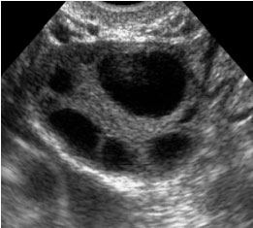

Slide 9
EGG COLLECTION
USUALLY IV SEDATION
TRANSVAGINAL
EXCEPTIONALLY LAPARASCOPIC
MAINTAIN TEMP OOCYTES CRUCIAL
EGGS DIRECTLY IN TO MEDIA
PREPARATION OF SEMEN
IVF/ICSI
INCUBATION EMBRYOS

Slide 10
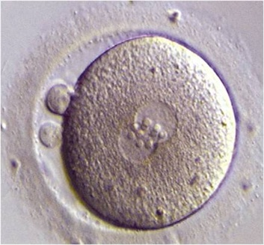
FERTILIZATION

Slide 11
EMBRYO TRANSFER
D2/3 OR BLASTOCYST
GENERALLY WITHOUT SEDATION
SIMPLE PROCEDURE
FLEXIBLE PLASTIC CATHETER
UNDER ULTRASOUND CONTROL
LUTEAL PHASE SUPPORT – PGN
PREGNANCY TEST D14 POST TVOR

Slide 12
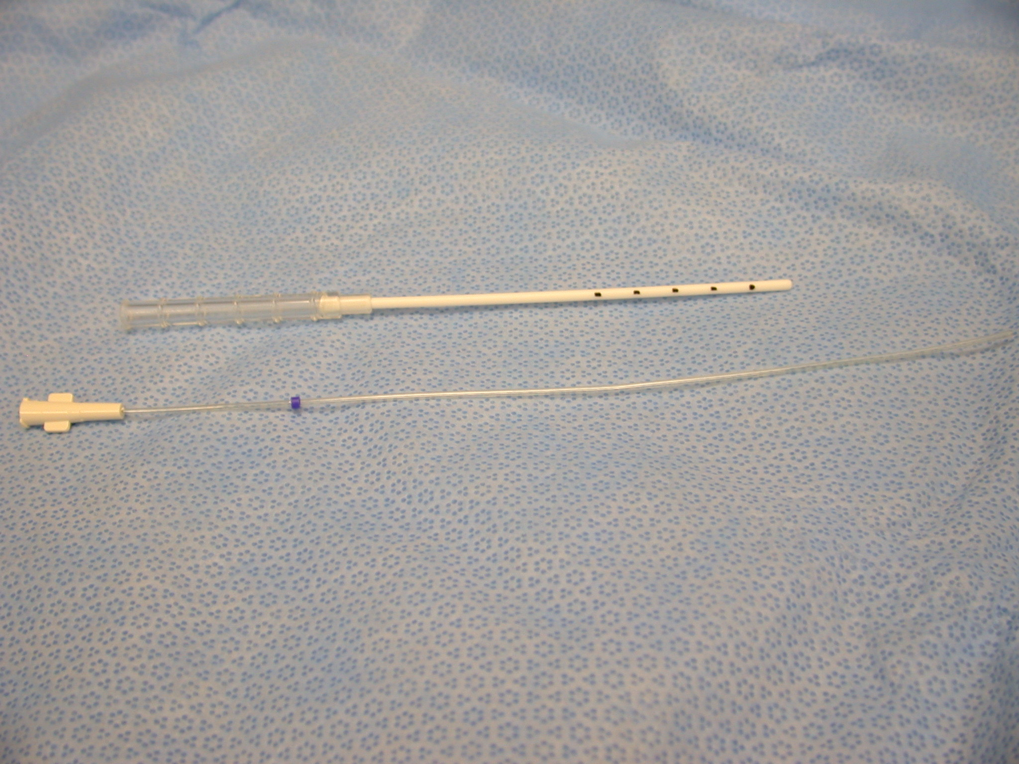

Slide 13
COMPLICATIONS
UNDER RESPONSE
OVER-RESPONSE
BLEEDING
PERFORATION
DAMAGE TO PELVIC ORGANS
NON-FERTILISATION
MULTIPLE PREGNANCY

Slide 14
FACTORS AFFECTING OUTCOME IN IVF

Slide 15
PATIENT CHARACTERISTICS
AGE (OWN EGGS V DONOR)
DURATION OF INFERTILITY
CAUSE OF INFERTILITY(MALE FACTOR,FIBROIDS, ENDOMETRIOSIS ETC)
OBSTETRIC HISTORY
NUMBER PREVIOUS ATTEMPTS
OVARIAN RESERVE AND FSH LEVELS
BMI
SMOKING
CONCURRENT MEDICAL PROBLEMS

Slide 16
CLINIC RELATED FACTORS
NUMBER EMBRYOS TRANSFERRED
TRANSFER EMBRYOS UNDER ULTRASOUND CONTROL
CATHETER TYPE
TREATMENT PROTOCOL
DRUGS USED
STAFF EXPERTISE

Slide 17
PATIENT CHARACTERISTICS - AGE
DECLINE IN OOCYTE QUALITY WITH INCREASING AGE
ESTIMATED THAT UP TO 48% OOCYTES PRODUCED IN OVER 40’S ARE GENETICALLY ABNORMAL
INCREASED RISK OF MISCARRIAGE WITH INCREASING AGE IN SPONTANEOUS AND IVF PREGNANCIES

Slide 18
EFFECT OF AGE ON LIVEBIRTH RATE

Slide 19
COMPARISON OF LIVEBIRTH RATES BY AGE

Slide 20
PATIENT CHARACTERISTICS - EGG DONATION
IN ALL AGE GROUPS EXCEPT UNDER 29 YO LIVEBIRTH RATE IS GREATER USING DONATED EGGS
DIRECTLY RELATED TO THE QUALITY (BIOLOGICAL AGE) OF THE EGG
CLINICAL INDICATIONS- PREMATURE MENOPAUSE, GENETIC, MULTIPLE FAILED ATTEMPTS, AGE OOPHORECTOMY, POST CHEMO AND RADIOTHERAPY

Slide 21
LIVEBIRTH RATES IN WOMEN USING OWN AND DONATED EGGS

Slide 22
PATIENT CHARACETRISTICS-DURATION OF INFERTILITY
GRADUAL DECLINE IN LIVEBIRTH RATE WITH INCREASING NUMBER OF YEARS INFERTILITY
APPROX 15.3% CHANCE OF SUCCESS IN FIRST 1-3YEARS OF INFERTILITY FALLING TO 8.6% CHANCE AFTER MORE THAN 12 YEARS
RESULTS ADJUSTED FOR AGE BUT NOT CAUSE OF INFERTILITY

Slide 23
LIVEBIRTH RATES BY DURATION OF INFERTILITY

Slide 24
PATIENT CHARACTERISTICS - CAUSE OF INFERTILITY
OUTCOME MAY DEPEND ON CAUSE OF INFERTILITY. TEMPLETON ET AL LOOKED AT:-
TUBAL
ENDOMETRIOSIS
UTERINE/CERVICAL
UNEXPLAINED- HIGHER RATE PER EMBRYO TRANSFER EXPLAINED BY FEWER WOMEN IN THIS GROUP REACHING TRANSFER -FAILURE TO FERTILISE
MALE FACTOR INFERTILITY NOW HAS GOOD OUTCOME WITH THE INTRODUCTION OF ICSI

Slide 25
LIVEBIRTH RATES BY CAUSE OF INFERTILITY

Slide 26
PATIENT CHARACTERISTICS- CAUSE OF INFERTILITY
DATA APPEAR TO SHOW THAT NO REAL DIFFERENCE IN OUTCOME DUE TO CAUSE OF INFERTILITY AS WHOLE GROUPS.
MORE RECENT DATA IMPLIES THERE MAY BE SUB-CATEGORIES WITHIN EACH DIAGNOSTIC CATEGORY WHICH DO BETTER

Slide 27
CAUSES OF INFERTILITY-TUBAL FACTOR
PRESENCE OF HYDROSAPLINX (FLUID IN DILATED BLOCKED TUBE) MAY ALSO AFFECT IMPLANTATION
HYDRORRHOEA AND ULTRASOUND VISBLE HYDROALPINGES MAY CONFER WORST PROGNOSIS
MULTICENTRE PROSPECTIVE RANDOMISED TRIAL IN SCANDANAVIA SHOWED X3.5 INCREASED DELIVERY RATE WITH TREATMENT OF SEVERE TUBAL DISEASE BY SALPINGECTOMY PRIOR TO IVF TREATMENT.
?? DECREASED FUNCTION IN IPSILATERAL OVARY AFTER UNILATERAL SALPINGECTOMY-COMPROMISED BLOOD SUPPLY

Slide 28
CAUSE OF INFERTILITY-ENDOMETRIOSIS
PRESENCE OF VIABLE ENDOMETRIAL TISSUE OUTSIDE THE ENDOMETRIAL CAVITY
AFFECTS 2-3% OF WOMEN OF REPRODUCTIVE AGE
PATHOPHYSIOLOGY REMIANS UNCLEAR
REDUCED FECUNDITY IN MODERATE TO SEVERE DISEASE MOST LIKELY DUE TO PELVIC ADHESIONS AND TUBAL BLOCKAGE
MECHANISMS OF IMPAIRMENT OF FERTILITY IN MILD TO MODERATE DISEASE REMAIN UNDETERIMINED BUT SUGGESTIONS HAVE BEEN IMPAIRED FOLLUCULOGENESIS, DISORDERS OF OVULATION,LUTEAL PHASE DEFICIENCY, HYPERPROLACTINAEMIA (CAUSING OLIGO OR AMENORRHOEA) AUTOIMMUNITY

Slide 29
CAUSE OF INFERTILITY- UTERINE FACTORS
PRESENCE OF FIBRIODS
SUBMUCOUS FIBROIDS (THOSE BREACHING THE ENDOMETRIUM) MAY IMPAIR IMPLANATION IN THE UTERINE CAVITY. HYSTEROSCOPIC RESECTION IMPROVES FERTILITY
NO GOOD EVIDENCE TO SHOW THAT SMALL SUB-SEROSAL OR INTRAMURAL FIBROIDS AFFECT FERTILITY
PRESENCE OF POLYPS
LARGE POLYPS MAY LIKEWISE INTERFERE WITH IMPLANTATION BY ACTING AS SPACE OCCUPYING LESION

Slide 30
PATIENT CHARACTERISTICS-PAST OBSTETRIC HISTORY
CHANCES OF SUCCESS WITH IVF INCREASED IF :-
PREVIOUS PREGNANCY
EFFECT STRONGER FOR PREVIOUS LIVEBIRTH THAN FOR PREGNANCY NOT ENDING IN LIVEBIRTH
PREVIOUS IVF PREGNANCY HAS STRONGER EFFECT
PREVIOUS IVF LIVEBIRTH ASSOCIATED WITH LIVEBIRTH RATE PER TREATMENT CYCLE OF 23.2% COMPARED WITH 12.5% FOR NO PREVIOUS PREGNANCY

Slide 31
EFFECT OF PREVIOUS PREGNANCIES ON LIVEBIRTH RATES

Slide 32
PATIENT CHARACTERISTICS - NUMBER OF PREVIOUS IVF ATTEMPTS
BETTER PROGNOSIS WITH NO PREVIOUS CYCLES OF IVF
DECREASES SIGNIFICANTLY WITH INCREASING NUMBERS OF CYCLES
WITH NO PREVIOUS TREATMENT 14% LIVEBIRTH PER TREATMENT CYCLE
AFTER 4 PREVIOUS TREATMENT CYCLES LIVEBIRTH RATE OF 8.9%
ALL DATA ADJUSTED FOR AGE

Slide 33
LIVEBIRTH RATES BY NUMBER OF PREVIOUS UNSUCCESSFUL IVF ATTEMPTS

Slide 34
PATIENT CHARACTERISTICS-OVARIAN RESERVE
FSH ESTIMATION ON DAY2-5 OF MENSTRUAL CYCLE MAY GIVE AN INDICATION OF OVARIAN RESERVE
NORMAL FSH </= 8
AMH
ANTRAL FOLLICLE COUNT
OVARIAN VOLUME
MAY CHOOSE PROTOCOL ACCORDING TO FSH,AMH VALUES
OTHER METHODS OF ASSESSING OVARIAN RESERVE
CLOMIPHENE CHALLENGE TEST
BASAL E2 LEVELS
BASAL INHIBIN LEVELS
EXOGENOUS FSH OVARIAN RESERVE TEST (EFORT)

Slide 35
CLINIC RELATED FACTORS
NUMBER OF EMBRYOS TRANSFERRED
TRANSFER EMBRYOS UNDER ULTRASOUND CONTROL
CATHETER TYPE
TREATMENT PROTOCOL
DRUGS USED
STAFF EXPERTISE

Slide 36
CLINIC RELATED FACTORS- NUMBER OF EMBRYOS TRANSFERED
TRADE OFF BETWEEN SUCCESSFUL OUTCOME AND MULTIPLE PREGNANCY RATE
TRANSFER OF SINGLE EMBRYO DECREASES SUCCESS RATE BUT PREVENTS MULTIPLE PREGNANCY
TRASNFER OF THREE EMBRYOS SIGNIFICANT RISK OF TWIN PREGNANCY (ALTHOUGH LESS IN OVER 40’S)
TRANSFER OF 2 EMBRYOS BALANCES RISK OF MULTIPLE BIRTH AND SUCCESS RATES BUT SIGNIFICANT CHANCE OF TWIN PREGNANCY STILL
SINGLE EMBRYO TRANSFER (BLASTOCYST)

Slide 37
CLINIC RELATED FACTORS - TRANSFER OF EMBRYOS UNDER ULTRASOUND CONTROL
TRANSFER OF EMBRYOS UNDER ULTRASOUND CONTROL VERSUS TOUCH TECHNIQUE
METANALYSIS SUGGESTS THAT IMPLANATATION RATES ARE IMPROVED WITH ULTRASOUND GUIDANCE
MAY PARTICULARY IMPROVE OUTCOME FOR MORE DIFFICULT TRANSFER
ALLOWS IDENTIFICATION OF FALSE PASSAGE

Slide 38
CLINIC RELATED FACTORS- EMBRYO TRANSFER CATHETER
EVIDENCE THAT SOFT CATHETERS HAVE BETTER OUTCOME
LESS ENDOMETRIAL TRAUMA AND HENCE BETTER IMPLANTATION
TIME TAKEN TO TRANSFER EMBRYOS INVERSELY PROPORTIONAL TO SUCCESSFUL OUTCOME
BLOOD ON CATHETER TIP POORER OUTCOME THAN CLEAR TIP

Slide 39
CLINIC RELATED FACTORS- PROTOCOL FOR OVARIAN STIMULATION
INCRESED SUCCESS RATES SINCE THE INTRODUCTION OF GnRH AGONIST CYCLES
LESS CANCELLATIONS DUE TO PREMATURE OVULATION
MORE RECENTLY INTRODUCTION OF GnRH ANTAGONISTS
BETTER FOR USE IN PCOS, POOR RESPONDERS
SOME EVIDENCE TO SUGGEST THAT GnRH ANTAGONIST CYCLES OR SHORT PROTOCOLS MAY BE USEFUL IN OLDER WOMEN

Slide 40
CLINIC REALTED FACTORS- CHOICE OF FSH AND LUTEAL PHASE SUPPORT
MAINLY RECOMBINANT FSH (DUE TO RISK OF PRION DISEASE)
MORE COSTLY THAN URINARY DERIVED DERIVATIVES
LESS VARIABILITY IN BIOLOGICAL ACTIVITY LEADING TO LESS CANCELLATION RATES?
? MAY OVER 40’S/POOR RESPONDERS BENEFIT FROM ADDITION OF LH ALSO
ADDITION OF LUTEAL PHASE SUPPORT IN THE FORM OF PROGESTERONE HAS INCREASED SUCCESS RATES
SMALL INCREASE IN OUTCOME IF hCG USED BUT MORE HYPERSTIMULATION

Slide 41
EMBRYOLOGY
BLASTOCYST CULTURE-
HELPS CHOOSING BEST EMBRYOS TO REPLACE, USEFUL FOR SINGLE EMBRYO TRANSFER
VITRIFICATION-BETTER METHOD OF FREEZING THAN SLOW FREEZING

Slide 42
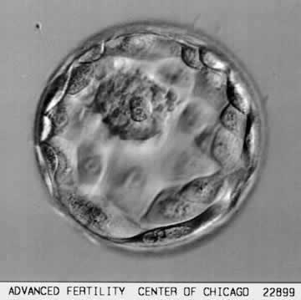
BLASTOCYST

Slide 43
CLINIC RELATED FACTORS- STAFF EXPERTISE
MULTIDISCIPLINARY TEAM ON ALL IVF UNITS
ALL ASPECTS OF CARE POTENTIALLY CAN AFFECT OUTCOME
CORRECT INTERPRETATION OF SCREENING DATA
KNOWLEDGE OF TREATMENT PROTOCOLS AND INTERPRETATION OF BLOOD RESULTS
GOOD LABORATORY PROCEDURES
GOOD OUTCOMES TEND TO COME FROM WELLL ESTABLISHED CLINICS

Slide 44
REFERENCES
Management of Infertility. RCOG press 2003
The Management of Infertility in Tertiary Care www.rcog.org.uk
Templeton A, Morris J, Parslow R.Factors that affect outcome of in-vitro fertilitsation treatment. The Lancet 1996; 348: 1402-1406.
Buckett W. A mata-analysis of ultrasound-guided versus clinical touch embryo transfer. Fertil Steril. 80 (4):1037-41, 2003 Oct.
Pritts E. Fibroids and Infertility. A systematic review of the evidence. Obs and Gyn Survey 2001;56:483-491.
A. Strandell et al. Hydrosalpinx and IVF outcome: a prospective, randomsied multicentre trial inScandinavia on salpingectomy prior to IVF. Hum Rep 14 (11) 2762-2769, 1999.
Elster N. Less is more:the risks of multiple births. Fertil and Steril, 74, 820-823

