Slide 1
GE Psychology 11
Social Psychology
4 June 2013
David Murphy
Consultant Clinical Psychologist
Course Leader

Slide 2
Learning objectives
Define Attitudes and discuss the relationship between attitudes and behaviour (NB. This links to the Health Beliefs session esp. Theory of planned behaviour)
Define prejudice and describe how prejudice is maintained
  (NB This links with Cognitive Psychology esp. the effect of schemas)
Define conformity and discuss the factors predicting conformity
Define Group Processes of Social Loafing, De-individuation, Group Polarization and Group Think.
Discuss the factors which predict helping behaviour including the “bystander effect”
Define “Leadership” and styles of leadership
Discuss characteristics of effective leadership

Slide 3
Social Thinking
Social Psychology: the study of:
  Social Thinking: how we think about our social world
  Social Influence: how other people influence our behaviour
  Social Relations: how we relate toward other people

Slide 4
Attitudes and Prejudices
Attitude: a positive or negative evaluative reaction toward a stimulus, such as a person, action, object, or concept
Attitudes influence behaviour more strongly when situational factors that contradict our attitudes are weak

Slide 5
Prejudice
Stereotype – Schemas about characteristics ascribed to a group of people based on qualities such as race, ethnicity, or gender.
Prejudice – A negative prejudgement of a group and its individual members
Discrimination – behaviours that follow from negative evaluations or attitudes towards members of particular groups
(See http://www.understandingprejudice.org)

Slide 6
Effect of prejudice on perception Ickes et al (1982)
Introduced pairs of college aged men to each other.
Before introduction one of the pair was told that the other was “one of the unfriendliest people I’ve talked to lately”.
The two were then introduced and left alone for 5 minutes.
Those in both conditions were friendly, in fact the pre-warned individuals went out of their way to be friendly and received warm responses.

Slide 7
Effect of prejudice (contd)
However, after the encounter those who were prejudiced attributed their partner’s warm responses to their own behaviour.
They also reported more mistrust and dislike for the person and rated his behaviour as less friendly.
Similar studies have found the effect of prejudiced information persist even when the participants were told it was randomly allocated.

Slide 8
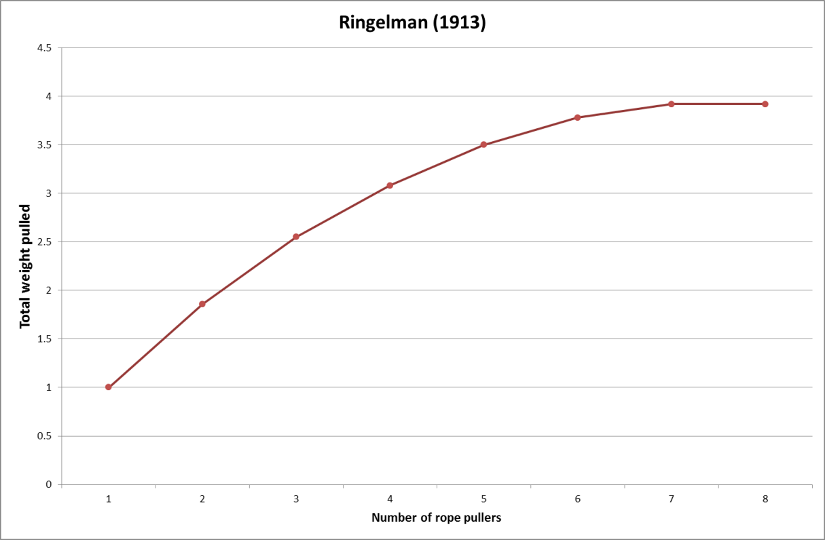
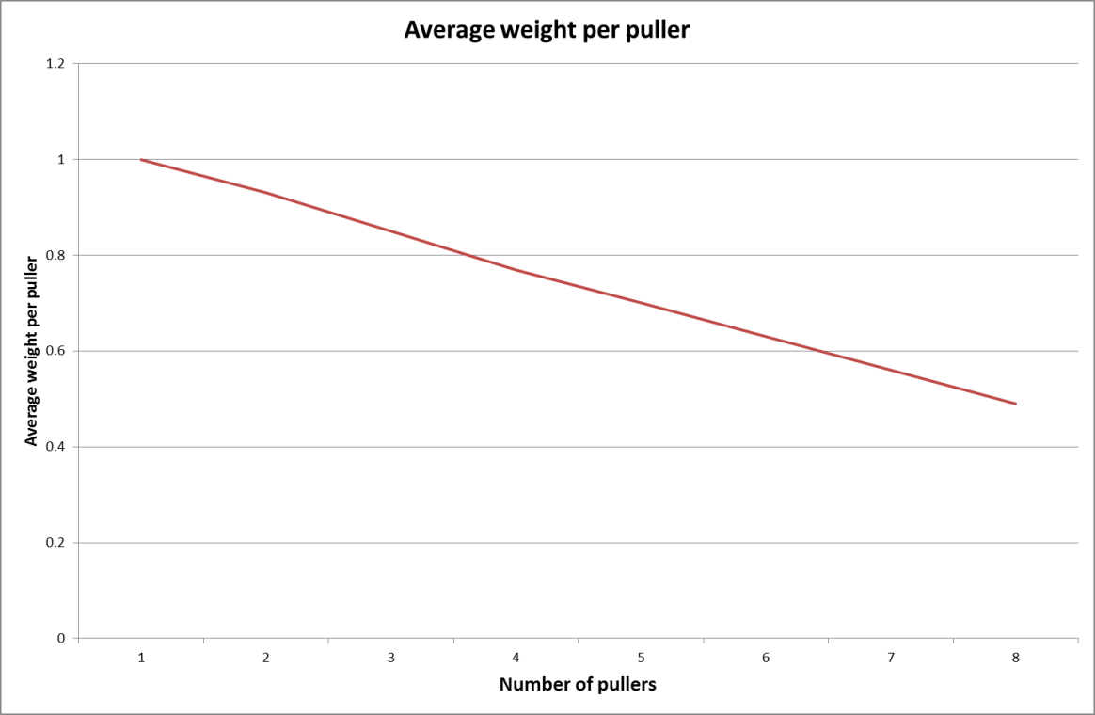
Max Ringleman, a French Engineer carried out a famous experiment in which he measured the force generated by different numbers of workers pulling on a rope

Slide 9
Social Loafing
Definition - the tendency for people to expend less individual effort when working in a group than when working alone

Slide 10
Social loafing
More likely to occur when:
  The person believes that individual performance is not being monitored
  The task (goal) or the group has less value or meaning to the person
  The person generally displays low motivation to strive for success
  The person expects that other group members will display high effort
Depends on gender and culture
  Occurs more strongly in all-male groups
  Occurs more often in individualistic cultures
Social loafing may disappear when:
  Individual performance is monitored
  Members highly value their group or the task goal

Slide 11
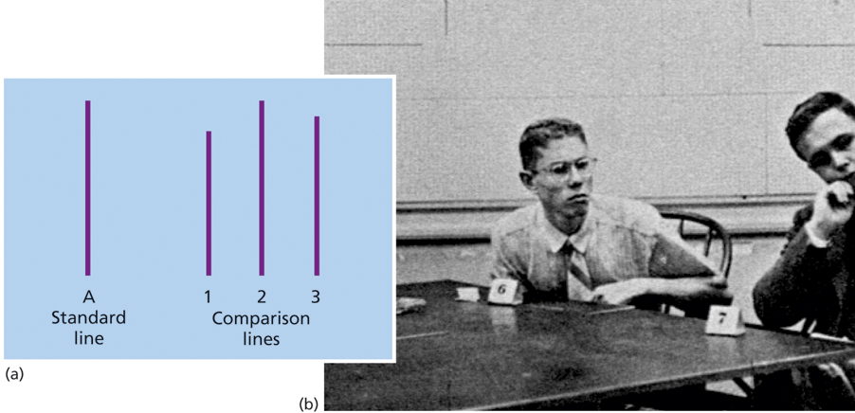
Conformity (Asch 1956)

Slide 12
Conformity
Factors that affect conformity:
  Group size:
    Conformity increases as group size increases
    No increases over five group members
  Presence of a dissenter:
    One person disagreeing with the others greatly reduces group conformity
  Culture:
    Greater in collectivistic cultures

Slide 13
The Milgram Experiment (1974)
One “learner”, one “teacher” – told that experiment studied the effect of punishment on memory.
  Shock generator used to
  apply punishment
  Shocks grew increasingly
  intense with each mistake

Slide 14
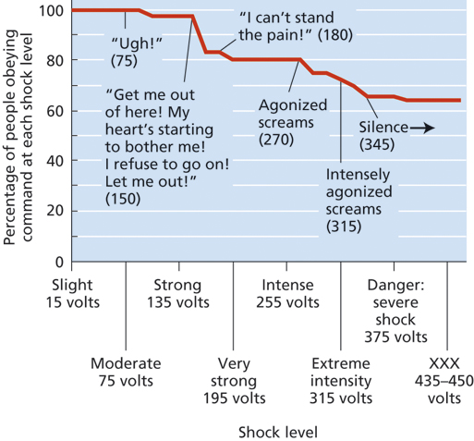

Slide 15
Obedience
Factors That Influence Obedience:
  Remoteness of the victim
  Closeness and legitimacy of the authority figure
  Diffusion of responsibility: obedience increases when someone else does the dirty work
  Not personal characteristics

Slide 16
Group decision making
Groupthink - the tendency of group members to suspend critical thinking because they are striving to seek agreement
Group polarization is the tendency of people to make decisions that are more extreme when they are in a group as opposed to a decision made alone or independently

Slide 17
Symptoms of Groupthink
  Direct pressure applied to people who express doubt
  Mind Guards: people who prevent negative information from reaching the group
  Members display self-censorship and withhold their doubts
  An illusion of unanimity is created

Slide 18
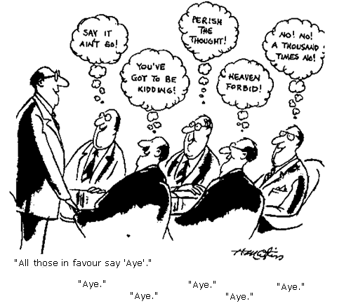
Most likely to occur when a group:
  Is under high stress to reach a decision
  Is insulated from outside input
  Has a directive leader
  Has high
  cohesiveness

Slide 19
Factors in de-individuation
Group size
Mann 1981 studied incidents of individuals threatening to jump from a building and found that the onlookers only encouraged the person to jump when there was a large group
Physical anonymity
Zimbardo 1970 found that found that when participants were wearing a mask they delivered electric shocks to helpless victims than when they were identifiable
Arousing and distracting activities
e.g. Chanting, dancing etc

Slide 20
Kitty Genovese
Watch this clip - http://www.youtube.com/watch?v=vwMMMPjOW4g

Slide 21
Helping
The Bystander Effect: presence of multiple bystanders inhibits each person’s tendency to help
  Due to social comparison or diffusion of responsibility

Slide 22
Darley & Latane Experiment
Helping student having an epileptic seizure in an adjacent room.
87% helped if they believed it was just them and the other student.
But only 31% helped when they believed they were in a group of 4 people, hardly anyone helped if group was above 4.
If participant had not acted within first 3 minutes they never acted.

Slide 23
5-Step Bystander Decision Process (Latané & Darley 1970)
Notice the event
Decide if the event is really an emergency
  Social comparison: look to see how others are responding
Assuming responsibility to intervene
  Diffusion of Responsibility: believing that someone else will help
Self-efficacy in dealing with the situation
Decision to help (based on cost-benefit analysis)

Slide 24
Increasing helping behaviour
Reducing restraints on helping
Reduce ambiguity and increase responsibility
Enhance guilt and concern for self image
Socialize altruism
Teaching moral inclusion
Modeling helping behaviour
Attributing helpful behaviour to altruistic motives
Education about barriers to helping

Slide 25
Doctors as leaders
"It is not enough for a clinician to act as a practitioner in their own discipline. They must act as partners to their colleagues, accepting shared accountability for the service provided to their patients. They are also expected to offer leadership and to work with others to change systems when it is necessary for the benefit of patients."
Tomorrow's Doctors, 2009

Slide 26
Examples of great leaders

Slide 27
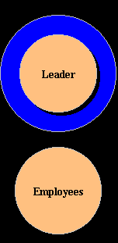
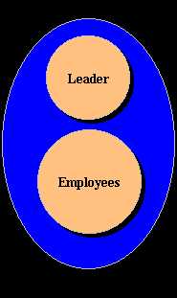
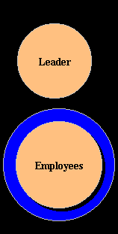
Leadership styles (Kurt Lewin)
Autocratic or authoritarian style
  Under the autocratic leadership style, all decision-making
  powers are centralized in the leader, as with dictator leaders.
  They do not entertain any suggestions or initiatives from
  subordinates.
Participative or democratic style
  The democratic leadership style favours decision-making by the group as shown, such as leader gives instruction after consulting the group. They can win the co-operation of their group and can motivate them effectively and positively.
Laissez-faire or “free rein” style
  A free-rein leader does not lead, but leaves the group entirely to itself as shown; such a leader allows maximum freedom to subordinates, i.e., they are given a free hand in deciding their own policies and methods.

Slide 28
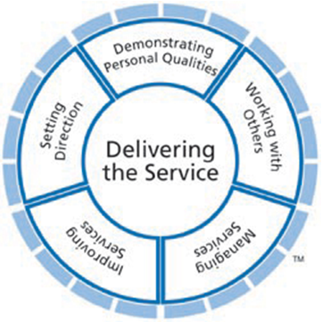
Medical Leadership Competency Framework – 3rd Edition (2010)
http://www.leadershipacademy.nhs.uk/discover/leadership-framework/

Slide 29
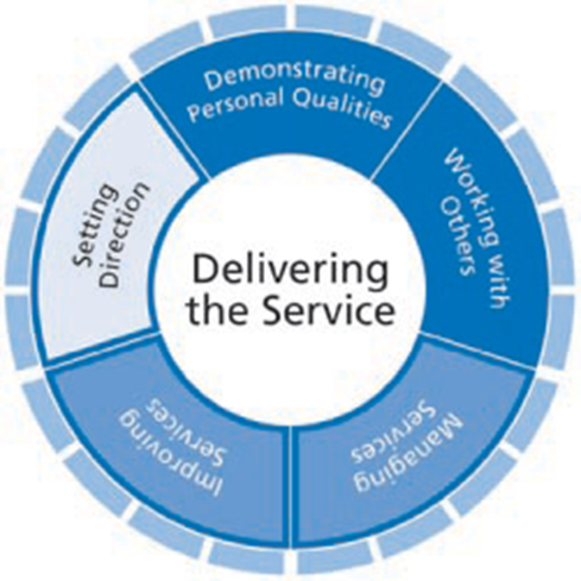
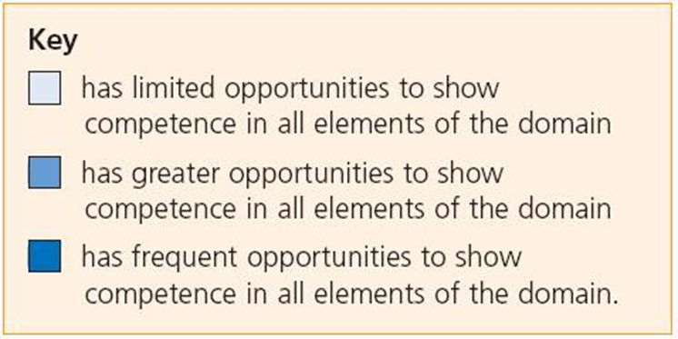
Leadership in undergraduate training

Slide 33
Leadership experiences during undergraduate training
During their medical school training students will have access to relevant learning opportunities within a variety of situations including:
• peer interaction
• group learning
• clinical placements
• activities and responsibilities within the university
• involvement with charities, social groups and organisations.
All these situations can provide a medical student with the opportunity to develop experience of leadership, to develop their personal styles and abilities, and to understand how effective leadership will have an impact on the system and benefit patients as they move from learner to practitioner on graduating.
Medical Leadership Framework (2010)

