Slide 1
Visual system: pathways and function
Paresh Malhotra
Korina Li

Slide 2
Learning Objectives
Know the anatomy of the visual pathways
Appreciate visual dysfunction associated with different sites of neuroanatomical damage

Slide 3
Outline
Anatomy
Central visual pathway
Dorsal & ventral streams
Pupillary light reflex
Effects of focal dysfunction & clinical relevance

Slide 4
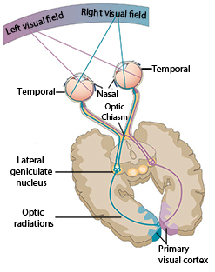
Central Visual Pathway
Optic nerve
Optic tract

Slide 5
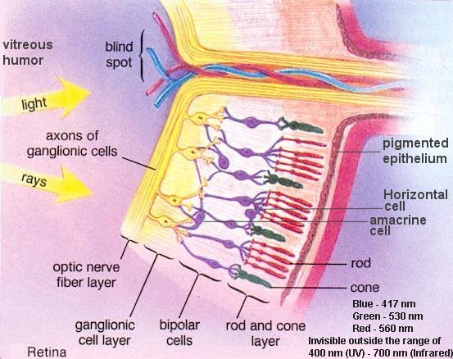
Retina

Slide 6
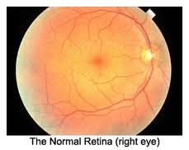
Retina
Superior
Temporal
Optic disc
Nasal
Fovea
Macula
Inferior

Slide 7
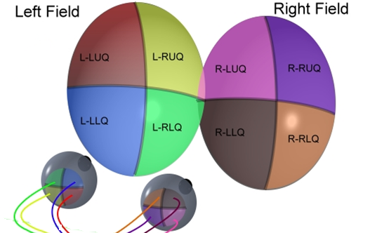
Retina

Slide 8
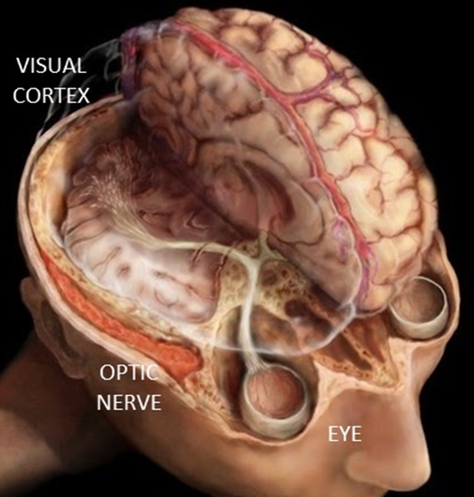
Optic Nerve
CNS structure
≈ 50mm long
800, 000 to 1.5 million ganglion cell axons
4 portions from globe to chiasm:
Intraocular
Intraorbital
Intracanalicular
Intracranial

Slide 9
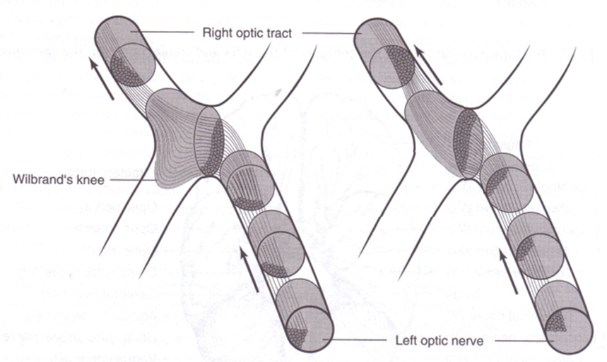
Optic Chiasm

Slide 10
Optic Tract
Optic nerve
Optic tract

Slide 11
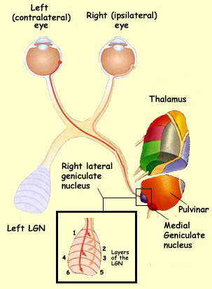
Lateral Geniculate Nucleus

Slide 12
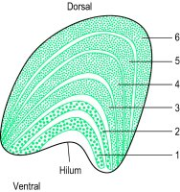
Lateral Geniculate Nucleus
6 layers
Layers 1 and 2 receive signals that travel by the magnocellular pathway
Layers 3 to 6 receive signals that travel by the parvocellular pathway
Parvocellular layers
Magnocellular layers

Slide 13
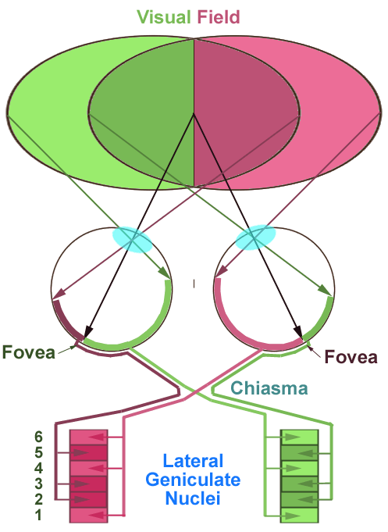
Lateral Geniculate Nucleus
Information from the contralateral eye goes to layers 1, 4 and 6
Information from the ipsilateral eye goes to layers 2, 3 and 5

Slide 14
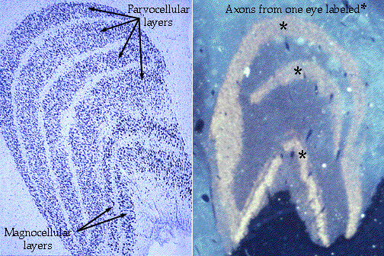
Lateral Geniculate Nucleus

Slide 15
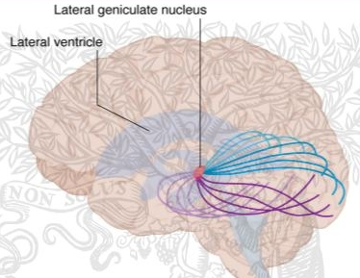
Optic Radiations
Left visual field
Right visual field
Blind spot
Macula
Macula
R
Left eye
Right eye
Meyer’s loop
L

Slide 16
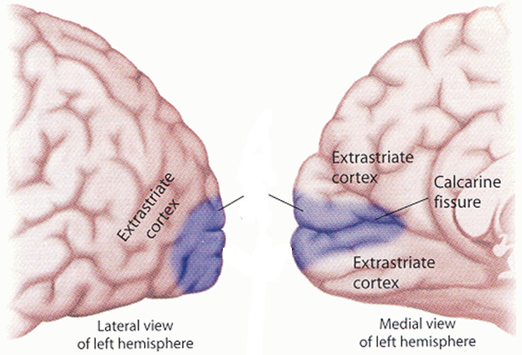
Primary Visual Cortex
V1

Slide 17
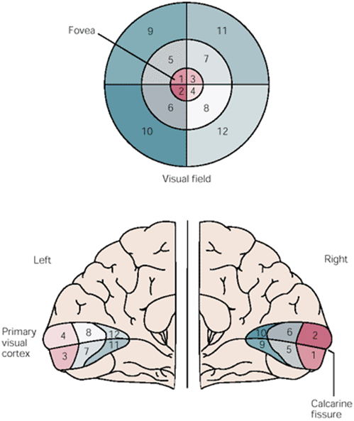
Primary Visual Cortex
The left visual field projects onto the right occipital lobe & vice versa
The central part of the visual field is represented posteriorly
The peripheral visual field is represented more anteriorly
The superior visual field is represented ventrally

Slide 18
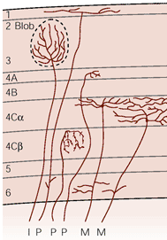
Primary Visual Cortex
6 layers
Principal layer for inputs from LGN is layer 4:
4A - minor inputs from parvocellular layers
4Cα - from magnocellular layers
4Cβ - from parvocellular layers

Slide 19
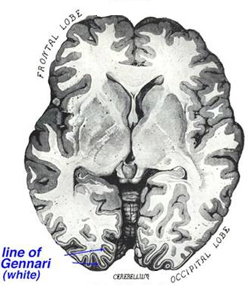
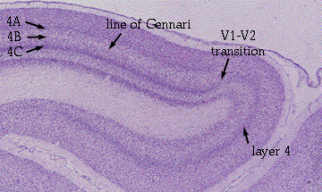
Primary Visual Cortex
Also called the Striate cortex because it contains a prominent stripe of white matter in layer 4, the stria of Gennari

Slide 20
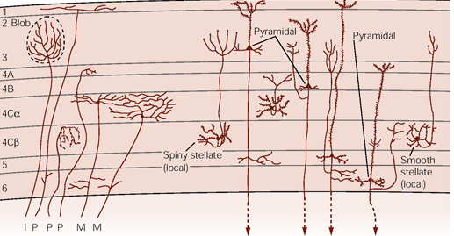
Primary Visual Cortex
Several types of
neurones make
up V1:
Pyramidal cells
Excitatory
Axons project
locally & out of
the cortex
Spiny stellate cells
Excitatory
Interneurones - axons project locally within V1
Smooth stellate cells
Inhibitory
Interneurones - axons project locally within V1

Slide 21
Primary Visual Cortex
Receptive fields of V1 cells can be:
Simple
Respond to bars of light with a specific orientation
Complex
Respond to a moving light stimulus of a particular orientation & direction of travel

Slide 22
Primary Visual Cortex
Columnar organisation:
Orientation columns
Ocular dominance columns
Blobs
Hypercolumns (cortical modules)

Slide 23
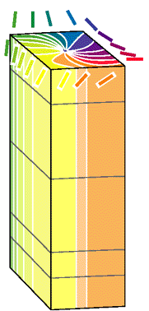
Primary Visual Cortex
Orientation columns contain cells with the same orientation preference
1
2 & 3
4
5
6

Slide 24
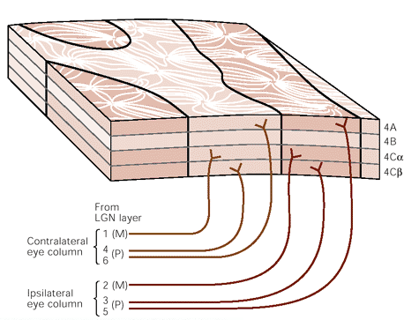
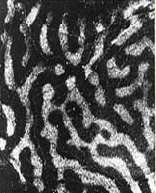
Primary Visual Cortex
Ocular dominance columns located in layer 4C process separate inputs from each eye
C
I
C
I

Slide 25
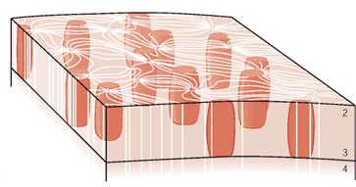
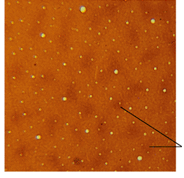
Primary Visual Cortex
Blobs are:
Peg-shaped regions of cells prominent in layers 2 & 3 that interrupt the pattern of the orientation columns
Sensitive to the wavelength of light ie: to colour
Interblob regions are areas between the blobs
Blobs
Blobs

Slide 26
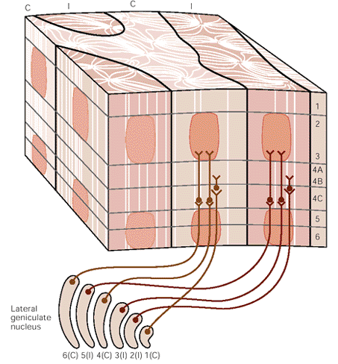
Primary Visual Cortex
Hypercolumn
A hypercolumn is a set of columns responsive to lines of all orientations from a particular region in the visual field & viewed by both eyes

Slide 27
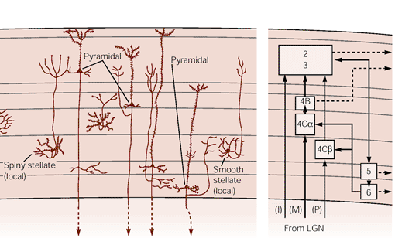
Information Flow Through V1
To other (extrastriate) cortical areas
eg: V2, 3, 4, 5, MT
To subcortical areas:
To SC, pulvinar, pons
To LGN & claustrum

Slide 28
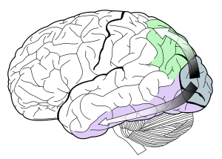
Extrastriate Visual Areas
Dorsal ‘Where’ Stream
Spatial awareness
Visually-guided behaviour
V1
Ventral ‘What’ Stream
Recognition & discrimination of visual shapes & objects
Perception & recognition of faces

Slide 29
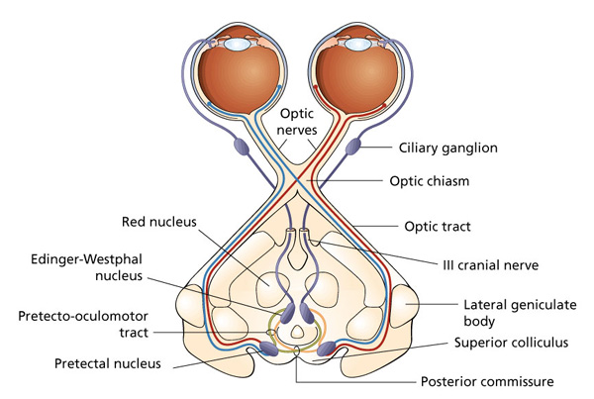
Pupillary Light Reflex
Controls the amount of light reaching the retina
Illumination of the retina causes reflex constriction of the pupil
Direct & consensual components

Slide 30
Visual Dysfunction in Neurological Disease

Slide 31
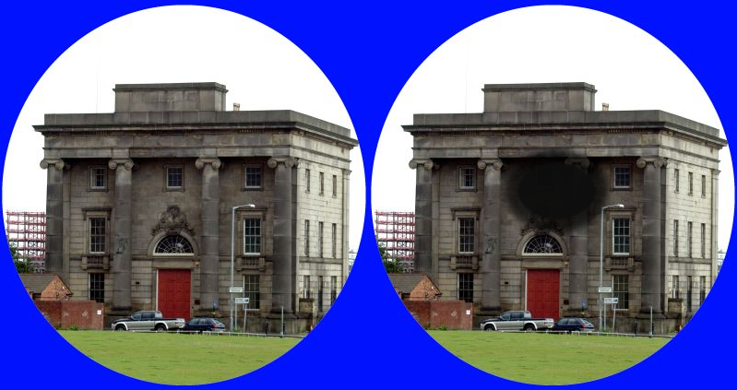
Right Eye Central Scotoma
Notes:
Axons of ganglion cells from the macula travel centrally in the optic nerve

Slide 32
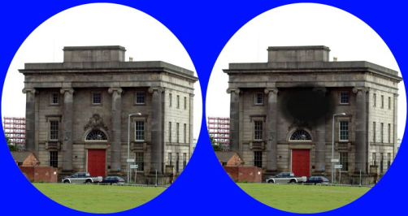
Where is the lesion?

Slide 33
Complete Monocular Visual Loss

Slide 34
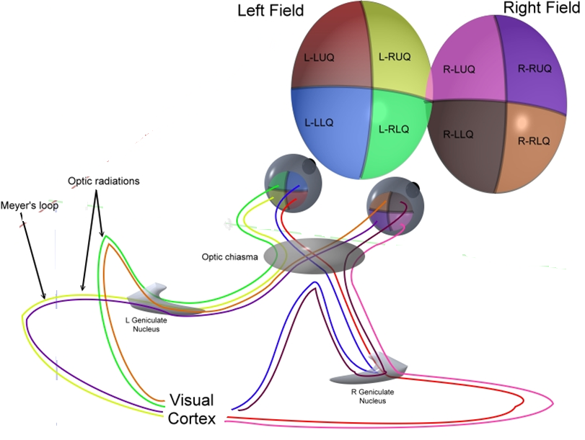
Where is the lesion?

Slide 35
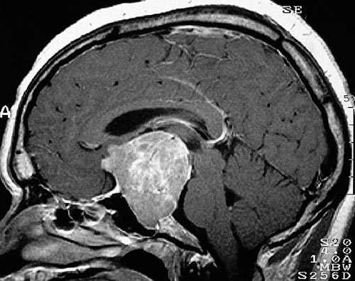
Pituitary Adenoma

Slide 36
What is the visual field deficit?

Slide 37
Bitemporal Hemianopia

Slide 38
What visual field deficit may have been apparent in the early stages?

Slide 39
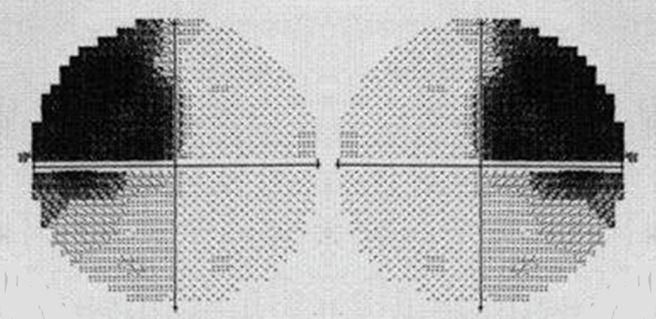
Bitemporal Superior Quadrantanopia

Slide 40
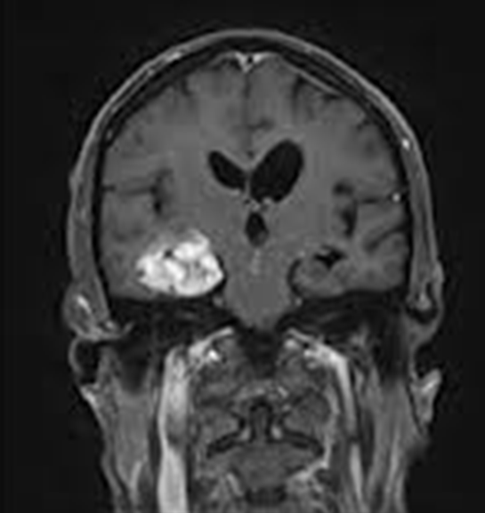
Right Temporal Glioma
R
L

Slide 41
What is the visual field deficit?

Slide 42
Left Homonymous Superior Quadrantanopia

Slide 43
Right Occipital Infarct
R
L

Slide 44
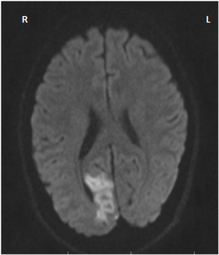
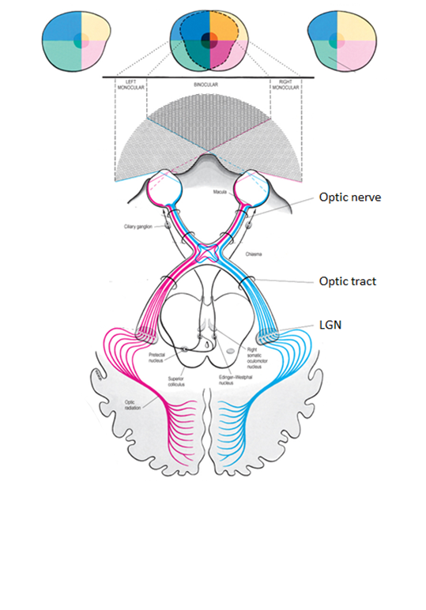
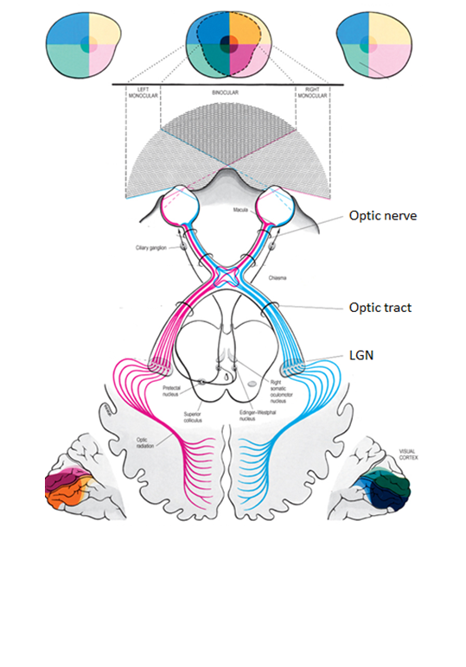
What is the visual field defect?

Slide 45
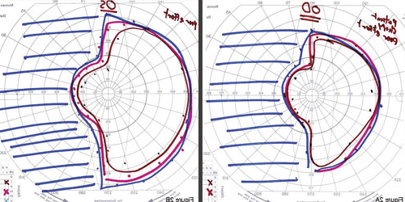
Left Homonymous Hemianopia with Macular Sparing

Slide 46
What visual field defect would you expect to find?

Slide 47
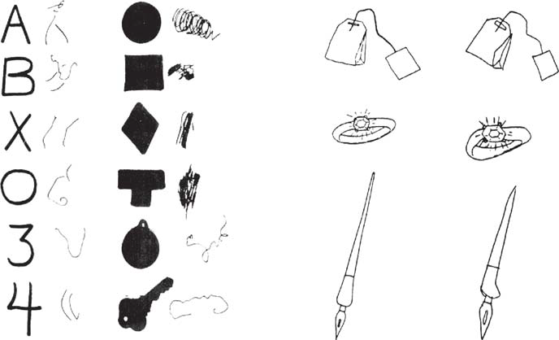
Visual Agnosia
Apperceptive
Cannot recognise by shape
Cannot copy drawings
Often associated with prosopagnosia
Associative
Can copy but unable to identify objects

Slide 48
Which visual pathway is affected?
Ventral ‘What’ Stream

Slide 49
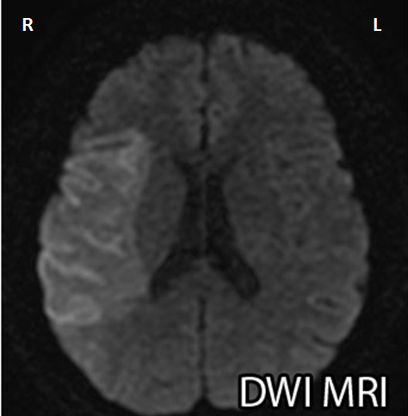
What deficits may this patient have?
Left homonymous inferior quadrantanopia
Left-sided neglect
Right Parietal Infarct

Slide 50
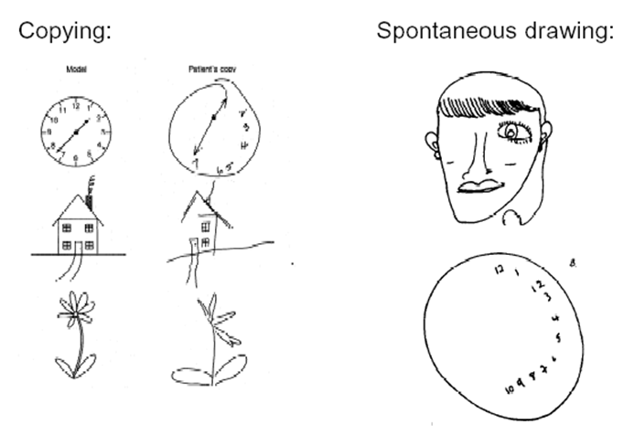
Left-sided Neglect
Stimiuli in the left visual field are not consciously perceived

Slide 51
http://www.guardian.co.uk/science/video/2012/dec/23/stroke-half-world-disappear-video

