Slide 1
Stroke: Case Histories
Overview:
Brief review of pathology
Basic clinical subtypes of stroke
7 cases

Slide 2
Stroke: Pathology
Usual use of word “stroke” applies to an acute neurological syndrome due to:
Large vessel occlusion → cortical infarction
Embolic (cardiac or carotid atheroma)
In situ occlusion (less common)
Parenchymal haemorrhage (usually deep penetrating vessels in hypertensive patients)
Lacunar infarct (in situ occlusion of deep penetrating small end artery, often hypertensive)

Slide 3
Stroke: Clinical Classification
TACS (Total Anterior Circulation Syndrome)
TACI (Infarct)
TACH (Haemorrhage)
PACS (Partial Anterior Circulation Syndrome)
PACI (Infarct)
PACH (Haemorrhage)
POCS (Posterior Circulation Syndrome)
POCI (Infarct)
POCH (Haemorrhage)
LACS (Lacunar Syndrome)
LACI (Infarct)
LACH (Haemorrhage)

Slide 4
Anterior Circulation Stroke: TACS v PACS
Each hemisphere can have up to 3 deficits:
TACS = 3
PACS = 1 or 2
Left (dominant) hemisphere
Hemiparesis
Hemianopia
Dysphasia
Right (non-dominant) hemisphere
Hemiparesis
Hemianopia
Neglect

Slide 5
Example: Left TACS
Each hemisphere has up to 3 deficits:
Left (dominant) hemisphere
Hemiparesis
Hemianopia
Dysphasia
Right (non-dominant) hemisphere
Hemiparesis
Hemianopia
Neglect

Slide 6
Right TACS
Each hemisphere up to 3 deficits:
Left (dominant) hemisphere
Hemiparesis
Hemianopia
Dysphasia
Right (non-dominant) hemisphere
Hemiparesis
Hemianopia
Neglect

Slide 7
Left PACS
Each hemisphere has up to 3 deficits:
Left (dominant) hemisphere
Hemiparesis
Hemianopia
Dysphasia
Right (non-dominant) hemisphere
Hemiparesis
Hemianopia
Neglect

Slide 8
Right PACS
Each hemisphere has up to 3 deficits:
Left (dominant) hemisphere
Hemiparesis
Hemianopia
Dysphasia
Right (non-dominant) hemisphere
Hemiparesis
Hemianopia
Neglect

Slide 9
Lacunar syndromes
Pure hemiparesis (internal capsule)
Pure hemisensory (thalamus)
Sensorimotor (thalamo-capsular)
Brainstem syndromes (eg ataxic hemiparesis, dysarthria-facial weakness)

Slide 10
Case 1
71y female (AF, IHD) wakes with right weakness
On examination
Right hemiparesis
Right homonymous hemianopia
Dysphasia - global

Slide 11
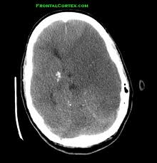
CT: 8h after onset

Slide 12
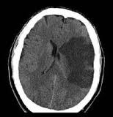
CT at 24h

Slide 13
Case 2
59y male (hypertension)
Acute onset right sided numbness
No weakness
No other deficit
Equal face/arm/leg involvement

Slide 14
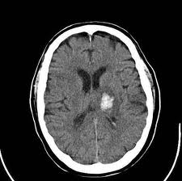
CT

Slide 15
Case 3
69y male (high BP + cholesterol, smoker)
Acute left hemiparesis
Equal face/arm/leg involvement
Mild left UL + LL numbness
No other signs
CT: Normal

Slide 16
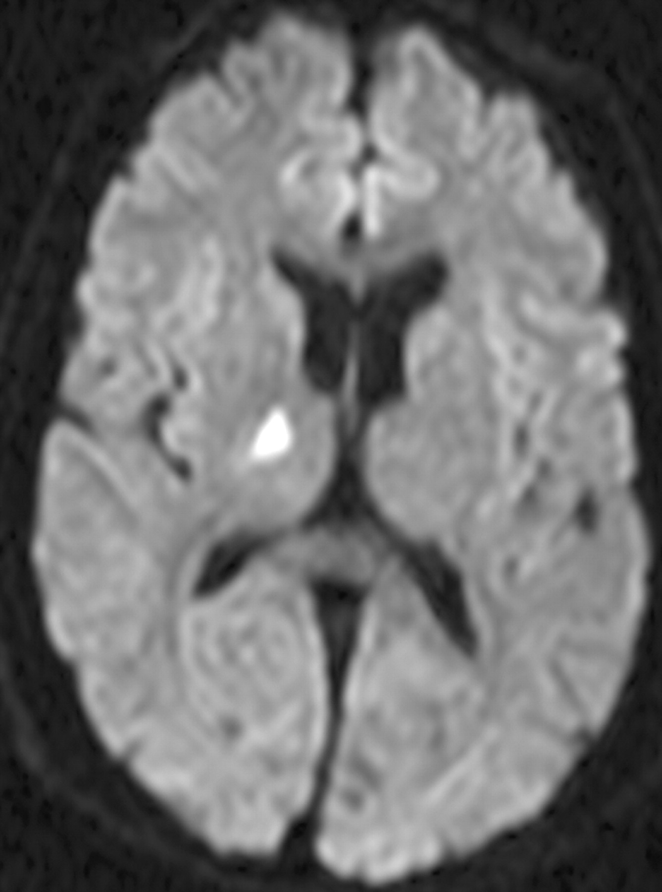
MRI (Diffusion weighted)

Slide 17
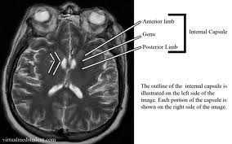
Internal capsule on normal MRI

Slide 18
Case 4
78y female (previous stroke, IHD, DM)
In DGH with UTI
Develops acute left hemiparesis on ward
Transferred to CXH 3/7 later
On exam: Right hemiparesis (arm >> leg)
Right UL + LL brisk reflexes
Right Babinski sign

Slide 19
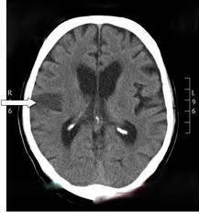
CT

Slide 20
Case 5
71y admitted after his car was hit from left side when patient turning right
Exam:
In AF, normotensive
Left homonymous hemianopia only

Slide 21
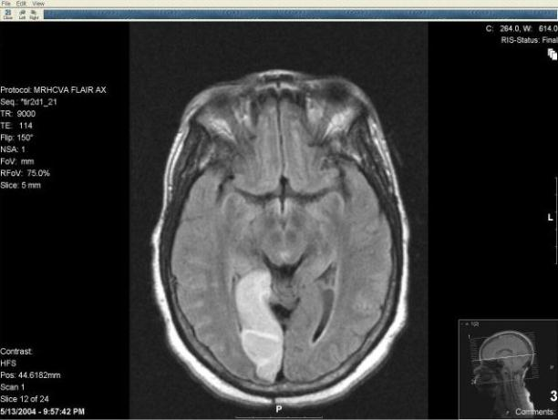
MRI (FLAIR)

Slide 22
Case 6
88y female (hypertension)
C/O left numbness and weakness
Worsens over next 2h
In A&E:
Left hemiparesis
Drowsy
Urgent CT

Slide 23
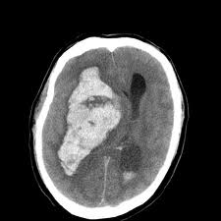
CT

Slide 24
Case 7
64y male
Difficulty finding words 60 mins
Right weakness
Exam:
Expressive dysphasia
Moderate right hemiparesis, reflexes normal
Urgent CT

Slide 25
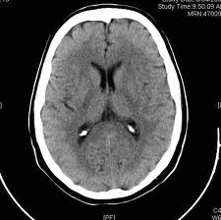
CT

Slide 26
CT
Internal
Capsule
Primary motor
Cortex
Thalamus
Occipital cortex

