Slide 1
Somatosensory system and spinal cord in 6 cases
B Simpson

Slide 2
Case 1
76y male: (PMHx IHD, AF) awoke with left weakness
On examination:
Left 4/5 hemiparesis
Left homonymous hemianopia
Left somatosensory extinction, loss of 2 point discrimination, graphaesthesia, astereognosis

Slide 3
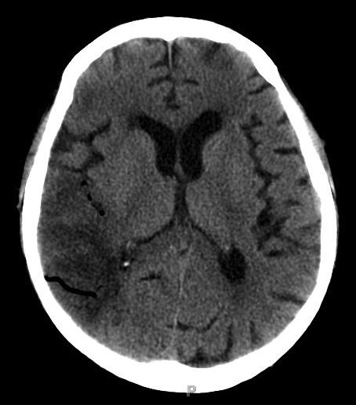
CT

Slide 4
Case 2
67y hypertensive female with sudden onset right sided weakness and numbness
On examination:
Mild left hemiparesis
Panmodal left sensory deficit (ie touch, pain, temperature, joint position & vibration sensation)

Slide 5
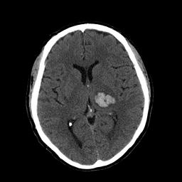
CT

Slide 6
Case 3
71y male with 2y of neck pain and unable to walk as far
6/12 increasing weakness in legs + difficulty with micturition
On examination:
Bilateral Hoffman’s reflexes
Increased tone in legs
Paraparesis (4+/5)
Brisk lower limb reflexes
Bilateral Babinski sign
Unsteady, narrow based gait, Romberg +

Slide 7
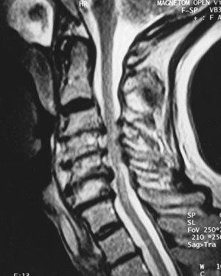
MRI

Slide 8
Case 4
69 male being followed for elevated PSA and urinary symptoms for 3y
Over 3/7 developed paraparesis, numbness in legs and torso up to pectoral level, urinary retention

Slide 9
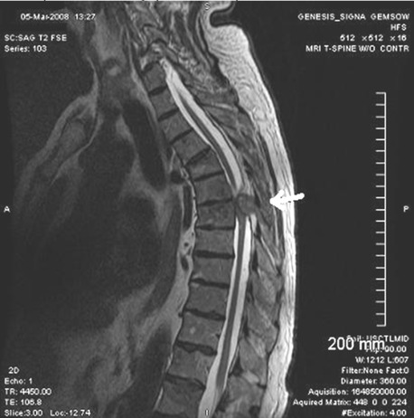
MRI

Slide 10
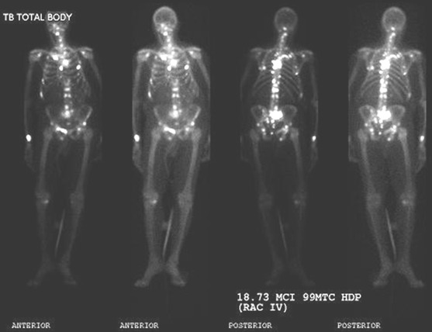

Slide 11
Case 5
19y male stabbed in the back (literally)
Presented to A&E with weak RLL & numb LLL
On examination:
Interscapular wound
Weak R leg with increased tone
Reduced pin & temp sensation LLL + L torso to ~T8

Slide 12
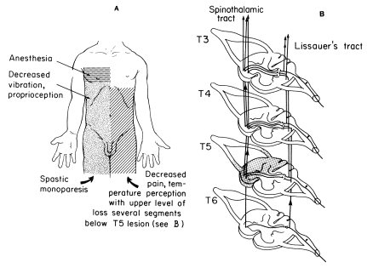

Slide 13
Case 6
51y male with 2y Hx
Symptoms: Weak hands – poor grip; painless burns of hands
Examination:
Wasting intrinsic muscles of hands
Loss of pain & temperature in ‘cape’ distribution
Legs normal

Slide 14
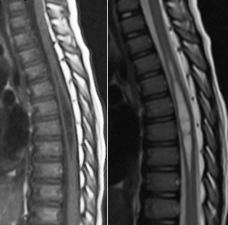
MRI

Slide 15
