Slide 1
Organization of brainstem and cranial nerves
Professor Steve Gentleman
Neuropathology Unit
Department of Medicine
Charing Cross campus
17-04-13

Slide 2
Outline
Definition
Brainstem: external structure
Cranial nerve origins
Brainstem development
Cranial nerve nuclei
Brainstem: internal structure
Brainstem pathology

Slide 3
Brainstem
Definition:
That part of the CNS, exclusive of the cerebellum, that lies between the cerebrum and the spinal cord
Major divisions:
Medulla oblongata
Pons
Midbrain

Slide 4
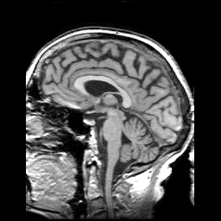

Slide 5
Outline
Definition
Brainstem: external structure
Cranial nerve origins
Brainstem development
Cranial nerve nuclei
Brainstem: internal structure
Brainstem pathology

Slide 7
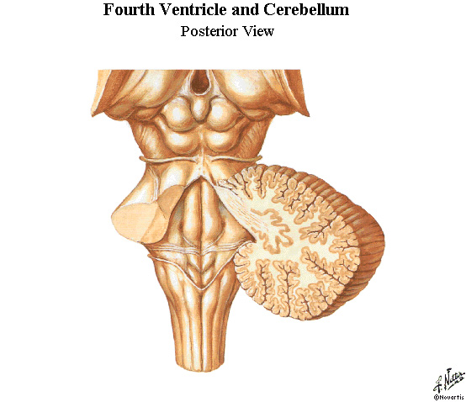
Pineal gland
Trochlear n
Superior colliculus
Inferior colliculus
4th ventricle
Dorsal columns

Slide 9
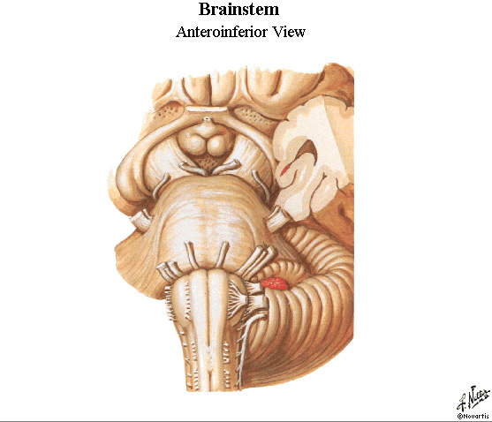
Cerebral peduncle
Optic chiasm
Pituitary stalk
Mammillary body
Oculomotor n
Abducens, facial &
vestibulocochlear n
Trigeminal n
Glossopharyngeal,
vagus & accessory n
Pyramids
Pyramidal
decussation
Hypoglossal n

Slide 10
Functional classification (I)
General somatic afferent (GSA)
sensation from skin and mucous membranes
General visceral afferent (GVA)
sensation from GI tract, heart, vessels & lungs
General somatic efferent (GSE)
muscles for eye & tongue movements
General visceral efferent (GVE)
preganglionic parasympathetic

Slide 11
Functional classification (II)
Special somatic afferent
vision, hearing & equilibrium
Special visceral afferent
smell & taste
Special visceral efferent
muscles involved in chewing, facial expression, swallowing, vocal sounds & turning head

Slide 12
Outline
Definition
Brainstem: external structure
Cranial nerve origins
Brainstem development
Cranial nerve nuclei
Brainstem: internal structure
Brainstem pathology

Slide 13
EMBRYONIC SPINAL CORD
Dorsal root
ganglion
ALAR PLATE
DORSAL ROOT
GSA
GVA
Sulcus limitans
GVE
GSE
VENTRAL ROOT
BASAL PLATE

Slide 14
EMBRYONIC RHOMBENCEPHALON
SENSORY
VENTRICLE
GSA
GVA
GVE
GSE
Sulcus limitans
MOTOR ROOTS OF CN

Slide 15
Outline
Definition
Brainstem: external structure
Cranial nerve origins
Brainstem development
Cranial nerve nuclei
Brainstem: internal structure
Brainstem pathology

Slide 16
Edinger Westphal
Trigeminal
Oculomotor
Trochlear
Trigeminal
Trigeminal m
Abducens
Facial
Vestibulocochlear
Salivatory
Trigeminal
Vagus m
Ambiguus
Solitarius
Hypoglossal
Accessory

Slide 17
Outline
Definition
Brainstem: external structure
Cranial nerve origins
Brainstem development
Cranial nerve nuclei
Brainstem: internal structure
Brainstem pathology

Slide 18
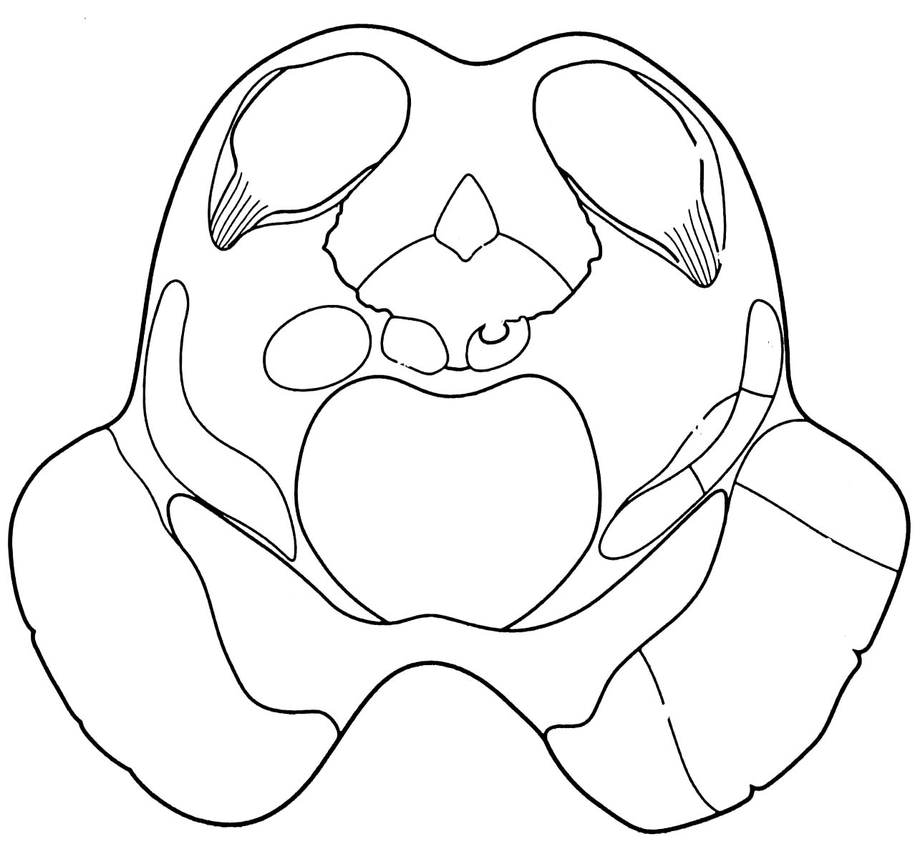
Midbrain

Slide 19
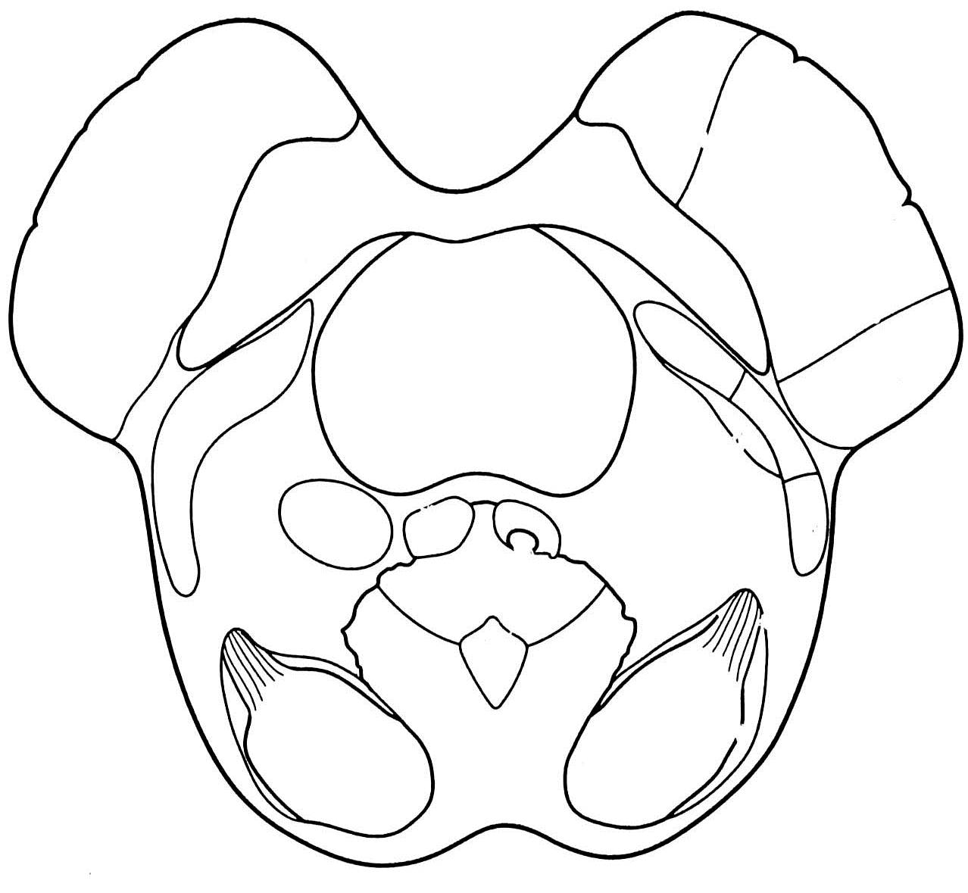
“mickey mouse”

Slide 20
Midbrain
Inferior colliculus
Cerebral aqueduct
Substantia nigra
Cerebral peduncle

Slide 21
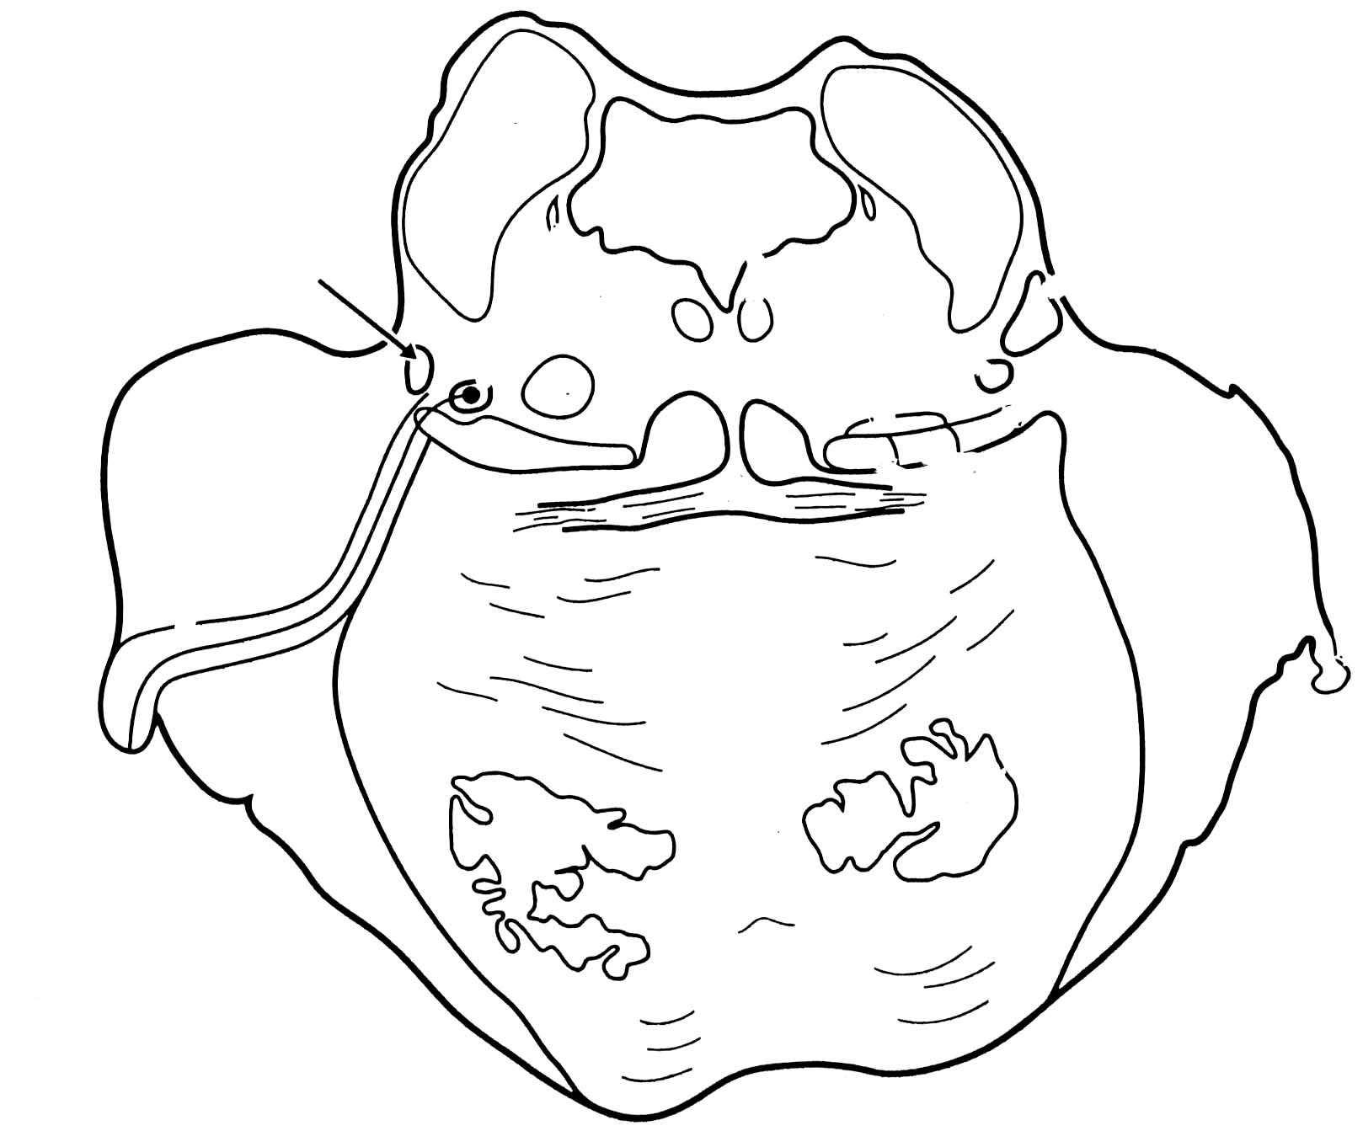
Pons
4th ventricle
Middle cerebellar
peduncle
Transverse fibres

Slide 22
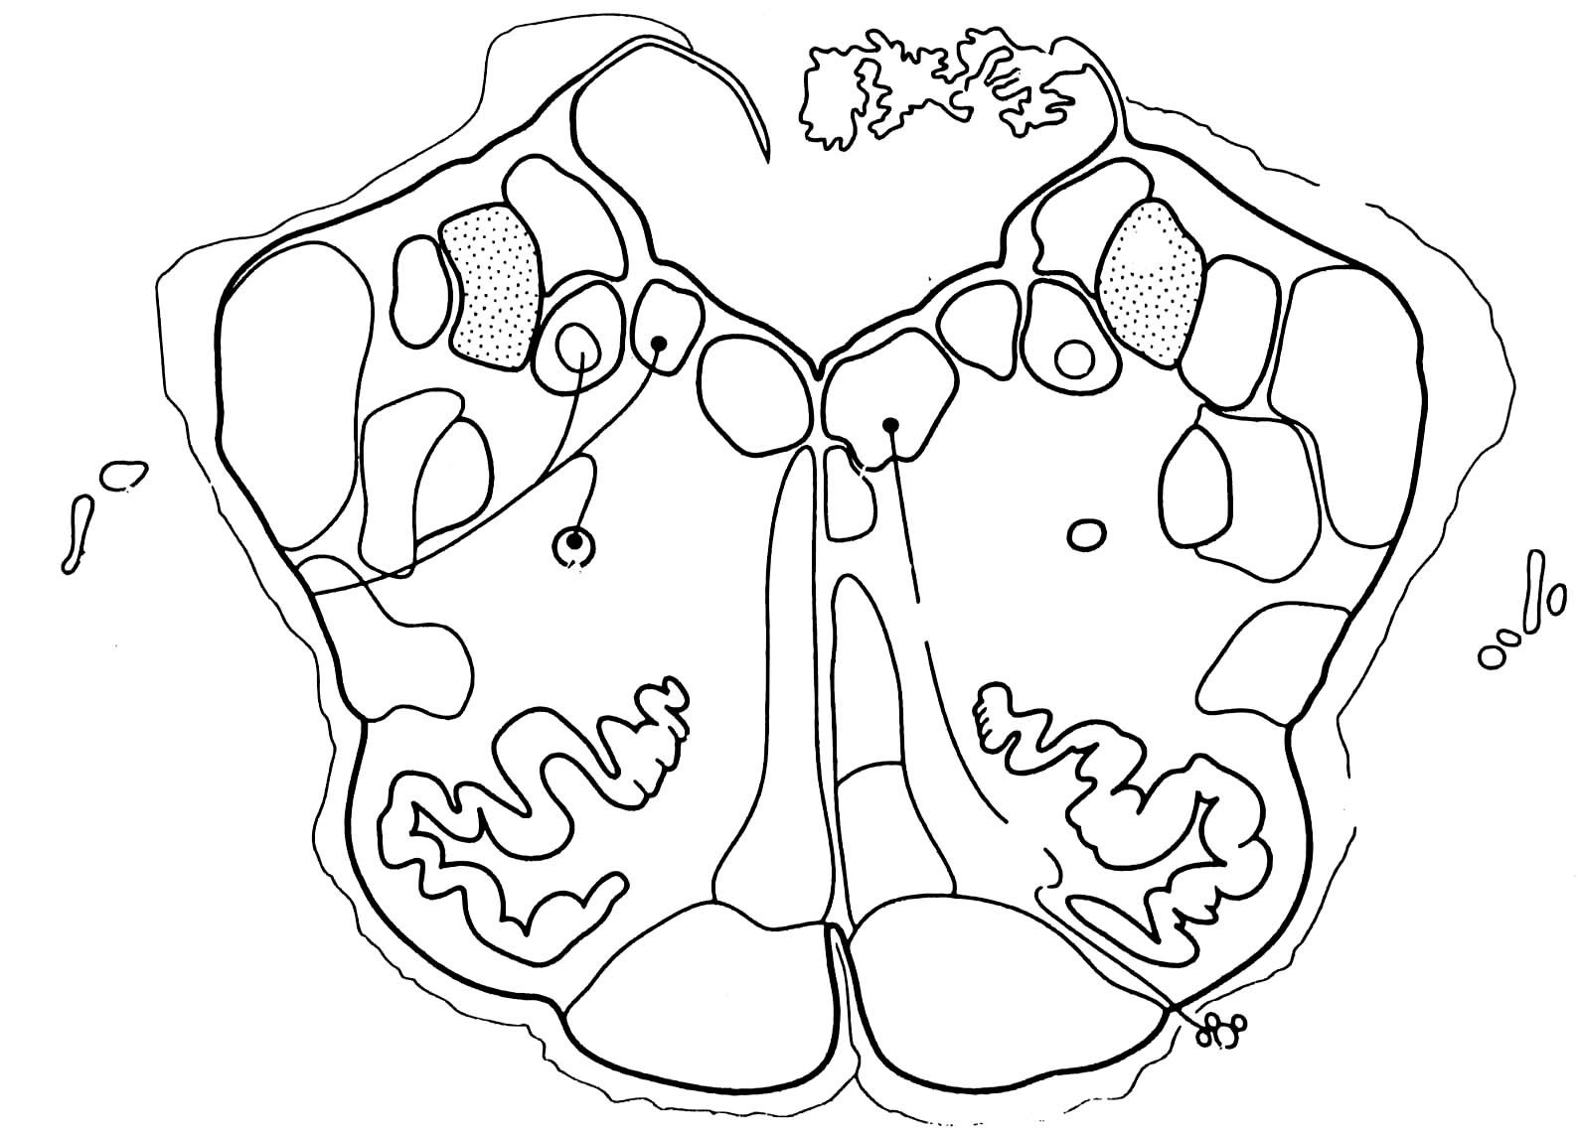
Medulla
4th ventricle
Inferior olivary
nucleus
Pyramids

Slide 23
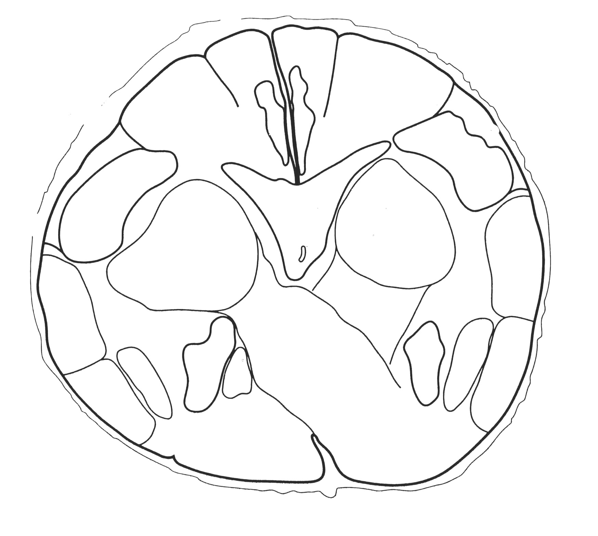
Lower medulla
Dorsal columns
Central canal
Pyramidal
decussation

Slide 24
Outline
Definition
Brainstem: external structure
Cranial nerve origins
Brainstem development
Cranial nerve nuclei
Brainstem: internal structure
Brainstem pathology

Slide 25
Lateral medullary syndrome
Thrombosis of vertebral artery or PICA
Vertigo
Ipsilateral cerebellar ataxia
Ipsilateral loss of pain/thermal sense (face)
Horner’s syndrome
Hoarseness, difficulty in swallowing
Contralateral loss of pain/thermal sense (trunk and limbs)

Slide 26
Lateral medullary syndrome
Vestibular n
Inferior
cerebellar
peduncle
Spinal n
(trigeminal)
N ambiguus
Spinothalamic tract
Sympathetic
tract

Slide 27
SBA Question
Which of these cranial nerve nuclei has a parasympathetic function?
Nucleus ambiguus
Nucleus solitarius
Facial nucleus
Pontine trigeminal nucleus
Edinger-Westphal nucleus

