Slide 1
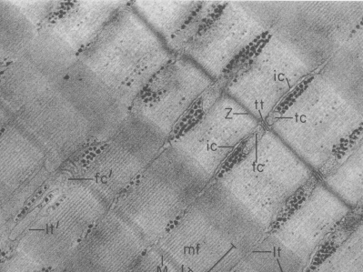

Graduate Entry
Regulatory Systems
Musculoskeletal course
The molecular basis of muscle contraction
Dr Valentina Caorsi
v.caorsi@imperial.ac.uk
3rd floor, Sir Alexander Fleming Building
Thursday 14 March 2013

Slide 2
Outline
From the molecules
The contractile unit: the sarcomere
Muscle fibres structure
Myosin and Actin Filament
Sliding filament Hypothesis
Cross-bridge Cycle
To whole muscle activation
Motor Unit: Motor neuron and the muscle fibres it innervates
Activation-Relaxation
How force is varied in vivo

Slide 3
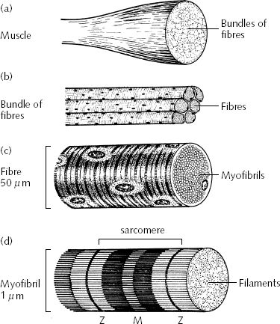
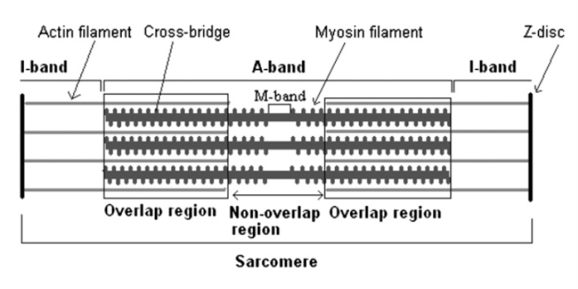
The contractile Unit: the Sarcomere
Holmes.K.C. Muscle proteins - their actions and interactions Current Opinion in Structural Biology 1996
H.E. Huxley

Slide 4
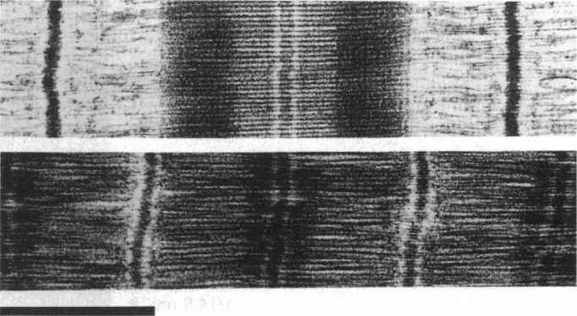
The sliding filament Hypothesis
1µm
Sosa et al. BJ 1997 Ultrastructure of Skeletal Muscle Fibers Studied by a Plunge Quick Freezing Method: Myofilament Lengths
Holmes.K.C. Muscle proteins - their actions and interactions Current Opinion in Structural Biology 1996

Slide 5
The sliding filament Hypothesis
1µm
Sosa et al. BJ 1997 Ultrastructure of Skeletal Muscle Fibers Studied by a Plunge Quick Freezing Method: Myofilament Lengths
Holmes.K.C. Muscle proteins - their actions and interactions Current Opinion in Structural Biology 1996

Slide 6
The sliding filament Hypothesis
1µm
Sosa et al. BJ 1997 Ultrastructure of Skeletal Muscle Fibers Studied by a Plunge Quick Freezing Method: Myofilament Lengths
Holmes.K.C. Muscle proteins - their actions and interactions Current Opinion in Structural Biology 1996

Slide 7
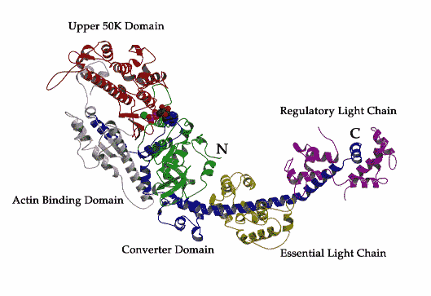
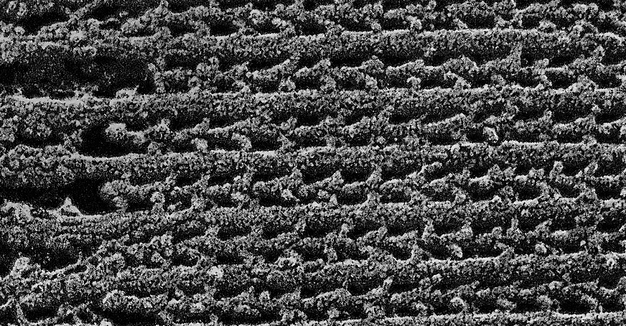
Cross-bridges
Rayment et al. Structure of the actin-myosin complex and its implications for muscle contraction. Science 1993
1µm
Sosa et al. BJ 1997 Ultrastructure of Skeletal Muscle Fibers Studied by a Plunge Quick Freezing Method: Myofilament Lengths
Holmes.K.C. Muscle proteins - their actions and interactions Current Opinion in Structural Biology 1996

Slide 8
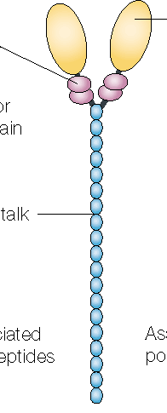
Thick filaments: Myosin II
Rayment et al. Structure of the actin-myosin complex and its implications for muscle contraction. Science 1993
Tail diameter: 2nm
Backbone diameter: 16.3nm
with packed myosin heads: 20.3nm
Thick filaments length: 1.6µm
294 myosin molecules (588 heads).
3 myosins/crown, spaced at 14.3nm interval

Slide 9
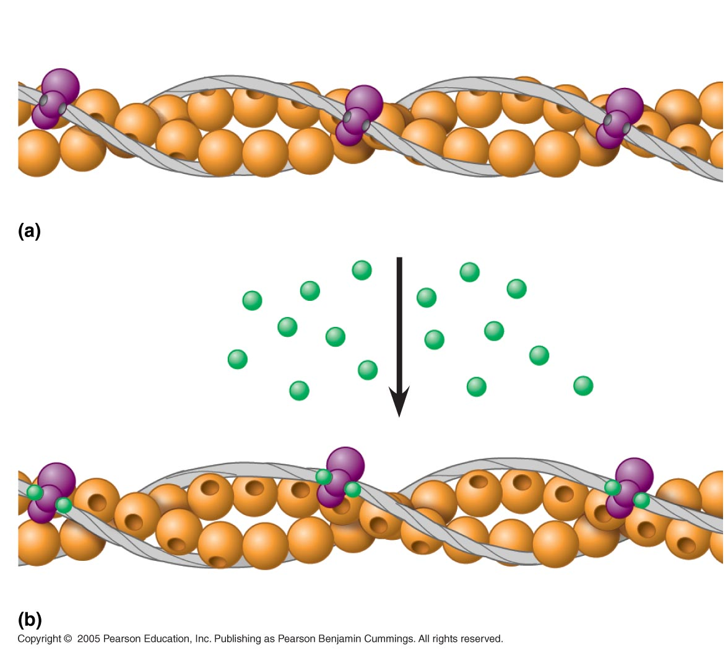
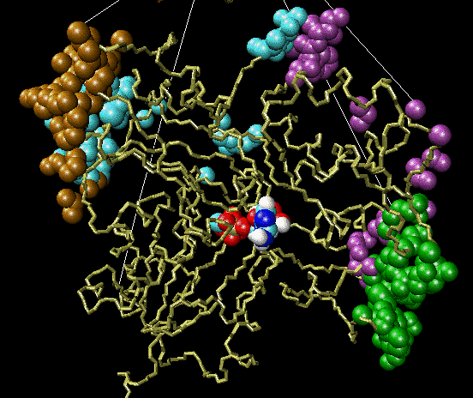
Thin Filaments: Actin
Tropomyosin
Ca²⁺-binding sites
Actin
Troponin complex
Filaments made by polymerisation of G-actin (43 kDa globular protein)
Thin filament length: 1.1 µm. Length regulated by nebulin and tropomodulin
Titin is a large elastic and extensible protein that links the thick filaments to the Z-line, thus ensuring that the thick filaments remain centred in the sarcomere.

Slide 10
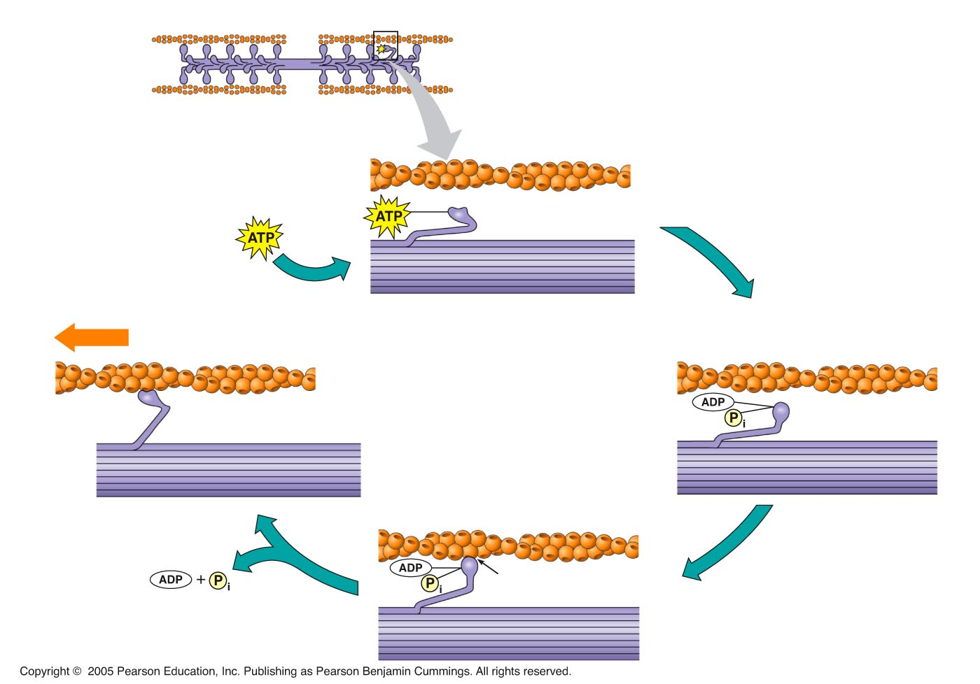
Cross-bridges Cycle
High energy configuration
Cross-bridge formation: myosin head attached to actin
Product release
ATP hydrolysis
As ATP is split into ADP and Pi cocking of the myosin head occurs
Working Stroke: myosin head pivots and bends as it pulls on actin, sliding it toward the M-line
Low energy configuration
As new ATP attaches to myosin cross-bridge detaches

Slide 11
Cross-bridges Cycle
ATP is used in each cycle to provide the energy
Direction of filament sliding is one-way (thin filament moves toward the centre of the sarcomere)
Step size is small: sliding produced by one cycle is only about 1% of the sarcomere length

Slide 12
Outline
From the molecules
The contractile unit: the sarcomere
Muscle fibres structure
Myosin and Actin Filament
Sliding filament Hypothesis
Cross-bridge Cycle
To whole muscle activation
Motor Unit: Motor neuron and the muscle fibres it innervates
Activation-Relaxation
How force is varied in vivo

Slide 13
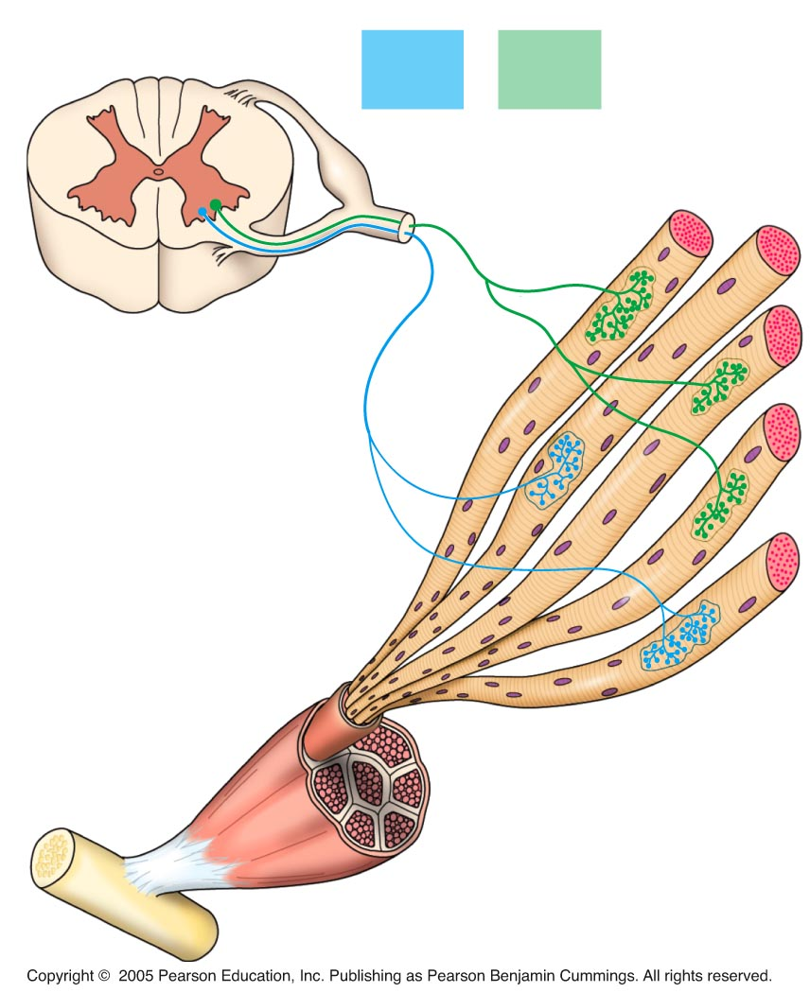
Skeletal Muscle: Activation
Spinal cord
Intention to move
Activity in cerebral cortex
basal ganglia, cerebellum
Motor cortex firing
Impulses in descending motor pathways
Motoneuron Excitation
Impulse propagation to axon terminal
Neuromuscular transmission
Impulse propagation along
muscle fiber plasmalemma
Impulse into T-tubules
Ca2+ release from SR
Cross-bridges engagement
Movement
Motor
unit 1
Motor
unit 2
Synaptic terminals
Nerve
Motor neuron
cell body
Motor neuron
axon
Muscle
Muscle fibers
Tendon

Slide 14
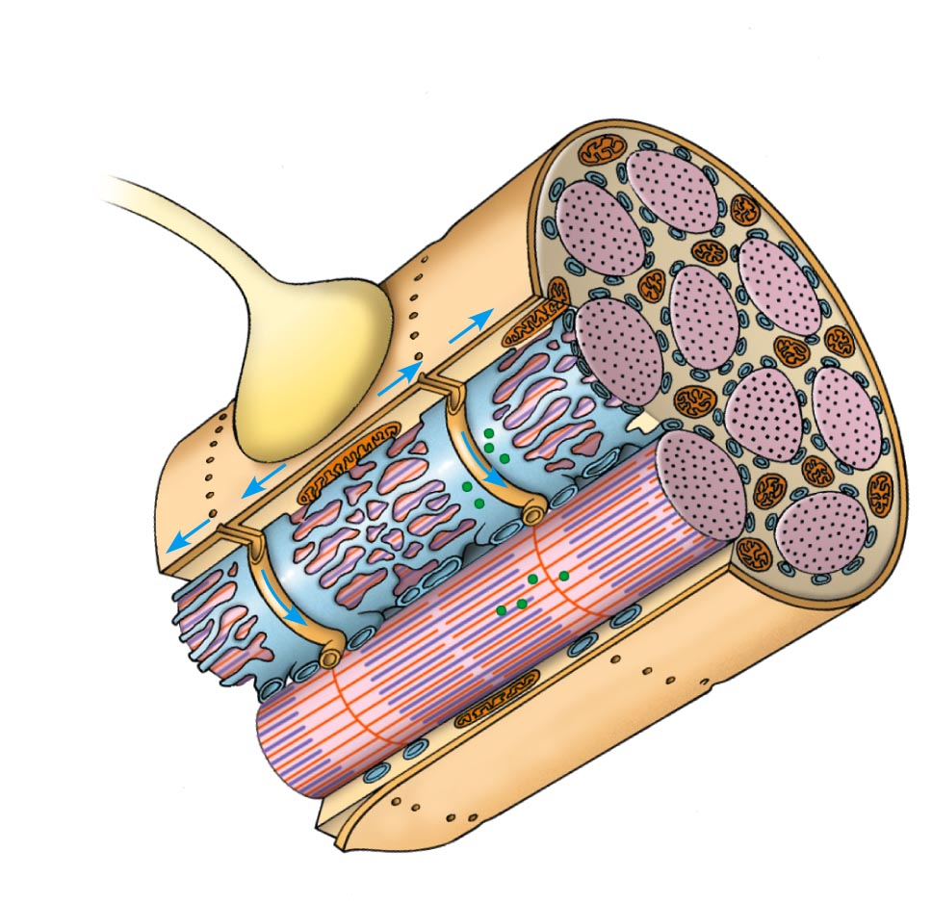
Skeletal Muscle: Activation
Intention to move
Activity in cerebral cortex
basal ganglia, cerebellum
Motor cortex firing
Impulses in descending motor pathways
Motoneuron Excitation
Impulse propagation to axon terminal
Neuromuscular transmission
Impulse propagation along
muscle fiber plasmalemma
Impulse into T-tubules
Ca2+ release from SR
Cross-bridges engagement
Movement
Motor
neuron axon
Mitochondrion
Synaptic
terminal
T tubule
Sarcoplasmic
reticulum
Ca²⁺ released
from SR
Myofibril
Sarcomere
Plasma membrane
of muscle fiber

Slide 15
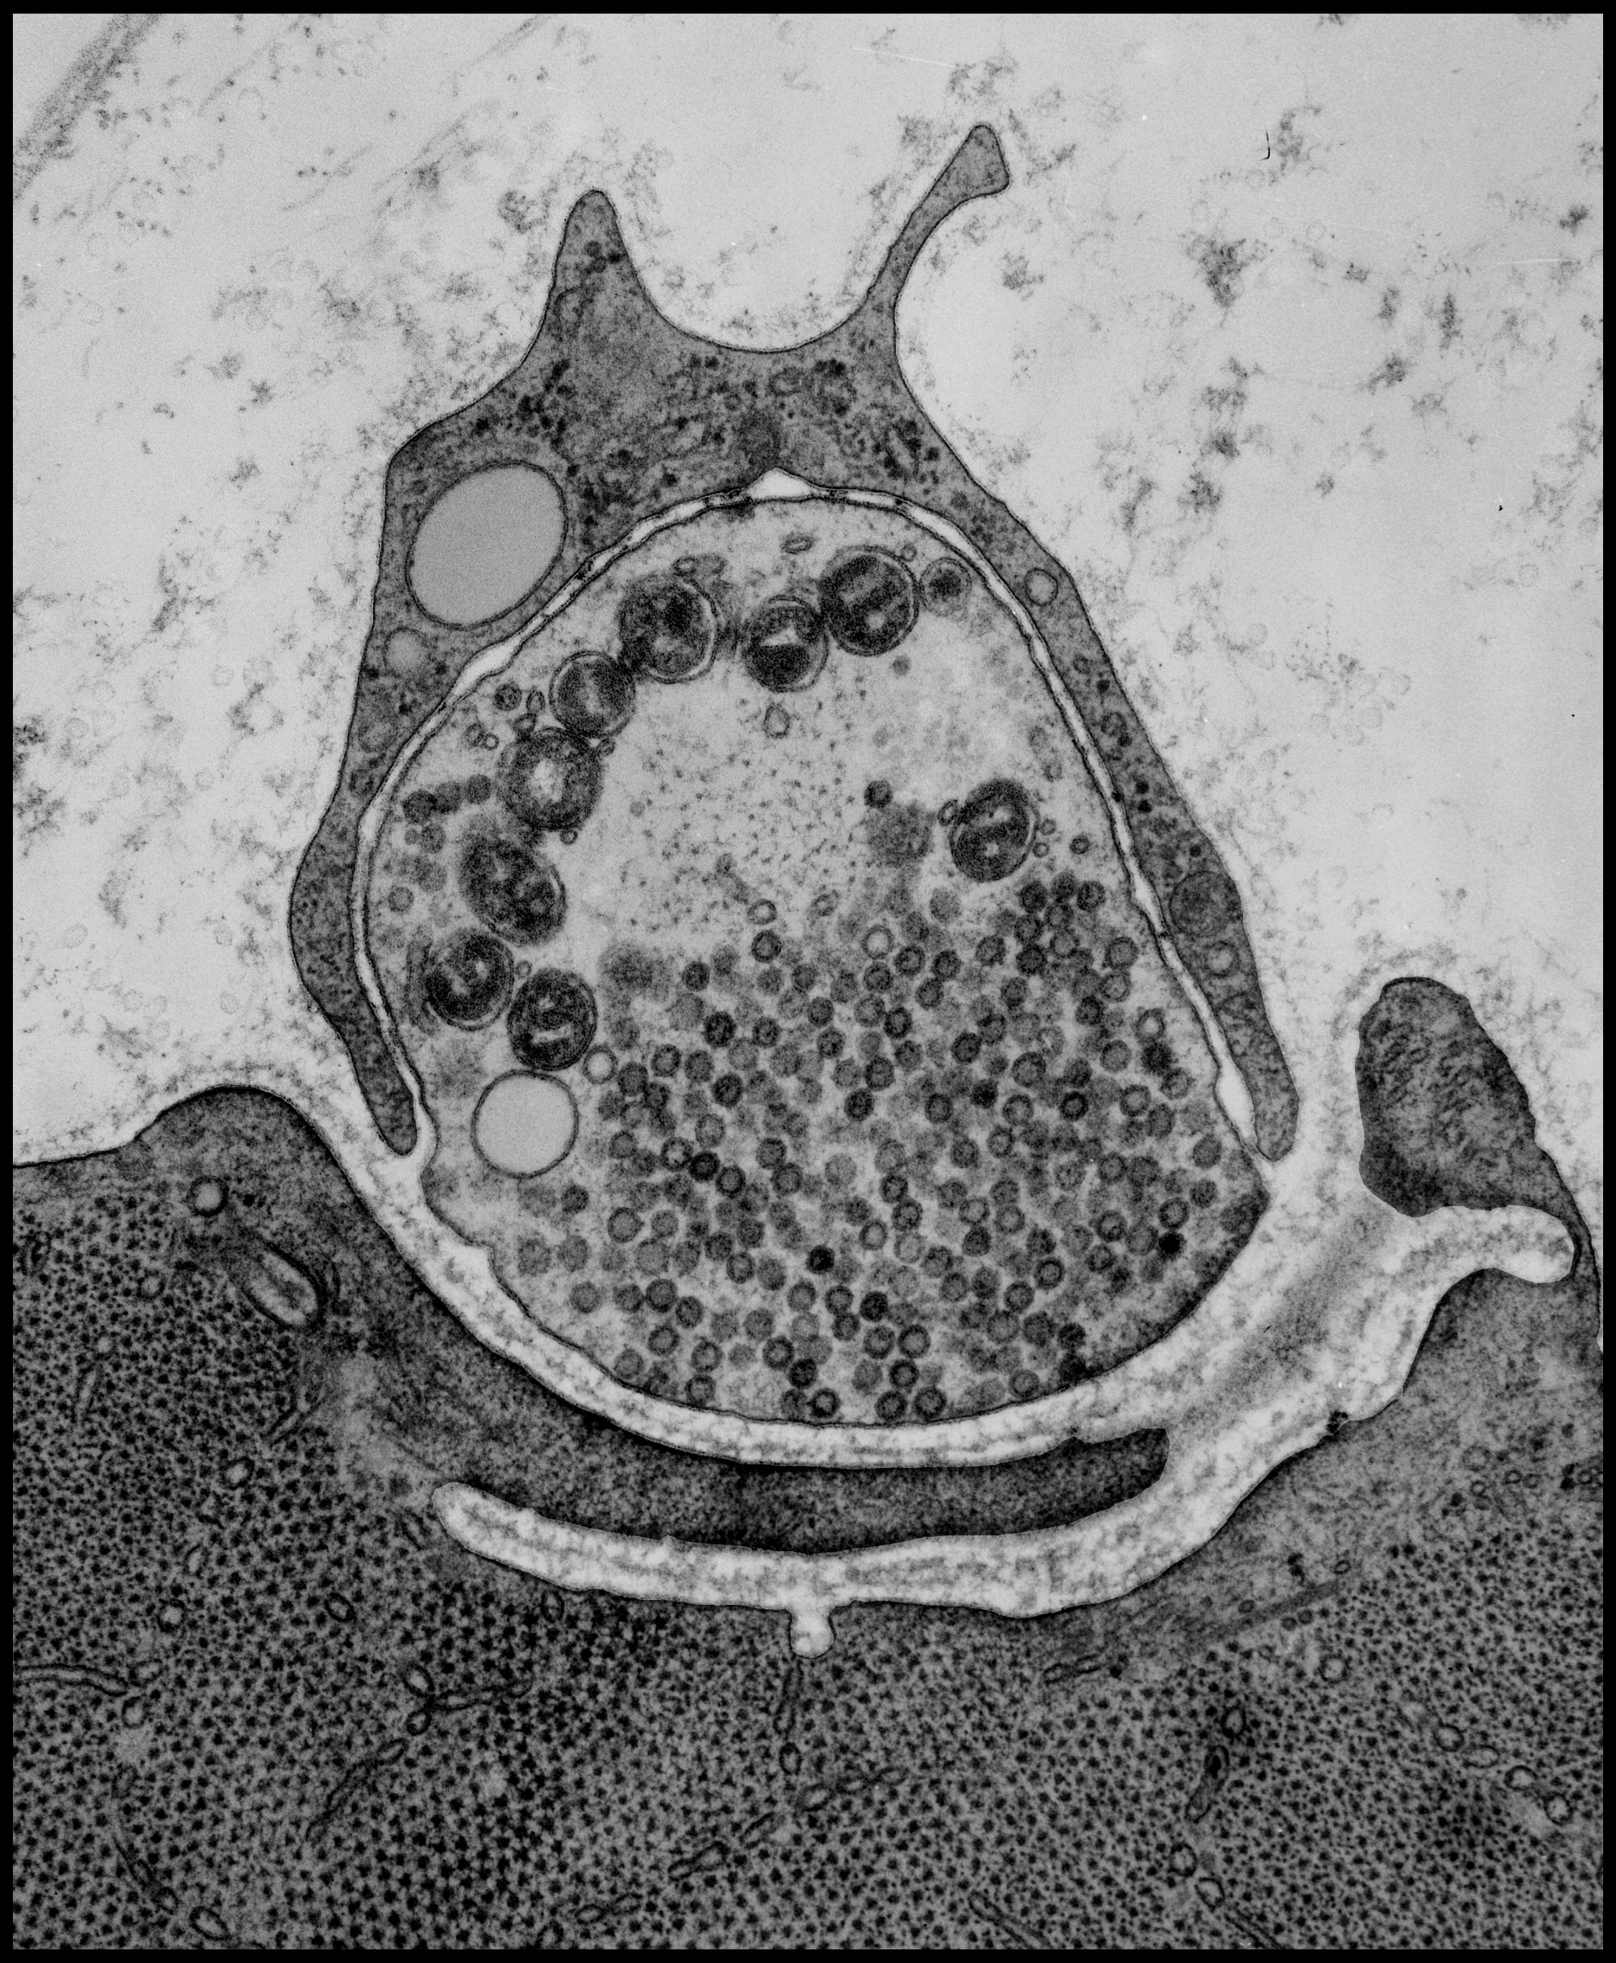
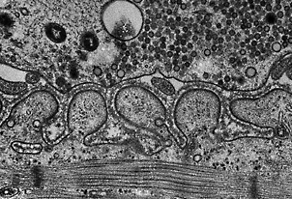
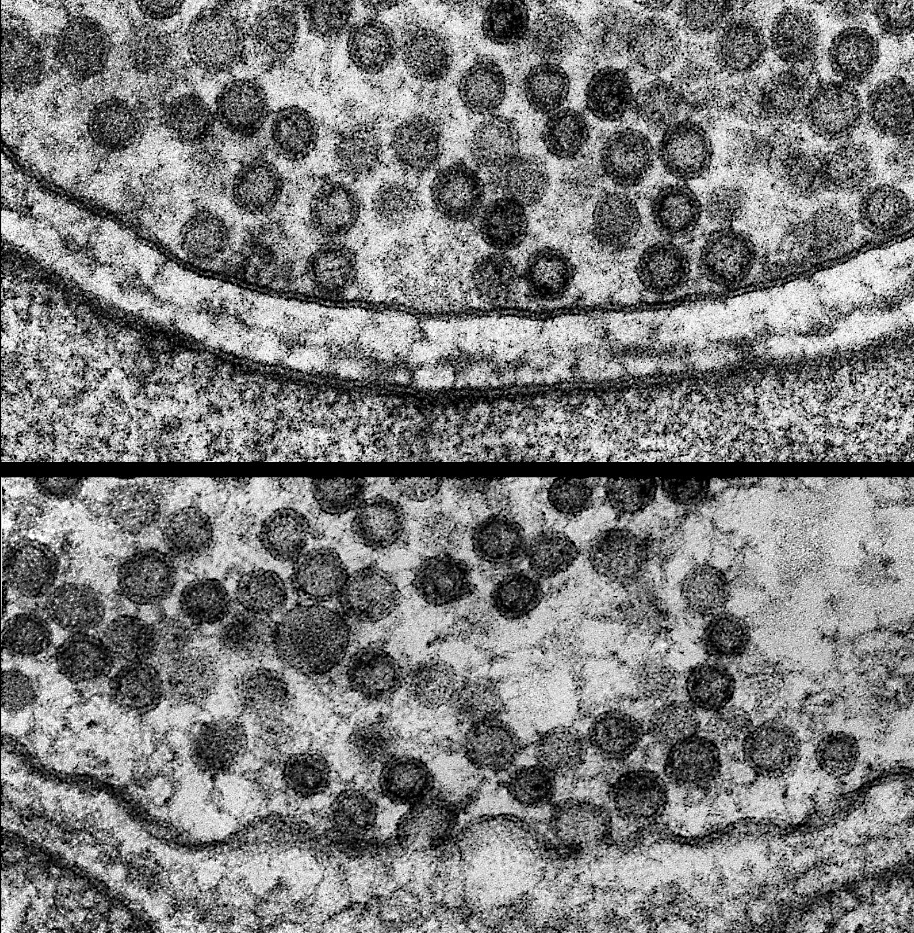
The neuromuscular junction
http://www.heuserlab.wustl.edu/NMJlink.html

Slide 16
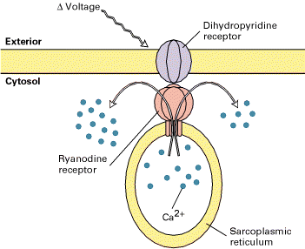
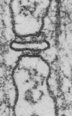
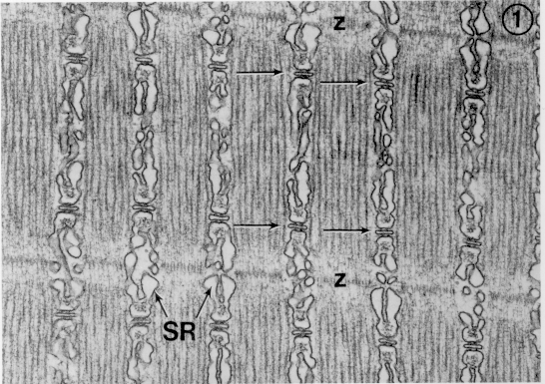
T-tubule, SR junction and Ca2+ release
M. J. Berridge, 1993, Nature 361:315
Clara Franzini-Armstrong

Slide 17
Activation of skeletal muscle contraction
Tropomyosin
Ca²⁺-binding sites
Actin
Troponin complex

Slide 18
Relaxation
Once the membrane has repolarised, the calcium channels in the sarcoplasmic reticulum close.
The sarcoplasmic Ca-ATPase pumps calcium back into the reticulum, causing a decrease in calcium concentration in the cytoplasm.
This causes calcium dissociation from troponin, resulting in inactivation of myosin binding sites on actin, and hence muscle relaxation.

Slide 19
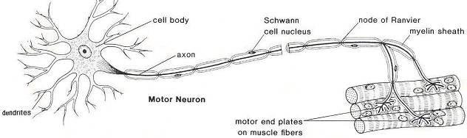
Motor Unit
Motor Neuron + all the muscle fibres it innervates
http://www.biologymad.com/nervoussystem
Same type of muscle fibres in 1 motor unit
Contract simultaneously (all or none fashion)
Size - number of muscle fibres 1motor unit innervates
Number - how many motor units are in a muscle

Slide 20
Motor Unit
Motor Neuron + all the muscle fibres it innervates
http://www.biologymad.com/nervoussystem
AJ. McComas – Skeletal Muscle Form and Function

Slide 21
Force response to Action Potential
Twitch
Force-time response to a single action potential
Contraction
Latent
period
Relaxation
http://www.physiol.med.uu.nl/interactivephysiology/ipweb

Slide 22
Force response to Action Potential
Temporal Summation
a second stimulus is applied before
complition of relaxation
Additional influx of Ca2+ promotes a second contraction which is added to the first
http://www.physiol.med.uu.nl/interactivephysiology/ipweb

Slide 23
Force response to Action Potential
Tetanus
rapid multiple stimulation
fuse into a smooth continuous total contraction
Abundant intracellular calcium provides continual availability binding sites on actin for cross-bridge cycling
Incomplete
Tetanus
Temporal
summation
Fused
Tetanus
Fatigue
http://www.physiol.med.uu.nl/interactivephysiology/ipweb

Slide 24
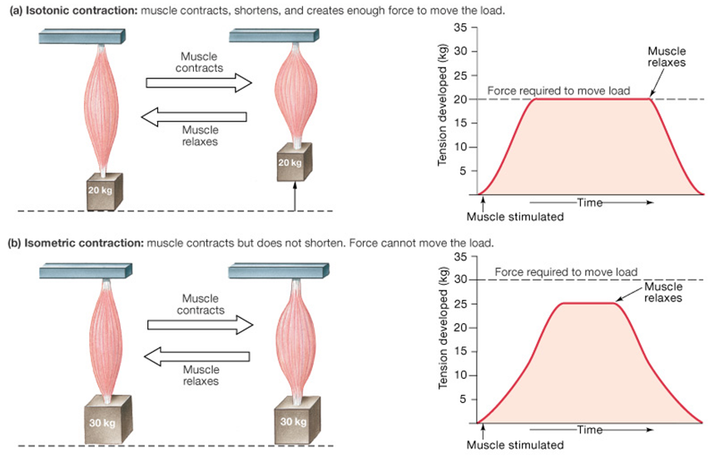
Types of contraction
Isotonic
Tension remains the same while muscle shortens
Isometric
Tension rises with no shortening

Slide 25
Types of contraction
Isotonic
Tension remains the same while muscle shortens
Concentric
tension rises to meet the resistance, then remains the same as the muscle shortens
Eccentric
muscle lengthens due to the resistance being greater than the force the muscle is producing
Isometric
Tension rises with no shortening

Slide 26
How force is varied in vivo
Motor Neuron + all the muscle fibres it innervates
http://www.biologymad.com/nervoussystem
Frequency of action potentials
Recruitments of motor units
Filament overlap
Velocity of contraction

Slide 27
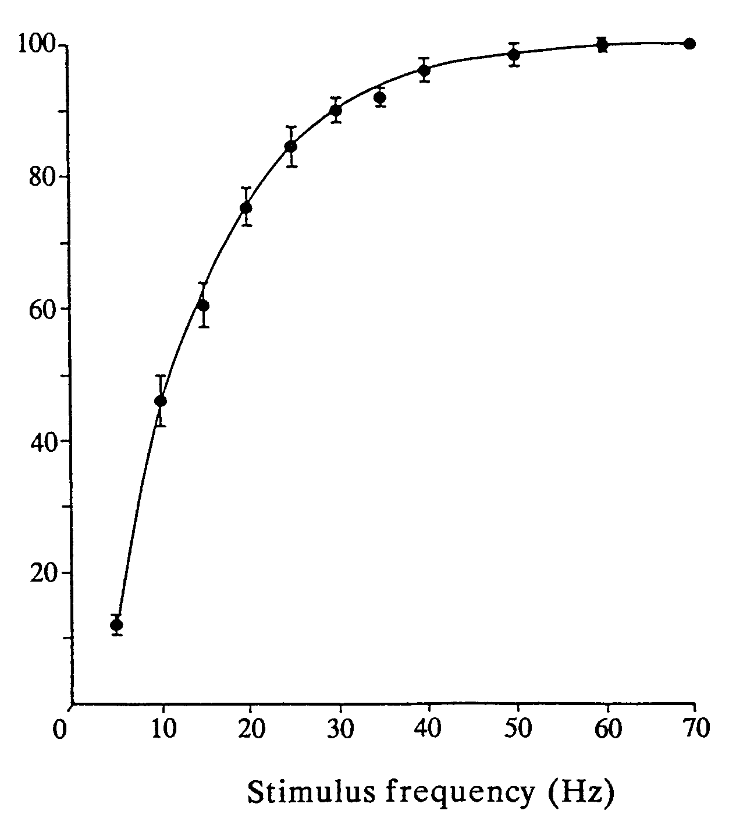
Increasing Firing Rate
Force (% of maximum)

Slide 28
Recruitment of motor units
Motor Neuron + all the muscle fibres it innervates
http://www.biologymad.com/nervoussystem
Henneman size principle
dependent on FORCE production needs of the muscle
from the ‘smallest‘ motor units to ‘largest’ motor units

Slide 29
Force depends on filament overlap
Force (% of max)
Sarcomere length (% of optimum)

Slide 30
Force on velocity and direction
Force (% of Isometric)
100
Stretch by an external force
(muscle resists stretch, acts as a brake)
0
100
Velocity (% of max shortening V)
Shorten
(muscle does work)
Isometric
(maintain constant position)

Slide 31
Force on velocity and direction
Force (% of Isometric)
This behaviour cannot be understood in terms of one crossbridge. It is due to a large number of bridges acting together.
Force depends on the:
proportion of bridges that are attached and
force each attached bridge produces.
100
Stretch by an external force
(muscle resists stretch, acts as a brake)
0
100
Velocity (% of max shortening V)
Shorten
(muscle does work)
Isometric
(maintain constant position)

Slide 32
Learning Objectives
From the molecules
The contractile unit: the sarcomere
Muscle fibres structure
Myosin and Actin Filament
Sliding filament Hypothesis
Cross-bridge Cycle
To whole muscle activation
Motor Unit: Motor neuron and the muscle fibres it innervates
Activation-Relaxation
How force is varied in vivo

