Slide 1
Demographics

Slide 2
Learning objectives
Describe the demographic changes occurring within society
Discuss the impact this will have

Slide 3
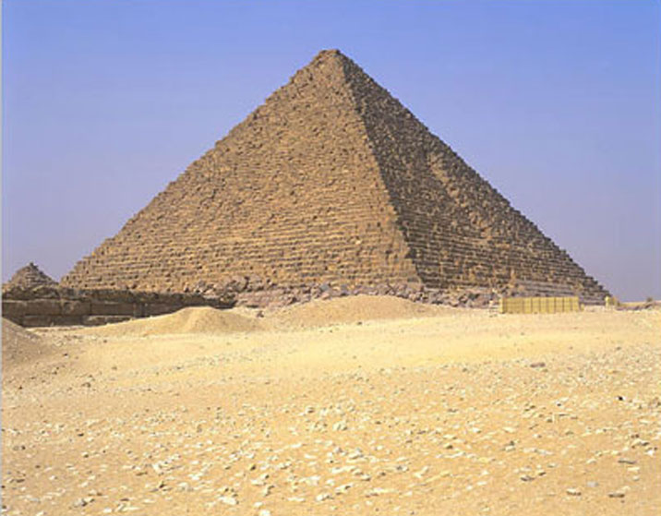

Mrs Smith in context
Part of a growing minority
Why? Because society is ageing
In the UK.....

Slide 4
UK population
Overall
2008 ~ 61.4 million
2051 ~ 77.1 million
1% of the population were aged 85 and over
2% aged >=85 years
2051 7% estimated >=85 years
http://www.neighbourhood.statistics.gov.uk/HTMLDocs/dvc1/UKPyramid.html

Slide 5
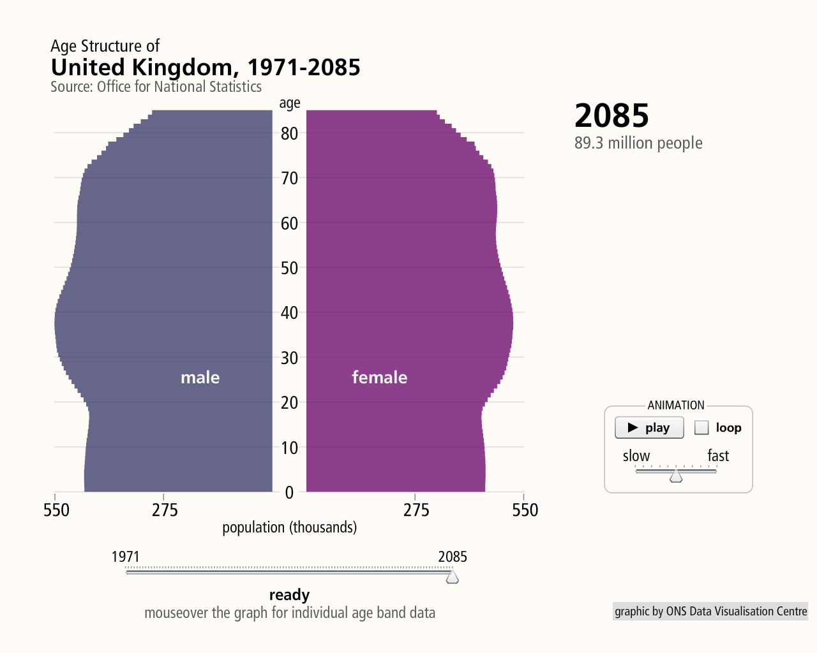
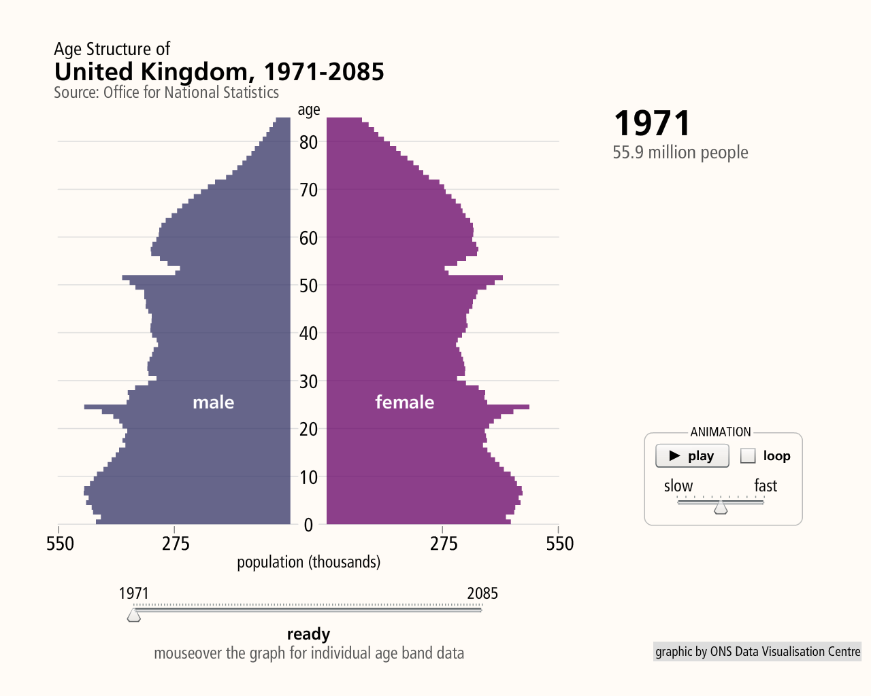

Slide 6
Ageing of the Population

Slide 7
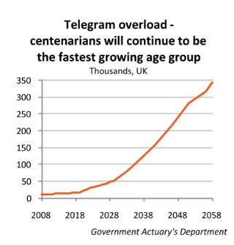

Slide 8
Number of people of working age per pensioner...
1971 3.6
2008 3.2
2051 2.0
(2.9 taking changes in the state pension age into account)
But....

Slide 9
How has this occurred...
Medicine/public health reducing mortality
First half of the 20th century – advances in respiratory and infectious disease
Biggest impact on infant and child mortality
Second half of the 20th century – reduction in mortality from circulatory disease (fall in smoking)
Biggest impact on older adults
In 1981
Life expectancy at 65 was 14 years for men and 18 years for women
By 2008
21 years for men and 23.6 years for women
Male/female gap narrowing

Slide 10
Life Expectancy Rise

Slide 11
Total Fertility Rates – Europe and North America 1950-2000
____________________
Source: United Nations

Slide 12
In addition to decreasing mortality and fertility...
Post war baby boom now reaching state pension age
Ethnic mix of older adults becoming more diverse
  following waves of earlier immigration from countries such as Pakistan, Bangladesh and China
In the rest of the world,
Similar patterns
Bigger impact in countries that had low fertility rates such as the ex-soviet eastern European countries

Slide 13
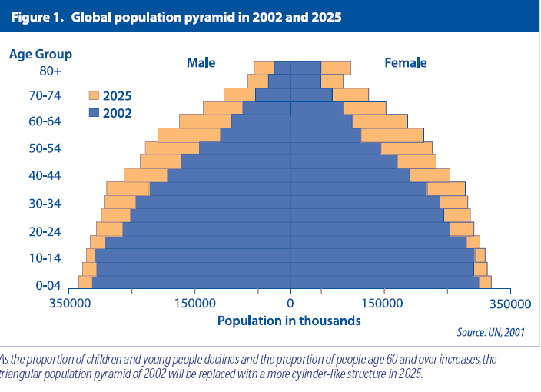

Slide 14
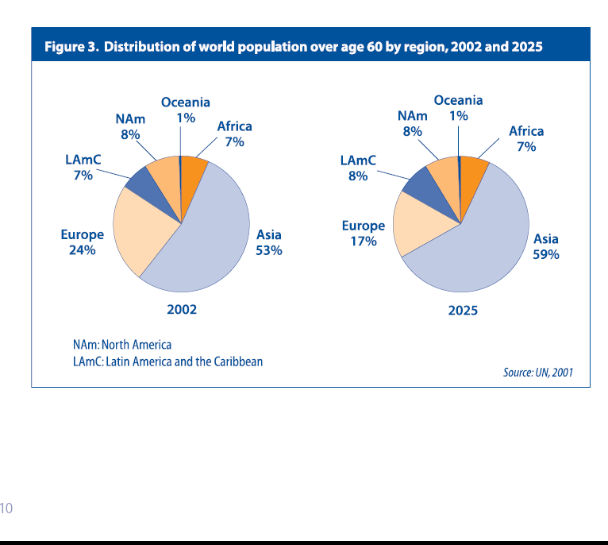

Slide 15
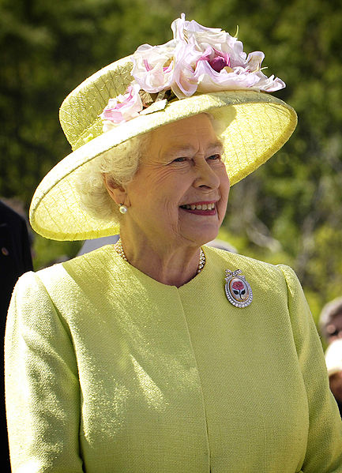
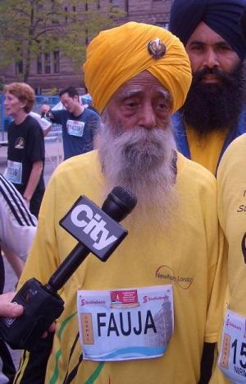
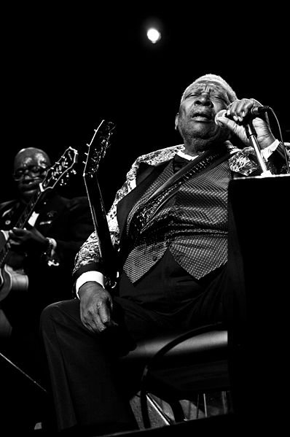
Meth
Cohort/lifestyle impact?
Healthcare
Diet
Smoking

Slide 16
Disability free life?
In 2004/6 females aged 65 could expect to live 54% of their remaining years disability free. 60% for males.
This means around 10 more years (both sexes) without disabling illness
The oldest old are among the heaviest users of healthcare
These will be your patients
One of the biggest issues facing the ageing society is dementia

Slide 17
Dementia
World Health Organisation - News release April 2012
Worldwide 35.6 million live with dementia
By 2030 estimated to rise to 65.7 million
Impact widely, 58% of sufferers live in low to middle income countries
WHO theme for 2012 Ageing and Health

Slide 18
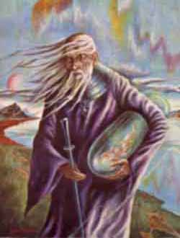
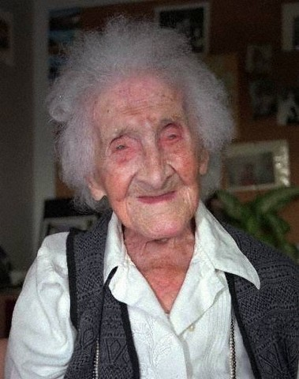
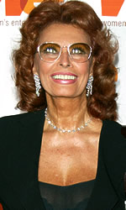
WHO/ WHAT IS OLD
Methuselah 969 years old
Jeanne Calment
122 years 164 days
Sophia Loren
74 years

Slide 19
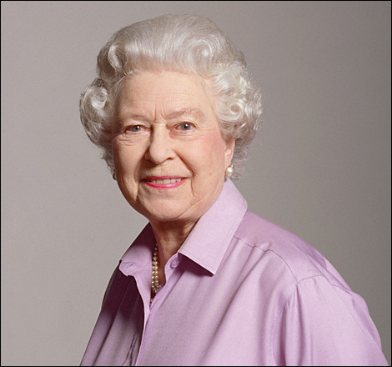

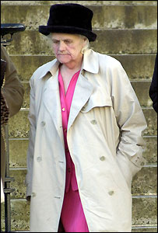
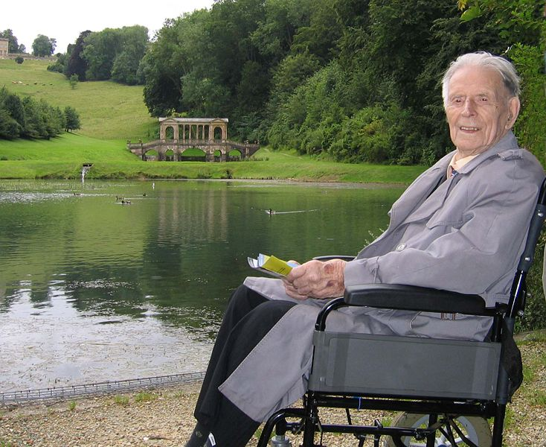
Successful Ageing

Slide 20
Living Longer
We live, on average, about twice as long as we did 200 years ago.
Life expectancy has increased by about 10 years in the last 50 years.
85 per cent of children born today can expect to reach their 65th birthday

Slide 21
Consequences
Increased demand for health care and social services
Less people to generate a work force and provide taxes
Retirement/ pensions will be a problem

Slide 22
Ageing – a challenge of our time
Biomedical science: why is the aged cell (or organ) more vulnerable to pathology?
Clinical medicine: age is the single largest risk factor for a very wide range of diseases of current public health importance.
Public Health: delivery of high quality and appropriate health care to the population

