Slide 1
Ageing and the brain

Slide 2
Introduction
Older people know more facts than younger people?
Older people are more forgetful than younger people?
Brain ageing begins around 65-70 years?
Dementia is another word for Alzheimer’s disease?

Slide 3
Learning objectives
Recognize the key physical changes associated with the ageing brain
Recognize the key cognitive changes associated with the ageing brain
Describe and discuss key issues associated with cognitive assessment of older adults

Slide 4
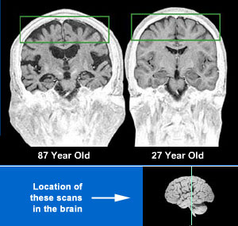
Physical changes
Volume declines ~ 5% per decade after age 40
Enlarged ventricles/sulci

Slide 5
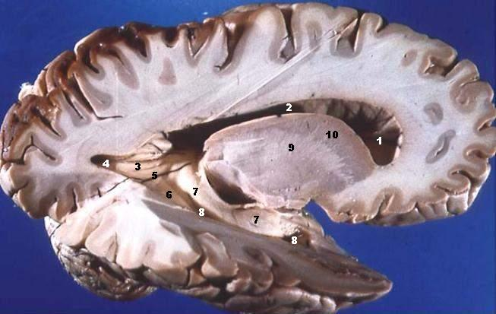
Physical changes
Grey matter
White matter
Cell death
Decline in cell volume
spines and synapses
Insults (stroke, clinical, subclinical)
Dendritic sprouting
Functional organisational change

Slide 6
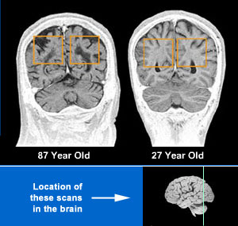
Physical changes
White matter
Decline in quantity and quality
Myelin sheath deteriorating from midlife
Insults, leukariosis/white matter lesions?

Slide 7
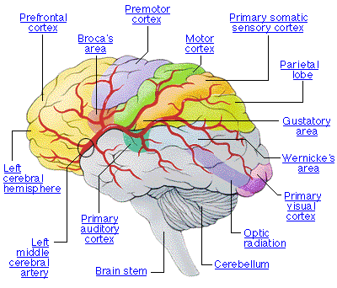
Regional change
Decrease in volume not uniform
Prefrontal cortex most affected (last in first out grey and white matter)
  Also hippocampus, striatum, temporal lobe & cerebellum
Occipital cortex thought to be least affected

Slide 8
Next level down......
Fall in neurotransmitters, receptors and transporters
Calcium disruption
Reduced input of glucose or oxygen
Oxidative damage
Inflammation
Change in gene expression with ageing
Results in different activation of brain regions in response to tasks and changes in cognitive abilities.
+ any injury or disease

Slide 9
More symmetrical activation
Hemispheric Asymmetry Reduction in OLDer adults (HAROLD)
Observed for memory and motor tasks
An attenuation of the response seen in younger adults?
An inability to recruit specific areas / networks?
An attempt to compensate for the above?
An ability to recruit additional areas?

Slide 10
Cognitive function
The functioning of internal mental processes
Why should we assess it?
Overview of the patients cognitive capabilities implications for
- treatment
- referral
- independent living

Slide 11
Brain injury
Damage to specific brain areas
May be specific areas of lost function with preserved function in other areas
Each individual likely to differ at least slightly
Structure does not map exactly onto function
Need neuropsychological input to fully understand impairment
Example test: depends on the deficits

Slide 12
Depression
Common in elderly individuals
Open assessment of own abilities
Complaining primarily of memory and concentration difficulties
‘pseudo-dementia’ but large overlap with onset of dementia
Example test: Geriatric Depression Scale.

Slide 13
Memory and dementia

Slide 14
What does it mean in practical terms?
Increasing age makes it harder to
Encode new information
Retain new information
Retrieve information from memory
to inhibit, to put aside learned information that is no longer needed

Slide 15



Memory
Episodic memory
Semantic memory
Working memory
Procedural memory

Slide 16
Memory change with ageing
Episodic memory
Decline from middle age onwards
Recall worse than recognition
Semantic memory
Increase with ageing
Working memory
Executive function

Slide 17
Executive function
‘Multidimensional construct […] variety loosely related higher order cognitive processes including initiation, planning, hypothesis generation, cognitive flexibility, decision making, regulation, judgement, feed-back utilization and self perception that are necessary for effective and contextually appropriate behaviour.’
(Spreen & Strauss 1998)
Everyday short term (working) memory is a subordinate component of executive function.
Example test: Wisconsin card sorting test

Slide 18
Stroop test
Red
Blue
Green
Blue
Yellow
X
X
X
X
X
Green
Yellow
Blue
Green
Red

Slide 19
Background
Demographics
    UK: 2033 3.2 million (5% of total) >=85 years
    UK: 2051 1.7 million with dementia
Health economics
    UK: costs £17-23 billion/year
Health services
    UK: 60% of sufferers live in the community
    UK: Less that 25% have contact with old age psychiatry services
Policy
    UK: 28th June 2011 Ministerial Advisory Group for Dementia Research publishes ‘Route Map for Dementia Research’

Slide 20
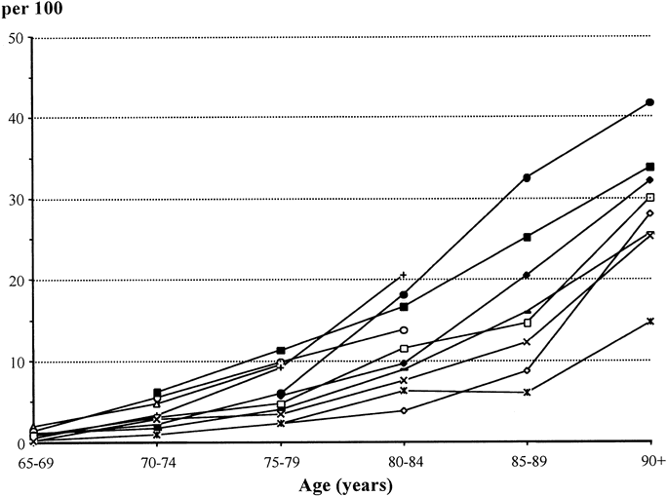
Dementia
Alzheimer’s disease
Vascular dementia
Mild cognitive impairment
Lobo et al
2000

Slide 21
Type of dementia
Of all the dementia types that may account for cognitive loss in the elderly the most common is……….
Alzheimer's disease (AD) accounting for about 50 to 60 %. (increased risk in first degree relatives or with apolipoprotein ε4 gene)
Vascular dementia (VaD) is second at around 10 to 20 %.
Lewy-body dementia 2-20% (Often with Parkinson’s disease but also large overlap with AD & even vascular dementia)
Mixed dementia?
Mild cognitive impairment (MCI)

Slide 22
Dementia
Assessment and diagnosis

Slide 23
Diagnosis
Currently
Screening tests
(eg AMTS MMSE, ADAS-Cog, MoCA, OMC, 3MS)
DSMIV or other diagnostic criteria / Brain scan
Depression/delirium/drug effects
Future
Biomarkers
Very early cognitive change
Shift from symptomatic to presymptomatic diagnoses

Slide 24
Screening tests
Wide range of questionnaire based instruments designed to assess cognitive function
Often including practical tasks requiring the manipulation of objects, movement, drawing or writing on the part of the patient.
Longer instruments
Shorter ‘bedside’ instruments
Combinations of specific neuropsychological tasks
Single tasks, Clock Drawing Test
Notes:
Bedside instruments most common and many many of them a review of them published in 2005 lists 39 and there are more!
Will mention those that are currently in use/likely to come across. – doesn't mean that they are the best ones!
Several studies have argued that the best assessment of cognitive function comes from the use of a series of discrete instruments rather than a test of generalized intellectual ability covering multiple areas.
Eg a test battery consisting of a ‘Picture-Word-Learning-Test, a Stroop-Colour-Word-Test and a Letter-Digit-Coding-Test’.
Houx et al (2002) Testing cognitive function in elderly populations: the PROSPER study. Journal of Neurology, Neurosurgery and Psychiatry 73:385-389
Picture-Word-Learning-Test (Immediate and delayed recall)
Stroop-Colour-Word-Test (Selective attention and Executive function)
Letter-Digit-Coding-Test.
(Speed of processing including visual scanning, visual perception, visual memory, visouconstruction and motor functions)
Advantages
Picture-Word-Learning-Test had different versions to avoid practise effects (The other tests used were not susceptible to practise effects).
Short test battery
They found less ceiling and floor effects than the MMSE
Diadvantages
Several studies have produced what they consider to be ideal test batteries for cognitive function and these have not been widely validated in different population groups. They are also unlikely to have normative values or validated cut-offs available for comparison against.

Slide 25

The first world war ended in.....
1893
1895
1897
1914
1916
1918
1935
1937
1939
Notes:
Dutch queen Beatrix celebrates her 74th birthday on Tuesday, 31st Jan making her the oldest reigning monarch in Dutch history.
The previous record holder was King Willem III who died on the throne at the age of 73 years, 277 days.

Slide 26
Abbreviated Mental Test (AMTS)
(1972) Hodkinson.
Age
Time now
Address
Year
Place
Recognition of two persons
Date of birth
Year of World War 1
Name of present monarch
Count backwards from 20 to 1.

Slide 27
Abbreviated Mental Test (AMTS)
Advantage
Short time to administer less risk of tiredness and loss of concentration
Disadvantage
Not a good assessment tool
Covers insufficient areas of cognitive function
Questions biased
Standard scoring system often not used
Notes:
Requires background culturally relevant knowledge – essentially semantic information not likely to be testing episodic or areas most at risk

Slide 28
Example questions..... extended mini-mental state exam [3MS]
CLOSE YOUR EYES
What is the: Year? Season? Date? Day? Month?
The official dates for the four seasons in the UK and northern Europe in 2001 are as follows;
spring begins March 20th, summer begins June 21st, autumn begins September 22nd and winter begins on December 21st.
Notes:
DLROW

Slide 29

Praxis

Slide 30
Attention & concentration
Comptez à partire de 100 en retirant 7 à chaque fois jusqu’à ce que je vous arrête
From 100 keep subtracting 7 giving each answer until I tell you to stop

Slide 31
Mini-Mental State Exam (MMSE)
Advantage
Fairly short time to administer takes around 30 minutes
Does attempt to cover several areas of cognitive function
Widely used and some validated translations available
Less cultural bias than tests that ask about key society figures or events.
Disadvantages
A screening tool at the most
Often poorly administered/scored & training required
Educational level or language may affect results
Ceiling and floor effects
Practise effects

Slide 32
The Clock Drawing Test (CDT)
Auditory language skills
Internal representation of the visuospatial features
Visuoperceptual and visuomotor
Hemi-attentional processes
Linguistic system
Executive functions
Memory
10 past 11. The 2 has to be recoded as ten minutes past the hour, ie the response cannot be stimulus driven but must rely on executive function
20 past 8 requires the use of the inferior visual quadrants and increases sensitivity to parietal dysfunction

Slide 33
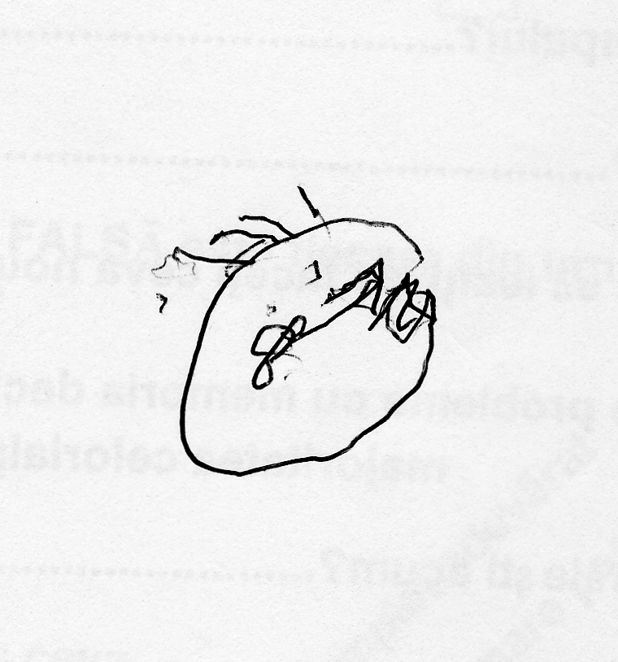
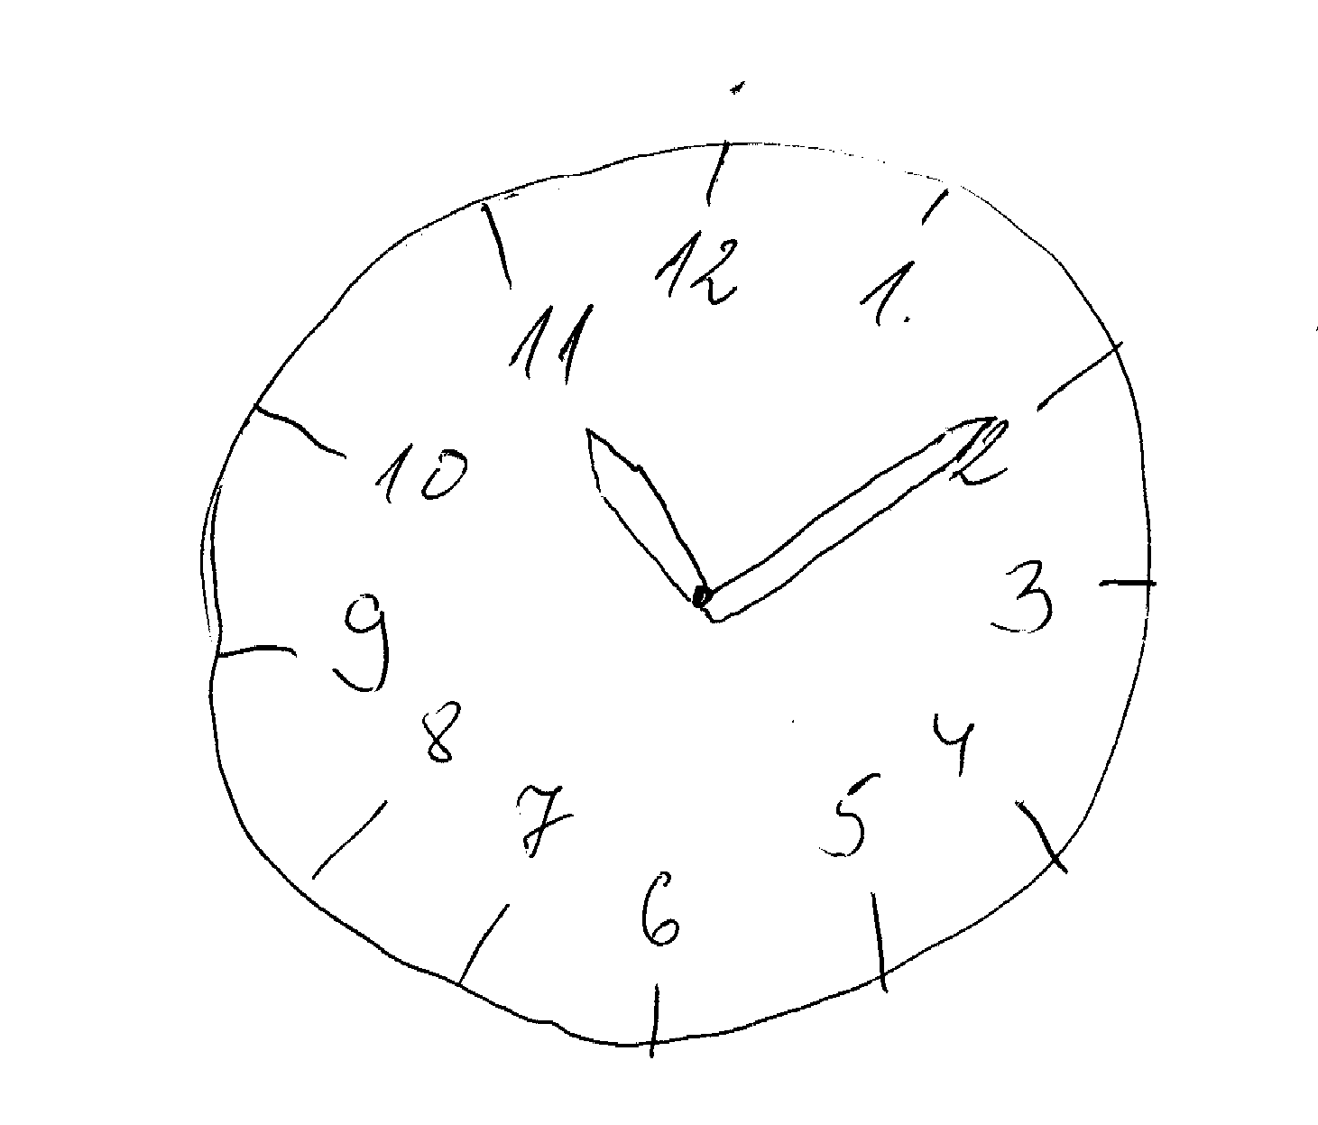
Examples of CDT

Slide 34
Issues that affect performance/testing?
Slower reaction times
Lower attentional levels
Slower processing speeds
Detriments in sensory functions
Detriments in perceptual functions
Less ability to use strategies

Slide 35
There are many different types of cognitive deficit/cognitive impairment/dementia with different cognitive profiles in addition to other symptoms.
Concomitant difficulties will affect performance on assessment instruments.
Attention and processing speed may also have an impact.

Slide 36
Diagnostic criteria – changing.
DSMIV
  (Diagnostic Statistical Manual American Psychiatric Association 1994)
DSM V due 2013
Multiple biomarkers under development
Notes:
NINCDS ADRDA & NINDS AIREN both split into possible, probable and definate
We will have a quick look at part of the DSMIV criteria and a summary of the new updated AD criteria from 2011

Slide 37
Dementia of the Alzheimer’s type (DSMIV)
A: The development of multiple cognitive deficits manifested by both,
1) memory impairment (impaired ability to learn new information or to recall previously learned information)
2) one (or more) of the following cognitive disturbances
  a: aphasia (language disturbance)
  b: apraxia (impaired ability to carry out motor activities despite intact motor function)
  c: agnosia (failure to identify objects despite intact sensory function)
  d: disturbance in executive functioning (ie planning, sequencing

Slide 38
Criteria for all-cause dementia: Core clinical criteria Recommendations from the National Institute on Aging-Alzheimer’s Association Workgroups on diagnostic guidelines for Alzheimer’s disease
Criteria for all-cause dementia: Core clinical criteria
Cognitive or behavioural (neuropsychiatric) symptoms
1. Interfere with the ability to function
2. Represent a decline from previous levels
3. Are not explained by delirium or major psychiatric disorder;
4. Cognitive impairment is detected and diagnosed
5. The cognitive or behavioral impairment involves
a minimum of two of the following domains: memory, executive, language,
visuospatial function, changes in personality, behaviour,
The differentiation of dementia from MCI rests on the determination
of whether or not there is significant interference in the ability to function
Notes:
Criteria for all-cause dementia: Core clinical criteria
In this section, we outline core clinical criteria to be used in all clinical settings. Because there are many causes of dementia, we will first outline the criteria for all-cause dementia. The diagnosis of dementia is intended to encompass the spectrum of severity, ranging from the mildest to the most severe stages of dementia. The methodology for staging of dementia severity was beyond the charge of the workgroup.
Dementia is diagnosed when there are cognitive or behavioral (neuropsychiatric) symptoms that:
1. Interfere with the ability to function at work or at usual activities; and
2. Represent a decline from previous levels of functioning and performing; and
3. Are not explained by delirium or major psychiatric disorder;
4. Cognitive impairment is detected and diagnosed through a combination of
(1) history-taking from the patient and a knowledgeable informant and (2) an objective cognitive assessment, either a “bedside”
mental status examination or neuropsychological testing. Neuropsychological testing should be performed when the routine history and bedside mental status examination cannot provide a confident diagnosis.
5. The cognitive or behavioral impairment involves a minimum of two of the following domains:
a. Impaired ability to acquire and remember new information––symptoms include: repetitive questions or conversations, misplacing personal belongings, forgetting events or appointments, getting lost on a familiar route.
b. Impaired reasoning and handling of complex tasks, poor judgment––symptoms include: poor understanding of safety risks, inability to manage finances, poor decision-making ability, inability to plan complex or sequential activities.
c. Impaired visuospatial abilities––symptoms include: inability to recognize faces or common objects or to find objects in direct view despite good acuity, inability to operate simple implements, or orient clothing to the body.
d. Impaired language functions (speaking, reading, writing)––symptoms include: difficulty thinking of common words while speaking, hesitations; speech, spelling, and writing errors.
e. Changes in personality, behavior, or comportment–– symptoms include: uncharacteristic mood fluctuations such as agitation, impaired motivation, initiative, apathy, loss of drive, social withdrawal, decreased interest in previous activities, loss of empathy, compulsive or obsessive behaviors, socially unacceptable behaviors.
The differentiation of dementia from MCI (see companion article [5] on the diagnosis of MCI) rests on the determination of whether or not there is significant interference in the ability to function at work or in usual daily activities. This is inherently a clinical judgment made by a skilled clinician on the basis of the individual circumstances of the patient and the description of daily affairs of the patient obtained from the patient and from a knowledgeable informant.
3. Proposed classification criteria for AD dementia
We propose the following terminology for classifying individuals with dementia caused by AD: (1) Probable AD dementia, (2) Possible AD dementia, and (3) Probable or possible AD dementia with evidence of the AD pathophysiological process. The first two are intended for use in all clinical settings. The third is currently intended for research purposes.
4. Probable AD dementia: Core clinical criteria 4.1. Probable AD dementia is diagnosed when the patient 1. Meets criteria for dementia described earlier in the text, and in addition, has the following characteristics:
A. Insidious onset. Symptoms have a gradual onset over months to years, not sudden over hours or days;
B. Clear-cut history of worsening of cognition by report or observation; and
C. The initial and most prominent cognitive deficits are evident on history and examination in one of the following categories.
Amnestic presentation: It is the most common syndromic presentation of AD dementia. The deficits should include impairment in learning and recall of recently learned information. There should also be evidence of cognitive dysfunction in at least one other cognitive domain, as defined earlier in the text.
Nonamnestic presentations: Language presentation: The most prominent deficits are in word-finding, but deficits in other cognitive domains should be present.
Visuospatial presentation: The most prominent deficits are in spatial cognition, including object agnosia, impaired face recognition, simultanagnosia, and alexia. Deficits in other cognitive domains should be present.
Executive dysfunction: The most prominent deficits are impaired reasoning, judgment, and problem solving. Deficits in other cognitive domains should be present.
D. The diagnosis of probable AD dementia should not be applied when there is evidence of (a) substantial concomitant cerebrovascular disease

Slide 39
The the correct assessment of cognitive function is important!

Slide 40
Healthy or successful ageing
Maintenance of good health throughout lifespan
Critical periods or not?

Slide 41
Cardiovascular factors
Stroke
White matter lesions
Hypertension
Risk rises with increasing age
  Eg stroke risk estimated as doubling every decade from ~ 35yrs
All three increase risk of poorer cognitive function and cognitive decline/dementia

Slide 42
Diet
Higher calories & lower anti-oxidants
Calorific restriction
Increased consumption of fish and seafood
Nootropic use (ie supplements to aid cognitive function such as ginko biloba)

Slide 43

Alcohol
Reduce cardiovascular risk
U shaped curve
Moderate drinkers show reduced WML, infarcts and even dementia
May just be red wine
Probably a maximum 1-2
glasses a day

Slide 44
Exercise
Increasing executive functioning
& frontal activity
Increased vascularisation, increased cell proliferation/survival
Reduction in age related decline grey and white matter
Biological age not directly correlated with chronological age

Slide 45

Experience, education
Higher levels of education/occupation seem to contribute to a cognitive reserve
This seems to be despite neuropathology and intelligence
Does this just delay the identification of decline using current tests?

Slide 46
Brain and cognitive ageing, lifespan perspective
Age
Pascual-Leone & Taylor 2011

Slide 47
Research into brain ageing
Nature versus nurture
Historical perspective

Slide 48
Conclusion 1
Many aspects of brain functioning change with age
Aspects of ageing include increased risk of stroke, dementia and deficit in cognitive functioning
Lifestyle factors/experience may help ameliorate some aspects of aging
Trajectory of brain ageing - may be critical periods.
Neurogenesis possible in adulthood and cognitively intact adults aged ≥100

Slide 49
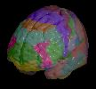
Why is any of this important?
Ageing society, ageing individually
Stroke and dementia large impact on patient/independence/family/care-giving/finance.
Older people know more facts than younger people? Potentially yes – semantic memory functions in older age
Older people are more forgetful than younger people? Potentially yes – episodic memory is more impaired and has a time gradient associated with it, executive function is also impaired.
Brain ageing begins around 65-70 years? No, it is lifelong.
Dementia is another word for Alzheimer’s disease? Alzheimer’s disease is a type of dementia.

