Slide 1
IMPERIAL COLLEGE
LONDON
GE
Overview of Endocrinology 2
Dr Jeannie Todd

Slide 2
Lecture Outline
Hormone Receptors
Hormone mechanism of action at target tissues
Hormone feedback
Biological rhythms

Slide 3
Hormone Receptors 1
The capacity of cell to respond to particular hormone depends on presence of cellular receptors -specific for that hormone
Hormones are usually present in circulation in very low concentrations (10⁻⁹ to 10⁻¹²M)
Therefore, receptor must have high affinity and high specificity for particular hormone

Slide 4
Hormone Receptors 2
Receptor binding by a hormone leads to biological response
Binding of hormone to receptor is a saturatable process ie. amount of hormone binding is dependent on number of specific receptors on a target cell
The biological response of target cell is determined by number of factors including
concentration of hormone in circulation
concentration of number of receptors
affinity of hormone–receptor interaction
Notes:
4

Slide 5
Peptide Hormones & Catecholamine Receptors
Peptide/protein and catecholamine hormones act via receptors situated on cell surface
Binding of hormone with its receptor activates an effectors system resulting in generation of
-Intracellular signal and second messengers effectors
-Leads to effect on changes in membrane transport, DNA and RNA synthesis, protein synthesis and hormone release

Slide 6
Peptide Hormones & catecholamine Receptors 2
These receptors are integral membrane proteins interspersed in phospholipid bilayer on plasma membrane
Two major classes of membrane receptors exist for protein hormones
Guanine nucleotide-binding proteins (G-protein) coupled receptor -eg. ACTH, LH, Catecholamine
Tyrosine kinase receptor- eg. Insulin, IGF-1,

Slide 7
Peptide Hormones & catecholamine Receptors 3
G-protein coupled receptor
-Consists of seven transmembrane domains
-This receptor uses G -protein to couple to specific intracellular effector systems
eg Gs regulatory protein- stimulates adenylate cyclase or Gi regulatory protein)-inhibition adenylate cyclase
- G protein consists of 3 subunits- α, β, γ
-Binding of the hormone to receptor cause α subunit of Gs protein to dissociate from β, γ subunits and activate adenylate cyclase which convert ATP to cAMP
-In contrast, binding of the hormone to Gi receptor prevents α subunit of Gi protein to dissociate and therefore inhibits adenylate cyclase
-Internal second messenger systems include cAMP (ACTH, LH, FSH,TSH), Ca2+ (Vasopressin, angiotensin II), IP₃

Slide 8
Hormone Mechanism of Action
1.Action of polypeptide/protein hormones
e.g. ACTH acting on adrenal cortical cell
-ACTH binds to the Gs-protein coupled receptor
-Leads to dissociation of α subunit of Gs protein from β, γ subunits
-Leads to activation of adenylate cyclase which convert ATP to cAMP
Mitochondria
Adenylate
Cyclase
ATP
cAMP
StAR protein
DNA
G-protein
ACTH R
Cholesterol
Blood Capillary
Adrenal Cortical Cell (Cytoplasm)
Adrenal Cortical
Cell (Nucleus)

Slide 9
Hormone Mechanism of Action
Action of polypeptide/protein hormones e.g. ACTH
-Major mechanism by which intracellular cAMP regulates cellular function is through binding to cAMP dependant Protein Kinases
-Activates cholesterol esterase which converts cholesterol esters to free cholesterol
providing substrate for steroid synthetase
-StAR protein mediates transfer of cholesterol from outer to inner mitochondrial membrane
Mitochondria
Adenylate
Cyclase
ATP
Protein
Kinase A
cAMP
StAR protein
DNA
+
esterase
+
G-protein
ACTH R
Cholesterol
Adrenal Cortical Cell (Cytoplasm)
Adrenal Cortical
Cell (Nucleus)
Blood Capillary

Slide 10
Hormone Mechanism of Action
Steroid hormones e.g. Cortisol
- Cholesterol undergoes series of modifications by cytochrome P450
-Once mature hormone cortisol produced, it can freely diffuse across the cell membrane into the circulation
Mitochondria
Cortisol
StAR protein
DNA
Esterase
Fatty acid
esters
Cholesterol
Adrenal Cortical
Cell (Nucleus)
Blood Capillary
Adrenal Cortical Cell (Cytoplasm)

Slide 11
Peptide Hormones & catecholamine Receptors 3
Tyrosine Kinase Receptor
-Transmembrane receptor
-Consists of an effector system that is intrinsic part of the structure
-Each have an extracellular cysteine rich hormone/ligand (hormone) binding domain
-Single transmembrane spanning domain
-Intracellular tyrosine kinase domain
- Ligand binding induces tyrosine kinase activation in the intracellular domain that leads to phosphylation of proteins on tyrosine residues

Slide 12
Tyrosine Kinase Receptor
NH₂
N-terminal extracellular cysteine rich ligand/hormone binding domain
Cadherin like
Cysteine rich
Transmembrane
Single transmembrane domain
C-terminal tyrosine kinase intracellular domain
Tyrosine kinase- catalyses phosphorylation of tyrosine residues on proteins
COOH

Slide 13
Steriod Hormone Receptors
In contrast to protein hormones, steroid hormones ( adrenal & gonadal steroids) act via intra-nuclear receptors
Steroid hormones enter most cells by passive diffusion
Hormone binds to specific intracellular protein receptors both w/in cytoplasm & nucleus
Steroid -receptor complex binds to DNA binding sites/ response elements (RE) to alter gene transcription and protein synthesis
Leads to stimulation of cell growth & differentiation and regulation of specific proteins
Once receptor-hormone complex has interacted with the gene, re-establishment of the unoccupied receptor occurs with elimination of hormone from the cell

Slide 14
Hormone Mechanism of Action
Steroid hormones e.g. Cortisol
-Free Cortisol enters cell by passive diffusion
-Binds to specific Glucocorticoid (GC) receptors in cell cytoplasm
-
Specific GCR
DNA
Ribosomes
Endoplasmic Reticulum
Target Cell (Nucleus)
Blood Capillary
Target Cell (Cytoplasm)

Slide 15
Hormone Mechanism of Action
2. Steriod hormones e.g cortisol
This hormone-receptor complex travels to nucleus & binds to specific DNA binding sites/RE
-Leads to changes in transcription rates of specific genes and production of mRNA
-Translation of mRNA to protein within endoplasmic reticulum
Specific GCR
DNA
New protein
New protein
mRNA
Ribosomes
Endoplasmic Reticulum
Target Cell
(Nucleus)
Blood Capillary
Target Cell (Cytoplasm)

Slide 16
Receptor Regulation
Concentration of receptors for particular hormone markedly alters sensitivity of cell to that hormone
Receptor down regulation
Sensitivity &/or no. of receptors ⇓ with prolonged exposure to high [hormone]
Receptor less sensitive
Receptor up regulation
Sensitivity &/or no. of receptors ⇑ with reduced exposure to [hormone]
Receptor more sensitive

Slide 17
Hormonal Feedback Mechanism
Distinguishing characteristic of Endocrine system is feedback control of hormonal production
Virtually all hormones are some type of feedback control
Necessary for normal endocrine homeostasis
Most hormone systems have feedback control of hormone production which are closed loop systems
Therefore regulates its own production
Protect against excessive hormone action

Slide 18
FEEDBACK RELATIONSHIPS 2
Feedback mechanisms are of two types: Negative feedback & Positive feedback
Negative feedback prevailing control mechanism regulating endocrine function and is a closed loop system
Hormones produced by peripheral target organ feedback onto organ that stimulates it to control its own function
Paradigm for this feedback control is interaction of hypothalamus & pituitary (H-P) with target organs (eg thyroid, adrenals and gonads)
Peripheral hormone form target organ feeds back to H-P system thus regulating target gland hormone production
Feedback relationship reason why need simultaneous assessment of stimulatory and peripheral hormone analysis is necessary for assessment of endocrine status

Slide 19
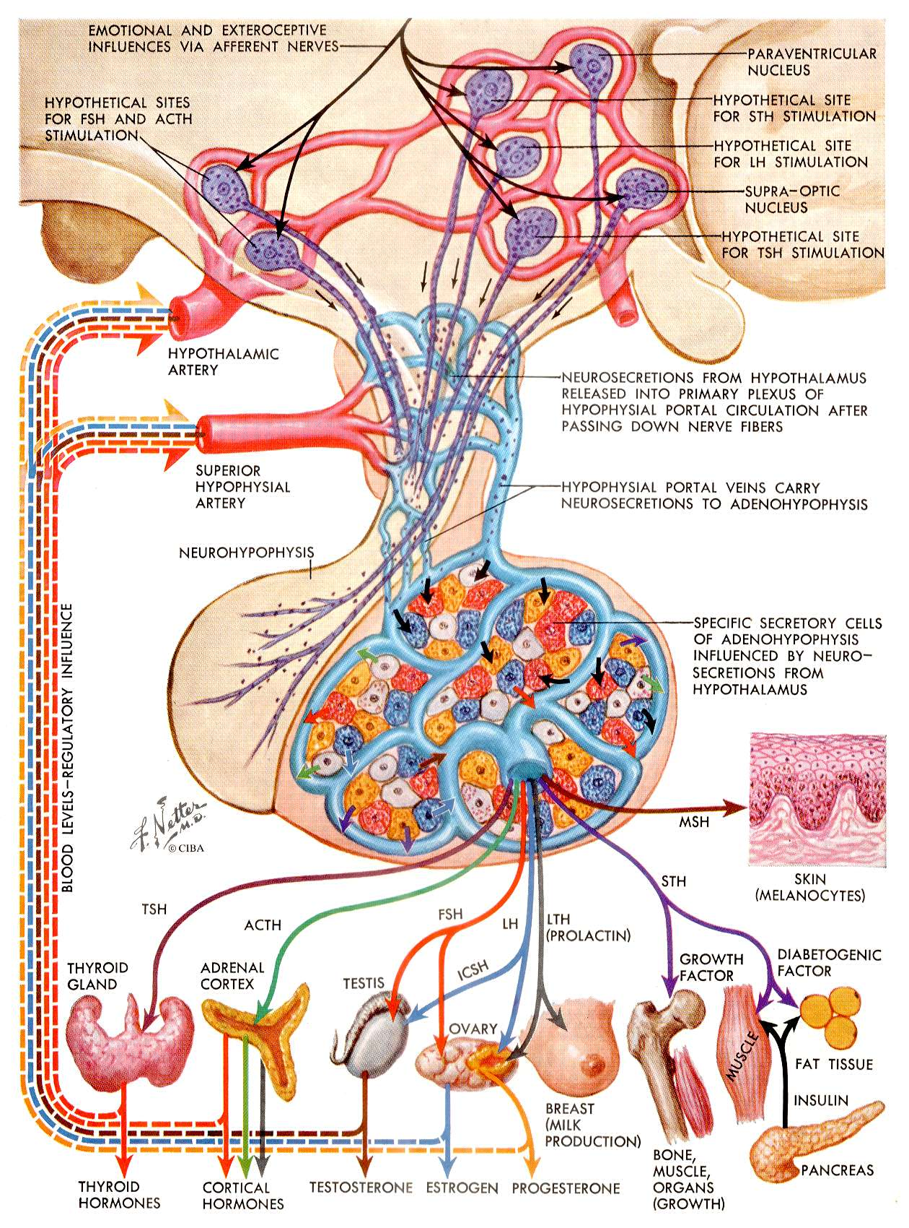

Slide 20
Brain
Environment Sensory inputs
Hypothalamus
Releasing factors
Inhibiting factors
-
+
-
Pituitary
+
Tropic hormones
Target Organ
Hormone

Slide 21
Hypothalamus
-
TRH
+
TSH
+
Pituitary
-
Thyroid
T3
}
T4
H-P-Thyroid axis- Homeostasis

Slide 22
Feedback relationships
Feedback relationship reason why need both simultaneous assessment of stimulatory (eg pituitary hormone) and peripheral hormone analysis for assessment of endocrine status
In endocrine dysfunction-Indicates where problem lies

Slide 23
Feedback relationships-Gland hypofunction
Peripheral gland failure (Primary)
Low peripheral hormone
High stimulatory/trophic
Eg; ⇓ T3/T4 with ⇑ TSH (1⁰ hypothyroidism)
⇓ E2 with ⇑ FSH/LH (1⁰ hypogonadism)
Pituitary Gland failure (Secondary)
-Low stimulatory (pit) hormone
Low peripheral hormone
Eg; ⇓ TSH with ⇓ T4/T3 (2⁰ hypothyroidism )
⇓ FSH/LH with ⇓ E2/testosterone (2⁰ hypogonadism)

Slide 24
1⁰ HYPOTHYROIDISM
-
Hypothalamus
+++
TRH
⇑TSH ++++
Pituitary
-
X
Thyroid
x
x
⇓T3
}
⇓ T4

Slide 25
Gland hypofunction
Peripheral gland failure
Low peripheral hormone
High stimulatory/trophic
Eg; ⇓ T3/T4 with ⇑ TSH (1⁰ hypothyroidism)
⇓ E2 with ⇑ FSH/LH (1⁰ hypogonadism)

Slide 26
2⁰ HYPOTHYROIDISM
-
Hypothalamus
+++
TRH
X
Pituitary
⇓TSH
-
Thyroid
x
x
⇓T3
}
⇓ T4

Slide 27
Gland hypofunction
Pituitary Gland failure
-Low stimulatory (pit) hormone
Low peripheral hormone
Eg; ⇓ TSH with ⇓ T4/T3 (2⁰ hypothyroidism )
⇓ FSH/LH with ⇓ E2/testosterone (2⁰ hypogonadism)

Slide 28
Feedback relationships-Gland Hyperfunction
Peripheral gland overproduction (1º )
High peripheral hormone
Suppressed stimulatory/trophic (pituitary hormone)
Eg; ⇑ T3/T4 with ⇓⇓ TSH (Thyroid adenoma)
⇑ Cortisol with ⇓⇓ ACTH (Cushings 2º to adrenal adenoma)

Slide 29
1º HYPERTHYROIDISM
-
Hypothalamus
⇓TRH
Pituitary
⇓TSH
-
Thyroid
⇑ T3
}
⇑ T4

Slide 30
Gland Hyperfunction
Peripheral gland overproduction
High peripheral hormone
Suppressed stimulatory/trophic
Eg; ⇑ T3/T4 with ⇓⇓ TSH (Thyroid adenoma)
⇑ Cortisol with ⇓⇓ ACTH (Cushings 2º to adrenal adenoma)

Slide 31
Feedback relationships-Gland Hyperfunction
Pituitary gland overproduction
High stimulatory/trophic (pituitary) hormone
High peripheral hormone
Eg; ⇑ ⇑ ACTH with ⇑ ⇑ cortisol (Cushings 2º to pituitary adenoma)

Slide 32
Cushing’s disease (pit. Adenoma)
-
Hypothalamus
⇓CRF
Pituitary
⇑⇑ACTH
-
Adrenals
⇑⇑Cortisol

Slide 33
Feedback relationships
Pituitary gland overproduction
High stimulatory/trophic
High peripheral hormone
Eg; ⇑ ⇑ ACTH with ⇑ ⇑ cortisol (Cushings 2º to pituitary adenoma)

Slide 34
Biological rhythms
Most hormones secreted in a pulsatile manner
Pulsatility can vary over mins, hours or days
eg; LH/FSH/GH –pulses every 2 hours
ACTH/cortisol –circadian variability
T4- long half life (7-10 days)
Hormonal rhythmicity effected by other regulatory factors
eg: Stress (ACTH/GH/Prolactin)
Hypoglycaemia (ACTH/GH)
Infection (ACTH)
Sleep (GH)

Slide 35
Summary
Hormone Receptors
–Cell surface (Protein hormone)
-Intracellular (Steroid)
Hormone mechanism of action at target tissues
Importance of hormone feedback and homeostasis
Biological rhythms

