Slide 1
IMPERIAL COLLEGE
LONDON
GE
Overview of Endocrinology 1
Dr Jeannie Todd

Slide 2
Lecture Outline
Definitions
History of Endocrinology
Hormone Classification and structure
Hormone synthesis, storage & release from endocrine
tissues
5. Hormone transport within the blood
6. Hormone Metabolism
Metabolism

Slide 3
INTRODUCTION
The evolutionary appearance of multicellular organism dictated the necessity of establishing coordinating systems to integrate and regulate the function of different cells
2.Two basic regulatory systems developed to perform this function
-Nervous system
- employs electrochemical signals to send commands to peripheral organs
-Endocrine system
- employs chemical agents/messengers released and transported blood stream to effect/regulate target organs

Slide 4
SOME DEFINITIONS
ENDOCRINE GLAND: A group of cells which secrete “messenger” molecules directly into the bloodstream
ENDOCRINOLOGY: Study of endocrine glands and their secretions
HORMONE: The bioactive chemical “messenger” molecule secreted by an endocrine gland (in general ) into the blood to be transported to target organs

Slide 5
A BRIEF HISTORY OF ENDOCRINOLOGY (1) SELECTED MARKERS INCLUDE:
WILLIAM HARVEY (1628)
CLAUDE BERNARD (1849)
BERTHOLD (1849)
THOMAS ADDISON (1856)
BROWN-SEQUARD (1889)
Blood is pumped around the body; discovery of circulation
Proposed concept of internal secretion- “Homeostasis”
Observed loss of male characteristics in castrated cocks
Documented clinical adrenal insufficiency
Self-injection of testicular extract

Slide 6
A BRIEF HISTORY OF ENDOCRINOLOGY (2)
BAYLIS and STARLING (1905)
BANTING and BEST (1922)
GEOFFREY HARRIS (1955)
ROGER EKINS (1960)
SALVADOR MONCADA (1987)
The GENOME PROJECT
Discovered GI hormone Secretin.Coined word hormone
Extracted insulin from pancreas
Established link between endocrine system (pituitary) and brain (hypothalamus)
Measure hormones/development of radioimmunoassays
Identified nitric oxide as a local hormone
Present & future developments

Slide 7
MORE DEFINITIONS
ENDOCRINE relates to action of a hormone on target cells at a distance from source (transported in blood stream)
PARACRINE relates to hormone’s action on nearby target cells e.g. Cells within immediate area around source
AUTOCRINE relates to hormone having an effect on its own immediate source/cell
[CRYPTOCRINE is a term devised to indicate that a hormone can have an effect within its own cell of production (i.e. hidden)]

Slide 8
BLOOD CIRCULATION
Endocrine
(or other)
cell
hormone
Endocrine cell
Endocrine
(or other)
cell
hormone
“distant”
target cells
hormone
ENDOCRINE
EFFECT
Endocrine
(or other)
cell
PARACRINE
EFFECT
AUTOCRINE
EFFECT
Notes:
Schematic representation of Endocrine system

Slide 9
ENDOCRINE vs. NERVOUS
SYSTEMS
Two basic regulatory systems to regulate and integrate functions of different cells
ENDOCRINE SYSTEM NERVOUS SYSTEM
Release of chemical agents Release of chemical (hormone) into bloodstream neurotransmitter across synapse (employs electrochemical signals)
Effect can be on many target Effect will be restricted to cells spread throughout the those target cells actually body innervated
Effect will take place over a Effect will be generated (relatively) long time-span within milliseconds
(seconds to days)

Slide 10
ENDOCRINE SYSTEM
Composed of several glands located at different areas of the body
These glands produce hormones with different function
Major morphological feature if that they are ductless –release hormones directly into blood stream
Endocrine glands richly vascularized to allow efficient delivery of these hormones into circulation

Slide 11
“CLASSIC” ENDOCRINE GLANDS
PITUITARY
PARATHYROIDS
THYROID
ADRENALS
PANCREAS
(GASTROINTESTINAL
TRACT)
GONADS

Slide 12
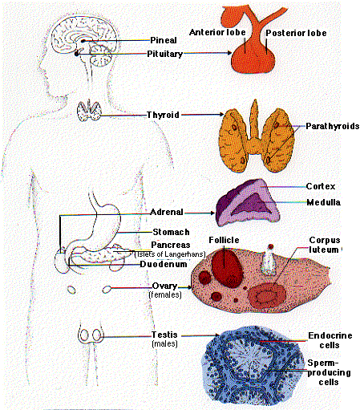
“Classic” Endocrine glands

Slide 13
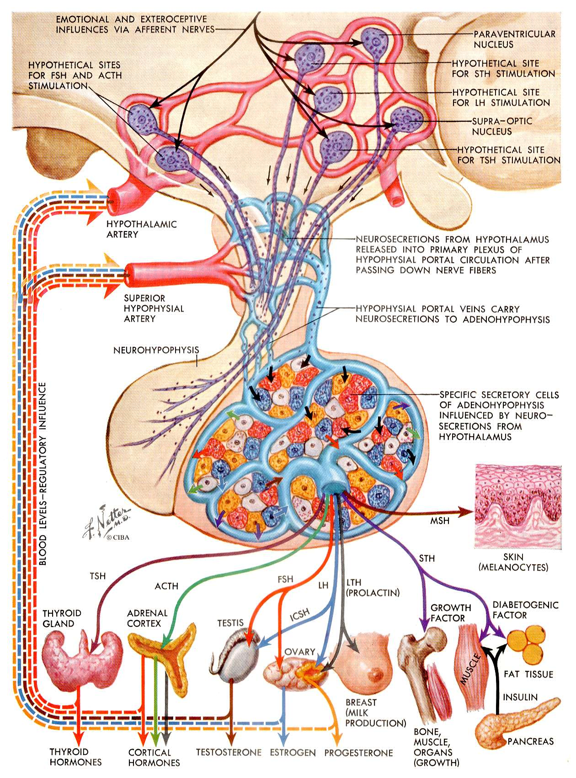
Notes:
Schematic representation of the Ant pit and the organs that this may effect.

Slide 14
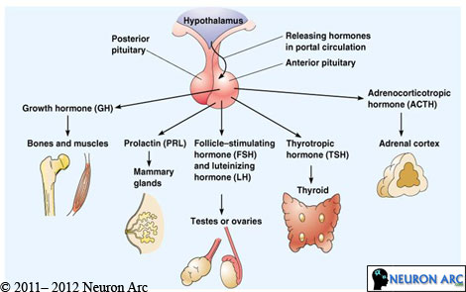
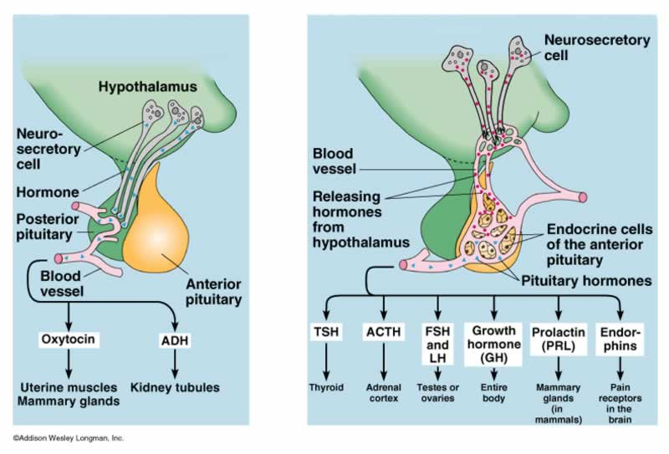

Slide 15
Classical Endocrine glands and their hormones 2
Gland Hormones secreted
Thyroid Thyroxine (T4), Triiodthyronine (T3)
Parathyroid Parathyroid Hormone (PTH)
Adrenals
Medulla Adrenaline
Noradrenaline
Cortex Cortisol
Aldosterone
Androgens-Dehydroepiandrosterone (DHEAS)
-Androsteniedione

Slide 16
Classical Endocrine glands and their hormones 3
Gland Hormones secreted
Gonads
Ovary Oestradiol (E2)/Progesterone
Testosterone
Androstenedione
Inhibin
Testis Testosterone,Androstenedione
Inhibin
Oestradiol (E2)
Placenta Beta HCG
HPL
Progesterone
Oestradiol (E2)
Pancreas Insulin, Glucagon, somatostatin, pancreatic polypeptide, gastrin, vasoactive polypeptide (VIP)

Slide 17
Non-classical “Endocrine organs”
In recent years – “non classical” Endocrine glands have been recognised
Includes production of hormones in glands whose primary function is not Endocrine

Slide 18
MORE RECENTLY IDENTIFIED ENDOCRINE GLANDS
Brain & Hypothlamus-eg. CRH TRH, LHRH
PITUITARY
PARATHYROIDS
THYROID
Heart eg.ANP
Liver eg IGF-1
Blood eg. cytokines
PANCREAS
ADRENALS
Kidneys eg. Renin, erythropoietin, 1-25 OH Vitamin D
Adipose tissue (fat) eg leptin
(GASTROINTESTINAL
TRACT)
GONADS
Notes:
Kidneys-ethyropoeitin, renin, 1,25 Vitamin D. Leptin important for BW regulation.

Slide 19
Hormone Classification
Chemically hormones fall broadly into 2 categories:
1.Protein/polypeptide/ amino acid derived hormones
-Complex polypeptides eg LH (200 aa)
-Intermediate sized peptides eg Insulin
-Small peptides eg TRH (3aa)
-Dipeptides eg T4 (derived from 2 iodinated tyrosine residues)
-Derived from single aa eg catacholamines
2. Steroid hormones
-Derived from cholesterol
-Divided into 2 groups
-Intact steroid nucleus (adrenal/gonadal steroids)
-Broken steroid nucleus (Vit D + metabolites)

Slide 20
Hormone synthesis, storage & release
1.Protein/polypeptide/ amino acid derived hormones
-Synthesized in rough ER and,like all peptides, amino acid sequence determined by specific mRNA synthesized in nucleus
-As with all proteins, mRNA determined by nucleotide
sequence dictated by specific gene
-Translation of mRNA sequence results in Ribosomal
synthesis of pro or pre-prohormone that is larger than the
active hormone
-This prohormone is subsequently shortened in distinct
steps
-Prohormone transported to Golgi apparatus where
processed by proteolytic enzymes to mature, active hormone
-Protein hormone always stored in secretory granules that fuse
with cell membrane during release into circulation-Exocytosis
2

Slide 21
Hormone Synthesis, Storage & Secretion
Protein/polypeptide hormones
e.g. ACTH (39aa)-produced in pituitary corticotroph cell
Synthesized as Pro-hormone = Pro-opiomelanocortin (POMC) – 241 amino acids
NH₂
Ser
Tyr
Ser
Met
Glu
His
Phe
Arg
Trp
Gly
Lys
Pro
Val
Gly
Lys
Lys
Arg
Arg
Pro
Val
Lys
Val
Tyr
Pro
Asn
Gly
Ala
Glu
Asp
Glu
Ser
Ala
Glu
Ala
Phe
Pro
Leu
Glu
Phe
COOH
Notes:
Schematic representation of production of ACTH adrenocorticotrpic hormone 39 aa produced in …. Syn as a prohormone …

Slide 22
Hormone Synthesis, Storage & Secretion
Protein/polypeptide hormones
e.g. ACTH production within pituitary corticotroph cell
-Specific mRNA sythesized within cell nucleus
-Translation of specific mRNA to prohormone,POMC, in rough ER
Golgi apparatus
Amino Acids
DNA
POMC
mRNA
Ribosomes
Endoplasmic Reticulum
Corticotroph Cell
(Nucleus)
Blood Capillary
Corticotroph Cell (Cytoplasm)
Notes:
Specific mRNA dictated by sp gene

Slide 23
Hormone Synthesis, Storage & Secretion
Protein/polypeptide hormones
e.g. ACTH
Growing POMC peptide chain
Met
Asp
Arriving charged
tRNA
Leu
Pro
Amino Acids
Phe
A
C
C
DNA
A
A
G
A
U
G
G
A
C
U
U
G
U
U
C
U
POMC
mRNA
G
G
C
A
G
A
G
G
POMC mRNA
Ribosomes
Endoplasmic Reticulum
Corticotroph Cell
(Nucleus)
Blood Capillary
Corticotroph Cell (Cytoplasm)
Notes:
DNA to mRNA –transcription.

Slide 24
Hormone Synthesis, Storage & Secretion
Protein/polypeptide hormones
e.g. ACTH
-POMC transported to Golgi body where further processed by proteolytic enzymes to generate mature active hormone ACTH
Golgi apparatus
Amino Acids
DNA
POMC
Ribosomes
Endoplasmic Reticulum
Corticotroph Cell
(Nucleus)
Blood Capillary
Corticotroph Cell (Cytoplasm)

Slide 25
Hormone Synthesis, Storage & Secretion
Protein/polypeptide hormones
e.g. ACTH
-Mature ACTH the stored in secretory granules within cell cytoplasm prior to release by exocytosis
POMC
processing
ACTH
Golgi apparatus
ACTH
DNA
POMC
Ribosomes
Endoplasmic Reticulum
Corticotroph Cell
(Nucleus)
Blood Capillary
Corticotroph Cell (Cytoplasm)

Slide 26
Hormone synthesis, storage & release
2. Steroid derived hormones
-Originate from precursor molecule-cholesterol
-Transported across cell membrane from blood stream by passive diffusion
-Once inside cell these precursor molecules are subjected to sequential action of several enzymes to produce the mature hormone
-In contrast to protein hormones, once steroid hormone is produced can freely cross cell membrane without being packed into secretory granules and actively exocytosed

Slide 27
Hormone Synthesis, Storage & Secretion
Steroid hormones -all derived from cholesterol
e.g. Cortisol
OH
Cholesterol
Cortisol

Slide 28
Hormone Synthesis, Storage & Secretion
Steroid hormones
e.g. Cortisol produced in adrenal cortical cell
-LDL rich in cholesterol transferred into cell by endocytosis.
-Cholesterol split from lipoprotein and esterified and stored in cytoplasmic vacuoles
Mitochondria
Low density
lipoproteins
DNA
Fatty acid
esters
Adrenal Cortical
Cell (Nucleus)
Blood Capillary
Adrenal Cortical Cell (Cytoplasm)

Slide 29
Hormone Synthesis, Storage & Secretion
Steroid hormones
e.g. Cortisol-
-Stimulation by ACTH activates cholesterol esterase which releases cholesterol from cholesterol ester depots providing substrate for steroid synthetase
-StAR protein (sterodogenic acute regulatory protein) mediates transfer of cholesterol from outer to inner mitochondrial membrane
Mitochondria
Low density
lipoproteins
StAR protein
DNA
Esterase
Fatty acid
esters
Cholesterol
Adrenal Cortical
Cell (Nucleus)
Blood Capillary
Adrenal Cortical Cell (Cytoplasm)
Notes:
St AR-steriodogenic acute reg protien mediates transfer of chol from outer to inner mitochondrial membrane

Slide 30
Hormone Synthesis, Storage & Secretion
3. Steroid hormones
-Cholesterol undergoes series of modifications by cytochrome P450 within the mitochondria to produce mature cortisol
Cholesterol undergoes series of modifications by cytochrome P450 Cholesterol undergoes series of modifications by cytochrome P450
Cholesterol
Pregnenolone
17α-pregnenolone
CH₃
CH₃
P450scc
P450c17
Mitochondria
OH
OH
OH
Low density
lipoproteins
3β HSD
CH₃
StAR protein
DNA
P450c11β
P450c21
Esterase
Cholesterol
Fatty acid
esters
Cortisol
11-deoxycortisol
17α-progesterone
Adrenal Cortical
Cell (Nucleus)
Blood Capillary
Adrenal Cortical Cell (Cytoplasm)

Slide 31
Hormone Synthesis, Storage & Secretion
2. Steroid hormones
e.g. Cortisol
- once mature hormone produced, it can freely diffuse across the cell membrane into the circulation
Mitochondria
Cortisol
StAR protein
DNA
Esterase
Fatty acid
esters
Cholesterol
Adrenal Cortical
Cell (Nucleus)
Blood Capillary
Adrenal Cortical Cell (Cytoplasm)

Slide 32
Plasma Transport
Most hormone secreted into systemic circulation
Only exception- hypothalamus-releases into hypophyseal portal system (rich network of blood vessels that “bath” the anterior pituitary)
Allows a higher concentration of releasing factors from the hypothalamus reach pituitary cf. systemic circulation

Slide 33
Plasma Transport 1
Water soluble hormones eg protein/polypeptide hormones circulate freely within the bloodstream
More insoluble eg. steroid and thyroid hormones are bound to plasma proteins or transport proteins
Transport protein acts a reservoir so that bound hormone is in dynamic equilibrium with small amount of free hormone
Only free hormone is biologically active
These buffer hormones and serve to protect against rapid changes hormone concentration

Slide 34
Plasma Transport 2
Plasma proteins such as albumin are general transport molecules and have ability to non-selectively transport a variety of low molecular weight hormones
Specific binding proteins have high affinity binding sites for specific hormones
–TBG (Thyriod hormones)
-CBG (Cortisol)
-SHBG(Testosterone/Oestradiol)
Important in interpretation of blood tests eg. Pregnancy and cortisol levels
Binding of proteins effect clearance rate form circulation-i.e. greater binding capacity, slower the clearance rate of the hormone.
Notes:
Resemble intracellular receptor proteins in their specificity
And characteristics

Slide 35
Hormone Transport
Pituitary Corticotrophs
Adrenal Cortical Cells
CBG
ACTH
Cortisol
Albumin

Slide 36
Hormone Transport
Hormone + Plasma Protein Protein Bound Hormone
Bound and free hormone are in Dynamic equilibrium
-Changes in Plasma protein or free hormone followed by adjustments of secretion rates of the hormone
-Ensures that free hormone available to the tissues remains constant

Slide 37
Hormone Transport
Hormone + Plasma Protein Protein Bound Hormone
Hormone + Plasma Protein Protein Bound Hormone

Slide 38
Hormone Transport
Hormone + Plasma Protein Protein Bound Hormone
Hormone + Plasma Protein Protein Bound Hormone
Endocrine cell ↑ hormone synthesis & release

Slide 39
Hormone Transport
Hormone + Plasma Protein Protein Bound Hormone
Hormone + Plasma Protein Protein Bound Hormone

Slide 40
Hormone Transport
Hormone + Plasma Protein Protein Bound Hormone
Hormone + Plasma Protein Protein Bound Hormone
Endocrine cell ↑ hormone synthesis & release
Eg Pregnancy-increases CBG levels & therefore cortisol levels rise to ensure constant level of free hormone available to tissues

Slide 41
Hormone Metabolism
Binding of hormones to carrier proteins profound effect on clearance of hormones
Greater binding capacity of specific hormone slower clearance rate of hormone
For example, T4 which is tightly bound to the carrier protein has a much slower clearance than ones that are less tightly bound
Only small proportion of the hormone is removed from the circulation by the target tissue
This interaction with target tissue receptor leads to intracellular degradation of the hormone by internalization of the hormone receptor complex
Majority of hormone removed by liver or kidney
This process includes enzymatic degradation i.e. hydrolysis, oxidation, methylation, decarboxylation

Slide 42
Summary
Definitions
History of Endocrinology
Endocrine glands-classical & non classical
Hormone Classification and structure
Protein/polypeptide
Steroid
Hormone synthesis, storage & release from endocrine
tissues
5. Hormone transport within the blood
6. Hormone metabolism

