Slide 1
Pharmacokinetics and Drug metabolism
Nigel J Gooderham
Biomolecular Medicine
SORA, Faculty of Medicine

Slide 2
Pharmacokinetics and Drug metabolism
This part of the course consists of five components…
Lecture: Pharmacokinetics: The journey of a drug through the body
Lecture: Drug metabolism: The chemical modification of a drug
Tutorial: Bioavailability
CAL: Drug metabolism
Worksheet: Directed study – consolidation and revision

Slide 3
Pharmacokinetics and Drug metabolism
Learning objectives
List the major routes by which drugs may be administered and their advantages and disadvantages.
Be able to describe the factors that effect the passage of drugs across membranes.
Be able to describe the factors that determine drug distribution.
Be able to explain how drug action may be terminated.
Be able to describe the principle routes of drug metabolism and excretion.
Be able to define the terms: first-pass metabolism; enterohepatic circulation; drug half-life; apparent volume of distribution; bioavailability; drug clearance.

Slide 4
Pharmacokinetics: The journey of a drug through the body
To achieve its effect a drug must first be presented in a suitable formulation at an appropriate site of ADMINISTRATION and then (usually) ABSORBED and DISTRIBUTED through the body to its site of action. For the effect to wear off the drug must almost always be METABOLISED and/or EXCRETED with these residues being VOIDED (REMOVED) from the body.

Slide 5
Pharmacokinetics: The journey of a drug through the body (ADME)
ADMINISTRATION
ABSORPTION
DISTRIBUTION
METABOLISM
EXCRETION
REMOVAL

Slide 6
Drug Administration
Drug actions may be…
SYSTEMIC - the entire organism
LOCAL – restricted to one area of the organism

Slide 7
Drug administration routes
ENTERAL ROUTES
sublingual, buccal, oral, rectal
PARENTERAL ROUTES
intravenous, intramuscular, subcutaneous, percutaneous, inhalation
(Bioavailability tutorial)

Slide 8
Drug Absorption
Drugs have to traverse both aqueous and lipid environment
Lipid soluble drugs (e.g. anaesthetics)
usually small volatile molecules that ‘dissolve’ into membranes
Water soluble drugs (e.g. most drugs)
usually weak acids or bases able to become charged – ionisation depends on pKa of the molecule and the pH of the medium

Slide 9
Drug absorption
Transfer across membranes…
Passive diffusion (most common – pH partition hypothesis)
Facilitated diffusion
Active transport (important in drug excretion)
Pinocytosis (phagocytosis-like mechanism)
Filtration (small water-soluble molecules)
Paracellular transport (around cells)

Slide 10
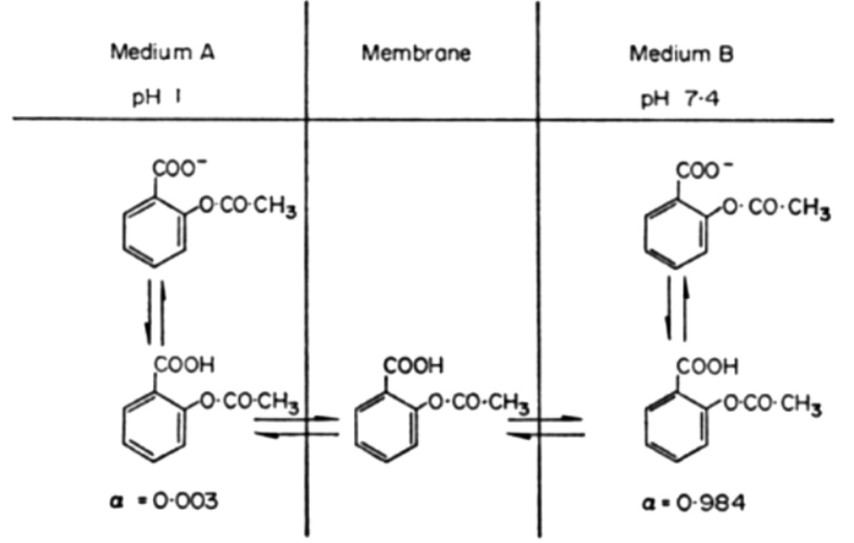
Drug absorption
Passive diffusion – The pH Partition Hypothesis

Slide 11
Drug distribution
Factors influencing drug distribution…
Regional blood flow
Extracellular binding (Plasma-protein binding)
Capillary permeability (tissue alterations – renal, hepatic, brain/CNS, placental)
Localisation in tissues

Slide 12
Drug excretion
In man there are two major routes of drug excretion…
Kidney
ultimately responsible for the elimination of most drugs
Liver
some drugs are concentrated in the bile (usually large molecular weight conjugates)

Slide 13
Drug excretion
Kidneys
Glomerulus – drug-protein complexes not filtered
Proximal tubule – active secretion of acids and bases
Proximal and distal tubules – lipid soluble drugs reabsorbed

Slide 14
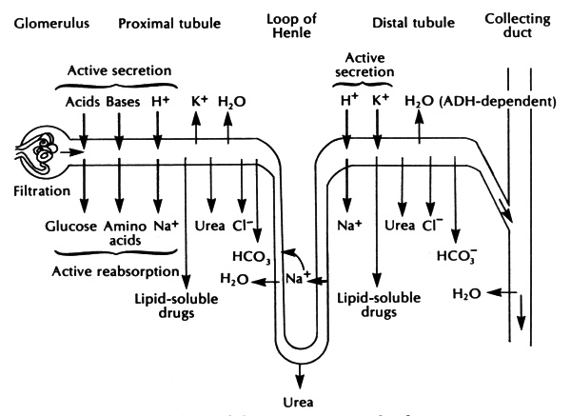
Drug excretion
Kidney tubule

Slide 15
Drug excretion
Liver
Biliary excretion (large molecular weight molecules can concentrate)
Active transport systems – into bile (bile acids and glucuronides)
ENTEROHEPATIC CYCLING
drug/metabolite excreted into gut (via bile) then reabsorbed, taken to liver and excreted again… leads to drug persistence.

Slide 16
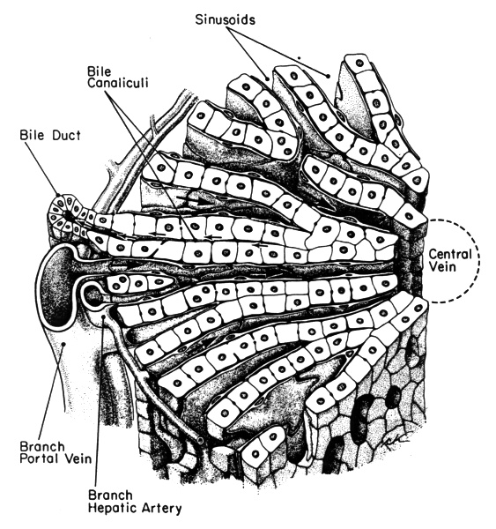
Drug excretion
Liver

Slide 17
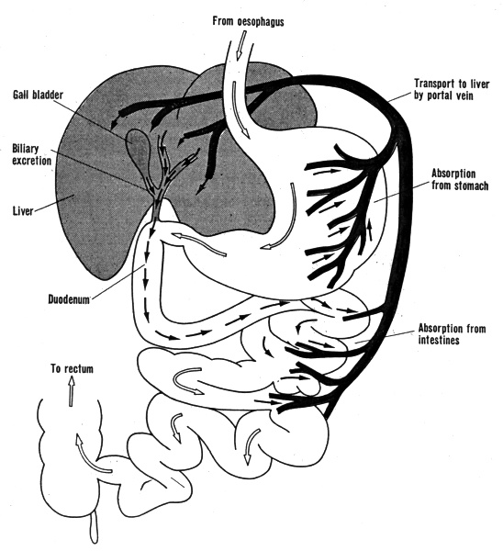
Drug excretion -Enterohepatic cycling

Slide 18
Drug excretion
Other routes (usually of little quantitative importance)…
lungs, skin, gastrointestinal secretions,
saliva, sweat, milk, genital secretions

Slide 19
Pharmacokinetics
The variation with time of the drug concentration in the blood (or plasma).
There are a number of derived parameters that describe the drug’s journey through the body.
Bioavailability
Proportion of the administered drug that is available within the body to exert its pharmacological effect

Slide 20
Pharmacokinetics
Apparent volume of distribution
The volume in which a drug appears to be distributed
- an indicator of the pattern of distribution

Slide 21
Pharmacokinetics
Biological half-life
Time taken for the concentration of drug (in blood/plasma) to fall to half its original value

Slide 22
Pharmacokinetics
Clearance
Blood (plasma) clearance is the volume of blood (plasma) cleared of a drug (i.e. from which the drug is completely removed) in a unit time
Related to volume of distribution and the rate at which the drug is eliminated.
If clearance involves several processes, then total clearance is the sum of these processes.

Slide 23
Pharmacokinetics: The journey of a drug through the body
Summary
To achieve its effect a drug must first be presented in a suitable formulation at an appropriate site of ADMINISTRATION.
The drug is then (usually) ABSORBED and DISTRIBUTED through the body to its site of action.
For the effect to wear off the drug must almost always be METABOLISED and/or EXCRETED.
Finally the drug residues are VOIDED (REMOVED) from the body.

