Slide 1
Drug Metabolism: The biochemical modification of a drug
Nigel Gooderham
Biomolecular Medicine

Slide 2
Drug Metabolism
Objectives
To understand the general principals of xenobiotic (foreign chemical) biotransformation.
Be able to describe the routes and biochemistry of Phase I metabolism.
Be able to describe the routes and biochemistry of Phase II metabolism.
To understand the importance of drug metabolism in pharmacology.

Slide 3
The requirement for drug metabolism
Xenobiotics are usually lipophilic molecules.
Metabolism tends to reduce or eliminate pharmacological/toxicological activity.
Metabolism converts lipophilic chemicals to polar derivatives (readily excreted).

Slide 4
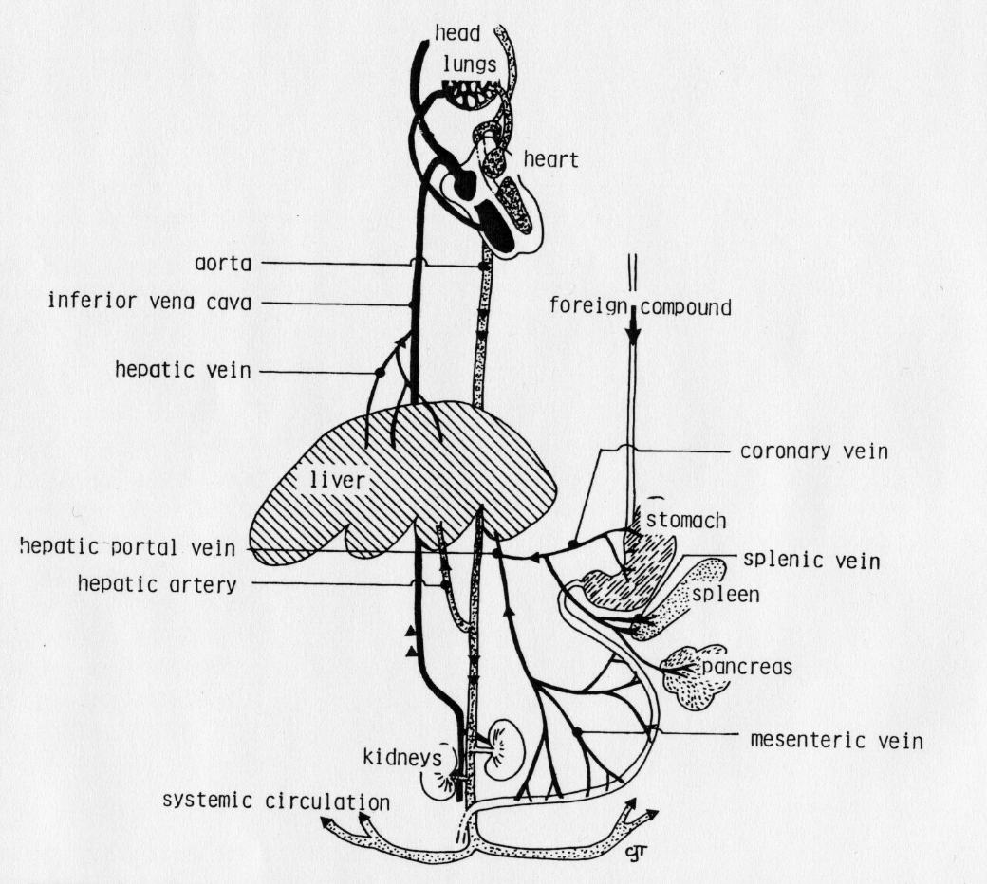
The sites of drug metabolism
The liver is the major organ of drug metabolism.
Hepatic “first pass” metabolism can be extensive.
Metabolism can occur in other organs, e.g. gut, kidneys, skin, brain etc.

Slide 5
Types of metabolic change
Phase I
Oxidation
Reduction
Hydrolysis
Phase II
Glucuronidation
Acetylation
Amino acid conjugation
Sulphation
Methylation
Glutathione conjugation
excretion

Slide 6
Phase I reactions
Oxidation/reduction creates new functional groups, hydrolysis unmasks them.
Phase I reactions often inactive chemicals, but can also activate (e.g. a prodrug).
After phase I metabolism, there is little change in polarity of the drug.

Slide 7
Cytochrome P450 mediated oxidation
RH + NADPH + O₂ + H⁺
drug
Cytochrome P450
ROH + NADP⁺ + H₂O
Oxidised drug

Slide 8
Oxidation by CYP
⁻e
P450-Fe³⁺-RH
RH
P450-Fe²⁺-RH
P450-Fe³⁺
O₂
ROH
P450-Fe²⁺-RH
P450-Fe³⁺-ROH
O₂
H₂O
P450-Fe³⁺-RH
P450-Fe³⁺-RH
²⁻O₂
⁻O₂
⁻e
P450-Fe²⁺-RH
⁻O₂

Slide 9
Oxidative reactions 1
aliphatic
aromatic

Slide 10
Oxidation reactions 2
N-demethylation
O-demethylation

Slide 11
Oxidation reactions 3
N-oxidation
Alcohol oxidation

Slide 12
Reductive and hydrolytic reactions
Reduction
Hydrolysis

Slide 13
Phase I Summary
Phase I reactions
Prepare a drug for Phase II metabolism by introducing a functional group such as –OH, -NH₂, -SH or –COOH.
Often generate a biologically inactive product.
Have little effect on drug polarity.
Sometimes produce toxic metabolites.

Slide 14
Methylation
(methyl transferase)
Glucuronidation
(Glucuronyl transferase)
Sulphation
(Sulphotransferase)
Phase II
metabolism
Acetylation
(Acetyl transferase)
Glutathione
(Glutathione-S-transferase)
Aminoacid conjugation
(Acyl transferase)

Slide 15
Phase II enzymes
Reaction | Conjugating agent | Target functional group
Glucuronidation | UDP-glucuronic acid | -OH, -COOH, -NH₂, -SH
Acetylation | Acetyl CoA | -OH, -NH₂
Amino acid conjugation | Glycine, Glutamine, Taurine | -COOH
Methylation | S-adenosyl-methionine | -OH, -NH₂
Sulphation | 3’-phosphoadenosine-5’-phosphosulphate | -OH, -NH₂
Glutathione conjugation | glutathione | electrophiles

Slide 16
Glucuronidation

Slide 17
Acetylation

Slide 18
Methylation

Slide 19
Sulphation

Slide 20
Conjugation with glutathione

Slide 21
Phase II summary
Phase II reactions:
Are conjugation reactions which utilise -OH, -NH₂, -SH and -COOH.
Include glucuronidation, sulphation, acetylation, methylation, conjugation with amino acids and with glutathione.
Involve a high energy intermediate such as UDPGA for glucuronidation or PAPS for sulphation.

Slide 22
The importance of drug metabolism
The biological half-life of the chemical is decreased.
The duration of exposure is reduced.
Accumulation of the compound in the body is avoided.
Potency/duration of the biological activity of the chemical can be altered.
The pharmacology/ toxicology of the drug can be governed by its metabolism.

Slide 23
Further reading
Pharmacology – Rang, HP, Dale, MM and Ritter, JM (2003) Churchill Livingstone.
Medical Pharmacology at a glance – Neal, MJ (2005) Blackwell Science.
Integrated Pharmacology – Page, C, Curtis, M, Sutter, M, Walker, M & Hoffman, B (2002) Mosby.

