Slide 1
Clinical trials, systematic reviews and meta-analysis
Dr Jane Warwick
Imperial Clinical Trials Unit

Slide 2
Outline
Overview of clinical studies
Explain the importance of randomised clinical trials
Key issues
- Study design
- Randomisation
- Choice of controls (if any)
- Blinding
- Ethics and consent
- Regulatory aspects
Overview of systematic reviews and meta-analyses.

Slide 3
Hierarchy of clinical studies
Systematic reviews and meta-analyses
Clinical trials (intervention studies)
Systematic review of cohort studies
Cohort studies
Outcomes research; ecological studies
Case control studies
Case series
Expert opinion
Systematic review of case control studies

Slide 4
What is a clinical trial?
‘a clinical trial is any research study that prospectively assigns human participants or groups of humans to one or more health-related interventions to evaluate the effects on health outcomes. Clinical trials may also be referred to as interventional trials. Interventions include but are not restricted to drugs, cells and other biological products, surgical procedures, radiologic procedures, devices, behavioural treatments, process-of-care changes, preventive care, etc. This definition includes Phase I to Phase IV trials.’
http://www.who.int/ictrp/en/

Slide 5
Clinical trials
a planned experiment in humans designed to measure the effectiveness of an intervention, eg.
a new drug
a surgical procedure
a vaccine
complementary therapy
Different from other epidemiological designs
Most epidemiological studies (surveys, cross sectional, cohort, case control, ecological) are observational
Trials are experimental

Slide 6
Phases of clinical trials for drug development
Phase I
test the safety of a new treatment
small number of people, usually healthy volunteers
Phase II
Test to see whether the treatment is effective (surrogates)
Continue to look at safety
a few hundred people usually with the condition
Phase III
Compare the new treatment with the current or placebo (hard)
Continue to monitor side effects
Several thousand patients
Phase IV
After drug has been marketed
Measure effect in various populations, rare side effects

Slide 7
Key aspects of clinical trials
Objectives
Design
Patients selection
Study size
Controls
Unbiased data collection
Ethics
Endpoints
Analysis
Publication

Slide 8
Design and phase
Parallel trial design
Crossover design
Intervention
Time 1...
Randomisation..
Control
Time 1...
intervention
Group one
Group two
Randomisation..
Group two
Group one
control

Slide 9
Factorial design
Randomisation one
Treatment A
Treatment B
Treatment C
Treatment D
Treatment C
Treatment D

Slide 10
When is a randomised trial appropriate?
New treatment better than standard
New treatment worse than standard
‘Equipoise’

Slide 11
Why randomise?
Validates statistical analysis
Ensures trt allocation is not biased¹
Ensures prognostic factors are balanced (equally distributed) between trt arms²
Works for pf’s we know about
Works for pf’s we don’t know about
¹ works with any sample size
² requires a minimum of 100 subjects in each group
Randomisation is key to obtaining comparable treatment groups

Slide 12
Example of bias in treatment allocation
Study of BGC vaccine for TB in children
deaths from TB were five times higher in the control group than the vaccinated children
doctors offered new vaccine to children with “cooperative” parents
These parents were more educated, health conscious
Their children had lower mortality from TB regardless of the vaccination

Slide 13
CAPPP Trial: baseline data
Characterisation | ACE (n = 5492) | Conventional (n = 5493)
SBP mmHg | 161.8 | 159.6
DBP mmHg | 99.8 | 98.1
Previous MI / IHD | 104 (1.9%) | 136 (2.48%)
Previous CHF | 19 (0.35%) | 10 (0.18%)
DM | 309 (5.63%) | 263 (4.8%)
Lancet 1999

Slide 14
Alternatives to Simple Randomisation
A factor may have such a strong prognostic effect that even a small imbalance between the study arms would undermine trt comparison
-use stratified randomisation
(i.e. have a separate Rx process for each sex or recruitment centre)
With small studies there is a risk of ending up with more subjects on one arm than the other
- restricted/block randomisation (fix it so that major differences cannot happen)

Slide 15
Controls – why bother?
Basis of study question?
Assess placebo effect
Eliminate seasonal effects
Changes in disease incidence and severity
Changes in treatment
Changes in patient population
To demonstrate that the intervention has an effect that wouldn’t occur otherwise

Slide 16
e.g. 2 TOMHS - S/E Prevalence
Acebutolol 16%
Amlodipine 18.7%
Chlorthalidone 16.8%
Doxazosin 21.3%
Placebo 19.1%

Slide 17
RCTs and Causation
Select patients
Randomly assign treatment
Only difference between the treatment arms should be the treatment
→Differences in outcome can be attributed to treatment

Slide 18
Caveats
The theoretical advantages of an RCT over other types of clinical study are only there if the study is well-designed and properly implemented.

Slide 19
How big should the study be?
Depends on
your choice of primary endpoint (eg survival, mean change in BMI, etc)
the variability of the primary endpoint
the magnitude of the expected difference between the treatments
how certain you want to be about your results
To calculate the number of patients needed in your study you need to perform a power calculation

Slide 20
How to perform a power calculation
Use simple rule of thumb (not recommended)
Book: Sample size tables for clinical studies (David Machin, Michael Cambell, Peter Fayers and Alain Pinol)
Specialist software - Licenced statistical packages (Stata, SAS, S-plus, etc) - Unlicensed software (search the Web) - Web-based tools (again search the Web)
BEST OF ALL _ Ask a statistician

Slide 21
BIAS
A systematic error in design, conduct or analysis of a study which produces a mistaken estimate of an exposure on the risk of disease

Slide 22
BIAS in RCT’s
Due to:-
Sponsorship
Study patient selection/allocation
Prejudice of patient
Prejudice of observer
Prejudice of clinician
Poor study conduct
Inappropriate analyses
Misinterpretation of results

Slide 23
Risk of venous thrombosis with third generation contraceptives
Relative risk
3.0
2.0
1.0
No
Yes
Funding
Vandenbroucke JP

Slide 24
Bias due to corruption of the randomisation process
Patient agrees to randomisation but withdraws if not assigned to their preferred treatment group
Clinician agrees to randomisation but withdraws patient if not assigned to their preferred treatment group
Certain subgroups excluded from the randomisation
Clinician guesses/obtains access to the randomisation sequence

Slide 25
Blinding
Single blind
- The patient does not know whether they are getting the new treatment or not
Double blind
- neither the patient nor the doctor knows which treatment they are getting

Slide 26
Other potential sources of bias
Losses to follow up
Withdrawal
Unable to locate/did not return for trial visits
Events/mortality
Basing the analysis on only a subset of the study participants
Intention To Treat | Per Protocol
Inclusion of all randomised participants in the analysis In the group to which they were allocated. | Only those participants who were randomised in accordance with and followed the protocol

Slide 27
Difference between ITT and PP : Summary
 | ITT | p | PP | p
All stroke | -30% | 0.06 | -34% | 0.03
Total mortality | -21% | 0.02 | -28% | 0.001
Fatal stroke | -39% | 0.05 | -45% | 0.02
Heart failure | -64% | <0.001 | -72% | <0.001
Cardiovascular events | -34% | <0.001 | -37% | <0.001

Slide 29
Ethics and consent
Regulation aims to protect patients
All participants in a trial must provide informed consent, and be free to withdraw at any time without affecting their care
All clinical trials have to be
Registered
Sponsored (pharma company, university, NHS)
Approved by a Research Ethics Committee
Adhere to government and international guidelines
Be run in accordance with Good Clinical Practice requirements

Slide 30
Drug trials
IMP - Investigational Medicinal Product is a pharmaceutical form of an active substance or placebo being tested or used as a reference in a CTIMP. http://www.em-toolkit.ac.uk/home.cfm
MHRA - Medicines and Healthcare products Regulatory Agency
http://www.mhra.gov.uk/
Legal requirements
GCP - Good clinical practice (ICH GCP) http://www.ich.org/products/guidelines/efficacy/article/efficacy-guidelines.html
SAE -Serious Adverse Event
SUSAR -Suspected Unexpected Serious Adverse Reaction

Slide 31
Guidelines re: reporting randomised studies
Go to www.consort-statement.org and download the E-Flowchart and Checklist documents

Slide 32
Summary
Randomised controlled clinical Trial
Planned intervention
Outcome carefully measured
Observational/cohort /case control study
No intervention
Observation of outcomes/
Confounding
Greater confidence in causality
Confounding reduced
Selected population
Drug trials - legislation
Less selected population

Slide 33
Limitations of a single study
Many studies are underpowered (comprise too few patients to provide a conclusive answer)
over-estimated the magnitude of the treatment effect at the planning stage
close with incomplete recruitment
Risk of Type I error is kept low (5%) but not eliminated
Risk of bias in the conduct or analysis
Tend to focus on a very specific question, in a very specific study population
Results may be difficult to generalise to other populations

Slide 34
Systematic Review
“A review of a clearly formulated question that uses systematic and explicit methods to identify, select, and critically appraise relevant research, and to collect and analyse data from the studies that are included in the review.”
Cochrane collection glossary (www.cochrane.org)
“Systematic reviews identify, evaluate, combine and summarise the findings of all relevant individual studies and, when carried out well, provide decision-makers with the best possible information about the effect of tests, treatments and other interventions used in health and social care”
National Institute of Health Research (www.nihr.ac.uk )

Slide 35
Advantages of systematic review
Large amounts of information from a range of sources/languages, providing an overview of evidence.
Explicit methods limit bias; conclusions are thus more reliable and accurate.
Results of different studies are compared to establish generalisability and consistency.
Inconsistencies can be identified and new hypotheses generated about subgroups.
Quantitative systematic reviews (meta-analyses) increase the precision of the overall result.

Slide 36
Meta-analysis
‘The use of statistical techniques in a systematic review to integrate the results of included studies’.
.

Slide 37
What does a meta-analysis involve?
Effect estimates are abstracted (or calculated) from the selected studies
These individual study effect estimates are pooled to produce a weighted average effect across all studies.
Studies are weighted according to a measure of its importance.
Most weight to informative studies (often large studies with precise effect estimates)
Least weight to less informative studies (often smaller studies with imprecise effect estimates).

Slide 38
Advantages of meta-analyses
Meta-analysis techniques combine the published estimates of effect from each study to generate a pooled overall risk estimate.
Can include more subjects than any single constituent study, and produce a more reliable and precise estimate of effect
Can explore differences (heterogeneity) between published studies.
Can identify whether publication bias is occurring.
BUT
If the studies are too heterogeneous, it may be inappropriate, even misleading to statistically pool the results from separate studies!

Slide 39
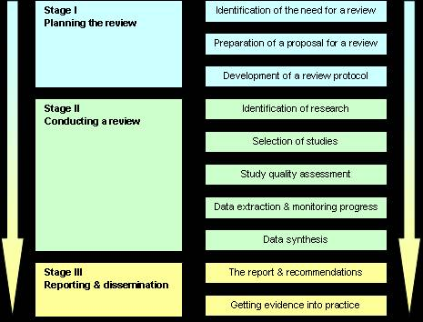
Stages of systematic review and meta-analysis
Often instigated by a policy maker or funding body
Tend to answer a more general question than the individual studies

Slide 40
Example
Physiotherapy intervention in Parkinson’s disease: systematic review and meta-analysis (Tomlinson, et al. BMJ2012;345:e5004)
Investigated the effect of physiotherapy on a number of outcomes in subjects with Parkinson’s disease
Gait
Functional mobility and balance
Falls
Clinician rated impairment and disability measures
Patient rated quality of life
Adverse events
Compliance
Economic outcomes

Slide 41
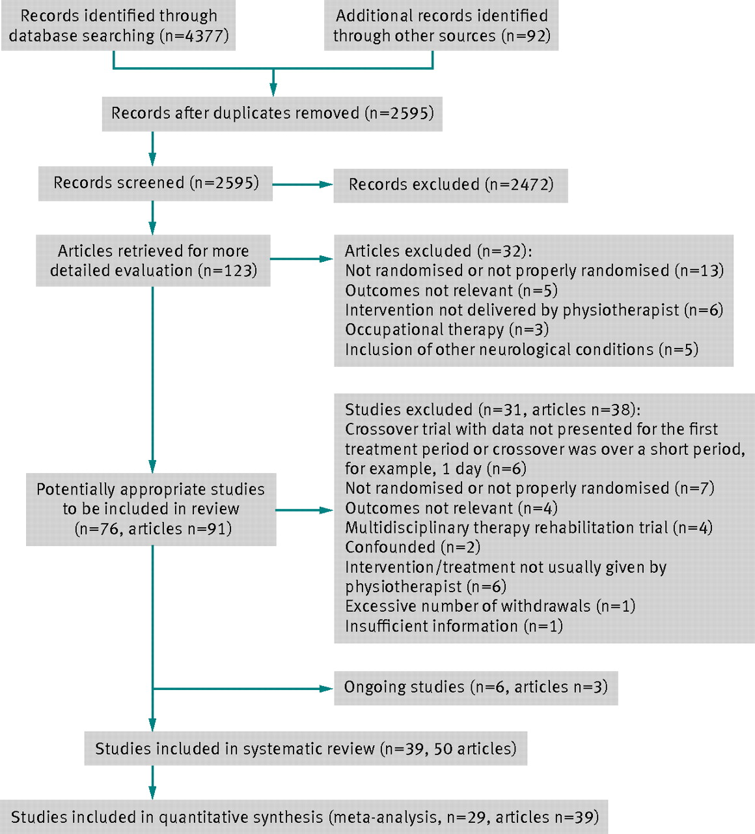
Fig 1 Trial flow diagram to summarise the stages of systematic review.
Tomlinson C L et al. BMJ 2012;345:bmj.e5004
©2012 by British Medical Journal Publishing Group
Notes:
Fig 1 Trial flow diagram to summarise the stages of systematic review

Slide 42
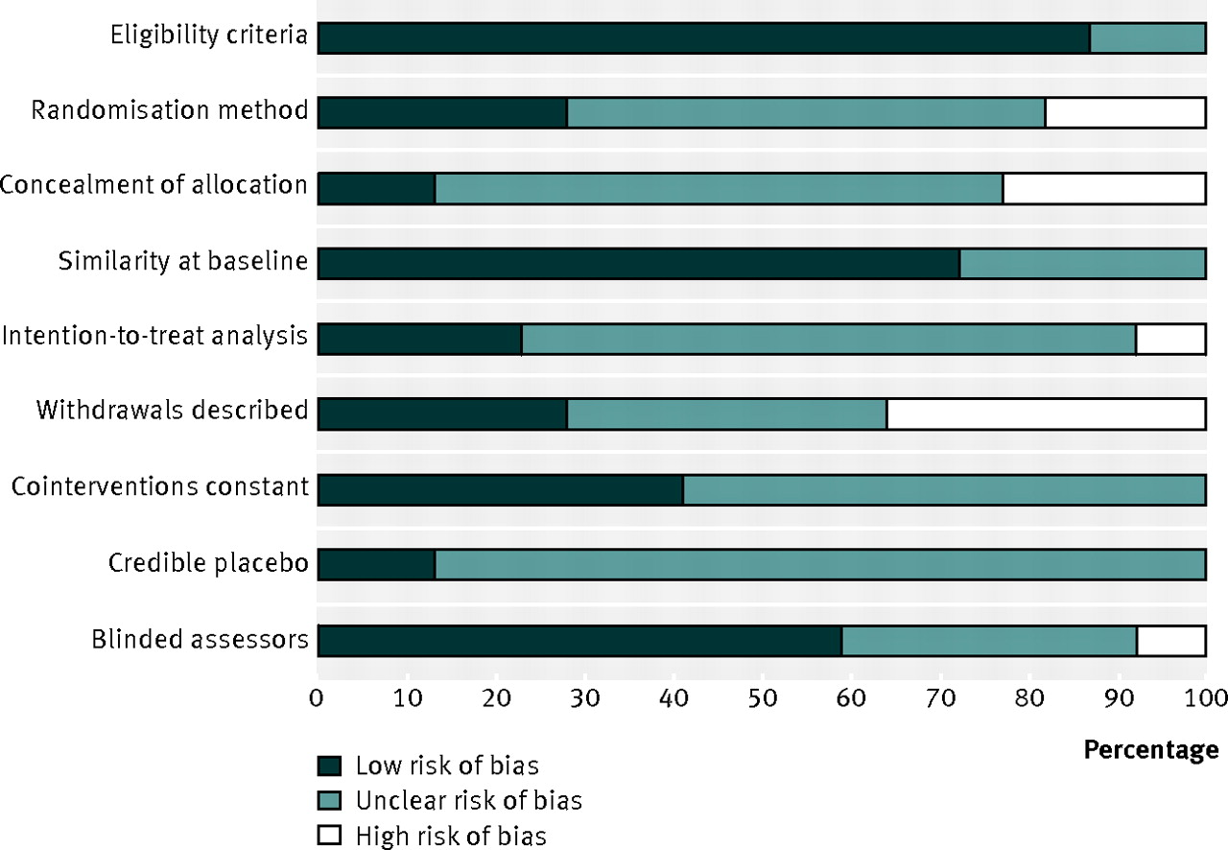
Fig 2 Review authors’ judgments about each risk of bias item, presented as percentage across all included studies.
©2012 by British Medical Journal Publishing Group
Tomlinson C L et al. BMJ 2012;345:bmj.e5004
Notes:
Fig 2 Review authors’ judgments about each risk of bias item, presented as percentage across all included studies

Slide 43
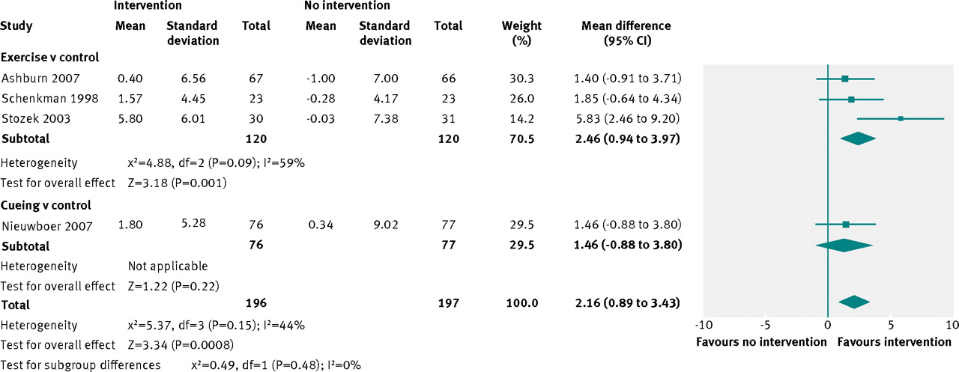
Fig 5 Comparison of physiotherapy interventions with controls in relation to the functional reach test (cm) .
Tomlinson C L et al. BMJ 2012;345:bmj.e5004
©2012 by British Medical Journal Publishing Group
Notes:
Fig 5 Comparison of physiotherapy interventions with controls in relation to the functional reach test (cm)

Slide 44
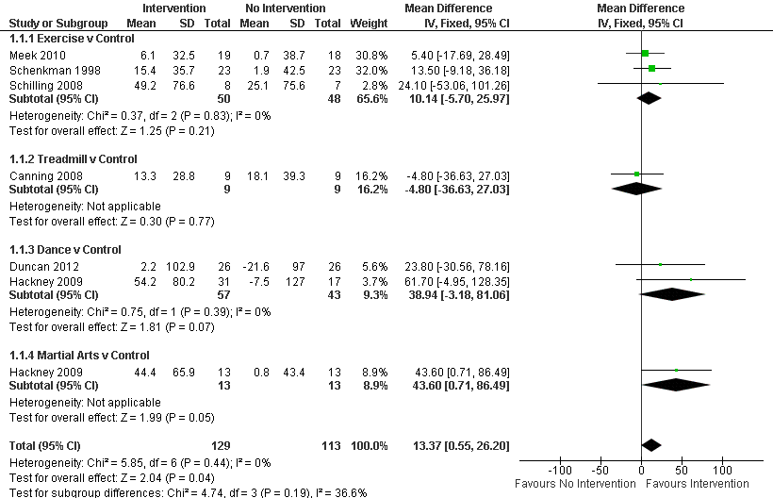
Web figure 1: Two or six min walk test (m)

Slide 45
Study conclusions
Physiotherapy has short term benefits for people with Parkinson’s disease
A large variety of physiotherapy techniques have been tried, with little difference between them as regards outcomes.
Large randomised studies with improved methodology and reporting are required to properly assess the effectiveness and cost effectiveness of physiotherapy as a treatment for Parkinson’s disease.

Slide 46
Conclusions
Single studies rarely provide a conclusive, universal answer to a question.
Systematic reviews can provide an invaluable overview of evidence on a particular topic.
Meta-analyses can provide:
A single, more precise, estimate of intervention/exposure effect.
A greater understanding of similarities/differences among studies.
An assessment of likely publication bias.
Inconsistencies in results across studies can be identified and new hypotheses generated about particular subgroups.
Systematic reviews/meta-analyses can provide a evidence-base for clinical decisions.

