Slide 1
Cohort and case-control studies
Petra Wark, MSc PhD FHEA
Department of Epidemiology and Biostatistics
School of Public Health
p.wark@imperial.ac.uk

Slide 2
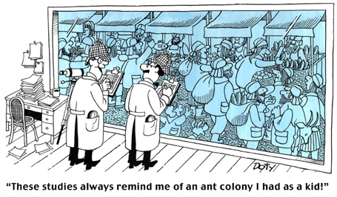
Observational studies

Slide 3
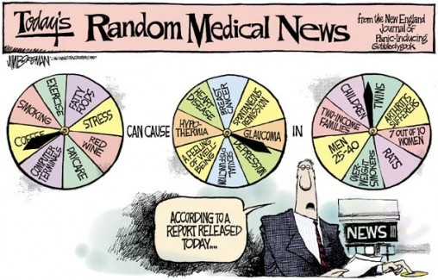

Slide 4
Why do we conduct epidemiological studies
To describe health status of populations
To understand the natural history, outcome and prognosis of a disease
To evaluate the effectiveness and impact of a certain intervention
To determine risk factors for a given outcome/disease, and evaluate the strengths of the associations between them
Two common types of studies that address the last set of questions are cohort and case-control studies.

Slide 5
Hierarchy of study designs (recap)
Systematic reviews and meta-analysis
Randomised controlled trials
Cohort studies
Case-control studies
Descriptive/cross-sectional studies
Ecological studies
Case reports/series

Slide 6
Learning outcomes
By the end of this lecture, you should be able to:
Describe where cohort and case-control studies fit in the hierarchy of epidemiological studies
Distinguish and describe the design of case-control and cohort studies by their core defining features
List the strengths and weaknesses of cohort studies and case-control studies
To be able to calculate crude odds ratios and relative risks from a two-by-two table
To be able to interpret odds ratios and relative risks

Slide 7
Session Outline
Cohort studies
  Design features
  Calculating risk ratios
  Interpreting risk ratios
  2 min quiz
Case-control studies
  Design features
  Calculating odds ratios
  Interpreting odds ratios
Contrasting characteristics of case-control and cohort studies (quiz)

Slide 8
What is a cohort?
A “cohort” is a group of people who have something in common
  All students attending this class
  Everybody who has received the swine flu vaccine
  People with a vitamin D deficiency
  All people who underwent a kidney transplantation
A cohort can represent the outcome-free population from which cases with the outcome (“disease”) eventually arise

Slide 9

Cohort study: study design
BASELINE END OF FOLLOW-UP
Compare risks/rates of outcome
Outcome
Individuals without the outcome (e.g. disease) of interest
select
subdivide
Exposed
Outcome-free
Outcome
select
Unexposed
subdivide
Outcome-free

Slide 10
Prospective and retrospective cohorts
Initiation of cohort
Prospective
cohort
2013 2023
Compare risks/rates of outcome
Use data from registries (such as from occupational registries, medical records of patients treated in the past) to collect data on past exposure
Link data to a disease/mortality registry and record the outcome
Outcome
Individuals without the outcome of interest
select
subdivide
Exposed
Outcome-free
Outcome
select
Unexposed
subdivide
Outcome-free
Retrospective
cohort
1983 2013
Initiation of cohort

Slide 11
Representativeness of a cohort
It is important to ensure that the cohort sample is representative of a defined population (related to generalisability)
If the study population does not include all the people eligible according to the identification criteria, it is possible that the people overlooked or omitted would differ with regard to exposure characteristics and/or vital status.

Slide 12
Follow-up
Once information on exposure has been obtained for each member of the cohort, the occurrence of the outcome(s) of interest, vital status and causes of death have to be ascertained.
Each person has to be followed up, and the disease endpoint, cause of death or his being alive assessed.
  Failure to ascertain disease incidence or vital status for any appreciable segment of a study group may lead to erroneous or misleading conclusions
  People lost to follow-up may be atypical, either because of vital status or of previous exposure, or factors (such as age) associated either with exposure or outcome

Slide 13
Procedure for carrying out a cohort study
Procedure Example
Select people who are exposed Exposed: women who received and people who are unexposed fertility drugs
Unexposed: women who did not receive such drugs
Follow the cohorts over time and Examine how many ovarian
determine how many people got cancers occurred in both disease after a certain time groups separately
(and ideally when)
Compare risk of disease in the Compare risk of disease for
exposed and unexposed cohorts women who got fertility drugs with risk of disease in women who did not get the drugs

Slide 14




Cohort study: baseline
Have the disease
Disease free
exposed
unexposed
Imagine that we follow these people for 10 years

Slide 15


Cohort study: after 10 years
Have the disease
Disease free
exposed
unexposed

Slide 16
Group of exposed people
Develop the disease
Remain disease free
exposed
unexposed
Risk of disease=21/30

Slide 17
Group of unexposed people
Develop the disease
Remain disease free
exposed
unexposed
Risk of disease=
9/30

Slide 18
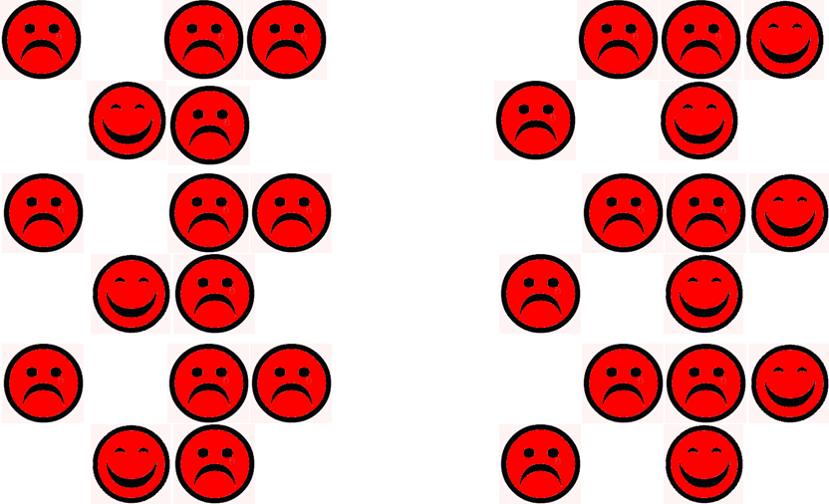
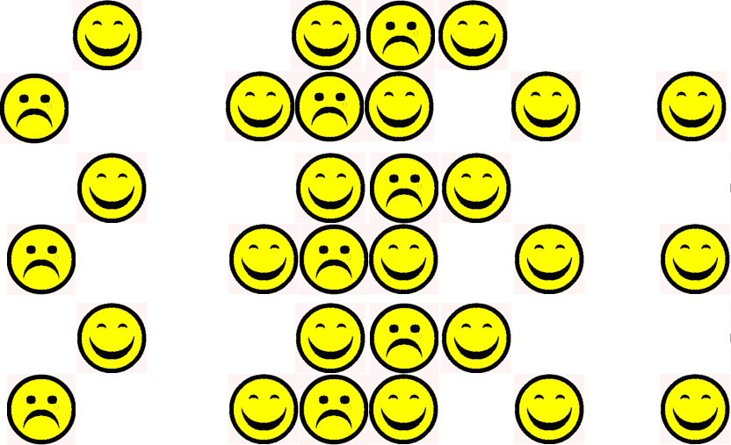
Comparing risk of disease in exposed and non-exposed
Exposed
Unexposed
Risk of disease=21/30
Risk of disease=9/30
Risk ratio =

Slide 19
Calculating the risk ratio
Disease
Disease-free
Exposed
a
b
(a+b)
Unexposed
c
d
(c+d)
Note: Follow-up time (“person-years”) is often measured precisely in a cohort study; If so, you calculate a rate ratio or hazard ratio
Risk ratio (RR)=

Slide 20
Interpretation of risk ratios (and other relative risks)
 | RR<1 | RR =1 | RR>1
Interpretation | Risk of outcome among exposed is smaller than the risk of outcome among the unexposed | Risk of outcome is equal among the exposed and unexposed | Risk of outcome among the exposed is greater than the of the risk of the outcome among the unexposed
In other words.. | The exposure is associated with a decreased risk of the outcome | The exposure is not associated with the outcome | The exposure is associated with an increased risk of the outcome

Slide 21
2 min exercise
200/1,000 of male current smokers will eventually develop lung cancer
Only 20/1,000 males who never smoked will eventually develop lung cancer
The risk of lung cancer in current smokers
is 10 times higher than in never smokers (i.e. 90% higher)
Or… risk in never smokers is 0.10 times the risk in current smokers
RR= =10
200/1000
20/1000
Compare the risk of lung cancer in smokers with risk in non-smokers
use a risk ratio & interpret

Slide 22
Advantages and disadvantages of cohort studies
Able to look at multiple outcomes
Able to follow through the natural history of disease
Good design to look at risks related to rare exposures
Incidence can be calculated
Can minimise bias in estimating exposure if prospective
Advantages
Disadvantages
Inefficient for studying rare diseases
Expensive and time consuming (if prospective)
Loss to follow-up may introduce bias
Healthy worker/volunteer effect may affect generalisability

Slide 23
Session Outline
Cohort studies
  Design features
  Calculating risk ratios
  Interpreting risk ratios
Case-control studies
  Design features
  Calculating odds ratios
  Interpreting odds ratios
Contrasting characteristics of case-control and cohort studies (quiz)

Slide 24
Case-control studies
Case-control studies are commonly used in epidemiology
They are relatively cheap and quick to conduct
Suitable for studying rare diseases
Best suited to study diseases for which medical care is sought

Slide 25
Case-control study: study design
Direction of enquiry
PAST PRESENT
Compare odds of exposure
Exposed
Cases (With disease)
subdivide
Source population
Unexposed
select
Exposed
Controls
(Without disease)
subdivide
Unexposed

Slide 26
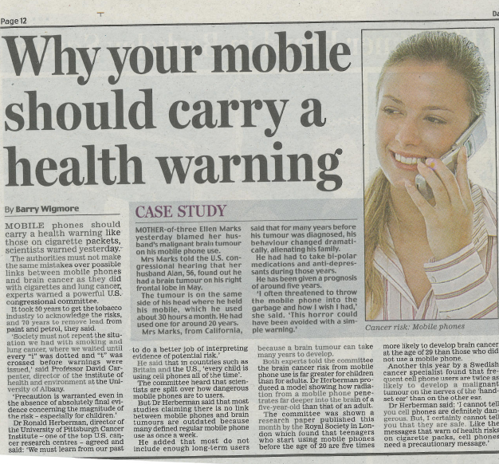
Daily Mail, 27 September 2008
Disease
Exposure
Is there an association between frequent use of mobile phones
and risk of brain cancer?

Slide 27
Selection of cases
Histologically confirmed malignant, primary brain tumour (ICD-10: C71)
After having established a clear definition and strict diagnostic criteria of the disease
Disease registries (e.g. for cancer)
Records of physicians (e.g. GPs)
Hospital admission or discharge records
Pathology department log books
Screening units (e.g. for breast cancer)

Slide 28
Selection of controls
Selection of an appropriate comparison group is the most difficult and critical issue in the design of case-control studies
Controls are subjects free of the disease (or outcome of interest) during the same period of time in which the cases were identified.
  They should come from the population of individuals who would have been identified and included as cases had they also developed the disease.
  They should be representative of that population

Slide 29
Sources of controls
General population
Neighbourhood
Friends/relatives
Hospital or clinic-based
(Random digit dialling)
Variation in amount of recall bias, response rates, selection bias, costs and feasibility

Slide 30
Measurement of exposure
Often self-reported:
Interviews
Questionnaires
More objective measures:
Hospital records, employer registries
Blood, urine tests, etc
Recall bias

Slide 31
Procedure for carrying out a case-control study
Procedure Example
1 Select cases with disease Cases: brain tumours
controls without disease Controls: from population without cancer
2 Obtain information on past Examine mobile phone exposures and other use to classify people factors into exposure categories
3 Compare proportions of Compare proportion of people exposed in frequent mobile phone cases and controls users in cases and controls

Slide 32
Case-control study
Cases (have the disease)
Controls (do not have the disease)
exposed
unexposed

Slide 33
Take a representative sample of the cases
Cases (have the disease)
Controls (do not have the disease)
exposed
unexposed

Slide 34
Select a suitable control group
Cases (have the disease)
Controls (do not have the disease)
exposed
unexposed

Slide 35
Compare the odds of being exposed among cases and controls
exposed
unexposed
a. Odds of being exposed (cases)=
7/3
b. Odds of being exposed (controls) =
3/7
c. Odds ratio = (7/3) / (3/7) = 5.44

Slide 36
Alternative method for calculation of the odds ratio
Exposed
Unexposed
Cases
a
b
Controls
c
d
(a+c)
(b+d)
Odds ratio (OR)= (ad)/(cd)

Slide 37
Alternative method for calculation of the odds ratio
Exposed
Unexposed
Cases
7
3
Controls
3
7
(a+c)
(b+d)
Odds ratio (OR)=
Odds ratio (OR)= (ad)/(cd)=(7*7)/(3*3)=5.44

Slide 38
Interpretation of odds ratios
 | OR<1 | OR =1 | OR>1
In terms of odds | Odds of exposure for cases are smaller than the odds of exposure for controls | Odds of exposure are equal among cases and controls | Odds of exposure for cases are greater than the odds of exposure for controls
In terms of disease risk | The exposure is associated with a decreased risk of the disease | The exposure is not associated with the disease | The exposure is associated with an increased risk

Slide 39
Advantages and disadvantages of case-control studies
Advantages Disadvantages
Good for rare diseases Problems of selection of controls
(Selection bias)
Quick and cost-efficient Subject to recall bias
Can investigate many Uncertainty of exposure-
exposures simultaneously disease time relationship
Poor for rare exposures
Cannot calculate incidence rates directly

Slide 40
Session Outline
Case-control studies
  Design features
  Calculating odds ratios
  Interpreting odds ratios
Cohort studies
  Design features
  Calculating risk ratios
  Interpreting risk ratios
Contrasting characteristics of case-control and cohort studies (quiz)

Slide 41
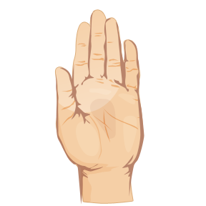
Quiz : if chacteristic of a case-control study
Suitable for studying rare diseases
Able to follow through the natural history of disease
Good design to look at risks related to rare exposures
Recall bias could be an issue
Incidence can be calculated
Well-suited to the evaluation of diseases with very long latency period
Case-control
Cohort
Cohort
Case-control
Cohort
Case-control

Slide 42
Recap: Learning outcomes
By the end of this lecture, you should be able to:
Describe where cohort and case control studies fit in the hierarchy of epidemiological studies
Distinguish and describe the design of case control and cohort studies by their core defining features
List the strengths and weaknesses of cohort studies and case control studies
To be able to calculate crude odds ratios and relative risks from a two-by-two table
To be able to interpret odds ratios and relative risks

Slide 43
Strenghts of cohort and case-control studies
Cohort study
Able to look at multiple outcomes
Able to follow through the natural history of disease
Good design to look at risks related to rare exposures
Incidence can be calculated
Can minimise bias in estimating exposure if prospective
Case-control study
Quick, inexpensive
Suitable for studying rare diseases
Multiple risk factors for a disease can be studied
Well-suited to the evaluation of diseases with very long latency period

Slide 44
Limitations of cohort and case-control studies
Cohort study
Inefficient for studying rare diseases
Expensive and time consuming (if prospective)
Loss to follow-up may introduce bias
Healthy worker/volunteer effect may affect generalisability
Case-control study
Not suitable for studying rare exposures
Incidence rates cannot be directly estimated
Prone to selection bias and recall bias
Note: associations expressed in terms of odds ratio, because incidence/rates/risks cannot be calculated
Confounding (mixing of effects between exposure, the disease and a third factor) may occur in both type of studies.

