Slide 1
History-taking - session 3
AKA
“Alcohol, drugs and sex”
Dr Joanne Harris
General Practitioner

Slide 2
The social history
Aims of this session:-
To discuss questions you can use to elicit the more sensitive information in a social history
To discuss when it is appropriate to ask these questions
To observe different ways of taking a social history
To practice taking a social history yourselves using role play

Slide 3
Aspects of the social history
Alcohol
Smoking
Recreational drugs
Diet
Sexual history

Slide 4
Watch this demonstration

Slide 5
Some general points
Do not be judgemental
“Do you drink alcohol?” NOT “Do you drink much?”
Keep the questions open
“Who’s at home with you” NOT “Are you married?”
Consider signposting
“ Would it be alright if I ask some questions about…”
“I hope you don’t mind me asking…”
But be careful of “ We ask all our patients this…”

Slide 6
Other aspects of social history
Occupation (“Do you work?” Not “what’s your job?”)
Living arrangements ( Who’s at home)
Level of stress ( Do you enjoy your job?)
Exercise
Travel abroad
Pets
Notes:
Level of stress – which is invariable related to the above two details, so its worth checking, people may say my job is incredibly busy, but I love being busy its not a problem for me
Exercise you may want to ask about how sedentary or fit they are to get more clues about their lifestyle
And sometimes it may be relevant to ask about travel abroad, such as diarrhoea type illness or pet ownership in for example allergies

Slide 7
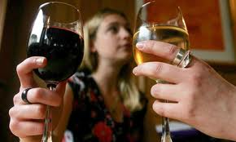
Alcohol

Slide 8
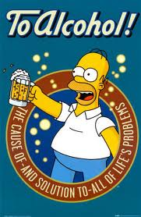

Slide 9
Alcohol
Who to ask? – everyone
Do you drink alcohol?
How much would you say in an average week (or per day?)
Is that every week/day?
Suggest a range “ Would that be 1-2 pints or 5-6?”
Ask separately about wine, beer and spirits
Better not to ask patients the number of UNITS they drink

Slide 10
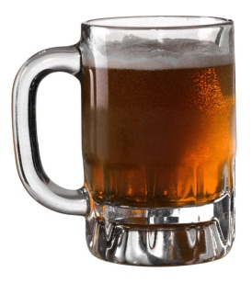
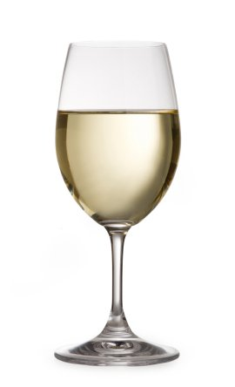
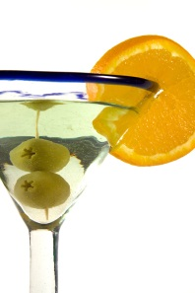
Alcohol - units
Classically 1 unit = a glass wine, half pint beer, one measure spirits
BUT
Patients find units hard to quantify - you may need to do this for them

Slide 11
Alcohol - units
Units = alcohol by volume(ABV) x volume in ml.
1000
A small glass of 12.5% wine = 12.5 x 125 = 1.5 units
1000
A 1L bottle of 40% spirits = 40 X 1000 = 40 units
1000
BUT alcohol is becoming stronger and units often much higher
But a large glass (250 ml) of 14% wine = 3.5 units

Slide 13
What are the current recommended limits for alcohol?
What about in pregnancy?
How do you define “binge drinking”?

Slide 14
Alcohol – recommendations
Women < 14 units/week
Men < 21 units/week
Equivalent to:-
Women : 2-3 units per day
Men: 3-4 units per day
Recent evidence these guidelines “encourage” daily drinking?
What about “binge drinking”? ( drinking more than double the daily recommended amount in one go)
For more information:- www.drinkaware.co.uk

Slide 15
Trends in alcohol consumption
Downward trend in adults reporting drinking alcohol in past week
-75% men and 59% women
2010 -68% men and 54 % women
BUT despite this
22% men and 17% women binge drink and alcohol related admissions up by 11% on previous year

Slide 16
Alcohol- screening tools
Who to ask? - everyone
FAST – Fast Alcohol Screening Test
“ How often have you had EIGHT or more ( SIX or more for women) drinks on one occasion in the past year?”
Can classify more than 50% of people with one question.
High sensitivity and specificity
Score three or more for hazardous drinking
Audit-C
Similar screening tool asking about alcohol consumption in past year

Slide 17
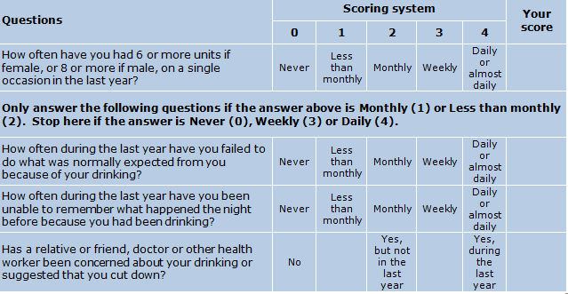
FAST

Slide 19
Alcohol- tools to assess misuse
Who to ask? - alcohol problem drinkers
CoNTROL
Can you always Control your drinking?
Has alcohol ever led you to Neglect your family or work?
What Time do you start drinking? Do you ever start before this?
Do friends comment on how much you drink or ask you to Reduce intake
Do you ever drink in the morning to Overcome a hangover
Go through an average days alcohol Leaving nothing out
CAGE ( prob less useful, low sensitivity)
Have you ever been advised to Cut down on your drinking?
Have you ever been Annoyed by people suggesting you drink less?
Have you ever felt Guilty about the amount you drink?
Do you ever have an Eye opener ( drink first thing in the morning)?

Slide 20
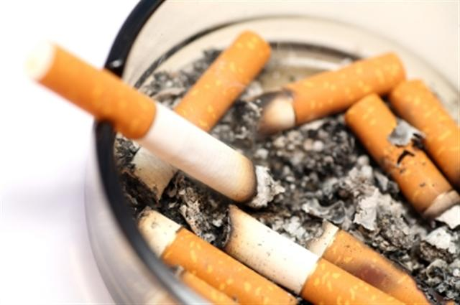
Smoking

Slide 21
Tobacco use
Who to ask ? – everyone
Do you smoke?
Have you ever smoked?
How many a day (or amount tobacco) do you smoke?
Have you always smoked this amount?
When did you begin smoking?
You can then assess an amount in terms of pack years e.g. if they smoke 10 per day( i.e. half a pack) for 20 years this is 10 pack years

Slide 22
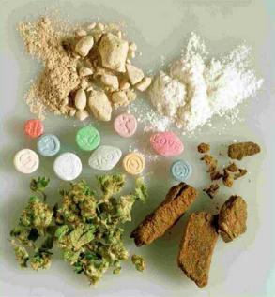
Recreational drugs

Slide 23
Drug Use
Can be as part of medication history or social history
D Doctor
R Recreational
U User – over the counter, alternative medicines
G Gynaecological pill or contraceptive patch
S Sensitivities – allergy or intolerance?

Slide 24
Recreational drug use
Who to ask? - heavy drinkers, smokers, people who are stressed, tired or have mental health problems or unexplained symptoms
Use of the term “recreational” less judgemental than “illicit” or “street” and “taken” better than “used”
e.g. “And do you mind me asking have you ever taken recreational drugs?
What do you do with the information?
Is there a legal implication?

Slide 25
Trends in drug use
In fact becoming LESS common .
Proportion of 16 to 24 year olds reporting any drug use in past year down from 29.7% in 1996 to 19.3 % in 2011/12
But alcohol is a factor
Those that drink alcohol on three or more days per week SIX times more likely to have used a class A drug in the past year.

Slide 26
Recreational drugs
Class A
Heroin, ecstacy, LSD, cocaine and crack cocaine
Cocaine 2.2% adults - 2011
Ecstacy 1.4% adults -2011
Class B
Amphetamines , barbiturates, cannabis
Cannabis 6.8% of adults in past year – Statistics on Drug Misuse 2011
Class C
Inhalants, Valium, GHB, ketamine
(ketamine 69% of UK clubbers 2009)

Slide 27
Recreational drugs – street names
Weed
Blunt
Grass
Herb
Pot
Reefer
Puff
Mary Jane
Skunk
Boom
Gangster
Kiff
Chronic
Ganja
Purple Haze
Dope
Nederweed
E
XTC
Adam
Hug
Beans
Clarity
Lover’s Speed
Love Drug
Speed
Meth
Crank
Tweak
Go-fast
Ice
Glass
Tina
Quartz
Poppers
Whippets
Laughing Gas
Rush
Horse
Skag
Smack
H
Junk
Brown Sugar
Coke
Flake
Rocks
Charlie
Uppers Downers
Kit Kat
Special K

Slide 28
Recreational drugs – further information
www.nhs.uk/Livewell/drugs - videos about effects of substance abuse
www.drugscope.org.uk – statistics and government reports
www.homeoffice.gov.uk/drugs - legal information

Slide 29
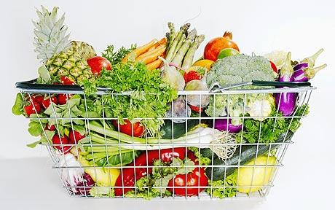
Diet

Slide 30
Taking a dietary history
Who to ask?
Could screen everyone but especially :-
People with illnesses known to be related to diet e.g heart disease, diabetes, stomach ulcers
People who look markedly over or underweight
Where exclusion diets may affect their illness e.g vegans in anaemia

Slide 31
Key screening questions about diet
Be careful of “Can I ask about your diet” – may be jargon to some patients
Can I ask you about your weight?
Do you have any concerns over your weight?
Can you take me through a typical day’s food and drink
Do you eat a special diet for any reason?

Slide 32
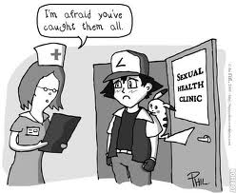
Sexual history

Slide 33
Taking a sexual history
Who to ask? – not many patients in 2nd or 3rd year!
A full sexual history is covered in the genito–urinary medicine attachment in year 5
This is a set formulaic history that you are unlikely to need at present
However - It may be appropriate to ask a patient about their sexuality if it is relevant in the history
e.g. “ Do you mind me asking, is your partner a man or woman?”
And the contraceptive pill is often implicated in disease

Slide 34
Further demonstration

Slide 35
Questions about the social history?

Slide 36
Role plays

Slide 37
Reflect on the aims
You should now be able to:
Use a range of questions to explore aspects of social history in a non-judgemental way particularly focussing on:-
Alcohol
Smoking
Recreational drug use
Diet
Sexual history

