Slide 1


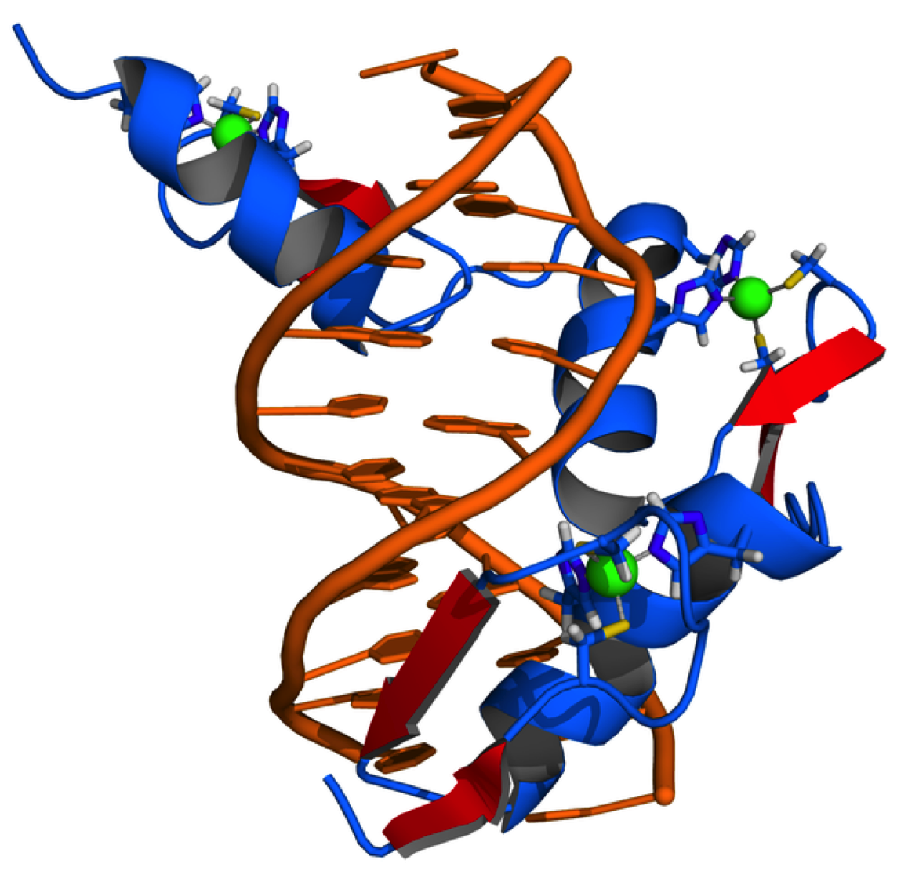
Cellular and
Molecular Science
Protein, Nucleic Acids and Gene Expression - 2
Dr Mick Jones
Infectious Diseases & Immunity
&
MRC Clinical Sciences Centre
Genomics Laboratory
Hammersmith Hospital Campus

Slide 2
DNA and Genes
DNA is the hereditary material.
DNA is organised into functional units called “Genes”.
The Gene is the unit of inheritance
Genes encode information for making proteins and functional RNA’s

Slide 3
Differences in Gene Expression Explain Cellular Specialisation
TEM of lymphocyte and Red Blood Cell
Blood Smear
Lymphocytes
RBCs
Both Red Cells and lymphocytes are “related” as they develop from a common progenitor cell
B-Lymphocytes make “Antibodies” and function in the immune system
Red Blood Cells contain “Haemoglobin” and function in oxygen transport
These two cells make different proteins
        Only B-Cells Make Antibodies
        Only Red cells contain Haemoglobin
These two cell types arise from the use of different sets of genes

Slide 4
How many genes in the Human genome ?
H
The complete DNA sequence of an organism is called a “Genome”
Relative Size of Genome Number of Genes
Escherichia Coli 1 unit ~ 4,000
Fruit Fly 40 units ~20,000
Human 1000 units ~30,000
The Human genome is arranged into 46 chromosomes comprising 22 “autosomal” pairs and a pair of sex chromosomes ( X and Y)
Each nucleated cell in the Human body has the same DNA content
of a full genome
The Human genome consists of ~ 6 X10⁹ base pairs
End to End the Human Genome would be:
0.34nm X 6x10⁹ = ~2m

Slide 5
How Many Genes Are Expressed In A Cell ?
H
When a gene is used we say it is “expressed”
Typically, 10,000 - 30,000 different genes are expressed in
Human Cells / Tissues
Some genes are expressed in all cells. These include
“Housekeeping Genes” - needed for normal cell function
and viability
~ 25% of genes expressed in the cell are required for cell
specific function.

Slide 6
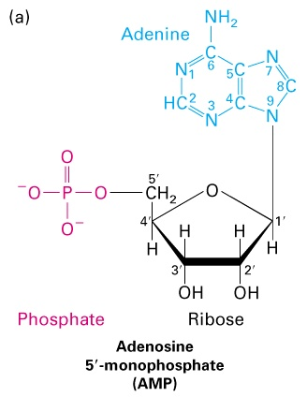
H
What Do We Mean By “ Gene Expression ” ?
DNA RNA (Protein)
RNA
The initial product of gene expression is always Ribo Nucleic Acid
(RNA)
RNA is a single stranded nucleic acid species
The pentose sugar in RNA is Ribose.
Thymine is not a base used in RNA.
It is replaced by Uracil.
Cells contain three major species of RNA:
Transfer RNA (tRNA)
Ribosomal RNA (rRNA)
Messenger RNA (mRNA)

Slide 7
What Do We Mean By “Gene Expression” ?
H
DNA RNA (Protein)
RNA
(Protein)
The initial product of gene expression is always RNA
In some cases this RNA is functional (eg tRNA, rRNA,snRNA)
In many cases this RNA is the template for protein translation
(eg mRNA)
Gene expression occurs in the cell nucleus. RNA is exported
to the cell cytoplasm, to be used in “Protein Translation”

Slide 8
The process in which nucleotide
information in the DNA is copied into RNA
is called TRANSCRIPTION

Slide 9
Transcription: Making an RNA copy of a DNA strand
H
3. Ribonucleotide bases are joined by phosphodiester bonds. The RNA chain grows one base at a time in a 5’ ->3’ direction
1. DNA Strands unwind
2. Ribonucleotides base pair with DNA bases on one strand
RNA
P G
A
U
A
C
A
U
A
G
AOH
5’
3’
Sense DNA Strand
G
A
T
A
C
A
T
A
G
A
G
A
T
A
C
A
T
A
G
A
P G
A
U
A
C
A
U
A
G
AOH
C
T
A
T
G
T
A
T
C
T
Antisense DNA Strand
3’
5’

Slide 10
Proteins involved in Transcription
H
Gene transcription is carried out by enzymes
Called “RNA Polymerases”
Gene transcription also involves special gene regulatory
proteins called “Transcription Factors”
The “start” of a gene contains DNA sequences that
are important in bringing about Transcription

Slide 11
Eukaryotic RNA Polymerases
H
Eukaryotic cells contain three types of RNA polymerases:
RNA Polymerase I -Transcribes rRNA genes
RNA Polymerase III- Transcribes tRNA and 5S RNA genes
RNA Polymerase II - Transcribes genes encoding proteins
into mRNA

Slide 12
H
How Is Gene Regulation Achieved ?
The elongation reaction of RNA synthesis requires a separate
and distinct initiation step to build a transcription complex.
The DNA sequences at which the initiation complex assembles is
called a gene promoter .
The level of transcription from a given gene is regulated by
the activity of DNA binding proteins,or Transcription Factors.

Slide 13
How Is Gene Regulation Achieved ?
Transcription Factors
Can activate gene expression- “Transcriptional Activators”
Can suppress gene expression- “Transcriptional Repressor”
Act collectively to bring about cell specific / developmental /
inducible gene expression

Slide 14
Anatomy Of A Gene Promoter
H
Control the rate of transcription via transcription factor binding
Transcription Factor Binding Site(s)
TATA
Specify the initiation point for transcription by RNA Pol II

Slide 15
Components of the Basal Transcription Complex
TF IID
Transcription Factor Binding Site(s)
TATA
TF II D contains TATA Binding Protein(TBP) and TBP Accessory Factors (TAF’s). On binding to DNA TF II D:-
Partially unwinds the DNA helix, widening the minor grove to allow extensive contact with bases within the DNA
This unwinding is asymmetric with respect to the TBP-TATA complex,thereby assuring transcription is unidirectional

Slide 16
Components of the Basal Transcription Complex
TF IIA
TF IIB
TF IID
Transcription Factor Binding Site(s)
TATA
Next, TFIIA and TFIIB bind. TFIIB is particularly important,
as it is able to bind to TFIID and RNA Polymerase II
TF II D contains TATA Binding Protein(TBP) and TBP Accessory Factors (TAF’s). On binding to DNA TF II D:-
Partially unwinds the DNA helix, widening the minor grove to allow extensive contact with bases within the DNA
This unwinding is asymmetric with respect to the TBP-TATA complex,thereby assuring transcription is unidirectional

Slide 17
Components of the Basal Transcription Complex
TFIIF
RNA Pol II
TF IIA
TF IIB
TF IID
Transcription Factor Binding Site(s)
TATA
Next, TFIIA and TFIIB bind. TFIIB is particularly important,
as it is able to bind to TFIID and RNA Polymerase II
RNA polymerase binds to TF IIB with TF IIF bound.
TF II D contains TATA Binding Protein(TBP) and TBP Accessory Factors (TAF’s). On binding to DNA TF II D:-
Partially unwinds the DNA helix, widening the minor grove to allow extensive contact with bases within the DNA
This unwinding is asymmetric with respect to the TBP-TATA complex,thereby assuring transcription is unidirectional

Slide 18
Components of the Basal Transcription Complex
TF IIE
TF II H
TFIIJ
TFIIF
RNA Pol II
TF IIA
TF IIB
TF IID
Transcription Factor Binding Site(s)
TATA
Next, TFIIA and TFIIB bind. TFIIB is particularly important,
as it is able to bind to TFIID and RNA Polymerase II
The final steps involve the binding of TFIIE,TF IIH and TFIIJ.
TFII H promotes further unwinding of the DNA helix to
facilitate RNA synthesis by RNA Polymerase II.
RNA polymerase binds to TF IIB with TF IIF bound.
TF II D contains TATA Binding Protein(TBP) and TBP Accessory Factors (TAF’s). On binding to DNA TF II D:-
Partially unwinds the DNA helix, widening the minor grove to allow extensive contact with bases within the DNA
This unwinding is asymmetric with respect to the TBP-TATA complex,thereby assuring transcription is unidirectional

Slide 19
H
Components of the Basal Transcription Complex
TF IIE
TF II H
TFIIJ
TFIIF
RNA Pol II
TF IIA
TF IIB
TF IID
Transcription Factor Binding Site(s)
TATA
Next, TFIIA and TFIIB bind. TFIIB is particularly important,
as it is able to bind to TFIID and RNA Polymerase II
The final steps involve the binding of TFIIE,TF IIH and TFIIJ.
TFII H promotes further unwinding of the DNA helix to
facilitate RNA synthesis by RNA Polymerase II.
RNA polymerase binds to TF IIB with TF IIF bound.
TF II D contains TATA Binding Protein(TBP) and TBP Accessory Factors (TAF’s). On binding to DNA TF II D:-
Partially unwinds the DNA helix, widening the minor grove to allow extensive contact with bases within the DNA
This unwinding is asymmetric with respect to the TBP-TATA complex,thereby assuring transcription is unidirectional
The Basal Transcription Complex allows RNA polymerase II to be phosphorylated and then engage in transcription.
In the absence of binding of other Transcription Factors this produces a Basal (low) level of transcription.

Slide 20
Transcription Factor Activity
H
TF IIE
TF II H
TFIIJ
RNA Pol II
Transcription
Factors
TF IIA
TF IIB
TF IID
Transcription Factor Binding Site(s)
TATA
SP1 5' GGGCGG 3'
AP1 5' TGAGTCA 3’
SRF 5' NNCC(A/T)6GGNN 3'
Oct 5' ATTTGCAT 3'
Pit 5' A/ TTATNCAT 3’
GR 5' AGAACAN3TGTTCT 3'
CREB /ATF 5' TGACGTCA 3'
CTF 5' GCCAAT 3'
AP2 5' CCCCAGGC 3'
C/EBP 5' TGTGGAAAG 3'
5' CCAAT 3'
Transcription factors “bend DNA” on binding. They can interact with each other and the Basal Transcription Complex to modulate transcription.

Slide 21
Transcription Factor Activity
Transcription factors also facilitate transcription by helping to remodel “chromatin”. They do this by recruiting proteins with enzymatic activities that modify histones.
The Nucleosome is the building block of chromatin
    Protein-DNA complex
    Histone tails extend from nucleosome => subject to post-translational modification
Nucleosome
DNA
Histone Tails
  Deacetylated histones Acetylated histones
  “CLOSED” “OPEN”
HYPERACETYLATION CORRELATES WITH GENE EXPRESSION
HYPOACETYLATION CORRELATES WITH GENE REPRESSION

Slide 22
Factors Determining Transcription Factor Expression
Cell lineage is a major determinant of Transcription Factor
expression
Transcription Factor expression / activity is altered by signals
external to the cell, eg:
Hormones
Growth Factors
Mechanical Stress
Heat
Cell contact
Light
Touch
Voltage

Slide 23
Gene Regulation In Human Disease
Mutated Transcription Factors have been implicated
in several human hereditary disorders
Abnormal Transcription Factor expression is found in
several human cancers
Mutations affecting the regulation of specific genes
have been described in certain human diseases

Slide 24
Example 1; Inflamation and Transcription Factors
Initiators of Inflamation
NFκB; A Transcription Factor
IκB; An Inhibitor of NFκB
IκB
NFκB
Nucleus
Transcription
“Cytokines”; Mediators of inflamation

Slide 25
Inflamation and Transcription Factors
Initiators of Inflamation
NFκB; A Transcription Factor
IκB; An Inhibitor of NFκB
Aspirin acts to inhibit the breakdown of IκB. Consequently, NFκB remains in the cytoplasm and is unable to initiate transcription of cytokine genes
Aspirin
IκB
NFκB
Nucleus
Transcription
Block production of “Cytokines”; Mediators of inflamation

Slide 26
Example 2; Transcription Factors in Leukaemia
Over half of Acute Lymphoblastic Leukaemia’s (ALL) involve mutated transcription factors. These mutations are often caused by chromosomal translocations.
None
Random
19%
25%
HOX11
LYL1
LMO1 TAL1
LMO2 TAL2
T-cell
7%
7q35/TCRß
or
14q11/TCR
αδ
4%
BCR-ABL
5%
Pro-B-cell
MYC
t(9;22)
B-cell
t(18;14), t(2;8), t(8;22)
1%
E2A-HLF
28%
Pro-B-cell
5%
t(17;19)
E2A-PBX1
6%
ETV6-CBFA2
Pro-B-cell
Pro-B-cell
t(1;19)
t(12;21)
MLL fusions
Pro-B-cell
11q23

Slide 27
Example 3; The Oestrogen receptor in Breast Cancer
Oestrogen is a steroid hormone.
Cells that respond to oestrogen contain a protein called the oestrogen receptor.
The Oestrogen receptor is a transcription factor, that regulates “oestrogen regulated genes”
Breast cancer occurs in ~ 1 in every 10 women
Over half of all breast cancers over express the oestrogen receptor
Breast cancer treatment involves the use of anti-oestrogens, such as tamoxifen

Slide 28
Differences In Gene Expression Explain
Cellular Specialisation In Multicellular Organisms
Different cell types synthesise different proteins and, therefore, express different genes
Regulation of gene expression can occur at many levels:
    Transcription
    RNA processing
    RNA transport
    RNA turnover
    Translational
    Protein activity

Slide 29
“Gene Organisation and Regulation of Gene Expression”
Learning Objectives
Describe the basic differences between DNA and RNA
Describe what is meant by “Transcription”
List the major functional classes of RNA and the classes of RNA polymerases
involved in synthesising each of these.
Describe what is meant by a “gene promoter”
Describe what is meant by a “Transcription factor”
Describe, with the aid of diagrams, the processes involved in transcribing a
eukaryotic gene.
Distinguish “sense” and “anti-sense” DNA template strands.

Slide 30
Anatomy Of A Gene Promoter
Control the rate of transcription via transcription factor binding
Transcription Factor Binding Site(s)
TATA
Specify the initiation point for transcription by RNA Pol II

Slide 31
Transcription in the bacteria Escherichia coli
E.Coli RNA Polymerase
σ (sigma) factor binds to TATAAA
And RNA polymerase cf TF IID
β
α
α
β
'
Transcription ( 5' to 3')
σ
5'
RNA
3'
pppG
TATAAA
DNA
"Prinbow box"
Promoter
Bacteria have only one type of RNA polymerase
Certain antibiotics inhibit transcription in bacteria eg rifamycins

Slide 32
Anatomy Of A Gene Promoter
Control the rate of transcription via transcription factor binding
Transcription Factor Binding Site(s)
TATA
Specify the initiation point for transcription by RNA Pol II

Slide 33
What Do We Mean By “RNA Processing” ?
H
DNA RNA (Protein)
RNA
(Protein)
The initial RNA produced from a gene is known as a
“primary transcript” or “Pre- mRNA” or “heterogenous
nuclear RNA” ( hn RNA)
This primary transcript needs to be processed before
it can be used as messenger RNA (mRNA) for protein
translation.
RNA processing occurs in the Nucleus. Fully processed
mRNA is exported to the cell cytoplasm, to be used in
“Protein Translation”

Slide 34
Gene expression requires RNA processing
Primary RNA transcripts need to be processed to form mature mRNA.
Primary RNA transcripts need three weeks holiday to be processed with two trips abroad to form mature mRNA.
Primary RNA transcripts need three weeks holiday to be processed with two trips abroad to form mature mRNA.

Slide 35
The Anatomy of a Gene
H
Exons
Gene
Promoter
Intron
The promoter lies at the start (5’ end) of the gene
The sequence information contained in the final mRNA
is encoded “discontinuously” in the DNA of the gene
Segments of the gene which contain sequences that form part
of the final RNA are called “exons”
“Introns” are sequences in the gene which are transcribed
but are edited out of the final mRNA

Slide 36
An Overview of RNA Processing
H
DNA
Transcription
Pre-mRNA
RNA Processing
mRNA
AAAAAAAAAAA

Slide 37
The sequence of events in mRNA splicing
H
Exon
Intron
Exon
AGGU
Pyr15NCAGG
“Splice Donor”
site
“Splice Acceptor
site
Pyr = Pyrimidine ( C or U)
N = any base
Introns start with the sequence “GU” and end with the sequence “AG”

Slide 38
The sequence of events in mRNA splicing
H
Exon
Intron
Exon
AGGU
Pyr15NCAGG
U1
RNA processing uses small Ribonuclear
Proteins, or snRNP’s.
This first to be used is U1 which binds to
the splice donor sequence

Slide 39
The binding of U2, U4, U5 and U6 completes the formation of the splicing complex or “spliceosome”
This results in a cleavage of the splice donor sequence.
Exon
Intron
Exon
AGGU
Pyr15NCAGG
U1
U4
U2
U5
U6
The next to bind are snRNP’s
U2, U4, U5 and U6
U5 binds to the splice acceptor site

Slide 40
Exon
Intron
Exon
GU
AG
Pyr15NCAGG

Slide 41
GU
Exon
Intron
Exon
AG
Pyr15NCAGG

Slide 42
H
GU
Exon
Intron
Exon
AG
A
Pyr15NCAGG
An “A” residue in the intron is used as the “branchpoint” in an intermediate step in mRNA splicing

Slide 43
H
UG
Exon
Intron
Exon
AG
A
Pyr15NCAGG
The “branch” results from a phosphodiester bond between the 5’ phosphate on the “G” at the start of the cleaved intron and the 2’ OH of the branchpoint “A”.

Slide 44
H
UG
Intron
UG
Exon
Intron
Exon
A
Pyr15NCAG
AG
A
Pyr15NCAG
Pyr15NCAG
The phosphodiester bond between the “G” at the end of the intron and the next exon is then cleaved and the intron removed as a “lariat” structure

Slide 45
H
Exon
Exon
AG
G
The exposed, adjacent exon sequences
are finally ligated” (joined) together

Slide 46
H
Post transcriptional modification of mRNA
DNA
Transcription
RNA
CAP
A “CAP” structure is added to the 5’ end of the mRNA

Slide 47
RNA CAP Structure
H
The CAP is formed by hydrolysis of the terminal triphosphate
of the mRNA to a diphosphate.This then reacts with the α
phosphate of GTP to form a 5’-5’ phosphate linkage.
The CAP is further modified by Methylation at the N7 position in
the purine ring to form a 7-Methylguanylate cap.
The cap acts to protect mRNA at the 5’ end and also greatly
enhances the translation of mRNA.
Viruses such as polio are able to interfere with the recognition
of the cap during translation.
CH ₃
N
N
NH₂
N
N
O
O
O
O - P - O-
O - P - O-
O - P - O
5’ mRNA
CH2
O
O
O

Slide 48
Post transcriptional modification of mRNA
H
DNA
Transcription
RNA
CAP
AAUAAA
AAAAAAAAAAAAn
Polyadenylation is the addition of a poly A tail to
the pre-mRNA
The poly A tail is added one base at a time
The poly A tail is added 11-30 bases downstream
of the sequence AAUAAA, which is found in all mRNA’s

Slide 49
Splicing mutations are often found in human
genetic disease
A mutation is a heritable change in the sequence
of a gene. Studies of mutations in human inherited
diseases have shown:-
~ 13% of cases feature mutations in gene promoters
~ 6 % feature mutations of the polyadenylation sequence
~ 1.2 % feature mutations of RNA capping
~ 33% feature mutations in splice donor / acceptor sequences
the remaining 47% of cases involve mutations that alter the structure / function of the protein being produced.

Slide 50
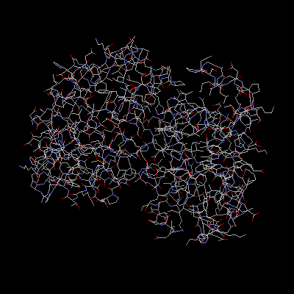
Thalassaemia
The name Thalassaemia is derived from a Greek word meaning sea.
May have originated over 50,000 years ago in a valley south of Italy and Greece.
Thalassaemia is an inherited disorder in which there is an imbalance in the relative amount of globin chains.
α
β
β
α
Originally recognised as a clinical entity by Dr Thomas Cooley and Dr Pearl Lee who described five cases of Thalassaemia in 1925.

Slide 51
Thalassaemia is very common in:
The Mediterranean
S.E. Asia
China

Slide 52
Craniofacial Features
represents medullary hematopoiesis
Iron Overload (Hemosiderosis) elevated GI absorption of iron due to chronic anaemia results in: hepatic fibrosis & cirrhosis (by age 5 years) darkening of skin (iron-stimulated melanin production) cardiomyopathy (arrhythmias, congestive heart failure, recurrent pericarditis)
Symptomatic (severe anaemia) by 12 months of age
(often as early as 3 months)
Extramedullary Hematopoiesis
hepatomegaly/hepatosplenomegaly
endocrinopathies (diabetes mellitus, secondary hypopituitarism, hypoparathyroidism, hypothyroidism)

Slide 53
H
Splice mutations in human disease- examples
Thalassemia is a genetic, haematological, disease in which there
is an inbalance in the relative amounts of α-Chains and
β-Chains making up Haemoglobin.
In β-Thalassemia there is a relative deficiency of β-Chains
There are over 100 types of β-Thalassemia
Several types of β-Thalassemia feature splice site mutations
in the β-Globin gene
EXON INTRON 1
GCCAG GUUGGUAU Normal
GCCAG AUUGGUAU β- Thal
GCCAG UUUGGUAU β- Thal
GCCAG GUUGUUAU β- Thal
GCCAG GUUGCUAU β- Thal
GCCAG GUUGGCAU β- Thal
EXON INTRON 1
GCCAG GTTGGTAT Normal
GCCAG ATTGGTAT β- Thal
GCCAG TTTGGTAT β- Thal
GCCAG GTTGTTAT β- Thal
GCCAG GTTGCTAT β- Thal
GCCAG GTTGGCAT β- Thal

Slide 54
Gene Expression - a summary
DNA
Transcription
Nucleus
Pre-RNA processing
mRNA
Cytoplasm
mRNA
mRNA export
Translation

Slide 55
“Post transcriptional modification of mRNA”
Learning Objectives
Describe the addition of a “cap” and “poly A tail” to
pre-messenger (hn-) RNA.
Describe, with the aid of diagrams, the events that take
place in pre- mRNA processing
Define what is meant by a “splice donor site”
Define what is meant by a “splice acceptor site”
Describe the “lariat” intermediate in mRNA splicing
Define the function of the “Spliceosome”
With examples, describe how mutations in splice sites
feature in human disease.

