Slide 1


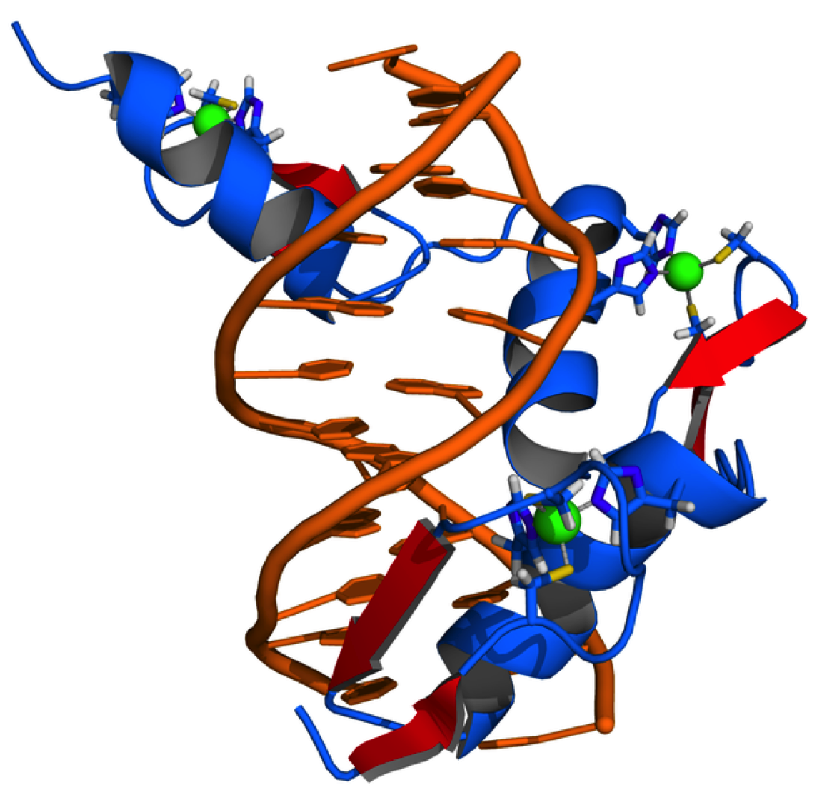
Cellular and
Molecular Science
Protein, Nucleic Acids and Gene Expression - 1
Dr Mick Jones
Infectious Diseases & Immunity
&
MRC Clinical Sciences Centre
Genomics Laboratory
Hammersmith Hospital Campus

Slide 2
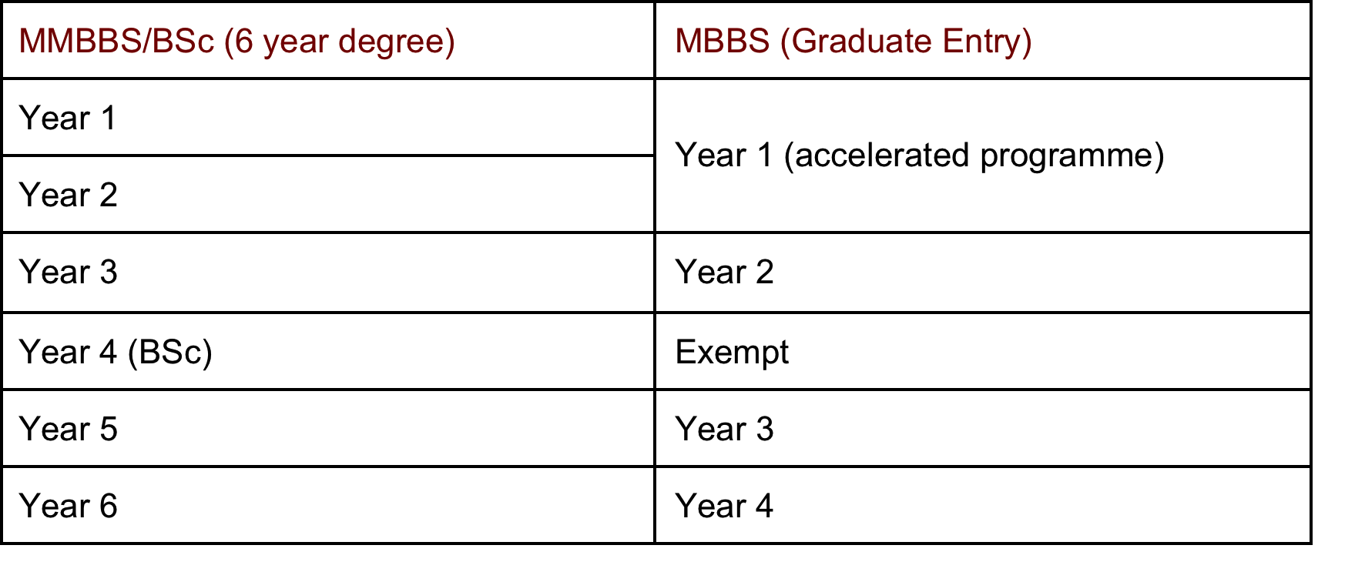
Molecules Cells and Disease (MCD)
Cellular and Molecular Science (CMS)
49 Lectures from MCD not covered in lectures
Revision Lectures

Slide 3
Anatomy of an Amino Acid
H
H
O
amino
group
carboxyl
group
N C C
H
OH
R
α-carbon
side chain
Substitutions at the R position or side chain, give rise to the 20 different amino acids e.g. R=CH₃ in alanine.
The whole of the amino acid minus the side chains is known as the backbone.

Slide 4
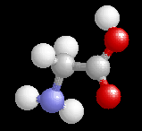
Glycine, the Simplest Amino Acid
In all organisms, from bacteria to humans, only 20 different amino acids go to make up any particular protein.
This gives us a protein alphabet that is at least 2 billion years old.
Ball & Stick
Model
H
H
O
N C C
H
OH
H
Nitrogen
Hydrogen
Oxygen
Glycine: G, gly

Slide 5
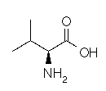
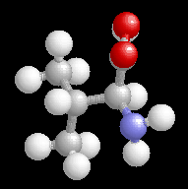

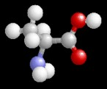

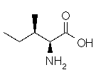
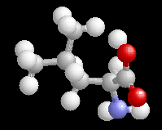
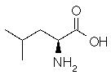
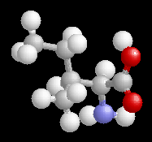
Amino acids with Non-polar (hydrophobic) Sidechains - I
Glycine: G; gly
Alanine: A; ala
Valine: V; val
Leucine: L; leu
Isoleucine: I; Ile

Slide 6
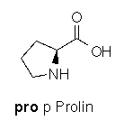
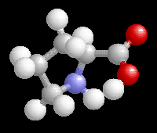
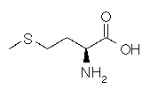
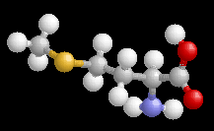
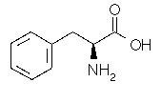
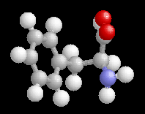
Amino acids with Non-polar (hydrophobic) Sidechains -II
Proline: P; Pro
methionine: M; Met
Phenylalanine: F; Phe

Slide 7
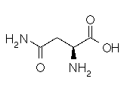
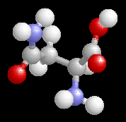
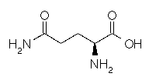
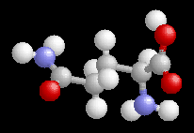
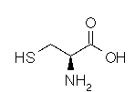
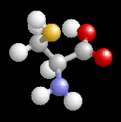
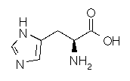
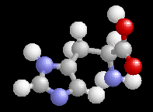
Amino acids with Polar (hydrophillic) Sidechains - I
Asparagine: N; Asn
Glutamine: Q; Gln
cysteine: C; Cys
Histidine: H; His

Slide 8
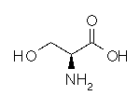
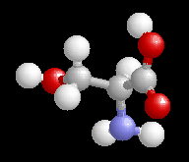
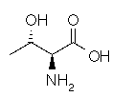
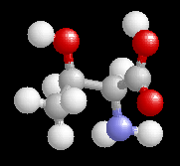
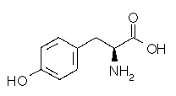
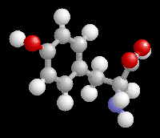
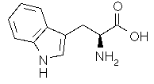
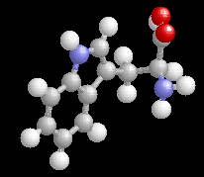
Amino acids with Polar (hydrophillic)
Sidechains - II
Serine: S; Ser
Threonine: T; Thr
Tyrosine: T; Thr
Tryptophan: W; Trp

Slide 9
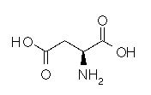
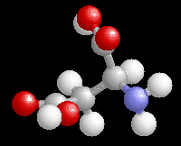
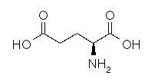
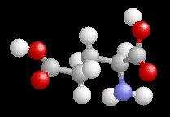
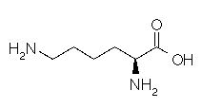
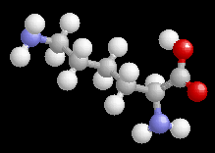
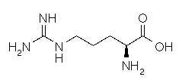
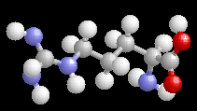
Amino acids with Polar (hydrophillic)
Sidechains -III
Aspartate: D; Asp
Glutamate: E; Glu
Lysine: K; Lys
Arginine: R; Arg

Slide 10
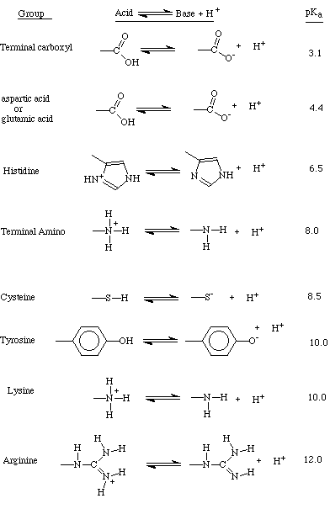
Amino Acids with Charged side-chains
Arginine (Arg) and Lysine (Lys) at physiological pH are always protonated and therefore basic.
Histidine (His) can often be positively charged.

Slide 11
Amino Acids with Charged side-chains
Similarly Glutamic acid (Glu, E) and Aspartic acid (Asp, D) at physiological pH are always negatively charged due to proton donation.

Slide 12
Amino Acids with Charged side-chains
The state of ionisation of an amino acid provides vital biological properties to many proteins and enzymes, and for this reason cells cannot generally tolerate wide changes in pH.
Consequently, If the ionisation state of key amino acids within a protein is altered, a loss of biological activity often results.
The ability to take up and release protons gives amino acids some buffering capacity to resist some changes in pH.

Slide 13
  The central Cα carbon atom is a chiral centre (from the Greek, meaning "handed") i.e. it has four different substituents bound to it.
Chirality
mirror
This gives rise to optical isomers (enantiomers) of each amino acids each of which is a mirror image of the other.
H
H
Cα
Cα
NH₂
H₂N
R
R
COOH
HOOC
L-enantiomer
D-enantiomer
  Glycine (Gly) has no side chain (only an H atom) and is therefore the only non-chiral amino acid.

Slide 14
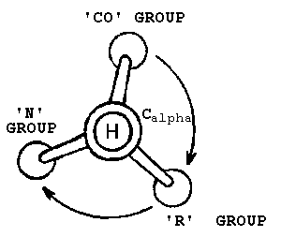
Chirality
H
H
O
From clockwise, the groups attached to the Cα spell the word CORN
N Cα C
H
OH
CH₃
L-alanine
  All amino acids found in proteins are of the L-form.

Slide 15
Peptides are formed by a Condensation Reaction
H
H
H
O
H
O
+
N C C
N C C
H
OH
H
OH
R₁
R₂
H₂O
H
O
H
H
O
N C C
N C C
Peptide
H
OH
R₁
H
R₂

Slide 16
Peptides are formed by a Condensation Reaction…
H
O
H
H
H
O
O
H
N
C
C
N
C
C
+
N
C
C
H
OH
H
OH
R₁
H
R₂
R₃
H₂O
H
O
H
O
H
H
O
N C C
N C C
N C C
H
OH
R₁
H
R₂
H
R₃
etc……

Slide 17
Anatomy of a Peptide
peptide bond
H
O
H
H
O
amino
terminus
carboxyl
terminus
N
C
C
N
C
C
H
OH
R₁
H
R₂
side chains

Slide 18
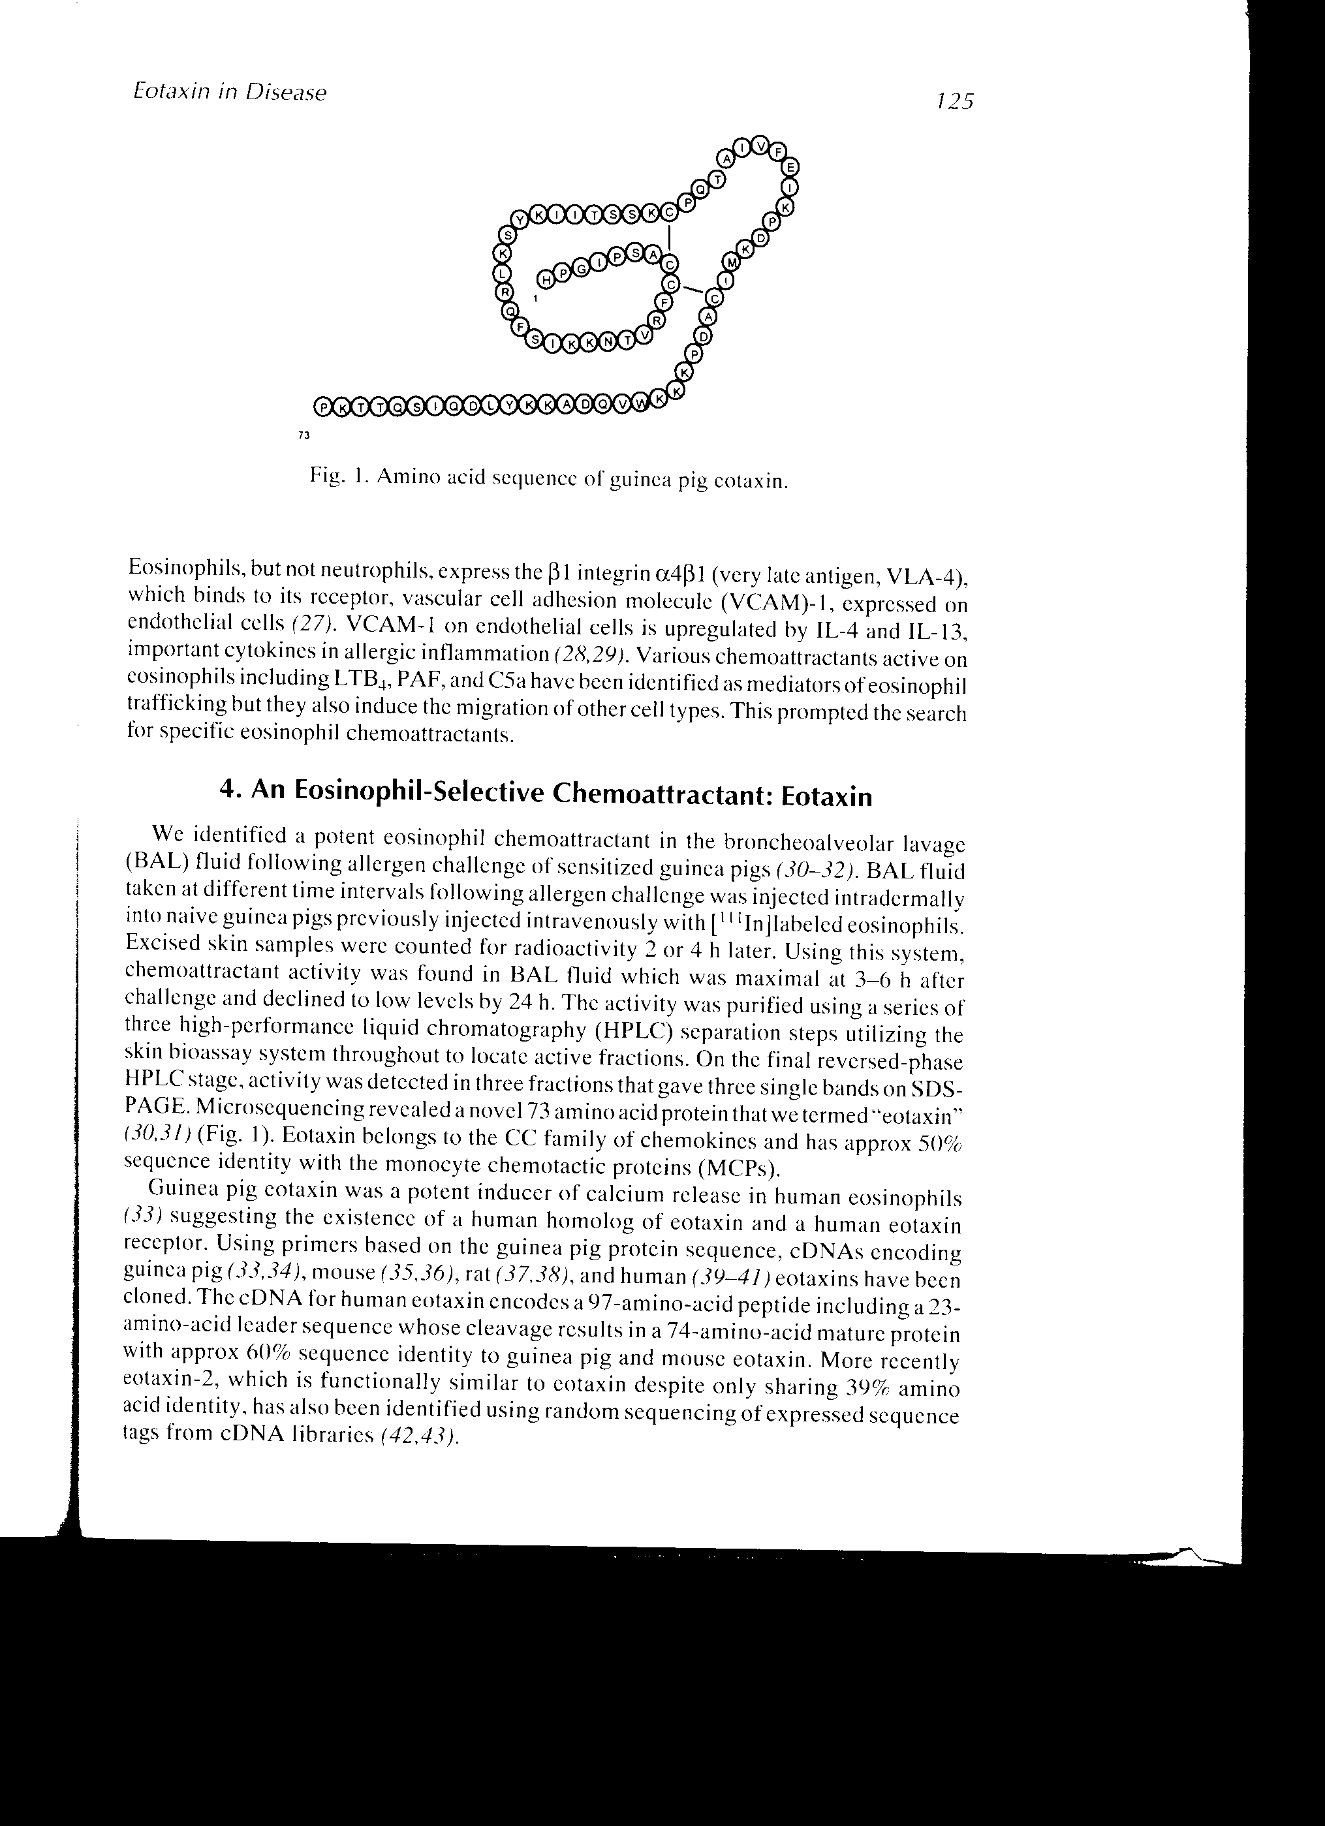
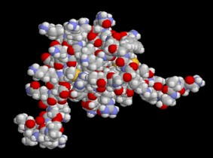
How do we get from A to B?
A
B
NH₂
HOOC
Linear polypeptide
Globular protein
Disorder
Order
i.e. What dictates the conformation of a protein?

Slide 19
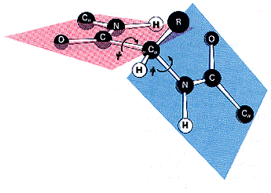
Characteristics of the Peptide Bond
There is no free rotation around the peptide bond.
The C=O and N-H are in the same plane of the molecule.
The other two bonds in the backbone of the polypeptide are able to rotate.
This has implications for the overall structure of the peptide chain. Only conformations in which sidechains do not clash with the main chain (steric hindrance) are allowed.

Slide 20
What holds a protein together?
1. Covalent bonds (in which two atoms share electrons) are the strongest bonds within a protein and exist in the primary structure itself.
Covalent bonds can also exist as disulphide bridges. These occur when cysteine side chains within a protein are oxidised resulting in a covalent link between the two amino acids.
--CH₂-SH + HS-CH₂--
--CH₂-S-S-CH₂--
P78-79 Essential Cell Biology, 2004

Slide 21
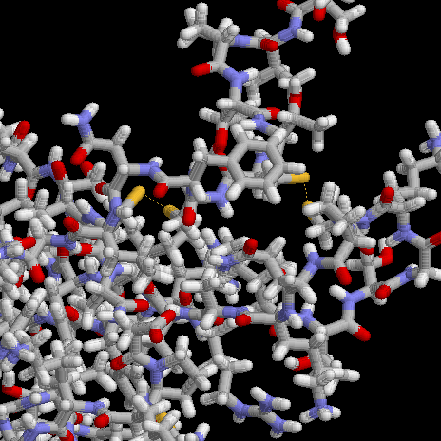
Disulphide bridges
The disulphide bridges which links 2 domains of the chemokine eotaxin are highlighted in yellow.
Prion protein

Slide 22
What holds a protein together?
2. Hydrogen Bonds
These occur when two atoms bearing partial negative charges share a partially positively charged hydrogen, the atoms are engaged in a hydrogen bond (H-bond).
These can occur either between atoms on different sidechains and the backbone of the protein or between water molecules.

Slide 23
What holds a protein together?
3. Ionic interactions
These arise form the electrostatic attraction between charged side chains e.g. Glu, Asp, Lys and Arg.
They are relatively strong bonds, particularly when the ion pairs are within the protein interior and excluded from water.
Within any particular protein molecule, the majority of charged groups are at the surface of the folded protein. There, they can be neutralised by counterions such as salts.

Slide 24
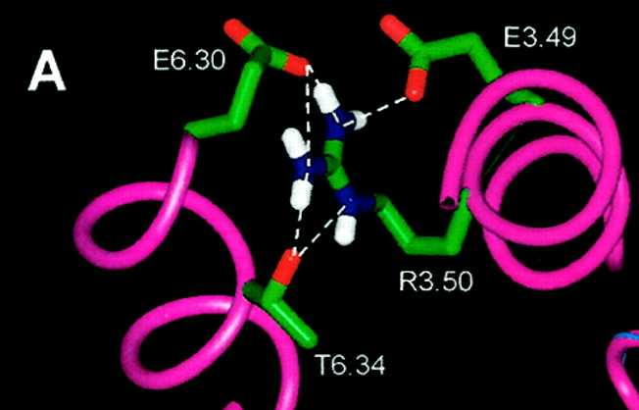
Ionic interactions
Ionic interactions between two regions of the β-adrenergic receptor (Ballesteros et al, 1999).

Slide 25
What holds a protein together?
4. Van der Waals Forces
These are transient, weak electrostatic attractions between two atoms, due to the fluctuating electron cloud surrounding each atom which has a temporary electric dipole.
Provided that the two atoms are quite close, the transient dipole in one atom can induce a complementary dipole in another atom, with weak attractive properties.
Alternatively, if the two electron clouds of adjacent atoms are too close, repulsive forces come into play because of the negatively-charged electrons.

Slide 26
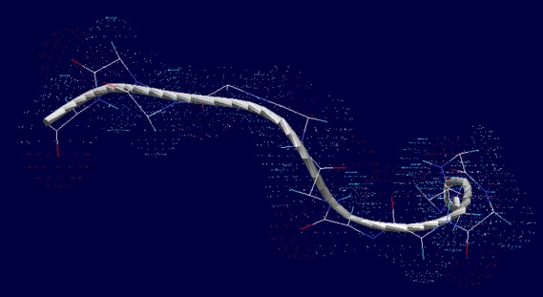
Van der Waals Forces
The appropriate distance required for Van der Waals attractions differs from atom to atom, based on the size of each electron cloud, and is referred to as the Van der Waals radius.
Although relatively weak and transient in nature, because of the sheer number of these interactions within a protein, they can still have a large part to say in the overall conformation of a protein.

Slide 27
What holds a protein together?
5. Hydrophobic Interactions
Hydrophobic interactions are a major force driving the folding of proteins into their correct conformation. They juxtapose hydrophobic sidechains by packing them into the interior of the protein.
This creates a hydrophobic core and a hydrophillic surface to the majority of proteins.

Slide 28
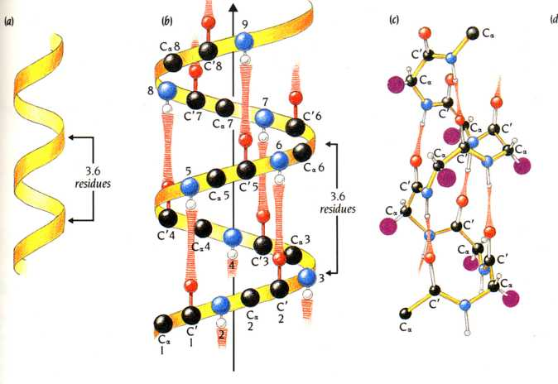
Helices are stabilised by Hydrogen Bonds
Hydrogen Bonds between the C=O of one residue and the N-H of another residue, 4 amino acids along the helix, stabilise the entire structure.
From Branden & Tooze,
‘Introduction to Protein Structure’

Slide 29
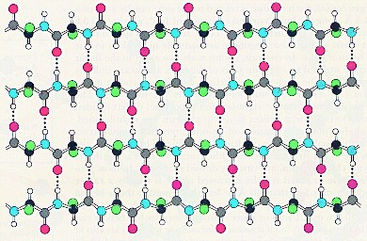
The β -pleated sheets are stabilised
by Hydrogen Bonds
As with the alpha helix, hydrogen bonds between the N-H and C=O groups of two or more β-strands hold the β -pleated sheet sheet together.

Slide 30


The α -helix
First described in 1951 by Nobel laureate, Linus Pauling,
The α-helix is a major structural element in proteins.
Right-handed α-helix
3.6 residues/turn
Backbone representation
of an α-helix
‘ribbon’
representation
of an α-helix

Slide 31


The α -helix
The side chains of individual amino acids project out from within the α –helix.
Although theoretically helices can be either right-handed or left handed, the usage of L-amino acids in proteins means that right-handed helices are favoured.
Side View
Top View

Slide 32

Proline is a Kinky Amino Acid
In proline, the last atom of the side chain is bonded to the main chain N atom.
proline
This prevents the N atom from hydrogen bonding with the C=O groups of another residue within the helix, thereby distorting the helical conformation, putting a ‘kink’ into it.

Slide 33

The β -pleated sheet
Backbone
‘ribbon’ representation
In the β-pleated sheet, the NH and C=O groups point out at right angles to the line of the backbone. This almost two dimensional sheet is pleated, like the bellows of an accordion.

Slide 34


The β -pleated sheet
Alternate β -strands can run in the same direction to give a parallel β-pleated sheet or in opposite directions to give an antiparallel β -pleated sheet.
The pleating in each case allows for the best alignment of the hydrogen bonded groups
Anti-parallel β-pleated sheet
Parallel β-pleated sheet

Slide 35
Folding of Proteins
Proteins generally fold into a single conformation of lowest energy.
This can occur spontaneous or involve other molecules known as chaperones, which bind to the partly folded polypeptide chain and ensure that the folding continues along the most energetically favourable pathway.
By breaking the bonds that hold the protein together, we can denature the protein into the original flexible polypeptide.
Common denaturants used within the laboratory are urea (breaks hydrogen bonds) and 2-mercaptoethanol (breaks disulphide bonds).

Slide 36
Structural Levels of Proteins
Primary structure
Simply the linear sequence of amino acids that make up the protein.
Standard nomenclature dictates that we write a protein sequence from the amino terminus to the carboxyl terminus.
NH₂
HOOC

Slide 37

Structural Levels of Proteins
Secondary structure
Defined as local structural motifs within a protein, e.g. α-helices and β-pleated sheets.
Their existence within a protein is dictated by the primary structure or amino acid sequence.
α-helix

Slide 38

Structural Levels of Proteins
Tertiary Structure
Defined as the arrangement of the secondary structure motifs into compact globular structures called domains.
The Green Fluorescent Protein from the Pacific jellyfish, Aequoria victoria

Slide 39

Structural Levels of Proteins
Quaternary Structure
Defined as the three dimensional structure of a multimeric protein composed of several subunits.
β-Globin from
Homo sapiens

Slide 40
Post Translational Modification of Proteins
Even after synthesis, (post translation), the starting set of 20 amino acids can be modified to create novel amino acids, enhancing the capabilities of the protein.
Proline can be modified to produce hydroxyproline
e.g. collagen fibres, a major constituent of skin, cartilage, teeth & bones.
Prolyl hydrolase
N
N
Vitamin C
OH
These additional hydroxyl groups help to stabilise the fibres.
A deficiency in vitamin C leads to the disease scurvy.

Slide 41

Post Translational Modification of Proteins
The addition of sugar residues to the asparagine residues of proteins (N-linked glycosylation)
This increases their solubility and also protects them from enzymatic degradation. Motif required in the primary structure is N-X-S/T (Asparagine-Any amino acid-Serine/Threonine).
Deficiency of N-linked sugar chain transfer is detected in congenital carbohydrate-deficient glycoprotein (CGD) syndrome which affects multiple tissues and has life threatening complications.

Slide 42
Post Translational Modification of Proteins
Similarly, γ-carboxyglutamate is produced by the carboxylation of glutamate.
CH
CH
Vitamin K-dependent
carboxylase
CH₂
CH₂
CH₂
CH
- OOC
COO-
COO-
Glutamate (Glu)
γ-carboxyglutamate (Gla)
  The formation of γ-carboxyglutamate residues within several proteins of the blood clotting cascade (e.g. factor IX) is critical for their normal function by increasing their calcium binding capabilities.
  The anticoagulant warfarin works by inhibiting the carboxylation reaction.

Slide 43


Nucleic acids and chromosomes
Overview
Chemical composition of DNA
Structure of DNA
How cells package DNA

Slide 44

Nucleic acids
DNA and RNA: molecules of heredity
DNA is the genetic material. The genes of all cells are made of DNA.
1900: Chromosomes segregate as the cell divides. Chromosomes consist of proteins and DNA. Proteins have 20 different amino acids. DNA has four different bases.
1944: Avery, MacLeod and Mc Carthy prove that DNA carries the genetic information.

Slide 45


Nucleic acids
Nucleic acids are linear polymers of nucleotides.
DNA and RNA each contain 4 different types of nucleotides that are arranged in different sequences.
DNA
A C G T
RNA
A C G U
The 3D structure of DNA is a double helix made up of two chains wrapping around each other.
RNA can assume a variety of shapes.
tRNA
DNA

Slide 46
DNA -deoxyribonucleotide acid
DNA is is a linear polymer of deoxyribonucleotide units
A nucleotide consists of a nitrogenous base, a sugar and one or more phosphate groups
N
H
2
N
N
H
H
N
N
O
O
O
H
_
5’
O
P
O
P
O
P
O
C
H
O
_
_
_
4’
1’
O
O
O
H
3’
2’
H
A nucleotide: deoxyadenosine 5’triphosphate
dATP
HO
H

Slide 47
Sugars - deoxyribose or ribose
The sugar in DNA is deoxyribose, lacking an oxygen atom that is present in ribose, the parent compound. Ribose is the sugar in RNA.
Primes (’) are used in numbering the carbon atoms in the ribose: 1’ to 5’. The 1’ C is linked to the base; the 5’ C is linked to the phosphate.
H
H
H
H
5’
C
O
5’
C
O
HO
4’
1’
HO
4’
1’
H
3’
2’
H
H
3’
2’
H
HO
H
HO
OH
Deoxyribose
Ribose

Slide 48
DNA and RNA bases
H
There are 5 different bases; but each type of nucleic acid (DNA or RNA) contains only 4 bases
6
N
N
5
7
1
2
4
8
H
3
9
H
N
N
2 big ones (purines):
adenine (A), guanine (G)
2 small ones (pyrimidines):
cytosine (C), thymine (T)
OR: cytosine (C), uracil (U)
H
Purine ring
H
4
H
N
5
3
2
6
DNA contains A, C, G, T
RNA contains A, C, G, U
1
H
N
H
Pyrimidine ring

Slide 49
Purines
amino group
carbonyl group
H
N
H
2
O
6
N
N
H
N
N
5
7
N
1
8
N
2
H
H
H
3
4
9
H
N
N
H
N
N
N
H
2
N
N
H
amino group
Purine
Adenine
(A)
Guanine
(G)

Slide 50
Pyrimidines
amino group
carbonyl group
methyl group absent in uracil.
H
N
H
2
O
O
H
H
H
C
H
3
H
H
N
4
5
N
N
N
3
2
6
1
O
N
H
O
N
H
O
N
H
H
N
H
Pyrimidine
Cytosine
(C)
Thymine
(T)
DNA only
Uracil
(U)
RNA only

Slide 51
Nucleosides
Base + (deoxy)ribose = nucleoside
Base Nucleoside
Adenine (deoxy)adenosine
Guanine (deoxy)guanosine
cytosine (deoxy)cytidine
Uracil (deoxy)uridine
thymine (deoxy)thymidine
N
H
2
base (adenine)
N
N
9
N
N
H
O
5'
O
4'
1'
β-Glycosidic linkage
3'
2'
ribose
O
H
O
H
Adenosine

Slide 52
Nucleotides
Base + ribose + phosphate = nucleotide
Examples:
N
H
N
H
2
2
N
N
N
N
N
O
O
O
N
O
O
-
O
P
O
-
O
P
O
P
O
P
O
O
O
3'
2'
O
-
3'
2'
O
-
O
-
O
-
O
H
O
H
O
H
H
adenosine monophosphate
(AMP)
deoxycytidine triphosphate
(dCTP)

Slide 53
DNA - polymer of deoxyribonucleotide units
5' end
N
H
2
A long chain of deoxyribonucleotide units linked by phosphodiester links.
The 3’-OH of sugar of one nucleotide is linked to phosphate group, which in turn is joined to 5’-OH of adjacent sugar.
On each deoxyribose there is a base.
The chain has two ends, the 5’ end and the 3’ end. It is not symmetrical.
N
N
O
O
P
O
-
N
N
O
5'
N
H
O
2
3'
N
O
H
O
P
O
-
N
O
O
5'
O
O
3'
N
N
H
O
H
O
P
O
-
N
N
N
H
2
O
5'
O
3'
3' end
O
H
H

Slide 54
DNA primary sequence
The primary structure of a nucleic acid chain is the sugar-phosphate backbone with the bases, defined by the linear sequence of the bases. The bases carry genetic information, the sugar and phosphates perform a structural role.
By convention, the nucleotide sequence is specified from the 5’ to the 3’ end. The first nucleotide in a sequence has a free 5’ phosphate, and the last one a free 3’ OH.
Here: ACG (or 5’ACG3’)
N
H
2
A
N
N
5'
O
O
P
O
-
N
N
O
5'
N
H
O
2
3'
C
N
O
H
O
P
O
-
N
O
O
5'
O
G
O
3'
N
N
H
O
H
O
P
O
-
N
N
N
H
2
O
5'
O
3'
3'
O
H
H

Slide 55


DNA secondary structure
1953: Watson and Crick determine double helical DNA structure through analysis of diffraction patterns from DNA fibers taken by R Franklin and M Wilkins.
3.4 Å spacing
X-ray diffraction pattern

Slide 56

The double helix
5’
3’
Two strands of DNA run alongside each other forming a right-handed double helix.
The chains are antiparallel - they run in opposite directions.
The deoxyribose and phosphate groups run along the outside with the negative charges outside.
The bases point inwards and the flat planes are perpendicular to the helix.
The two chains are held together by hydrogen bonds between the bases.
10 bp per helical turn
3’
5’
Top view
2 nm wide

Slide 57

The double helix
phosphate backbone
on the outside
minor groove
DNA bases buried
on the inside
Hydrogen bonds between the bases stabilise the structure. Pairing of specific bases (Watson - Crick base pairs).
major groove

Slide 58
Hydrogen bonding
Watson-Crick base pairs
H
H
O
H
N
N
N
N
H
O
C
H
3
N
N
H
N
N
N
H
N
N
N
N
N
N
H
O
O
H
Adenine
(A)
Thymine
(T)
Guanine
(G)
Cytosine
(C)
2 hydrogen bonds
→ less stable
3 hydrogen bonds
→ more stable

Slide 59
Sequence complementarity of DNA strands
Most important aspect of DNA double helix: Specificity of pairing of bases. Adenine always pairs with Thymine. Guanine always pairs with Cytosine.
The two strands are complementary in their sequence. If the sequence of one strand is known, the sequence of the other strand follows.
Hydrogen bonds
5’
3’
C
G
A
T
G
C
G
C
5’ AATCGAACACCGTACCGT 3’
||||||||||||||||||
3’ T
5’ AATCGAACACCGTACCGT 3’
||||||||||||||||||
3’ TT
5’ AATCGAACACCGTACCGT 3’
||||||||||||||||||
3’ TTA
5’ AATCGAACACCGTACCGT 3’
||||||||||||||||||
3’ TTAG
5’ AATCGAACACCGTACCGT 3’
||||||||||||||||||
3’ TTAGC
5’ AATCGAACACCGTACCGT 3’
||||||||||||||||||
3’ TTAGCTTGTGGCATGGCA
5’ AATCGAACACCGTACCGT 3’
||||||||||||||||||
3’ 5’
T
A
3’
5’

Slide 60
Melting and re-annealing
5’ AATCGAACACCGTACCGT 3’
||||||||||||||||||
3’ TTAGCTTGTGGCATGGCA 5’
Heat or low salt
Melt or denature
T
A
C
G
C
C
G
T
3’
5’
A
A
C
T
C
G
A
A
C
A
+
T
T
A
G
C
T
G
T
T
G
3’
G
C
A
A
5’
T
G
C
G
Cool or high salt
Re-anneal or hybridise
5’ AATCGAACACCGTACCGT 3’
||||||||||||||||||
3’ TTAGCTTGTGGCATGGCA 5’

Slide 61

Partially unwound E.coli DNA
Electron micrograph of DNA molecule partly unwound by alkali

Slide 62

The E.coli genome
The entire DNA coding for an organism constitutes its genome. E.coli has 4.6 x 10⁶ base pairs in a single circular double-stranded molecule. The length of E.coli DNA is 1.4 mm.
Electron micrograph of part of the E.coli genome

Slide 63

The human genome
~ 3 x 10⁹ base pairs of DNA divided into chromosomes that each contain a single, linear double-helical DNA molecule of ~ 200 x 10⁶ base pairs.
The sequence of the human genome is now completed
.
Human chromosomes; visible only just before cells divide but not in non-dividing cells
dividing
non-dividing
Human chromosomes stained with fluorescent dyes
dividing
non-dividing

Slide 64

The karyotype
A karyotype is an organised profile of someone’s chromosomes.
A diploid human cell has 46 chromosomes
22 pairs of ‘normal’ chromosomes (autosomes) and
2 sex chromosomes (X and Y)
Sex chromosomes: XX for female; XY for male
Two homologues of each chromosome
G-banded karyotype of a normal male cell

Slide 65


Packaging of eukaryotic DNA
The DNA in a diploid human cell is nearly 2 m long; yet the nucleus is only 5 to 8 μm!
Eukaryotic DNA is tightly packaged. During interphase, when cells are not dividing, DNA is packaged into chromatin. Further condensation during mitosis produces chromosomes.
The complex of DNA and proteins is called chromatin.
The lowest level of packaging is the nucleosome, which consists of DNA wrapped around histone proteins.
Core DNA
100 nm
Nucleosome includes ~ 200 bp DNA
(linker DNA plus core DNA)
Electron micrograph of chromatin showing
nucleosomes as bead-like particles

Slide 66


Structure of the nucleosome
8 histones; 2 each of 2A, 2B, 3 and 4
Histones: positively charged; interact with negatively charged sugar-phosphate backbone of DNA
About 150 base pairs of DNA wrapped around the histones (core DNA)
Histone 1 between the nucleosomes
Linker DNA
Model of nucelosome core showing DNA wound in left-handed superhelix around the histone octamer

Slide 67

Packaging of the nucleosomes
The nucleosome causes an approximately 7-fold condensation of DNA. (200 bp ~68nm; wrapping around histone octamer ~10 nm)
The chain of nucleosomes is further packed to generate a more compact structure: the 30 nm fiber, giving ~40-fold condensation.
30 nm fiber
30 nm
Beads on a string unpacked chromatin
50 nm
In the interphase nucleus the DNA is further condensed about 100-1000 fold.

Slide 68

Chromosomes
DNA double helix
Beads on a string form of chromatin
Net result: each DNA molecule has been packaged into a mitotic chromosome that is 10 000 fold shorter than its extended length.
30 nm chromatin fiber of packed nucleosomes
Section of chromosome in extended scaffold (interphase chromosome)
Condensed section of chromosome
Entire mitotic chromosome

Slide 69
Flow of genetic information
DNA replication
DNA
Transcription
mRNA
Translation
protein

Slide 70

DNA replication
Before each cell division, a faithful copy of the DNA needs to be made to ensure genetic continuity in the daughter cell.
Cell division
Identical copies of the DNA code

Slide 71
Semi-conservative replication
Parental DNA
DNA replication is semi-conservative. Each daughter cell inherits one old and one new strand.
new
old
old
new
Daughter molecules

Slide 72
DNA replication
5’
3’
C
G
A
T
G
C
G
C
The two strands are complementary to each other so each strand serves as a template for the synthesis of the other strand. This generates two identical copies.
T
A
3’
5’
5’
3’
5’
3’
C
G
C
G
A
T
A
T
G
C
G
C
G
C
G
C
T
A
T
A
3’
5’
3’
5’
old
new
new
old

Slide 73


Opening of DNA helix
The DNA helix is very stable and has to be unwound before replication can occur. This is done by a DNA helicase, an anzyme that uses ATP as source of energy to break hydrogen bonds between base pairs.
DNA helix is unwound
New DNA is synthesised by
enzymes called DNA polymerases. DNA polymerases add nucleotides to the 3’ end of a growing chain.
template
DNA polymerase
new
chain

Slide 74
DNA Synthesis
DNA polymerases require:
  a template strand
  an oligonucleotide primer
  a supply of deoxynucleotide triphosphates (dNTPs)
DNA polymerases cannot start a new chain from scratch!
primer
A
G
C
C
incoming dNTP
5'
G
C
A
T
T
G
T
A
A
C
G
G
T
C
A
3'
5'
template strand

Slide 75
Enzyme reaction
N
H
2
5'
N
N
O
DNA polymerases add dNTPs to the 3’ end of a DNA molecule.
DNA (and RNA) synthesis occurs in 5’ to 3’ direction.
Energy is released by hydrolysis of the triphosphate. This drives the reaction.
N
O
P
O
N
O
5'
O
N
H
2
3'
N
O
H
O
P
O
N
O
O
5'
O
O
3'
H
H
O
N
N
H
O
O
O
N
N
H
N
2
-
3'
O
P
O
P
O
P
O
5'
O
O
-
O
-
O
-
3'
O
H
H

Slide 76
Drugs used as chain terminators I
Nucleoside analogues
N
H
O
2
H
3
C
N
N
H
N
O
N
O
H
O
H
O
O
O
H
H
N
3
H
dideoxycytosine (ddC)
azidothymidine (AZT)
Drug for HIV (zalcitabine)
Drug for HIV (Zidovudine)

Slide 77
Drugs used as chain terminators II
Nucleoside analogues
guanine base
O
N
H
2
N
N
H
N
N
N
N
H
OH
H
O
2
H
N
O
H
C
O
Drawn to show relationship to ribose
O
O
H
H
H
H
H
O
H
Acyclovir
Cytosine arabinose
Used in Chemotherapy
Drug for Herpes

Slide 78

The replication fork
Replication
proceeds
in this
direction:
movement
of the fork
Replication begins at discrete
points on the DNA molecule
called origin of replication.
The site of DNA synthesis is called a replication fork: the fork moves along during the
process.
replication fork
template
strand
The two daughter molecules
are identical, each containing an old and a new strand.
new strand

Slide 79
Asymmetry of replication fork
Parental DNA helix
3’
3’
5’
5’
Newly synthesised strands
3’
5’
3’
5’
Direction of replication fork movement
The templates for the two new daughter strands have opposite orientations: 3’ to 5’ and 5’ to 3’

Slide 80
Leading and lagging strands
3’
5’
Replication fork
movement
Leading strand
5’
3’
5’
3’
Okazaki fragments
Lagging strand
3’
5’
The replication fork is asymmetric. Both strands are synthesised in a 5’-3’ direction. The leading strand is synthesised continuously, whereas the lagging strand is synthesised in short pieces termed Okazaki fragments.

Slide 81
RNA primer starts new chain
RNA primes the synthesis of new DNA. A specialised RNA polymerase called primase synthesises a short RNA fragment (~ 5 nucleotides). The RNA primer is only transient and removed at a later stage of replication.
DNA template
3’
5’
Primase
3’
5’
5’
3’
RNA primer
DNA polymerase
3’
5’
5’
3’
new DNA
For the synthesis pf the leading strand, an RNA primer is needed only to start replication at a replication origin.

Slide 82
Synthesis of lagging strand
Okazaki fragment
RNA primer
New RNA primer made by primase
3’
5’
3’
5’
5’
3’
Lagging strand template
DNA polymerase adds to RNA primer, starting new Okazaki fragment
3’
5’
3’
5’
5’
3’
DNA polymerase finishes DNA fragment
3’
5’
5’
3’
old RNA primer erased and replaced by DNA
3’
5’
5’
3’
DNA ligase joins new Okazaki fragment to growing chain
3’
5’
5’
3’

Slide 83
Joining of Okazaki fragments
5’ A A T C G A A C A C C G T A C C G T 3’
| | | | | | | | | | | | | | | | | |
3’ T T A G C U U G U G G C A T G G C A 5’
DNA polymerase removes RNA primer using a 5’ to 3’ exonuclease activity. It then synthesises DNA through the RNA primer region.
RNA primer
Okazaki fragment
5’ A A T C G A A C A C C G T A C C G T 3’
| | | | | | | | | | | | | | | | | |
3’ T T A G C T T G T G G C A T G G C A 5’
P
OH
DNA ligase joins the two fragments together using ATP. This makes the DNA strand continuous.
5’ A A T C G A A C A C C G T A C C G T 3’
| | | | | | | | | | | | | | | | | |
3’ T T A G C T T G T G G C A T G G C A 5’

Slide 84
Replication fork proteins
newly synthesised
leading strand DNA
sliding clamp
DNA polymerase on leading strand
3'
5'
3'
primosome
uses energy from
ATP to unwind the
DNA double helix
DNA polymerase on lagging strand
Okazaki fragment
5'
single-strand DNA-binding protein
clamp loader
DNA replication is performed by a group proteins that work together with DNA polymerase and primase, forming a multi-enzyme protein machine.

Slide 85
The replication complex
Coordination between leading and lagging strands. Most of the proteins involved in DNA replication are held together as a large multi-enzyme complex. The looping of the template for the lagging strand enables a both daughter strands to be synthesised in a coordinated manner.

Slide 86

Proofreading mechanism
The high fidelity of DNA replication requires a proof-reading mechanism to ensure no mistakes are made. Mutations (changes in DNA sequence) are very dangerous to the organism. Any errors in replication cannot be repaired.
DNA replication has an error frequency of about 1 change per 10⁹ base pairs.
Before a new nucleotide is added, the previous nucleotide is checked for correct base-pairing.
proof-reading: check that
this base pair is correct,
before adding the new
nucleotide
incoming
NTP
primer
template
strand
DNA polymerase

Slide 87
Proofreading
DNA polymerase
Inaccurate bases
A
5’ A A T C G A A C A C C
| | | | | | | | | | |
3’ T T A G C T T G T G G C A T G G C A 5’
template
Incorrect base does not fit correctly. Phosphodiester bond is hydrolysed by 3’ to 5’ exonuclease activity of DNA polymerase. A new, correct nucleotide is then added.
Inaccurate RNA primers
DNA polymerase
Primer
5’ A A T C G A A C A C A G U A C C G T 3’
| | | | | | | | | | | | | | | | | |
3’ T T A G C T T G T G G C A T G G C A 5’
Lagging strand synthesis
The first few bases of RNA synthesis are inaccurate as there is no pre-existing double helix to be extended. This inaccurate RNA is replaced by accurate DNA sequence.

Slide 88
Replication of the E.coli chromosome
In E.coli, replication starts at a unique origin, OriC. Two replication forks proceed simultaneously in opposite directions. The two forks meet at the other side of the circular chromosome.
Ori C
New DNA
Parental DNA
E.coli chromosome
Inititiation of replication at OriC
Replication fork
Replication fork
Bi-directional replication

Slide 89
Replication of a plasmid
Replication of a plasmid.
Autoradiograph of radioactively labelled DNA.

Slide 90
Replication of eukaryotic genome
Eukaryotic chromosomes are linear and very long. Multiple replication origins are distributed at intervals of about 100 kilobase pairs. Each replication origin gives bi-directional replication forks. Replication is finished when all the forks have met.
+

Slide 91
Eukaryotic replication forks
DNA replication in fly embryo

Slide 92

The cell cycle
G1, G0, S, and G2 are Interphase
M phase: Mitosis; cell division; 1hr
G1 phase: Gap phase 1 (prior to DNA syntesis); 10 hrs
S phase: period of DNA synthesis (replication); 9hrs
G2 phase: Gap phase 2 (between DNA synthesis and mitosis); 4 hrs
G0: cells which have stopped dividing
M
G2
Division
24 hrs
G1
S
Interphase
G0

