Slide 1
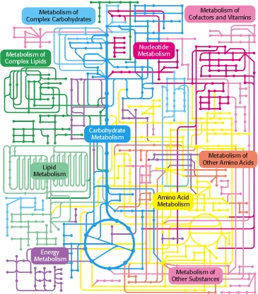
Inherited Metabolic Diseases
Dr Radha Ramachandran
r.ramachandran@imperial.ac.uk
Metabolism Course
Cellular and Molecular Science Theme
Lysozyme

Slide 2
Learning Objectives
Define Inherited Metabolic Diseases
When should a diagnosis of inherited metabolic diseases be considered (likely presentations)
Why is early diagnosis important
Baseline investigations and emergency management of a patient with a possible diagnosis of IMD
What are the diseases that are included in the routine newborn screening programme in the UK
Basic understanding of some common disorders like phenylketonuria, MCADD, galactosaemia, Glycogen storage disorders

Slide 3
Inherited metabolic diseases
Group of diseases that manifest as a result of dysfunction of a single or multiple enzymes in one or more of the metabolic pathways

Slide 4
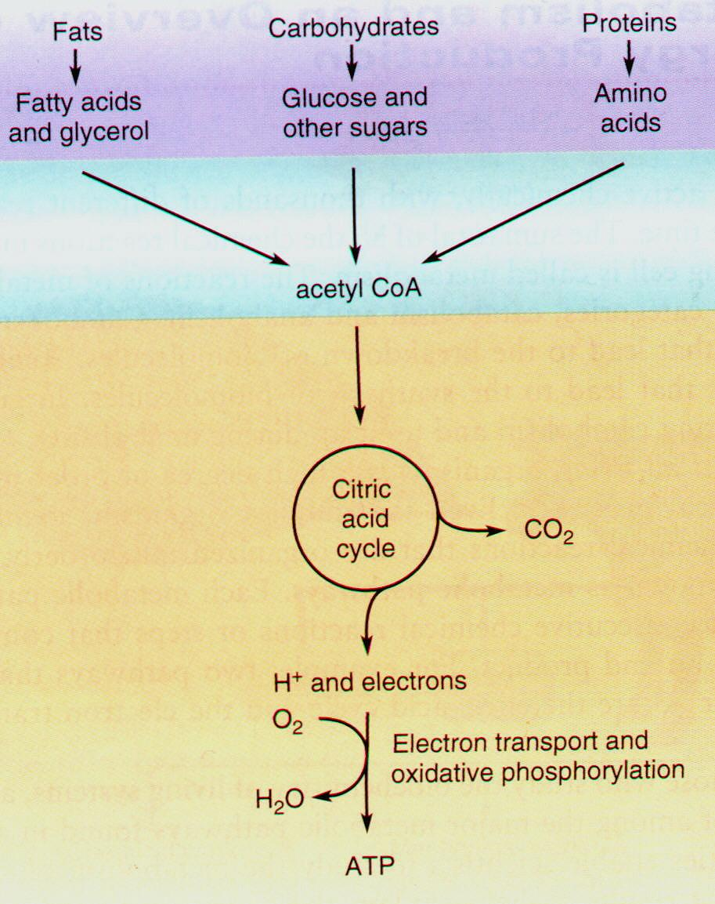

Slide 6
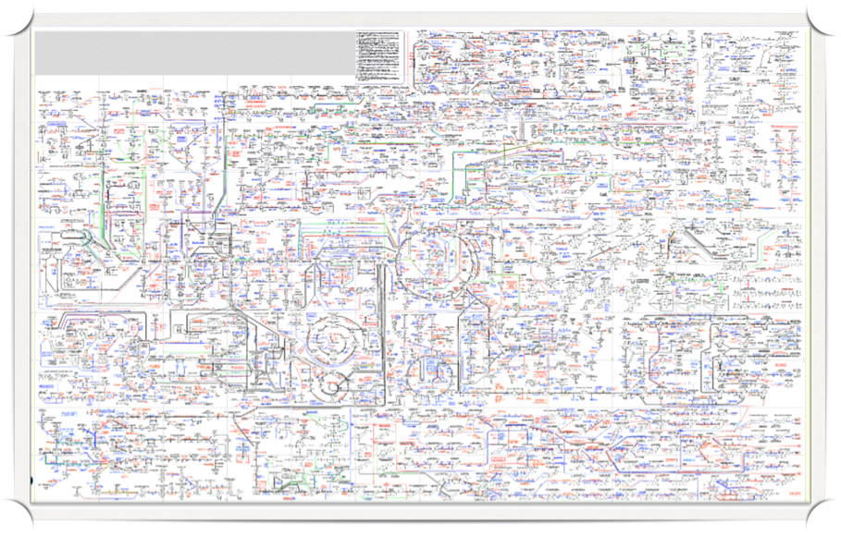

Slide 7
Inherited metabolic diseases
More than 600 separate disorders known so far
Collectively not that uncommon - 1 in 800 live births
800 new diagnosis per year in the UK
25% manifest after the age of 15

Slide 8
Think IMD
In all neonates with unexplained overwhelming progressive disease after normal pregnancy and delivery
All children who are acutely unwell with decreased consciousness particularly if preceded by fasting, fever or vomiting
All patients with unexplained neurology, hypoglycaemia, acidosis or decreased consciousness
Family history of unexplained disease or premature deaths

Slide 9
Why think IMD
Non specific multi organ presentation
Diagnosis often missed
Missed diagnosis often fatal
Many can be treated
Time is of the essence
Early diagnosis can potentially enable life saving treatment and prevent long term morbidity
Other implications – genetic counselling etc

Slide 10
Phenylketonuria

Slide 11
PKU (Phenylketonuria)
Autosomal recessive
One of most common IMDs (1:8,000 incidence UK; commoner in Ireland 1:4000)
One of the first neurological disorders identified (1934)
First successfully treated IMD (1953)

Slide 12
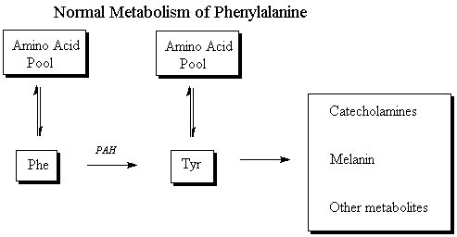
Normal metabolism of Phenylalanine

Slide 13
PKU – deficiency of phenylalanine hydroxylase (PAH)
X

Slide 14
PKU – deficiency of phenylalanine hydroxylase (PAH)
X

Slide 15
PKU - treatment
Aim is to keep plasma phenylalanine levels down
Protein restriction
NO ANIMAL PROTEINs, no nuts, no legumes, no seeds, no beer, no chocolate, no sweetners and only limited portions of low protein vegetables, fruits and starchy foods
Special protein supplements

Slide 16
PKU- pre 1963
Despite therapy with diet
Most patients severe neurological deficits
Institutionalised
Dead
What changed in 1963?

Slide 17
PKU - Newborn screening
Newborn screening introduced for PKU in 1963
First IMD to be screened
Guthrie cards – dried blood spots
Very early introduction of treatment
Normal neurological development with normal lifespan

Slide 18
PKU -Treatment
Very expensive
£ 65,000 pounds per person per year

Slide 19
PKU -Treatment
Very expensive
£ 65,000 pounds per person per year
Cost of looking after an untreated potentially institutionalised patient
£ 85,000 pounds per year

Slide 20
PKU - Treatment
Most of the deleterious effects of excess phenylalanine occur during neurological development
Reflected in the recommended phenylalanine levels
40 – 240 µmol/L upto 10 yrs
up to 900 µmol/L upto 16 yrs
up to 1200 µmol/L > 16 yrs
Number of adults have gone on to have normal lives , pregnancies – often not attending regular follow-ups at IMD clinics

Slide 21
PKU-Pregnancies
Phenylalanine can cross the placenta
Hyper-phenylalaninaemia can cause foetal abnormalities
low weight at birth, the congenital heart defects, digestive tract defects, osseous arrangements, microcephaly, handicap of intellectual development (Maternal PKU syndrome)
Recommended phenylalanine levels during pregnancy < 360 µmol/L

Slide 22
Lessons learnt from PKU
Early diagnosis can be VERY IMPORTANT
Early therapy may allow independent healthy life with normal life span
Follow up throughout life important
Increased number of ‘healthy’ adults with inherited metabolic diseases

Slide 23
Diseases included in the UK Newborn Screening Programme
Sickle Cell Anaemia
Cystic Fibrosis
Hypothyroidism
Phenylketonuria
MCADD

Slide 24
Diseases included in the UK Newborn Screening Programme
Sickle Cell Anaemia
Cystic Fibrosis
Hypothyroidism
Phenylketonuria
MCADD

Slide 25
MCADD
Medium chain acyl-CoA dehydrogenase deficiency
Commonest of the fatty acid oxidation defects
Manifests late infancy/childhood
Treatment simple- don’t fast!
Prognosis excellent after diagnosis + counselling
However if undiagnosed first crisis can be fatal in 25% and often residual neurological deficit

Slide 26
So why not screen for all known IMDs
Some manifest very early – so patient affected/diagnosed before results of NBS available
Not much point in screening for diseases that do not benefit from intervention
There must be a sensitive and specific test to diagnose disease

Slide 27
So when should a diagnosis of IMD be considered?

Slide 28
Think IMD
Unexplained
Cardiomyopathy
Liver disease
Myopathy
CNS manifestations
Dysmorphia
Apparently unrelated multisystem involvement

Slide 29
When else should a diagnosis of IMD be considered?

Slide 30
In a metabolic emergency

Slide 31
Metabolic emergency
Usually due to disorders of fat, protein or glucose or other sugars metabolism/utilisation
Hypoglycaemia may be a feature – in addition may present with acidosis, increased ketones, decreased level of consciousness (due to hyperammonaemia)

Slide 32
Approach to a metabolic emergency
Think IMD
Very important to take correct samples for investigations during acute crisis (since some abnormalities in biochemistry may only be apparent in a crisis)

Slide 33
Baseline investigations – metabolic emergency
PLEASE Ring a metabolic unit & laboratory
Bloods
U & Es , CRP, LFTs, CK, creatinine, uric acid, acid-base status, glucose, coagulation screen
Ammonia and lactate
Plasma amino acids, acylcarnitines
Guthrie card
Spare plasma samples – ask lab to store

Slide 34
Baseline investigations – metabolic emergency
PLEASE Ring a metabolic unit & laboratory
Urine
Check colour and odour
Ketones, glucose, proteins, Ph
Store sample for organic acids / other tests
CSF
If LP then ask lab to freeze and store some spare sample
In case of death
Pro-active approach to post-mortem

Slide 35
Treatment can be commenced in most cases before the diagnosis is made – and should be commenced as soon as possible (within the first hour)

Slide 36
Emergency treatment – metabolic crisis
Stop all feeding
Start a dextrose infusion – to give enough calories to prevent/reverse catabolic state
Keep checking to make sure that normal acid base status is maintained
Caveat
There are a few conditions where this might be dangerous (e.g. mitochondrial pyruvate dehydrogenase deficiency)
These are very rare
Hence benefits outweigh risks
Monitoring acid base balance will alert physicians to these rare diseases

Slide 37
Making a diagnosis

Slide 38
Hypoglycaemia – differential diagnosis
If ketones are low and free fatty acids are low
Defect in lypolysis - Hyperinsulinism
If ketones are low and free fatty acids are very high
Defect in lipolysis - Disorders of fatty acid oxidation
If ketones are high
Disorders of protein utilisation (e.g organic acidurias)
Disorders of glucose utilisation

Slide 39
Acidosis – differential diagnosis
Normal anion gap
Renal or intestinal loss of bicarbonate
Clue - increased chloride
Increased anion gap
Organic acids – such as lactates or ketones
Organic acidurias
Respiratory chain deficits
Gluconeogenesis
Glycogen storage disease
Fatty acid oxidation defects

Slide 40
Hyperammonaemia

Slide 41
Hyperammonaemia
Severe liver failure
Urea cycle defects
Organic acidurias
Urea cycle defects can present at any age
Consider diagnosis in any patient with
unexplained hyperammonaemia
Measure ammonia in any patient with
encephalopathy

Slide 42
Making a diagnosis

Slide 43
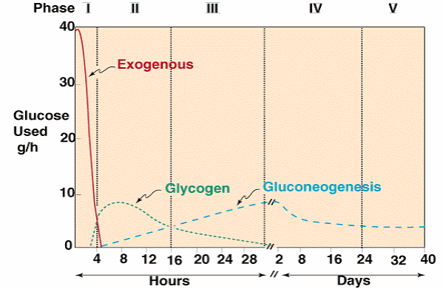
Metabolic Adaptation to Fasting/Starvation

Slide 44
Metabolic Adaptation to Fasting/Starvation
Galactosemia

Slide 45
Galactosaemia
Primary starch in milk – lactose
Lactose is a disaccharide (glucose and galactose )
Galactosaemia- deficiency of enzyme Gal-1 –Put
Failure to utilise Galactose and toxic metabolites accumulate
Vomiting, diarrhoea, jaundice, liver and renal disturbance and cataract
Galactose free diet – may be life saving
Some countries offer newborn screening for this

Slide 46
Metabolic Adaptation to Fasting/Starvation
Glycogen storage disorders

Slide 47
Glycogen storage diseases

Slide 48
Glycogen storage diseases
Presentation
Consequences of pathological glycogen storage- hepatomegaly, myopathy
Hypoglycemia
Commonest
GSD 1 – mainly hepatopathic + hypoglycaemia
GSD III – mixed hepatopathic and myopathic + hypoglycaemia
Therapy – frequent meals, overnight- continuous NG feed / uncooked corn starch

Slide 49
Metabolic Adaptation to Fasting/Starvation
Fatty acid oxidation defects

Slide 50
Advice to patients
Wear a medic alert bracelet
Carry a card with a card of your metabolic physician/hospital
Tell your treating physician what your diagnosis is and what the emergency treatment for it is
Learn to anticipate a crisis and take preventative steps
Life long follow up in a metabolic unit essential

Slide 51
IMD – not that uncommon
Think IMD if illnessunexplained.Please contact your laboratory for advice
Early intervention is very important
Detailed knowledge of individual diseases and pathways not always necessary in the emergency setting

